Slide 1
Autoimmune bullous diseases
Rare diseases, severe forms are lethal
Skin and mucous membranes
Two groups according to the level of cleavage
Intraepidermal – Pemphigus and variants
Subepidermal – pemphigoid group, DHD, EBA
Autoantibodies IgG/IgA against antigens in the epidermis and junctional zone

Slide 2
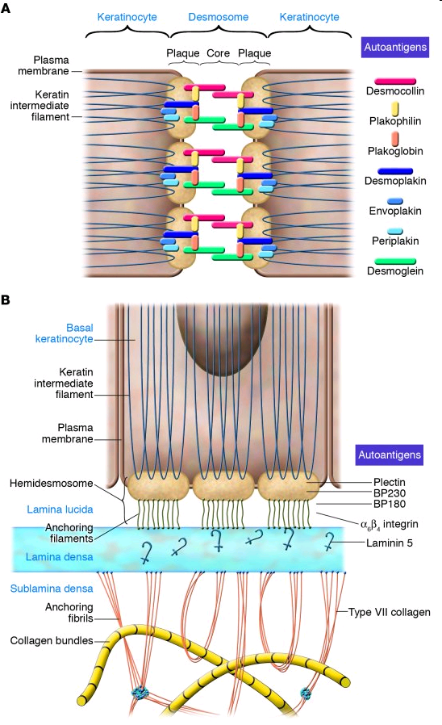
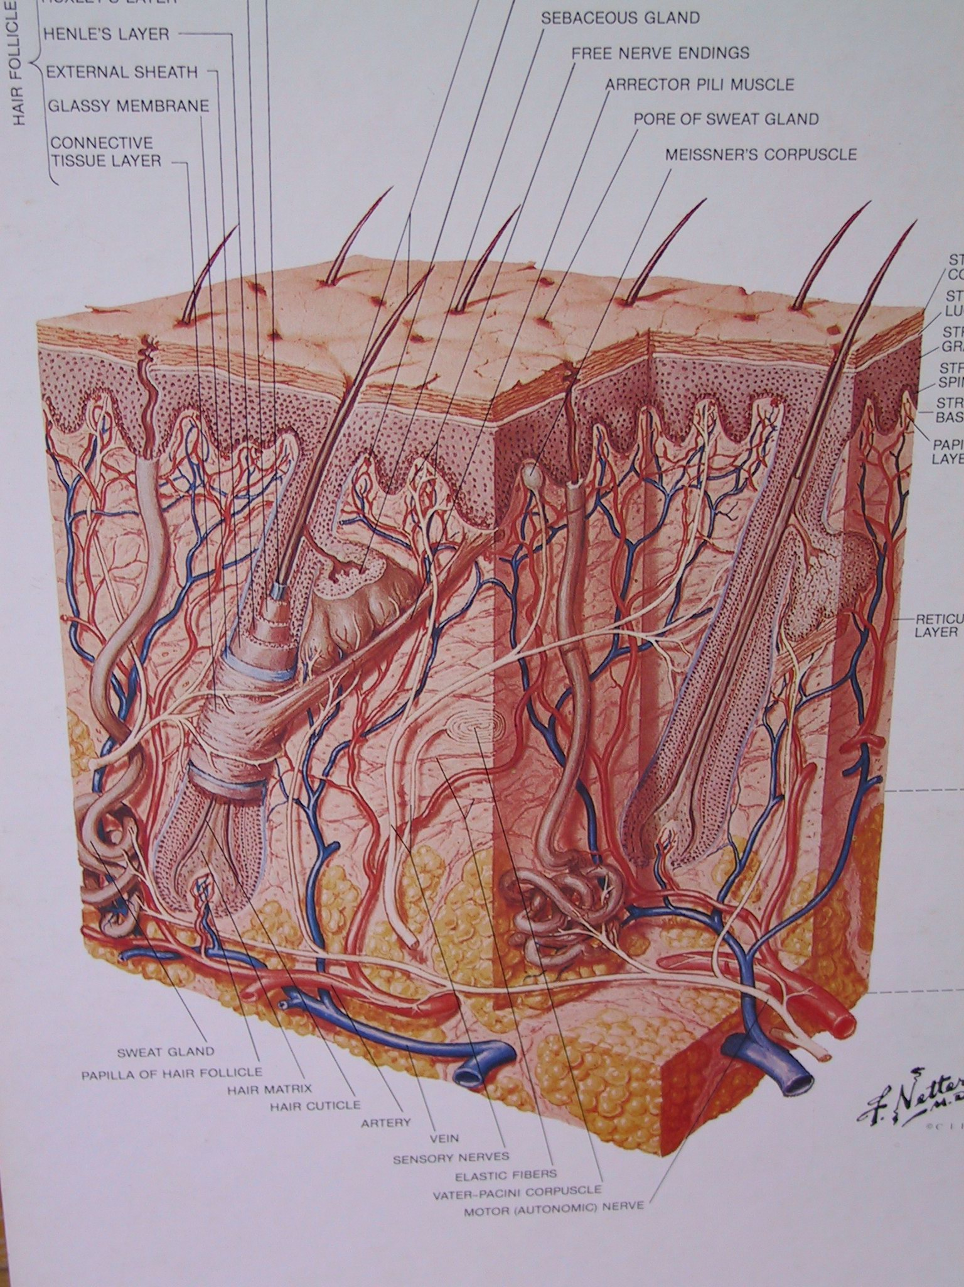
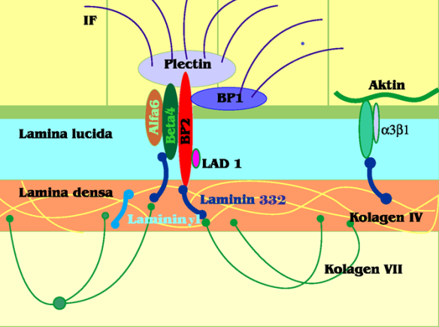
Pemphigus - desmosomes
Pemphigoid - hemidesmosomes
Diagnostics – Tzanck test, histology, immunofluorescence direct & indirect, ELISA, immunoblot

Slide 3
Pemphigus
Suprabasal (Dsg 3,1, IgG)
pemphigus vulgaris
vegetans
Superficial (Dsg 1, IgG)
pemphigus foliaceus
fogo selvagem (Brazil)
drug induced (thiols, phenols, penicilamin, captopril)
pemphigus erythematosus Senear Usher – fotosensitivity, ANA antibodies
Paraneoplastic Pemphigus – lichenoid, EEM features, bronchiolitis
IgA pemphigus

Slide 4
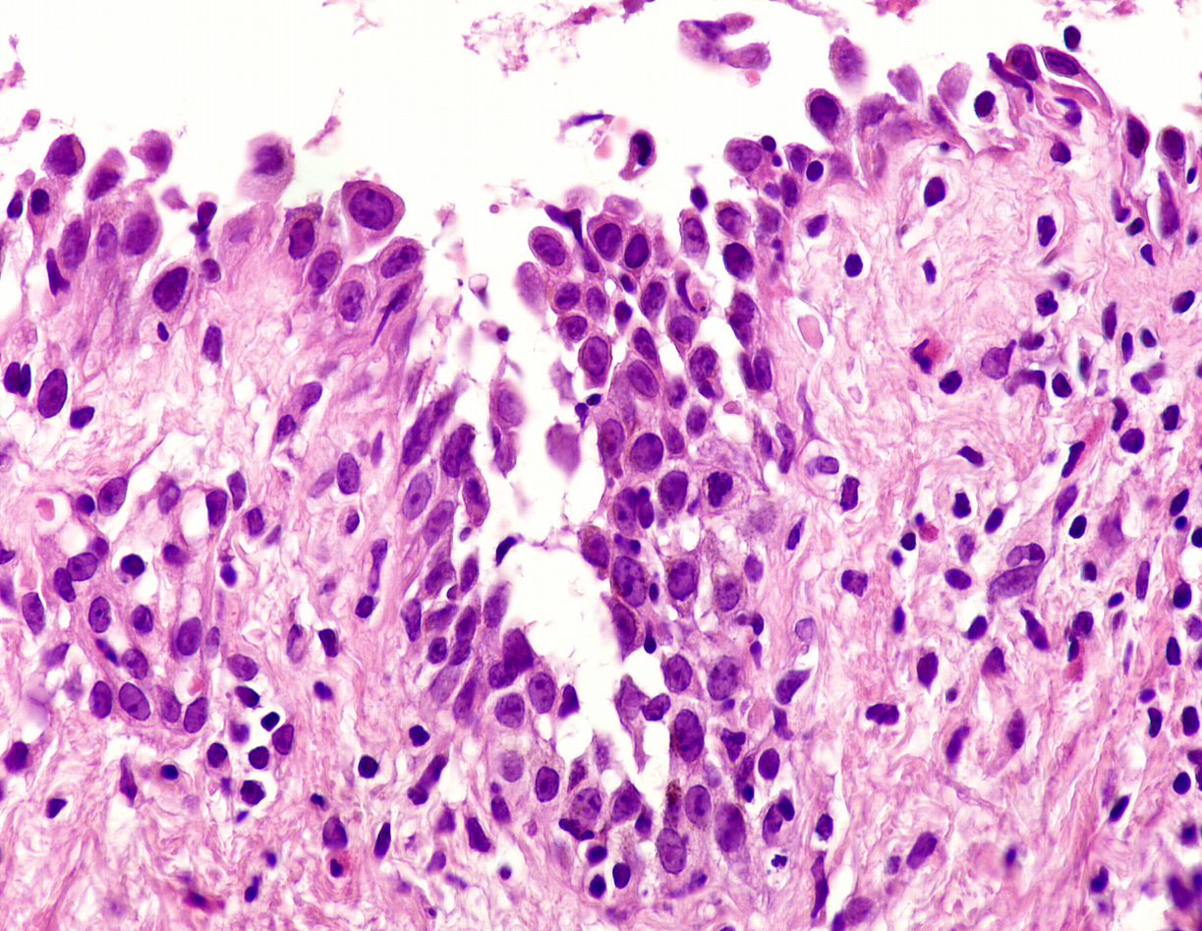
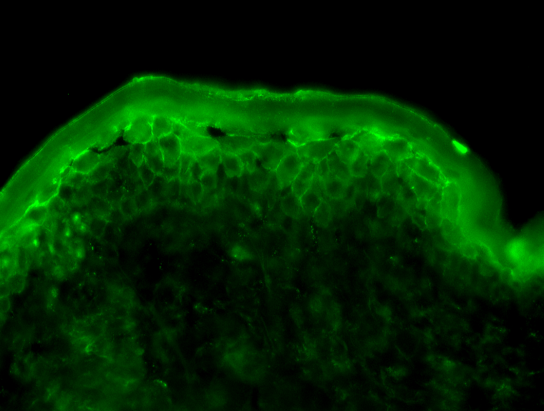
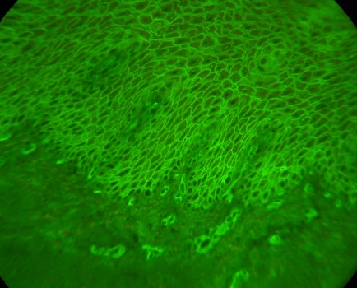
Pemphigus
Suprabasal acantholysis H+E
Direct IF – pemphigus foliaceus
Anti IgG/C3
Indirect IF – monkey esophagus
ICS anti IgG

Slide 5
Pemphigus vulgaris
Rare bullous disorder with autoantibody-induced intraepidermal blisters (desmosomes - acantholysis)
Incidence 5/ 1 million inhabitants
Chronic disease, can be lethal
Average age 30-60 years
Etiopathogenesis
Genetic factors (HLADR4)
Drug induced, infections, phenols
Antibodies against desmoglein 1,3

Slide 6
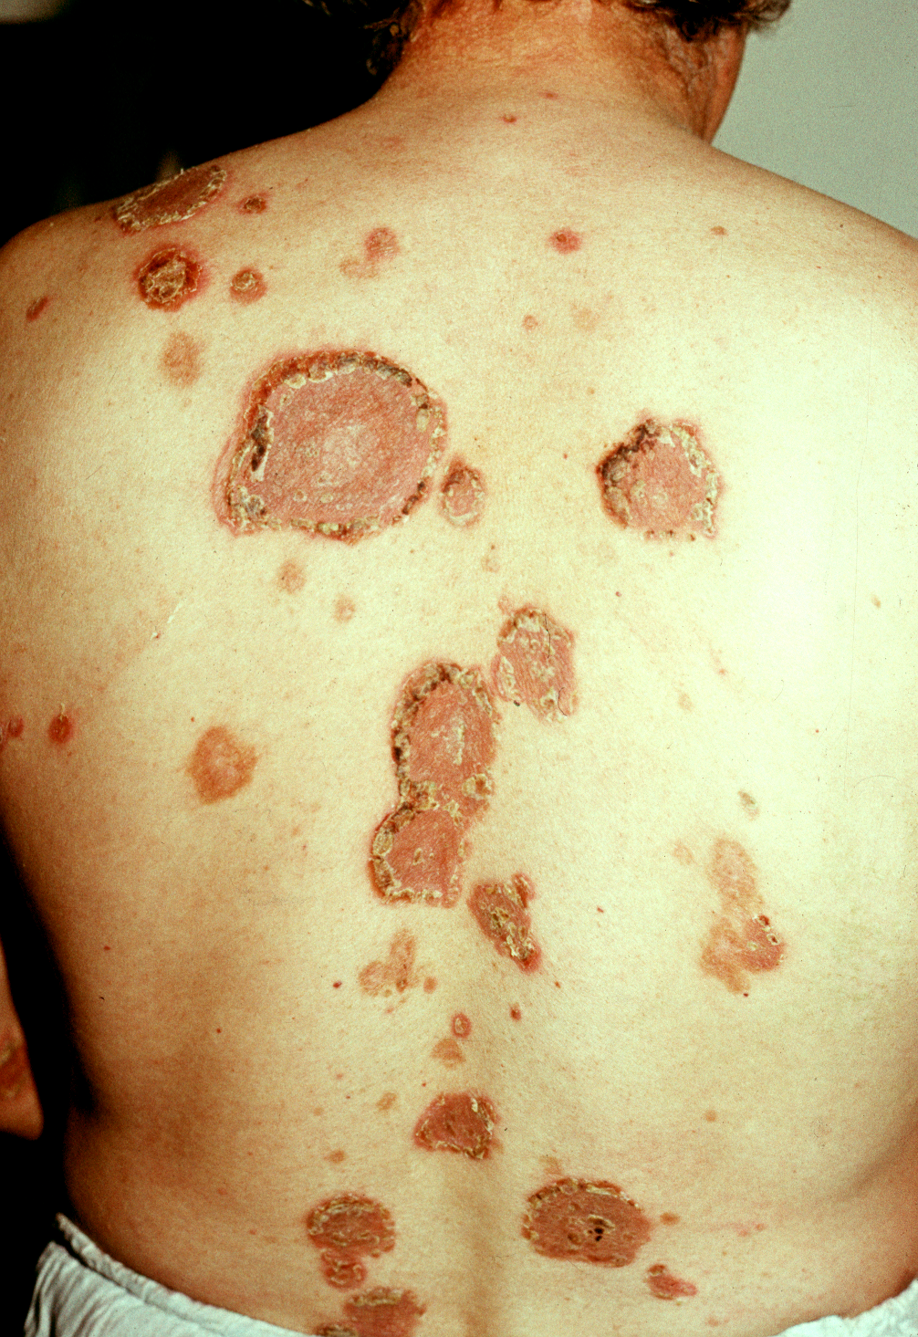
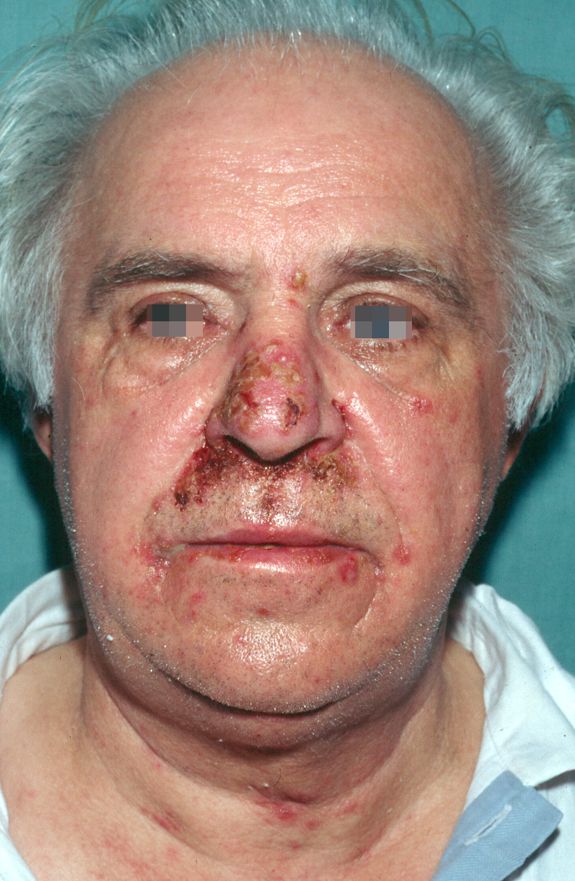
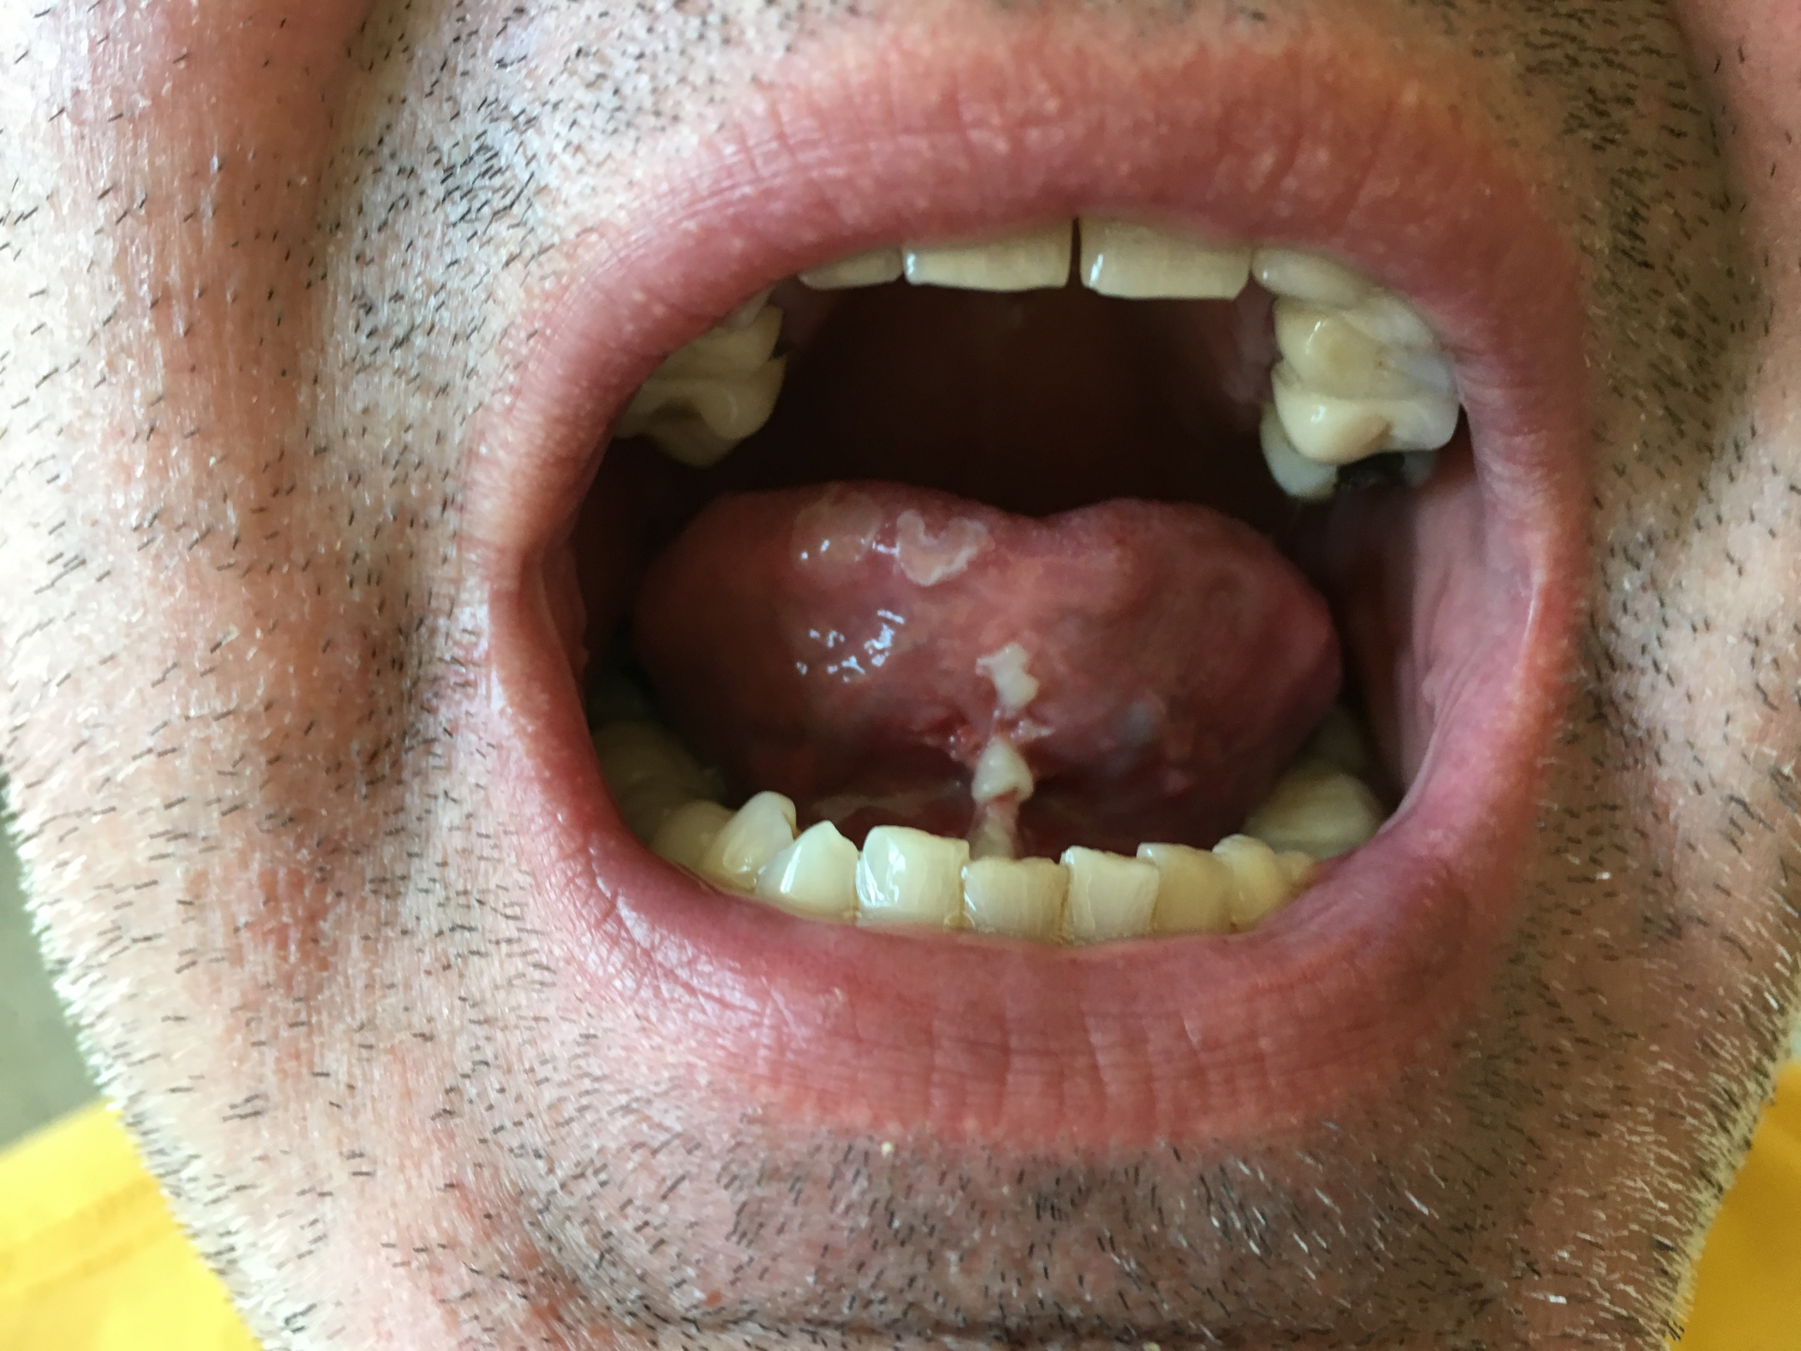
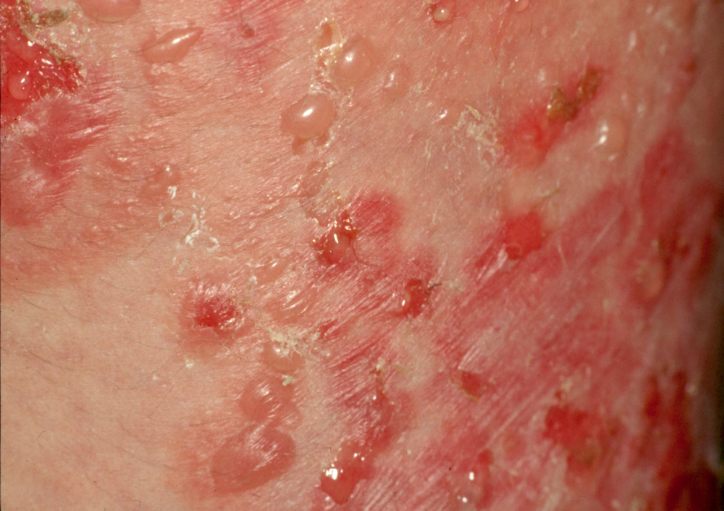
Nikolsky sign

Slide 7
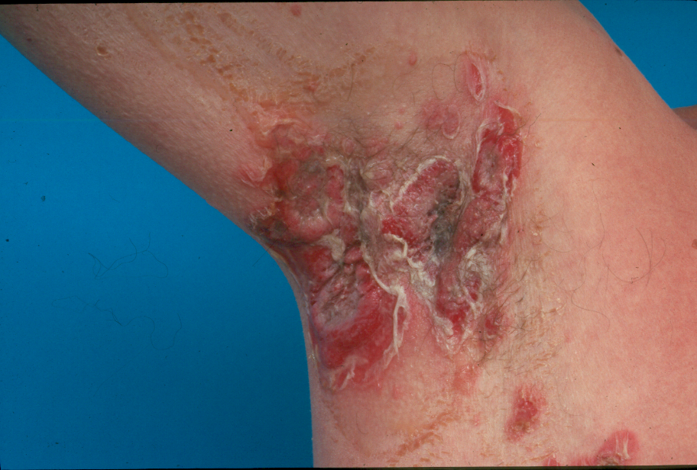
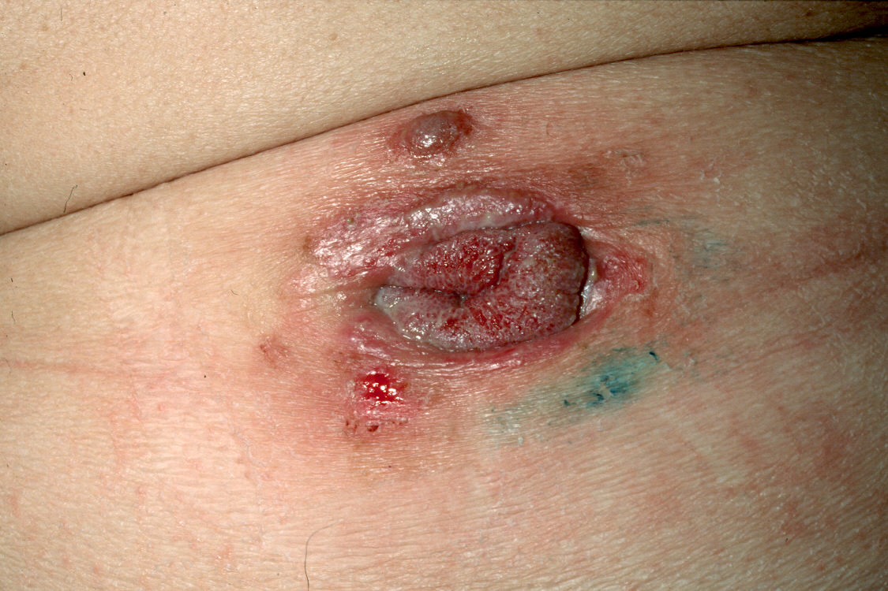
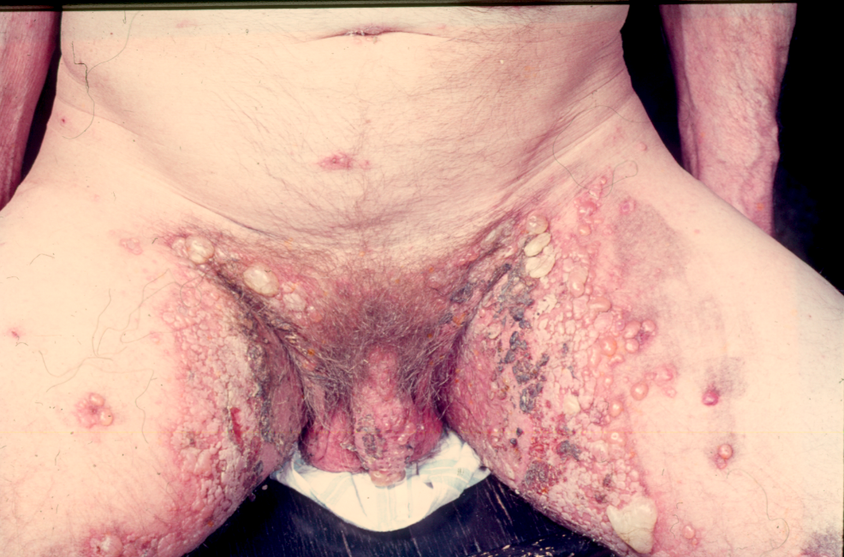
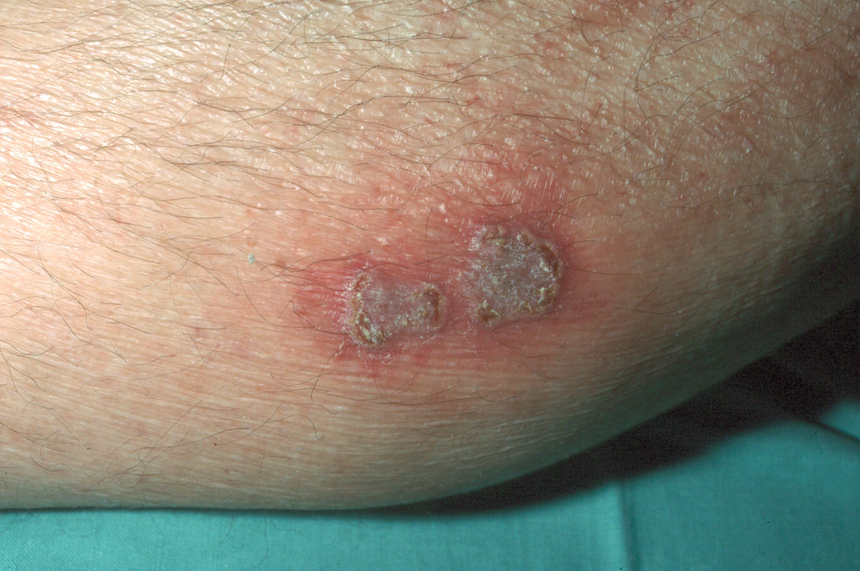
Pemphigus vegetans

Slide 8
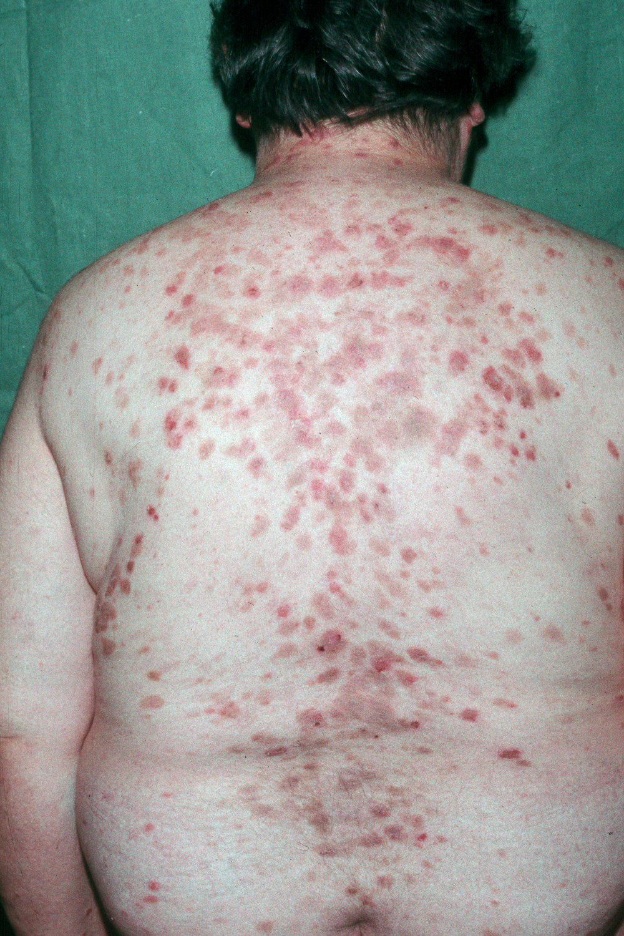

Pemphigus foliaceus

Slide 9
Pemphigus therapy
Corticosteroids (Prednisone 1-1,5mg/kg/d)
...taper to 15 -20 mg/d
Immunosuppresives - corticosteroid sparing agents
Mycophenolate mofetil 2g/d
Azathioprine – cave TPMT deficiency
MTX 10-20mg per week
(Cyclophosphamide – toxic)
-
Rituximab anti CD20 antibody –risk of infections
Dapsone
IVIG 1-2g/kg pulse every 6 weeks
Immunoadsorption IgG
Long term therapy, 2 years minimum, often life long

Slide 10
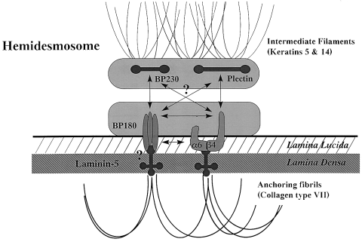
Subepidermal autoimmune bullous dermatoses
Rare disorders with autoantibody-induced subepidermal blisters (basement membrane – hemidesmosomes)
Bullous Pemphigoid - BP
Pemphigoid gestations ( variant of BP)
Cicatricial Pemphigoid – mucous membrane pemphigoid
Epidermolysis bullosa acquisita (association diabetes, bowel disease)
IgA linear dermatosis – typically childhood, in adults drug induced – vankomycin
Dermatitis herpetiformis Duhring

Slide 11
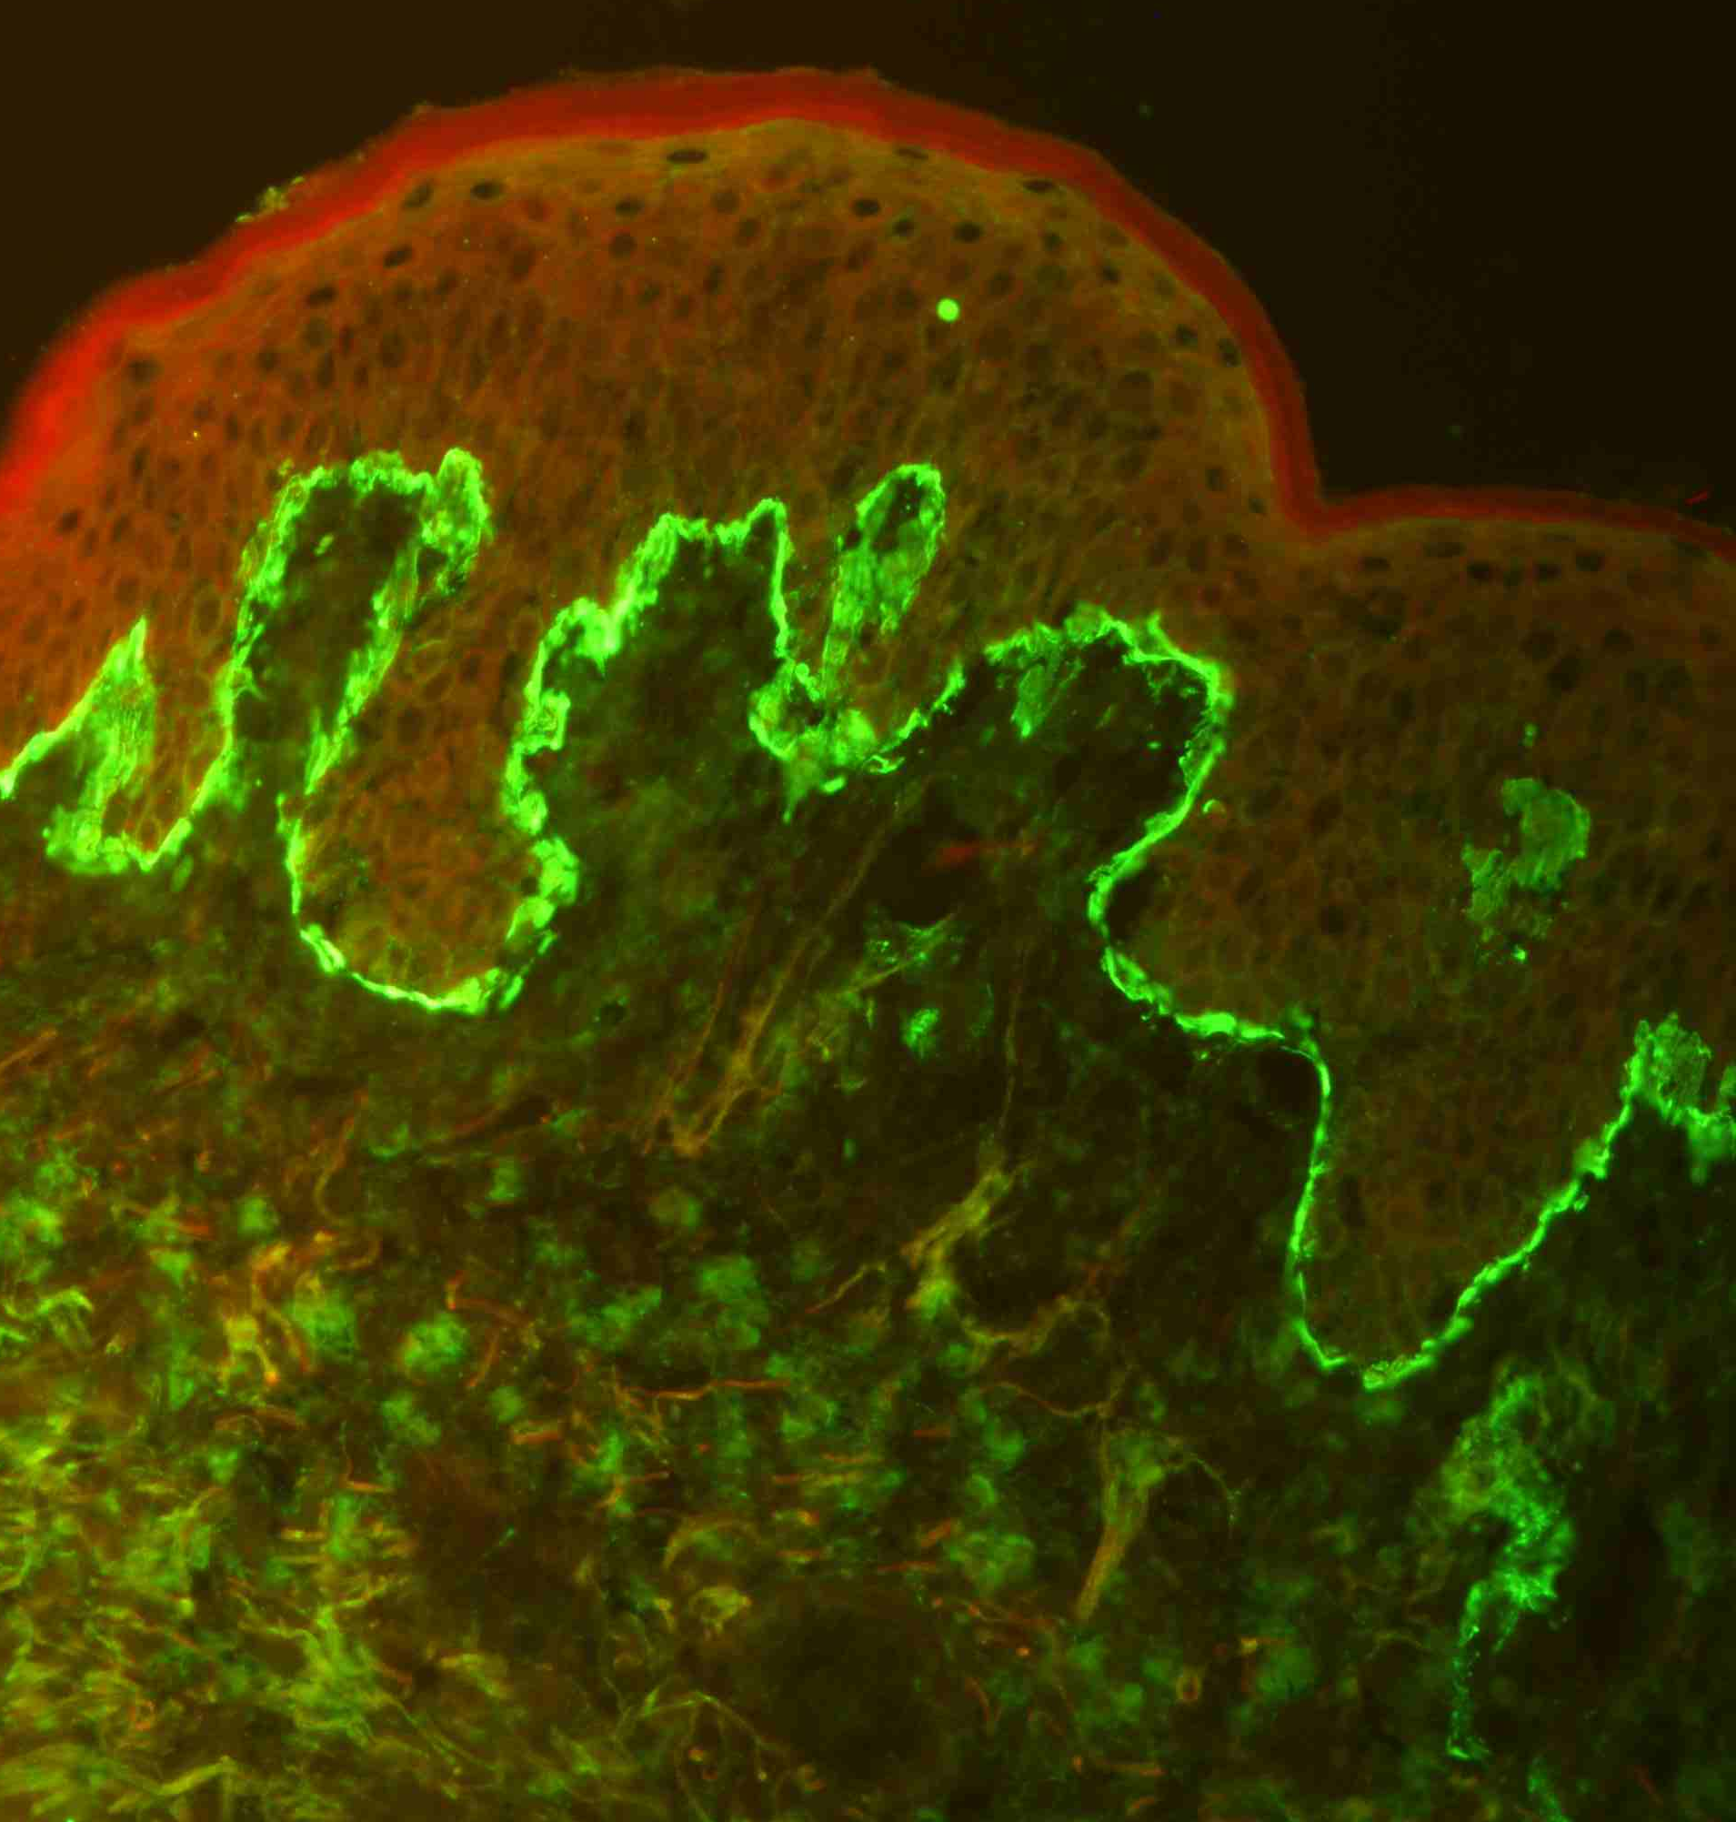
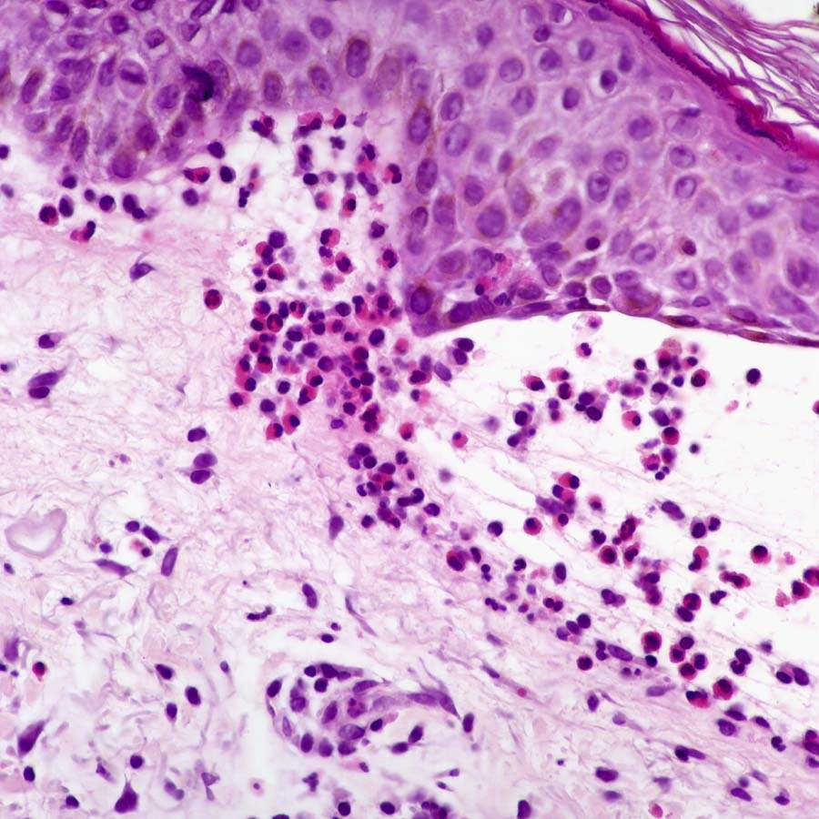
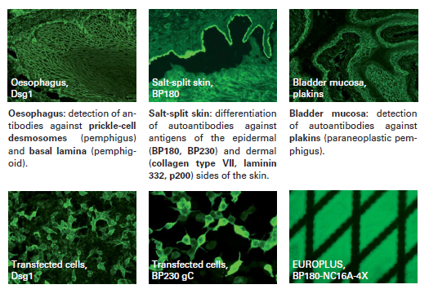
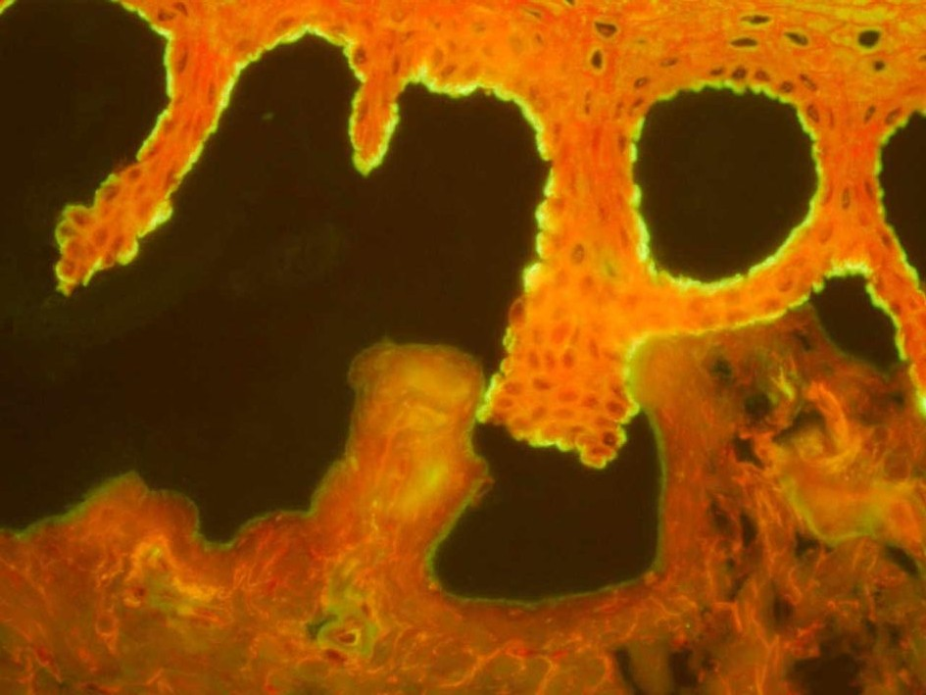
Direct IF line on BM IgG/C3
BP – subepidermal blister - eosinophils
Salt split skin blister roof in BP

Slide 12
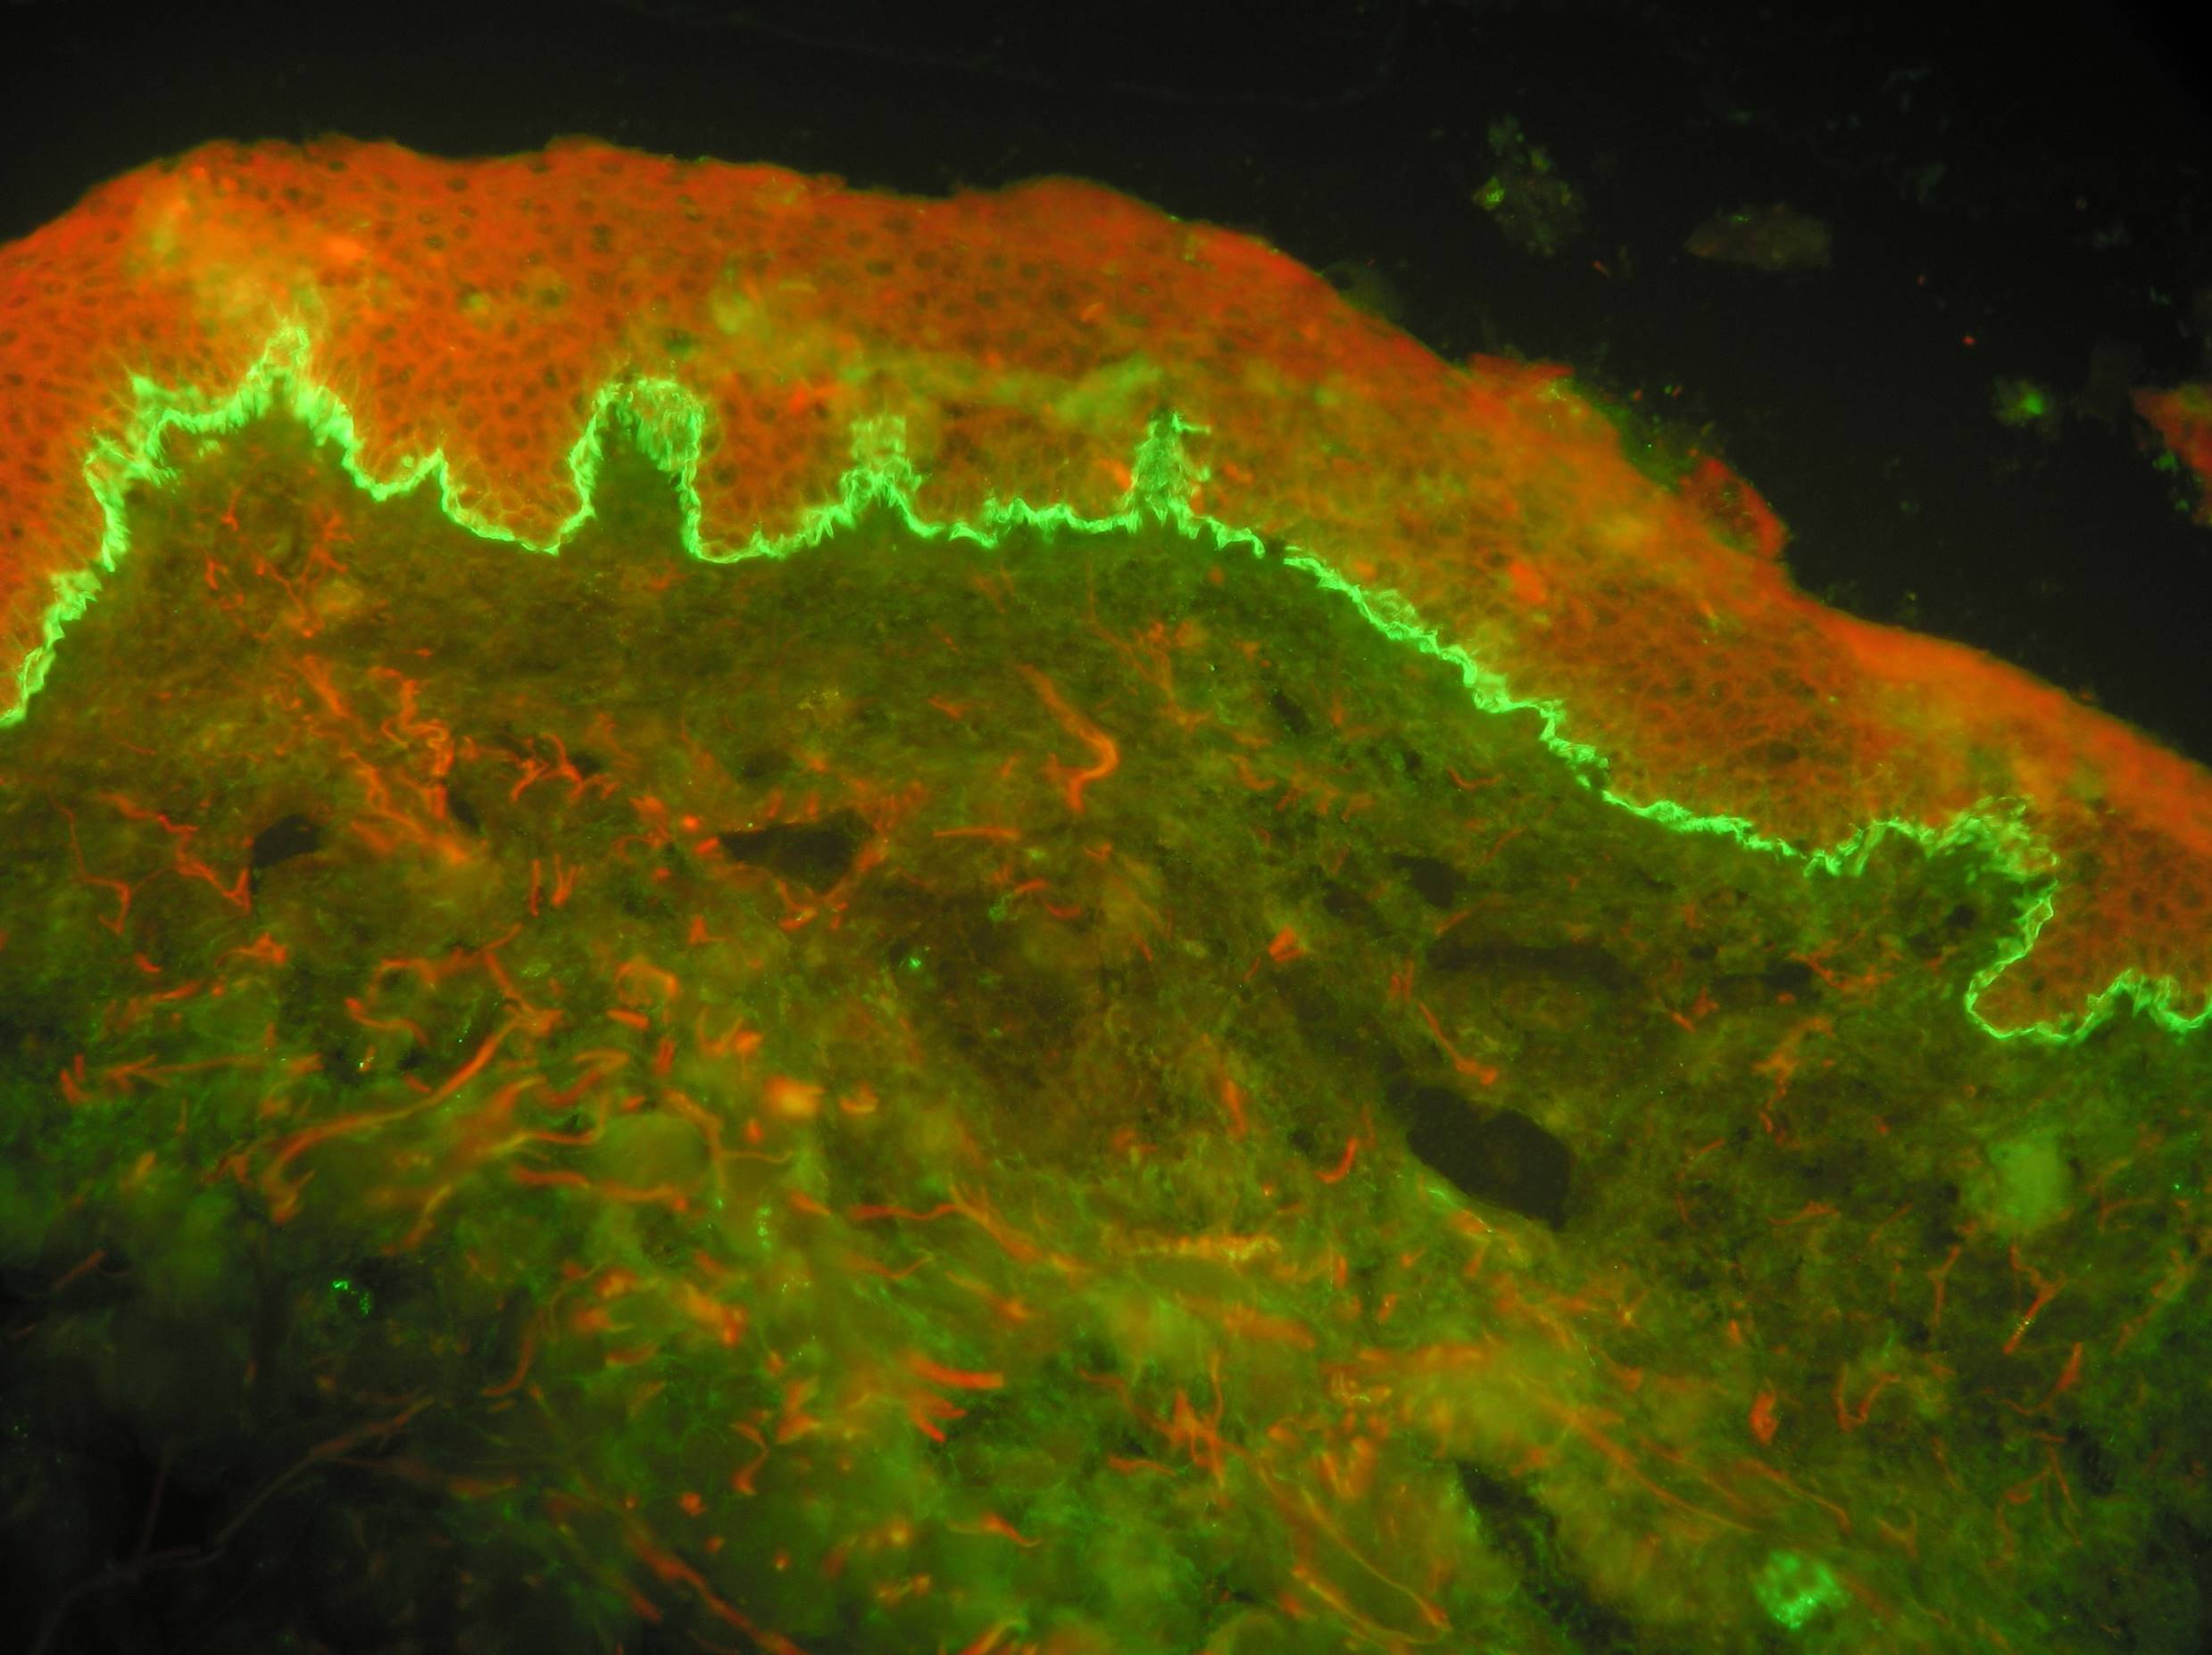
Pemphigoid bullosus
Elder people – over 70 years
Many concomitant diseases
Paraneoplastic disease (13%) prostate, breast cancer
Drug induced (PNC, enalapril, furosemid, gliptins)
Neurodegenerative diseases!
Cerebral stroke + paresis, Parkinson disease, dementia
(BP expression in neuronal tissue)
1 year survival 60% patients

Slide 13
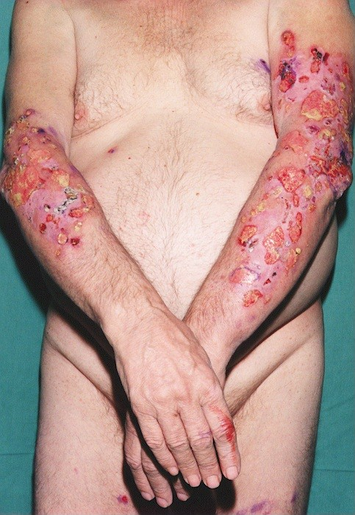
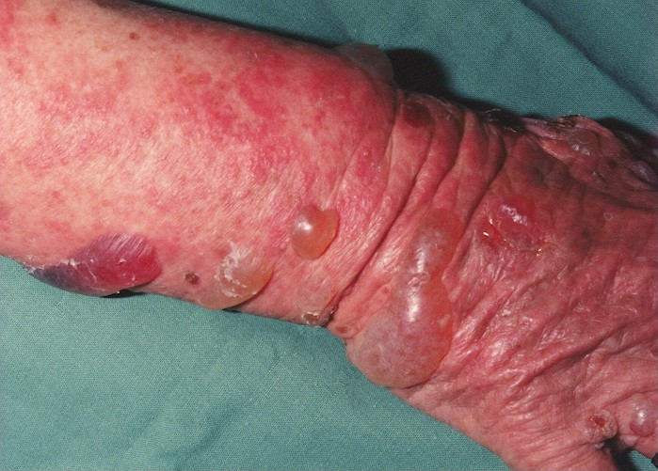
BP tense hemorrhagic blisters, infiltrated skin
Tissue and blood eosinophilia, strong pruritus

Slide 14
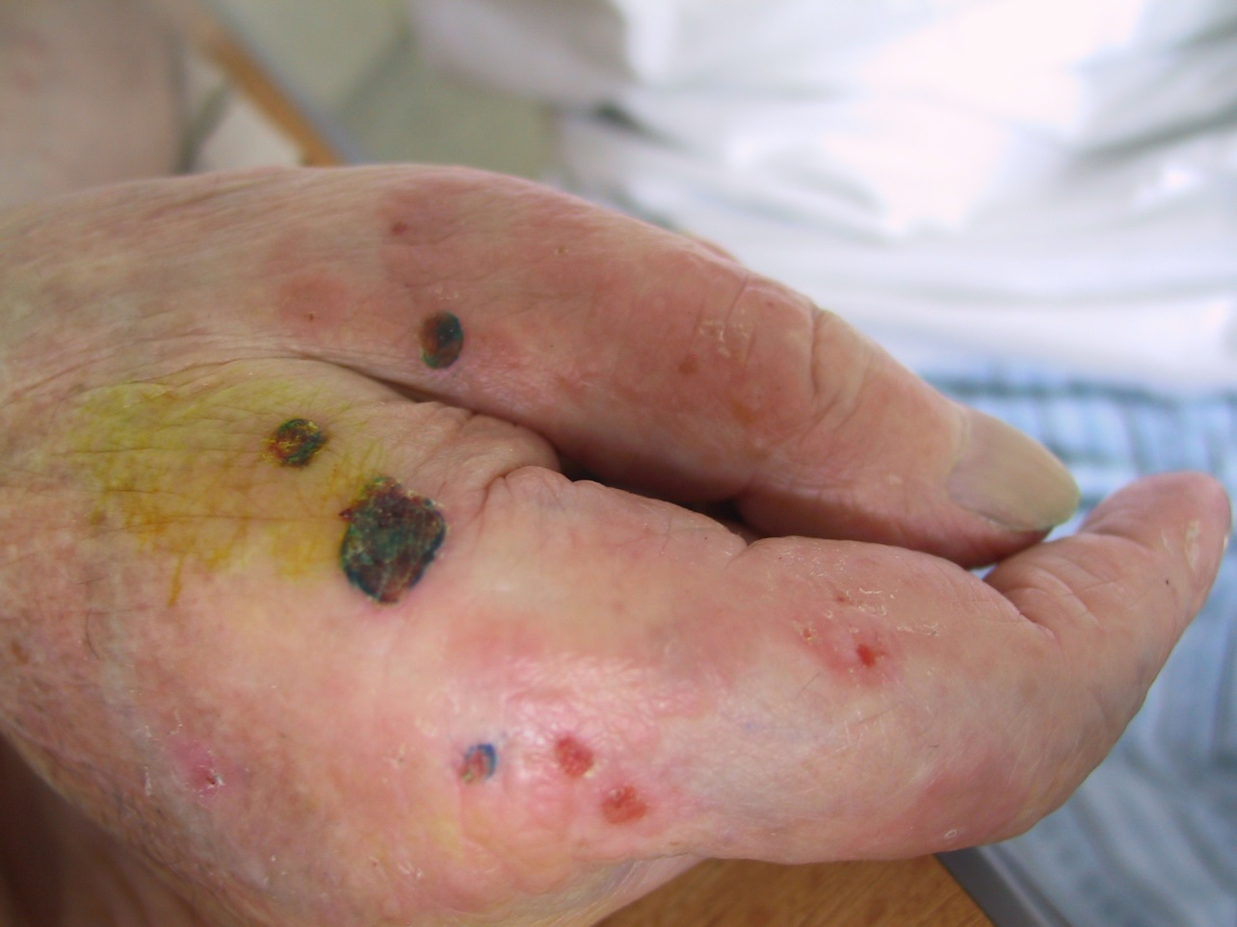
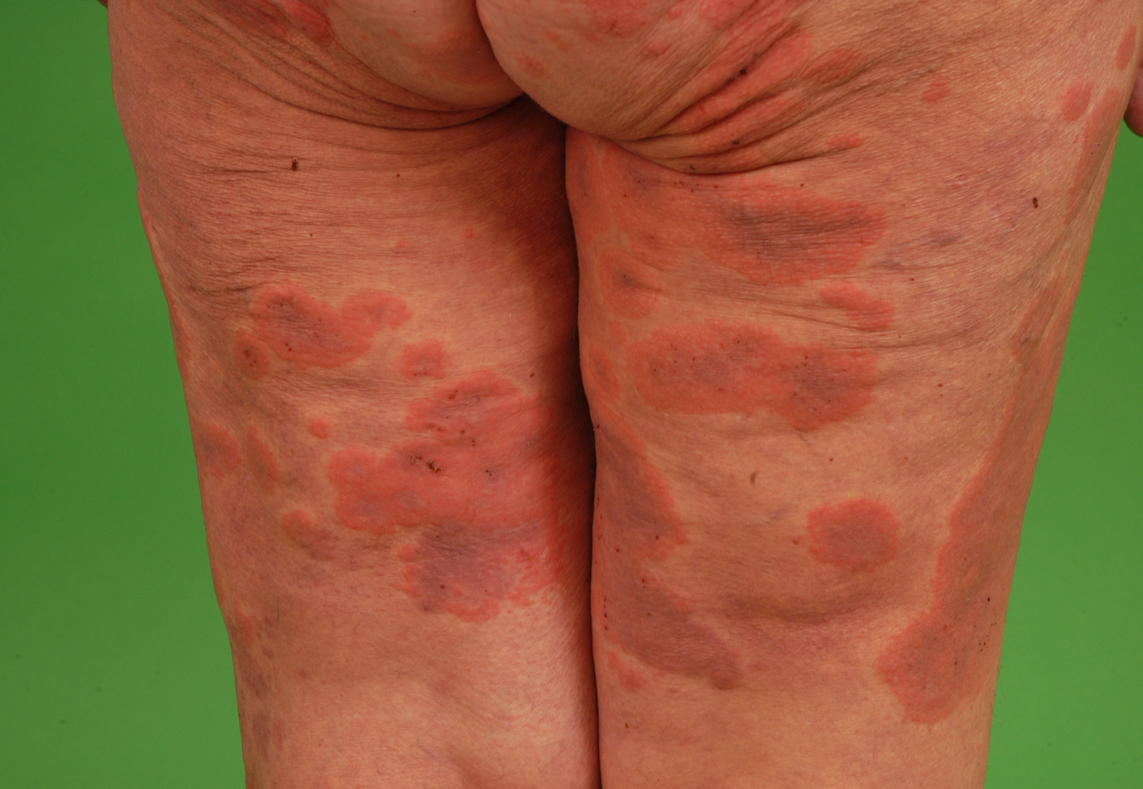
BP in paretic limb
Urticarial lesions in BP

Slide 15
Pemphigoid bullosus therapy
Corticosteroids (Prednisone 0,5-0,7mg/kg)
or
Potent topical corticosteroids
(clobetasol)
Immunosuppresives ( azathioprine, methotrexate, mycophenolate)
Dapsone
TTC – antiinflammatory effect

Slide 16
Cicatricial Pemphigoid MMP
Incidence 1/million inhabitants
60 years of age
Paraneoplasia (stomach cancer), topicals for glaucoma
Mucose membranes stenosis, scarring
Conjunctiva - entropion, symblepharon, trichiasis blindness
Pharynx, larynx,
Genital area
Skin – minor disease Brunsting Perry Pemphigoid
Therapy – as in pemphigus

Slide 17
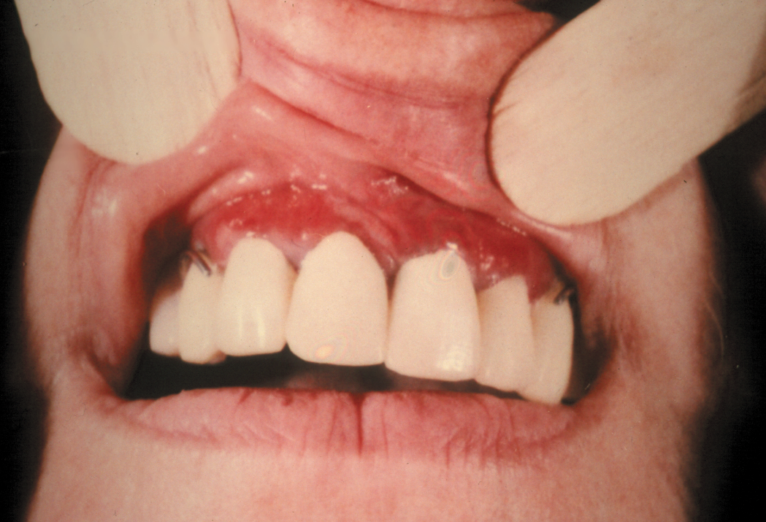
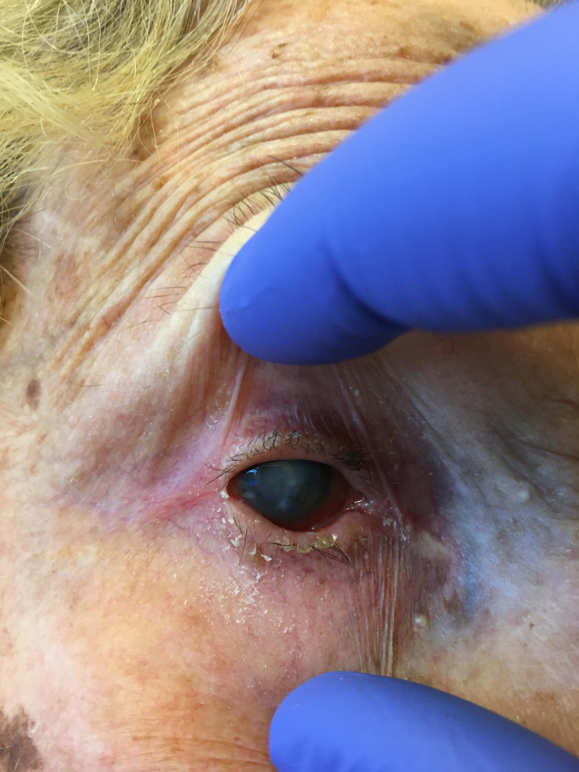
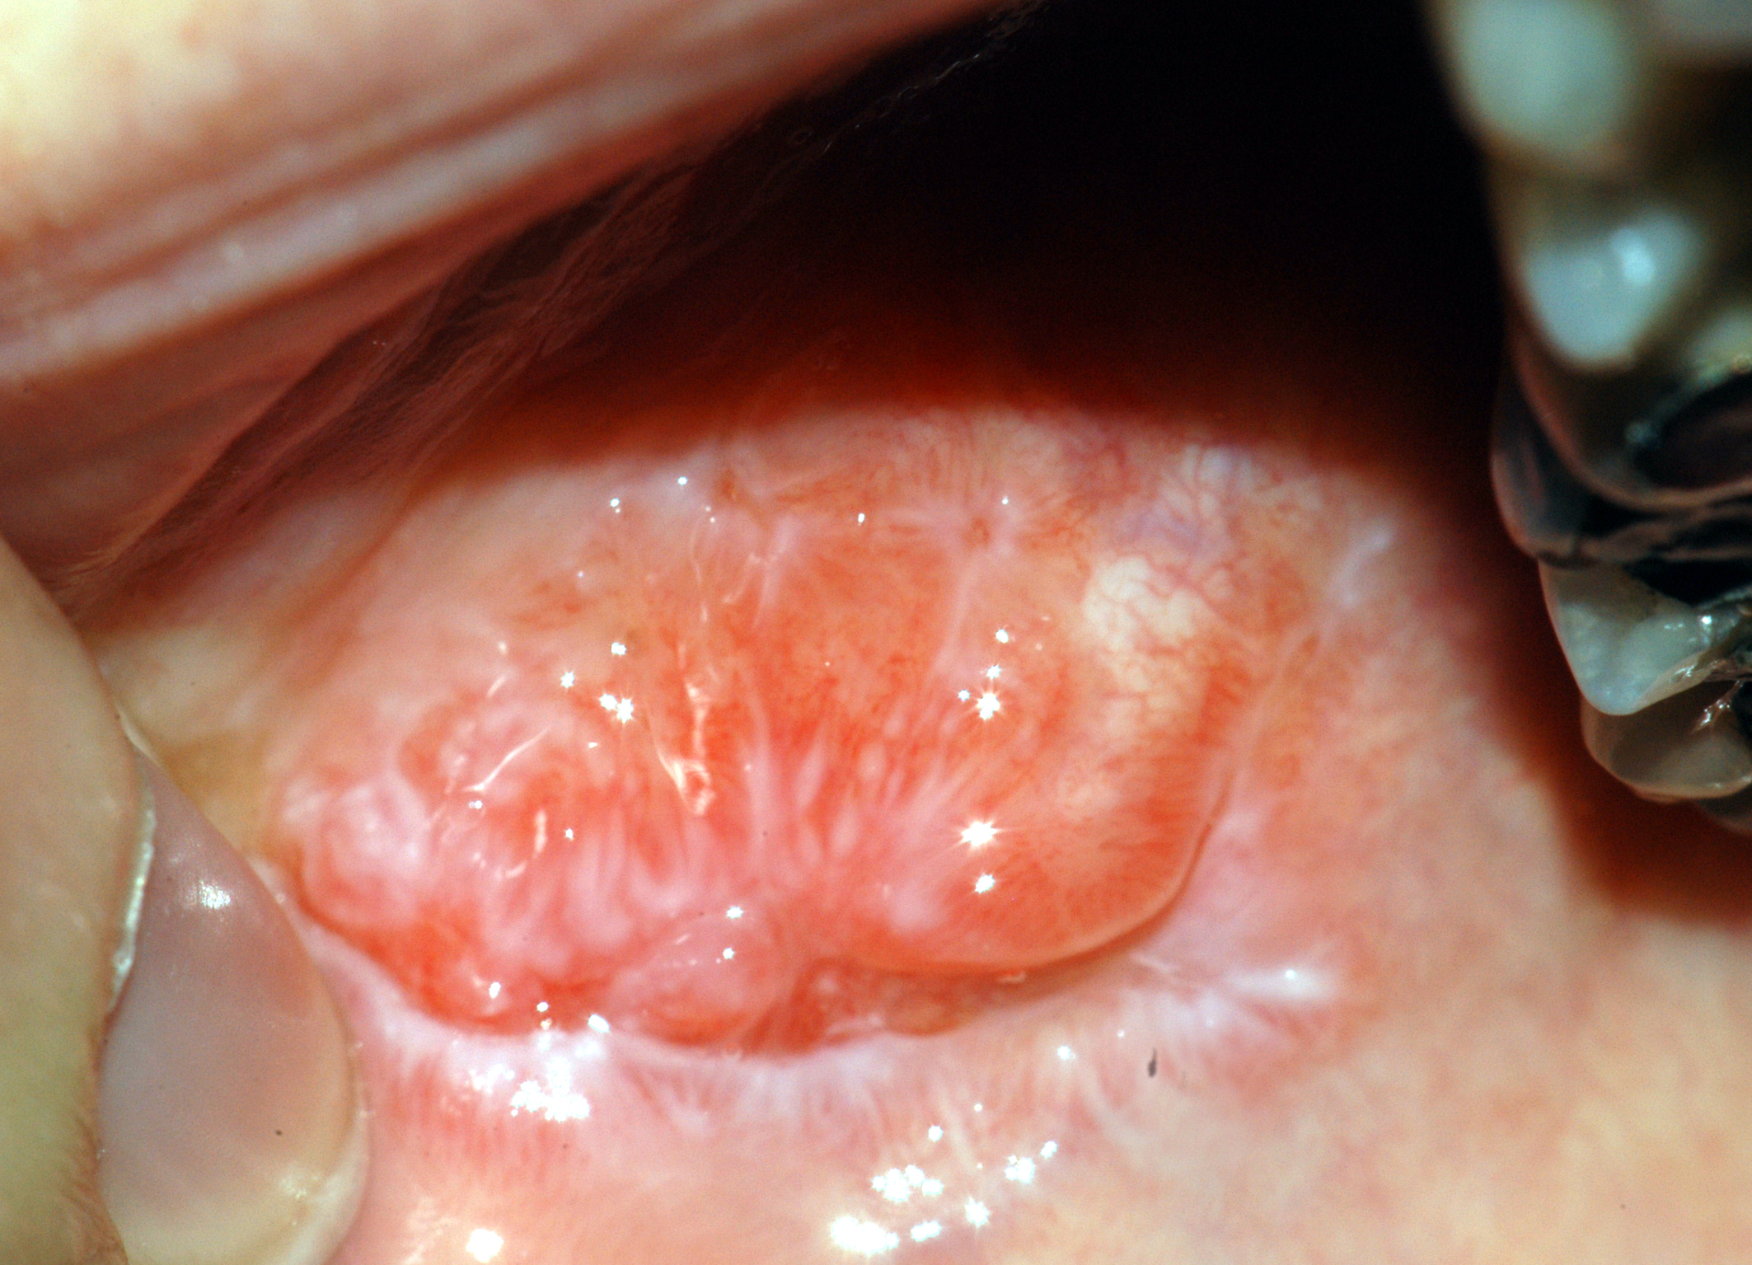
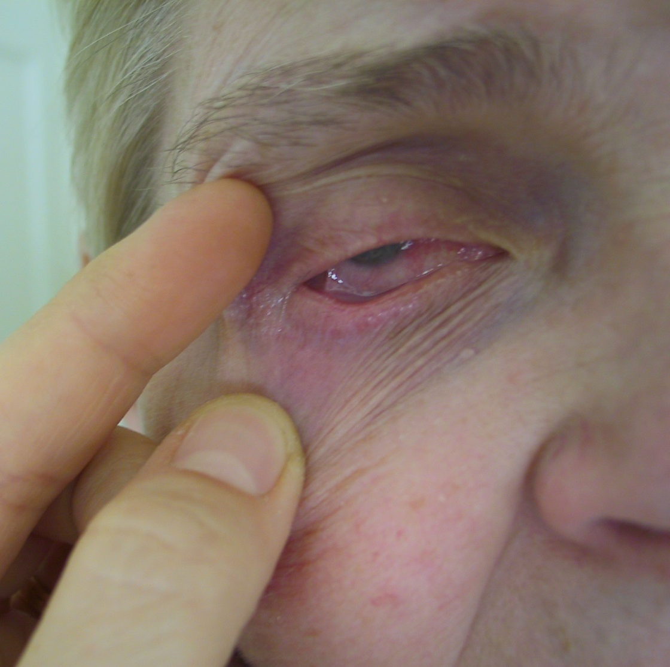
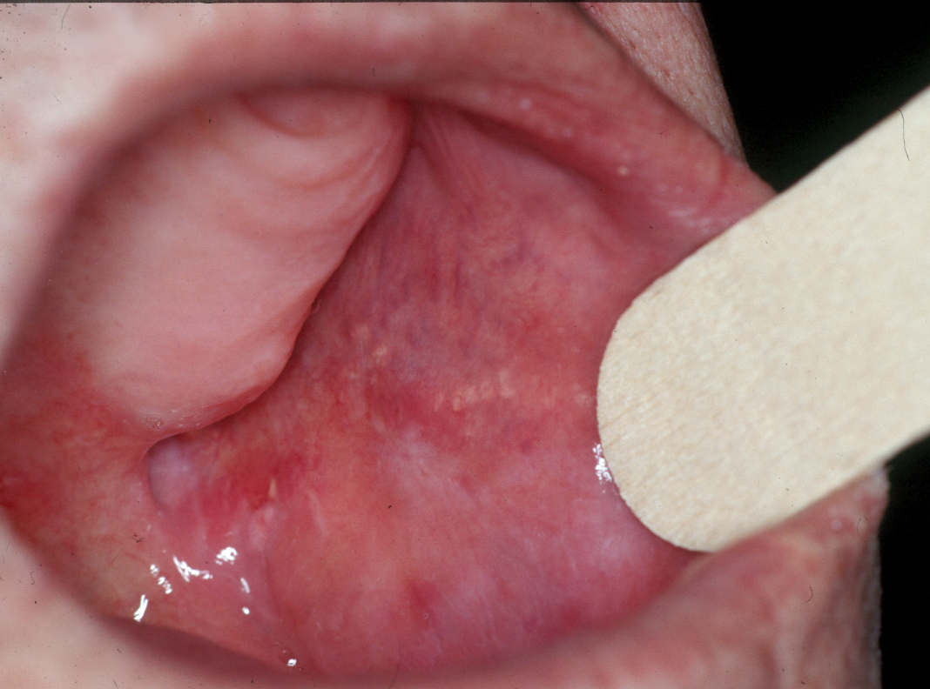
Pictures from Praktická dermatologie

Slide 18
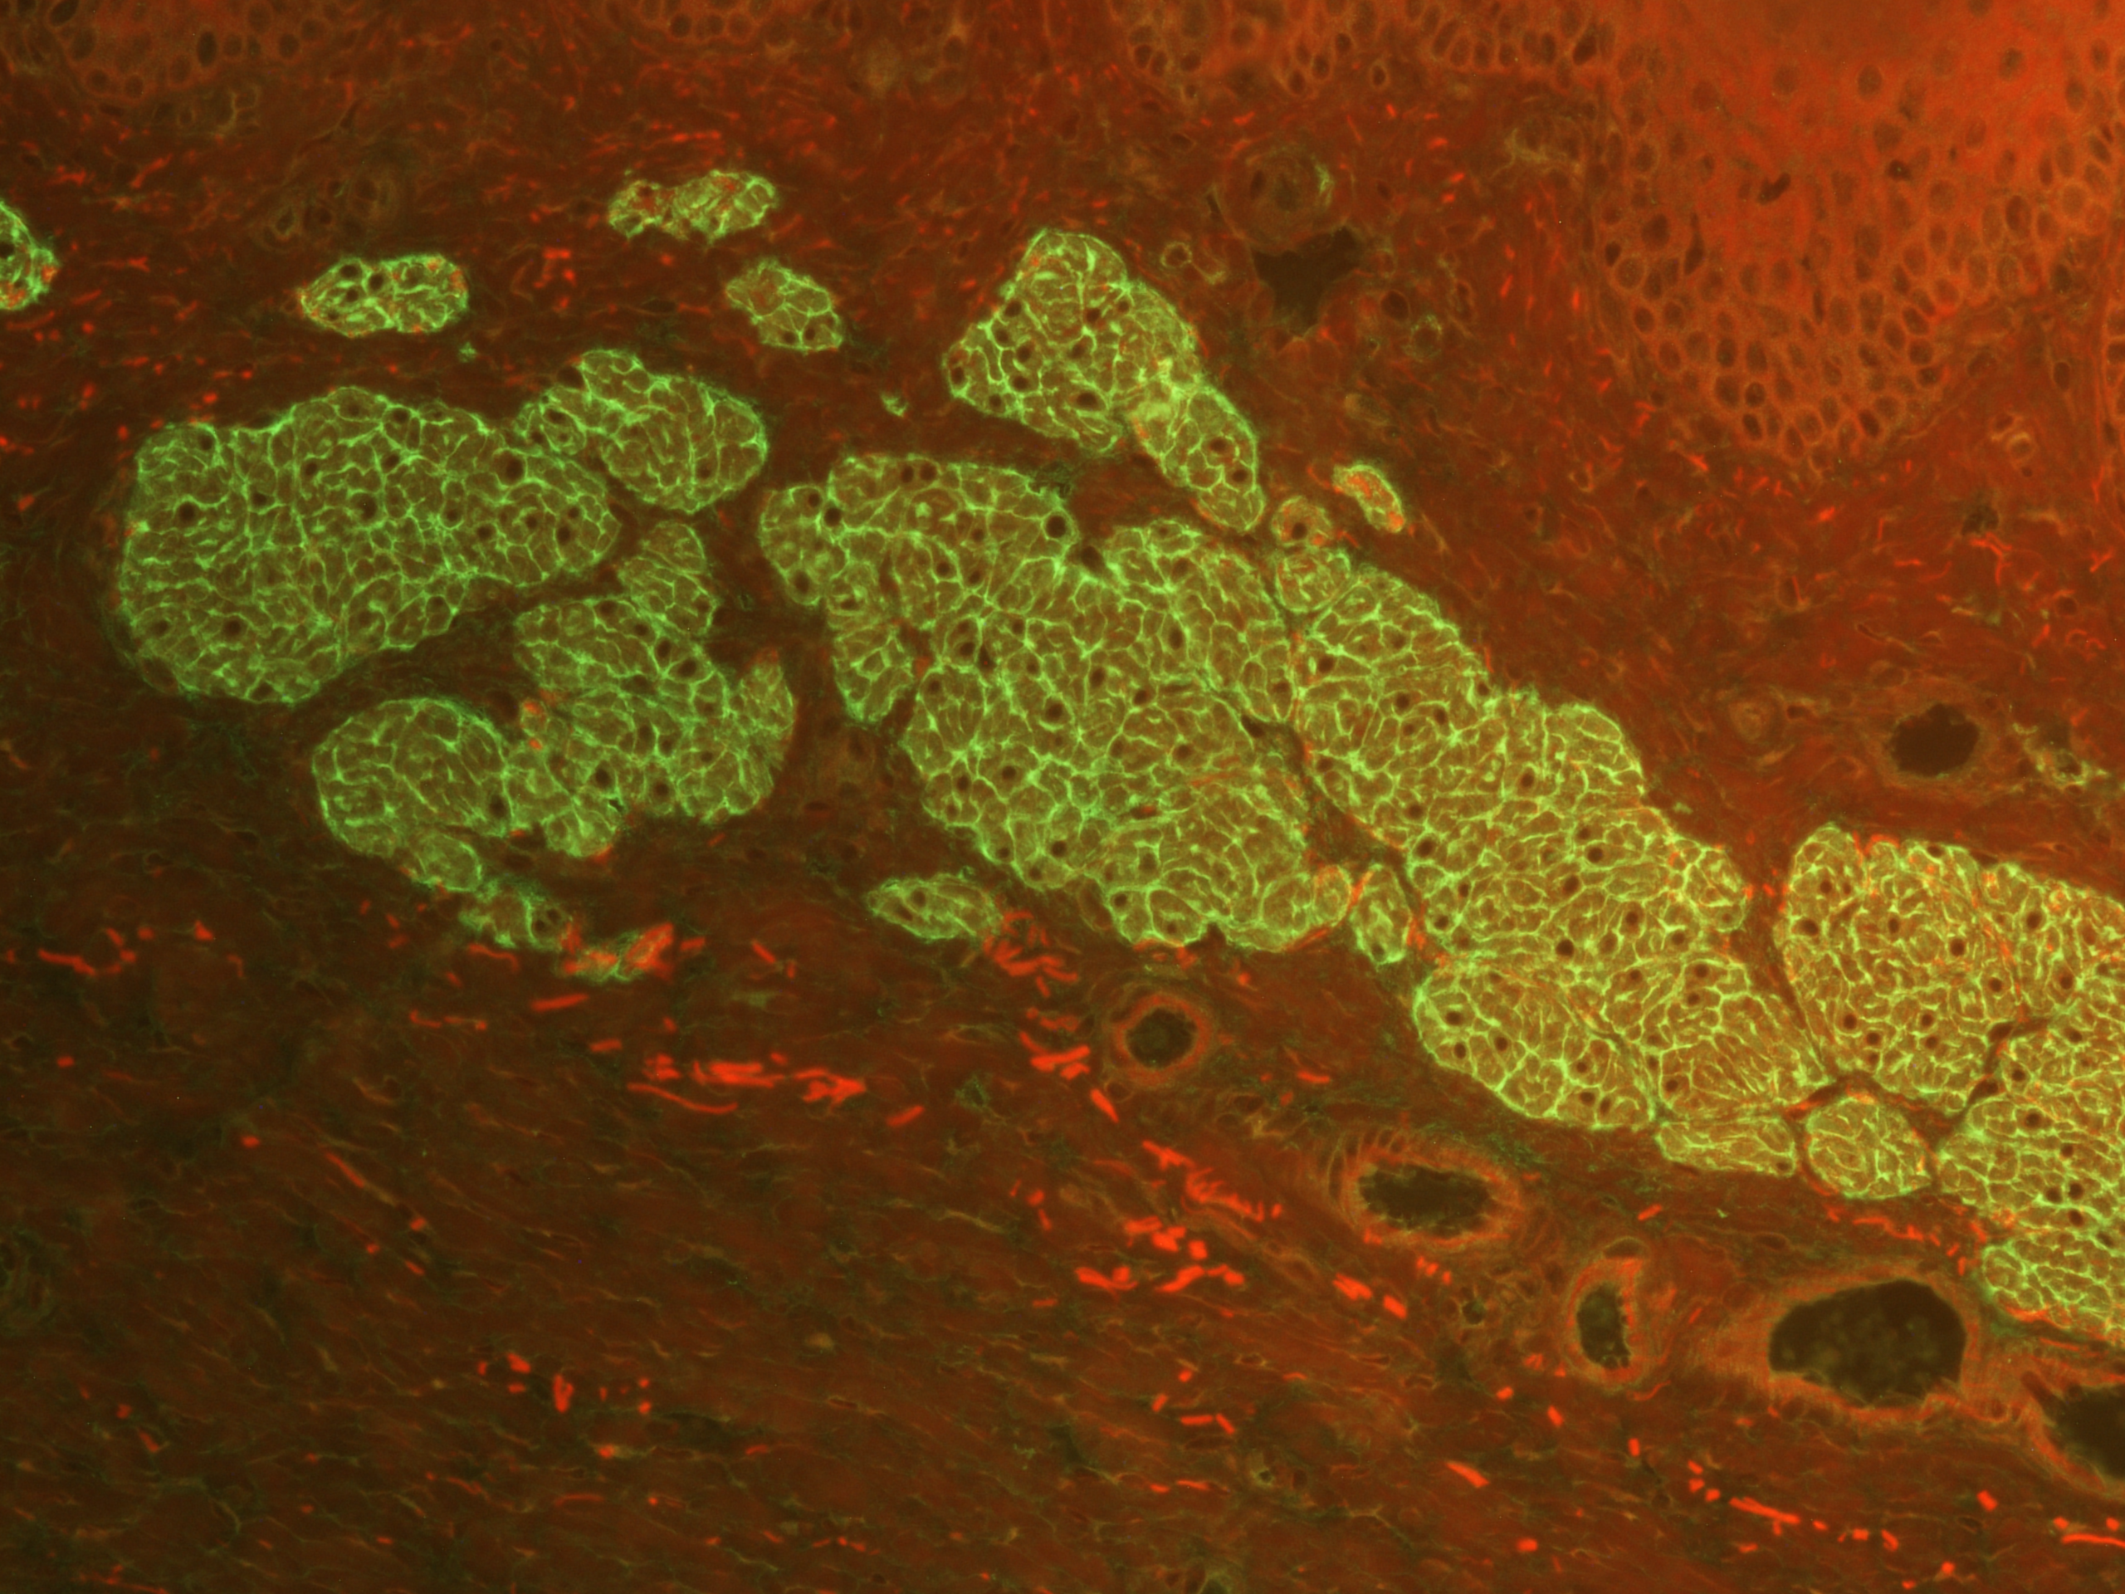
Dermatitis herpetiformis Duhring
rare disease – incidence 3/1 million inhabitants
gluten sensitive entheropathy – coeliakia
IgA antibodies against endomysium (tissue transglutaminase)
cross reaction with eTG on reticulin fibers in dermal papilae
sensitivity to gluten, iodine

Slide 19
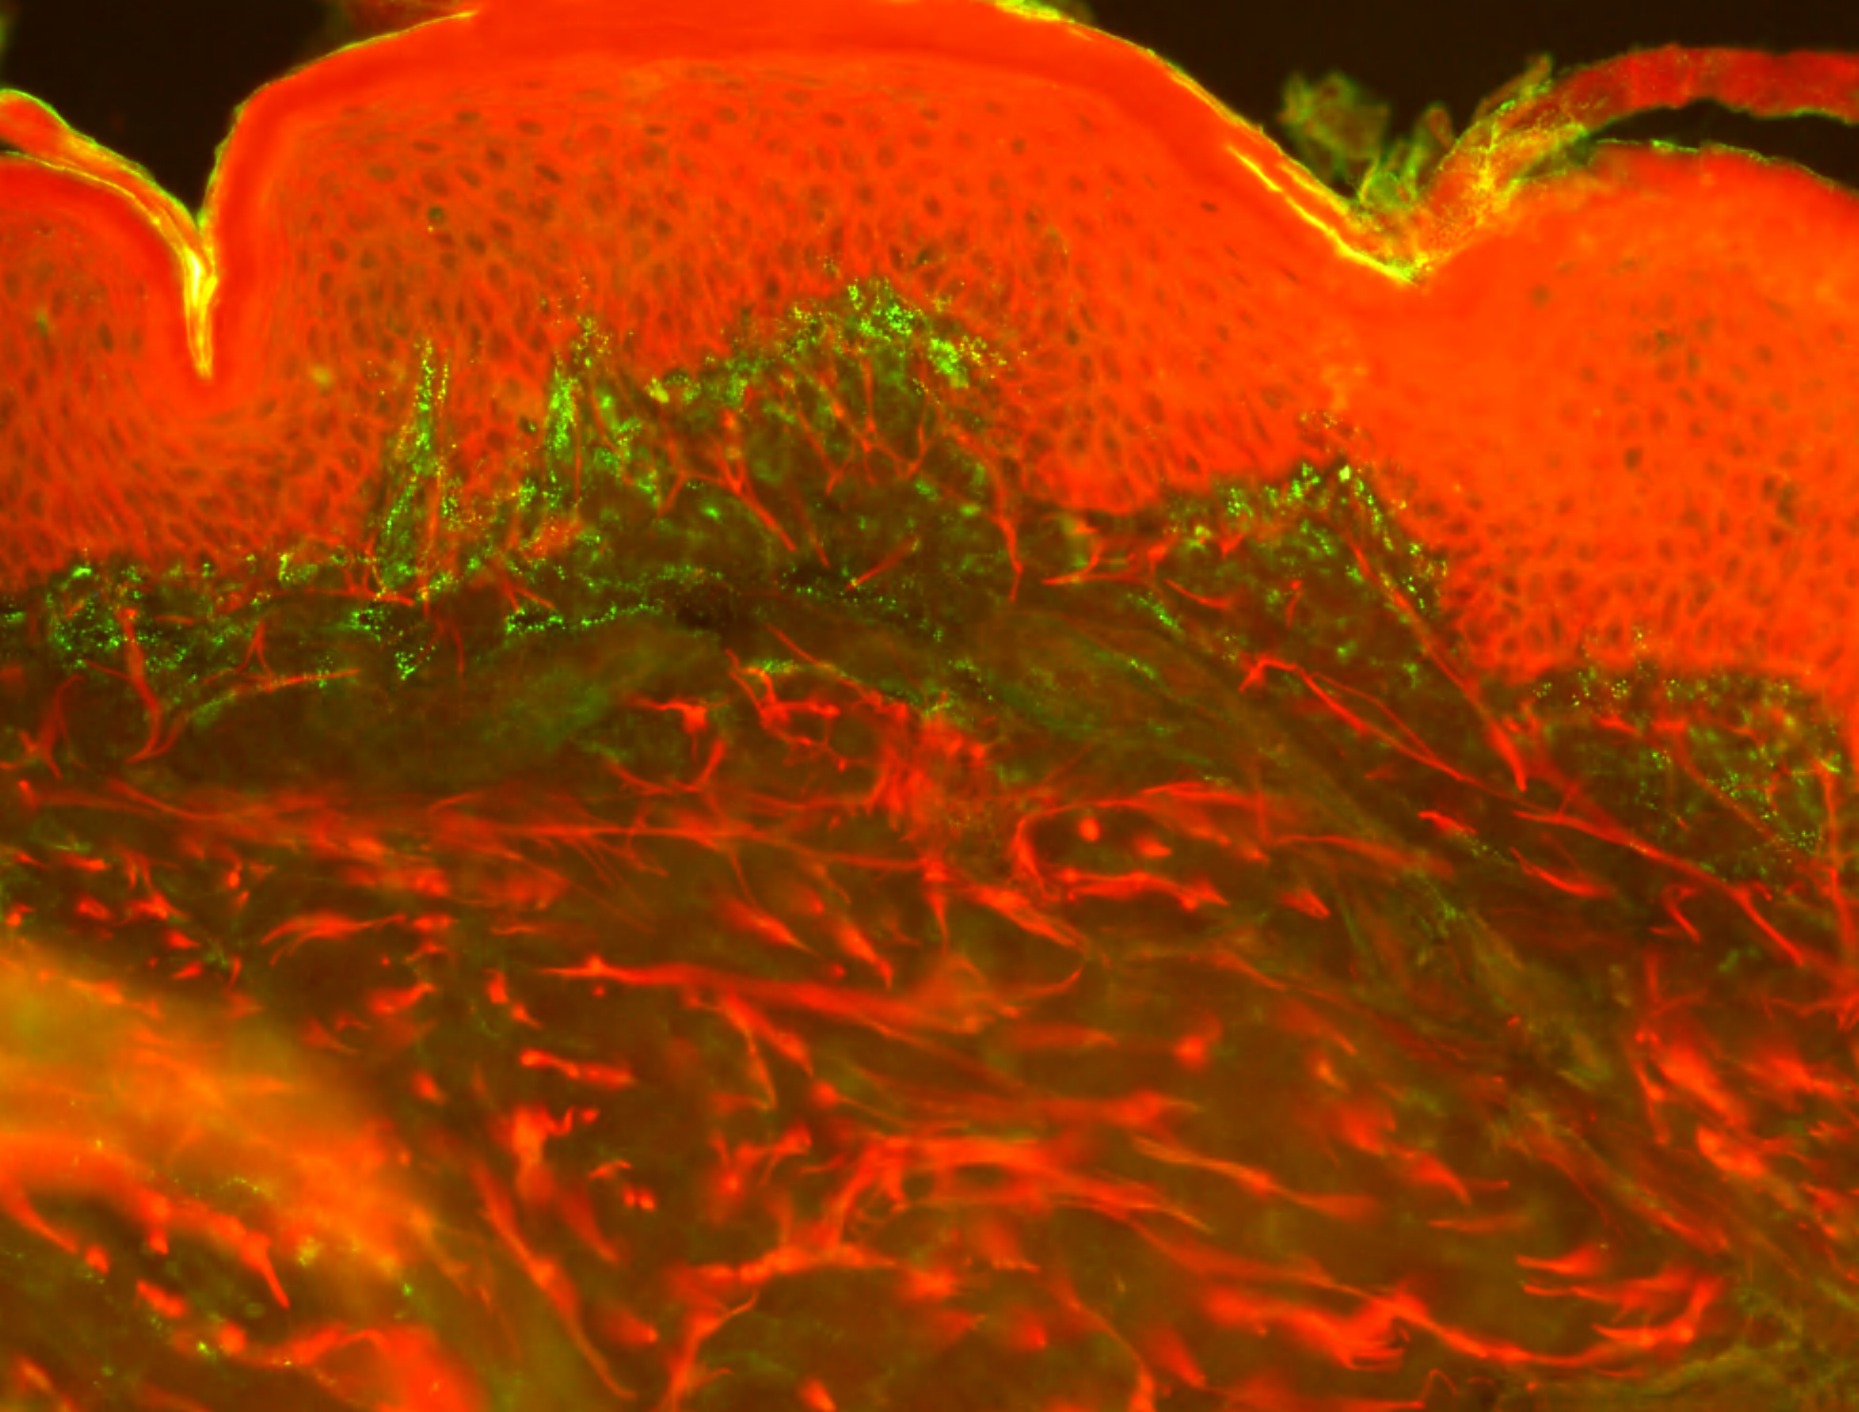
Dermatitis herpetiformis Duhring
Children rarely
Young adults
HLA DQ2, DQ8 association
Predilection sites – elbows, knees, sacrum, hairline
Therapy
Gluten free diet
Dapsone
Topical corticosteroids

Slide 20
