Slide 1
Malignant skin tumors
MUDr. Anna Žáková
I. Dermatovenerologická klinika Fakultní nemocnice u sv. Anny v Brně a LF MU

Slide 2
Precancerosis, CIS
A) obligatory prec. -
are cutaneus lesions- from which can grow up malignant tumors after the years - obligatory precanc.
B) Facultative - in certain causes they can cause malignant tumor
- histological picture is variable - from inflammatory changes with epithelic hyperplasia to ca in situ

Slide 3
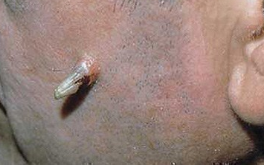
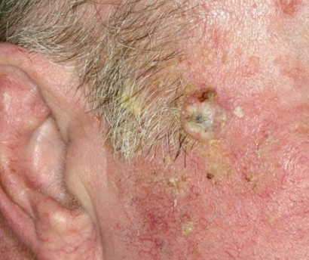
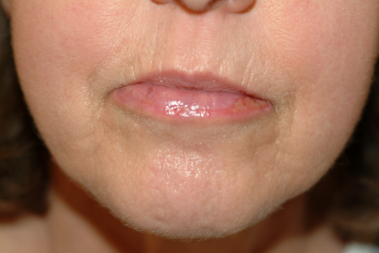
Precancerosis, CIS
A) obligatory prec.- include:
Keratosis actinica
Spinalioma 15%
Cornu cutaneum
Actinic cheilitis
Leukoplakia
Leukoplakia simplex, verrucosa, erosiva
M. Bowen
Erythroplasia Quyerat
Bowenoid papulosis – HPV 16
Lentigo maligna – melanosis circumscripta Dubreih
LMM
B) Facultative
Chronic inflammation- ulcerations, scars – chronical iritation-
growing granulation tissue- sometimes changes to spinalioma
Notes:
Precancerosis are cutaneus lesions- from which can grow up malignant tumors after the years- obligatory precanc.
Facultative precancerosis- in certain (serten-určitých) causes they can cause malignant tumor
Keratosis actinica- extremely common dysplazia of epidermis, especially in skin types I and II
- it is induced by chronical exposure to UV irradiation, so we can find it at solar localization (forehead, bald scalp, cheeks, nose, ears,
lower lip)
- terapy- superficial cryotherapy- quick, cheap, effective
- it can grows to spinalioma, cornu cutaneum, actinic cheilitis
Leukoplakia- chronical white lesions on mucosa membranes- localization-mouth,genital
- it caused by exogenic irritation (mechnical, fyzical, chemical factors, smoking)
M. Bowen- it is intraepidermal ca (ca in situ), very often change to spinalioma
- localization- trunk, lower extremitas
- etiology- arsenic exposure, human papilomavirus,
- manifestation- oval red-brown patch or plague with variable scale
- therapy- excision
Lentigo maligna- it is induced by chronical exposure to UV irradiation
- proliferation atypical epidermal melanocytes – it changes into melanoma
- appears- as irregularly shape and variable pigmented grey, brown and black patch spreads for many years

Slide 4
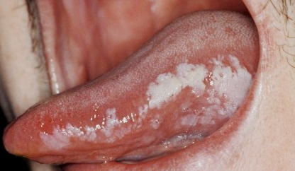
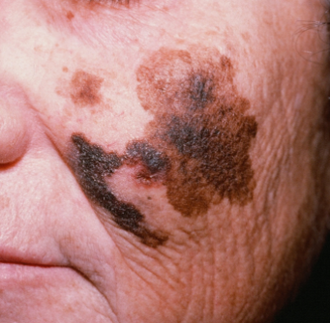
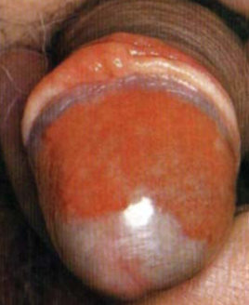

Slide 5
A) obligatory precancerosis
Actinic Keratosis
extremely common dysplazia of epidermis, especially in skin types I and II
It is a SCC in situ
- it is induced by chronical exposure to UV (UVB) irradiation (15 – 20 years after that), so we can find it at solar localization (forehead, bald
scalp, cheeks, nose, ears, lower lip

Slide 6
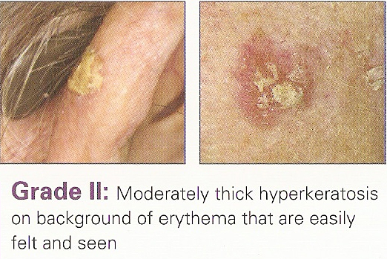
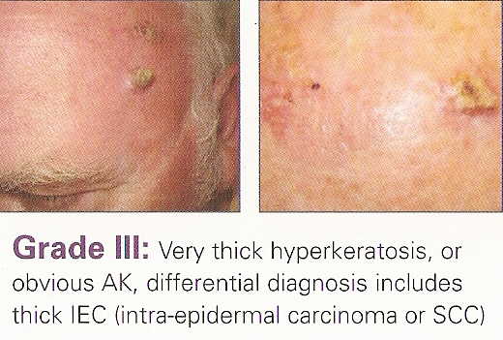
Classification of AK

Slide 7
„Field cancerization“
Some patients have a „field cancerization“ – effect with hundreds of AK
Most common on bald scalp in elderly, imunosuppressed patients

Slide 8
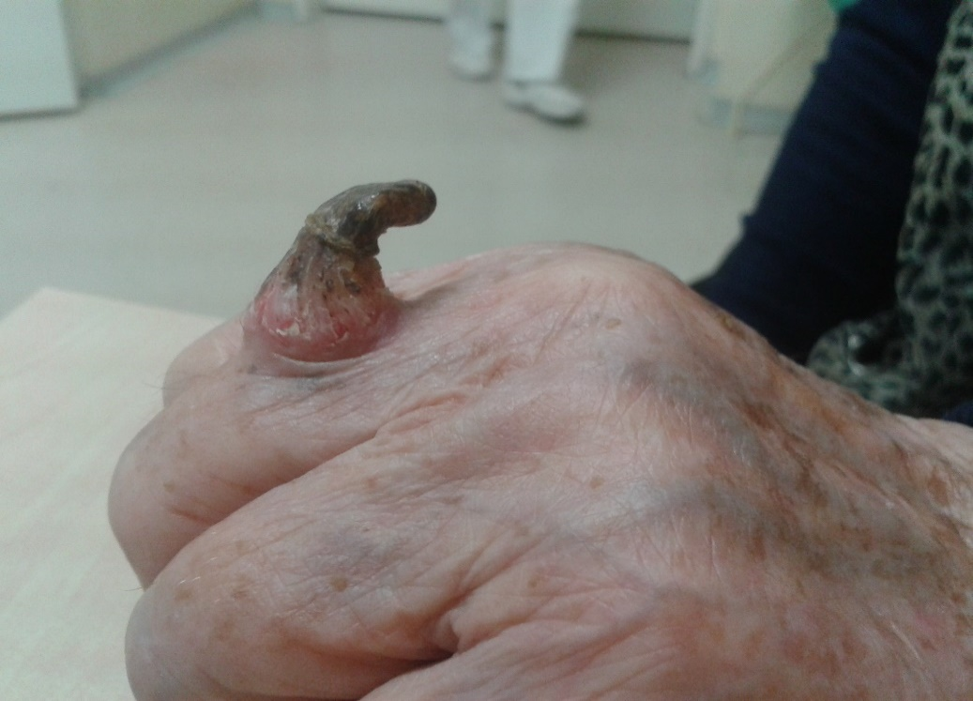
it can grows to
spinalioma (15-20%) after many years
cornu cutaneum - on the surface of the increasing lesion, the horn masses of cylindrical or conical shape resemble a horn
actinic cheilitis – white lesion with irregular surface
on the muccose of the lower lip, with erosions or
crack
Therapy – superficial cryotherapy - quick, cheap, effective
- curettage, shave excision or photodynamic therapy

Slide 9
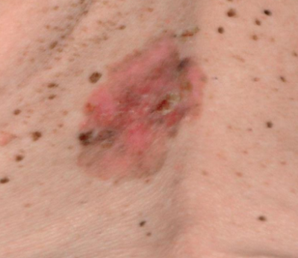
M. Bowen
- it is intraepidermal ca (ca in situ), but not on sun – exposed skin, very often change to
spinalioma
- localization- trunk, lower extremitas
- etiology- arsenic exposure (in the past), human papilomavirus,
- manifestation- oval red-brown patch or plague with variable scale
- therapy – excision
Erythroplasia of Queyrat
Is SCC in situ on the transitional eithelium of the penis, female genitalia or mouth
Red velvety patch with a sharp border
Therapy - excision

Slide 10
Leukoplakia
- chronical white lesions on mucosa membranes – spinalioma of lip
localization-mouth,genital
- it caused by exogenic irritation (mechnical, fyzical, chemical factors, smoking)

Slide 11
Lentigo maligna
- it is induced by chronical exposure to UV irradiatio
- proliferation atypical epidermal melanocytes – it changes into
melanoma
- appears- as irregularly shape and variable pigmented grey, brown and black patch spreads for many years

Slide 12
B) Facultative precancerosis
Chronic inflammation- ulcerations, scars – chronical irritation -
growing granulation tissue - sometimes changes to spinalioma

Slide 13
Malignant skin tumours - division into:
1. non-melanoma skin tumors (NMSC)
represent a large group of neoplasias that are found on the skin with the exception of melanoma
A) Epithelial malignant skin tumors = carcinomas
Carcinoma basocellulare
Squamous cell carcinoma
Ca verrucosum
B) Mezenchymal malignant skin tumors
Kaposi´s sarcoma
2. Melanoma

Slide 14
A) Epithelial malignant skin tumors = carcinomas

Slide 15
Basal cell carcinoma BCC (carcinoma basocelullare)
Tu from basal cell layer
Is the most common malignant tumor (80% of NMSC)
It grows slowly and become localy destructive, but almost never metastasizes

Slide 16
Basal cell carcinoma - epidemiology
The age peak is 60-80 years
The incidence is increasing
BCC is also 10 times more common than SCC
The most common typ of malignant tumor in Europe, USA, Australia
Twice as common in men

Slide 17
Basal cell carcinoma – risk factors
1. UV radiation - chronic exposure, especially UVB radiation (280-320nm)
- But UVA radiation also has a certain share in carcinogenesis - it is absorbed by skin chromophores, oxygen radicals are formed, DNA is damaged
- developing of BCC increases in direct proportion to the lifetime cumulative dose of UV radiation
Latency period after radiation therapy is - 15 to 20 years
- Radiation sources: solar (recreational, at work), medical (NBUVB, PUVA?), Solariums
- Significantly increased risk of basal cell carcinoma - working outdoors (farmers, bricklayers, etc.)

Slide 18
Basal cell carcinoma – risk factors
2. phototype (lighter skin - higher risk), geographical location
3. immunosuppression (transplant patients) - the risk of developing basal cell carcinoma is about 10 times higher than in the general population, especially after liver and kidney transplantation
4. genetic factors - Gorlin's sy, Xeroderma pigmentosum
5. exposition of carcinogens (arsenic salts)

Slide 19
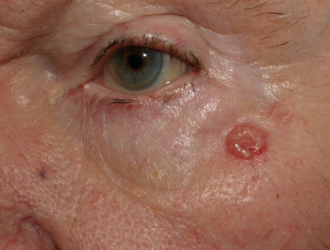
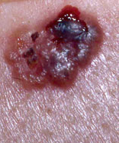
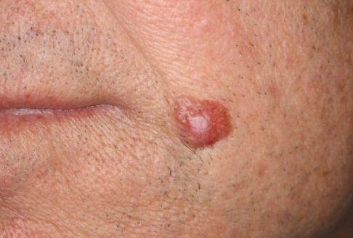
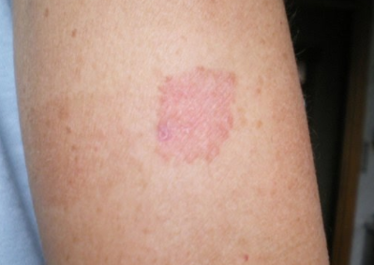

Slide 20
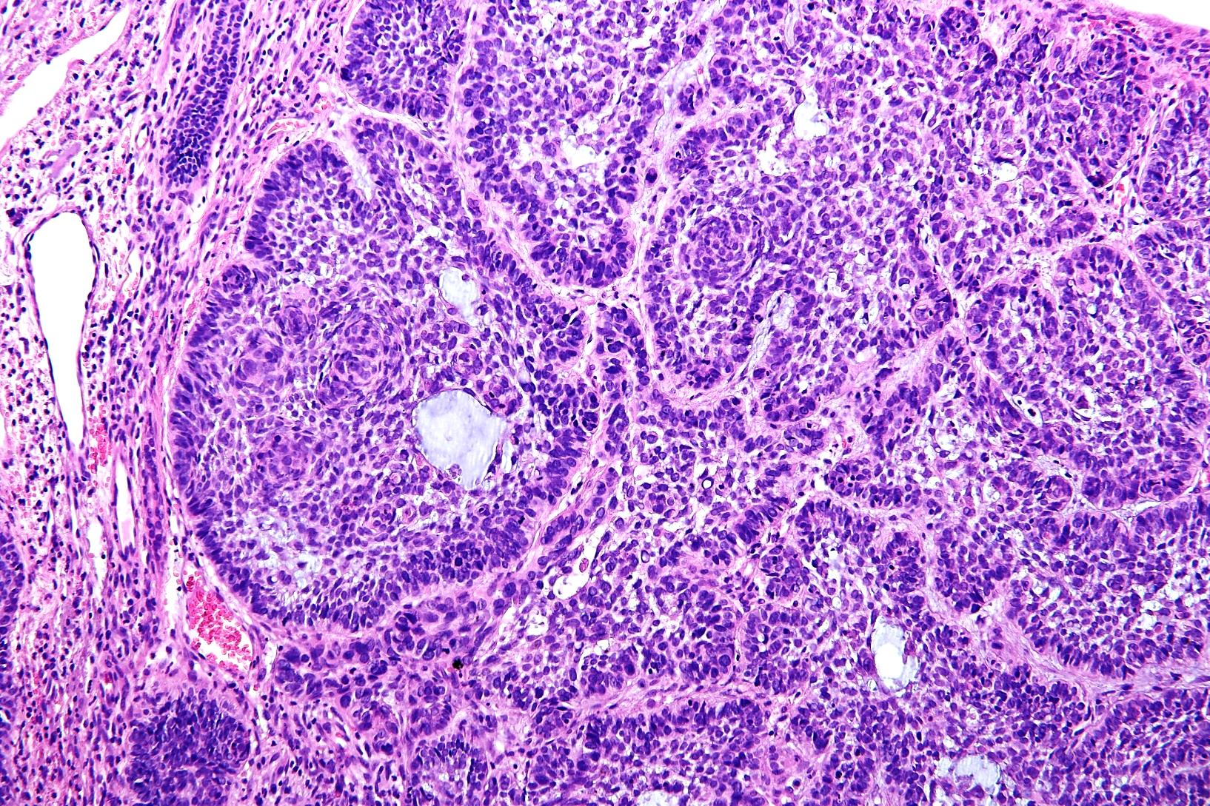

Slide 21
Basal cell carcinoma – clinical features
Nodular or solid BCC
- the most common variant (60%)
localization: neck, head
Irregular pink papule or nodule with telangiectases, pearlescent appearance
During the time in the center of nodule arises central ulceration = (ulcus rodens)

Slide 22
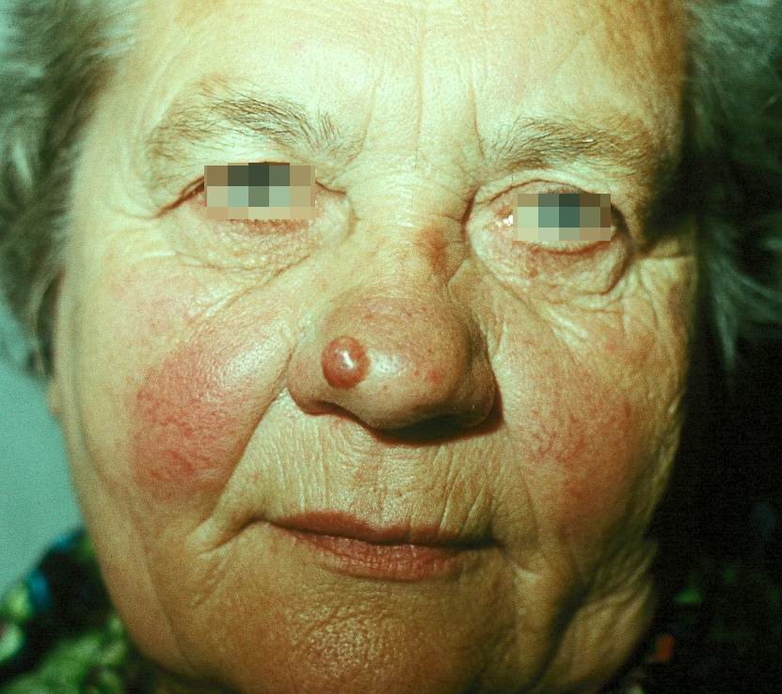
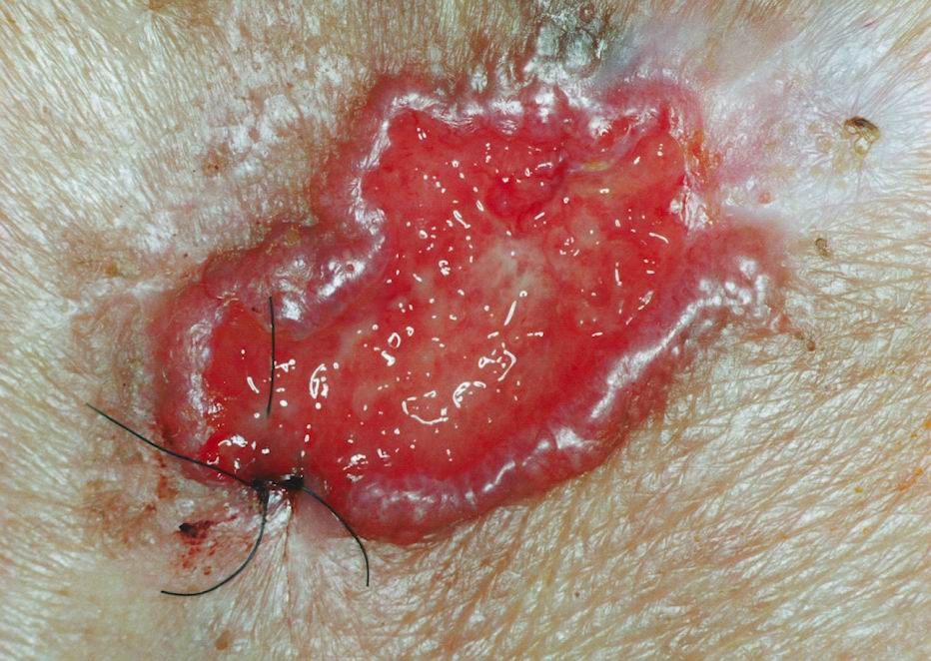

Slide 23
Basal cell carcinoma – clinical features
Ulcus terebrans
- with long-term growth, basal cell carcinomas can grow deeper, through cartilage or bone with the formation of a devastating granulating lesion

Slide 24
Basal cell carcinoma – clinical features
Superficial BCC (15-30%)
localization: trunk, limbs
Red – brown macules and patches with scale and pearly border
The most common type of BCC in arsenic toxicity

Slide 25
Basal cell carcinoma – clinical features
Sclerosing (sclerodermiform) BCC 3%
localization : head and neck
this presents as indurated scar, smooth, slightly elevated lesion of yellow or whitish color, sometimes with crusts on the surface

Slide 26
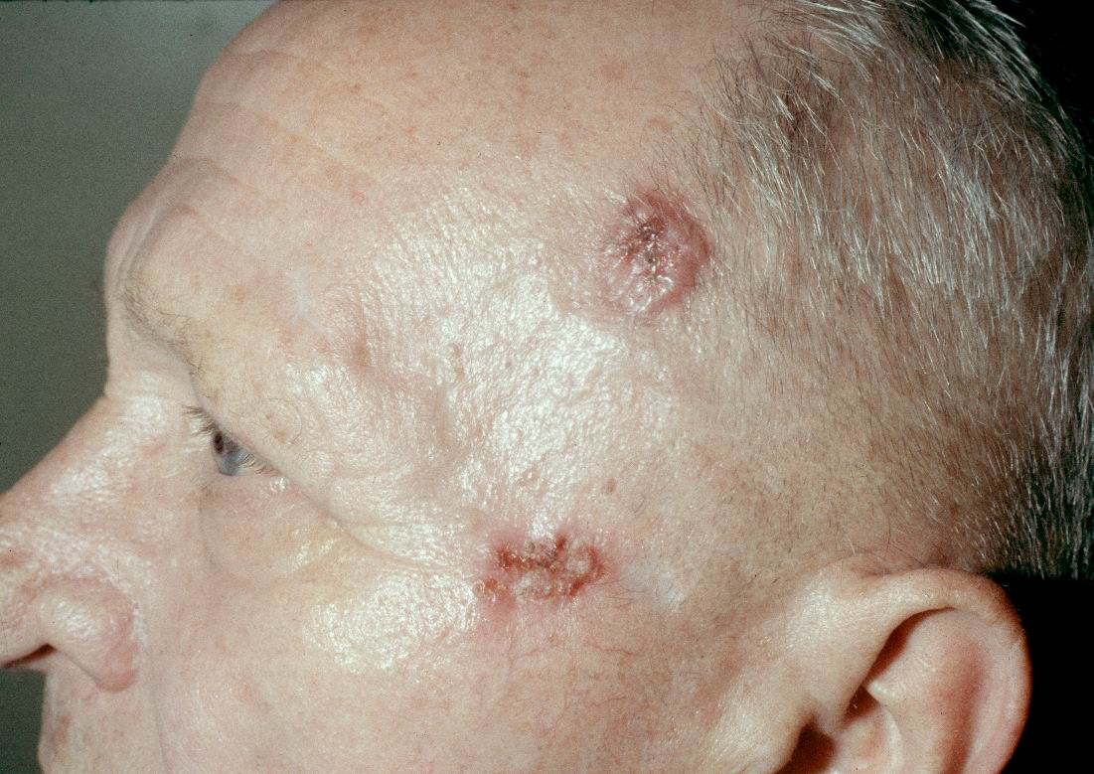

Slide 27
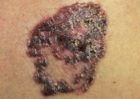
Basal cell carcinoma – clinical features
Basal cell carcinoma with pigment
- easy confusion with melanoma

Slide 28
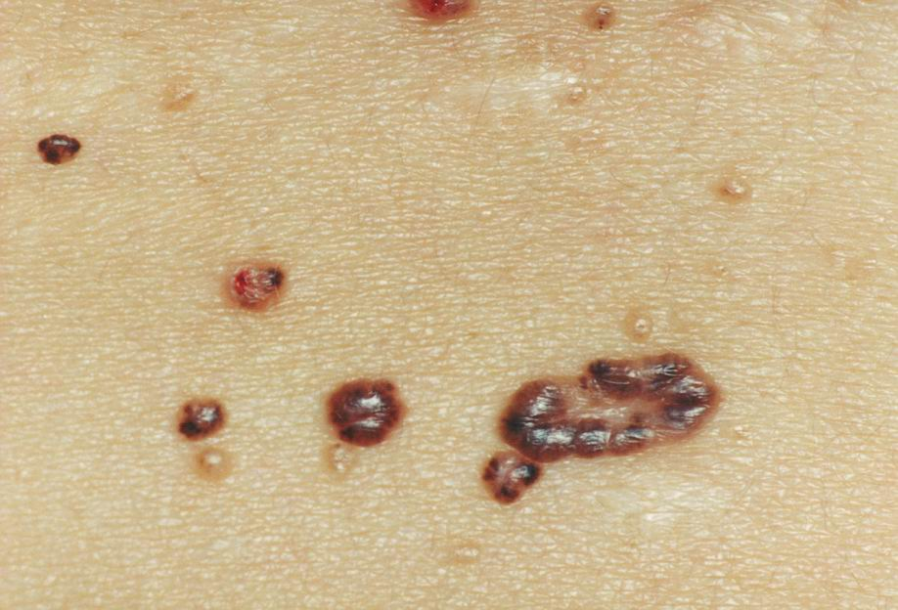

Slide 29
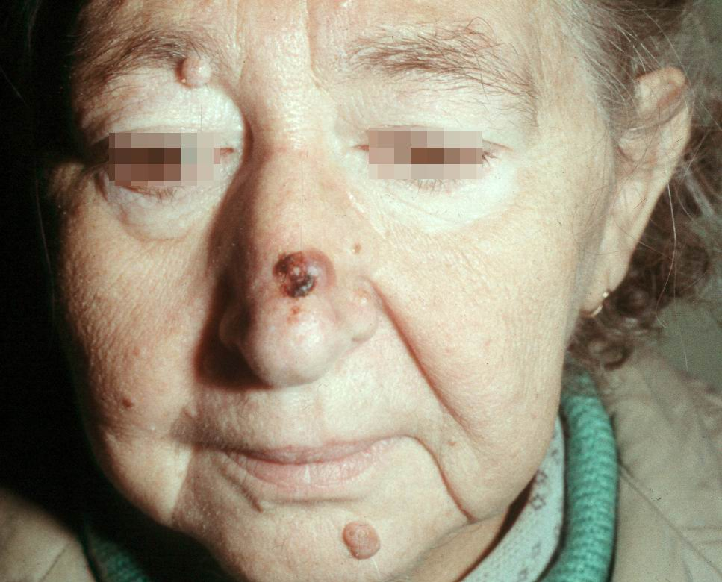

Slide 30
Basal cell carcinoma – clinical features
Fibroepithelioma (Pikus tumor)
- localization: trunk (lumbal region)
- Small smooth papule with pearls surface

Slide 31
Basal cell carcinoma – clinical features
Bazosquamous basal cell carcinoma (metatypic basal cell carcinoma)
localization: head, neck
histologically structures of basal cell carcinoma and squamous cell carcinoma
faster and more aggressive growth

Slide 32
Basal cell carcinoma – therapy
It depends on localization and size of tu
Smaller tu – excision, bigger tu – radical operation, more superficial – cryotherapy
Or laser, photodynamic therapy, 5% imiquimod, 5% fluorouracyl in special cases

Slide 34
Basal cell carcinoma – therapy
1st choice method for all types of BCC - surgical excision
Advantages: histological verification, high success rate - recurrences 2-8% after 5 years from the procedure
Disadvantages: invasive, scars, problematic in elderly polymorbid patients, incomplete excision

Slide 35
Basal cell carcinoma – therapy
Cryodestruction
- suitable for low-risk basal cell carcinomas
Recommended exposure time - 2-3 repetitions for 10s,
Advantage: fast, cheap method, repeated execution, high success rate 97%
Disadvantages: there is no standardized method, hypopigmentation, according to the experience of the doctor recurrence - 8-40%
CO2 laser - low-risk basal cell carcinomas
- Rather recommended in combination with PDT (nodular basal cell carcinomas)

Slide 36
Basal cell carcinoma – therapy
PDT (photodynamic therapy) - targeted treatment using a photosensitizer - methyl ester of delta aminolevulinic acid, that we apply topically to the treated lesion (it is taken up preferentially by cells with higher metabolic activity) followed by irradiation with visible light in the presence of oxygen
Indications: superficial AI and thin nodular basal cell carcinomas, especially for large or multiple lesions

Slide 37
Basal cell carcinoma – therapy
Radiotherapy
- Indicated for medium and high-risk basal cell carcinomas as primary, more often adjuvant therapy, if excision is possible - always prefer a surgical solution
histological verification is necessary before
Indications: after incomplete excision, recurrence of BCC except recurrence after RT, BCC spreading to bone or cartilage, perineural spread of BCC
advantages: can be used for KI surgical excision, especially for pac. older age, an efficiency around about 90% at 5 years of follow-up
Disadvantages: going to the center, many visits, post-radiation dermatitis, alopecia

Slide 38
Squamous cell carcinoma SCC (carcinoma spinocellulare)
The second most common type of skin cancer is 20% of all skin malignancies
epithelial tumor which starts with intraepithelial growth, then after long time turns into a destructively growing tumor
metastasizes predominantly by the lymphatic vessels (5-10%)
localized in places exposed to sunlight, at the same time on the skin there are signs of solar damage
70% of spinaliomas - head, neck, 15% on the upper limbs
occurrence in our population 11/100 000

Slide 39
Squamous cell carcinoma – risk factors
Age over 50 years
Male gender
Light skin, hair, low phototype
UV exposure
Chronic skin changes (scars, fistulas)
Immunosuppression
Human papillomavirus - HPV infection
Chemical carcinogens (arsenic, asphalt)
Ionizing radiation (medical, at work)

Slide 40
Squamous cell carcinoma – clinical features
diffusely infiltrating
- Elevated hyperkeratosis or a solid infiltrated lesion with a nodular surface

Slide 41
Squamous cell carcinoma – clinical features
Ulcerative spinalioma
- a chronic ulcer with rigid edges

Slide 42
Squamous cell carcinoma – clinical features
Exophytic spinalioma
aggressive, rapidly metastatic form
- rapidly growing, soft, exophytic, bleeding and crumbling nodul

Slide 43
Squamous cell carcinoma - examination
It is necessary histological verification
invasive forms – we have to examine sentinel LU nodes (UZV, CT, MRI), in lymphadenopathy - thin aspiration

Slide 44
Squamous cell carcinoma - therapy
Radical surgical excision
Radiotherapy - especially in the elderly
Chemotherapy - oral form of 5-fluorouracil - in inoperable or metastatic forms

Slide 45
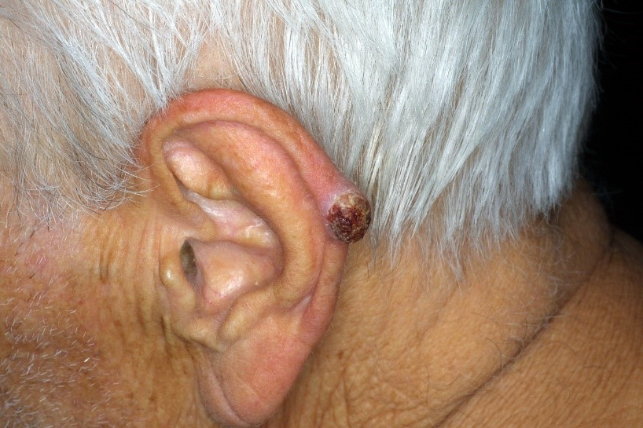

Slide 46
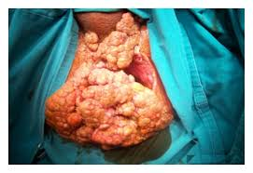
Verrucous carcinoma (Ca verrucosum)
Rare , highly differentiared spinoca with verrucous surface
Invasive growth
Lower tendency to meta
HPV 6,11
Epithelioma cuniculatum, papilomatosisi cutis carcinoides, florid oral papilomatosis, giant condyloma – BUSCHKE- LOWENSTEIN
Therapy: excision, RT, laser; retinoids, INF, chemo

Slide 47
B) Mezenchymal malignant skin tumors

Slide 48
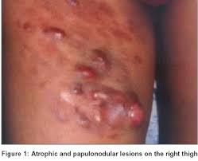
Dermatofibrosarcoma protuberans
Recurrent fibrous tumour, locally invasive growth, low tendency to meta, often reccurence after surgical excision
Like a keloid
CD34+ fibroblasts
Therapy: wide and deep surgical excision (3-5cm, to fascia)

Slide 49
Kaposi sarcoma
Malignant vascular tumour
Risk f.: imunosupression, HHV 8
types:
Classical – Europe, 50-80y, 15:1
Endemic – Africa, 25-40y, 17:1
Iantrogenic – imunos., 20-60y, 3:1
Epidemic – AIDS, 37 y, 106:1
Clinical forms:
Classical – localised, nodular
Disseminated form ( skin + mucosal. Mem, GIT)
Stages:
Inicial- macula
Infitrated- macules
Tumorous – plaques, papules,nodules

Slide 50
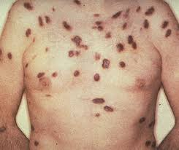
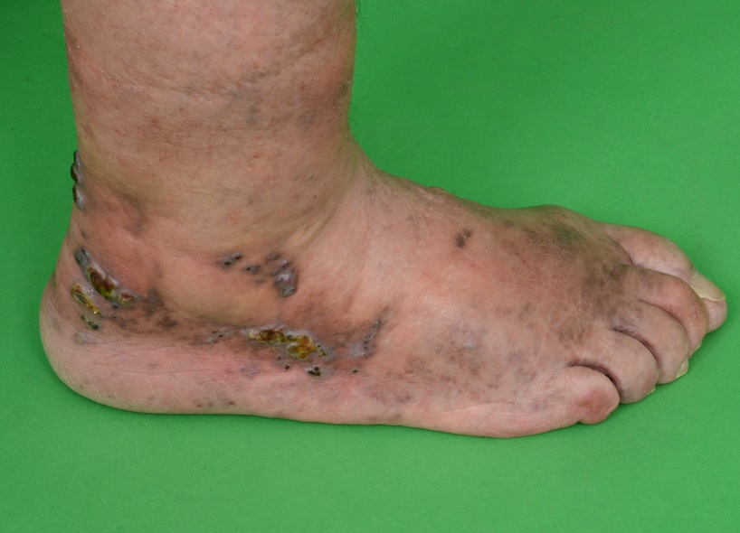
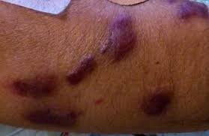
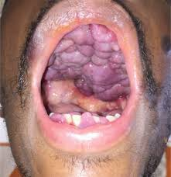
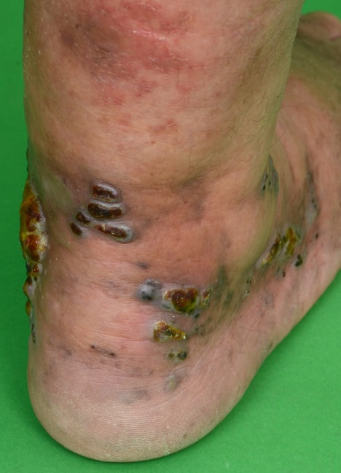
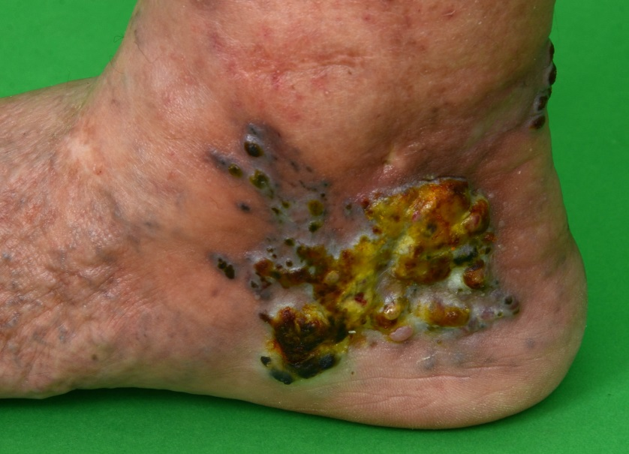
Therapy:
Surgical, kryo, PDT, RT, laser
INF alfa, chemo, antiretrovirotics- HIV +
Prognosis:
Classical- great, indolent
Disseminated – fatal

Slide 51
2. Melanoma
The most dangerous type of skin cancer
Malignant tu. with high potential of mts
Develops by neoplastic proliferation of melanocytes (pigment- containing cells) in the skin, eye, rarely occur in the mucose of the mouth, intestines, lungs….
Develops from a mole ( mark, nevus pigmentosus) or „de novo“
It is more often among people of middle age
In women – most commonly occur on the legs, in men on the back
Prognosis: Breslow to 1 mm 10y ….93–99 %, 1,01–2 mm …. 70–92 %, 2,01–4 mm ……40–69 % over 4 15–39 % případů; + mitosisis, ulceration, meta!!!
Follow up and prevention!

Slide 52
Risk factores of melanoma
Ultraviolet light exposure ( especially sunburn in childhood with blisters, cumulative dose of UVB , be carefull about tanning devices)
People with many moles especially – dysplastic nevus syndrome
Phototype I, II ( light skin, blond or red hair, blue eyes, or Snow White type with black hair, fine-bone white skin and blue eyes) – typically in Australia, New Zealand, Northern Europe
Genetic defects such as xeroderma pigmentosum
Immunosupression
Inicidence is rising - 15/100 000/y ( Australia 60-70)
Notes:
Important ( důležité) is addindg ( sčítání) of light exposure during holydays, therapeutic UV during life
They are fifteen per one thousand per year new cases in CR, but in countries

Slide 53
The growth of melanoma
Radial growth phase : melanocytes are found only in the epidermis, they spread into the higher layers of epidermis and then new clones with different speed of growth of malignant cells develope in the places far from the original, the tumor is less than 1mm thick
Vertical growth phase : malignant cells spread deeper to papillary dermis, the tumor becomes able to grow into the surrounding tissue, can spread through blood or lymph vessels, the tumor is more than 1 mm thick
The Breslows depth of the lession - the depth of invasion from stratum granulosum to the malignant cell , which is situated deepest
Notes:
Divelop, fejzis, depf, invejžn

Slide 54
Growth of tumor
Notes:
We use Breslow and Clark level to estimate ( odhadnout) prognosis of TU. The highest level of Breslow or Clark the poorest prognosis.
Hodnota – value ( velju)

Slide 55
Malignant melanoma
4 Clinical forms:
Lentigo maligna melanoma – face – older patients
Superficial spreading – most often
Nodular – rapid metastases
Acrolentiginous – often late diagnosis

Slide 56
Melanoma – clinical features
Lentigo maligna melanoma – face and neck of older patients from previous lentigo maligna
irregular edges and color, slowly increasing lesion (lentigo maligna), size of 5 or more cm, after several years of horizontal growing it starts vertical growing which ends in nodule pigmented knot or amelanotic knot develop ( = transition to LMM)
Notes:
Lentigo maligna melanom develops from Ca in situ – lentigo melanoma, which is mole with…..

Slide 57
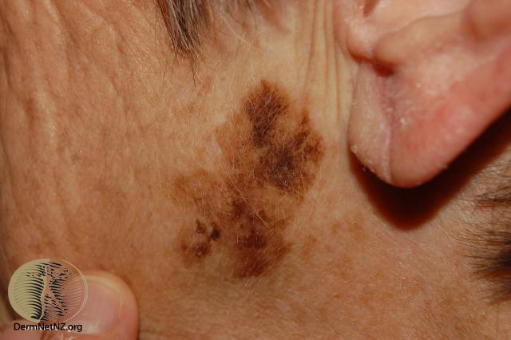
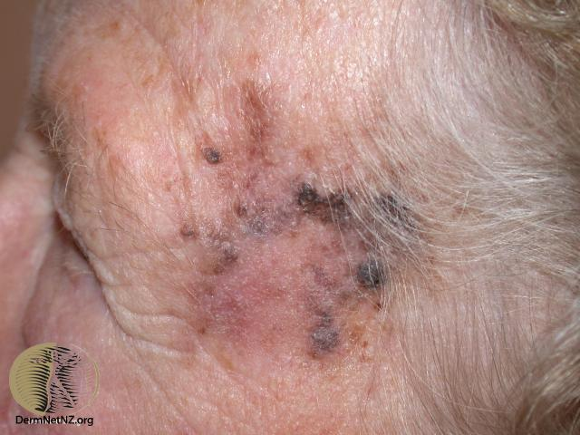
LMM

Slide 58
Melanoma – clinical features
Superficial spreading melanoma
most often type (60-70%)
At the beginning it grows slowly and symetrically, then it changed to nevus with irregular borders, it is slightly elevated than rest of the skin, it starts to change color from light to dark brown/black, some places spontaneous regreds or it could change their color to red
Secondary nodular melanoma – the appearance of the nodule in the original lession, it is sign of vertical growth, worse prognoses
Notes:
Regresion = pigmentation disappeare

Slide 59
SSM

Slide 60
SSM

Slide 61
Melanoma – clinical features
Nodular melanoma
– the second most frequent type (15-30%)
- rapid becomes metastatic – developes skin local metastasis, metastases in brain, lymph nodes, liver, bones
Rapid growth, lump elevated above the skin surface, firm to the touch, with wide base, easily bleeding
Amelanotic form – red lump with suppurating surface
Bad prognose
Notes:
Suppurating - mokvající

Slide 62
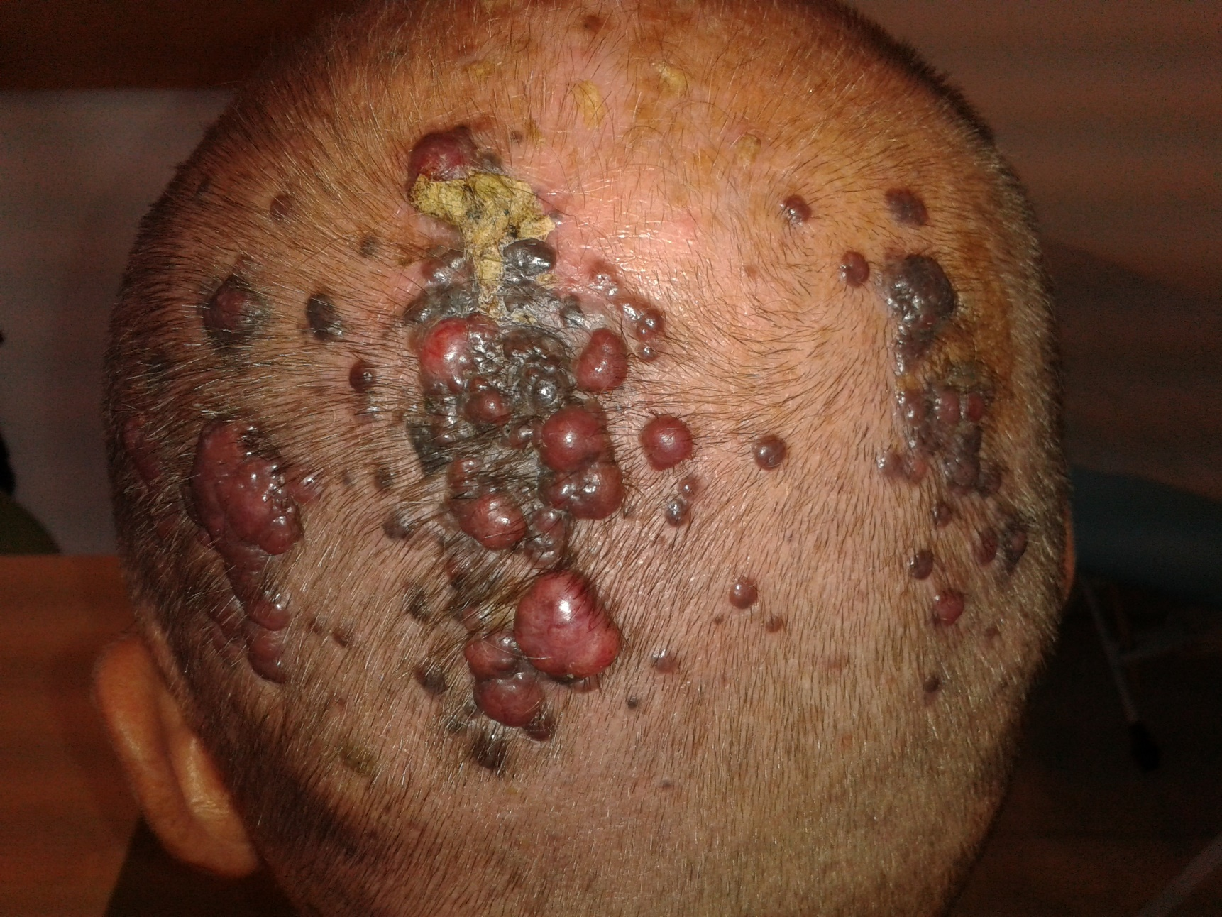
NM

Slide 63
NM - amelanotic

Slide 64
Melanoma – clinical features
Acrolentiginous
- often late diagnosis
More frequent among dark skin people
Localization – palms, soles, nails
Irregular pigmentation of under the nail plate or red suppurating lump, with rest of pigmentation near the nail plate

Slide 65
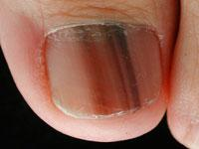
AKL

Slide 66
AKL

Slide 67
Diagnosis
Visual inspection – typical signts of malign lesion - ABCDEF rule
Dermatoscophy (manual or total body)
Biopsy
Sentinel lymph node biopsy
Staging – chest X ray, CT, MRI, PET/CT

Slide 68
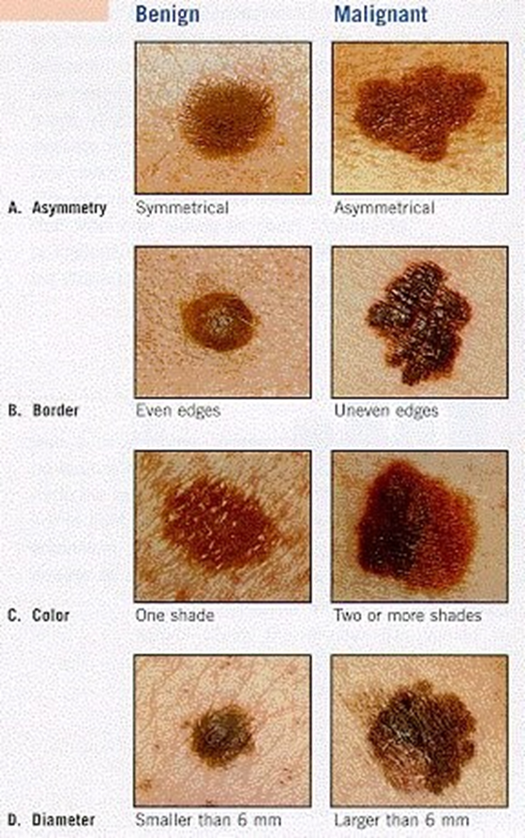
Malignant melanoma
Rules for evaluation of pigmented naevi:
Asymetry
Borders
Colour
Diameter 5mm and more
Evolution (bleeding, growth)

Slide 69
Dermatoscopy : MM x névus

Slide 70
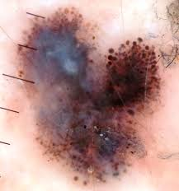

Slide 71
Therapy
Therapy:
Surgery- wide excision + sentinel LN extirpation
Adjuvant: RT (inoperable meta in LN), INF alfa
Organ meta: chemotherapy, biological therapy- dacarbazine (chemo), CTLR 4 inihibitors- ipilimumab, BRAF inhibitors- dabrafenibe, vemurafenib, EGFR inh,…..
The effectiveness of treatment for metastatic melanoma is limited, the average survival time is 6-9 months !!!!!!!!!
The only reliable therapy for MM is early clinical dg. and early surgical removal.
Follow up and prevention!

Slide 72
Prevention
- Limited excessive and intense sunbathing and skin burns in childhood and adulthood - Search for risky pac. - with a high number of pigmented nevi and carriers of dysplastic nevi - Public informations - early detection of MM - early excision - healing

Slide 73
Thank you for your attention

