Slide 1
The structure and function of the skin

Slide 2
The skin
largest organ of the body
protects us from microbes and the elements
helps regulate body temperature
and permits the sensations of touch, heat, and cold

Slide 3
Skin of an adult person
surface 1,5 -2 m²
weight 18-20 kg (15-19 % of total weight)
epidermis and dermis thikness - 2 mm (0,5 - 3,5 kg)
subcutis thikness - 8-25 mm

Slide 4
Layers of the skin
Epidermis - the outermost layer of skin, provides a waterproof barrier and creates our skin tone
Dermis - beneath the epidermis, contains connective tissue, museles, senzory neurons, blood vesseles, hair follicles, hairs, and sweat glands
Subcutaneous tissue (hypodermis) - made of fat and connective tissue.

Slide 5
Layers of the skin
Ep idermis
Dermis
Subcutaneous
fat

Slide 6
1. Epidermis
the thinnest part of the skin - thickness 0,3 – 1,5 mm
the outermost layer of skin
formed by cells:
- keratinocytes - arranged into 5 layers
- melanocytes
- Langerhans cells
- Merkels cells

Slide 7
1. Epidermis

Slide 8
Layers of epidermis and keratinocytes
Stratum basale
– the deepest part of the epidermis, prolifaration of keratinocytes occurs there, the keratinocytes are connected by molecules called desmosomes to each other and to the basal membrane (layer between epidermis and dermis) are connected by hemidesmosomes
Stratum spinosum
– above str. basale, layer where process of differentiation starts (change in morphology of keratinocyte and production of keratin)
Stratum granulosum
– an area where the keratinization process is completed and keratohyalin granules become visible (precursors for keratin)
Stratum lucidum – amorphous band between str. granulosum and str. corneum (visible by microscope only on palms and soles of feet)
Stratum corneum
– consists of corneocytes (remnants of keratinocytes) made up of keratin and cell walls without nuclei
Keratinocytes of stratum basale and lower part of stratum spinosum have ability to divide – this part is called stratum germinativum Malpighi

Slide 9
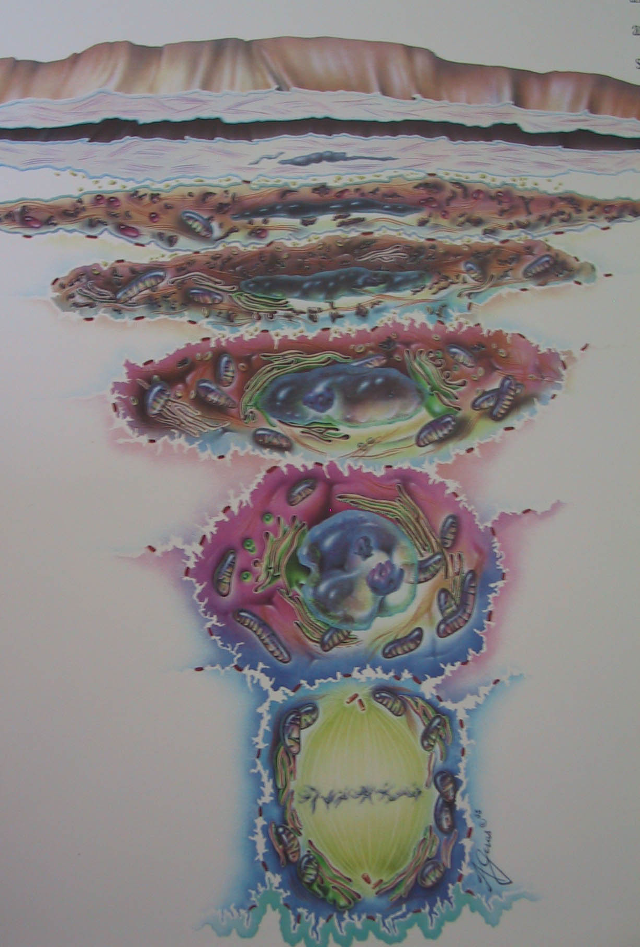
Keratinization
the epidermis is a self-renewing structure
keratinocytes are formed by mitosis in the stratum basale
as they move up through the stratum spinosum and stratum granulosum, they differentiate to form a rigid internal structure of keratin, microfilaments and microtubules (keratinization)
the outer layer of the epidermis, stratum corneum, is composed of layers of flattened dead cells (corneocytes) that have lost their nucleus. T
corneocytes are shed from the skin in process called desquamation
this process takes approximately 28 days, the change from a basal layer keratinocytes to a corneocyte takes 14 days and then the loss of this cell remnant as scale occurs after another 14 days
Horny layer
Granular
layer
Spindle cell
layer
Basal cell
layer

Slide 10
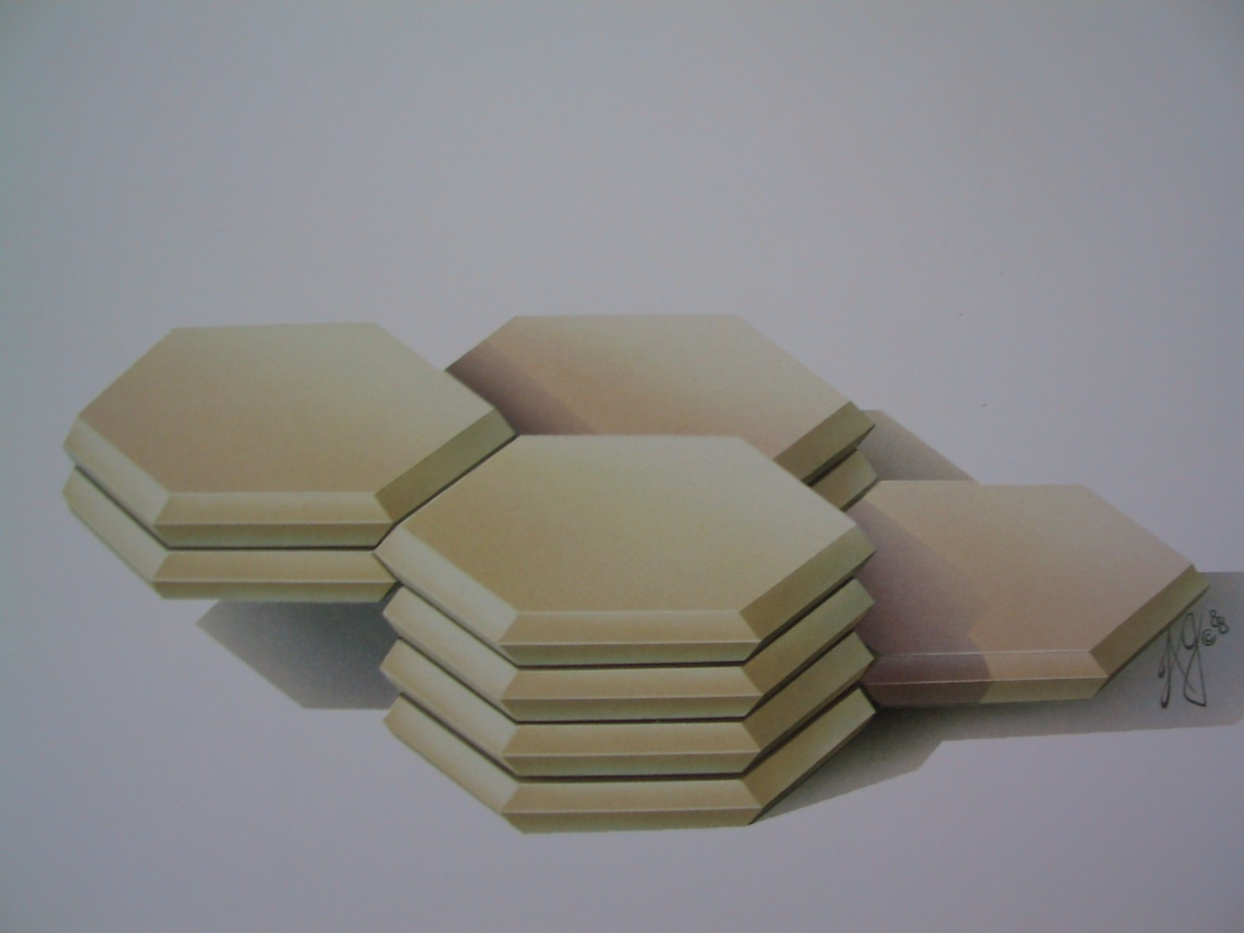
Horny layer - epidermal barrier
surface od epidermis is called horny layer (stratum corneum) or epidermal barrier
stratum corneum can be compared to a brick wall
the keratinocytes are connected together due to epidermal lipids and adhesion molecules
the lipids stabilize the epidermis and help to seal the barrier but also allow the passage of substances throught the epidermis in both directions

Slide 11
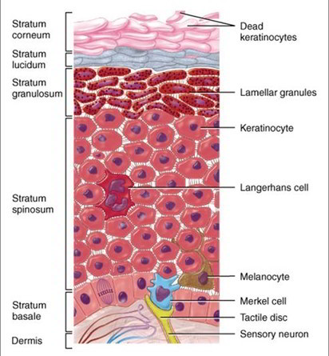
Other cells in the normal epidermis
Melanocytes – synthesize melanin (main photoprotective factor)
Langerhans cells – antigen-processing cells of the skin
Merkel cells – neuroendokrine cells
that function as mechanoreceptors

Slide 12
Melanocytes
clear cells located in the stratum basale
are derived from the neural crest and migrate into epidermis
main function of melanin is to absorb ultraviolet (UV) radiation to protect us from its harmful effects

Slide 13
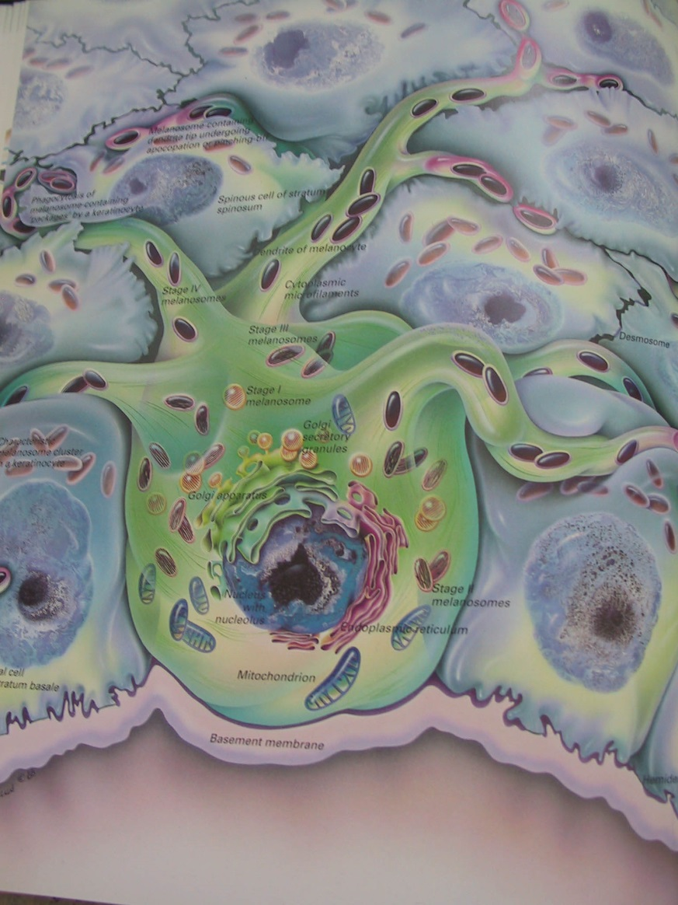
Epidermal melanin unit
- synthesis of melanin is complex process starting with tyrosine, the most important enzyme is tyrosinase
An important intermediate is DOPA (a precursor of dopamine)
- the melanin is packaged into melanosomes in the Golgi apparatus and transferred to keratinocytes by dendrites
- melanocytes have long cell extension denrites and can provide 30-40 keratinocytes with melanin
Tyrosinase
Tyrosine –> Dopa –> Dopaquinone –> Eumelanin, pheomelanin
Notes:
They produce the pigment melanin, manufactured from tyrosine, which is an amino acid, packaged into cellular vesicles called melanosomes, and transported and delivered into the cytoplasm of the keratinocytes (Graham-Brown and Bourke, 2006).
Skin colour is determined not by the number of melanocytes, but by the number and size of the melanosomes (Gawkrodger, 2007). It is influenced by several pigments, including melanin, carotene and haemoglobin. Melanin is transferred into the keratinocytes via a melanosome; the colour of the skin therefore depends of the amount of melanin produced by melanocytes in the stratum basale and taken up by keratinocytes.
Melanin occurs in two primary forms:
Eumelanin – exists as black and brown;
Pheomelanin – provides a red colour.
Skin colour is also influenced by exposure to UV radiation, genetic factors and hormonal influences (Biga et al, 2019).

Slide 14
Langerhans cells
antigen-presenting dendritic cells
part of the body’s immune system
constantly on the lookout for antigens
in their surroundings so they can trap
them and present them to T-helper
lymphocytes, thereby activating an
immune response

Slide 15
Merkel cells
present in very small numbers in the stratum basale
closely associated with terminal filaments of cutaneous nerves and seem to have a role in sensation, especially in areas of the body such as palms, soles and genitalia

Slide 16
Types of cell junctions in the epidermis
desmosomes – complex structures with many proteins holding cells together – the most important are the desmogleins
adherent junctions - connect actin filaments and involve cadherins and catenins
gap junctions

Slide 17
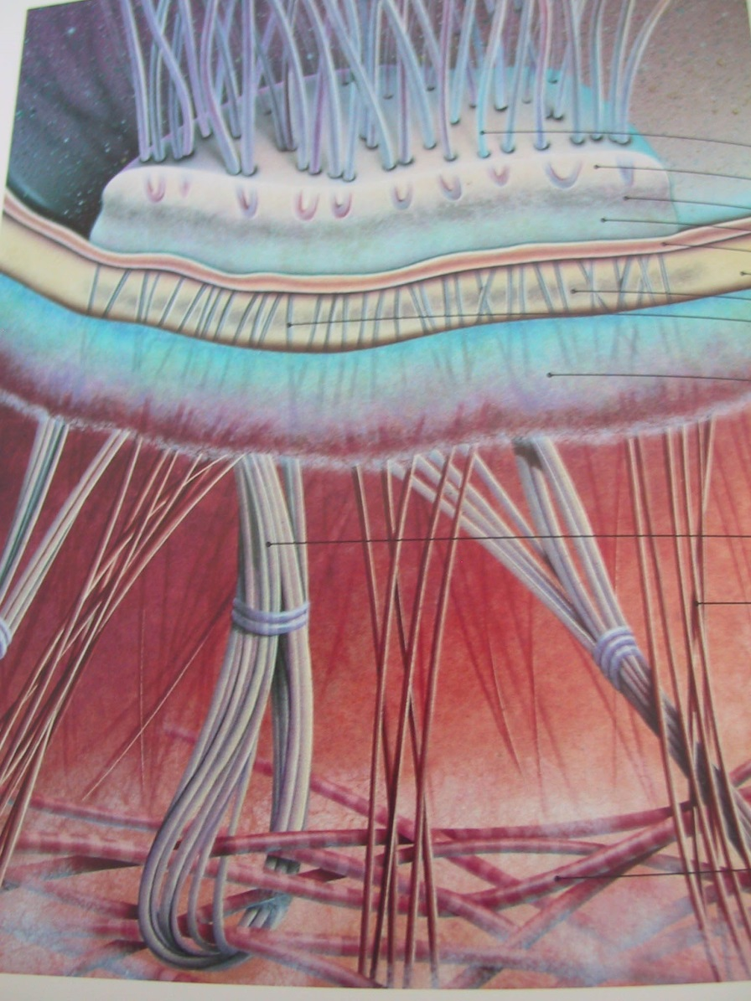
Dermo epidermal junction –basal membrane zone
- narrow, undulating, multi-layered structure situated between the epidermis and dermis, which serve as cohesion between these two layers
- key components of the basal membrane zone – hemidesmosomes – junctional complexes, attach keratinocytes of str. basale to underlying basal membrane sharing many features with desmosomes
- is made up of lamina lucida and lamina densa
- barrier functions – allowing molecules to diffuse to and from the dermis

Slide 18
2. Dermis
thickness: 0,6 – 3 mm
connected to the epidermis at the level of the basal membrane
consists of two layers, the papillar and reticular layer which merge together without clear demarcation
contains: connective tissue
senzoric neurons blood vessels
hair follicles and hairs
sweat glands

Slide 19
Layers of dermis
Stratum papillare – formed into papilles orientated to epidermis, connective tissue with cells, elastic filaments, nerve endings, senzoric corpuscules - Meissner, Ruffini, ...
Stratum reticullare – bigger part of the dermis, thick network of colagen and elastic filaments, less amount of cells, Vater-Pacini corpuscules

Slide 20
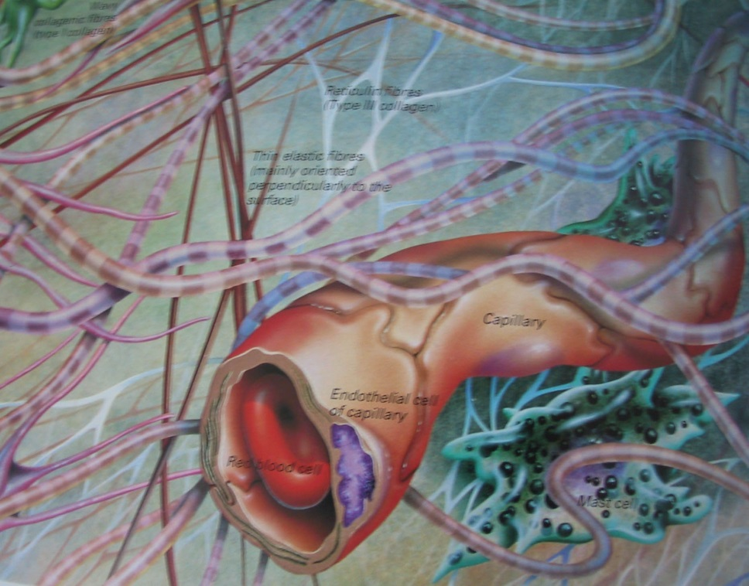
2. Dermis
- the major structural component of the skin
- composed of collagen (strength), elastin (elasticity), blood/ lymph vessels and specialized cells called fibroblasts and mast cells.
- work together in a mesh like network.
- the network is surrounded by a gel-like substance called ground substance, which is made mostly from glycosaminoglycans (composed of hyaluronan, glycoproteins and proteoglycans), gel substance plays a key role in hydration and moisture level of the skin.

Slide 21
Types of cells in dermis
3 type of cells:
Fibroblasts - the synthesis of collagen and elastin
Histiocytes – created from monocytes (from blood vessels), active form call as mastocytes
Mastocytes – fagocyte antigens, release mediators (histamine, heparin, prostagalndins, leukotirens, tryptase etc.)

Slide 22
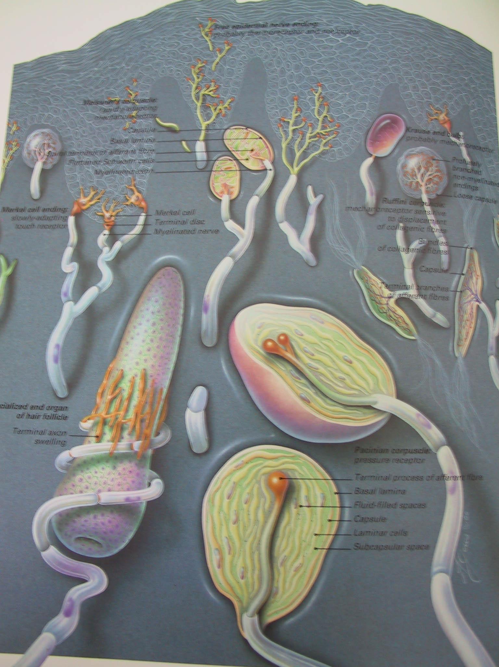
Inervation of skin
Nerve endings
Merkels cells
Sensitive corpuscles
heat
cold
pressure
vibrations
touch
itch
pain

Slide 23
Adnexal structures
Hair
nails
glands (eccrine, apocrine, sebaceous)
most of these adnexal structures is localized in dermis

Slide 24
The adnexal glands
Eccrine glands
– widely distributed over the body, mostly concentrated on palms and soles, they can´t be found on the lips, external ear canal, clitoris and labia minora
- „skin kidneys“ – sweat is usually clear and odorless
Apoccrine glands
– associated with hair follicles, their secretory duct empties into the upper part of the hair follicule
- sweat is odoriferous due to bacteries
- found in armpits, anogenital area and areolas

Slide 25
The adnexal glands
Sebaceous glands
- assotiated with hair follicules
- sebaceous localization
- their secretion lubricates the follicle to allow the hair shaft to growth outwards against less resistence
- androgen sensitive

Slide 26
Hairs
first hairs start to grow in the 20.th. week of pregnancy - lanugo
the number of hair follicules is final after birth, new follicules aren´t produced
there is 5 milion hair follicules on human body (on head approx. 100 000)

Slide 27
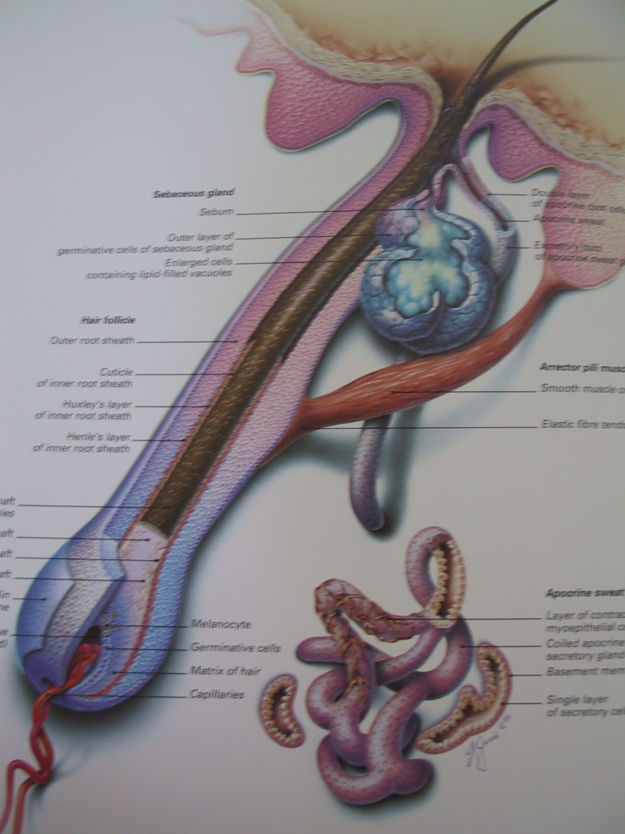
Pilosebaceous unit
- The lower part of the follicule is extended
into the bulbus, there is the papila with
capillaries, above the papila germinative
matrix and its cells diferentiate to other
layers of the follicule and
from this part to the growing hair
- Hair is Inside of the follicule,
consisting of medula, cortex a cuticula
- Around hair there is inner root sheath,
which ends under opening of ductus
of sebaceous gland to follicule
- Musculus arrector pili – is under the
ductus of sebaceous gl.,
isn´t on beard, axillar and pubic hair

Slide 28
The hair cycle
Include:
anagen – growing phase (2-6 years)
katagen – (days – weeks)
telogen - (2-4 months)
Colour of the hair – depends on numbers and activity of melanocytes in hair follicule

Slide 29
Types of hairs
Lanugo - starts to grow in the 20.th. week of pregnancy
Velus hair – change from lanugo after birth
Terminal hair – has more pigment, is stronger, contain medula
pili longi – capillus (pilus capitis)
barba
hirci
pubes
body hairs
pili breves – cilia
supercilium
vibrisae
tragi

Slide 30
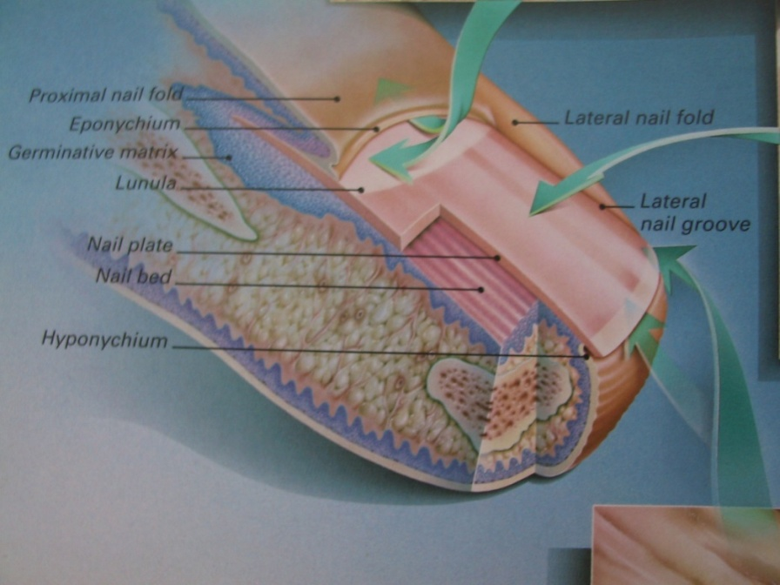
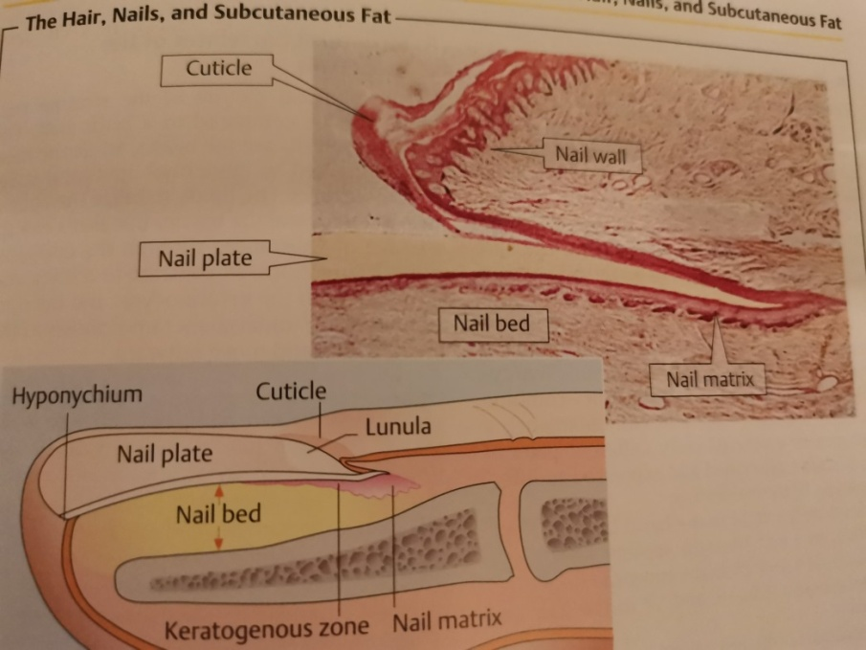
The nail
consists of the nail matrix, nail plate,
nail bed and periungual skin
(paronychium)
the nail matrix – growth zone of the nail
the nail plate – is sealed proximally
by the cuticule (eponychium) and
laterally by the nail folds
nails grow slowly, a finger nail requires
4-6 months to replace itself, toenail 2-18
months, grow faster at night, in summer,
in young than in the elderly, and in men
than women

Slide 31
3. Subcutis
lies between the dermis and muscle fascia, tendons or ligaments
consists of adipocytes and connective tissue
the subcutis contains numerous connective tissue septae which carry lymphatics and blood vessels and nerves
the network of septae keeps the lobules of fat in place and provides support
adipocytes are metabolically active

Slide 32
3. Subcutis

Slide 33
Skin functions
Protection
Thermoregulation
Storage
Sensation
Metabolism
Immunologal processes
Detoxification
Social function

Slide 34
The function of the skin
Protection against
chemicals
physical factors (mechanical, thermic, actinic)
Biological factors (Infections, antigens)
Preservation of balanced internal environment
Loss of water, electrolytes, macromolecules
epidermal barrier
horny layer, water reservoir, sweat gland,…

Slide 35
The function of the skin
Temp erature regulation
- p ers p iration
- vasodilatation
- vasoconstriction
Sensation
Storage (fat, water)
blood vessels, eccrine sweat glands
thermoreceptors – cold and heat
mechanoreceptors – touch, pressure, vibrations
nociceptors – pain and itch
energy reservoir - subcutaneous fat

Slide 36
The function of the skin
Metabolic – vitamin D synthesis, metabolism od sacharides, li p ids and p roteins, secretion of keratin, eanin, sebum, sweat
Immunological function
Psychosocial function
Keratinocytes
Langerhans cells, T-lymphocytes, macrophages, mastocytes, keratinocytes
Cosmetic quality, lips, hair

Slide 37
Thank you for your attention
You can find the overview here: https://www.youtube.com/watch?v=MPLV4h0Tr8c

