Slide 1
Development and teratology of cardiovascular and lymphatic systems
8.3.2021
Anna Mac Gillavry

Slide 2
Development of the heart
Formation of primary heart field
WHEN? - middle of the 3rd week (day 16)
WHAT? - progenitor heart cells
WHERE? - from epiblast through the primitive streak to the visceral layer of lateral plate mesoderm
DO WHAT? - form PHF

Slide 3
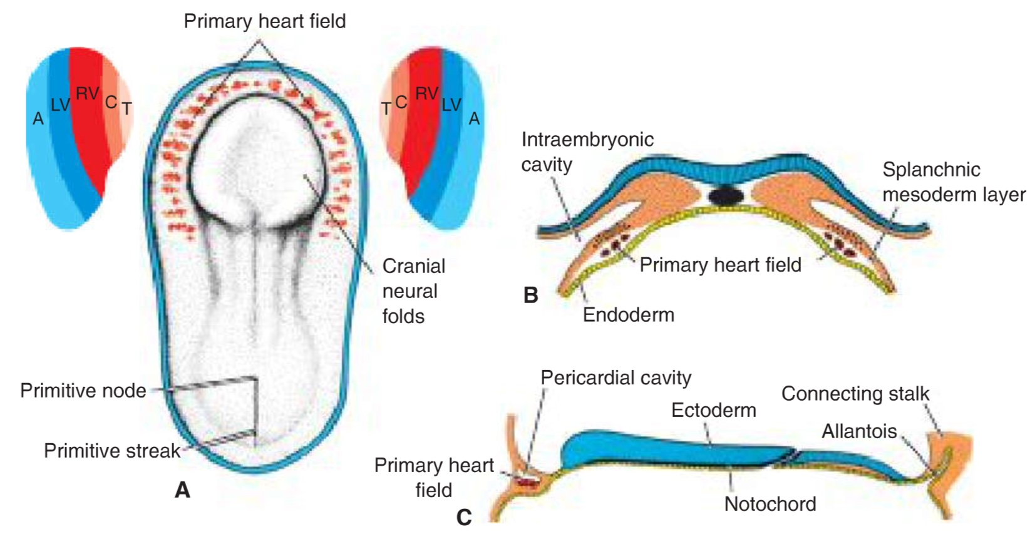
T.W. Sadler, Langman´s medical embryology, 14th edition

Slide 4
Formation of the heart tube
WHEN? - day 20-22
WHAT? - the paired heart tubes
WHERE? - thoracic region
DO WHAT? - the caudal portion fuse except for the caudalmost part

Slide 5
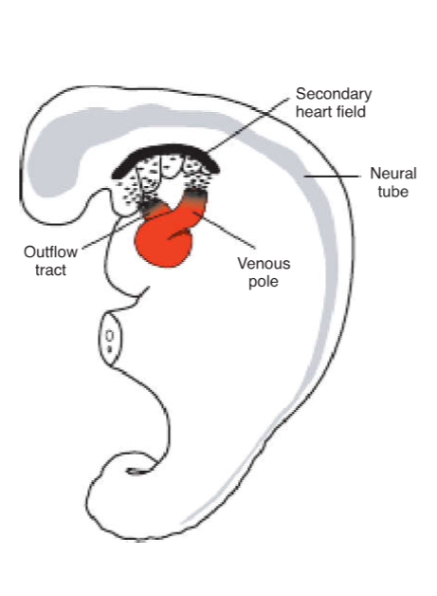
Heart tube lengthening
SHF appears on day 20-21 in splanchnic mesoderm ventrally to the posterior pharynx:
right ventricle, conus cordis, truncus arteriosus
atria, sinus venosus
T.W. Sadler, Langman´s medical embryology, 14th edition

Slide 6
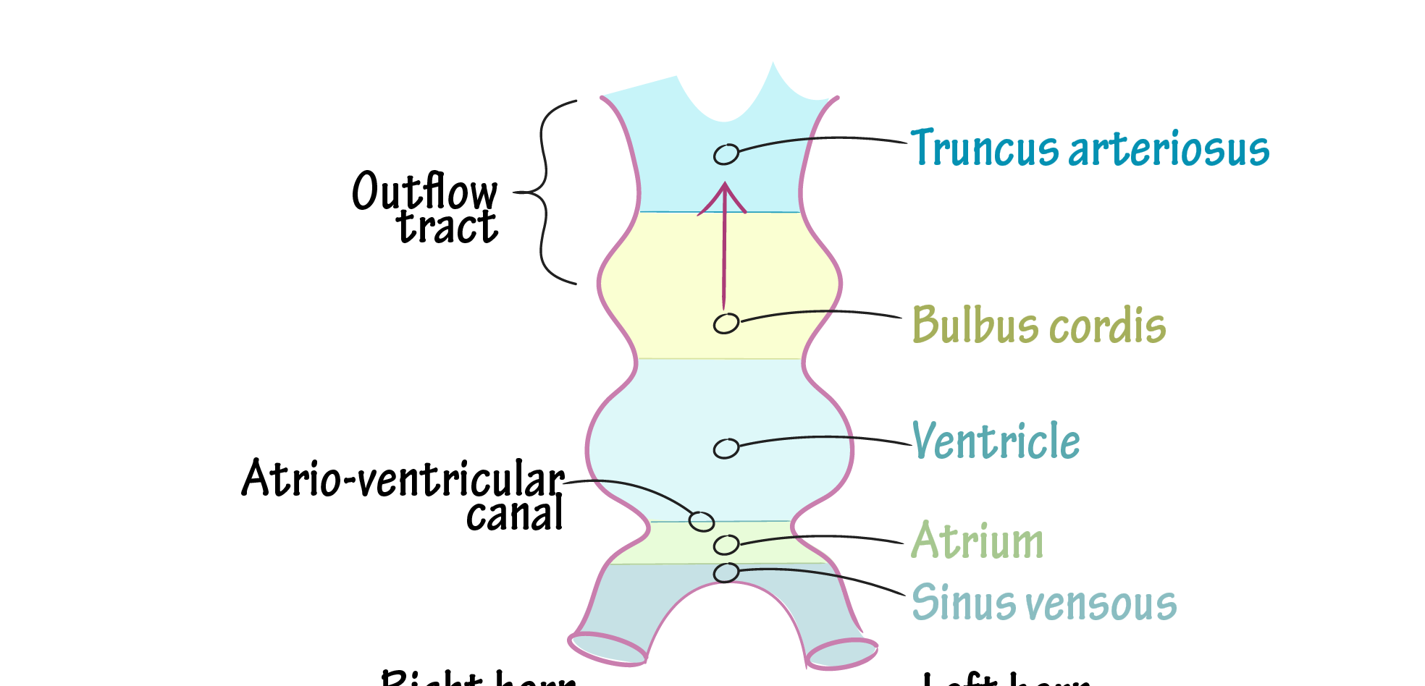
https://www.drawittoknowit.com/course/embryology/glossary/developmental-process/heart-tube-looping

Slide 7
Formation of the heart loop
WHEN? - day 23-28
WHAT? - the primitive heart tube
DO WHAT? - cephalic portion bends ventrally, caudally and to the right; caudal portion bends dorsally, cranially and to the left

Slide 8
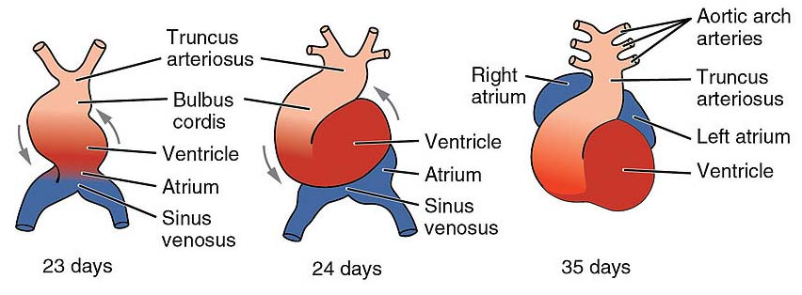
https://teachmeanatomy.info/the-basics/embryology/cardiovascular-system/

Slide 9
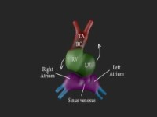
https://youtu.be/a0qyagIgBPw

Slide 10
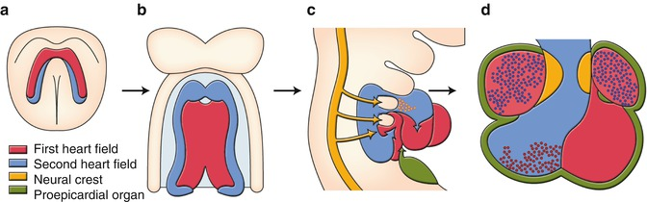
https://radiologykey.com/embryology/
Notes:
PHF portion of atria and the entire left ventricle

Slide 11
Formation of the cardiac septa
WHEN? - day 27-37
WHAT? – septum in the common atrium
– septum in the atrioventricular canal
– septum in the truncus arteriosus and conus cordis
– septum in ventricles

Slide 12
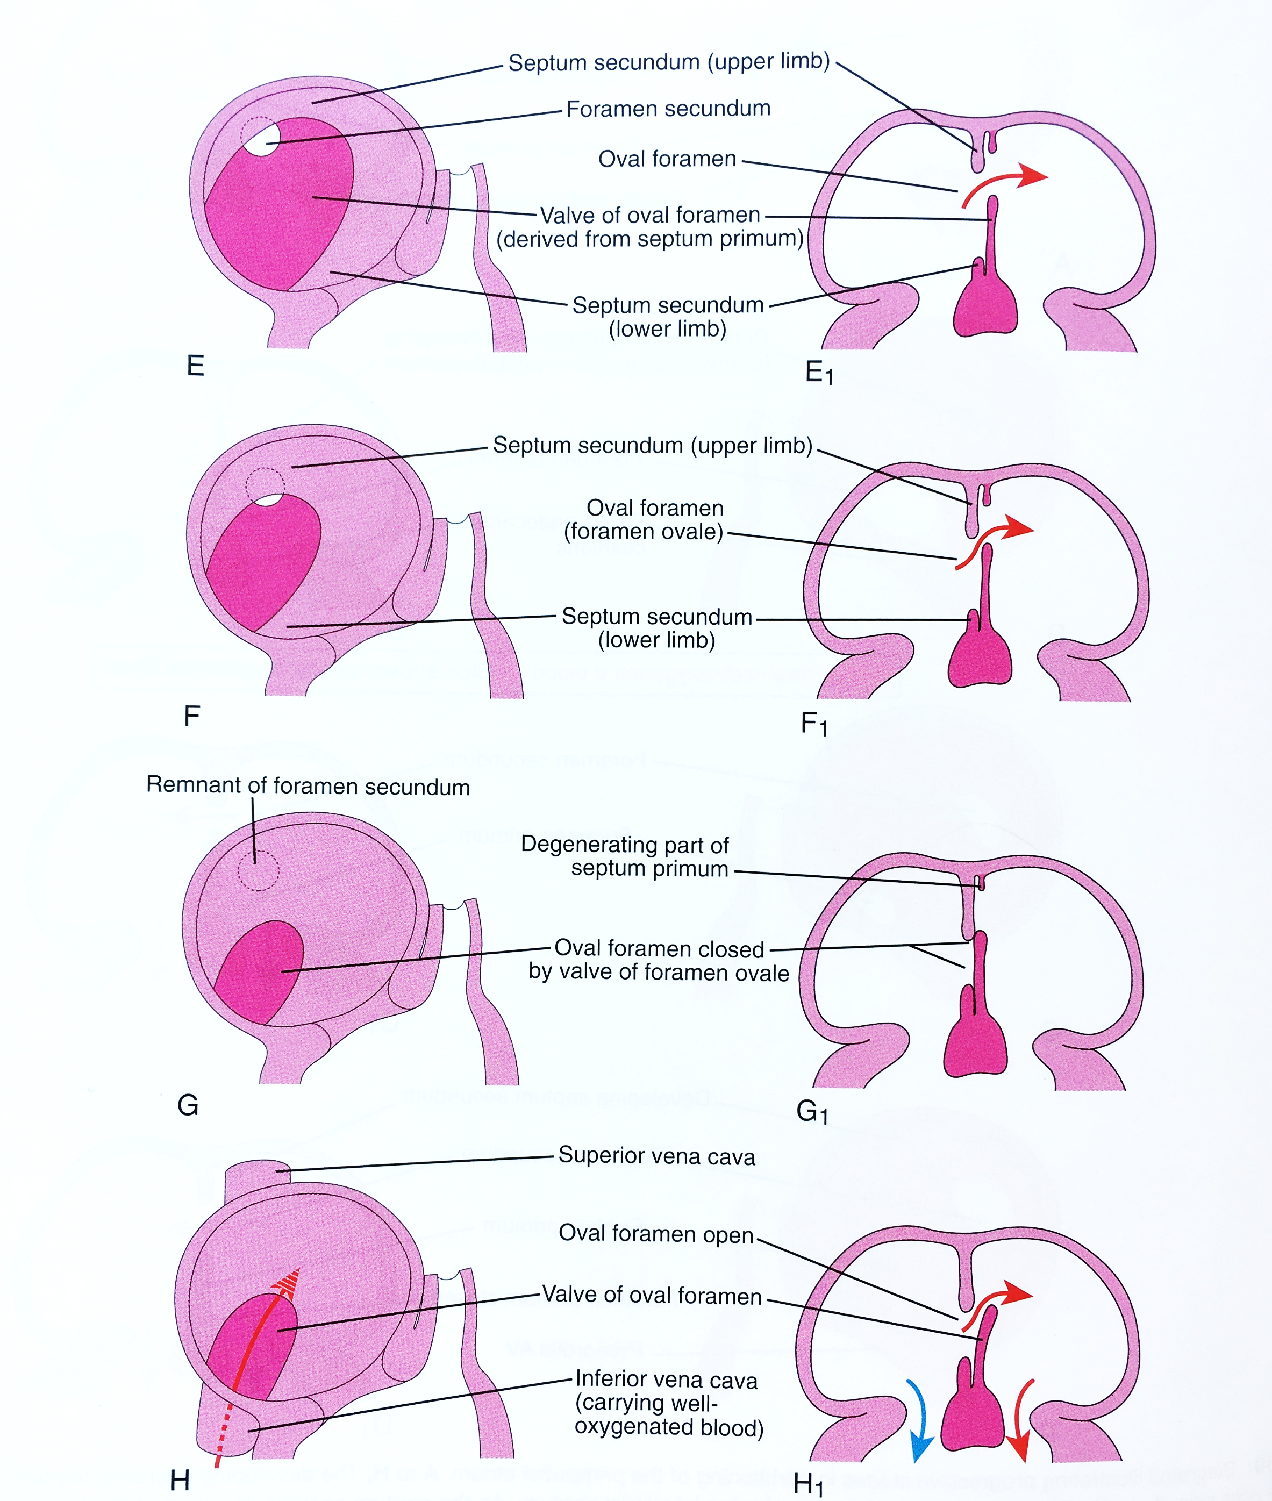
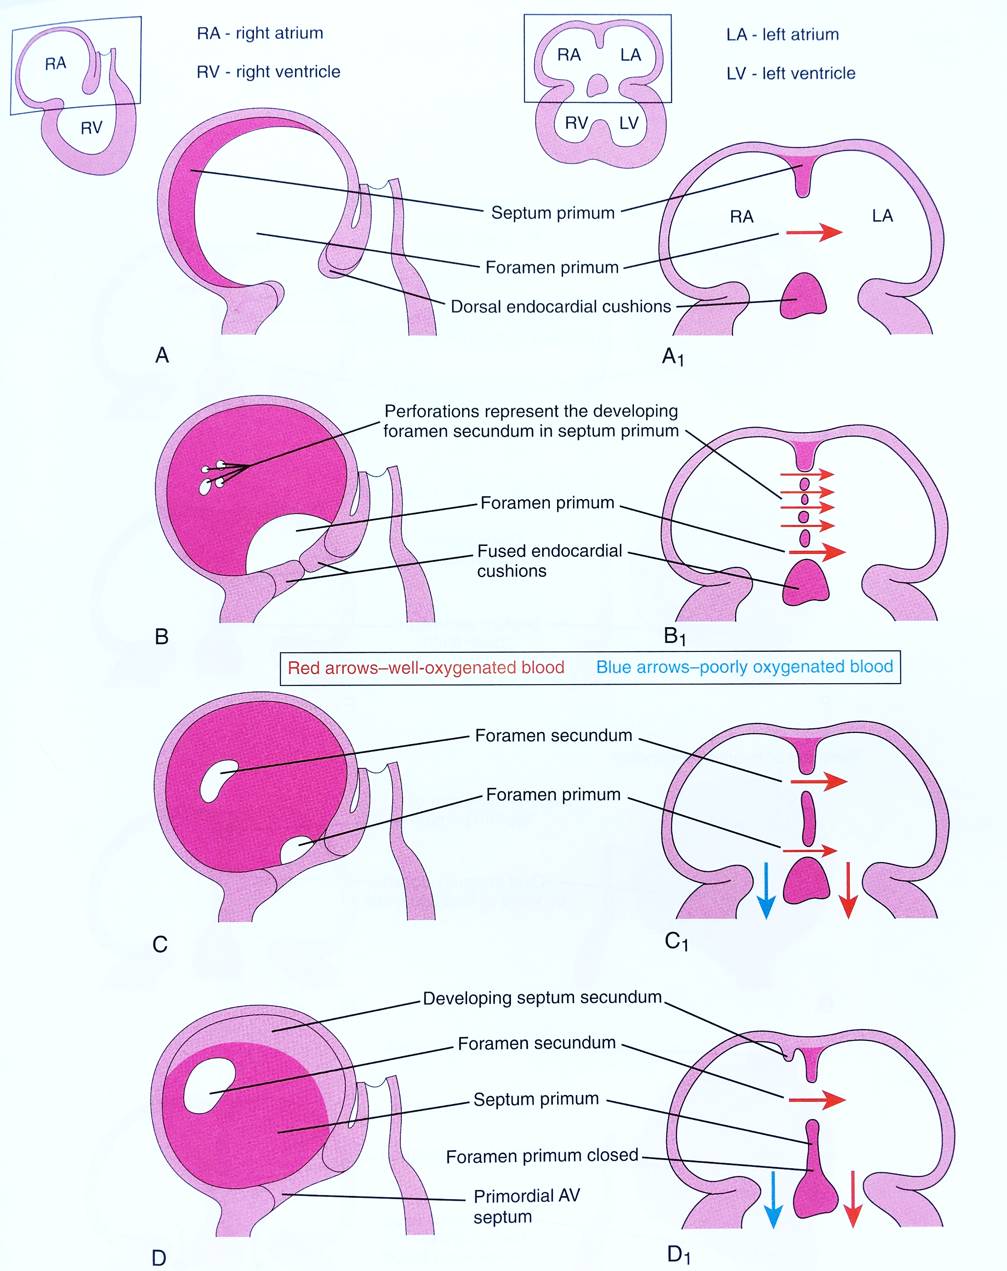
Septum in the common atrium
K. Moor, Before we are born

Slide 13
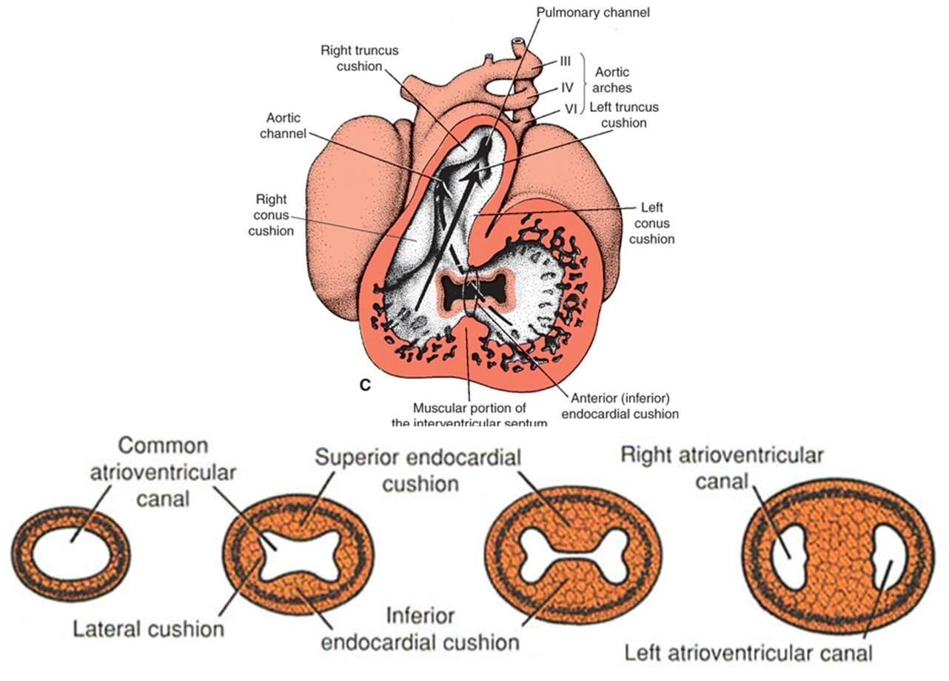
Septum in the atrioventricular canal
T.W. Sadler, Langman´s medical embryology, 12th edition

Slide 14
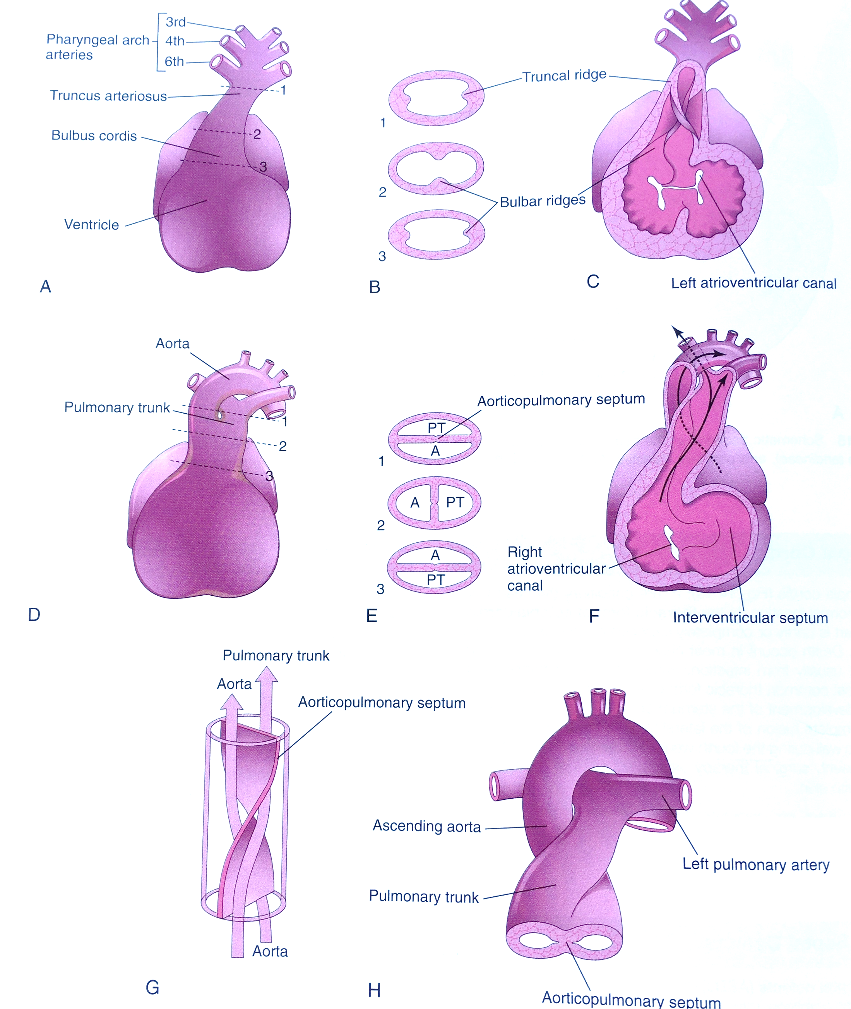
Septum in the truncus arteriosus and conus cordis
K. Moor, Before we are born
Notes:
Right superior truncus swelling grows distally to the left; left inferior truncus swelling grows distally to the right

Slide 15
Congenital heart defects (CHDs)
Dextrocardia
Ventricular inversion
Ectopia cordis
Ventricular septa defects (12/10 000)
Persistent truncus arteriosus (0,8/10 000) – always present with VSD
Atrial septal defects (6,4/10 000; 2:1 prevalence in F to M):
Patent oval foramen
4 clinically significant ASD:
Ostium sekundum ASDs
Endocardial cushion defects with a foramen primum
Sinus venosus ASDs
Common atrium - combination of the above
Transposition of great arteries (4,8/10 000)
Tetralogy of Fallot (9,6/10 000) – displacement of conotruncal septum:
Pulmonary stenosis (obstructed right ventricle outflow
2. VSD
3. Dextroposition of the aorta
4. Right ventricle hypertrophy (as a result of the pulmonary stenosis)
Aortic stenosis and aotric atresia
Unequal division of TA
Pulmonary atresia, pulmonary stenosis
Notes:
In 1% of live born infants

Slide 16
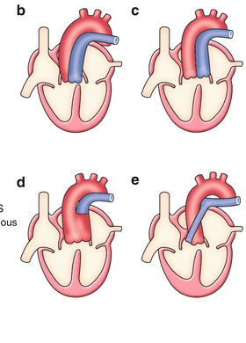
Notes:
(a) Normal and (b–e) abnormal septation and alignment of the outflow tract. (b) Double outlet right ventricle (DORV). (c) Transposition of the great arteries (TGA). (d) Persistent truncus arteriosus (PTA). (e) Tetralogy of Fallot (TOF).

Slide 17
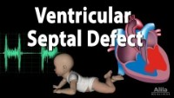
https://youtu.be/1rH-lcKukiM

Slide 18
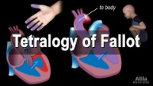
https://youtu.be/sJPWRZ4qb_I

Slide 19
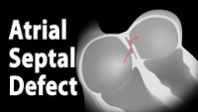
https://youtu.be/O3b5id9ZIdY

Slide 20
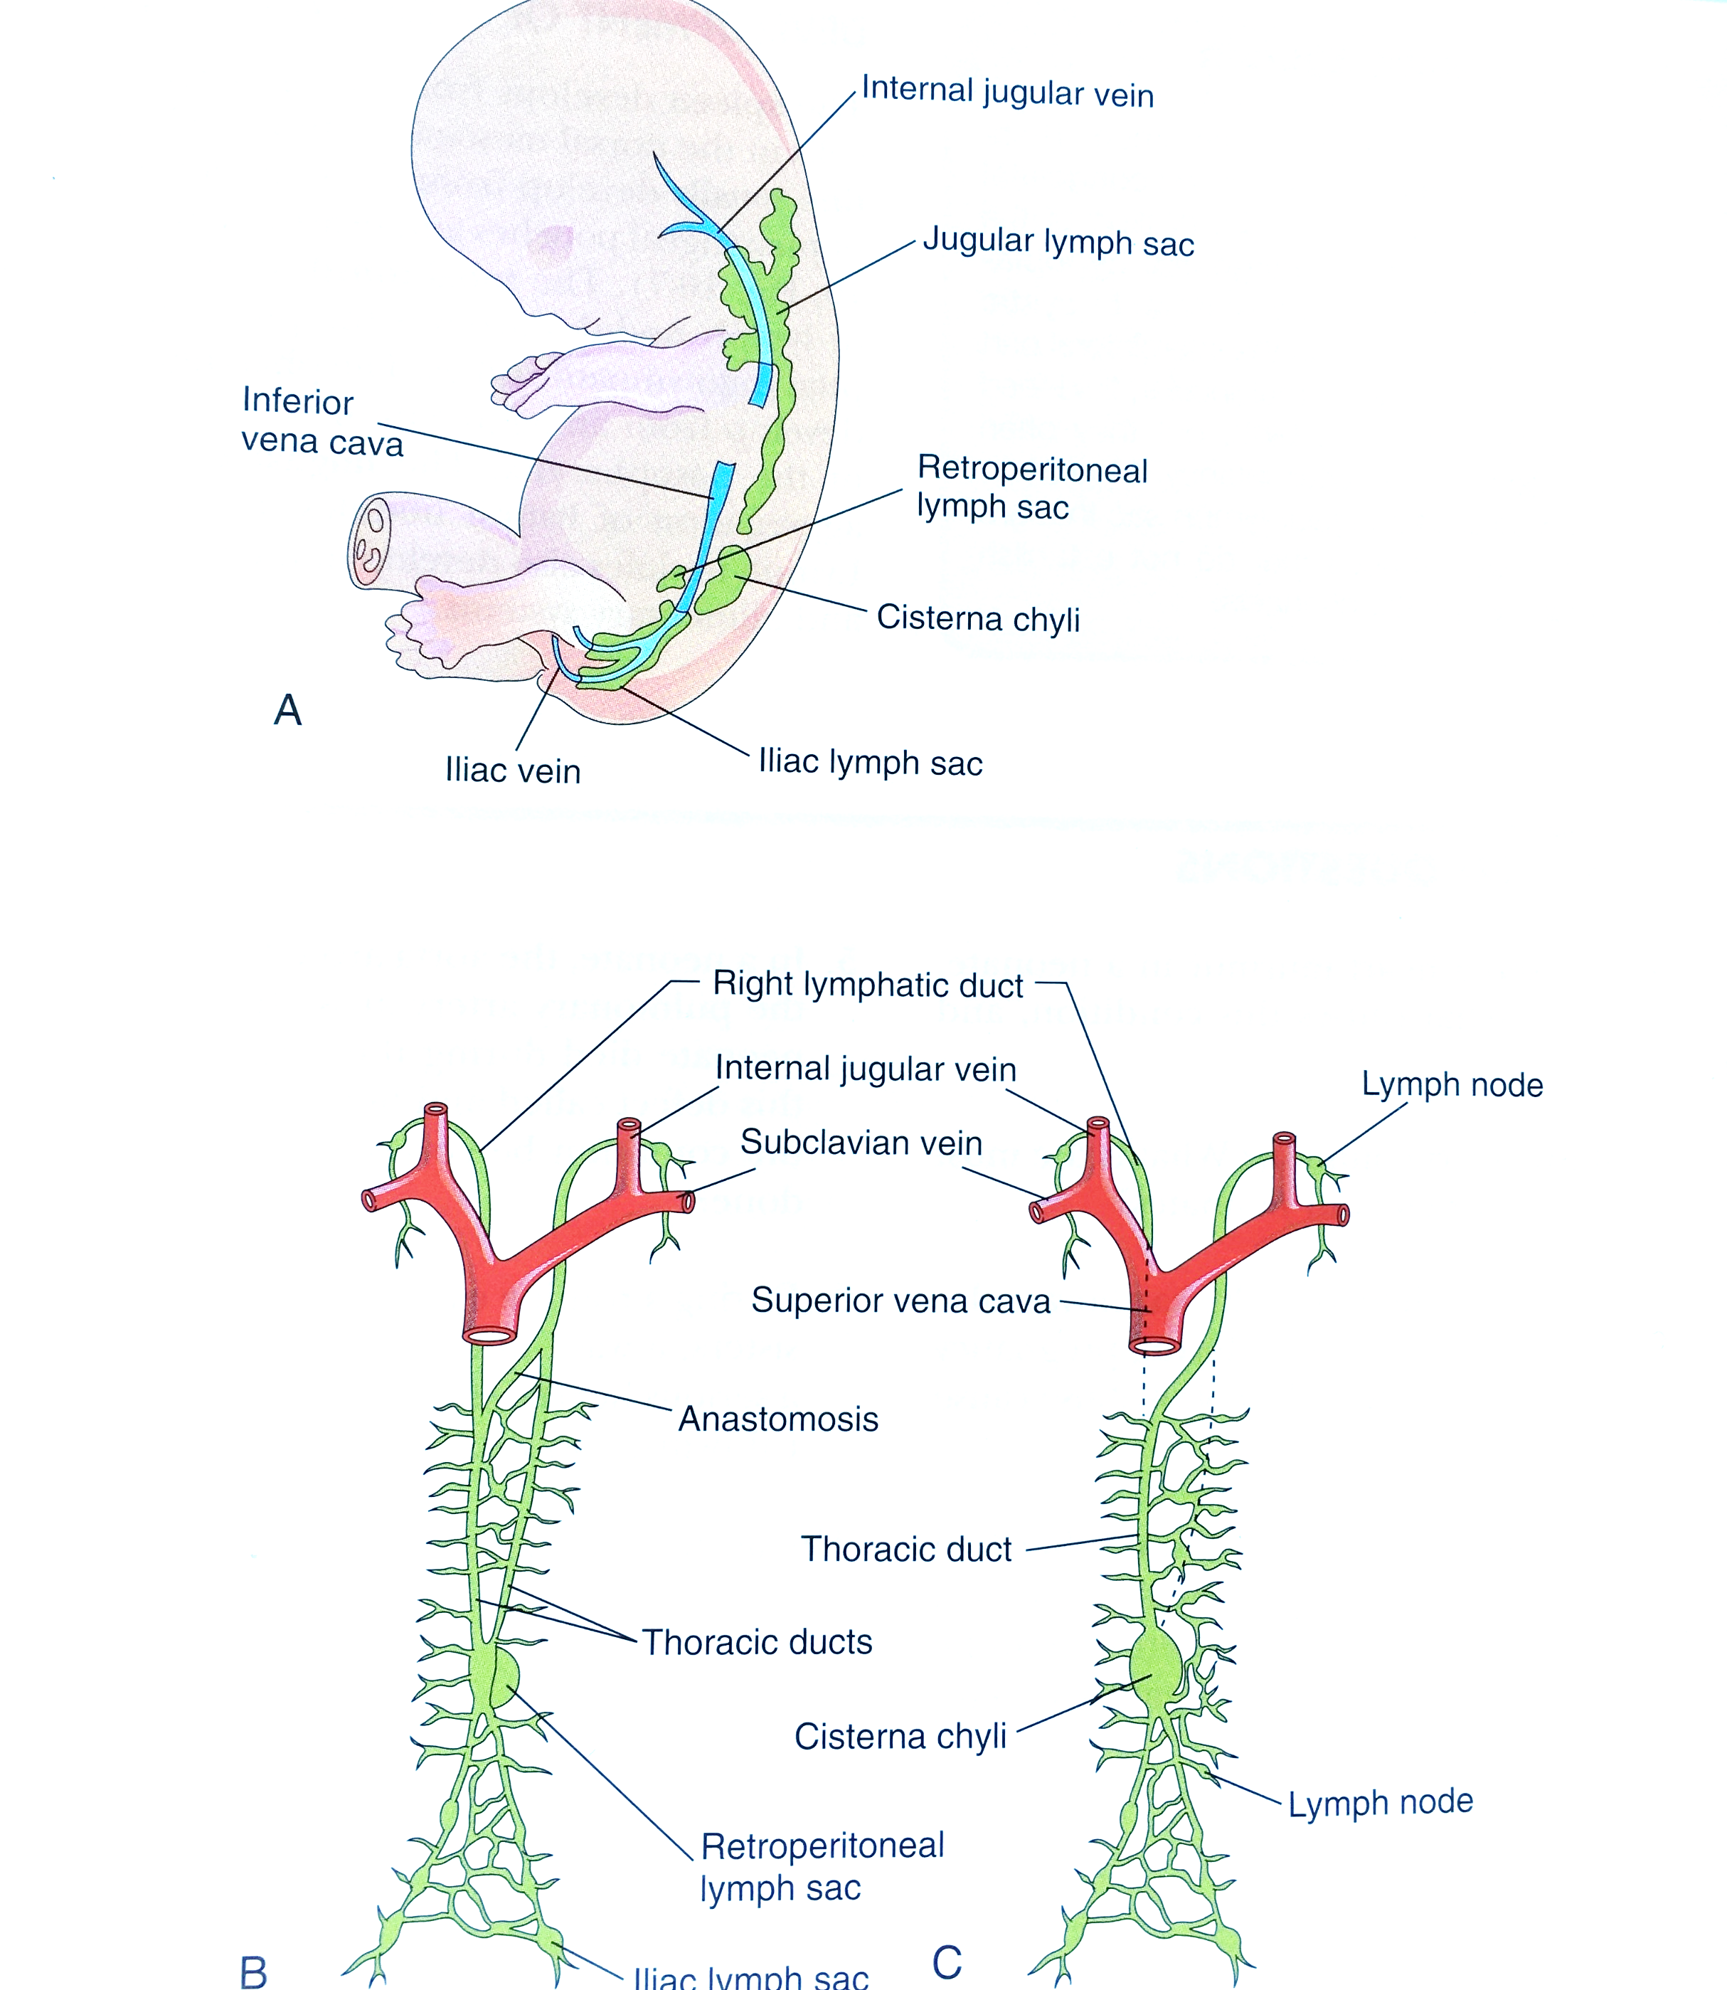
Lymphatic system development
K. Moor, Before we are born

