Slide 1
XXIV
Compiling daily diet
Principles of proper nutrition
Physiology II - practice

Slide 2
Principles of proper nutrition
Intake and expenditure of energy should be in balance
Keep adequate body weight (defined by BMI and waist circumference)
Eat 5 or more meals daily in regular intervals (every 3-4 hours) - number of recommended daily meals depends on the total energetic value of food which should be taken in:
  1 600 kcal in 6 meals
  2 200 kcal in 9 meals
  2 800 kcal in 11 meals
Do regular physical activity - exercise at least 30 minutes 5-times a week

Slide 3
Principles of proper nutrition
The food should vary and contain all the necessary nutritional components
Frequent intake of fresh vegetables and fruits (optimally 5 times a day)
Prefer dark bread and wholemeal products
Increase consumption of food rich in fibre, vitamins and minerals (fruit, vegetable, legume)

Slide 4
Principles of proper nutrition
Proteins of animal origin are necessary especially for children and elderly people
Restrict consumption of red meat (pork, beef)
Exchange red meet for poultry or deer or lamb
Increase consumption of fish and seafood (at least twice a week)

Slide 5
Principles of proper nutrition
Restrict consumption of fat, sugar, salt, and alcohol
Restrict food rich in cholesterol (egg, fat meat, entrails, certain milk products)
Restrict consumption of sweet drinks, stewed fruit, sweets – consume them only exceptionally
Drink sugarless water and fruit juice
Restrict consumption of salted peanuts, chips
Significantly restrict consumption of canned food, fried food, and sausages
If alcohol is consumed, temperate intake is recommended - not drink more than 20 g of alcohol daily (approx. 200 ml of wine, 0.5 l of beer, 50 ml of spirits)

Slide 6
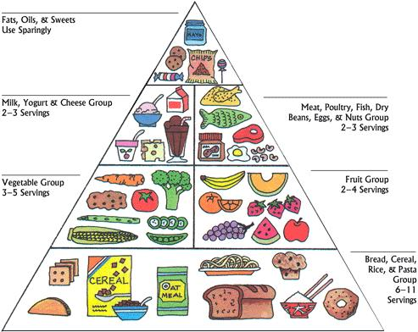
Food pyramid
http://mariasols.com/wp-content/uploads/2008/05/food_pyramid.JPG

Slide 7
Compiling of daily diet
For evaluation of food intake:
  determination of intake of energy, amount of macro- and micronutrients
For therapeutic intervention:
    recommendation of daily food intake according to individual needs of patient and principles of proper nutrition (obese patients, patients with food intake disorders, sportsmen)

Slide 8
Compiling of daily diet
Detailed summary of daily diet:
  Meal/day time (breakfast, snack/elevenses, lunch, snack/tea, dinner)
  Exact amount of food (in grams)
  Energy content and composition of each individual food according to caloric tables
    Energy content in kJ or kcal (1 kcal = 4,184 kJ)
    Content of basic nutrients (saccharides, lipids, proteins)
    Content of vitamins, minerals and trace elements
Sum of accepted energy
Recommended values

Slide 9
Protocol: procedure, interpretation, conclusions
Write down weight, height, age and gender of the person for whom you will compile the daily diet.
Determine the daily energetic output
Create a diet representing the food consumed yesterday. Write down:
  the sum of accepted energy, nutrients, chosen minerals and vitamins
  the recommended values of the parameters
Compare energetic input and output, consumed and recommended daily doses of nutrients, minerals and vitamins. Comment whether the diet of examined person is appropriate. Write down the mistakes that were done and the way how to correct them.

