Slide 1
Angelman syndrome a case report
MUDr. Klára Drábová, Ph.D.

Slide 2
Angelman syndrome
Mother - healthy
Father - healthy, smokes 20/day
They tried together for a concept for over 2 years, then there was a consultation in the center of assisted reproduction and in vitro fertilization, IVF – the 1st embryo-transfer was successful.
Our proband is from the 1st pregnancy, after the embryo-transfer the mother had hyperstimulation syndrome, she was in the ICU for 14 days. Prenatal screenings in pregnancy were normal, mother began to give birth prematuraly, maturation of lungs was completed, delivery at 34th week of pregnancy, a boy was born, 2180g/44cm, Apgar Score 9-9-10, 2 weeks in an incubator for immaturity, worse sucking, neonatal jaundice with fototherapy for 2 days, then they started with developmental rehabilitation.

Slide 3
Angelman syndrome
In the next course he gain weight, has slower psychomotor development.
At the age of 2 months - was operated for incarcerated inguinal hernia.
Then he was monitorated for pes abductovalgus on the right leg, it was recommended intensive rehabilitation.
He was examinated by neurologist – diagnosis: cerebral palsy, spastic paraparesis of lower limbs, microcephaly, stigmatization, MRI of the brain was normal.
At the age of 3 years he had his first epileptic seizures.

Slide 4
Angelman syndrome
Epileptic seizures recurred, once he was hospitalited on Department of Anestesiology and Resuscitation for status epilepticus, then on paediatric ICU.
Psychomotor development – from the age of 5 month he started to turn, up to 1 year of age no progress, at 1,5 year of age he began to sit, independent walk started at age of 3,5 years, walking was unceirtain, swaying, later atactic. At the age of 5 month he was not speaking, just maked sounds, smiling, significantly salivating, wearing diapers.

Slide 5
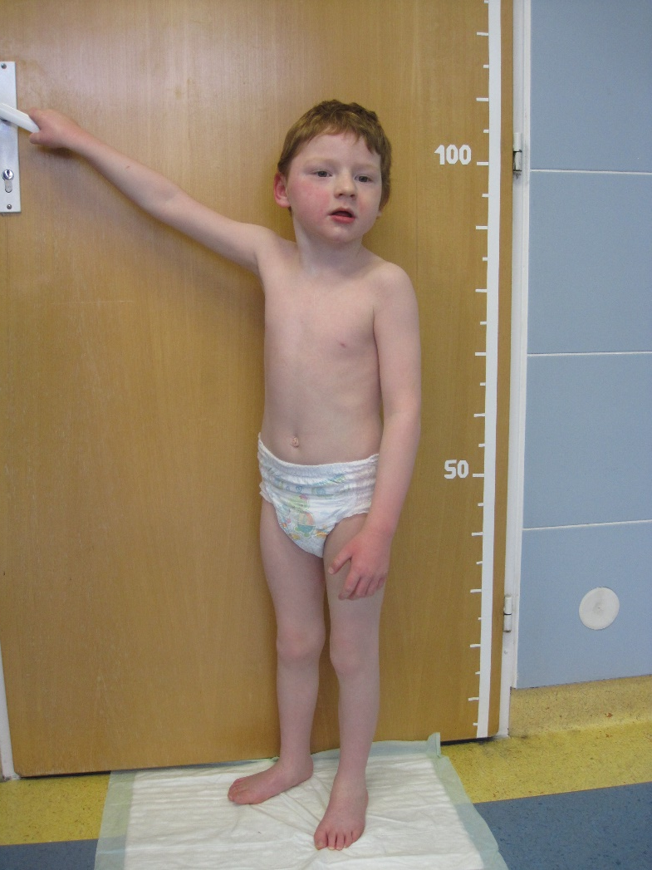
Our patient:
height 105cm (below the 3rd percentile),
weight 16kg (below the 3rd percentile),
head circumference 47cm (significantly below the 3rd percentile),
brachycephaly, flat occiput, lower hairline, red hair, face – narrow eye slits, epicanthus, pronounced nose, thin upper lip, the oral cavity – high palatum, teeth missing after extraction because of dental caries, excessive drooling, normal neck, thorax without deformithy, limbs symethric, spastic paraparesis, genua valga, flat feet, upper limbs – short fingers, transverse groove on the right palm, he was smiling, friendly, very activ, fascinated with watter

Slide 6
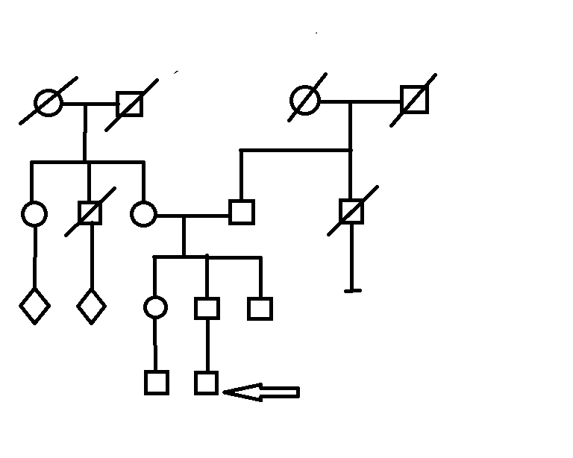
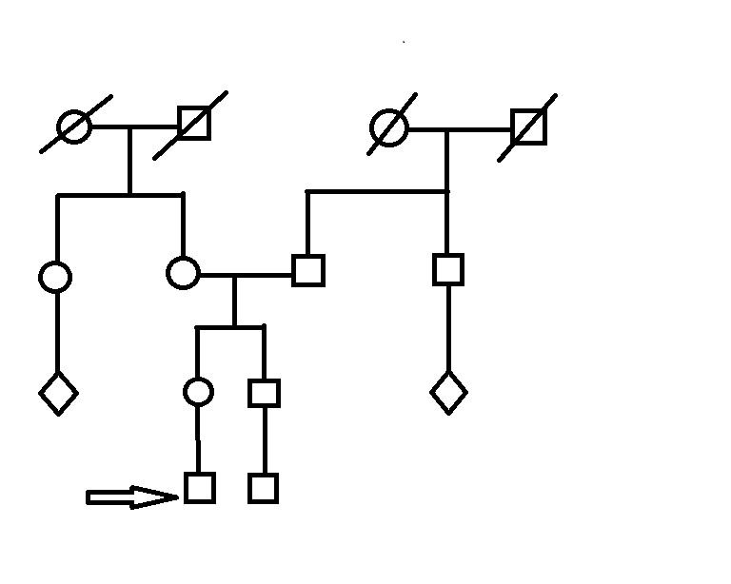
Angelman syndrome - pedigree
Mother´s pedigree
Father´s pedigree
65 ?
56 –pulm.embolism
87 –breast cancer
55 – lung cancer
75 - stroke
High age
suicide
suicide
Healthy
Healthy
Healthy

Slide 7
Angelman syndrome – genetic examination
1) Karyotype:
46, XY normal male
2) Array-CGH:
It was found microdeletion of the region 15q11.2-q13.1 about the size approximately 5,74 Mb.
Microdeletion of the region 15q11.2-q13.1 is described as a causal for Angelman and Prader-Willi syndrome.
The result was verified by the MLPA method. This change was not found in either parent.

Slide 8
Angelman syndrome – genetics
Angelman syndrome (AS, Happy puppet syndrome) is a microdeletion syndrome, most often caused by a deletion of the region 15q11-13 on the maternal chromosome or a uniparental disomy of the paternal chromosome.
The incindence of that syndrome is about 1 / 16,000.
Prader–Willi syndrome (PWS) is a microdeletion syndrome 15q11-13 on the paternal chromosome or a uniparental disomy of the maternal chromosome.
The incidence of that syndrome is about 1 / 10,000-30,000.

Slide 9
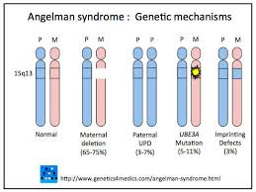
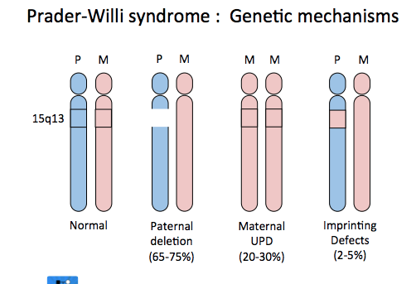
Angelman / Prader-Willi syndrome

Slide 10
Angelman syndrome - symptoms
Developmental delay, including no crawling or babbling at age of 6 to 12 months
Intellectual disability
No speech or minimal speech
Difficulty walking, moving or balancing well
Frequent smiling and laughter
Happy, excitable personality
Trouble going to sleep and staying asleep
Seizures, usually beginning between 2 and 3 years of age
Stiff or jerky movements
Small head size, with flatness in the back of the head
Tongue thrusting
Hair, skin and eyes that are light in color
Unusual behaviors, such as hand flapping and arms uplifted while walking
Sleep problems

Slide 11
Prader-Willi syndrome - symptoms
Newborns and infants
Hypotonia, craniofacial dysmorphy – almond shaped eyes, strabism, a narrow forehead at the temples, a thin upper lip and a downturned mouth, small hands and feet
feeding difficulties and underweight until the age of 1 year
Fatigue, poor response to stimulation, week crying
Toddlers and children
the child will start to show an increased interest in food, ask for extra food and behave badly to get extra food. This behaviour increases during childhood and is seen in all children with Prader-Willi syndrome.
hypogonadotropic hypogonadism – reduced production of sex hormones and reduced fertility
Short stature (about 150 cm), obesity, skoliosis, short arms and legs
Learning difficulties, delay in development, behavioural problems, sleep problems

Slide 12
Angelman syndrome – conclusion
Angelman syndrome (and Prader-Willi too) is one of the microdeletion syndromes.
The presented case report shows the characteristic phenotype of Angelman syndrome.
Our patient is monitorated multidisciplinarily.

