Slide 1
Psychopathology
Seminars on Psychiatry - VLA
MUDr. Alena Damborská, Ph.D.

Slide 2
Outline
Introduction – why, what, how
Domains of psychopathology

Slide 3
Aim – learning outcomes
To learn the vocabulary – symptoms of mental illness
To learn the concepts of discrete psychological functions
To learn the description of major and most frequent symptoms

Slide 4
Psychiatry studies mental disorders
Description
Etiology
Prognosis
Prevention
Treatment
General psychiatry
studies impairment of brain and mind functions
Special psychiatry
is devoted to different mental diseases

Slide 5
Domains of psychopathology
Personality
Emotions
Cognition
Behavior
Psychopathology describes symptoms of impaired psychic functions

Slide 6
Psychic functions
  Personality
  Emotions
    mood
    affect
  Cognition
    consciousness
    attention
    orientation
    perception
    memory and learning
    thinking and decision making
    intellect
  Behavior
    volition
    action

Slide 7
Norm and pathology
Personal
  Subjective ego-dystonic experience
  Significant change in habitual experience and behaviour
    Does not need to be realised – recognized by peers
Cultural
  Conformist and non-conformist behaviour
    Usual behaviour and experience corresponding to the culture and individual’s position within it
    Non-conformity is not a sign of psychopathology
Typical clinical pictures = overt signs of mental illness
  Hallucinations, catatonia…
Always search for the reason of behaviour: “Why”?

Slide 8
Consciousness
= awareness of one´s body and environment

Slide 9
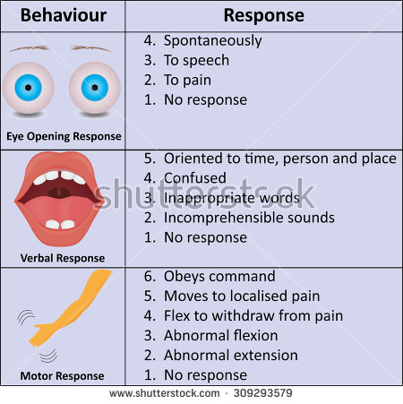
Disorders of Consciousness
Quantitative changes - reduced vigility (alertness):
Somnolence
Sopor
Coma
Notes:
Clouding of consciousness = a person is less wakeful or aware than normal, feeling „foggy“, they are not aware of time, their surroundings and find difficult to pay attention
Somnolence:
pathologicaly sleepy
delayed reactions to touch, speech
bradypsychism
mild intoxications, mild brain injury, at the beginning and the end of narcosis
Sopor
Looks like sleeping
Inapropriate words, incomprehensible sounds
Bradycardia, hypopnoe, hypotensis
intoxications, brain injury, infections
Coma
No response to any stimuli

Slide 10
Disorders of Consciousness
Qualitative changes – disturbed perception, thinking, affectivity, memory, and behavior:
Obnubilation (twilight state) - impaired self-awareness, rapid onset and rapid end, aimless acting, complete amnezia on this state
  intoxication, brain tumors, dissociative personality disorder
Delirium (confusional state)

Slide 11
Delirium
= transient cognitive disorder
core features: impaired consciousness with attention deficit, rapid onset, fluctuating course
other features: desorientation, psychomotor changes (agitation), distored perception (illusions, hallucinations), disorganized thought (delusions), sleep disturbances, emotional changes (irritability, flatness of emotions), enhanced suggestibility
intoxication, infection, dehydration, abstinence syndrom

Slide 12
Orientation
= awarenes of oneself (person) with reference to time, place, and situation

Slide 13
Disturbances of orientation
disorientation in time (major depression)
unawareness of onself = disorientation to person (dementia)

Slide 14
Attention
= the act or the power of fixing the mind on something

Slide 15
Disturbances of attention
Hypoprosexia (major depression)
Hyperprosexia (neurotic disorders)

Slide 16
Perception
= awareness of what is presented through the sense organs
= detection and interpretation of the stimuli

Slide 17
Disturbances of perception
Illusions = distorted perception of present stimuli
Hallucinations = perception of absent stimuli
  Sensory modality
    Auditory: 3rd person perspective, commenting, imperative, contrary
    Visual: simple (flashes, geometric patterns), complex scenes, microzoopsia…
    Tactile, Gustatory, Olfactory, Movements
  Intrapsychic hallucinations (delusions of control)
    Thought broadcasting, thought imputation/amputation, thought echo’s
  Location/source of hallucinations – inadequate (from a teeth, toe…)

Slide 18
Abnormal coordination of sensorimotor cortex
Corollary discharge theory:
  a copy of the motor plan sent from the motor to the sensory cortex (“efference copy”)
  suppression of awareness of sensation in self-generated actions - expected (efference) and experienced (reafference) sensations match
  discrimination of origination of actions (self/non-self)
  …we are not able to tickle ourselves...
absence of the “efference copy” in the sensory cortex = perception of exogenous origin of actions
…move the image across your retina by: a) moving an object
b) moving your eye
c) pressing your eye
Schizophrenia: failure of corollary discharge mechanism
inner voice = hallucinations
Ford et al., 2001; Ford and Mathalon, 2004; 2005
Notes:
Abbility to distinbuish the sensory consequences of one´s own activity from
passive sensory reception from environmental activity
Presynaptic and postsynaptic inhibition
Expected sensation = „efference copy“ for a particular movement
Experienced sensation = „reafference copy“, sensory feedback for the movement – increase in gamma coherence between frontal and temporal lobes during active talking compared to passive listening
Parkinson´s disease: misjudgement during limb movement, inapropriate coordination between the proprioceptive sensory feedback and corollary discharge mechanism at higher centres, the patient is unable to predict limb position leading to bradykinesia (slowing of his limb movements)
Schizophrenia = inability to distinguish between thoughts and action generated from self and others

Slide 19
Emotions

Slide 20
Emotions
= physiological automatic responses to salient positive/negative stimuli
  př. potential sexual partner is present/public speaking
  Brain response – increased arousal, increased attention, increased alertness, increased vigility
  Body response – endocrine (cortisol), vegetative (flushing, paleness, sweating, tachycardia, mydriasis, increased blood pressure, hyperpnea), behavioral (tremor, face expression, freezing)
Feelings
= conscious perception of the brain and body changes during emotion
- Experiential brain response
př. joy, love, anger, fear

Slide 21
Emotions
Physiological Mood
  Long lasting emotional state
  Strengthens an affect of the same direction, suppresses an affect of the oposite direction
Physiological Affect
  Brief and strong emotional response
  No changes of consciousness, no amnesia

Slide 22
Disturbances of emotions

Slide 23
Disturbances of emotions
Pathological mood
  Manic
  Depressive
  Euphoria
  Expansive
  Exaltation
  Explosive
  Anxious
  Resonant
  Apathy

Slide 24
Disturbances of emotions
Pathological affect
  excessively very strong emotional reaction
  short change of consciousness (obnubilation)
  amnesia
Phobia = persistent irrational fear and wish to avoid a specific situation, object, activity
  agoraphobia, claustrophobia

Slide 25
Affect
Quality (depressed, euthymic, euphoric)
Intensity (mild, moderate,severe)
Content (perplexity, fatuousity)
Dynamics
  Range = diversity of emotional states (flattening, restricted, expansive)
  Reactivity = rapidity with which one affect shifts to another (lability, incontinence, irritability)
Congruence = Appropriateness (incongruent emotions in schizophrenia)
https://www.coursera.org/learn/international-psychiatry/lecture/X6IZW/the-affect-in-the-mental-state-examination
Notes:
Flattening of emotions = limitations in capacity to engage in different affects
Irritability = escalation into anger
Incontinence = easily deflected by suggestive interventions

Slide 26
Depression - syndrom
Affective symptoms
  depressed mood – bad, down, black, oppressive – distinguish from physiological sadness
  anhedonia
  (anxiety)
Motivation
  loss of interest in usual activities
  inability to perform, initiate activity (abulia, hypobulia)
Cognitive
  evaluation, self-esteem
  attention (hypoprosexia), memory
  negative cognitive biases
Suicidal activity – hoplessness, suicidal thoughts
Vegetative, „somatic“
  insomnia, constipation, anorexia. decreased libido, loss of energy and fatigue, psychomotor retardation

Slide 27
Mania - syndrom
Affective symptoms
  expansive moods: mania, euforia, iritability, dysforia
Cognitive
  increased speed vs. decreased accuracy: cognition (flight of ideas), memory (hypermnesia), speech (pseudoincoherence), decisions (risky)…
  distractibility
  inflated unrealistic self-esteem
Behavioral
  hyperactivity, restlessness
  overinvolvement – socially, sexually, occupationally…
Vegetative, somatic
  insomnia (decreased need to sleep), anorexia (decreased need to eat), increased energy

Slide 28
Thinking
= goal-directed flow of ideas and associations initiated by a problem and leading toward a reality-oriented conclusion
evaluated via speech of the patient

Slide 29
Thought disturbances

Slide 30
Quantitative disturbances: Speed
Decrease
  bradypsychism (retardation) - slowing of the flow of associations, slowed and diminished verbal production (major depression)
  thought blocking - cessation of the flow of associations = patient stops the verbal production without any recognisable impulse from surroundings (schizophrenia)
Increase
  flight of ideas: excessive speed of thinking manifested as extreme speed in speech (= logorrhoea) (manic episode of bipolar disorder)

Slide 31
Quantitative disturbances: Structure
circumstantiality
  indirect speech that is delayed in a reaching the point, characterised by an overinclusion of details (obsessive-compulsive disorder, neurotic disorders)
perseverative thinking
  involuntary persistence of response to some question or topic, verbigeration - a meaningless repetition of specific word or phrase (manic episode of BD)
tangentiality
  patient never gets from desired point to desired goal

Slide 32
Quantitative disturbances: Structure
illogical (paralogic) thinking, loosening of associations
  thinking containing erroneous conclusions or internal contradiction
neologism
  new word created by the patient often by combining syllables or other words
incoherent thinking
  thought that is not understandable
  word salad: incoherent mixture of words and phrases
absence of abstraction = hyperconcretism
The apple does not fall far from the tree
  https://www.coursera.org/learn/international-psychiatry/lecture/BzKL8/the-thought-process-in-the-mental-state-examination
Notes:
Idiosyncratic = peculiar to the individual, strange, unusual
Magic and symbolic thinking – a type of paralogic thinking: illogical associations (e.g. guessing hockey results by clockwise position)

Slide 33
Semanting priming
= automatic (implicit) memory function
  tunes your associations based on current content of mind
  network of representations (words, meanings) is activated
  optimal performance = focused activation around the network node
  Lexical decision task: word x nonword (student x stadent)

Slide 34
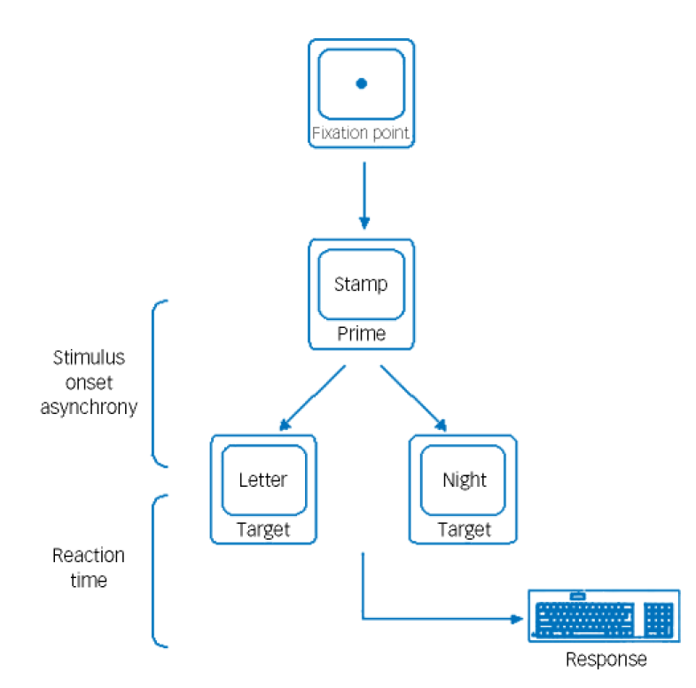
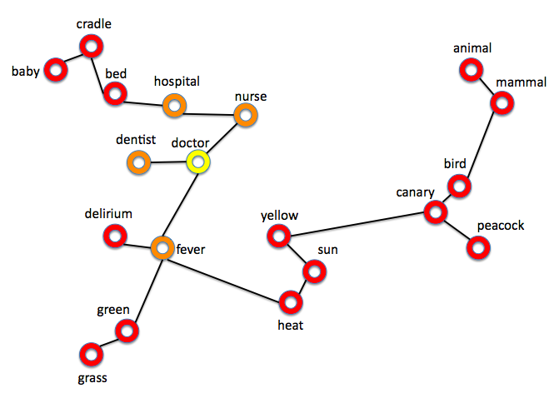
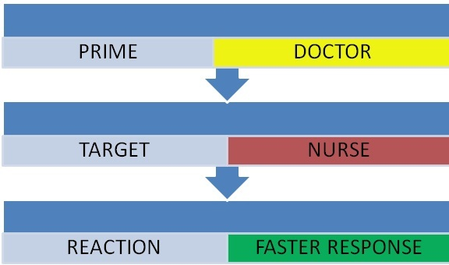
Lexical decision task
Pomarol-Clotet et al., 2008

Slide 35
Semantic priming and Formal Thought Disorder (FTD)
Meta-analysis of 36 studies (Pomarol-Clotet et al., 2008)
  SCH vs. HC d = 0,7 (95% CI -0,02 – 0,16)
  FTD vs. HC d = 0,38 (95% CI 0,21 – 0,55)
  Semantic hyperpriming in FTD = pathological hightening of normal associative processes = fast response to distant words
  - more extensive network activation

Slide 36
Qualitative disturbances: Content
Delusions
Obsessions

Slide 37
Delusions
= False beliefs
  not a conventional belief (not shared)
  inadequate/bizzare content
  formed by logical thinking process but based on a patholgical assumption
  not consistent with patient‘ s intelligence and cultural background
  cannot be corrected by rational arguments
  influence on behaviour
Formation (development)
  Delusionoal mood – feeling that something is wrong, different, unreal
  Delusional perception – things have special meaning, perceived as significant
  Making sense out of it = ”AHA”, delusion formation

Slide 38
Melancholic delusions (micromanic, depressive)
delusion of self accusation
  false interpretation of real past event resulting in feeling of guilt
hypochondriac delusion
  false belief of having a fatal physical illness
nihilistic delusions
  false feeling that self, others or the world is non-existent or ending
delusions of failure
  false belief that one is unable to do anything useful, worthlessness
delusion of property (ruin)
  false belief that one lost all property

Slide 39
Delusions of grandeur (megalomanic, expansive)
delusion of importance
  exaggerated conception of one‘s importance
delusion of power, extrapotence
  exaggerated conception of one‘s abilities/possibilities, supernatural skills
delusion of identity
  false belief of being the offspring of member of an important family

Slide 40
Paranoid Delusions
based on ideas of reference (false ideas that behaviour of others refers to a patient):
delusion of persecution
  false belief that one is being persecuted
delusion of infidelity
  false belief that one‘s lover is unfaithful
erotomanic delusion
  false belief, that someone (usually famous) is deeply in love with them

Slide 41
Delusions of thought control
= false feeling that one‘s will, thoughts, feelings, or movements are controlled by another agent
thought withdrawal
  false belief that one‘s thought are being removed from one‘s mind by other people or force
thought insertion
  false belief that thought are being implanted in one‘s mind by other people or force
thought broadcasting
  false belief that one‘s thought can be heard by others
thought control
  false belief that one‘s thoughts are being controlled by other people or force

Slide 42
Obsessionshttps://www.coursera.org/learn/international-psychiatry/lecture/klFvK/thought-content-and-the-delusion
Obsessions
= thoughts, impulses or images entering the mind despite the person´s effort to exclude them
persistent, irresistible, repetitive, stereotypical, monotonous
interfere with directed behaviour and attention
ego-dystonic => associated with anxiety
vs. preoccupation of thought (Over-valued ideas): certain idea is in the centre of thinking, is coming back, usually associated with a strong affective tone (person, money, success…), other things are not considered to be important
- schizophrenia, narcissistic personality, BPD, mania, psychosis

Slide 43
Memory
= function that enables to store and remember information

Slide 44
„Life cycle“ of a memory trace
Immediate memory
  information stored for 15-20s
Short-term memory
  consolidation of the memory trace – several minutes to 2 days
  medial temporal structures (hippocampus)
Long-term memory
  formed trace
  large cortical areas
  Declarative (explicit) – for events, language, knowledge
  Procedural – for motor patterns (riding bike, skiing)

Slide 45
Memory disturbances

Slide 46
Quantitative disturbances
Amnesia: short/long-term memory impairment in a state of normal consciousness
  anterograde: failure to form new information
  retrograde: failure to recall old information
    organic (head trauma, tumor, surgery etc.)
    dissociative amnesia: selective inability to recall previously learned information with normal functioning in the present (normal learning)
Hypomnesia
Hypermnesia: unusually vivid memory
  mania, posttraumatic stress disorder (intrusive memories), obsessive or paranoid personality traits
Notes:
Dissociative amnesia – crime victim has no memory of having been robbed but recalls details of the rest of the day
Caused by overwhelming stress during traumatic events

Slide 47
Qualitative disturbances
paramnesias – retrospective falsification of memories during its recollection (incaccuracy in time and situation of the recalled event)
confabulation – filling memory gaps with inaccurate information

Slide 48
Amnestic disorders

Slide 49
Characteristics
Definition: acquired impaired ability to learn and recall new information (and past events sometimes)
No attention deficit or clouding of consciousness (delirium), no other cognitive dysfunction (dementia)
caused by structural or chemical damage to the brain via systemic disease (metabolic, hypoxia, substance abuse) or primary cerebral disease (brain infections, brain tumors, head trauma)

Slide 50
Clinical notes
Transient global amnesia
  episodes of transitory inability to learn (to form memories)
  inability to recall memories from the episode
  restoration to completly intact cognitive state
  no behavioral changes x may be confusion
sudden/gradual onset (head trauma/chronic toxic exposure)
disorientation to place and time, spared orientation to person
lack of insight
confabulations

Slide 51
Intellect
= mental ability that includes logical and rational aspects of the mind

Slide 52
Intellect disturbances
Mental retardation (insufficient development)
Dementia (decline)

Slide 53
Dementia
persistent diminution of cognition in the setting of a stable level of consciousness
three main symptomatic domains:
  neuropsychologic: cognitive decline
  neuropsychiatric: behavioral and psychological symptoms
  activities of daily living

Slide 54
Dementia
memory: impaired learning, recall, and recognition
executive functions: non-realistic planning, decreased flexibility
thought and language (disorganized structure, decreased fluency)
  perseveration (following a topic after its change), echolalia (repetition of other's speech)
  impaired abstraction (concrete thinking)
poor judgment („what to wear in cold weather“), loss of insight (unawareness of symptoms)
attention: increased distractibility
visuospatial abilities (inability to reproduce a complex drawing)
higher cortical functions - gnosis and praxis: apraxia (lack of motion skills), agnosia (inability to recognize objects, sounds..)
Notes:
Distractibility = state of being easily distracted
Perseveration = a person who continues talking about a topic even when the conversation has moved on to other things

Slide 55
Volition and Action
= voluntary movements

Slide 56
Volition disturbances
Hypobulia (depression, schizophrenia)
Abulia
Hyperbulia (mania)

Slide 57
Catatonia = qualitative disturbance of voluntary movements
immobility, abnormal behaviors, abnormal movements

Slide 58
„Positive“
  agitation
  active negativism
  mannerism (odd caricature of normal movements)
  stereotypies (repetitive, nonsensical movements)
  grimacing
  echolalia, echopraxia
Notes:
Active negativism = doing oposit to the demand

Slide 59
„Negative“
  mutism
  passive negativism
  catalepsy (passive induction of a posture held against gravity)
  posturing (spontaneous and active maintenance of posture against gravity)
  waxy flexibility (slight and even resistance to positioning by examiner)
  stupor (no psychomotor activity)
Notes:
Passive negativism= refuse to meet demands, obey orders

Slide 60
Presentations
Psychosis: https://www.youtube.com/watch?v=ZB28gfSmz1Y&t=35s
Depression: https://www.youtube.com/watch?v=4YhpWZCdiZc
Mania: https://www.youtube.com/watch?v=zA-fqvC02oM&list=PLFZTljPAn-Kx257X3b9ET8qZfVOcC8V5o&index=7&t=0s

Slide 61
Next steps – clinical vignettes
Have a look at videos:
  Depression: https://www.youtube.com/watch?v=4YhpWZCdiZc
  Mania: https://www.youtube.com/watch?v=zA-fqvC02oM
  Hallucinations: https://www.youtube.com/watch?v=0tn8xLQY53U
  Hallucinations and delusions: https://www.youtube.com/watch?v=ZB28gfSmz1Y
  Delirium: https://www.youtube.com/watch?v=lJH1AoVuVS0
  Delirium: https://www.youtube.com/watch?v=hwz9M2jZi_o
  Anxiety: https://www.youtube.com/watch?v=Ii2FHbtVJzc
  Panic attack: https://www.youtube.com/watch?v=9YaS_4tXBNU
  Catatonia: https://www.youtube.com/watch?v=_s1lzxHRO4U
  Obsessions, Compulsions: https://www.youtube.com/watch?v=xMwOLoPFKlM
  Obsessions, Compulsions: https://www.youtube.com/watch?v=syM6XYzht20
  Conversion: https://www.youtube.com/watch?v=_jOuqAcgMrA
  Suicide: https://www.youtube.com/watch?v=A-m_aIQfXZA

