Slide 1

Surgery
Content and history
Operating room

Slide 2
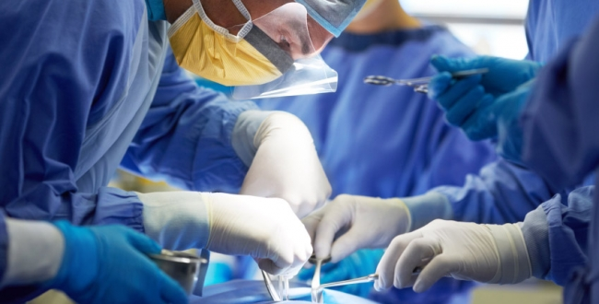
The Origin of the word Surgery comes from the Greek word „ Cheirourgiké“
Cheir – hand
Ergein – work

Slide 3
Content of surgery
Surgery may be defined as „ the art of treating lesions and malformations of the human body by manual operations, mediate and immediate.“
The Surgeon should be familiar not only with the normal anatomy and physiology of the body and various pathological contitions to which it is liable, but also with the nature of process by which repair of injured or diseased tissues is affected.
All forms of surgery are considered invasive procedures

Slide 4
Division of surgery
Surgical procedures are commonly cathegorized mainly by:
Urgency
Type of procedure
Involved body system
Degree of invasiveness
Special instrumentation
Three main categories of terapeutic surgery
Emergency – stopping rapid internal bleeding, as soon as possible to
save life
Urgent – removal of inflamed appendix - within hours
Elective – planned operations – hip joint replacement

Slide 5
Surgical Specialities
Basic surgical field – General surgery
Specialized surgical fields:
Thoracic surgery – surgery of lung, mediastinum, chest wall
and pleural cavity
Cardiac surgery - surgical treatment of disease of heart and great vessels
Neurosurgery - surgery of the central, peripheral and autonomic nervous system
Urology - surgery of urinary tract of males and females and reproductive system of males
Vascular surgery - surgery of vascular system – arteries, veins and lymphatic circulation
Plastic surgery- corrects surgically appearence and function of external shape of the body
Transplantation surgery- surgical transfer of tissues and organs
Ortopedic, Maxillofacial and Pediatric surgery, Otorhinolaryngology,
Ophtalmology etc…

Slide 6
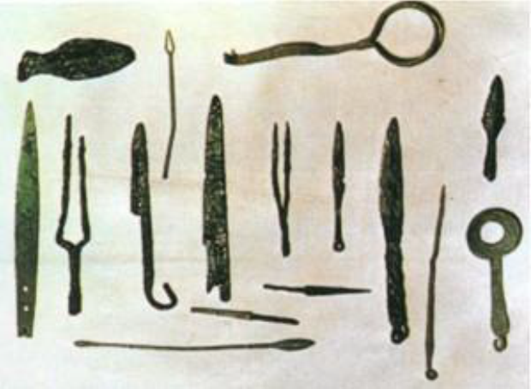
History of surgery
Evidence that the surgical assistance was provided was found from the period around year 4600 BC – the period of Assyria, Babylon, Ancient Egypt and India
Mesopotamia: Sumerians developed several important medical techniques, used bronze instruments with sharpened obsidian

Slide 7
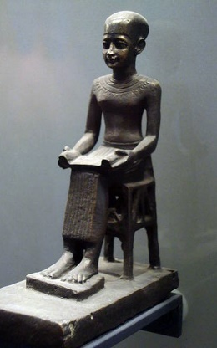
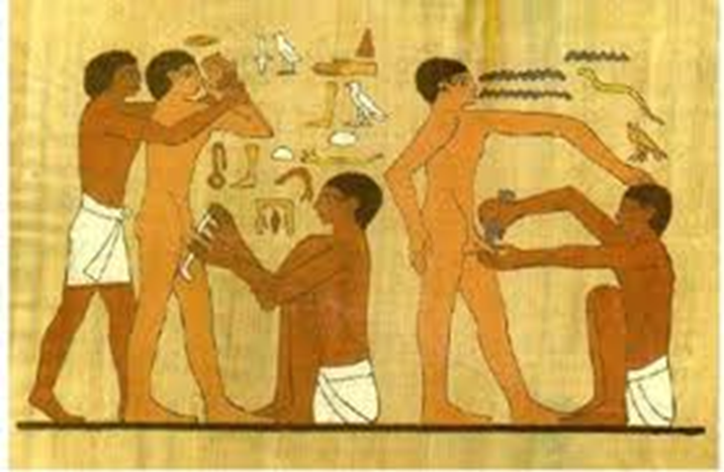
Egypt: 2700 BC first tract on surgery written
by Imhotep
The oldest recorded engraving of a medical procedure: circumcision on the doorjamb of the entrance to the Temple of Memphis

Slide 8
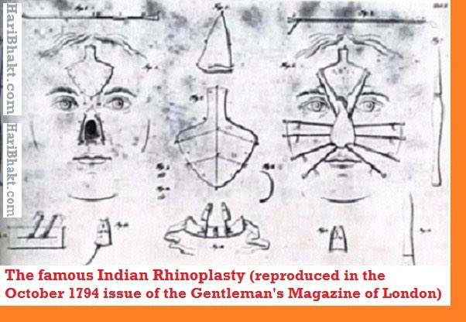
India: The Susrutha Samhita – oldes known surgical text written by Sushruta (600 BC), first known description of several operations- uniting of bowel, the removal of prostate gland, rhinoplasty, draining of abscesses, removal of cataract lenses

Slide 9
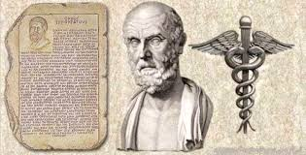
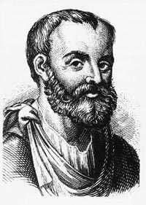
Greece : Hippocrates
- the father of medicine (460-377 BC)-
- first monography – Corpus hippocraticum – summarized all medical knowledgenad experiences of Ancient world, contains The Hippocratic Oath.
Alexandria period (300BC- 400 AD)
- report of human body section, basic knowlege of
human anatomy
Galénos (129-216AD)
- teacher and surgeron
- autopsies of live animals,
- report eye a brain operations

Slide 10

Ancient China
Hua Tuo (140 -208 AD)
– famous Chinese physician
- first person who performed the
surgery with the aid of anesthesia
- drink containing hashish and
akonitine
- performed skull trepanation,
laparotomy, splenectomy,
anastomosis of intestines

Slide 11
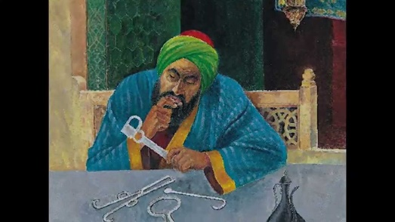
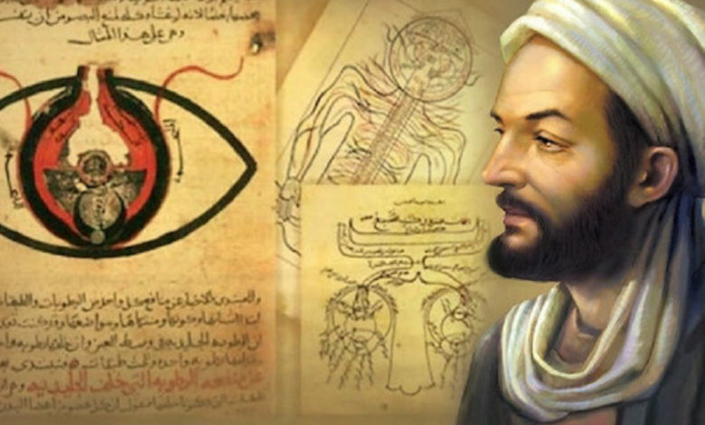
Medieval world
Arabic period
Al- Zahrawi (Abukasim) (936-1013)
- specialized in curing disease with cauterization
- Invented several devices used during surgery
- Pioneer in neurosurgery, treatment of head, and
spinal injuries, subdural effusions
- First clinical descriptionon an operative procedure
for hydrocephalus
Ibn Sina ( Avicenna , 980-1038)
Canon Medicinae – medical knowleges and
experiences of Arabic and Greek medicine

Slide 12
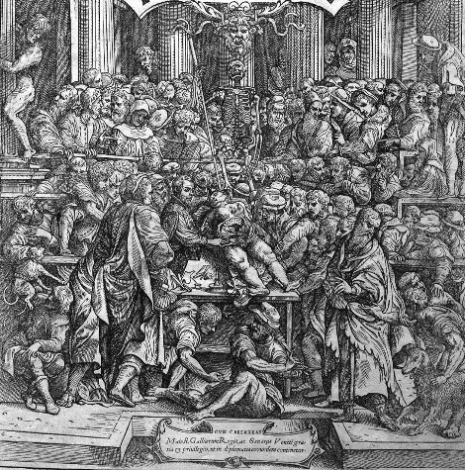
European period
From 13th – to 16th century development in Europe characterized by so-called Italian-French period)
13th century – first universities in Italy (Padua, Napoli, Bologna) – performed anatomical sections

Slide 13
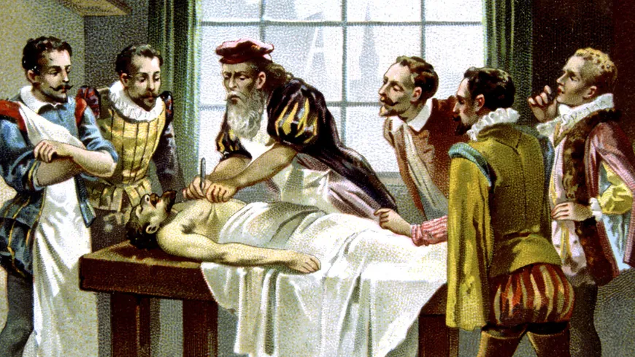
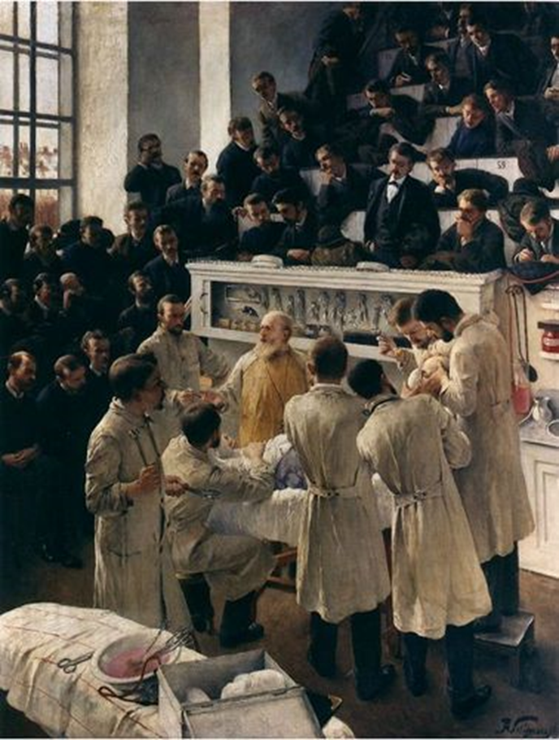
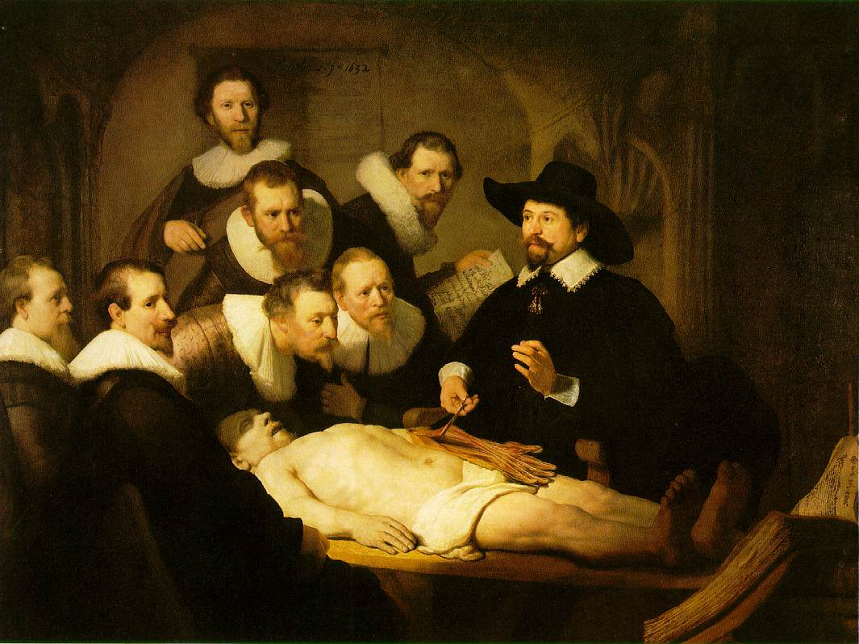

Slide 14
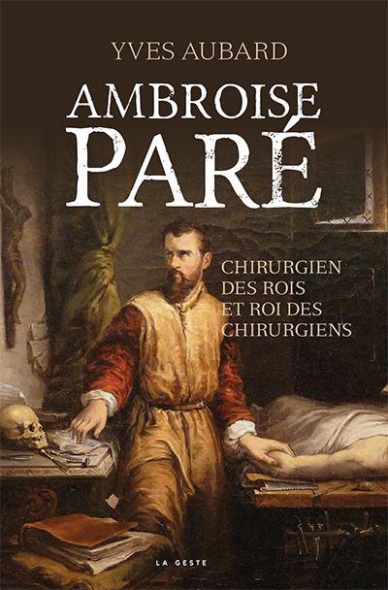

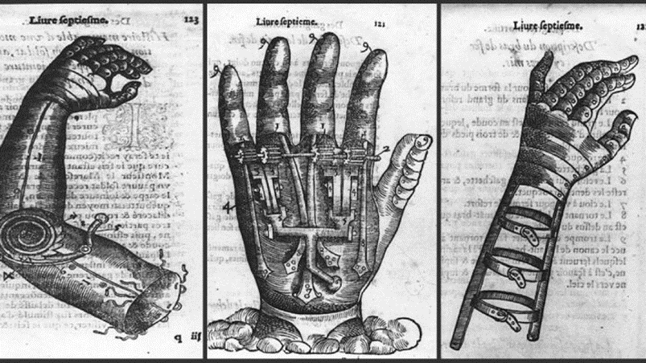
France – surgery has lower status than pure
medicine until Rogerius Salermitanus
wrote file „Chirurgia“ – surgery was considered as craft,
performed by healers and barbers
The first real surgeons were the healers from
numerous wars - especially Ambroise Paré (1510-1590). Became a royal healer (French kings Charles IX and Henry III)
- tying blood vessels in amputated limbs, he replaced the painful burning, he wrote his experience in many volumes
- Prostesthetics in 16th century (Ambroise Paré)

Slide 15
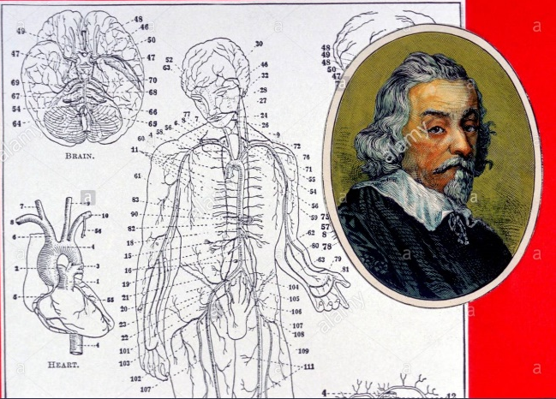
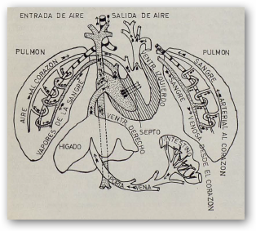
At this time, the anatomy ( Vesalius, Eustachio, Fallopia) developed boisterously
First physiological findings
- William Harvey
1628 – described systemic
circulation
- Michael Servetus
1553 – described pulmonary
circulation
Since 15th century surgery was taught as a separate branch at the universities of Montpellier, Paduam, Bologna.

Slide 16
Modern Surgery
Modern Surgery developer rapidly with scientific era.
Three main developments permitted the transition to modern surgical approaches
control of bleeding
control of infection
control of pain (anesthesia)
- operations without excessive risk to the
patient ( control of bleeding, blood
transfer, knowlege of shock conditions, etc.)
- operation without the spread of the
infection
- operations without pain ( anesthesia)

Slide 17
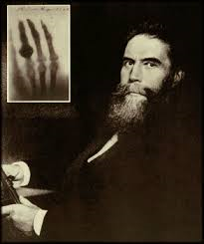
1847 I.F. Semmelweis discovered basic principles of antisepsis (washing hands with chlorine of lime solution)
Joseph Lister – introduced carbolic acid ( phenol) to sterilize surgical instruments and to clean wound
Louis Pasteur – discovered reasons of purulence, surgeons started to disinfect operation field with disinfectants
W.S. Halsted – set up wearing of rubber gloves for surgery
1846 Charles Jackson – discovered ether for anesthetic use
C. Roentgen discovered X-rays for medical use
1929 – A. Fleming described first true antibiotic-Penicilin
After the Second World War were discovered and used subsequent antibiotics. Many diagnostic methods were
improved nad new technologies were discovered ( ultrasond, CT, MRI, endoscopy, etc.)

Slide 18
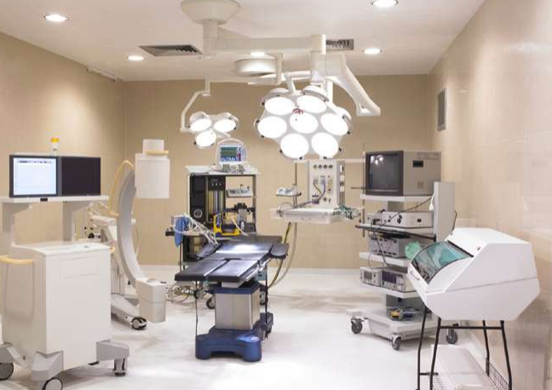
Operating theatre

Slide 19
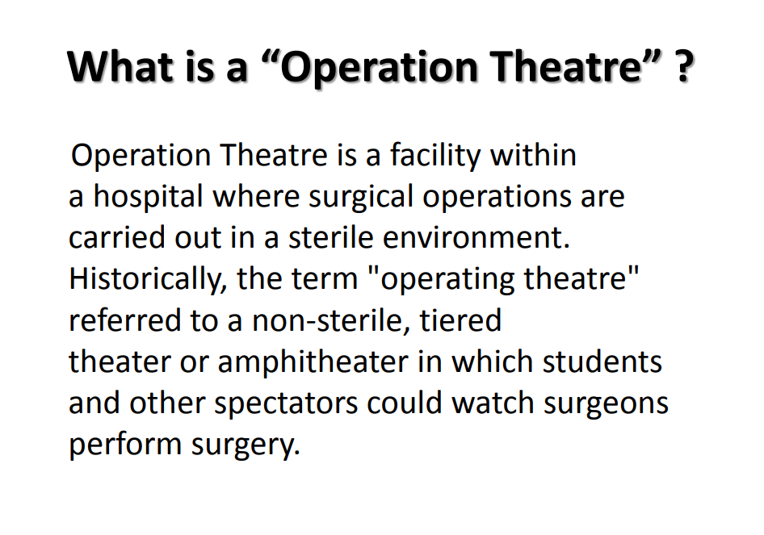

Slide 20
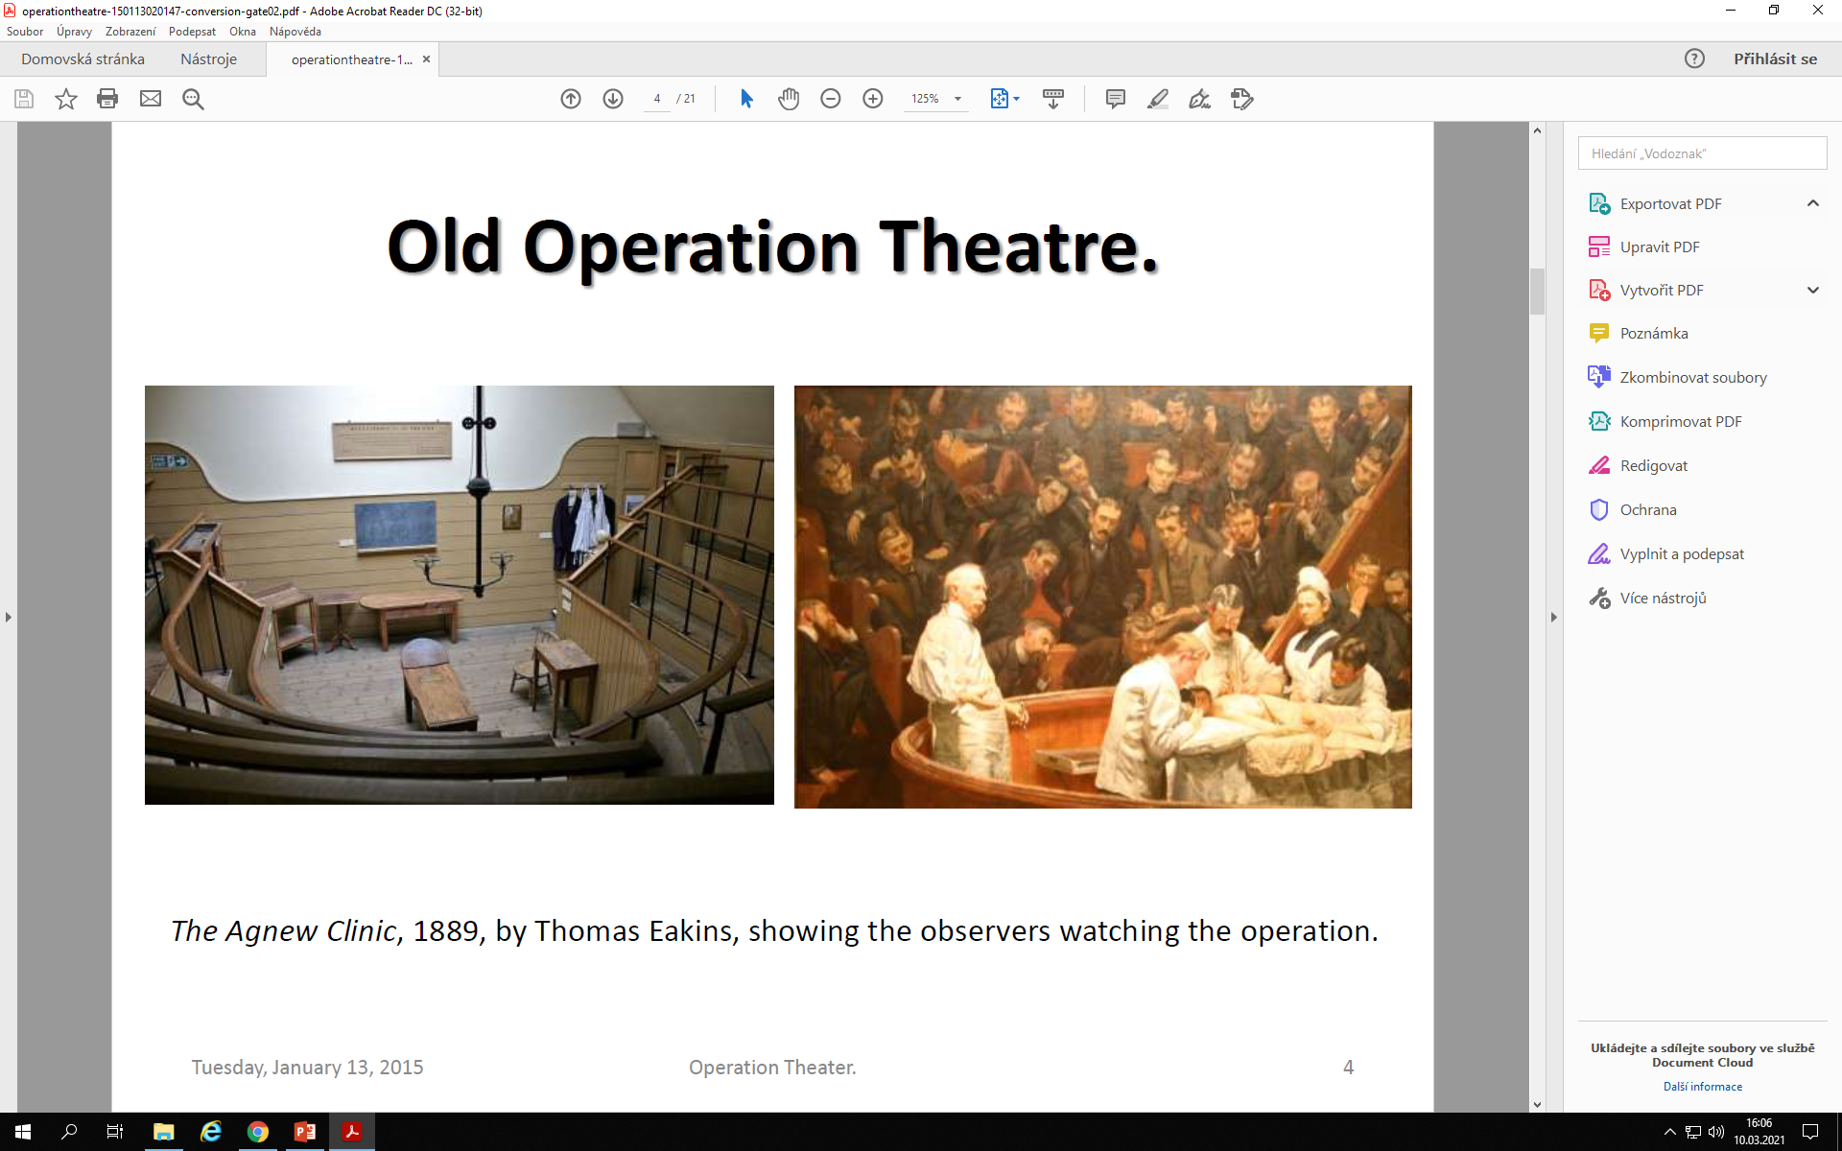

Slide 21
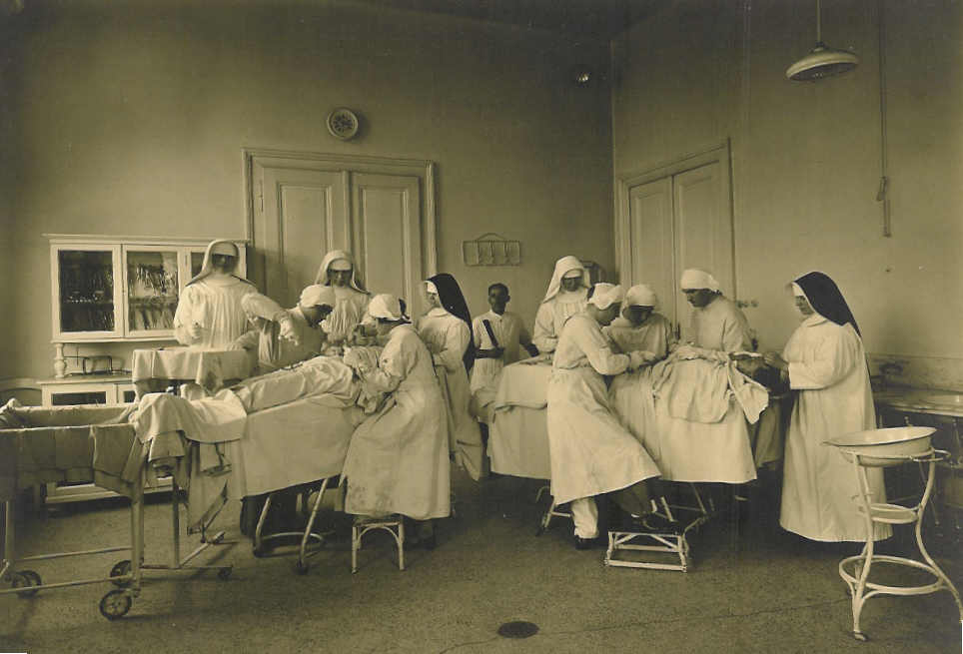

Slide 22
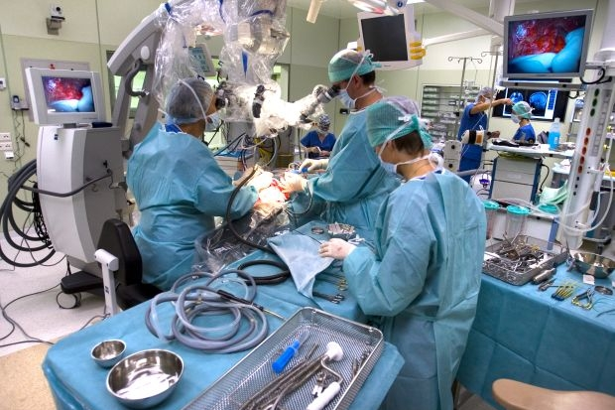

Slide 23
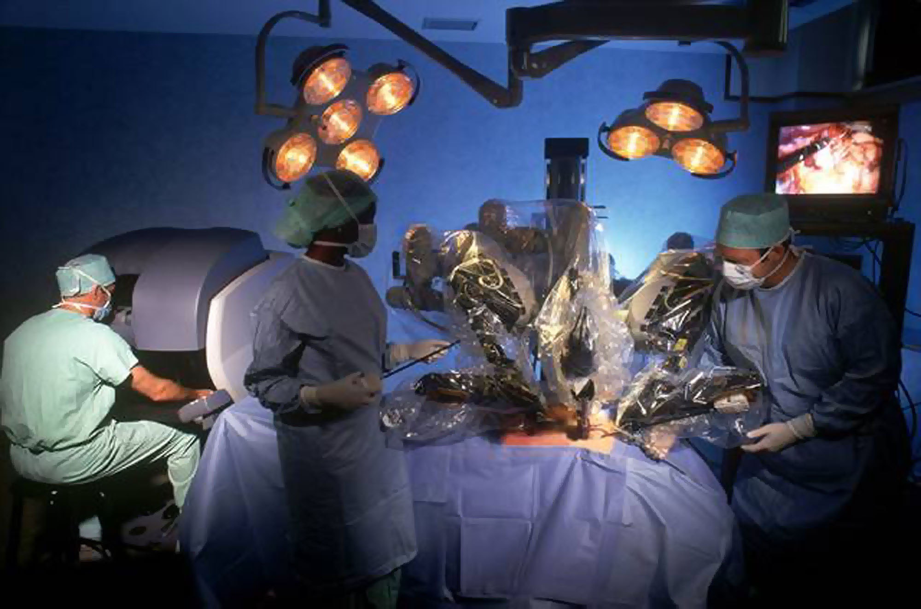

Slide 24
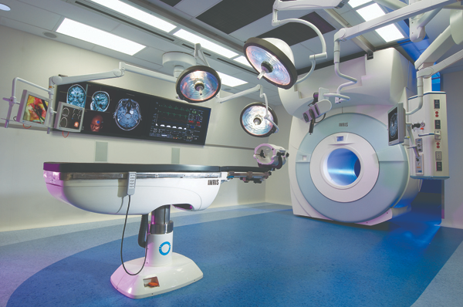

Slide 25
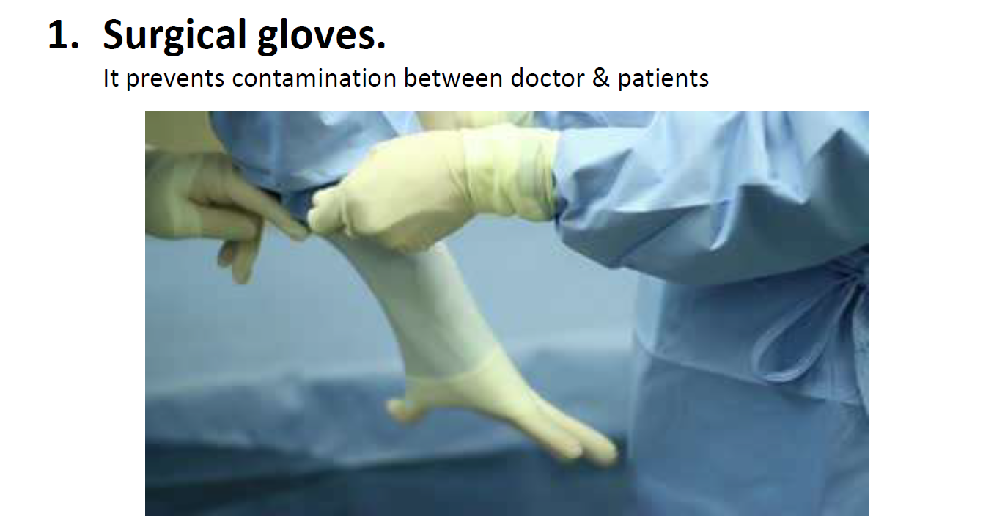
Surgeon and assistant equipment

Slide 26


Slide 27
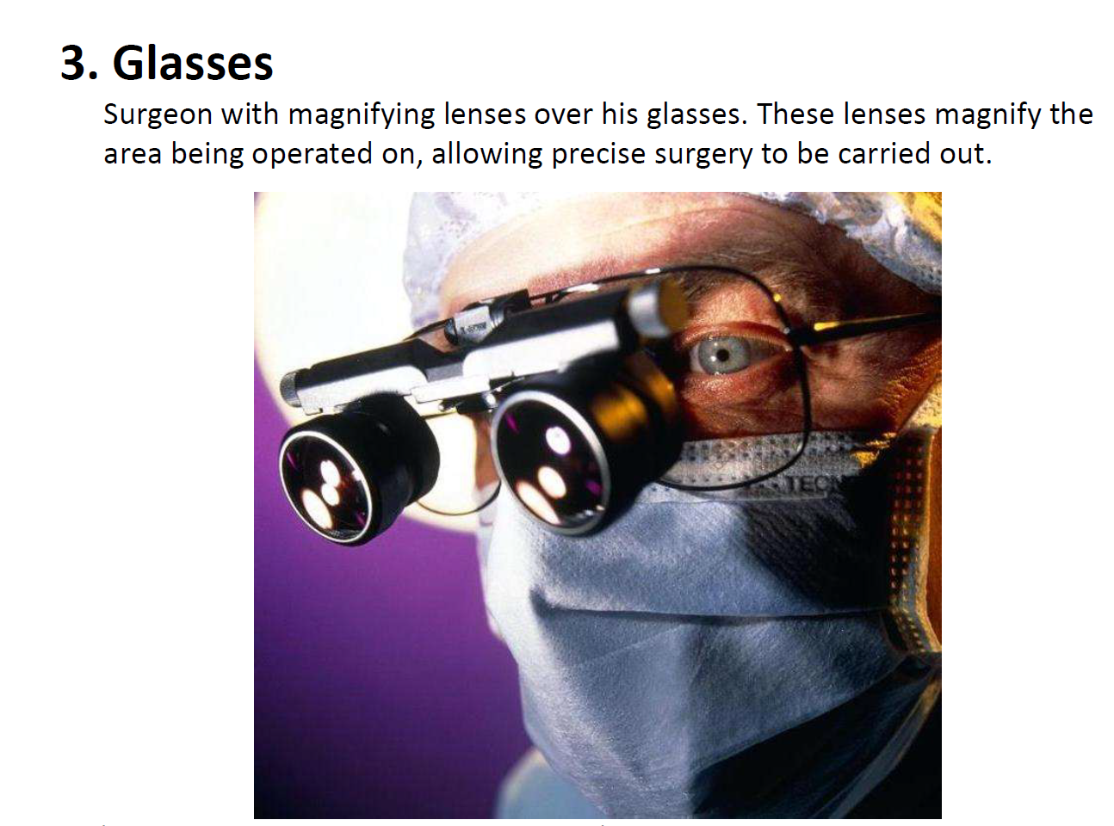

Slide 28
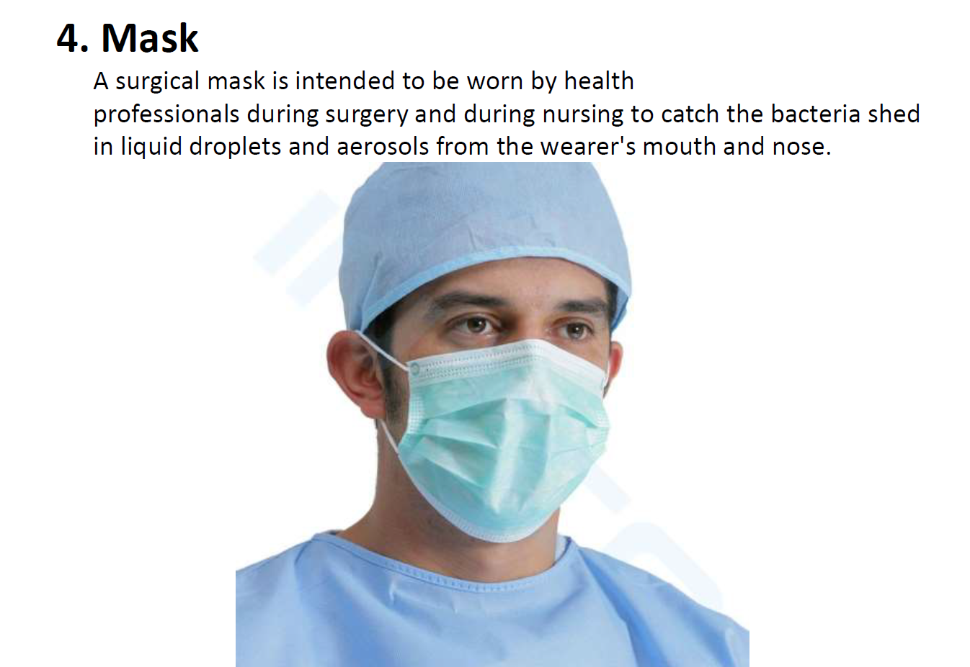

Slide 29
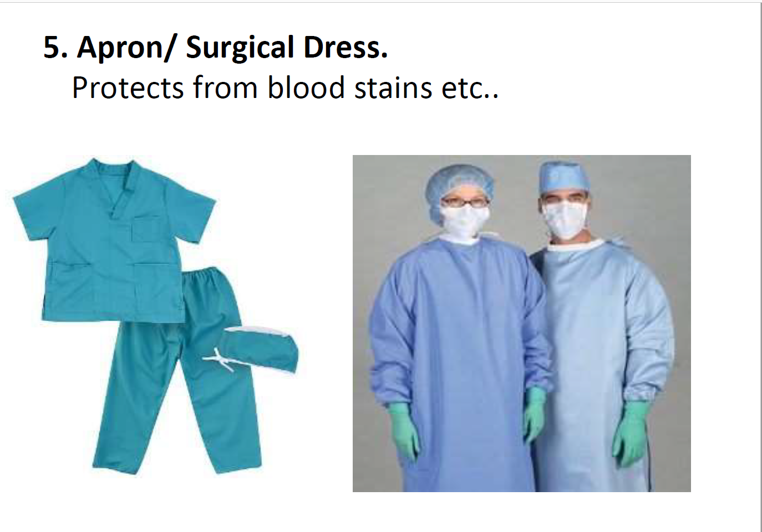

Slide 30
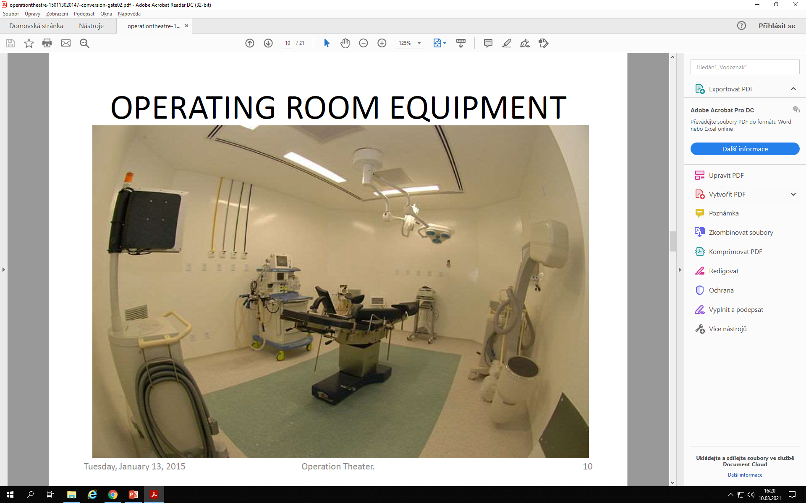
Operating room equipment

Slide 31
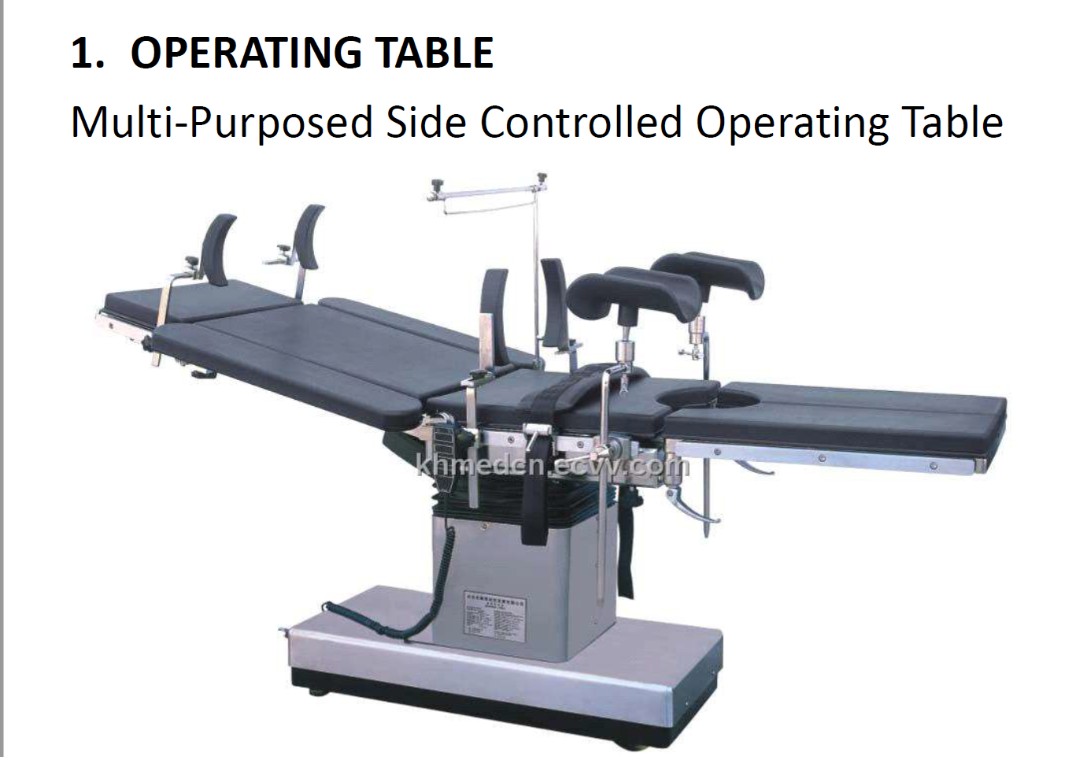

Slide 32
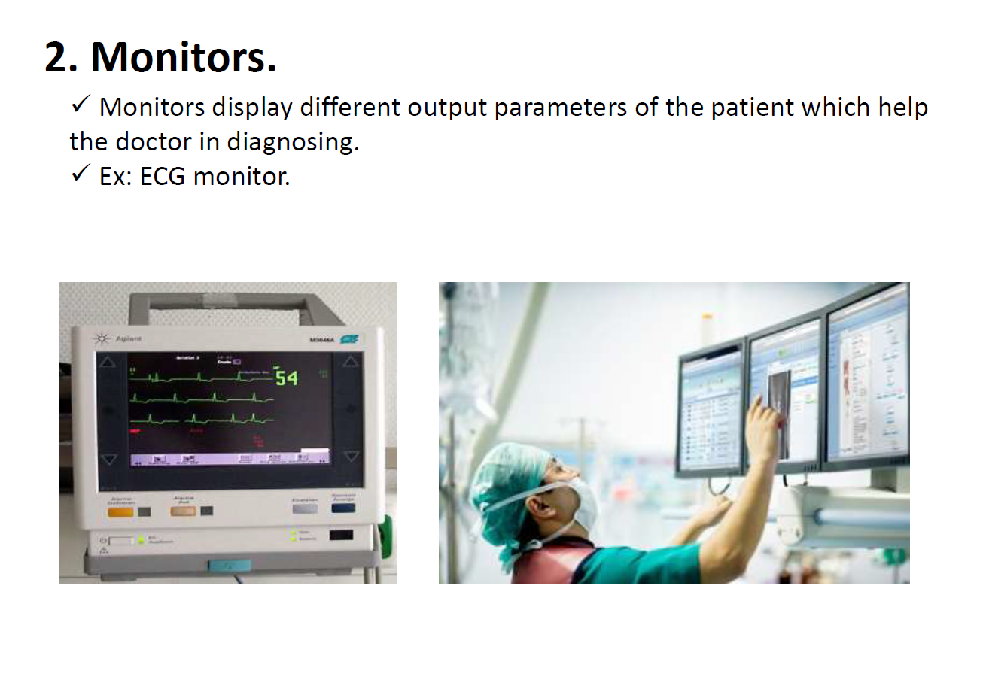

Slide 33
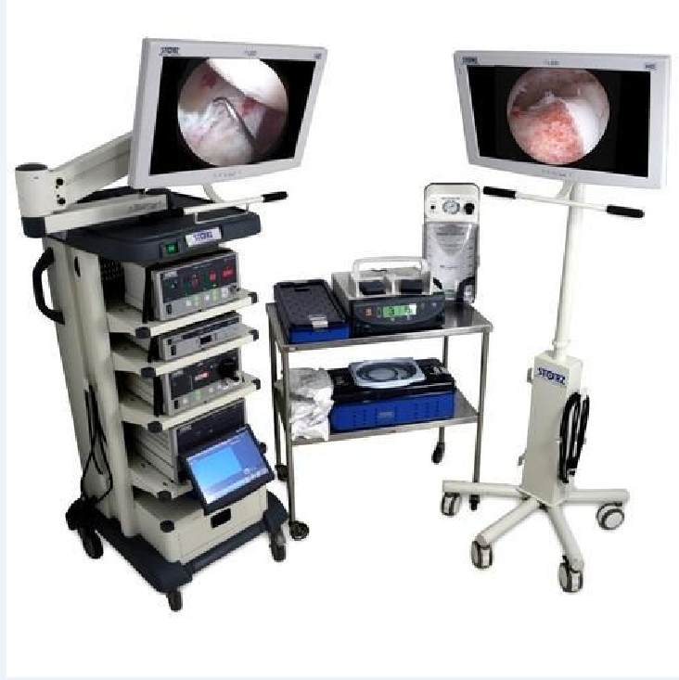

LAPAROSCOPIC TOWER

Slide 34
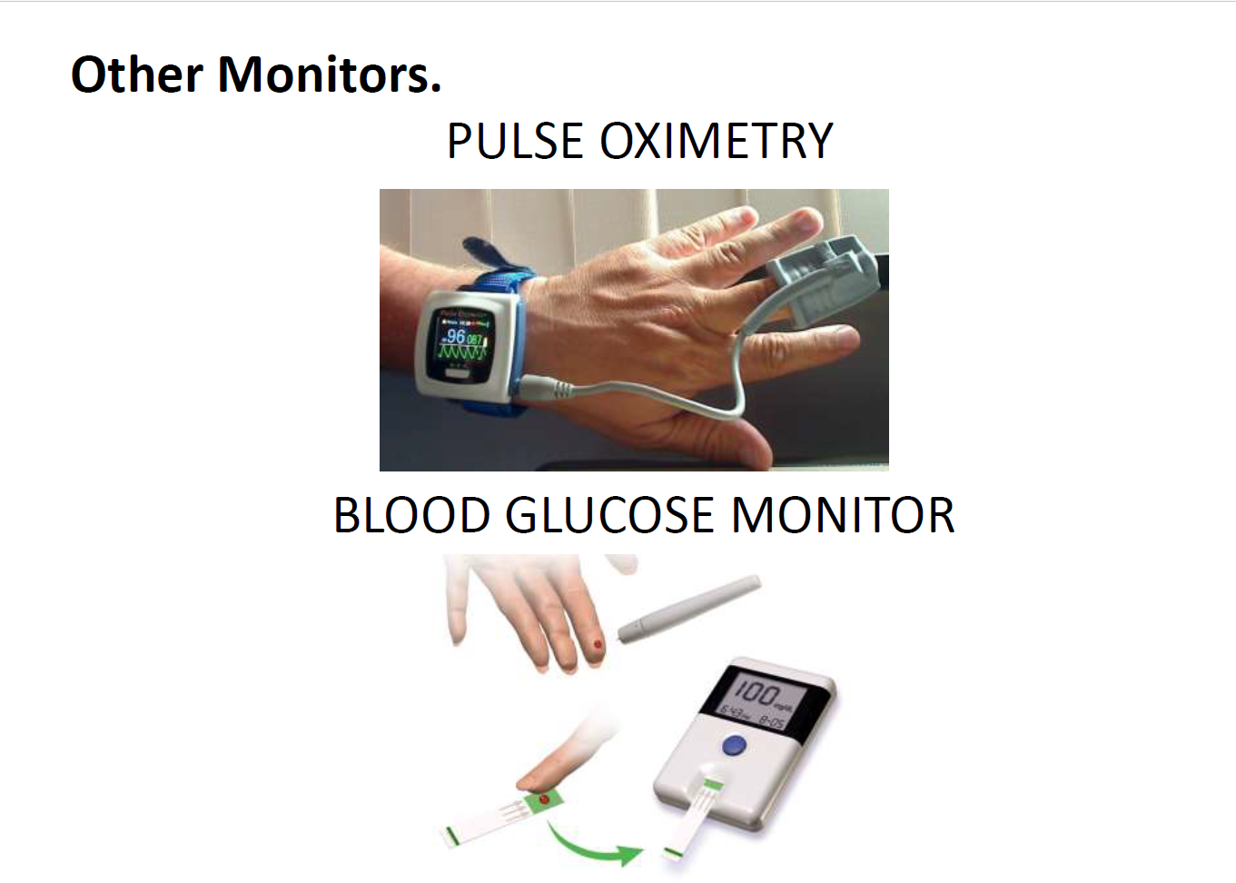

Slide 35
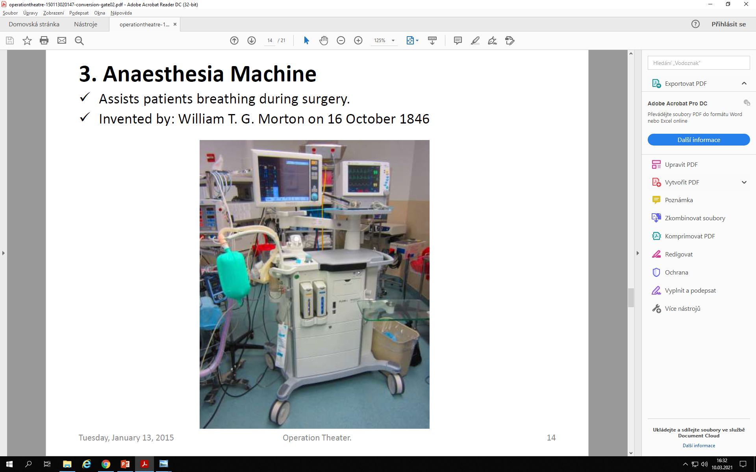

Slide 36
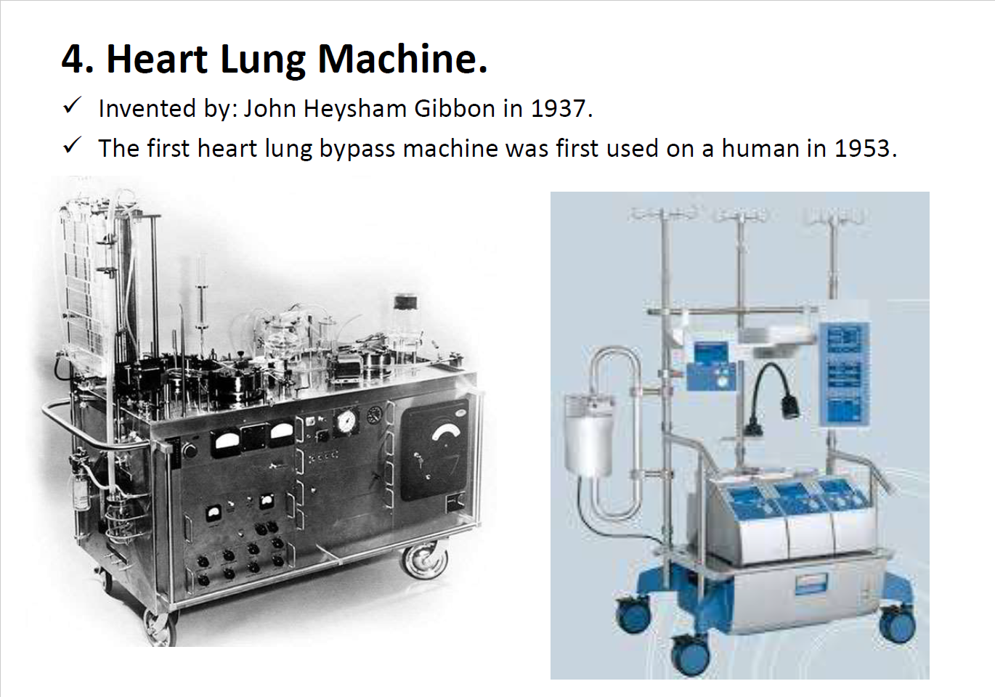

Slide 37
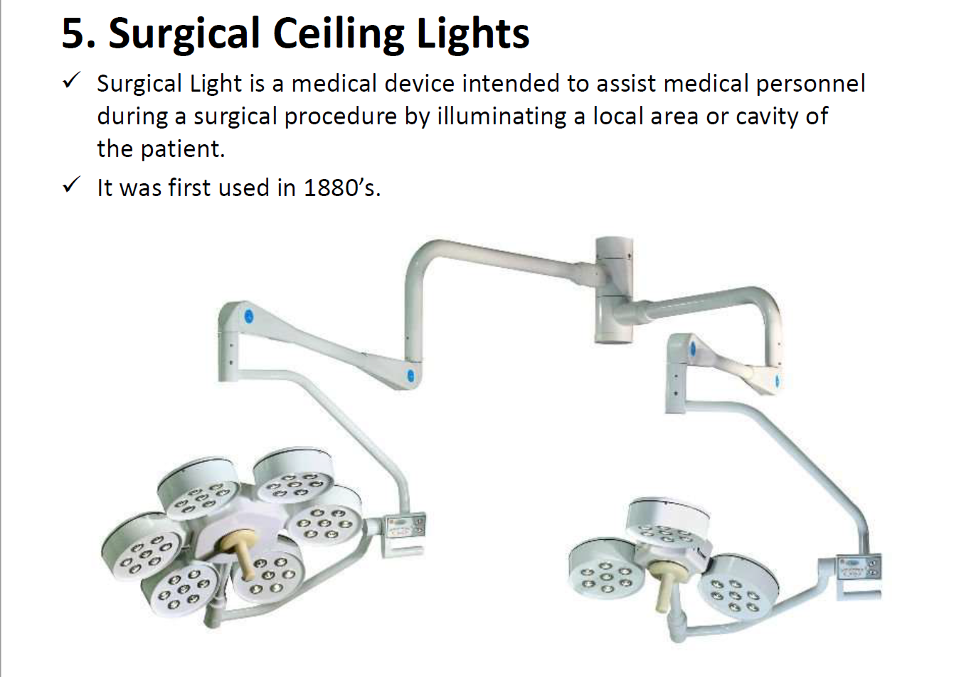

Slide 38
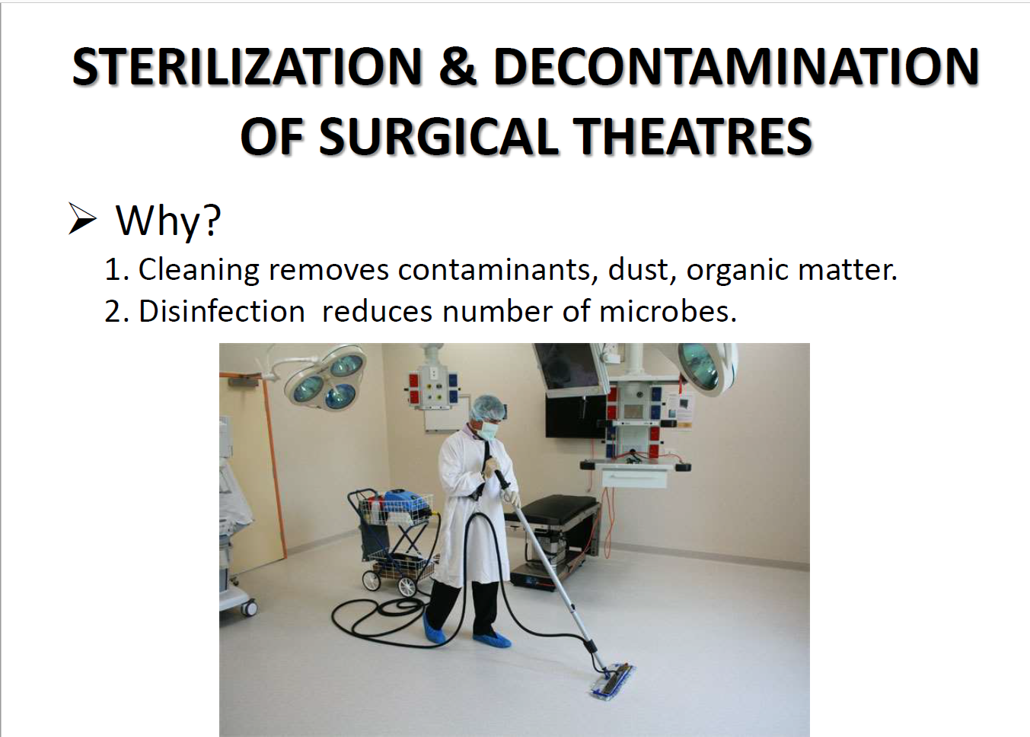

Slide 39
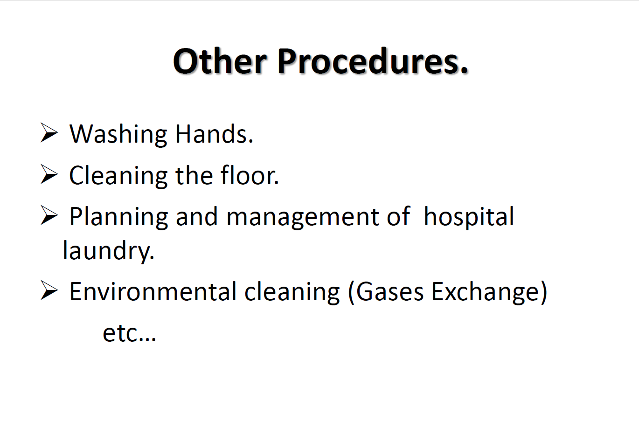

Slide 40
