Slide 1
2. week, CFF II

Slide 2
Week 2: UNIT 6/2: Conversation: Where were you? Grammar: Past tense II(irregular forms). Reflexive verbs: ses, sis. The second position in Czech sentences. Locative singular.
WARM UP: Teacher’s choice
MEZINÁRODNÍ DEN ŽEN (8. března)
Žena ve videu lezla. Žena ve videu psala. Žena ve videu zpívala. Žena ve videu kreslila (malovala). Žena ve videu absolvovala univerzitu. Žena ve videu klikala. Žena ve videu hrála fotbal. Žena ve videu mluvila do mikrofonu. Žena ve videu hlasovala (volila). Žena ve videu řídila letadlo – pilotovala letadlo. Žena ve videa držela se za ruce. Žena ve videu pracovala na počítači. Žena ve videu letěla do vesmíru. Žena ve videu vyhrála. Žena ve videu pracovala v laboratoři. Žena ve videu točila (natáčela). Žena ve videu jezdila na kole.
1. REVISION
Revise: Is it correct or not? Link

Slide 3
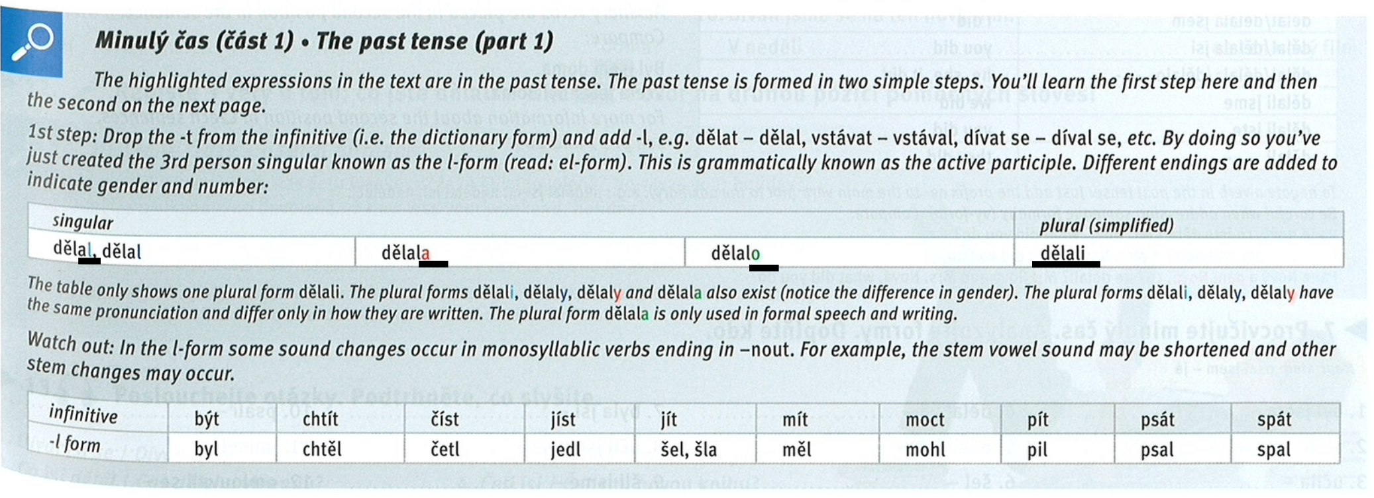
Irregular forms in past tense
Textbook – page 49, grey box
Practice irregular forms of the past tense: Textbook – page 50, ex. 6.
Practice with Flash cards: Link

Slide 4
Listening
Listen fill in the gaps and observe the second position in Czech sentence: Link
Sentence order
Practice the second position in Czech sentence: Textbook – page 51, ex. 11.
Listen and underline what you hear: Textbook – page 51, ex. 13: AUDIO LINK

Slide 5
Locative singular
Study the locative singular: Textbook – page 52, grey box.
Listen and observe the locative case : Textbook - page 52/ex. 1 - Is it true or not? AUDIO LINK
Practice the locative sg.: Textbook – page 52, ex. 2 + 3.
Study prepositions v/ve - na – u: Textbook – page 53, grey box.
Practice the prepositions: Textbook – page 53, ex. 9.

Slide 6
Summary
6. SUMMARY
Revise the past tense: link
Watch the video to sum up your knowledge about the past tense:

Slide 7
Homework
(must be uploaded before your lesson in week 3!)
TEXT: Write a short text about your last weekend. Use the past tense and the locative case. You can also use time expressions you find in Textbook (page 54, grey box). "Kde jsi byl/a a co jsi tam dělal/a?" (10 sentences minimum). Upload your text into your homework vault.

