Slide 1
week 3
CFF II.

Slide 2
Week 3: UNIT 6/3: Conversation: Do you know who it was? Grammar: Time expressions. Verbs ZNÁT a VĚDĚT. Countries and nationalities.
Warm up
Byl (a) jsem doma. Jsem doma. Jel do nemocnice ráno.
1. REVISION
Revise the locative singular: Link
Revise prepositions: Link
Revise the second position in sentence: Link

Slide 3
3. TIME EXPRESSIONS
Observe the gray box in the Textbook - page 54.
Practice with the Textbook - page 54/ex. 1 + 3 + 4.

Slide 4
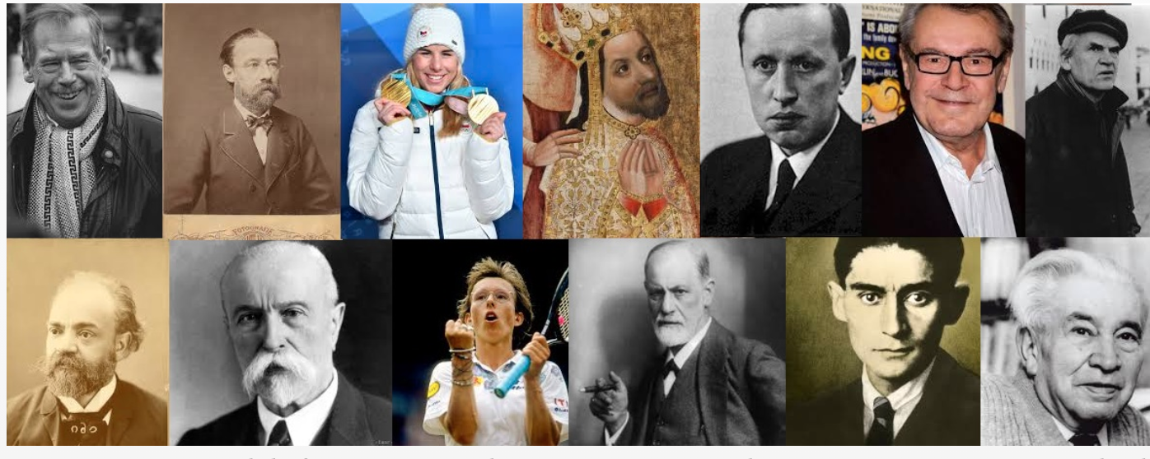
4. WORKING IN GROUPS
Discuss: Do you know any famous Czech people?
Read the text and translate (vocabulary can be found on the second page): Link "Kdo to byl?"
Prepare a short text about somebody famous (historical figure), the reading exercise can be your model. Countries and nationalities can be found in the Textbook - page 56.
Read your text and show it to other groups.

Slide 5
ZNÁT - VĚDĚT - UMĚT
Observe the grey box in the Textbook - page 55.
Online tutorial: Link (You can use Czech subtitles with automatic translation into English.)
Practice: Textbook - page 55/ex. 4.
Online practice: Link
Online practice: Link

Slide 6
6. COUNTRIES AND NATIONALITIES
A list in the Textbook - page 56
Online practice: Flash cards

Slide 7
7. UNIT 6 REVISION
Quiz: Kahoot
HOMEWORK
Revise for the progress test.
HW (week 03): znát, vědět, umět
HW (week 03): locative
Test 1 information

