Slide 1
INTRODUCTION TO THE STUDY OF PHARMACOLOGY
Notes for Students
This study material is exclusively for students of general medicine and densistry in Pharmacology I course. It contains only basic notes of discussed topics, which should be completed with more details and actual information during practical courses to make a complete material for test or exam studies. Which means that without your own notes from the lesson this presentation IS NOT SUFFICIENT for proper preparation for neither tests in practicals nor the final exam.

Slide 2
Copyright notice
The presentation is copyrighted work created by employees of Masaryk university.
Students are allowed to make copies for learning purposesonly.
Any unauthorised reproduction or distribution of the presentation or individual slidesis against the law.

Slide 3
Literature
Rang, H.P. a kol. Rang and Dale‘s pharmacology 8th ed.(2016)
http://web.b.ebscohost.com/ehost/ebookviewer/ebook/bmxlYmtfXzExNjA0OTNfX0FO0?sid=82e7fdcf-dd4c-43d3-b3a3-7b4b24c21b8e@sessionmgr103&vid=0&format=EB&lpid=lp_1&rid=0

Slide 4


Slide 5
Literature
Practicals in Pharmacology, 2006
Hadasova, Novakova, Pistovcakova,
Vinklerova, Sulcova, Starobova
Pdf available at: IS.muni.cz

Slide 6
„GENERICS“
Drug which is produced and distributed after ending of patent protection - mostly manufactured by other company which has not developed the original drug (the same active substance!)
Mostly cheaper than original preparation
Assumed to be identical in dose, strength, route of administration, safety, efficacy, and intended use
Bioequivalent trials are needed before registration
Registration procedures are much easier than in orig. preparation
Drug patents give 10 years of protection, but they are applied for before clinical trials begin, so the effective life of a drug patent tends to be between 7 and 12 years

Slide 7
„GENERIC PRESCRIPTION“
prescription of the generic name (INN) on Rx formulary
+ dose, number of doses
Pharmacist will chose apropriate ready-mady preparation after consultation with the patient
„ GENERIC SUBSTITUTION“
  substitution of the prescribed preparation with another one (generic)

Slide 8
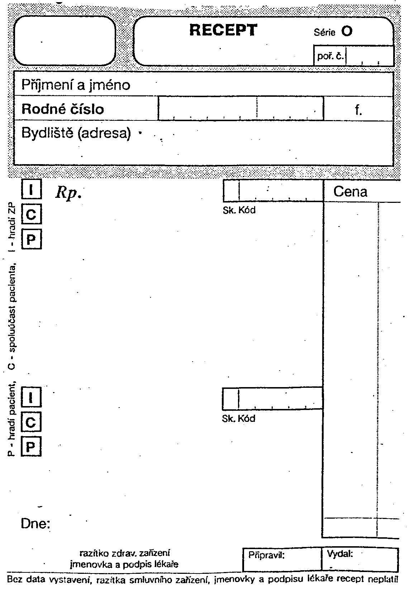
Latin terminology in drug prescription

Slide 9

Pharmacopoeia
pharmacon = drug
poieo = prepare
Substances in pharmacopoeia- called officinal drugs

Slide 10
Definition
basic reference work for pharmaceutical drug specifications
published by the authority of a government or a medical or pharmaceutical society
book containing directions for the identification of samples and the preparation of compound medicines
assures quality, efficacy, safety, standards

Slide 11
Pharmacopoeias may be:
National e.g. Brazilian, British, Chinese, Indian, Japanese, Mexican, Spanish, United States
Regional e.g. European (Ph.Eur.)
    The 7th Edition of the European Pharmacopoeia
International The International Pharmacopoeia

Slide 12
National and regional pharmacopoeias
Cover medicines used in the relevant country or region
Are legally binding "official" in the relevant country or region
Are prepared by a national or regional authority

Slide 13
International Pharmacopoeia
A few dates…
The history of the International Pharmacopoeia dates back 1874…
→ 1948 First World Health Assembly established
Expert Committee on Unification of Pharmacopoeia
→ 1950 WHA approved publication of Pharmacopoeia Internationalis

Slide 14
International Pharmacopoeia
→implementation: “ready for use” by Member States
"The Ph.Int [… ] is intended to serve as source material for
reference or adaptation by any WHO Member State wishing to establish pharmaceutical requirements. The pharmacopoeia, or any part of it, shall have legal status, whenever a national or regional authority expressly introduces it into appropriate legislation."
[World Health Assembly resolution WHA3.10, WHO Handbook of Resolutions and Decisions, Vol. 1, 1977, p. 127]

Slide 15
International Pharmacopoeia
A collection of monographs and requirements for:
→ Drug substances
→ Excipients
→ Finished dosage forms
→ General methods and requirements:
dosage forms, e.g. tablets, liquid preparation for oral use
dissolution testing
→ Supplementary information, e.g. General guidelines for Chemical Reference Substances
→ Infrared reference spectra

Slide 16
Specifications of substances
Description, Chemistry, Solubility, Storage, Labelling
Definition, with information on polymorphism if relevant
Identification
Assay
Specific tests (sulphated ash, optical rotation, loss on drying…)
Related substances

Slide 17
Specifications of substances
Precise description of analytical methods
Impurities (chemical names, structures, origin)
Any relevant information on
Performance testing (e.g. dissolution)
Stability
Validation of analytical methods

Slide 18
International Pharmacopoeia
current: 4th Edition + 1st Supplement
→ Consolidated in : 2 Volumes
Vol. 1: pharmaceutical substances (A-O)
Vol. 2: pharmaceutical substances (P-X)
+ dosage forms + radiopharmaceuticals
+ methods of analysis + reagents
1st Supplement - new requirements and revisions

Slide 19
PHARMACOPOEIA BOHEMICA
3 volumes + CD, 2017
Translation of 7th ed. of Eur. Pharmacopoieia
Issued by The Czech Ph. Comm. Of Ministry of Health

Slide 20
Vol. 1 General methods and requirements
Vol. 2 Monographs A-N
  Medicines, excipients
Vol. 3
Monographs N-Z
  Medicines, excipients
  National part
General methods and requirements
Tables (I-XII)
  Medicines, excipients

Slide 21
PHARMACOPOEIA
WHAT we can not find there !
  pharmacological properties of drugs, their pharmacodynamics,
  pharmacokinetics
  indications, contra-indications
  toxic effects

Slide 22
Drug dosology in paediatrics
Doses divided into 3 age groups
0-1 1-6 6-15
Calculation according to the body surface
body surface[m²]
Dose for children = -------------------------- x adult dose
1,73
7 * age (yrs) + 45
Body surface [m²] = --------------------------------------
100

Slide 23
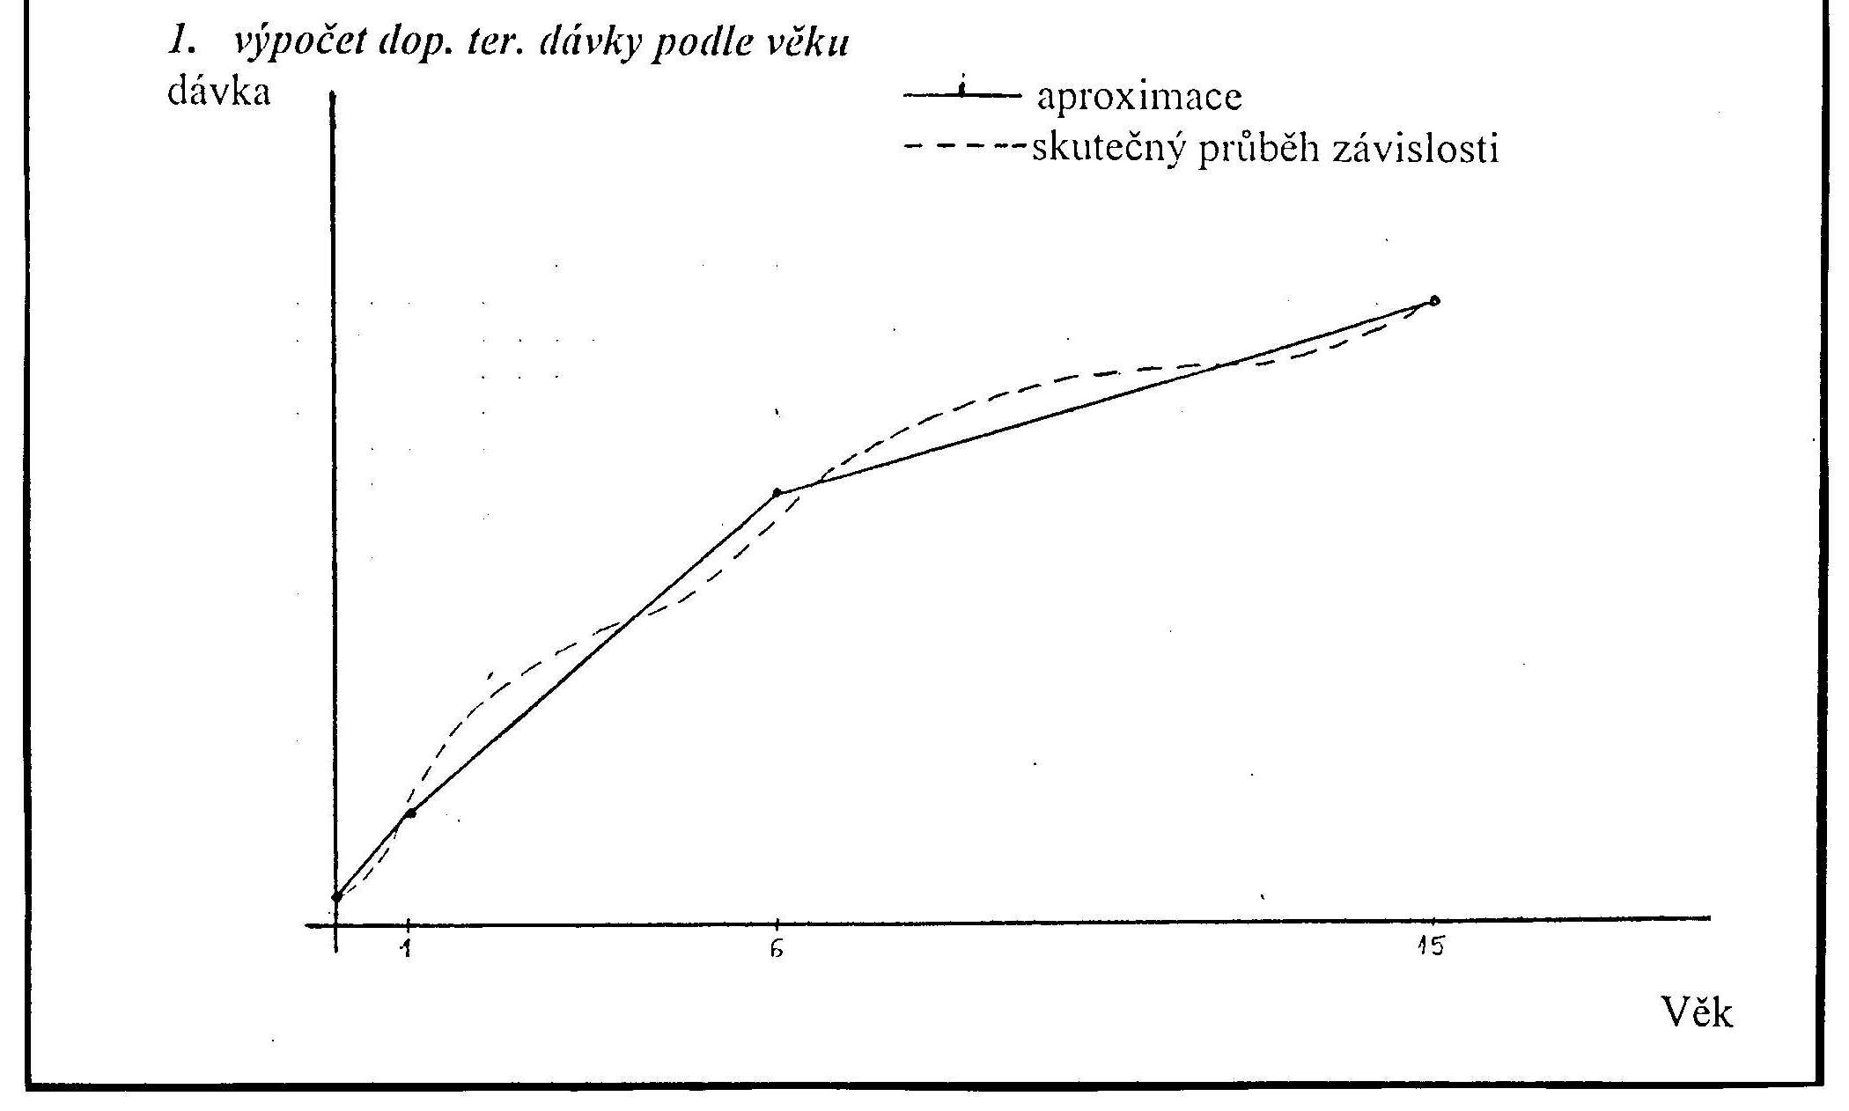

Slide 24
Doses for children
Interpolation
d₂ - d₁
d = d₁ + -----------. n_{d}
n
d…..recommended dose for the given age
d₁.…recommended dose for lower limit of the age interval
d₂ … recommended dose for upper limit of the age interval
n…..number of year intervals within the range of age
n_{d}….number of year intervals from the beginning of range of age to the age of the given child

Slide 25
Calculate the DTS of a substance X for 10 years old child,
if the dose interval from 6 to 15 years of age is 0,7-1,5 g.
d2 - d1
d = d1 + -----------. nd
n
d1 = 0,7
d2 = 1,5
n = 9
nd = 4
1,5 – 0,7
d = 0,7 + -----------. 4 = 0,7 + 0,088*4 = 1,05 g
9

