Slide 1

Drugs used in diseases characterized by bronchial obstruction

Slide 2
Copyright notice
The presentation is copyrighted work created by employees of Masaryk university.
Students are allowed to make copies for learning purposesonly.
Any unauthorised reproduction or distribution of the presentation or individual slidesis against the law.

Slide 3
Bronchial asthma
chronic inflammatory disease of airways
affecting 300 million people all acros the globe
prevalence in CZ: 8 %, in children over 10 %
Characteristics:
  bronchial hyper-reactivity
  obstruction (often reversible)
  inflammation
Symptoms:
  shortness of breath (bronchoconstriction, mucous plug, oedema, airway remodeling due to the inflammation)
  difficult and prolonged expiration → wheezing, whistling
  cough (especially at night or in early morning)

Slide 4
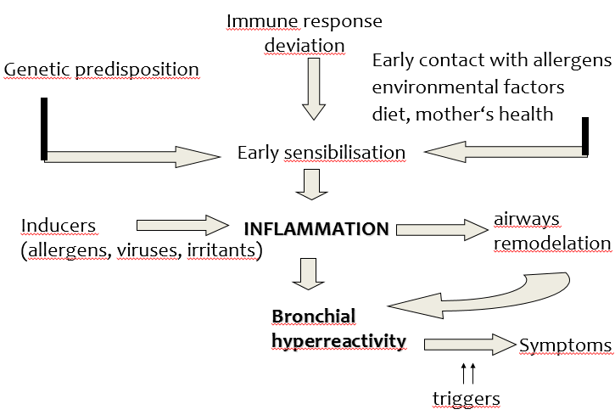
Bronchial asthma
ALERGIC ASTHMA
NON-ALERGIC ASTHMA
allergy not present
excercire-induced, aspirin-sesitive, infectious, work-related, endogenous

Slide 5
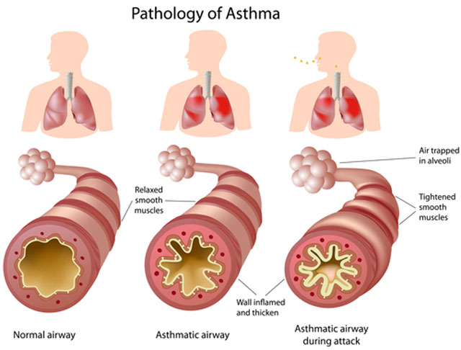
https://www.canstockphoto.com/anatomy-of-asthma-6231875.html

Slide 6
Diagnose
Anamnesis – personal, familiar
Clinical examinations - auscultation, signs of atopy, eosinophilia,
PEF – Peak Expiratory Flow
FEV 1 – Forced Expired Volume in one second
Laboratory tests- eosinophilia, IgE
Allergy testing

Slide 7
Classification with regard
to seriousness
Intermittent – sign up to once a week, night symptoms up to twice a month, pulmonary function normal
Mild persistent– signs no more than once daily, night symptoms up to twice a month, PEF at least 80 %
Moderate persistent– signs once a day and are not permanent, night sign no more than once a week, PEF 60-80 %
Severe persistent– permanent signs, daily, obstruction, PEF ≤ 60 %

Slide 8
Managment of asthma
the disease itself cannot be fully treated, the goal is to keep asthma under control
Goals:
minimalize both acute and chronic symptoms
reduction of exacerbations (lessen SABA administration)
improvement of the quality of life (physical activity)
avoid adverse effects of the treatment

Slide 9
Chronic obstructive pulmonary
disease (COPD)
affecting 600 million people all across the globe
prevalence: 8 %
risk factors: smoking, polluted air, dust and chemical vapors at workplace, genetic predisposition
Characteristics:
  chronic inflammation caused and maintained by long-term exposure to harmful agents (irritating gases and particles)
  poorly reversible, progressing bronchial obstruction
  production of mucus
Symptoms:
  cough (usually whole day, hardly ever only during night)
  expectoration
  shortness of breath

Slide 10
Managment of COPD
we can only slow the progression
reduction of risk factors is necessary (mainly top quit smoking)
Goals:
symptom reduction
improvement in physical condition and overall health state
prevention of complications and exacerbations

Slide 11
Administration
  oral, parenteral (injections, infusions)
  inhalation
  - local administration, high drug concentration at the site
  of action
  - fast onset of the effect
  - minimal penetration to systemic circulation → ↓ risk of side effects

Slide 12
Drugs used in diseases characterized
by bronchial obstruction
BRONCHODILATATORS
- β₂ sympathomimetics
- parasympatholytics
- glucocorticoids
- methylxanthines
- roflumilast (COPD only)
- antileukotrienes
- imunoprofhylactics
- monoclonal antibodies
- noselective sympathomimetics (epinephrine, life-saving medication)
- adjuvant medication (antitussics, drugs facilitating expectoration)
asthma only

Slide 13
β₂ sympathomimetics
MoA: selective β₂ stimulants
  - inhibition of mediator release from mast cells + stimulation of ciliary beat frequency
- diagnostics – post-bronchodilator test (salbutamol)
- mostly inhaled, may be also given orally (mainly in kids)
- not completely selective in their binding to β receptors
long-term use = down-regulation of receptors

Slide 14
β₂ sympathomimetics
Indication: asthma, COPD
AE: nervousness, tremor, cephalgia, palpitation, hypokalemia (mainly when given orally)
CI: hypertension, dysrhythmia, pregnancy

Slide 15
β₂ sympathomimetics
Short-acting = SABA (also rapid-acting = RABA)
  fast onset of effect, which lasts 4 – 6 hours, inhalation
  salbutamol
  fenoterol
Long-acting = LABA
  effect lasts for up to 12 hours, inhaled or administered orally
  salmeterol
  clenbuterol
  formoterol (RABA)
  indakaterol (U-LABA)
  vilanterol (U-LABA)

Slide 16
Parasympatholytics
MoA: competitive antagonism of M receptors
- in a form of inhalation
- can be combined with β₂-sympathomimetics or glucocorticoids
Indication: COPD, asthma
AE: if entering the systemic circulation (low risk, they contain quaternary nitrogen in their structure) – anticholinergic effects
CI: glaucoma, prostate hypertrophy, pregnancy

Slide 17
Parasympatholytics
ipratropium
  - used in asthma as well – in patients resistent to β2 sympathomimetic treatment (approx. 1/6 of patients)
  short acting (SAMA)
aclidinium (LAMA)
tiotropium (U-LAMA)
  glykopyrronium-bromide (U-LAMA)
  umeclidinium (U-LAMA)
COPD
only

Slide 18
Glucocorticoids
MoA: inhibition of phospholipase A2
by lipocortin
Effects I:
  ↓ cytokine, PG a LT secretion
  ↓ lipolytic and proteolytic enzyme secretion
  ↓ endothelial permeability
  block of cell migration
  ↓ bronchial hyperreactivity,

Slide 19
Glucocorticoids
Effects II:
  reduction of edema
  prevention of chronic irreversible changes
  (hypertrophy and hyperplasia of bronchial smooth muscles, subendothelial fibrosis and thickening of mucous basal membrane)
  increase in sensitivity of β₂ adrenergic receptors to β₂-SM

Slide 20
MoA at the cellular level
glucocorticoid + cytoplasma receptor
production of specific mRNA
production of some proteins (lipocortins)

Slide 21
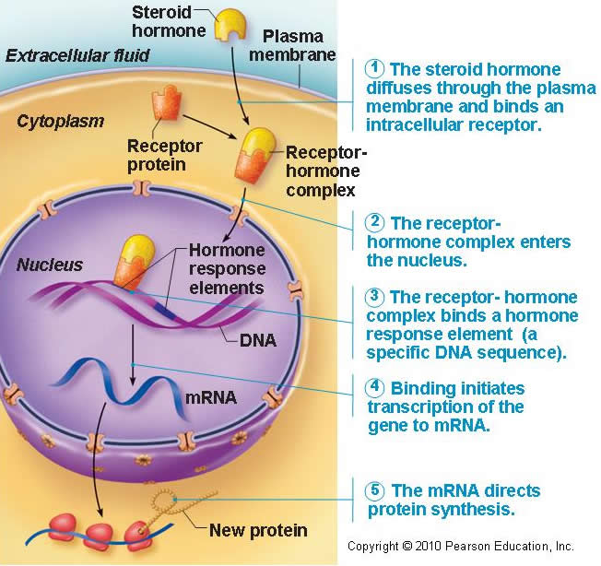
MoA at the cellular level
After entering the cell they bind to specific receptors in cytoplasm causing change of conformation = activation of receptors
Complexes of corticoid + receptor are transported to cell nucleus and bind to DNA elements.
The result is increased transcription of genes either inducing or inhibiting synthesis of other proteins
GLC receptors are present in all tissues!!!
Proteins called lipocortins are able to suppress phospholipase A

Slide 22
Antiinflammatory effect of GC
AA cascade inhibition
glucocorticoids
membrane phospholipids
lipocortin
phospholipase A2
arachidonic acid
Inh. 5-LOX
A-A
NSAIDs
lipooxygenase
PROSTAGLANDINE
PROSTACYCLINES
TROMBOXANES
cyclooxygenase
LEUKOTRIENS
Mobilization of fagocytosis
Changes in vessels permeability
Inflammation
inflammation

Slide 23
Glucocorticoids
given by inhalation
  lower risk of systemic adverse effects
  AE: affected vocal cords – croaky voice, oral candidiasis (thrush)
beclomethasone
budesonide
fluticasone
ciclesonide
mometasone
systemic administration
  orally, via injection – acute conditions, doses are gradually decreased, in severe persistent asthma – if nothing else is effective
prednisone
triamcinolone
hydrocortisone (injection)

Slide 24
Methylxanthines
MoA: phosphodiesterase 1 – 4 inhibitors
adenosine receptors antagonists
sustained-release drug forms
Effects:
– bronchodilatation
– cardiostimulation (+chrono, +inotropic eff. )
– diuretic eff.
– CNS and respiratory center stimulation
– stimulation of hydrochloric acid secretion

Slide 25
Methylxanthines
Effects:
- substrates of CYP450 – be cautious if patient is a smoker!
CI: pregnancy, epilepsy, cardiovascular disease
AE: tachycardia, palpitations, sleeplessness

Slide 26
Methylxanthines
theophylline
  - combination therapy with β₂ SM is convenient
  - becoming obsolent, therapeutic drug monitoring needed
  - variable pharmacokinetics, low therapeutic index
aminophylline
  - a complex of theophylline and ethylendiamine (better solubility)
  - COPD, emphysema

Slide 27
roflumilast
  selective long-acting inhibitor of phosphodiesterase 4
  reduces the inflammation in bronchi in COPD

Slide 28
Antileukotrienes
MoA: antagonism of LT-receptors / inhibition of lipoxygenase
LT receptor antagonists:
  treatment of persisting asthma, allows lowering of glucocorticoid dose
  1-2x a day, orally
montelukast
Inhibitors of LOX:
  need for frequent application
  not registered in CZ (zileuton – USA)

Slide 29
Imunoprophylactics
(mast cells stabilizers)
MoA: stabilisation of mast cell membrane → ↓ Ca²⁺ influx → ↓ degranulation of mast cells and thereby ↓ histamine release
influence on lymphocyte function
prevention of asthma attack, they do not affect already present bronchospasm
Use: as preventive, long-term, maintenance therapy – mild and moderate asthma
when combined with other antiasthmatics, they allow lowering of their dose
CI: pregancy (1. trimester)
nedokromil, ketotifen (H1 antihistamine), cromoglycate

Slide 30
Monoclonal antibodies
Anti-IgE
omalizumab
antibodies against a part of IgE, which binds to mast cells
Indication: severe persistent allergic asthma, which cannot be otherwise controled
administred subcutaneously in specialized centres only

Slide 31
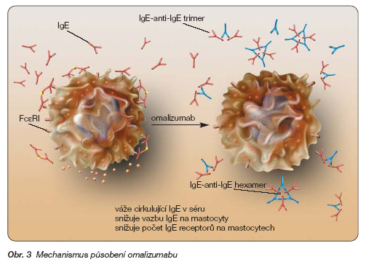
Anti-IgE
omalizumab
http://www.remedia.cz/Okruhy-temat/Respiracni-onemocneni/Omalizumab-terapeuticka-perspektiva-v-lecbe-tezkeho-bronchialniho-astmatu/8-1o-gD.magarticle.aspx

Slide 32
Monoclonal antibodies
Anti-IL-5
mepolizumab, reslizumab
add-on treatment for severe refractory eosinophilic asthma in adult patients

Slide 33
Other options
Bronchial thermoplasty
bronchoskopic procedure, during which a therapeutic radiofrequency energy is delivered to the airway wall, resulting in reduction of smooth mucle cells
Allergen immunotherapy
induces tolerance to the triggering allergen

Slide 34
Devices for inhaled medications
MDI = metered dose inhalers
  drugs as solutions, propellants
BAI = breath-actuated inhalers
DPI = dry powder inhalers
  spinhaler, diskhaler, turbohaler
nebulizers (liquid → aerosol)

Slide 35
Devices for inhaled medications
spacers for children and elderly
patient must be educated how to use their inhaler
→ up to 41 % of patients use incorrect technique
inhalers often combine two drugs (bronchodilator + glucocorticoid or two bronchodilators)
(„fixed combination“), SABA/LABA + LAMA called „dual combination“

Slide 36
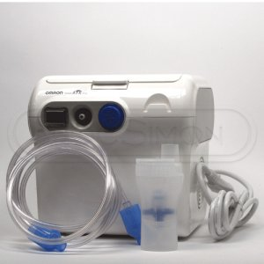
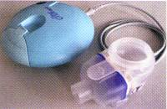
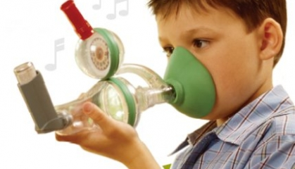

Slide 37
Adjuvant medication in diseases characterized
by bronchial obstruction and
another drugs affecting respiratory system
antitussives
drugs facilitating expectoration
H₁ antihistamines (mainly II. a III. generation)

