Slide 1

Antidepressants

Slide 2
Depression
the most common affective disorder
pesimistic mood with feelings of dejection, low self-worth or guilt for at least two weeks
different grades of severity
world-wide one of the most common causes of premature death
emotional and biological symptoms

Slide 3
Depression
loss of interest, happiness and motivation
loss of self-confidence, remorse, feeling of guilt
suicidal tendencies (in 2/3 patients)
loss of energy and tiredness
attention deficit, indecision
agitation (if anxiety is present)
sleep disorder (characteristic is early wake-up)
change in appetite
decrease of libido
the most common affective disorder
pesimistic mood with feelings of dejection, low self-worth or guilt for at least two weeks
different grades of severity
world-wide one of the most common causes of premature death
emotional and biological symptoms

Slide 4
Depression
https://www.youtube.com/watch?v=wCd6LPzWscc
https://www.youtube.com/watch?v=2VRRx7Mtep8

Slide 5
Monoamine theory of depression
depression = monoamine deficit in particular parts of the brain
mania = hyperactivity of monoamines in the CNS
clinical evidence – substances decreasing monoamine activity = mood aggravation
the specific roles of 5-HT and NA are not clear
antidepressants directly or indirectly increase the monoamine activity

Slide 6
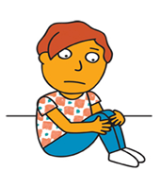

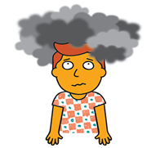
Depression
Mild depression
  lost of interest and enjoyment in usual activities, patient are able to perform usual daily activities/duties
  outpatient treatment
Moderate depression
  deep sadness, unability to work, loss of enjoy
  outpatient/inpatient treatment
Severe depression
  severe inhibition, person také can care about him/herself, general „slowlness“, just lying surrounded by his/her dark thoughts...
  inpatient treatment

Slide 7
Depression
Goldberg Depression Questionnaire
https://www.gracepointwellness.org/5-depression-depression-related-conditions/article/973-goldberg-depression-questionnaire

Slide 8
Other possible factors:
Brain neuroplasticity deficit in depression
HPA axis activation in depression

Slide 9
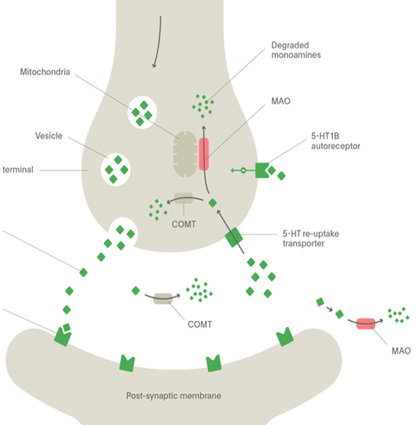
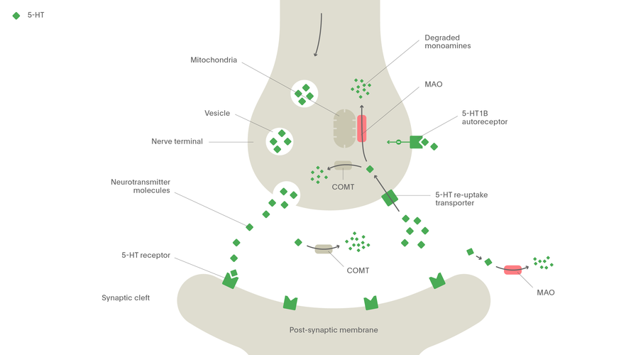
Mode of action of antidepressants
iMAO
MAO
SMS
MAO
5HT - AUTORECEPTOR
TCA
α2- AUTORECEPTOR
SNRI
NARI
Noradrenaline
Serotonin
NET
SERT
SSRI
SARI
MAO
5-HT1A
MAO
α1
β3
5-HT2A
5-HT2C
NASSA

Slide 10
Mode of action of antidepressants
most AD increase 5-HT, NA or D activity
General modes of action of antidepressants:
MAO inhibition (selective MAO A/ nonselective)
reuptake inhibition (SERT, NAT)
desensitisation/antagonism of presynpatic
autoreceptors (5-HT_{1D}, α₂)
agonism on receptors 5-HT_{1A}
antagonism on receptors 5-HT_{2A}
increase of
5-HT and/or NA
increased BDNF
activity

Slide 11
Efficacy of antidepressants
in general partial response or remission in 60-70% of patients
„only 30 %“ in the first line of antidepressant treatment
significant interindividual differences in treatment response
the efficacy of distinct groups of AD is equipotential
= criterions of AD selection
1. depression side symptoms (agitation, anxiety, insomnia)
2. decrease of adverse reactions risk

Slide 12
SSRI – selective serotonin reuptake inhibitors
inhibit also NAT, but more selective for SERT
PK and PD differences between single agents = one SSRI can be replaced by other in case of therapy failure
drugs of choice in most patients
great safety profile – but not tolerability
↑ risk of suicide in tennagers
risk of drug-drug interactions (iCYP 2D6 and 3A4 inhibitors)
I: depression, anxiety, OCD, PTSD, migraine, pain

Slide 13
SSRI
AE
GIT irritation
↑ bleeding, sex. dysfunction, anhedonia
Serotonin syndrome
induced by hyperactivity of serotonine in the CNS
high risk in combinations of serotonergic drugs (AD, triptans, opioids)
Antidepressant discontinuation syndrome - FINISH

Slide 14
SSRI
fluoxetine
5-HT_{2A}antagonist, CYP2D6 strong inhibitor
sertraline
- the strongest SERT inhibitor
- weak DAT inhibitor, anxiolytic activity
paroxetine
- weak antimuscarinic effect = sedative; CYP2D6 strong inhibitor
citalopram
- the lowest risk of drug-drug interactions

Slide 15
SNRI – serotonin and noradrenaline reuptake inhibitors
MofA – nonselective blockade of 5-HT and NA
„activating“ drugs
AE
stimulation of adrenergic receptors = insomnia, sex. impairment, ↓ apetite, hypertension
increased risk of suicide, discontinuation sydrome
venlafaxine + desvenlafaxine
duloxetine – also for neuropathic pain, hepatotoxic

Slide 16
NDRI – noradrenaline and dopamine reuptake inhibitors
bupropion
little effect on 5-HT
in comparison to other DAT and NAT inhibitors does not cause euphoria
in the treatment of smoking cessation
AE
risk of seizures
aggravation/development of psychotic signs

Slide 17
NARI – noradrenaline reuptake inhibitor
reboxetine
MofA – blockade of NAT: SERT = 20:1
M, H1 and α₁ antagonist
AE
stimulation of adrenergic receptros = insomnia, restlessness, anxiety
constipation, sex. dysfunction
atomoxetine –ADHD therapy

Slide 18
SARI – serotonine antagonist and reuptake inhibitor
trazodone
MofA
SERT inhibition
5-HT_{1A} agonism
5-HT_{2A} and _{2C} antagonis
H₁ and α₁antagonismus
AE: hypotension, sleepiness
CYP2D6 substrate, 3A4 inhibitor

Slide 19
NASSA – noradrenergic and specific serotonergic antidepressants
mirtazapine
is not reuptake inhibitor
α₂ antagonist
5-HT2A, 5-HT2C and 5-HT3 antagonist
H1 and weak α1 antagonist
increased apetite and weight gain
suitable in depression with sleep disorder, low risk of sex. impairment

Slide 20
SMS – serotonin modulator and stimulator
vortioxetine
MofA: inhibice SERT
5-HT_{1A}agonism
5-HT_{1D}, 5-HT₃ antagonism
AE: pruritus, nausea, live dreams
risk of serotonine syndrome
CYP2D6 substrate

Slide 21
MASSA-melatonine agonist and serotonin selective antagonist
MofA: MT₁ and MT₂ agonist
5- HT_{2C} antagonist
increased melatonin release and resynchronizes circadian rhythm
CYP1A2 substrate
risk of hepatotoxicity = monitoring of transaminases
in single dose when going to bed

Slide 22
TCA
MofA: 5-HT, NA and D reuptake inhibition
+ 5-HT2A antagonism and 5-HT1A agonism
+ antagonism of H₁, M, α₁ and 5-HT_{2C} => AE
serotonergic adrenergic
clomipramine imipramine, desipramine amitriptyline, nortriptyline

Slide 23
TCA
AE:
antiM – confusion, cognitive deficit, peripheral effects
antiH₁ – sedation, weight gain
antiα₁ – ortostatic hypotension
anti 5HT_{2C} - weight gain
proarrhythmogenic
significant acute toxicity
initial dose usualy titrated

Slide 24
TCA
liver metabolism - CYP2D6 and 3A4
plasma protein binding
long t_{1/2} = risk of drug accummulation
„older“ drugs, still in use
I: resistant depression
co-analgesics

Slide 25
iMAO
ireversible inhibitors today obsolete
reversible selective iMAO A – moclobemide
the strongest effect on 5-HT > NA > D
„cheese reaction“
positive effect on cognition
inhibitor of CYP2D6, 2C19 and 1A2
AE: hypotension, CNS stimulation, weight gain

Slide 26
Esketamine
NMDA antagonist
intranasally, supervision needed
in combination with SSRI or SNRI in resistant depression
blood pressure monitoring necessary
fast onset of action
AE: dissociation incl. hallucinations, sedation, somnolence, BP changes

Slide 27
Side effects of antidepressant therapy
Nonselective serotonergic activity (SSRI, iMAO, TCA, SNRI)
+ anxiolytic and antidepressant activity
- sex. impairment, emotional flatness, serotonin syndrome
Nonselective noradrenergic activity (TCA, NARI)
+ „activation“ of patient, antidepressant activity
- tremor, tachycardia, hypertension

Slide 28
Side effects of antidepressant therapy
Antihistaminergic activity = sedation, weight gain
α₁lytic activity = ortostatic hypotension and risk of falls
Antimuscarinic activity = cognitive deficit and peripheral effects
QT interval prolongation
SSRI, TCA

Slide 29
activating x sedative AD
fluoxetine
nortriptyline
venlafaxine
trazodone
mirtazapine
agomelatine
paroxetine, fluvoxamine, citalopram
dosulepine, maprotiline

Slide 30
How long should be antidepressant treatment continued?
Pharmacotherapy shouldbe continued:
  after 1st episode min. 6 -12 months
  after 2nd episode 2 years
  after 3rd episode 5 years
  after 4th episode lifelong treatment
the efficacy could be evaluated after 4-6 weeks
the first step is the dose increase

Slide 31
Antidepressant discontinuation
after remission is reached and maintained for specific time
if discontinued to soon = high risk of relapse
in some risk of discontinuation syndrome (venlafaxin, paroxetin)
Antidepressant substitution
some AD has long elimination halftime = „wash out“ period (moclobemide, imipramine, clomipramine and fluoxetine)
gradual dose decrease and titration of new AD

Slide 32
Augmentation of antidepressant therapy
Antipsychotics
separately or in combination with antidepressants
in depression with psychotic symptoms, and in prophylaxis
atypical antipsychotics
Anxiolytics
in the begining of therapy of depression with significant anxiety component to decrease the risk of suicide
Phytopharmacology

Slide 33
Nonpharmacologigal antidepressive measures
psychotherapy
physical exercise
phototherapy
rTMS (transcranial magnetic stimulation)
ECT

