Slide 1


Drug addiction to the individual substances
Department of Pharmacology FM MU

Slide 2
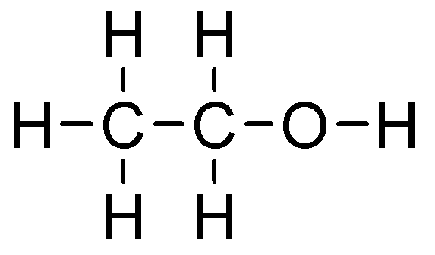

Alcohol
syn. ethanol, ethyl alcohol,
spirit

Slide 3
Alcohol
- is an intoxicating ingredient found in beer, wine, and liquor
- is produced by the fermentation of yeast, sugars, and starches
it passes directly from the digestive tract into the blood vessels.
In minutes, the blood transports the alcohol to all parts of the body, including the brain.
Short-term effects of alcohol consumption
improved mood
memory, and insight are impaired.
impairment of judgment, emotional control, and motor coordination
respiratory depression and death can result from overdose
most serious consequences occur when alcohol is combined with other psychoactive agents

Slide 4
Alcohol
Long-term effects of alcohol misuse:
Brain:
Memory loss, blackouts, and exaggerated states of emotion
Problems with coordination and muscle movement
Depressed nerve centers in hypothalamus that control sexual arousal and performance
Korsakoff’s psychosis (persistent learning and memory problems)
Learning difficulties
Slowing of neurogenesis, of the growth of new brain cells
Sleep impairment, as alcohol decreases REM sleep and sleep apnea
Peripheral neuropathy, leading to a loss of sensation

Slide 5
Alcohol
Long-term effects of alcohol misuse:
Esophagus:
Increased risk of cancer in esophagus, larynx, and mouth
Vomiting from excessive drinking can tear the esophagus
Pancreas:
Reduced amount of digestive enzymes secreted by the pancreas, which inflames and leaks
digestive enzymes that attack the pancreas
Liver:
Liver failure, fat accumulation in liver cells, hepatitis
Cirrhosis
Hepatic encephalopathy, a serious brain disorder that can cause changes in sleep patterns,
mood, personality, shortened attention span, anxiety and depression, and problems with
coordination such as shaking or flapping hands (called asterixis).

Slide 6
Alcohol
Long-term effects of alcohol misuse:
Stomach:
Ulcers
Gastritis (inflammation of stomach lining)
Acid reflux
Intestinal bleeding
Risk of stomach cancer
Diarrhea and vomiting
Hypoglycemia
Calories in alcohol make chronic drinkers less hungry, leading to malnutrition

Slide 7
Alcohol
Long-term effects of alcohol misuse:
Reproductive system:
Decreased sperm production and testosterone in men due to decreased sex hormone secretion
Decreased estrogen metabolism in the liver, which boosts estrogen levels and can contribute to menstrual irregularities and infertility
Kidneys:
Kidney failure, which affects regulation of fluids and electrolytes in body
Heart:
Heart disease and heart attack
High blood pressure
Irregular or rapid heartbeat
Coronary artery disease

Slide 8
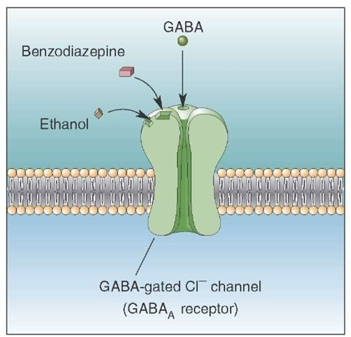
Alcohol – mechanism of action
Two specific neurochemical systems in the brain are implicated in mediating alcohol intoxication:
gamma aminobutyric acid (GABA) and its receptor (GABA_{A})
2) glutamate and N-methyl-D-aspartic acid receptor (NMDA).
GABA: the major inhibitory neurotransmitter in the brain
When these receptors are activated by their specific
neurotransmitter, cellular activity changes.
E.g. BZD (which share many behavioural properties with
alcohol), enhance chloride ion transport through the
GABA_{A} receptor, causing a decrease in neuronal activity
Drugs that mimic the effects of GABA enhance and
prolong the behavioral effects of alcohol

Slide 9
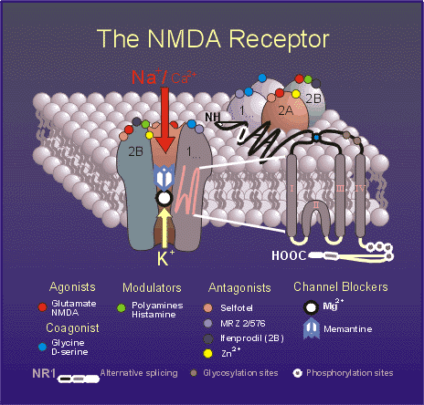
Alcohol – mechanism of action
Glutamate: the major excitatory neurotransmitter in the brain, is also believed to play an important role in alcohol intoxication and behaviour
Alcohol antagonizes NMDA-induced behavioral responses
Inhibition of NMDA receptors is an important mechanism by which acute alcohol consumption affects brain function and behaviour

Slide 10
Alcohol – mechanism of action - summary
Alcohol mimics effects of GABA in the brain, binding to GABA_{A} receptors
and inhibiting neuronal signaling.
Alcohol is a positive allosteric modulator of GABA_{A} receptors. It increases chloride conductance through GABA_{A} receptors, resulting in cellular hyperpolarization.
Alcohol inhibits the major excitatory neurotransmitter, glutamate, particularly
at the NMDA receptor.
It decreases calcium conductance through NMDA receptors, further decreasing cellular excitation.
These dual actions on GABA_{A} and NMDA
receptors contribute to alcohol’s anxiolytic, sedative, and CNS-depressant effects
It also releases other inhibitors, such as dopamine and serotonin by a process that is still poorly
understood but that appears to involve curtailing the activity of the enzyme that breaks
dopamine down.

Slide 11
Alcohol
Withdrawal symptoms
may appear anywhere from six hours to a few days after your last drink.
These usually include at least two of the following:
tremors
anxiety
nausea and/or vomiting
headache
increased heart rate
sweating
irritability
confusion, insomnia, nightmares

Slide 12
Alcohol
Withdrawal symptoms
Symptoms may worsen over two to three days and persist for weeks
They may be more noticeable when you wake up with less alcohol in your blood
The most severe type of withdrawal syndrome is known as delirium tremens
Its symptoms include:
extreme confusion and agitation
fever
seizures
tactile hallucinations (e.g., itching, burning, and numbness)
auditory hallucinations (e.g., hearing non-existent sounds)
visual hallucinations (e.g., seeing non-existent images)

Slide 13
Alcohol
Pharmacologic Treatment of Addiction
Dominative psychotherapy
+
Supportive pharmacotherapy
Achievement and maintenance
of total abstinence:
DISULFIRAM
ACAMPROSATE
NALTREXONE (NALOXONE)
Decrease in risk consumption:
NALMEFENE

Slide 14
Alcohol
Pharmacologic Treatment of Addiction
DISULFIRAM: irreversibly inhibits acetaldehyde dehydrogenase.
Intake of ethanol during disulfiram therapy will lead to accumulation of acetaldehyde,
which is considered the main contributing factor to the disulfiram-alcohol reaction
The disulfiram- alcohol reaction is characterised by:
• Intense vasodilation of the face and neck causing flushing, increased body temperature,
sweating, nausea, vomiting, pruritis, urticaria, anxiety, dizziness, headache,
blurred vision, dyspnoea, palpitations and hyperventilation.

Slide 15
Alcohol
Pharmacologic Treatment of Addiction
ACAMPROSATE: has a chemical structure similar to that of amino acid neuromediators,
such as gamma-amino-butyric acid (GABA)
Acamprosate may act by stimulating GABAergic inhibitory neurotransmission and
antagonising excitatory amino-acids, particularly glutamate.
It stabilizes the chemical balance in the brain that would otherwise be disrupted by alcoholism, i.e.
it helps to maintain abstinence, decreases craving

Slide 16
Alcohol
Pharmacologic Treatment of Addiction
NALTREXONE: opioid antagonist (all opioid receptors).
It reduces alcohol consumption (decreasing „reward“ effect).
The mechanism of action of naltrexone in alcoholism is not completely elucidated,
however an interaction with the endogenous opioid system is suspected
to play an important role.
Alcohol consumption in humans has been hypothesized to be reinforcing through an
alcohol-induced stimulation of the endogenous opioid system.
Hepatic side effects have included hepatocellular injury, hepatitis, and elevated liver
transaminases and bilirubin.

Slide 17
Alcohol
Pharmacologic Treatment of Addiction
NALMEFENE: modulator of the endogenic opioid system acting as competitive
antagonist at μ a δ receptors and partial agonist at κ receptors with predominant
affinity to the μ and κ receptors.
It has similar structure and mechanism to naltrexone. However, it shows better bioavailability
after p.o. administration, longer half time of elimination and no hepatic adverse effects.
Nalmefene reduces alcohol consumption, possibly by modulating cortico-mesolimbic functions
(there is close association between mesolimbic µ- and δ-opioid receptor activation
and dopamine release in nuccleus accumbens) .

Slide 18
Alcohol
Pharmacologic Treatment of Addiction
Clonidine:
α₂ sympatomimetic drug with central effect.
Clonidine is a drug used to lower blood pressure.
Clonidine is now sometimes used in the treatment of alcohol withdrawals.
It is believed to help reduce a number of associated symptoms including:
Tremor
Elevated blood pressure
Anxiety
Tension
Sweating

Slide 19
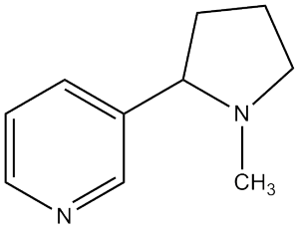
Nicotine

Slide 20
Nicotine
Pharmacokinetics and metabolism:
Nicotine is a weak base (pKa = 8.0).
Absorption through mucous membranes depends on pH.
Chewing tobacco, snuff, and nicotine gum are buffered with an alkaline pH to facilitate
absorption through buccal mucosa.
Smoking is a highly efficient form of drug administration, as the drug enters the circulation rapidly
through the lungs and moves into the brain within seconds.
Inhaled drugs escape first-pass intestinal and hepatic metabolism.
The more rapid the rate of absorption and entry of a drug into the brain, the greater the rush, and
the more reinforcing the drug.
Smoking produces high concentrations of a drug in the brain that are comparable to those seen
after intravenous administration.
Nicotine is rapidly and extensively metabolized by the liver, primarily by the liver enzyme CYP2A6.

Slide 21
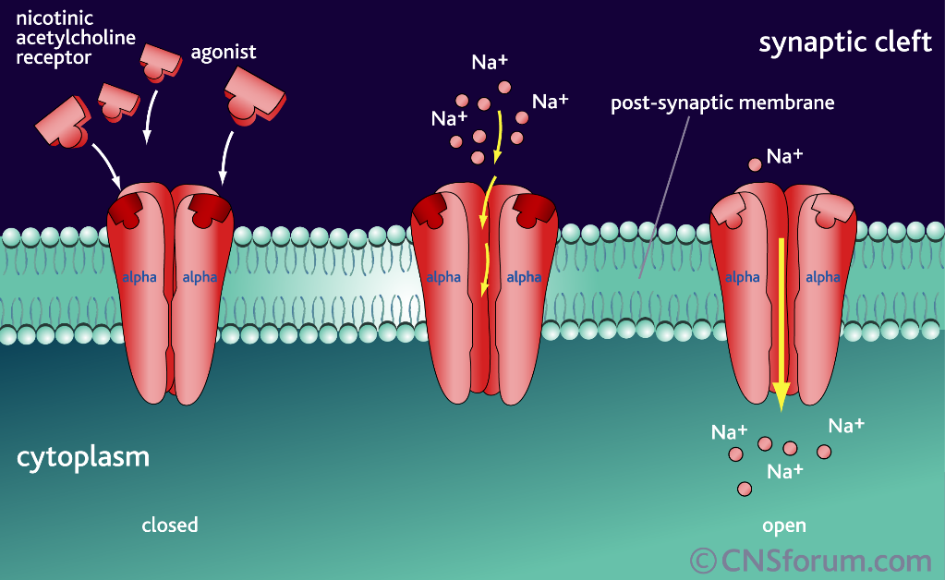
Nicotine – mechanism of action
When a person inhales smoke from a cigarette, nicotine is distilled from the tobacco and is
carried in smoke particles into the lungs, where it is absorbed rapidly into the pulmonary venous
circulation.
It then enters the arterial circulation and moves quickly to the brain.
Nicotine diffuses readily into brain tissue, where it binds to nAChRs, which are ligand-gated ion
channels.
When a cholinergic agonist binds to the outside of the channel, the channel opens,
allowing the entry of cations, including sodium and calcium.

Slide 22
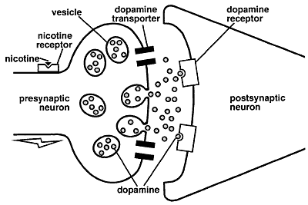
Nicotine
Nicotine binds to specific receptors on the presynaptic neuron.
When nicotine binds to receptors at the cell body, it excites the neuron so that it fires
more action potentials that move toward the synapse, causing more dopamine release.
When nicotine binds to nicotine receptors at the nerve terminal, the amount of dopamine
released in response to an action potential is increased.

Slide 23
Nicotine
Most of the nicotine-mediated release of neurotransmitters occurs via modulation by
presynaptic nAChRs.
Chronic cigarette smoking reduces brain monoamine oxidase A and B activity: increase in dopamine and norepinephrine in synapses, thus augmenting the effects of nicotine and contributing to addiction.
Dopamine release signals a pleasurable experience, and is critical to the reinforcing effects of
nicotine and other drugs of abuse.
Chemically or anatomically lesioning dopamine neurons in the brain prevents nicotine
self-administration in rats.

Slide 24
Nicotine
Effects:
Nicotine from tobacco induces stimulation and pleasure, reduces stress and anxiety.
Smokers come to use nicotine to modulate their level of arousal and for mood control
in daily life.
Smoking may improve concentration, reaction time, and performance of certain tasks.
Nicotine releases catecholamines, increases heart rate and
cardiac contractility, constricts cutaneous and coronary blood vessels, and transiently increases
blood pressure.

Slide 25
Nicotine
Withdrawal symptoms
These include:
irritability
depressed mood
restlessness
anxiety
problems getting along with friends and family
difficulty concentrating
increased hunger and eating
insomnia
craving for tobacco

Slide 26
Nicotine
Withdrawal symptoms
Mood disturbances comparable in intensity to those seen in psychiatric outpatients.
Hedonic dysregulation, the feeling that there is little pleasure in life and that activities that were
once rewarding are no longer enjoyable.
Relative deficiency in dopamine release following long-standing
nicotine exposure accounts for many of the mood disorders and the anhedonia, as well as the
tobacco craving, that may persist in smokers for a long time after they have quit.

Slide 27
Nicotine
Pharmacologic Treatment of Addiction
Nicotine Replacement Therapy
Nicotine medications act on nAChRs to mimic or replace the effects of nicotine from tobacco.
Nicotine replacement medications are believed to facilitate smoking cessation in several ways.
1) relief of withdrawal symptoms when a person stops tobacco use. Amelioration of these symptoms is observed with relatively low blood levels of nicotine.
positive reinforcement, particularly for the arousal and stress relieving effects – it is most relevant to rapid-delivery formulations such as nicotine nasal spray (to a lesser extent, nicotine gum, inhaler, and lozenge).
The use of these products allows smokers to dose themselves with nicotine when they have the urge to smoke cigarettes.

Slide 28
Nicotine
Pharmacologic Treatment of Addiction
Nicotine Replacement Therapy
3) the last mechanism of benefit is related to the ability of nicotine medications to
desensitize nicotinic receptors.
This desensitization results in a reduced effect of nicotine from cigarettes (when a person lapses to smoking while on nicotine replacement therapy, the
cigarette is less satisfying and the person is less likely to resume smoking).

Slide 29
Nicotine
Pharmacologic Treatment of Addiction
Bupropion (Norepinephrine Dopamine Reuptake Inhibitor)
Bupropion was marketed as an antidepressant medication before it was marketed for smoking
cessation.
The serendipitous observation of spontaneous smoking cessation among veterans
treated with bupropion for depression led to the exploration of bupropion as a smoking
cessation medication.
Bupropion increases brain levels of dopamine and norepinephrine, simulating the effects of nicotine on these neurotransmitters.
Bupropion also has some nicotine receptor–blocking activity, which could contribute to reduced reinforcement from a cigarette in the case of a lapse.

Slide 30
Nicotine
Pharmacologic Treatment of Addiction
Varenicline
Varenicline was synthesized with the goal of developing a specific antagonist for the α4 β2
nAChR.
Varenicline was shown in vitro receptor binding studies to have high affinity
for the α4 β2 nAChR, and relatively little effect on other nAChR subtypes or neurotransmitter
receptors.

Slide 31
Nicotine
Pharmacologic Treatment of Addiction
Varenicline
Varenicline is a partial agonist of the α4 β2 receptor.
Nicotine, a full agonist, causes substantial dopamine release. Varenicline produces less of a response than nicotine (~50%) but at the same time blocks the effects of any
nicotine added to the system.
Clinical trials have found that varenicline is superior to bupropion in promoting smoking cessation, and prolonged administration of varenicline has been shown
to reduce relapse in smokers who were abstinent 12 weeks after initial therapy.

Slide 32
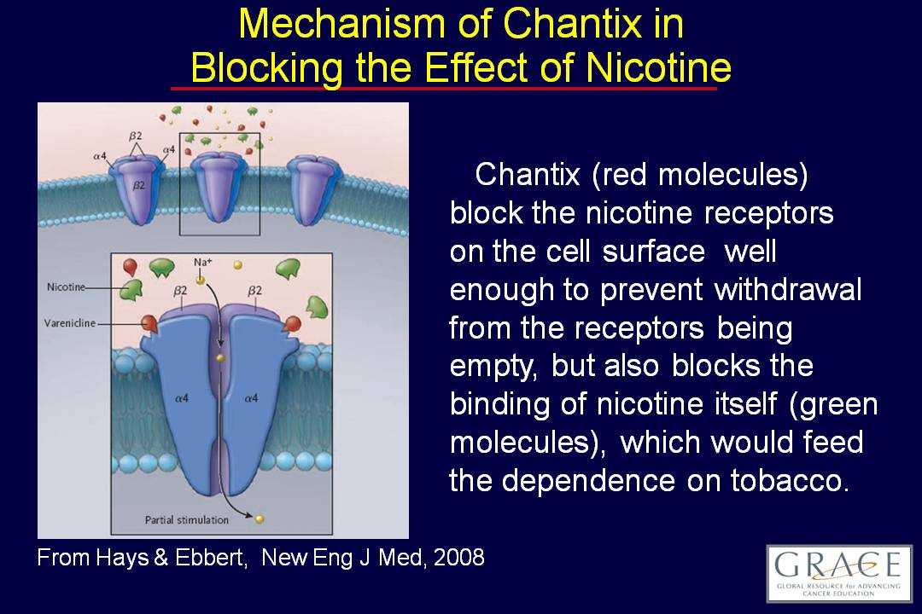

Slide 33
Nicotine
Pharmacologic Treatment of Addiction
Clonidine:
α₂ sympatomimetic drug with central effect.
Clonidine is a drug used to lower blood pressure.
Some studies have reported amelioration of craving, anxiety, restlessness, tension and hunger
by clonidine therapy.
Clonidine is probably as effective as bupropion, however with more adverse effects:
dry mouth, sedation, dizziness, postural hypotension.
Nortriptyline:
tricyclic antidepressant drug – inhibition of norepinephrine and serotonin reuptake.
Noradrenergic effects probably alleviate withdrawal symptoms.
Other useful effects – anxiolytic.

Slide 34
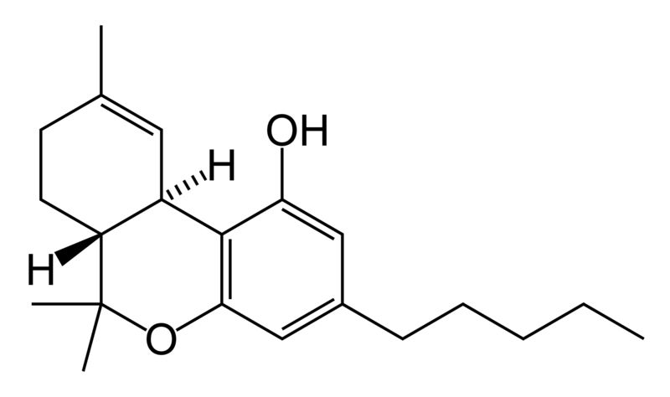
Cannabinoids
(hemp drugs)
THC

Slide 35
Cannabinoids
Phytocannabinoids
Endogenous cannabinoids (endocannabinoids)
Synthetic cannabinoids

Slide 36
MECHANISM OF ACTION
Endocannabinoid system
Cannabinoid receptors (CB₁, CB₂)
Endocannabinoids
Decomposing enzymes

Slide 37
Endocannabinoid system
Cannabinoid receptors (CB₁, CB₂)
Subtypes of cannabinoid CB receptors: CB₁ a CB₂ (Howlett a kol., 2002).
CB₁ receptors: nerve endings particularly in CNS (cortex, hippocampus, basal ganglia,
hypothalamus, cerebellum, spinal cord)
CB₂ receptors: mainly in peripheral tissues (testicles, sperm, cells of immune system).
Psychoactive effects: CB₁ receptors

Slide 38
Endocannabinoid system
Endocannabinoids
anandamide (N-arachidonoylethanolamine)
noladin ether (2-arachidonyl glyceryl ether)
virodhamine (O-arachidonoylethanolamine)
N-arachidonoyldopamine
Decomposing enzymes
fatty acid amide hydrolase (FAAH)
monoacylglycerol lipase (MGL)

Slide 39
Physiologic functions of endocannabinoid system are very complex.
They involve:
motor coordination
memory
appetite
modulation of pain
neuroprotective effects
homeostasis maintenance (Pacher et al., 2006).

Slide 40
Cannabinoids
IMPAIRMENT OF:
Short-term memory
Co-ordination of movements
Learning
Problem solving
High concentrations of cannabinoid receptors: hippocampus, cerebellum, basal ganglia.
Hippocampus is important for short-term memory.
Cerebellum: short-term memory.
Basal ganglia: motor co-ordination.

Slide 41
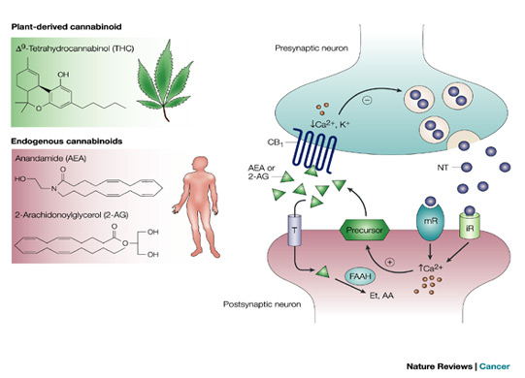
MECHANISM OF ACTION
Cannabinoids
Plant-derived cannabinoids such THC function in the body by activating specific
cannabinoid receptors that are normally engaged by a family of endocannabinoids
Exogenous administration of THC will displace bound endocannabinoids from the receptor and
furthermore, it will inhibit their production following long-term administration.
Cannabinoid CB₁ receptors are localized presynaptically.

Slide 42
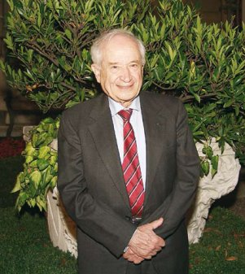
Cannabinoids
Tetrahydrocannabinol (THC)
Raphael Mechoulam
THC (1964)

Slide 43
Cannabinoids
Tetrahydrocannabinol (THC)
Hemp is the most widespread illegal drug from the point of view of production and commerce.
In EC: the most frequently used illegal drug.
The most significant use: age 5 – 24 years.
The most frequently abused forms of hemp drugs:
marijuana
hashish
hemp (hashish) oil.

Slide 44
Cannabinoids
Tetrahydrocannabinol (THC)
Effects:
may vary dramatically among different users
pleasant euphoria and sense of relaxation/anxiety, fear, distrust, or panic
heightened sensory perception (e.g., brighter colors)
laughter
altered perception of time
increased appetite.
People who have taken large doses of marijuana may experience an acute psychosis,
which includes hallucinations, delusions, and a loss of the sense of personal identity.

Slide 45
Cannabinoids
Tetrahydrocannabinol (THC)
Adverse Consequences of Marijuana Use:
Impaired short-term memory
Impaired attention, judgment, and other cognitive functions
Impaired coordination and balance
Increased heart rate
Anxiety, paranoia
Psychosis

Slide 46
Cannabinoids
Tetrahydrocannabinol (THC)
Persistent (lasting longer than intoxication, but may not be permanent):
Impaired learning and coordination
Sleep problems
Long-term (cumulative effects of repeated use):
Potential for addiction
Potential loss of IQ
Increased risk of chronic cough, bronchitis
Increased risk of schizophrenia in vulnerable people
Potentially increased risk of anxiety and depression

Slide 47
Cannabinoids
Tetrahydrocannabinol (THC)
Hemp drugs do not provoke physical (somatic) dependence.
Psychic dependence occurs in 8 – 10 % after long-term use.

Slide 48
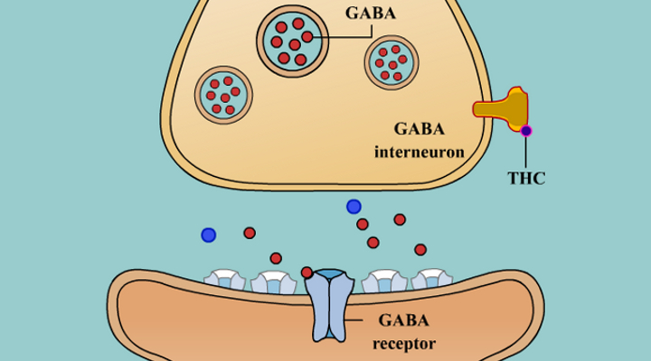
Cannabinoids
THC stimulates neurons in the reward system to release dopamine.
It inhibits release of GABA, it inhibits release of glutamate, it affects other neurotransmitters.
GABA normally acts to dampen the amount of dopamine released in the nucleus accumbens.
When GABA is blocked by THC, the result is an increase in the amount of dopamine released.
GABA is naturally also inhibited by endocannabinoids produced by the brain. They are believed
to play an essential role in the release of dopamine in day-to-day functions.

Slide 49
Withdrawal symptoms
The most common symptom: insomnia (from a few nights of practically no sleep at all, up to
a few months of occasional sleeplessness).
Other symptoms: depression
nightmares and vivid dreams
anger, fear or anxiety, loss of concentration
Physical symptoms: headaches
night sweats

Slide 50
Since March 4, 2013:
Legal possibility to use hemp for therapeutic purposes in the Czech Republic.
Only in pharmacies.
Rx.
Personal cultivation and utilization of hemp for
therapeutic purposes is prohibited by law.

Slide 51
Cannabinoids
Pharmacologic Treatment of Addiction
Currently, no medications are indicated for the treatment of marijuana use disorder, but research
is active in this area.
Because sleep problems feature prominently in marijuana withdrawal,
some studies are examining the effectiveness of medications that aid in sleep.
Medications that have shown promise in early studies or small clinical trials include the sleep
aid: zolpidem
anti-anxiety/anti-stress medication: buspirone
anti-epileptic drug: gabapentin (that may improve sleep).

Slide 52
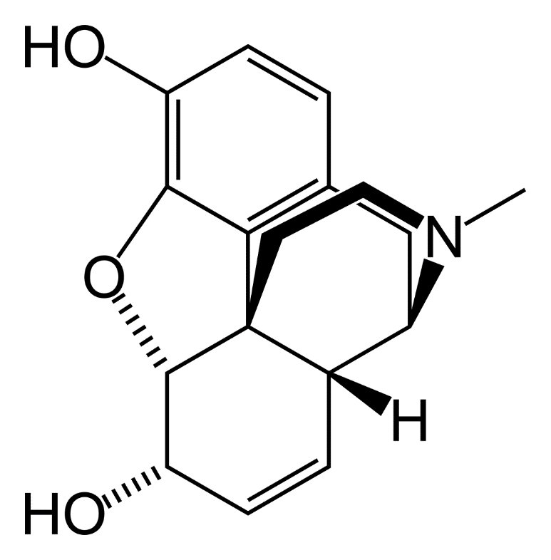
Opioids
morphine

Slide 53
Opioids
VENTRAL TEGMENTUM
NUCLEUS ACCUMBENS
alcohol
opioids
alcohol
alcohol
DA: dopamine
GABA: GABA-ergic interneuron
Glu: glutamate
∪: opiod receptor
Addictive substances activate dopaminergic pathway: ventral tegmentum – nucleus accumbens.
Opioids act indirectly – they inhibit GABA-ergic interneurons in ventral tegmentum, which suppresses they inhibitory effect on dopaminergic neurons, that are disinhibited.

Slide 54
Opioids
VENTRA TEGMENTUM
NUCLEUS ACCUMBENS
alcohol
opioids
alcohol
alcohol
DA: dopamine
GABA: GABA-ergic interneuron
Glu: glutamate
∪: opiod receptor
However, opioids can act also directly – they bind to opioid receptors in nucleus accumbens.

Slide 55
Opioids
Opium
Globally, opium has gradually been superseded by a variety of purified, semi-synthetic,
and synthetic opioids with progressively stronger effects.
This process began in 1804, when Friedrich Wilhelm Adam Sertürner first isolated morphine
from the opium poppy.
The process continued until 1817, when Sertürner published the isolation of
pure morphine from opium.
Morphine represent 10 % of raw opium. It is 10x stronger

Slide 56
Opioids
Morphine
Natural source: opium.
Use: analgesic drug.
Massive use during wars.
Strong addictive potential (smaller than heroin).
Frequently abused by medical staff.
Not very common as street drug.

Slide 57
Opioids
Morphine
Effects:
may vary dramatically among different users
Respiratory center depression. High doses: respiratory arrest.
After i.v. administration: calm euphoria.
Increased self-confidence.

Slide 58
MECHANISM OF ACTION
Opioids
Morphine
Opiod receptors: µ, κ, δ in CNS.
Neurons form other receptors, thereby increasing sensitivity.
Increasing tolerance: excessive reaction of neurons following abrupt cessation.
Fast dependence development
(physic and psychic).

Slide 59
Opioids
Fentanyl
Synthetic opioid – therapy of acute and chronic pain, general anesthesia
i.v., transdermal patches
USA: abused particularly by medical staff.

Slide 60
Opioids
Heroin
Synthetized in 1874.
Chemically: diacetylmorphine
Orall administration: extensive first-pass effect.
Injections: it avoids this first-pass effect, very rapidly crossing
the BBB (higher fat solubility than morphine).
Once in the brain, it then is changed to morphine, which bind to opioid receptors.
Administered i.v., heroin is two to four times more potent than morphine and is faster
in its onset of action „rush or flash„. .

Slide 61
Opioids
Heroin
In 1895, the German drug company Bayer marketed diacetylmorphine as an OTC drug
under the trademark name Heroin.
The name was derived from the Greek word heros because of its perceived
"heroic" effects upon a user.
It was developed chiefly as a morphine substitute for cough suppressants
that did not have morphine's addictive side-effects.

Slide 62
Opioids
Heroin
Routes of application:
Orally (first-pass effect)
Injections (risk of infections)
Smoking
Insufflation
Suppositories (limited way)

Slide 63
Opioids
Heroin
Initial effects:
Feeling a surge of pleasurable sensation—a “rush.”
The rush is usually accompanied by:
a warm flushing of the skin
dry mouth
heavy feeling in the extremities
(at beginning) nausea, vomiting, and severe itching.
After the initial effects:
Drowsiness for several hours; clouded mental function
slower heart function
severely slower breathing (enough to be life-threatening)

Slide 64
Opioids
Heroin
Long-term effects:
Repeated heroin use changes the physical structure and physiology of the brain, creating long-term imbalances in neuronal and hormonal systems that are not easily reversed.
Impairment of: decision-making abilities
ability to regulate behavior
responses to stressful situations.
Constipation.
Heroin also produces profound degrees of tolerance and physical dependence.

Slide 65
Opioids
Withdrawal symptoms
Withdrawal may occur within a few hours after the last time the drug is taken.
Symptoms include:
restlessness
muscle and bone pain
insomnia
diarrhea
vomiting
cold flashes with goose bumps (“cold turkey”)
leg movements.

Slide 66
Opioids
Withdrawal symptoms
Major withdrawal symptoms peak between 24–48 hours after the last dose of heroin and
subside after about a week.
However, some people have shown persistent withdrawal signs for many months.
Heroin is extremely addictive no matter how it is administered, although
routes of administration that allow it to reach the brain the fastest (i.e., injection and smoking)
increase the risk of addiction.

Slide 67
Opioids
Pharmacologic Treatment of Addiction
Medications developed to treat opioid addiction work through the same opioid receptors as the
addictive drug, but are safer and less likely to produce the harmful behaviors that
characterize addiction.
Three types of medications include:
(1) agonists, which activate opioid receptors
(2) partial agonists, which also activate opioid receptors but produce a smaller response
(3) antagonists, which block the receptor and interfere with the rewarding effects of opioids.

Slide 68
Opioids
Pharmacologic Treatment of Addiction
Methadone (Dolophine® or Methadose®): slow-acting opioid agonist.
Oral application - it reaches the brain slowly, dampening the “high” that occurs with other routes of
administration. Methadone has been used since the
1960s.
Methadone is only available through approved
outpatient treatment programs, where it is dispensed to patients on a daily basis.

Slide 69
Opioids
Pharmacologic Treatment of Addiction
Buprenorphine (Subutex®):
partial agonist at μ-opioid receptors and κ receptor antagonist .
Buprenorphine relieves drug cravings
without producing the “high” or dangerous side effects of other opioids.
Suboxone® is a novel
formulation of buprenorphine that is taken orally or sublingually and contains naloxone
(an opioid antagonist) to prevent attempts to get high by injecting the medication. If an
addicted patient were to inject Suboxone, the naloxone would induce withdrawal symptoms,
which are averted when taken orally as prescribed.

Slide 70
Opioids
Pharmacologic Treatment of Addiction
Naltrexone (Depade® or Revia®): opioid antagonist.
Naltrexone blocks the action of opioids, is not addictive or sedating,
does not result in physical dependence; however, patients often
have trouble complying with the treatment, and this has limited its effectiveness.
An injectable
long-acting formulation of naltrexone (Vivitrol®) recently received FDA approval for treating
opioid addiction. Administered once a month, Vivitrol® may improve compliance by eliminating
the need for daily dosing.

Slide 71
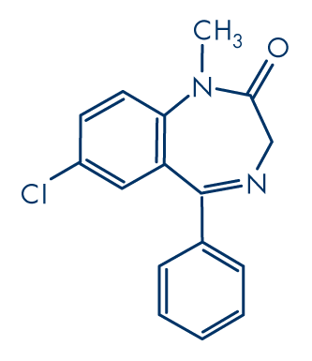
Benzodiazepines
diazepam

Slide 72
Benzodiazepines (BZD)
Frequently used and abused psychotropic drugs.
Often prescribed as anxiolytics, sedatives and hypnotics.
Mostly abused in combination with other substances (alcohol, heroin).

Slide 73
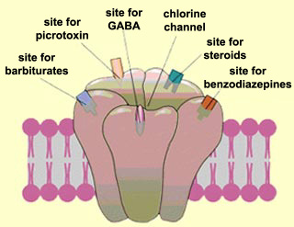
MECHANISM OF ACTION
Benzodiazepines (BZD)
GABA_{A} receptors in the brain
BZD enhance responses to the inhibitory neurotransmitter GABA by opening GABA-activated
chloride channels and allowing chloride ions to enter the neuron.
This action allows the neuron to become negatively charged and resistant to excitation,
which leads to the various anti-anxiety, sedative, or anti-seizure activity.

Slide 74
Benzodiazepines (BZD)
Effects:
Sedative-hypnotics for sleep
Adjuncts to anesthesia to induce relaxation and amnesia (procedural memory loss)
To reduce anxiety (anxiolytic)
Panic disorders
To treat or prevent seizures
Muscle relaxant

Slide 75
Benzodiazepines (BZD)
Effects:
Cognitive losses
Short-term memory impairment
Confusion
Increased risk of developing dementia

Slide 76
Benzodiazepines (BZD)
Withdrawal symptoms
Dizziness
Difficulty with concentration
Confusion and cognitive difficulty
Memory problems
Blurred vision or nystagmus
Agitation
Low blood pressure
Respiratory depression
Coma

Slide 77
Benzodiazepines (BZD)
Withdrawal symptoms
BZD withdrawal can be severe and can provoke life-threatening
withdrawal symptoms, such as seizures, particularly with abrupt or overly-rapid dosage
reduction from high doses or long time users.
Ten to 15 % of people withdrawing from BZD, experience
a protracted withdrawal syndrome which can sometimes be severe.
Symptoms may include:
tinnitus, psychosis, cognitive deficits, insomnia, paraesthesia
(tingling and numbness), pain (usually in limbs and extremities), muscle pain,
weakness, tension, painful tremor, shaking attacks,
jerks, may occur even without a pre-existing history of these symptoms

Slide 78
Benzodiazepines (BZD)
Pharmacologic Treatment of Addiction
Flumazenil was found to be more effective than placebo in reducing feelings of hostility
and aggression in patients who had been free of benzodiazepines for 4–266 weeks.
This may suggest a role for flumazenil in treating protracted benzodiazepine withdrawal symptoms.

Slide 79
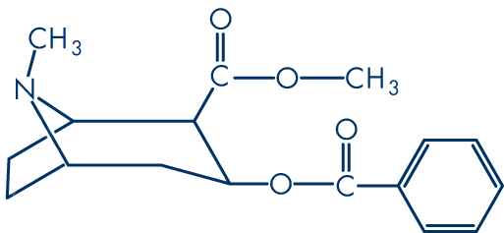
„Classical“
psychostimulants
cocaine

Slide 80
„Classical“ psychostimulants
Substances with stimulating effects on CNS
Cocaine
Cocaine is a powerfully addictive stimulant drug made from the leaves of the
coca plant (Erythroxolon coca) native to South America.
It produces short-term euphoria, energy, and talkativeness in addition to potentially dangerous
physical effects like raising heart rate and blood pressure.

Slide 81
„Classical“ psychostimulants
Cocaine
Routes of administration:
Orally (chewing coca leafs)
Nasal insufflation (so called snorting, sniffing or blowing)
Injection
Inhalation (cocaine is smoked by inhaling the vapor by sublimating solid cocaine by heating)
Suppository (limited way called "plugging“)

Slide 82
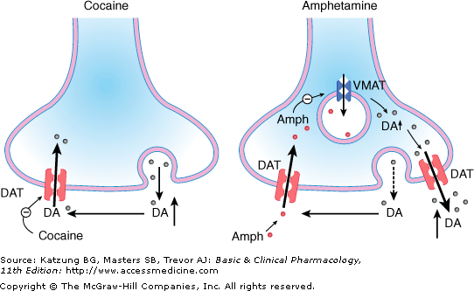
MECHANISM OF ACTION
„Classical“ psychostimulants
Cocaine
Cocaine inhibits dopamine transporter (DAT), thereby decreasing dopamine reuptake
→ increase in dopamine extracellular concentration.

Slide 83
„Classical“ psychostimulants
Cocaine
Short-term effects:
Short-term euphoria
Feelings of superiority
Talkativeness
Loss of appetite
Increased heart rate, blood pressure, body temperature
Contracted blood vessels
Increased rate of breathing
Disturbed sleep patterns
Hyperstimulation

Slide 84
„Classical“ psychostimulants
Cocaine
Long-term effects:
Disorientation, apathy, confused exhaustion
Irritability and mood disturbances
Increased frequency of risky behavior
Delirium or psychosis
Severe depression
High blood pressure, leading to heart attacks, strokes, and death
Destruction of tissues in nose if sniffed
Malnutrition, weight loss
Sexual problems

Slide 85
„Classical“ psychostimulants
Cocaine
Withdrawal symptoms
Symptoms generally last for about a week or two include:
Depression, anxiety
Sleep disturbances
Tremors and shakiness
Pain
Inability to feel pleasure
Exhaustion
Challenges in concentration
Intense craving → relapses

Slide 86
„Classical“ psychostimulants
Cocaine
Pharmacologic Treatment of Addiction
Presently, there are no proven medications to treat cocaine addiction.
Promising substance: Vigabatrin – originally for epileptic patients as an anti-convulsant medication.
It increases the amount of GABA in the brain (irreversible inhibition of transaminase)
GABA inhibits the production of dopamine and dopamine is the chemical
which cocaine use causes to wash over the brain creating the intense
pleasure that users are seeking.
A drug which can temper the effects of dopamine essentially reduces the
addictive effects of cocaine

Slide 87
„Classical“ psychostimulants
Cocaine
Pharmacologic Treatment of Addiction
Bromocriptine: agonist of dopamine D₂ receptors (used with mixed success).
Originally intended for treatment of Parkinson’s disease.

Slide 88
MECHANISM OF ACTION
„Classical“ psychostimulants
Amphetamine
Amphetamine is substrate for dopamine transporter (DAT) and inhibits dopamine (DA) transport.
Amphetamine is taken into the presynaptic part by the transporter instead of DA.
Interferes with vesicular monoamine transporter (VMAT) function and prevents
filling of synaptic vesicles with DA.
It leads to increase in cytoplasmic DA. Due to increased cytoplasmic dopamine direction of
DAT reverses.
→ increase in extracellular DA

Slide 89
„Classical“ psychostimulants
Methamphetamine (pervitin)
1893: synthesis of methamphetamine from ephedrine by Japanese chemist Nagai Nagayoshi
Ephedrine: substance from Ephedra shrub (Ephedra vulgaris)
– used traditionally for hundreds of years in China

Slide 90
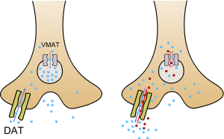
MECHANISM OF ACTION
„Classical“ psychostimulants
Methamphetamine (pervitin)
Increased dopamine (norepinephrine) release + inhibition of DAT
→ increased levels of monoamines in the synaptic cleft.
Methamphetamine works by taking advantage of its similarity to dopamine.
It attaches itself to the DAT (it binds to them more powerfully than dopamine, and will push
dopamine out). Methamphetamine then gets transported into the cell.
Interferes with vesicular monoamine transporter (VMAT) function and prevents
filling of synaptic vesicles with DA.
It leads to increase in cytoplasmic DA. Due to increased cytoplasmic dopamine direction of
DAT reverses.
→ increase in extracellular DA

Slide 91
„Classical“ psychostimulants
Methamphetamine (pervitin)
Application:
Orally
Smoking
Inhalation (snorted)
Injections

Slide 92
„Classical“ psychostimulants
Methamphetamine (pervitin)
Very widespread substance in this country.
Most frequently used route of administration in CR: i.v.
Usual doses: 50 – 250 mg/day (price 800 – 1000 Kč/gram).
Estimation: number of problem drug users (high-risk drug users in CR: 20,5 thousands.
2/3 of the total number of problem drug users in CR.

Slide 93
„Classical“ psychostimulants
Methamphetamine (pervitin)
Short-term effects:
Increased attention and decreased fatigue
Increased activity and wakefulness
Decreased appetite
Euphoria and rush
Increased respiration
Rapid/irregular heartbeat
Hyperthermia

Slide 94
„Classical“ psychostimulants
Methamphetamine (pervitin)
Long-term effects:
Addiction
Psychosis, including:
  paranoia
  hallucinations
  repetitive motor activity
Changes in brain structure and function
Deficits in thinking and motor skills
Increased distractibility

Slide 95
„Classical“ psychostimulants
Methamphetamine (pervitin)
Long-term effects:
Memory loss
Aggressive or violent behavior
Mood disturbances
Severe dental problems
Weight loss

Slide 96
„Classical“ psychostimulants
Methamphetamine (pervitin)
Primary neurocognitive deficits associated with long-term methamphetamine use:
Attention/Psychomotor Speed
Learning & Memory
Executive Functions
  Resulting in:
    Poor judgment
    Lack of insight
    Poor strategy formation
    Impulsivity
    Reduced capacity to determine consequences of actions

Slide 97
„Classical“ psychostimulants
Methamphetamine (pervitin)
Withdrawal symptoms
Depression
Anxiety
Fatigue
Excessive sleeping and lethargy
Increased appetite
STRONG CRAVING
→ RELAPSES

Slide 98
„Classical“ psychostimulants
Methamphetamine (pervitin)
Pharmacologic Treatment of Addiction
There are currently no medications that counteract the specific effects of methamphetamine or
that prolong abstinence.
UNDER RESEARCH
Ibudilast: suppresses the neuroinflammatory actions of glial cells.
It has been shown to inhibit methamphetamine self-administration in rats.
Uknown safety and effectiveness in humans with methamphetamine addiction.

Slide 99
MDMA (3,4-methylenedioxy-methamphetamine, ecstasy)
1912: first synthesized and patented by a German pharmaceutical company under the name
of “methylsafrylamin”.
It was not intended for therapeutic use, but only as a precursor for therapeutically
active compounds.
Merck had no intentions of using MDMA as an appetite suppressor, as many times erroneously
has been written.
The company decided against marketing the drug and had nothing more to do with it.
MDMA acts as both a stimulant and psychedelic, producing an energizing effect,
as well as distortions in time and perception and enhanced enjoyment from tactile experiences.
During the 1970s, in the United States, some psychiatrists began using MDMA as a
psychotherapeutic tool believing that the drug eliminated the typical fear response and
increased communication.

Slide 100
MDMA (3,4-methylenedioxy-methamphetamine, ecstasy)
MDMA is taken orally,
usually in a tablet or capsule, and its effects last approximately 3 to 6 hours.
The average reported dose is one to two tablets, with each tablet typically containing between
60 and 120 milligrams of MDMA.

Slide 101
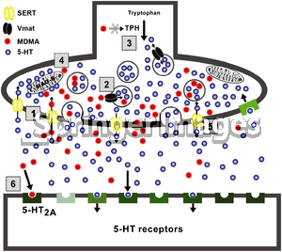
MECHANISM OF ACTION
MDMA (3,4-methylenedioxy-methamphetamine, ecstasy)
1) MDMA, like serotonin (5-HT), is a substrate of the serotonin transporter (5-HTT) and uses the transporter to enter inside the neuronal terminal, although at high concentration (it may also enter by diffusion).

Slide 102
MECHANISM OF ACTION
MDMA (3,4-methylenedioxy-methamphetamine, ecstasy)
2) Once inside, MDMA produces an acute and rapid enhancement in the release of 5-HT from the storage vesicles, possibly by entering the vesicles via the vesicular
monoamine transporter (VMAT) and depletes vesicular neurotransmitter stores.

Slide 103
MECHANISM OF ACTION
MDMA (3,4-methylenedioxy-methamphetamine, ecstasy)
3) MDMA also inhibits tryptophan hydroxylase (TPH), the rate-limiting enzyme for
5-HT synthesis.

Slide 104
MECHANISM OF ACTION
MDMA (3,4-methylenedioxy-methamphetamine, ecstasy)
4) Monoamine oxidase B (MAO-B), located in the outer membrane of the mitochondria of serotonergic neurons, is the enzyme responsible for 5-HT degradation and its activity is partially inhibited by MDMA.

Slide 105
MECHANISM OF ACTION
MDMA (3,4-methylenedioxy-methamphetamine, ecstasy)
5) Due to the increase in the free cytoplasmatic pool of 5-HT, MDMA promotes a rapid release of intracellular 5-HT to the neuronal synapse via reversal of the 5-HTT activity.

Slide 106
MECHANISM OF ACTION
MDMA (3,4-methylenedioxy-methamphetamine, ecstasy)
6) MDMA hallucinogenic properties depend on the agonist activity at the 5-HT_{2A}-receptor.

Slide 107
MDMA (3,4-methylenedioxy-methamphetamine, ecstasy)
Effects:
feelings of mental stimulation
emotional warmth
empathy toward others
general sense of well being
decreased anxiety
enhanced sensory perception

Slide 108
MDMA (3,4-methylenedioxy-methamphetamine, ecstasy)
Possible dangerous adverse effect:
marked rise in body temperature (hyperthermia)
following vigorous physical activity for extended periods
Symptoms of MDMA overdose:
High Blood Pressure
Faintness
Panic attacks
Loss of consciousness
Seizures

Slide 109
MDMA (3,4-methylenedioxy-methamphetamine, ecstasy)
Is MDMA addictive?.
Experiments have shown that animals will self administer MDMA - an important indicator
of a drug’s dependency potential
although the degree of self-administration is less than some other drugs of abuse such
as cocaine
Dependency on MDMA is relatively rare.
There is a risk associated with transition to other stronger stimulants (pervitin, cocaine).

Slide 110
MDMA (3,4-methylenedioxy-methamphetamine, ecstasy)
Withdrawal symptoms (mild)
Fatigue and mood swings.
Craving and irritability.
There are no specific pharmacologic treatments for MDMA abuse.

Slide 111
„New“ synthetic substances
Broad spectrum of substances.
„New“´= new in the market.
Majority o these substances (including their psychotropic properties) is known many years.
Increase in the last 15 years in association with rave parties and MDMA use.
empathogens and entactogens

Slide 112
„New“ synthetic substances
Substances derived from phenylethylamine a tryptamine.
For the first time described in a detailed way by prof. Alexander Shulgin (1925 – 2014) in books:
PIHKAL (Phenylethylamines I Have Known And Loved)
TIHKAL (Tryptamines I Have Known and Loved).

Slide 113
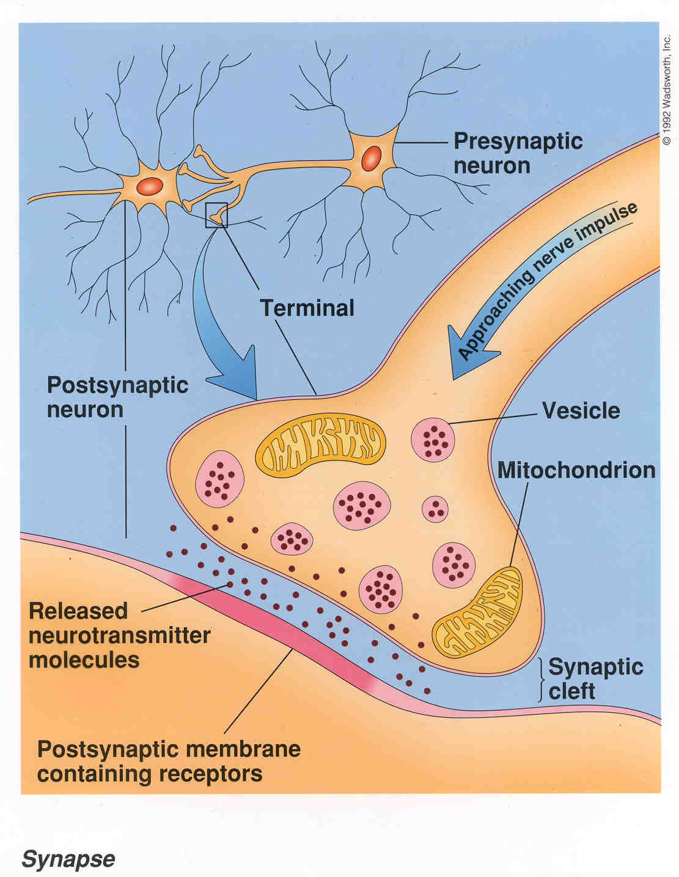
MECHANISM OF ACTION
„New“ synthetic substances
Majority of these substances affects more neurotransmitter systems in the CNS.
Usually the most important system: serotonergic.
Other important systems: dopaminergic and noradrenergic, sometimes cholinergic.
1. mechanism: direct acting at receptors.
2. mechanism: inhibition of neurotransmitter reuptake.

Slide 114
MECHANISM OF ACTION
„New“ synthetic substances
3. mechanism: increase neurotransmitter release.
4. mechanisms: inhibition of decomposing enzymes

Slide 115
„New“ synthetic substances
Phenylethylamines
PMA (para-methoxy-amphetamine)
2,4-DMA (2,4-dimethoxy-amphetamine)
MDA (3,4-methylenedioxy-amphetamine)
MMDA (3-methoxy-4,5-methylendioxy-amphetamine)
TMA (3,4,5-trimethoxyamphetamine)
DMMDA (2,5-dimethoxy-3,4-methylenedioxyamphetamine)
TeMA (2,3,4,5-tetramethoxyamphetamine)

Slide 116
„New“ synthetic substances
Tryptamines
DBT (N,N-Dibutyl-T)
DET (N,N-Diethyl-T)
DiPT (N,N-Diisopropyl-T)
DMT (N,N-Dimethyl-T)
DPT (N,N-Dipropyl-T)

Slide 117
Hallucinogens
Hallucinogenic compounds found in some plants and mushrooms have
been used - mostly during religious rituals -for centuries.
Many hallucinogens have chemical structures similar to those of natural neurotransmitters
(e.g., acetylcholine-, serotonin-, or catecholamine-like).
While the exact mechanisms by which hallucinogens exert their effects remain unclear,
research suggests that these drugs work, at least partially, by temporarily interfering with
neurotransmitter action or by binding to their receptor

Slide 118
Hallucinogens
LSD
(d-lysergic acid diethylamide) is one of the most potent mood-changing chemicals.
It was discovered in 1938 and is manufactured from lysergic acid,
which is found in ergot, a fungus that grows on rye and other grains.
Sensations and feelings change much more dramatically than the
physical signs in people under the influence of LSD.
The user may feel several different emotions at once or swing rapidly from
one emotion to another.
If taken in large enough doses, the drug produces delusions and visual hallucinations.
The user’s sense of time and self is altered.
Experiences may seem to “cross over”
different senses, giving the user the feeling of hearing colors and seeing sounds.
These changes can be frightening and can cause panic.

Slide 119
Hallucinogens
Mescaline
principal active ingredient in peyote (small, spineless cactus).
This plant has been used by natives in northern Mexico and the southwestern United States as a part of religious ceremonies.
Mescaline can also be produced through chemical synthesis.

Slide 120
Hallucinogens
Psilocybin
Mushrooms containing psilocybin are available fresh or dried and
are typically taken orally.
Psilocybin (4-phosphoryloxy-N,N-dimethyltryptamine) and its
biologically active form, psilocin (4-hydroxy-N,N-dimethyltryptamine),
cannot be inactivated by cooking or freezing preparations.
The effects of psilocybin, which appear within 20 minutes of ingestion, last approximately 6 hours.
Effects: alterations of autonomic function, motor reflexes, behavior, and perception.
hallucinations, an altered perception of time, and an inability to discern fantasy from reality

Slide 121
Hallucinogens
PCP (phencyclidine) was developed in the 1950s as an intravenous anesthetic.
Its use has since been discontinued due to serious adverse effects (patients often became
agitated,delusional, and irrational while recovering from its anesthetic effects).
PCP is a “dissociative drug,” meaning that it distorts perceptions of sight and sound and produces
feelings of detachment (dissociation) from the environment and self.
Effects: feelings of strength, power, and invulnerability,
numbing effect on the mind

