Slide 1
Complications of endodontic treatment
Local
Regional
Systemic

Slide 2
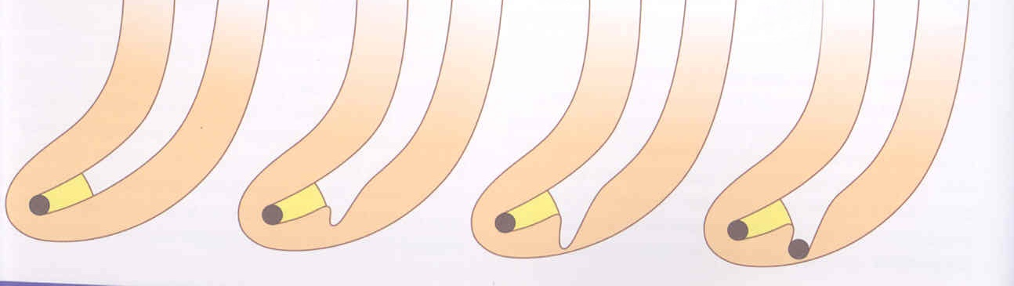
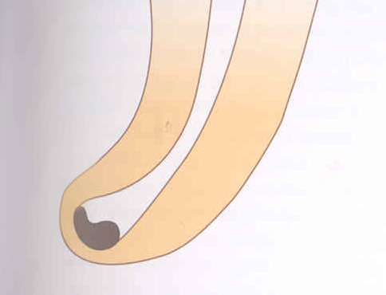
Plug of
dentin chips
Ledging
Transportation of the root canal
Via falsa
Zipping a elbow

Slide 3
Local complications

Slide 4
Plug
Reasons
Insufficient irrigation and
recapitulation
Loss of the working length

Slide 5
Solution
Repeated careful instrumentation with a thin instrument
Irrigation is not effective in this case!!!

Slide 6
Ledging
Reasons
The instrument is not bended in advance!
No control of the WL
=
No recapitulationLoss of the WL

Slide 7
Solution
The instrument must be bended in advance
Careful but complete rotation
Finishing with the fine filing
No NiTi!!!

Slide 8
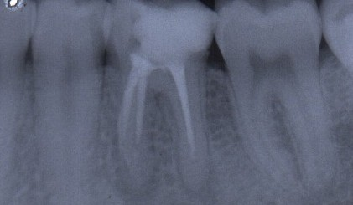
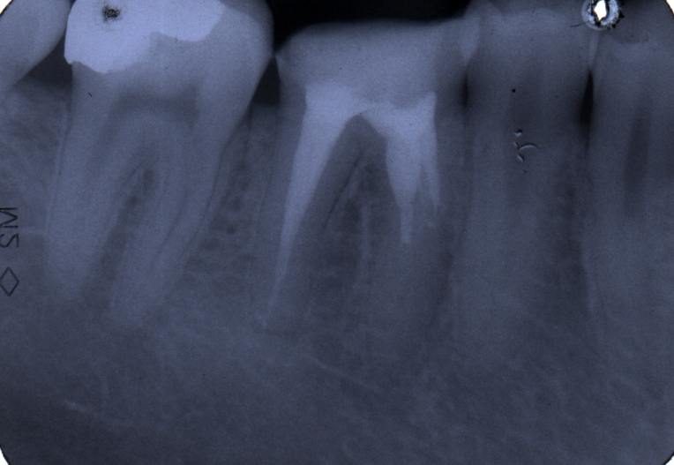
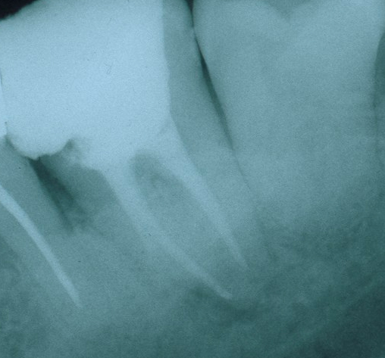
Ledging

Slide 9
Zipping a Elbow
The instrument is not bended in advance!
Rotation in curved canals

Slide 10
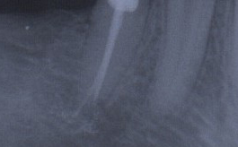

Slide 11
Stripping
Reasons
Bad orientation in morphology – no diagnostic x-ray
Instruments are nod bended
Rotary NiTi with a big taper
Dangereous zones
Mandibular molars – mesial roots
Premolars, esp. maxillar
Mandibular incisors
Oblast isthmu

Slide 12
Stripping
Důkladný přehled!
Šetřit oblast isthmu!
Ruční preparace!
Menší kónus NiTi !

Slide 13
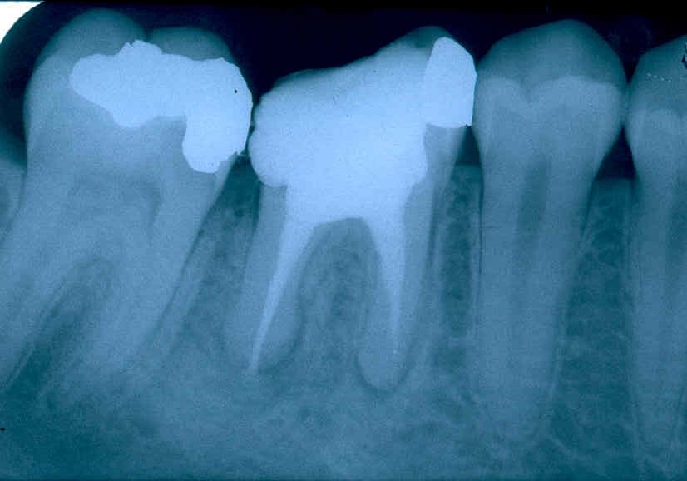
Stripping
Bend the instrument and eventually blunt it !

Slide 14
Fracture of the root canal instrument
Reasons
Insufficient coronal flaring
Old root canal instrument
Aggresive force
Incorrect movement of the root canal instrument

Slide 15
Solution
Enlargement of the root canal till the instrument
Ultrasound tips
Rotating root canal instrument – caution!
Bypass
Leaving in
Surgical treatment

Slide 16
Bypass

Slide 17
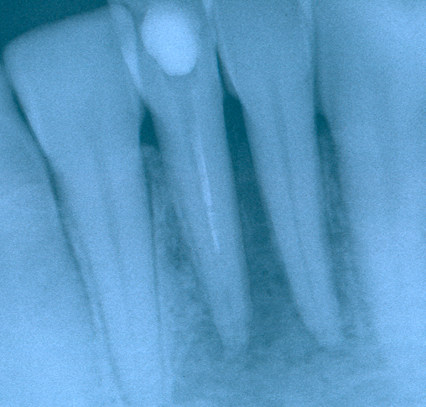
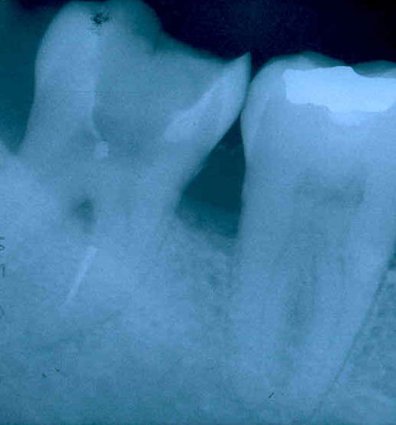
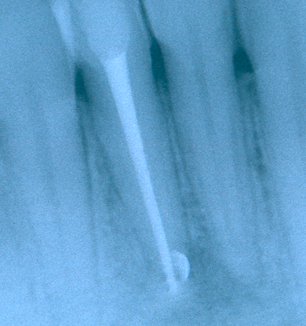
Fractured instrument

Slide 18
Via falsa - Perforation
Perforation of the bottom of the pulp chamber or the coronal part of the root canal
Perforation in the middle part of the root canal
Apical perforation

Slide 19
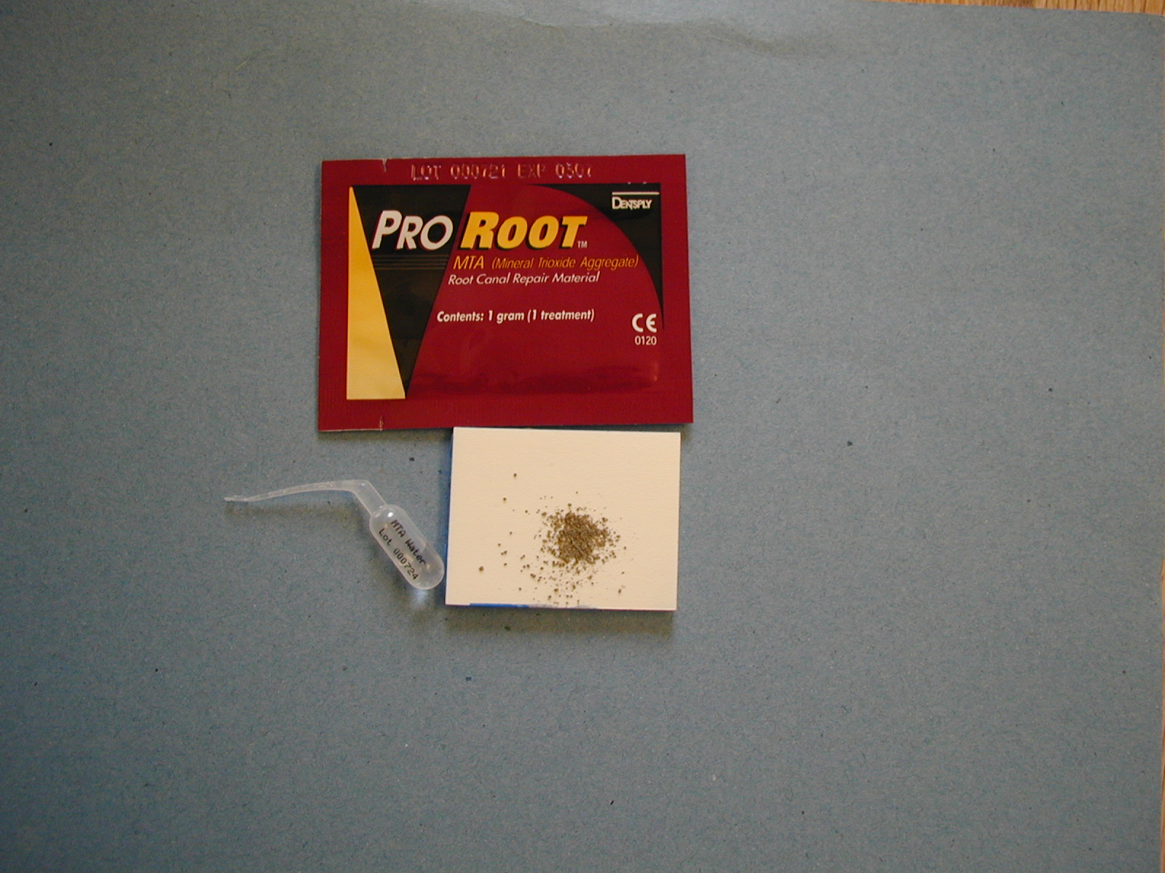
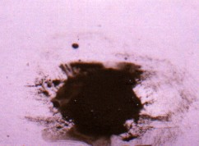

Slide 20
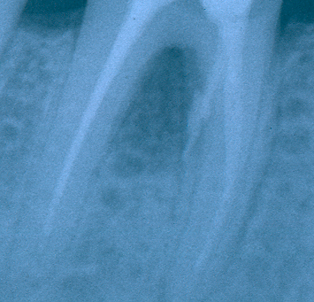
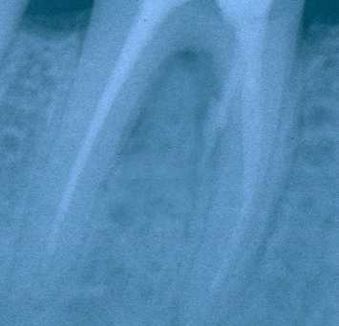
MTA composition
Dicalcium silicate
Trikalcium silicate
Trikalcium aluminate
Tetrakalcium aluminate
Cuprum sulphate
Bismuthum trioxide
= Portland cement

Slide 21
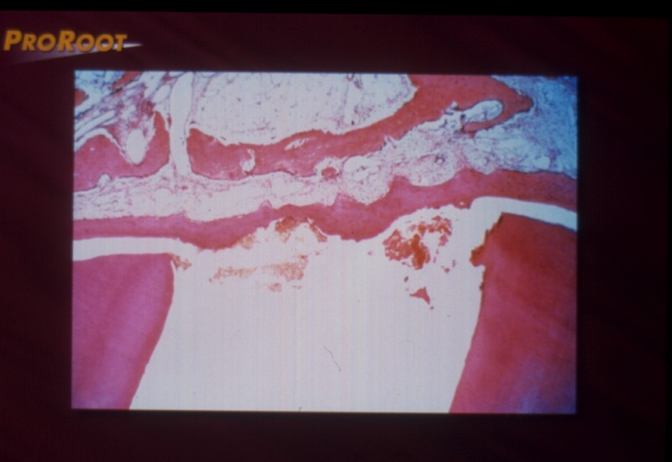
MTA
Good sealing ability
Promotion of healing

Slide 22
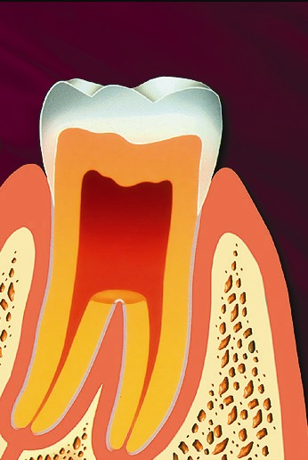
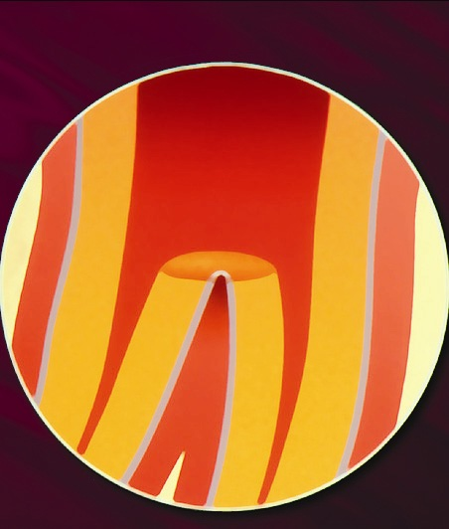

Slide 23
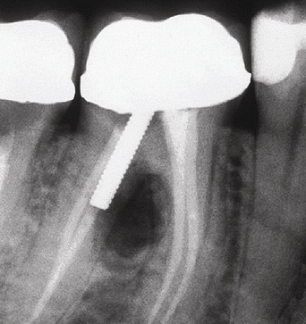
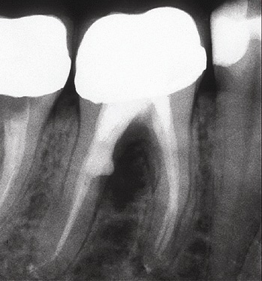
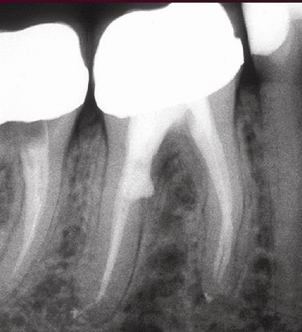

Slide 24
Via falsa - treatment
No bleeding
Desinfection
MTA – moisture (wet cotton pellet)
Filling

Slide 25
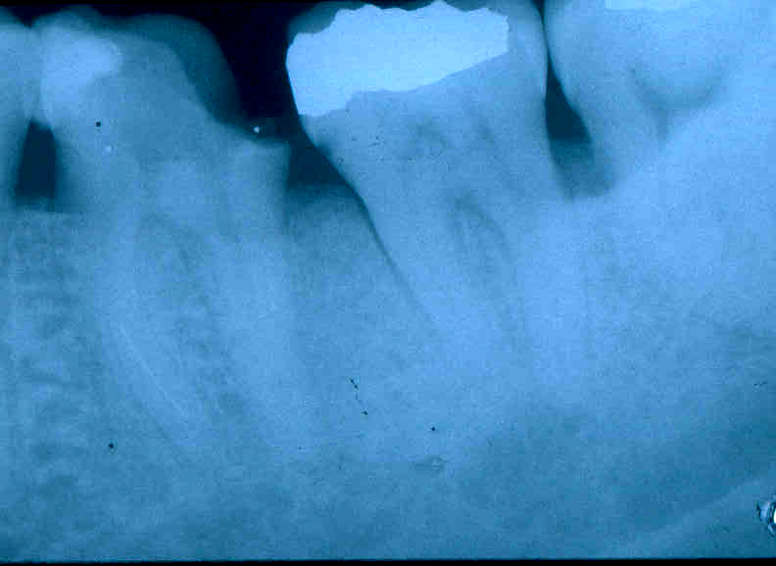
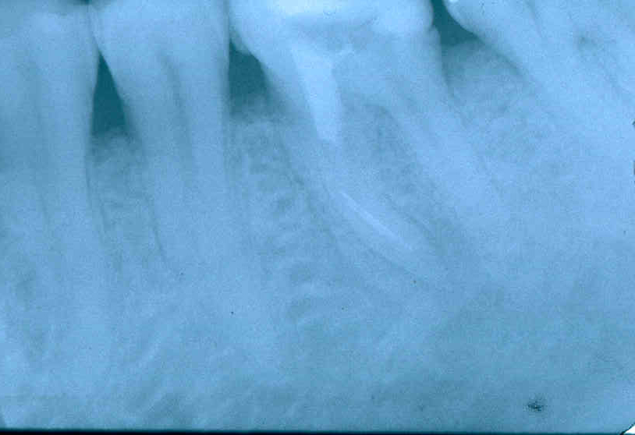
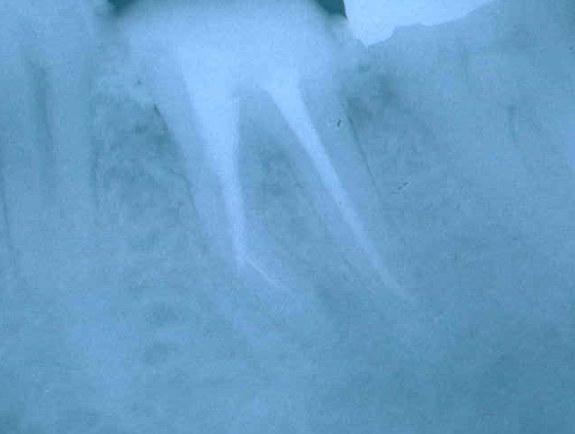
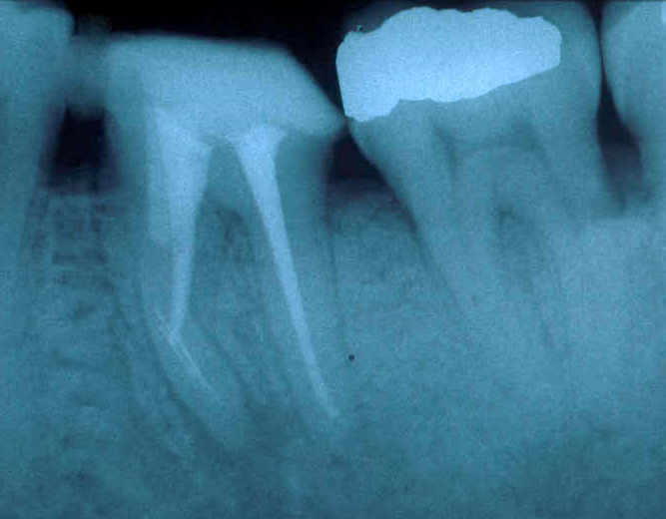

Slide 26
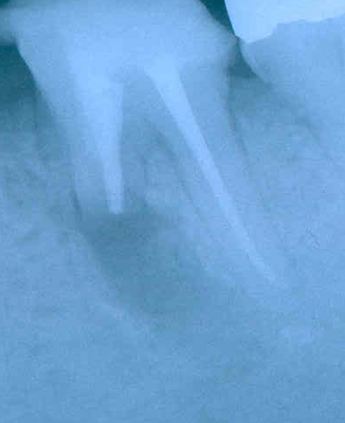
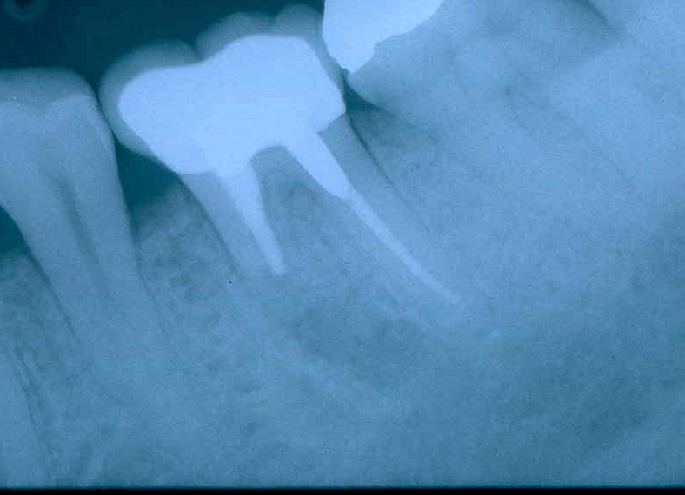
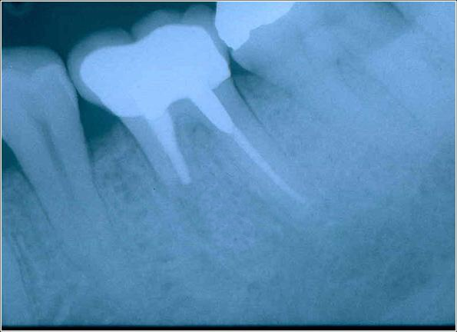

Slide 27
Via falsa
Apical perforation
Plug of MTA, root canal filing

Slide 28
MTA
Umožňuje hojení – dobrý okrajový uzávěr !
Zabraňuje přístupu mikroorganismům,
umožňuje hojení dřeně a periodoncia tvrdou
tkání.

Slide 29
Zdroj: Manuál firmy Maillefer

Slide 31
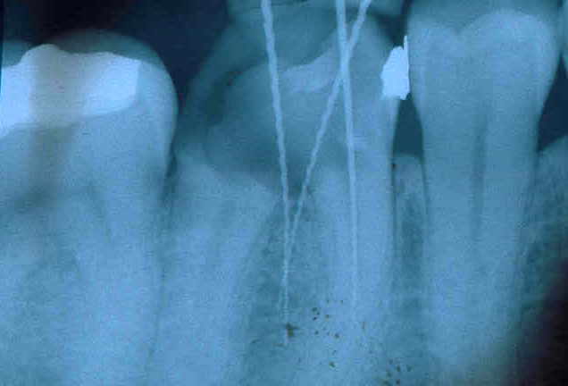
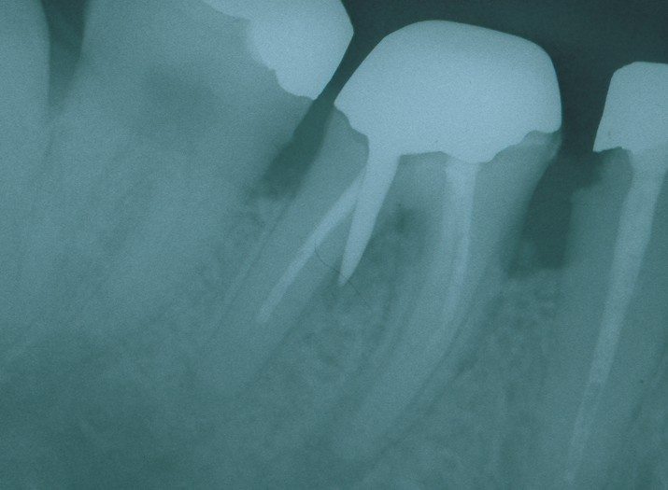
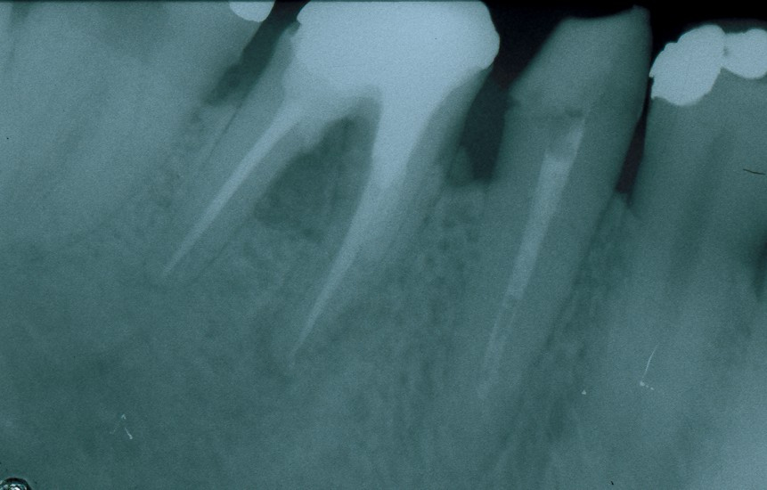

Slide 32
Regional complications

Slide 33
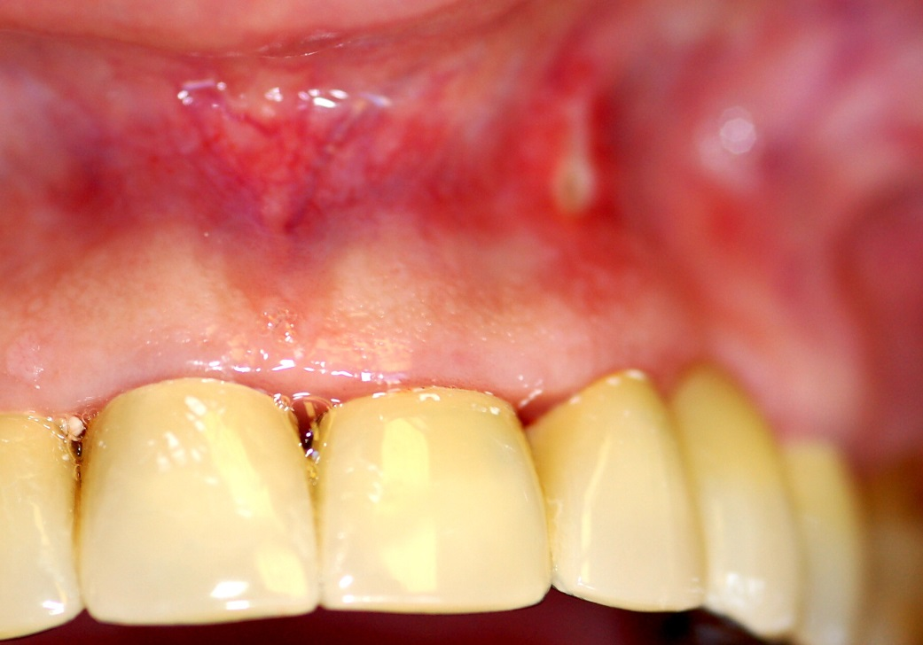
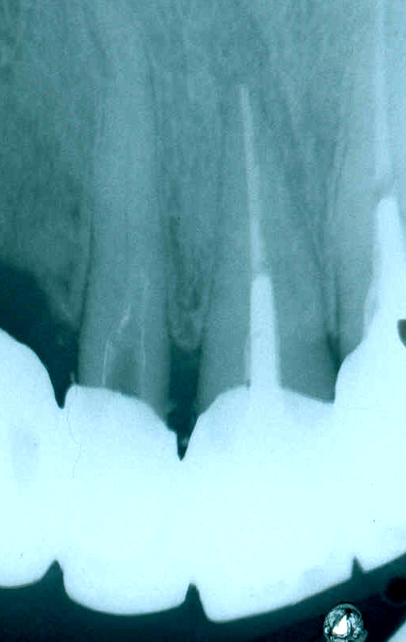
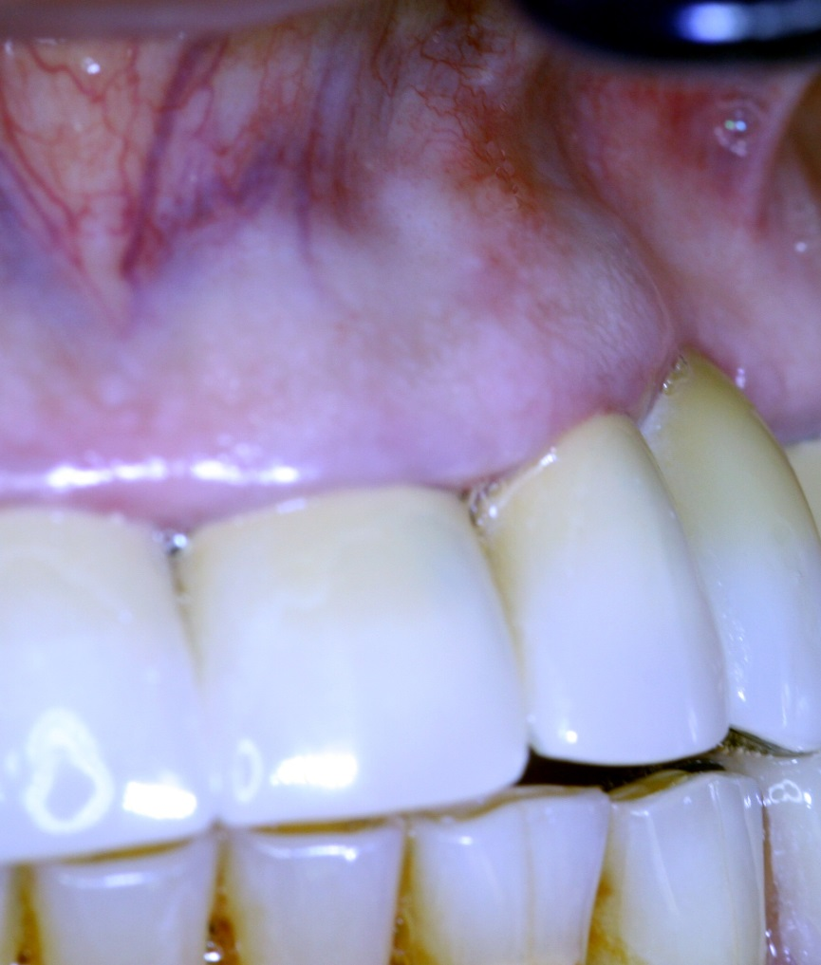
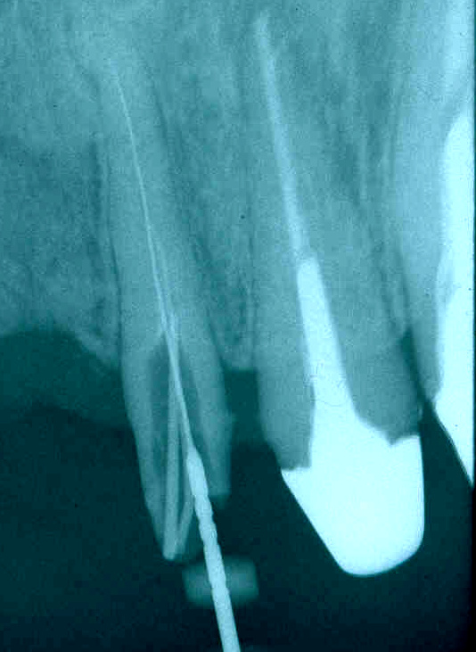
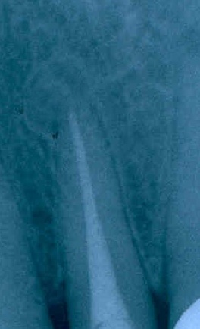

Slide 34
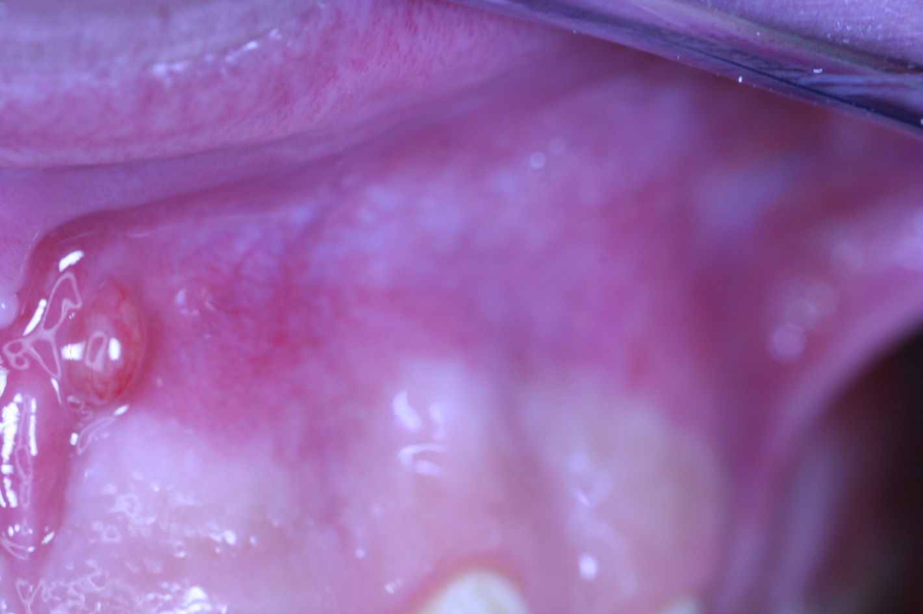
Píštěl

Slide 35
Systemic complications

Slide 36
Systemic complications
Periostitis
Inflammation of soft tissues (face, neck)
Gulp of the instrument (X ray, remnant diet, information)- cough
Aspiration of the instrument -emesis

Slide 37
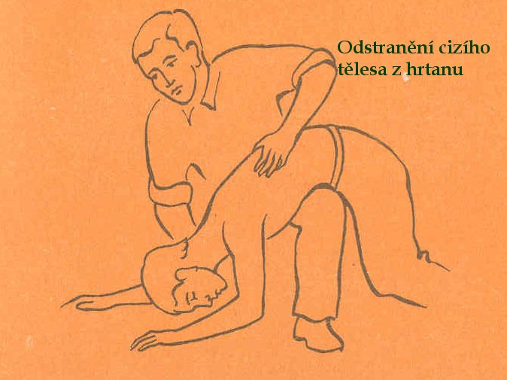
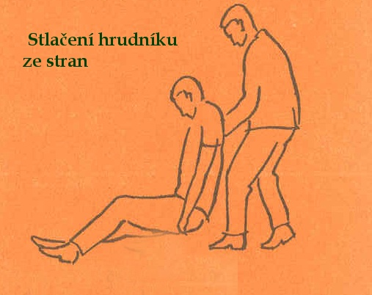

Slide 38
Caution!
Always find the loss instrument !!!!!!

