Slide 1
Types of fever
Fatehi Saada & Elaine Smit

Slide 2
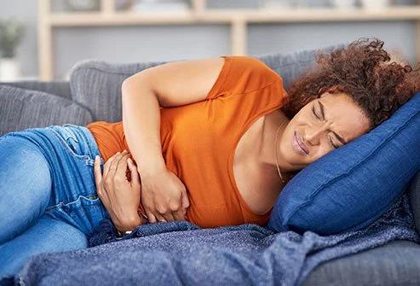
What is fever?
Fever is an elevation of body temperature above normal circadian variation as a result of change in thermoregulatory centre, located in anterior hypothalamus.
Effects:
Inhibits growth of some microbial agents
Increases heart rate
Increases respiration
Increases the use of body proteins as a source of energy
Causes:
infections, including the flu and pneumonia
some inflammatory diseases
food poisoning

Slide 3
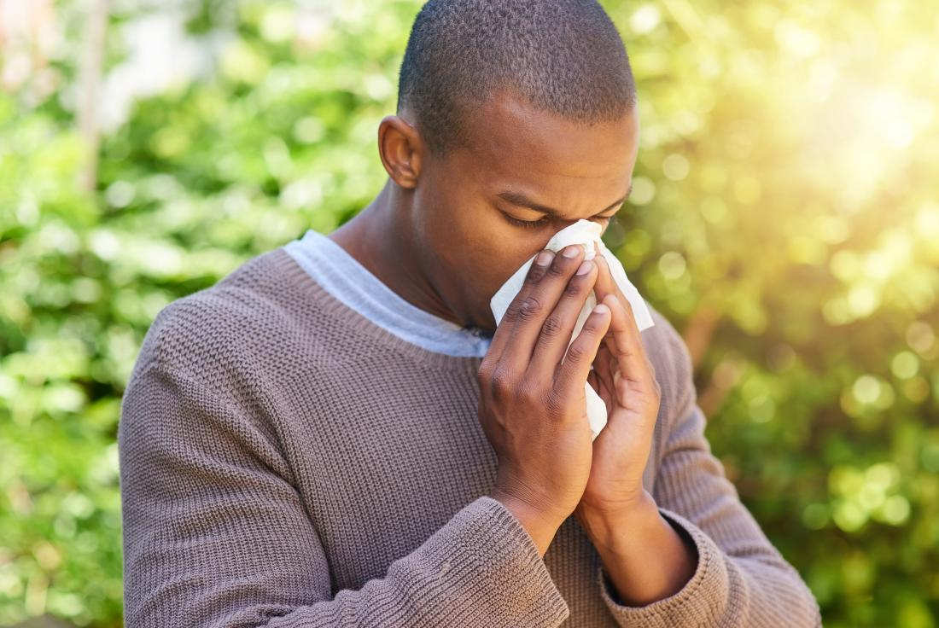
General terms
Latin terms:
Febris, is, f.
Meaning: Fever
Inflection: 3rd declension noun, follows the paradigm (dosis – EXCEPTION!)
Calor, oris, m.
Meaning: Heat
Inflection: 3rd declension noun, follows the paradigm (dolor)

Slide 4
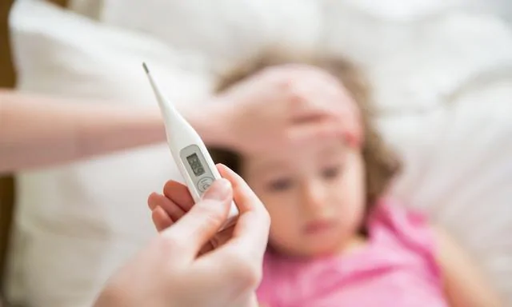
General terms
Greek components:
Pyret-
Meaning: relating to pyros which means fire or fever.
Example: antipyretic which is a drug reducing fever.
Therm-
Meaning: heat.
Example: hypothermia which means low body temperature.

Slide 5
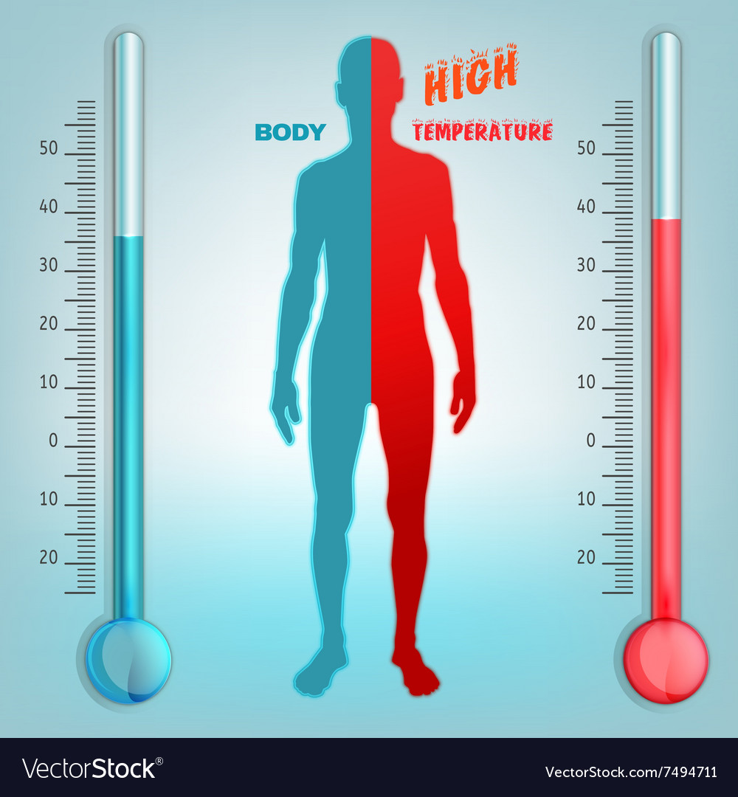
Body temperature
Body temperature is controlled in the hypothalamus.
The normal 'set-point' of core temperature is tightly regulated within 37 ± 0.5°C.
Temperature: Rectal>Oral>Axillary
The body may raise its temperature to help fight off an infection. When the body is hotter, it makes it harder for viruses or bacteria to survive.

Slide 6
Body temperature
01
Hypothermia, ae, f.
Meaning: the condition of having a dangerously low body temperature (below 35 C).
Symptoms: shivering, exhaustion or feeling very tired, confusion, or fumbling hands.
Causes: exposure to cold-weather conditions or cold water.
01
02
02
Subfebris, is, f.
When the body temperature is above normal but not within the range to be classified as fever, i.e. between 37 and 37.9 C.
03
Subfebrilis, e
related to subfebris

Slide 7
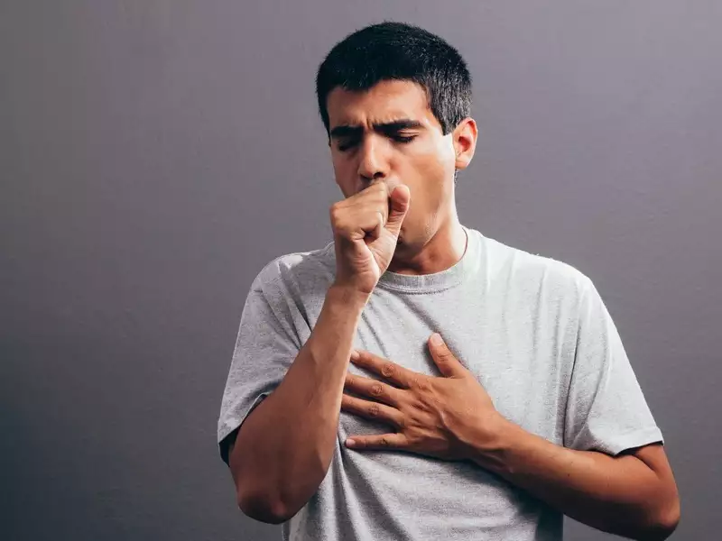
Body temperature
04
05
03
febris, is, f./pyrexia, ae, f.
Meaning: an abnormally high body temperature, i.e. between 38 and 39.9 C
Symptoms: rise in temperature, weakness, fatigue, cough or sore throat
febrilis, e
related to fever, feverous
06
afebrilis, e
not related to fever, non-feverous

Slide 8
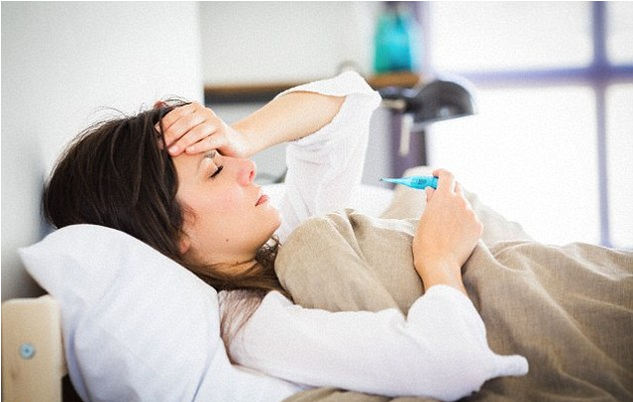
Body temperature
07
08
febricula, ae, f.
A mild fever of short duration, of indefinite origin, and without any distinctive pathology.
hyperpyrexia, ae, f
Meaning: a very high fever (more than 40 C)
Symptoms: increased or irregular heart rate, muscle spasms, rapid breathing, seizures.

Slide 9
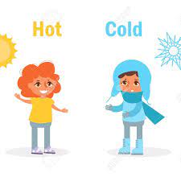
Types of fever named after progression
01
02
F. continua:
Continuus, a, um
temp. remains above normal during day & there will be little/no change in the temp.
F. intermittens:
Intermittens, entis
feverous state alternates with non-feverous state

Slide 10
Types of fever named after progression
03
04
F. remittens:
Remittens, ntis
temp. remains above normal during day & it will fluctuate more than 1°C in the day
Oscillating
F. recurrens:
Recurrens, entis
Having multiple fevers during a specific time period.

Slide 11
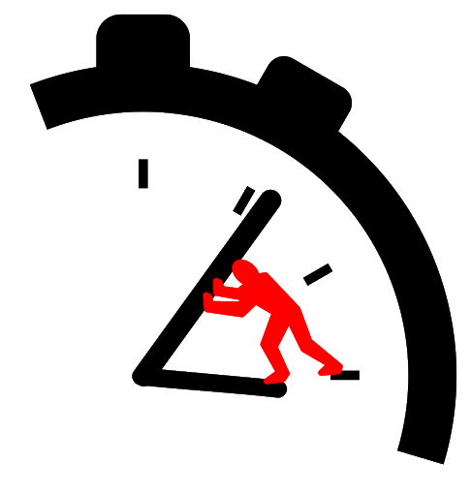
Types of fever named after progression
05
06
F. ephemera:
Emphemerus, a, um
Lasting a day
F. inversa:
Inverse fever,
When the temperature is higher in the morning than in the evening, which is not usual

Slide 12
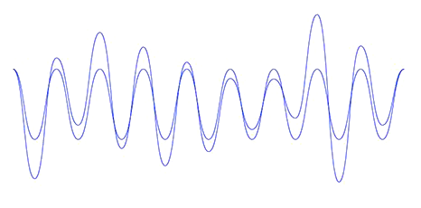
Types of fever named after progression
07
08
F. undulans:
Undulans, antis
Results in the rise and fall of temp., looks like a wave.
F. biphasica:
Biphasicus, a, um
Characterised by an early elevation in body temperature followed by a later one.

Slide 13
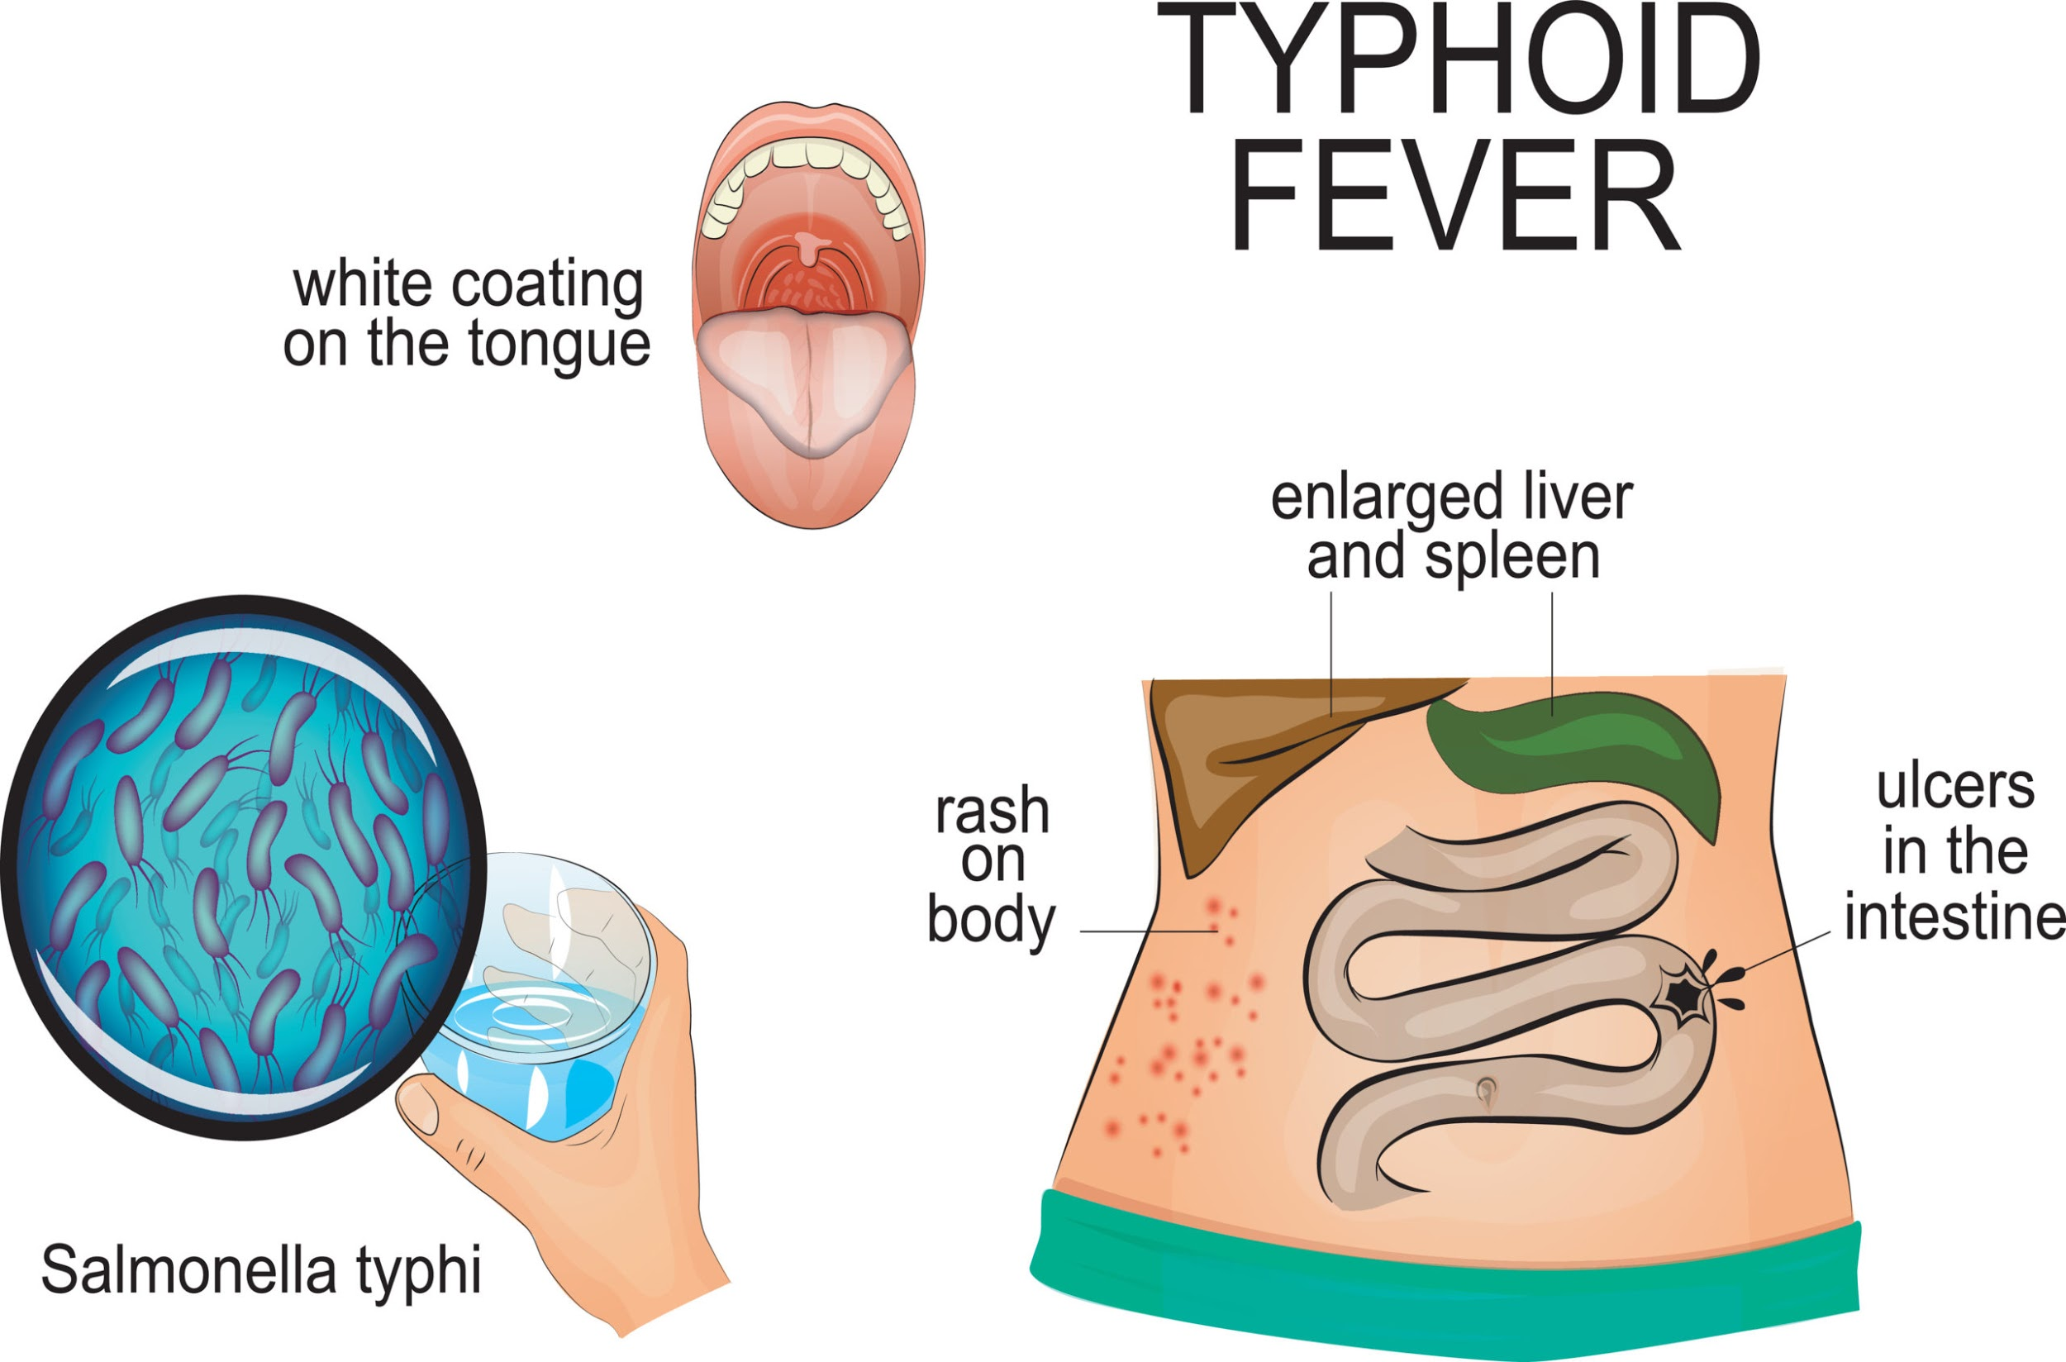
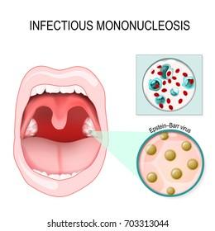
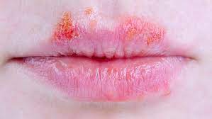
Types of fever accompanied with a particular disease
f. glandularis
f. herpetica
f. gastrica
JUPITER
SATURN
Typhoid fever
Mononucleosis
Herpetic disease

Slide 14
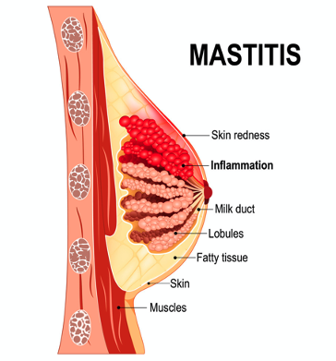
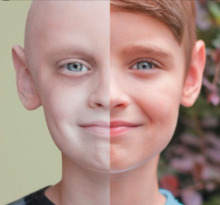
Types of fever accompanied with a particular disease
f. lactea
f. pallida
f. tertiana, quartana, quintanna
Inflammation of mammary gland
Rheumatic fever
Typically seen in malaria, repeating itself each 3/4/5 days

Slide 15
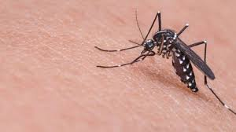
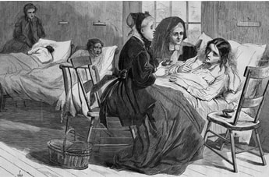
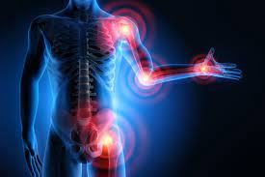
Diseases
01
03
f. flava = yellow fever Headache, jaundice, muscle spasms
f. puerperalis
= childbed fever, due to post-partum infection of reproductive organs
f. rheumatica
= inflammatory disease
painful joints, muscle spasms

Slide 16
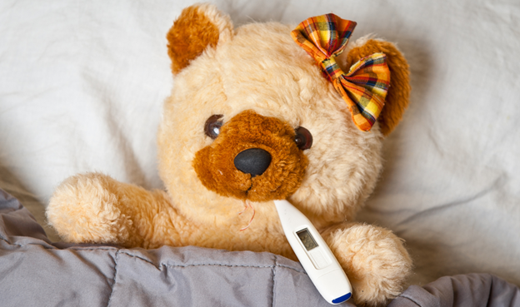
Thank you!

