Slide 1
Oral Histology and Embryology Practice
Mgr. Jan Křivánek, Ph.D.

Slide 2
Oral Histology and Embryology Practice
1. practice
Introduction
Cards, sitting order
Organisation of practice
Attendance and substitution of missed lessons
Protocols
Tests (3. and 6. pract.)
Safety rules

Slide 3
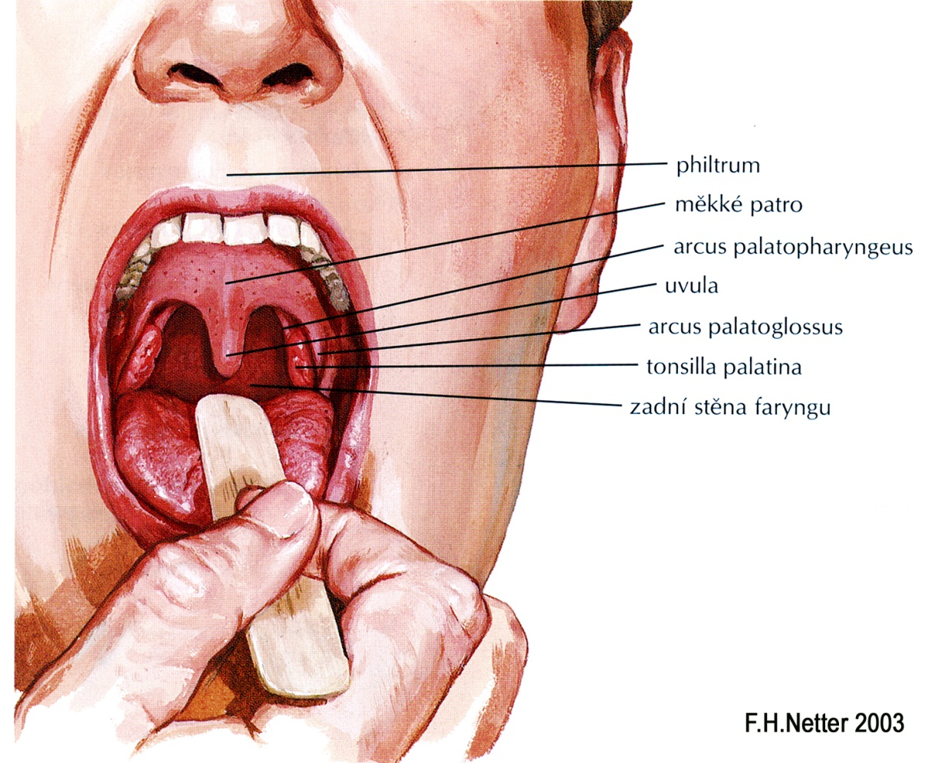
Microscopic anatomy Lips Tongue Palate Cheeks

Slide 4
Oral cavity (cavitas oris)
vestibulum oris / cavitas oris propria
Borders
Lips, cheeks, hard and soft palates, caudally floor of cavity, faucial isthmus (connection to oropharynx)
Inside
Tongue, teeth, gums, tonsilla palatina
Major salivary glands:
gl. submandibulatis
gl. sublingualis
gl. parotis

Slide 5
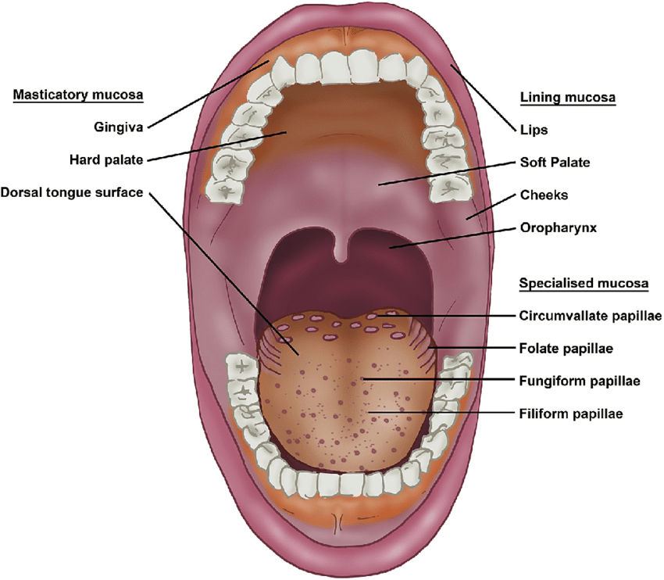
Oral mucosa
Cook, Sarah et al. A food perspective. Food Hydrocolloids. 2017.

Slide 6
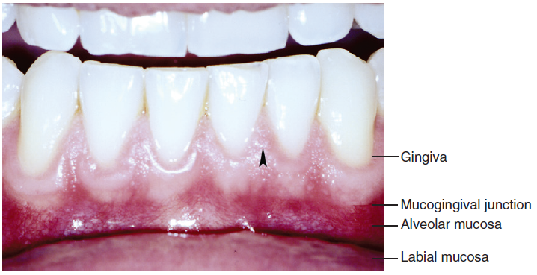
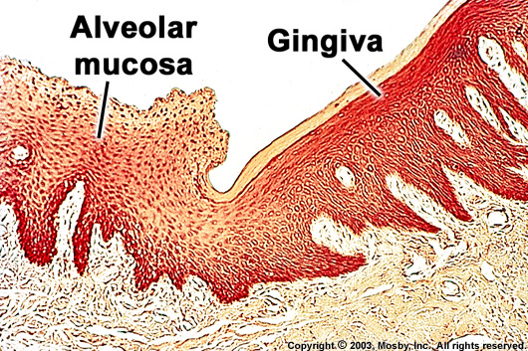
Oral mucosa
epithelium
thick stratified squamous
nonkeratinized
keratinized
Lining mucosa
Masticatory mucusa
(Specialized mucosa)
Lamina propria mucosae
Contains numerous of melanocytes or melanophages
Multiple papilae projected against the epithelium. Their shape and density are spatially different
(depends on different mechanical needs of oral mucosa)

Slide 7
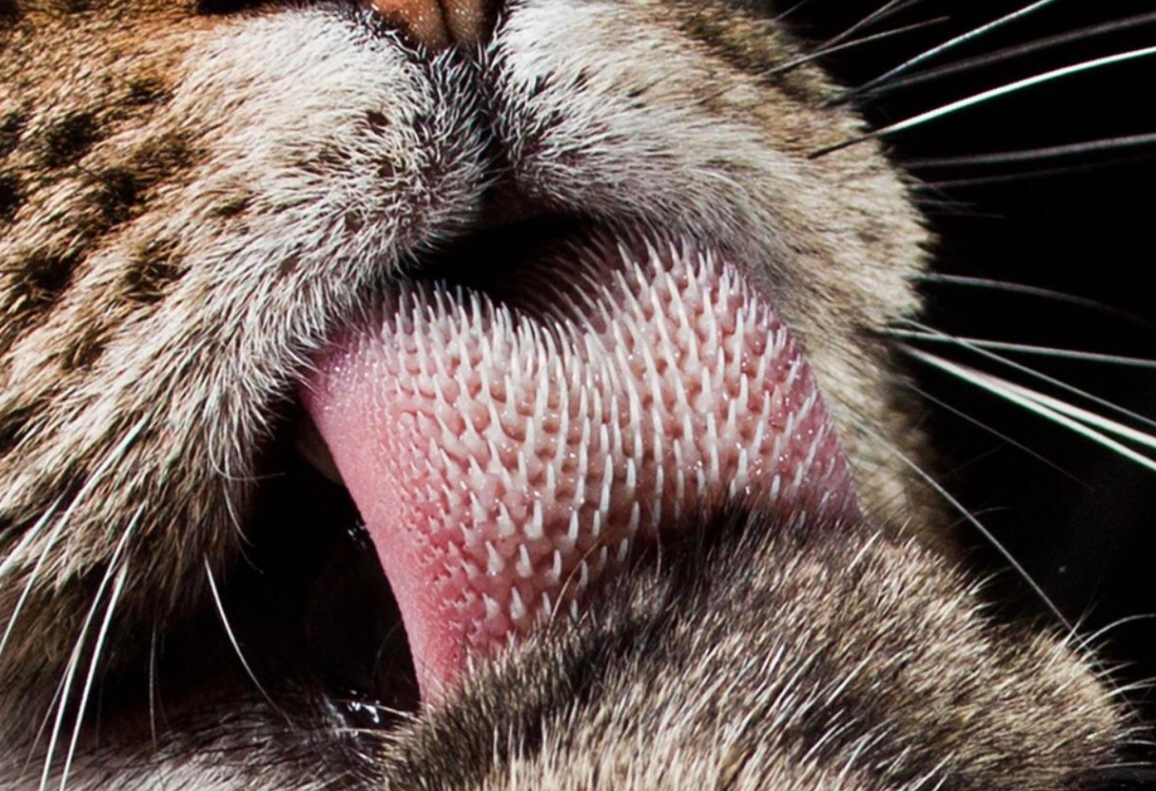
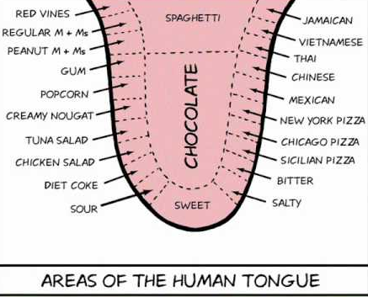
Oral mucosa classification
Lining (65 %)
Inner part of lips, cheeks soft palate, inferior aspect of the tongue, floor of the mouth and alveolar process (except of the gingiva)
tela submucosa located under mucosa
soft and slightly movable (submucous coat)
lamina propria from loose connective tissue
Masticatory (25 %)
Hard palate and gingiva
epithelium keratinized
tela submucosa is missing
lamina propria composed from dense collagenous of irregular type and firmly connected with periosteum (mucoperiosteum)
Specialized (10 %)
dorsal surface of the tongue
mucosa protrudes into papillae
tela submucosa is missing
lamina propria connected with aponeurosis linguae

Slide 8
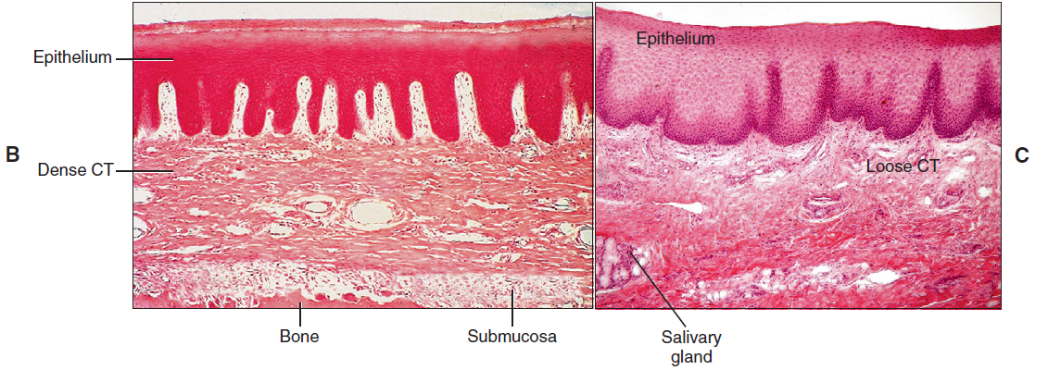
Gingiva
Lip
Lamina propria from dense collagenous connective tissue of irregular type
Firmly connected to periosteum (mucoperiosteum)
Lamina propria from loose collagenous tissue
Tela submucosa under mucosa
Mucosa is slightly movable
B, In histologic sections, the gingival epithelium is seen to be tightly bound to bone by a dense fibrous connective tissue (CT), whereas the epithelium of the lip (C) is supported by a much looser connective tissue.

Slide 9
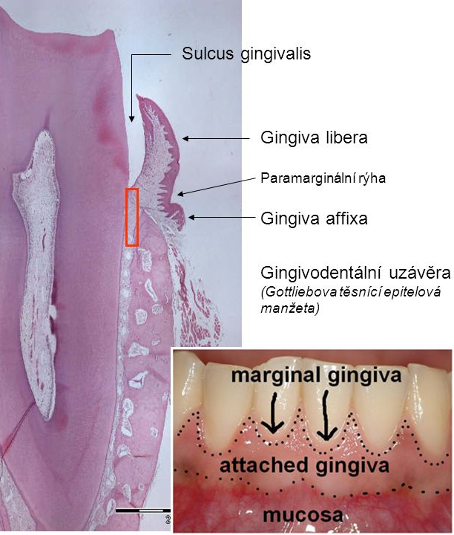
Oral mucosa regeneration
Oral epithelium turnover time: 4 - 24 days
Significant local differences
Gingivo-dental junctional epithelium 4-6 days
Gingiva affixa epith. (masticatory mucosa) 10 days
Taste buds 10 - 14 days
Lining epith. of lips and cheeks mucosa 14 days
Lining epith. of the floor of mouth 20 days
Masticatory epithl. of hard palate 24 days
Epidermis of the face and neck frontal side 7 days
Epidermis (rest) 30 days
(faster turnover time in case of the face is probably caused by inductive effect of the ectomezenchyme)

Slide 10
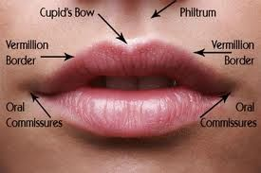
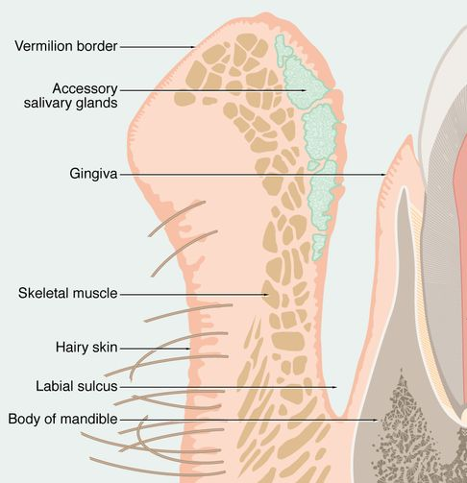
Lip
This coloration represents the combined effect of a
number of factors: the concentration and state of dilation
of small blood vessels in the underlying connective tissue,
the thickness of the epithelium, the degree of keratinization,
and the amount of melanin pigment in the epithelium.
Color gives an indication as to the clinical condition
of the mucosa; inflamed tissues are red, because of dilation
of the blood vessels, whereas normal healthy tissues are a
paler pink.
Vermilion zone
Sagitally:
ventral aspect of the lip
dorsal aspect of the lip
a) lamina epithelialis mucosae - stratified squamous epithelium
b) lamina propria mucosae - loose areolar connective tissue
m. orbicularis oris
vermilion zone
Why do the lips have a red color?
Notes:
Lidské rty jsou pravděpodobně jedním z tělesných znaků ovlivněných pohlavním výběrem. Splňují totiž všech sedm kritérií, které Barber (1995) pro znaky ovlivněné pohlavním výběrem vytyčil. Jsou to následující kritéria: znak je sexuálně dimorfní, není přímo zapojen při rozmnožování, je nejvýraznější v době rozmnožování, je buď atraktivní pro opačné pohlaví nebo slouží k zastrašování soupeřů, míra jeho fenotypového projevu ovlivňuje reprodukční úspěšnost jedince, znak se mění v průběhu života a je variabilní mezi jedinci stejného pohlaví, jeho projev je závislý na pohlavních hormonech.
Plnost ženských rtů zvyšuje atraktivitu obličeje, signalizuje totiž mládí a plodivost. Ke zvýšení své atraktivity žena používá rtěnku, případně trvalejší kosmetické zásahy (augmentací). Zdobení rtů (tetování, mutilace, piercing) je rozšířené u mnoha kultur světa současnosti i minulosti. Jeho základním významem je signalizovat společenskou a pohlavní dospělost jedince, zpravidla žen. Rty jsou pravděpodobně ovlivněny pohlavním výběrem.
Anemie je všeobecným ukazatelem zdravotního stavu člověka. Anemická bledost (tj. nedostatek červeného krevního barviva hemoglobinu) je tudíž často znakem infekce a je možné očekávat, že bude figurovat při pohlavním výběru. Kromě toho, jestliže je anemie adaptivní odpovědí na parazitickou infekci, pak zdravotní výdaje udržování vysoké hladiny hemoglobinu možná zajišťují, že organismus nesoucí těžkou zátěž parazitů nebude riskovat předstírání zdravé červenosti (Jones 1997).
also called margin or zone, is the normally sharp demarcation between the lip and the adjacent normal skin. It is where lipstick is sometimes applied. It represents the change in the epidermis from highly keratinized external skin to less keratinized internal skin. It has no sebaceous glands, sweat glands, or facial hair.^{[1][2]}
It has a prominence on the face, creating a focus for cosmetics and is also a location for several skin diseases. Its functional properties, however, remain unknown.

Slide 11
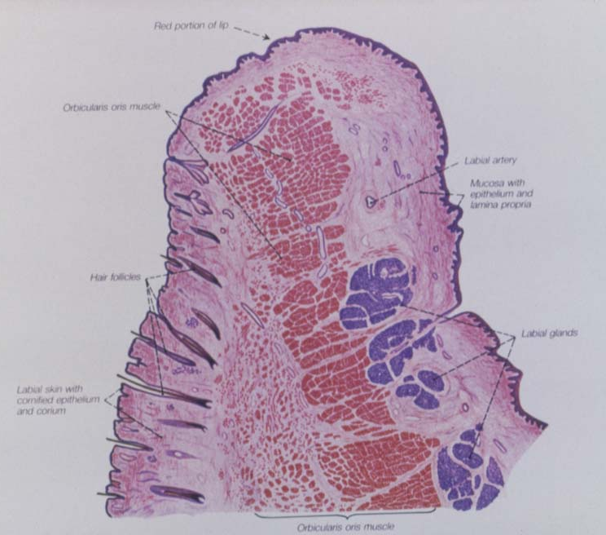
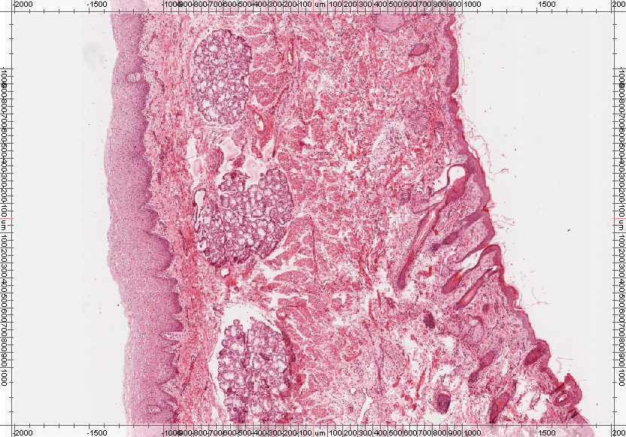
glandulae labiales
(mixed)

Slide 12
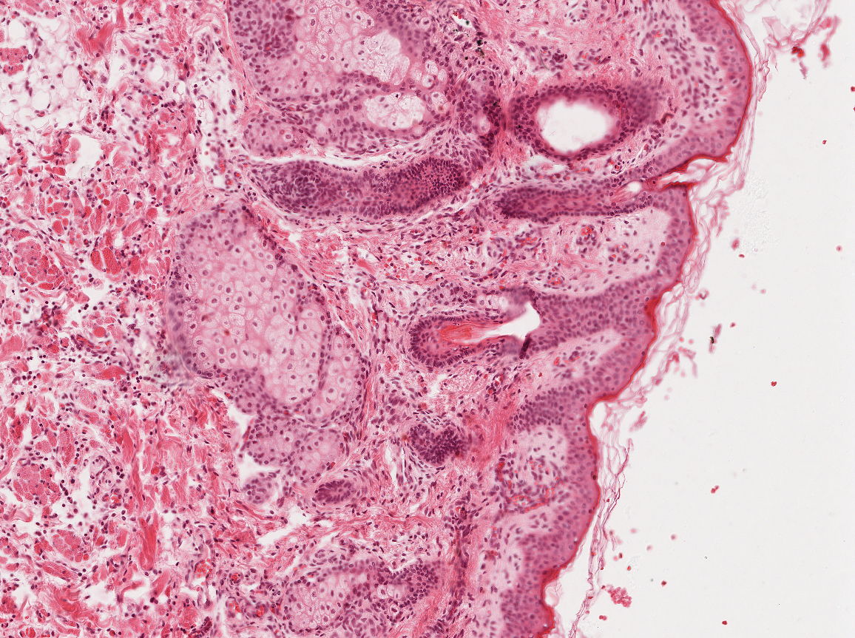
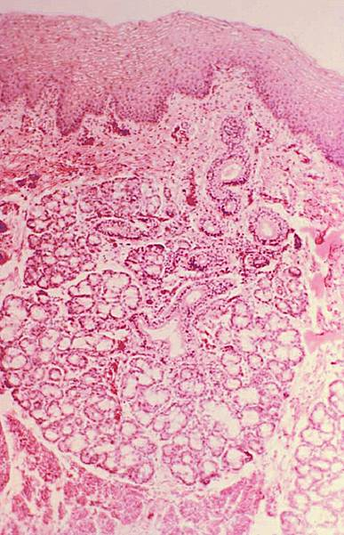
Lip
(skin side)
Ret
(mucous side)
Sebaceous glands
lamina propria
tela submucosa
Hair follicle

Slide 13
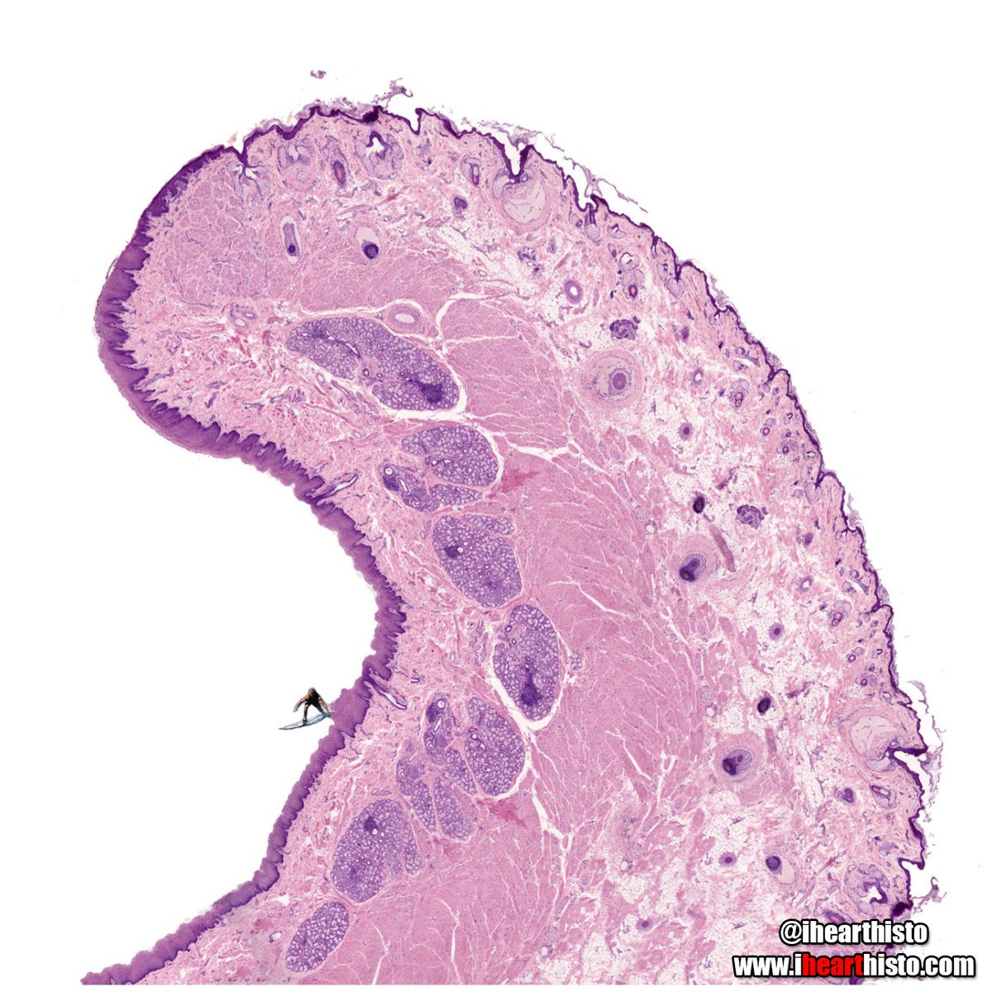
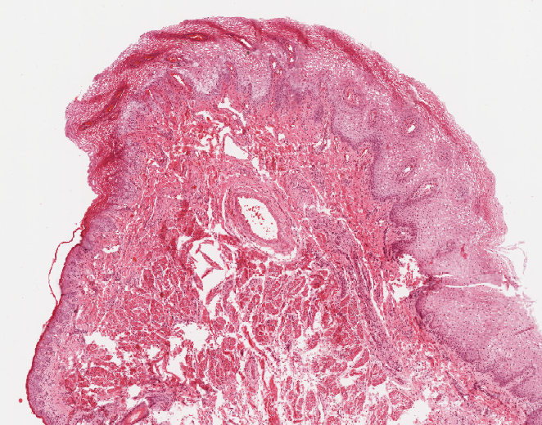
?
Adult
Suckling

Slide 14
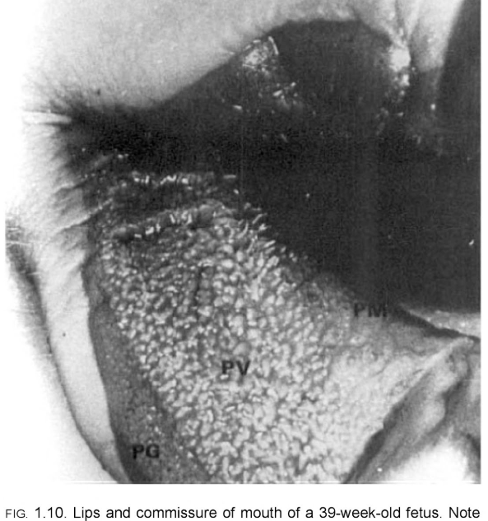
Newborns vermilion zone can be divided into:
PG - pars glabra (Glabra = flat)
PV - pars villosa (Villosa = vilous)
(PM - pars mucosa)
pars villosa
pars mucosa
pars glabra

Slide 15
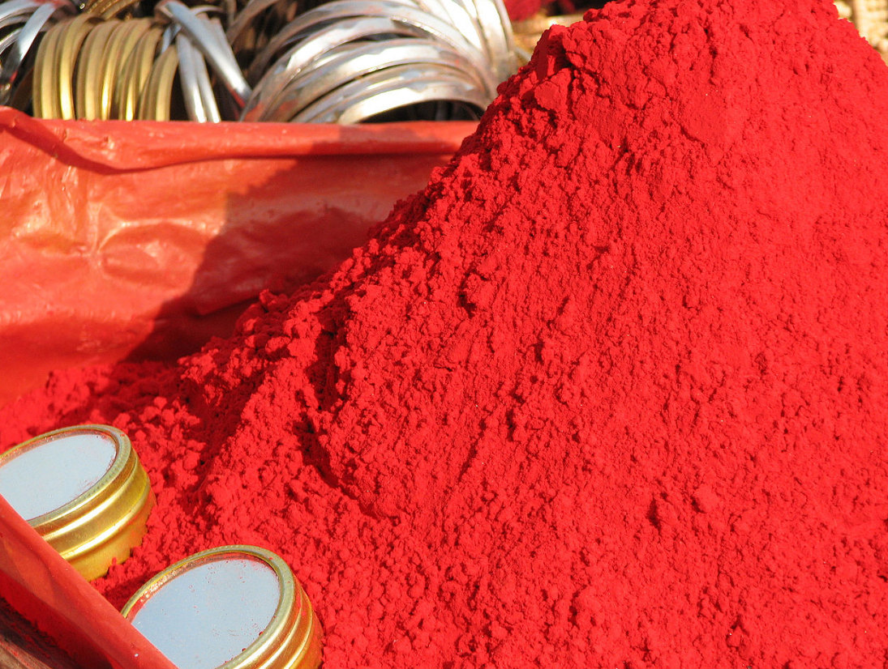
Newborns vermilion zone
ventral (skin) and dorsal (mucous) side are connected by vermilion zone
NEWBORNS vermilion zone can be divided into:
pars glabra (2 mm) more narrow, ventral
pars villosa (asi 4 mm) wider, dorsal
Vermilion zone
Pars glabra
Stratified squamous epithelium with keratinization signs
Lamina propria protrudes by higher papillae than dermal papillae
In 50 % small sebaceous glands are in lamina propria
Pars villosa
Thick stratified squamous epithelium
Numerous and slender papillae, which form the labial torus (torus labialis)
Papillae are HIGHLY VASCULARIZED and contains numerous of sensitive NERVE ENDINGS
Facilitates firm connection with the nipple during breastfeeding
zonation of the vermillion zone disappears with advanced age of a child
Notes:
The vermilion border (sometimes spelled vermillion border), also called margin or zone, is the normally sharp demarcation between the lip and the adjacent normal skin.

Slide 16
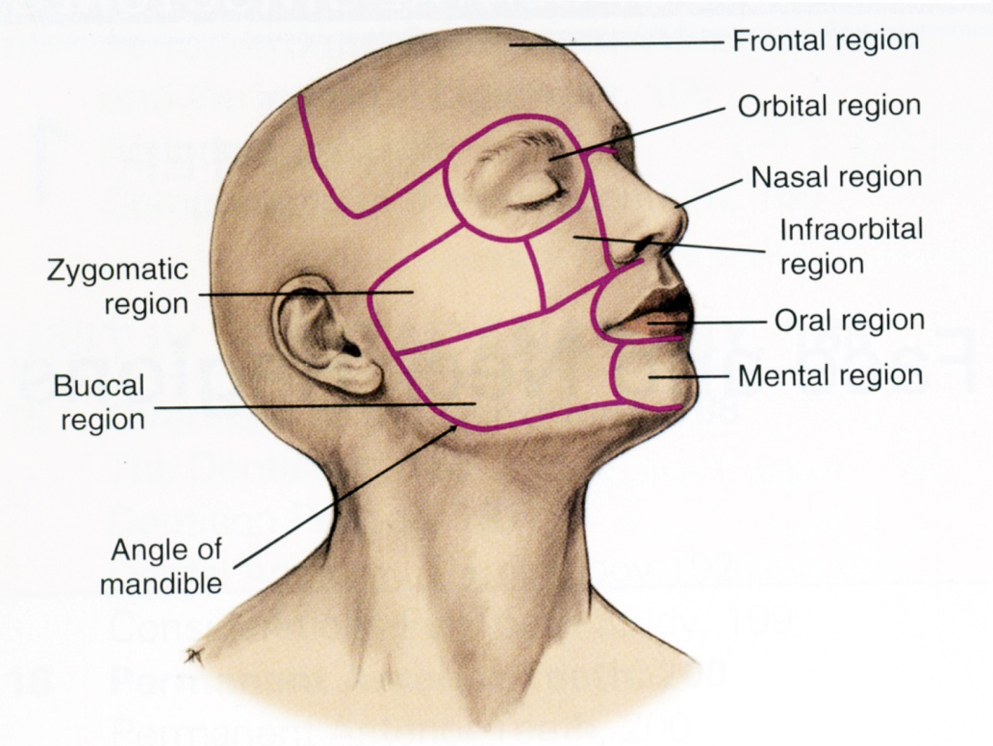
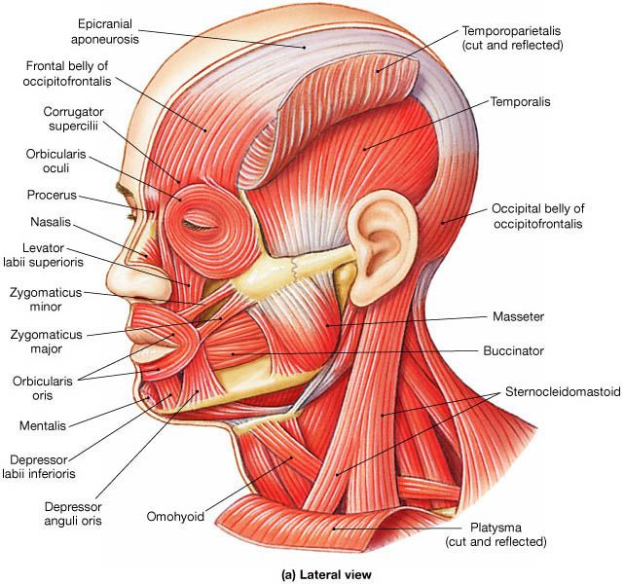
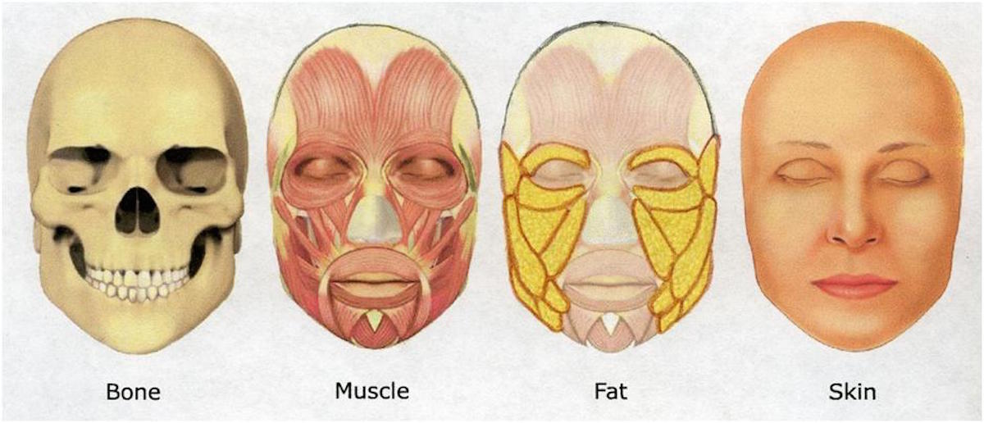
Cheek (bucca)
Histologically similar to the lip

Slide 17
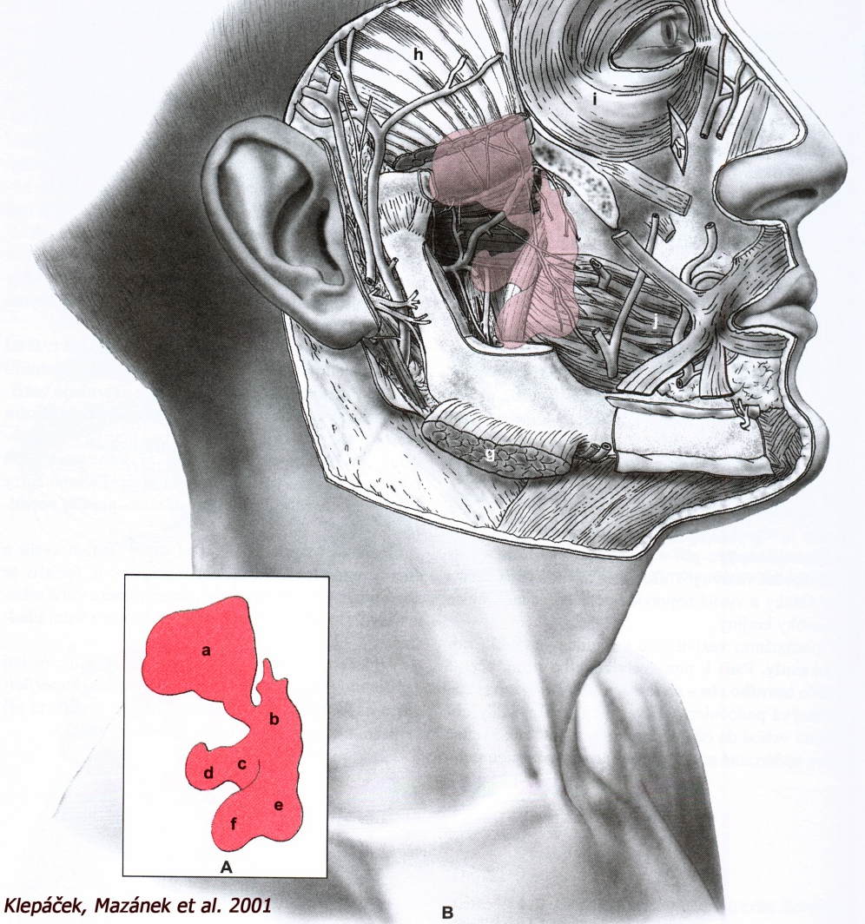
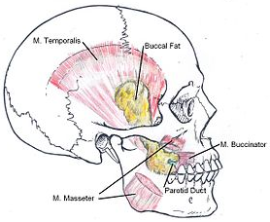
Between m.buccinator and m. masseter:
Corpus adiposum buccae
https://www.brainyoo.de/Brainyoo2Web/
wikipedia
Notes:
Function[edit]
Some people describe the buccal fat pad’s primary function in relation to chewing and suckling, especially in infants. This theory derives some support from the loss of volume to the intermediate lobe, which would be most directly involved in chewing and sucking, from infancy to adulthood.
Another proposed function is as gliding pads that facilitate the action of the muscles of mastication.^{[1]}
The buccal fat pad may also function as a cushion to protect sensitive facial muscles from injury due to muscle action or exterior force.^{[1]}

Slide 18
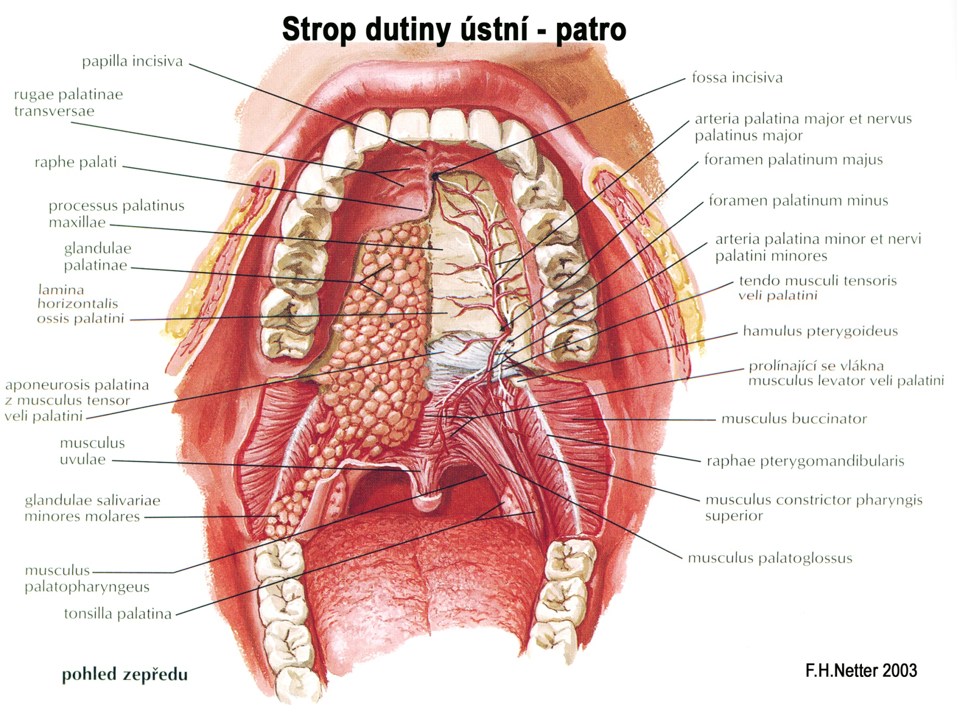
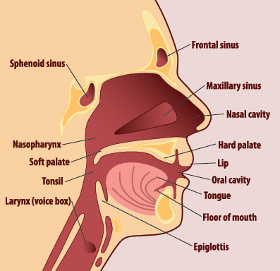
Palate
palatum durum
palatum mole

Slide 19
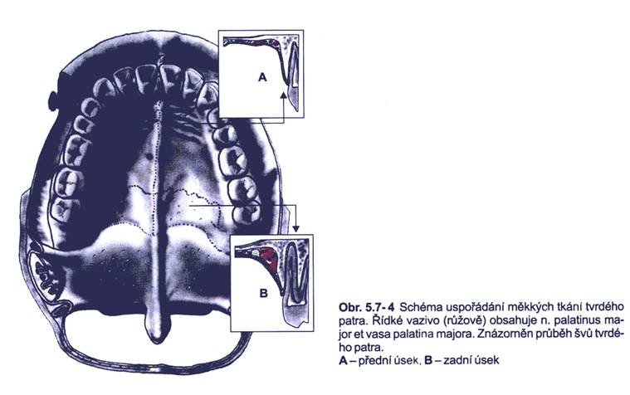
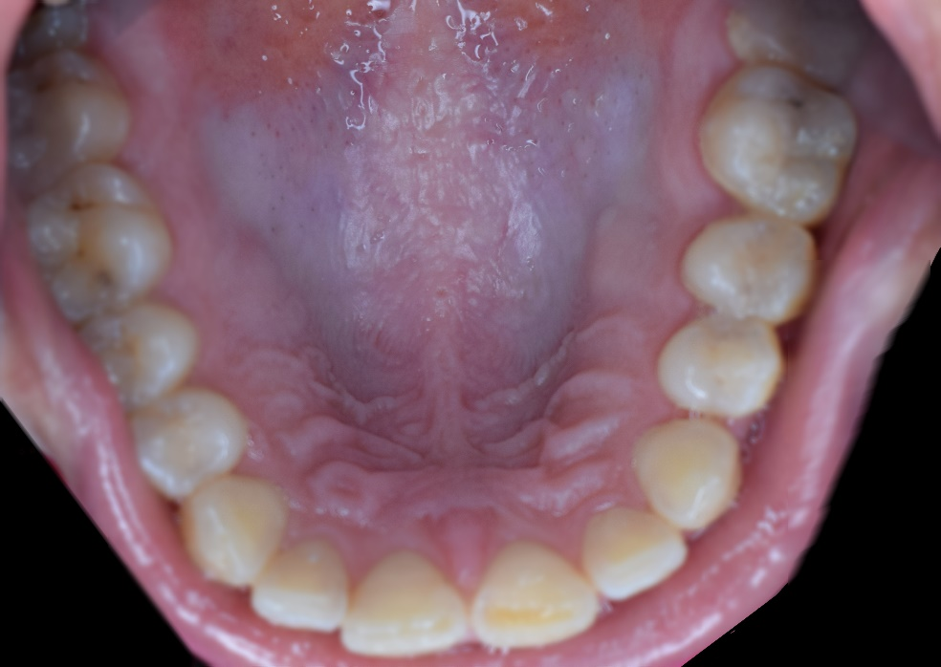
Hard palate (palatum durum)
Masticatory mucosa:
Epithelium stratified squamous keratinizing
Tela submucosa missing
Huge regional variability:
raphe palati
Adipous zone
Glandular zone

Slide 20
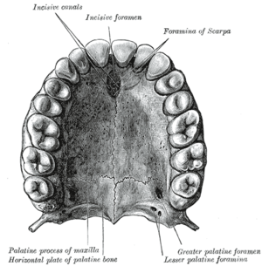
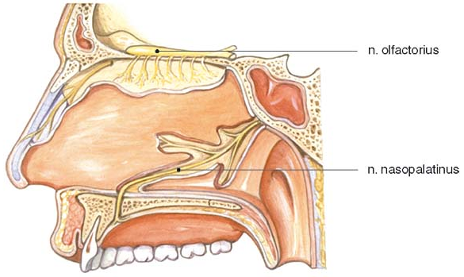
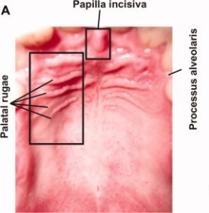
Local differences in hard palate structure
Palatal raphe
Midline from the incisive papilla to soft palate, mucosa without glandulae and adipocytes
Foramen incisivum
Location on the papilla incisiva
Maintains connection with nasal cavity before birth is closed
Adipose zone
Paired structure
Medially divided by papilla incisiva and raphe palati, Laterally bordered by gingiva and premolars
Mucosa is thickened into 3-5 transversal plicae - plicae palatinae transversae, core of plicae is formed by stripes of dense colagenous connective tissue interlaced with adipocytes
Glandular zone
Paired structure
Mucosa is smooth and contains true mucous glands – gll. palatinae

Slide 21
glandulae palatinae
Hard palate – glandular zone (frontal view)

Slide 22
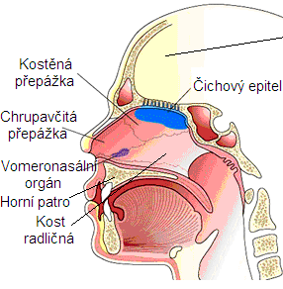
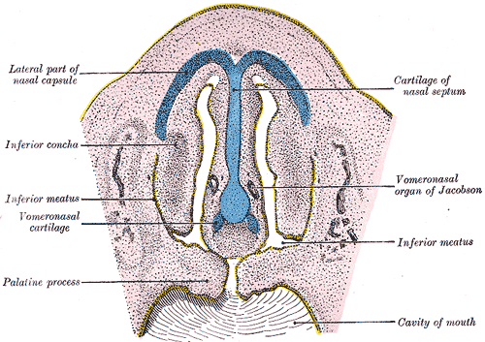
Vomeronasal organ (organon Jacobsoni)
RUDIMENTARY in human
Under nasal septum musosa anteriorly to and above the incisive duct
2- 6 mm long, dead-end thin canal
Well developed in reptiles - the olfactory organ

Slide 23
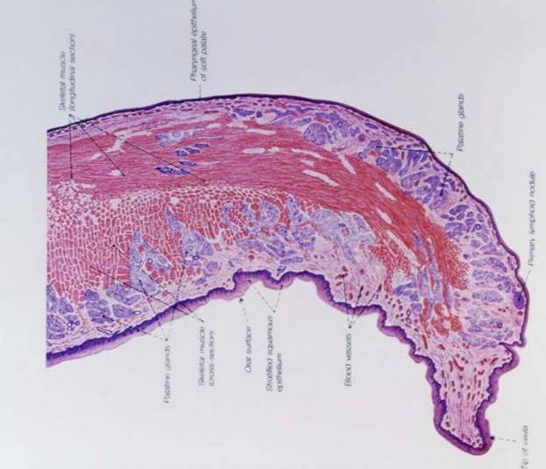
Soft palate
(palatum molle)
Nasal side
Respiratory epithelium
(pseudostratified)
aponeuroza
Stratified squamous keratinizing epithelium
Oral side
uvula

Slide 24
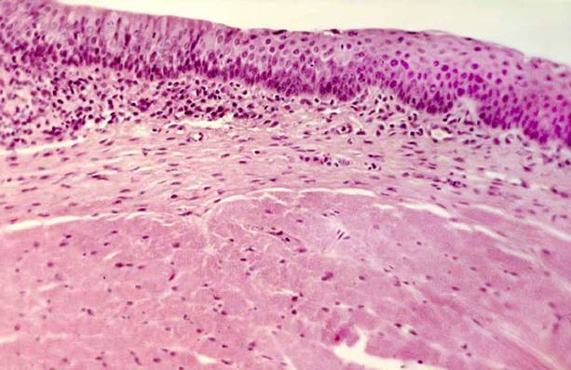
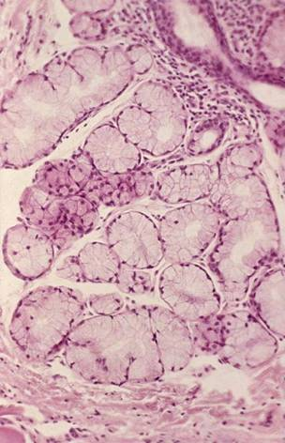
Transitional zone on nasopharyngeal side
Mixed gll. nasales
(nasal side)

Slide 25
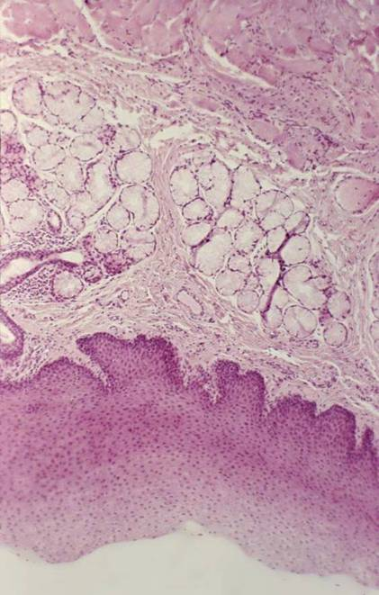
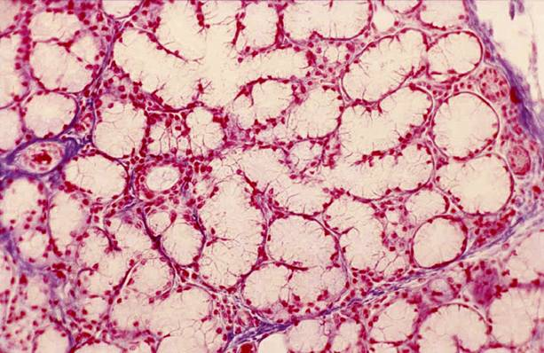
Tela submucosa
Oral mucosa
(lining type)
gll. palatinae

Slide 26
Soft palate(palatum molle)
Movable mucosal fold terminated by a uvula – uvula (gr. staphylos)
Interposed between the oral cavity and nasal fossae
Core tissue - aponeurosis palatina, composed of tendons and muscles of striated muscles (mostly m. tensor veli palatini)
- Nasal aspect - mucosa of respiratory passages and tela submucosa with mixed glandulea (glandulae nasales)
- Oral aspect - lining mucosa, dorsally passes to the nasal aspect (over uvula)
between mucosa nad aponeurosis is submucous coat with mucinous glandulae (glandulae palatinae)

Slide 27
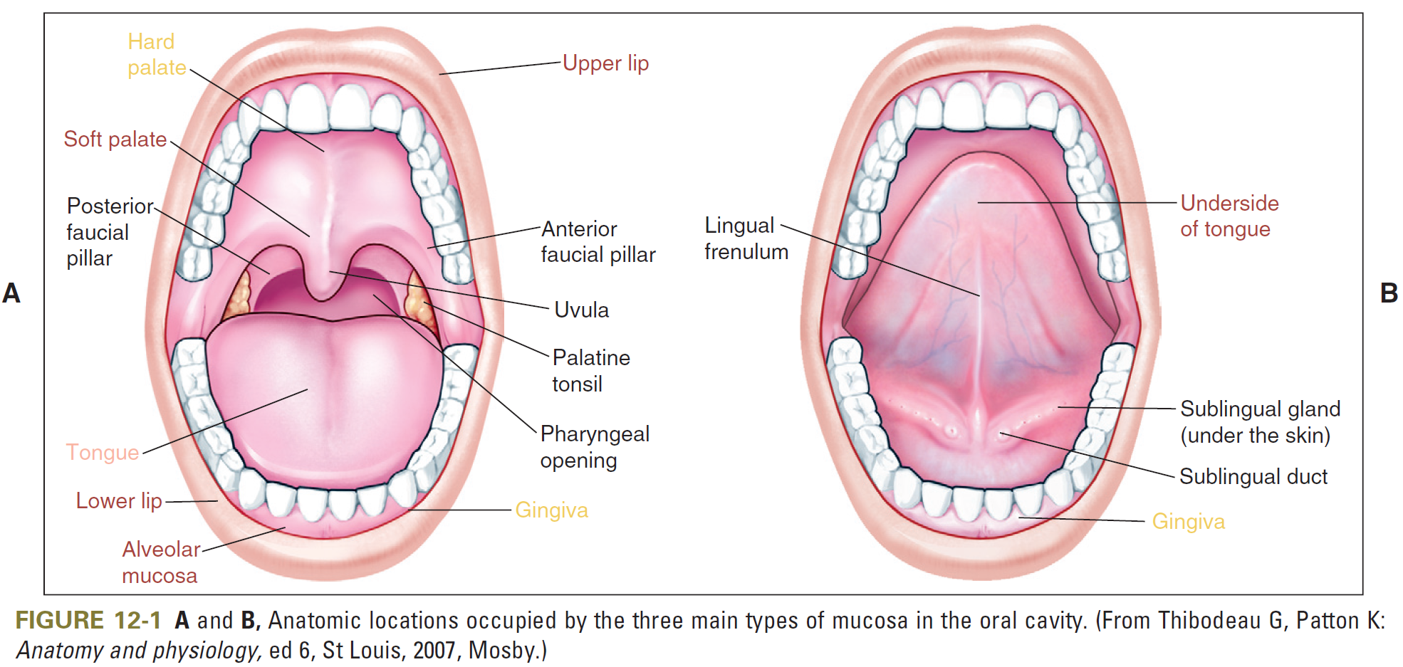

Slide 28
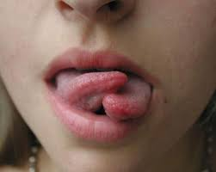
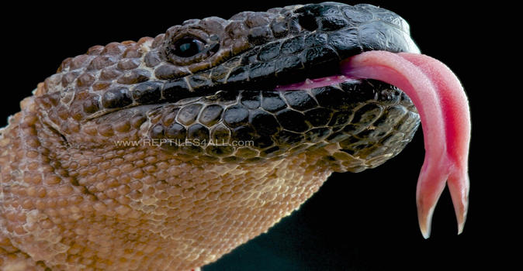
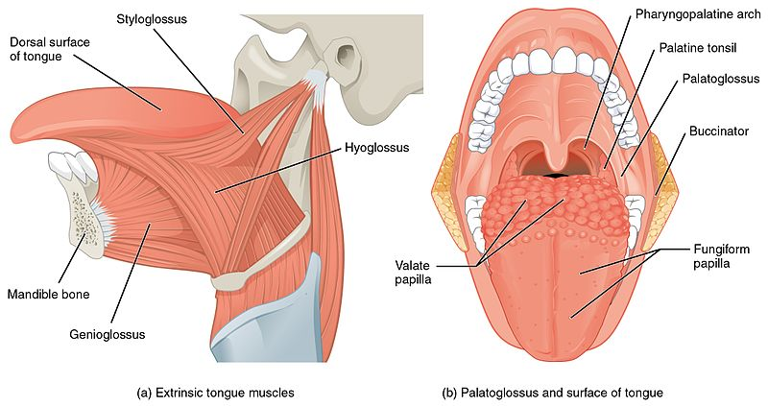
Tongue
Lingua (lat.)
Glossa (gr.)
radix
Base: intra- and extraglossal striated muscles
Evulutionary: developed in terrestrial vertebrates and amphibians (tetrapods) from muscles of oral floor

Slide 29
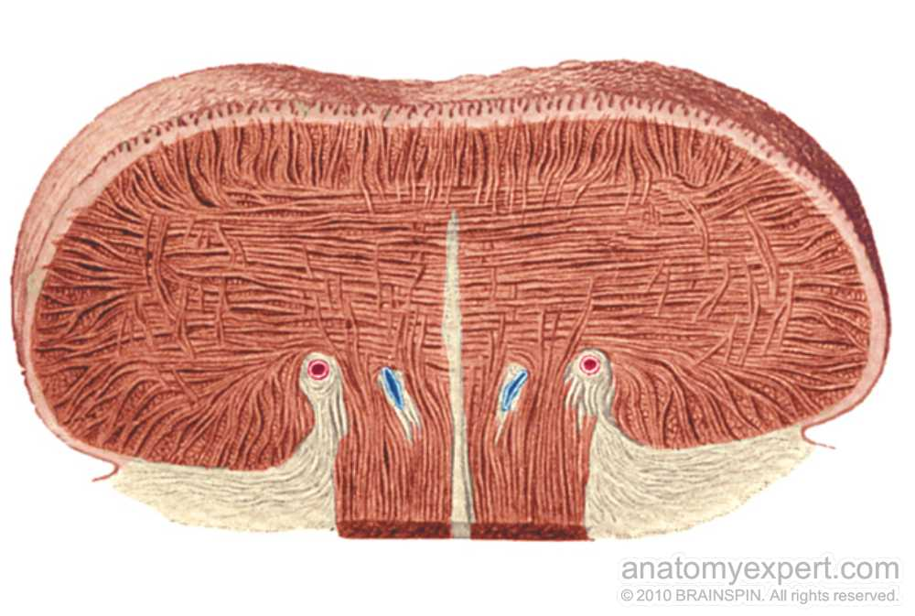
Surface
Dorsum linguae
Specialized oral mucosa
Inferior aspect
Lining mucosa
Fibrous parts
aponeurosis linguae
very stiff fibrous membrane
septum linguae
Composed from dense collagenous tissue

Slide 30
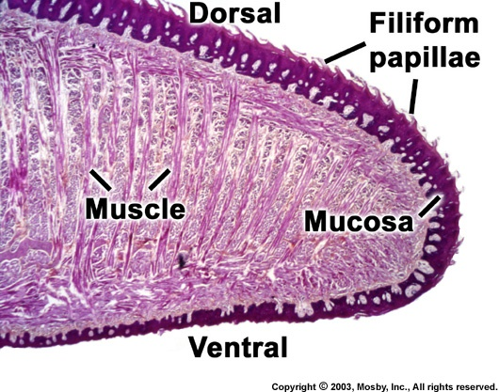

Slide 33
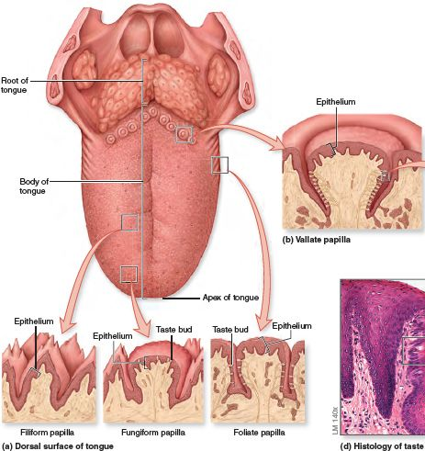
Dorsum lingue
Specialized oral mucosa
Firmly connected with aponeurosis linguae
Rough surface
Mucosal outgrowths - lingual papillae
Covered by nonkeratinized squamous stratified epithelium (except of papillae filiformes)

Slide 34
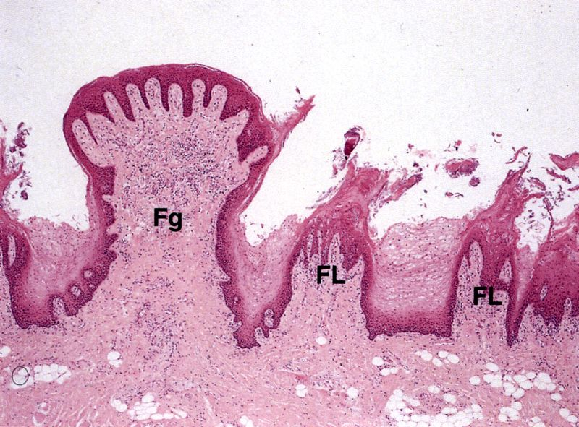
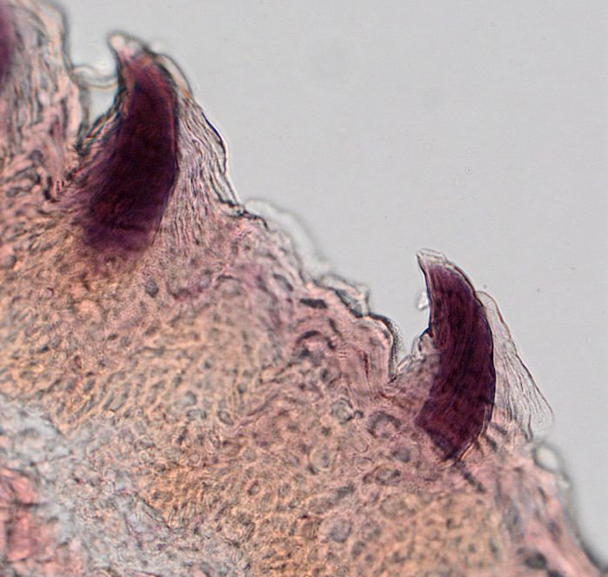
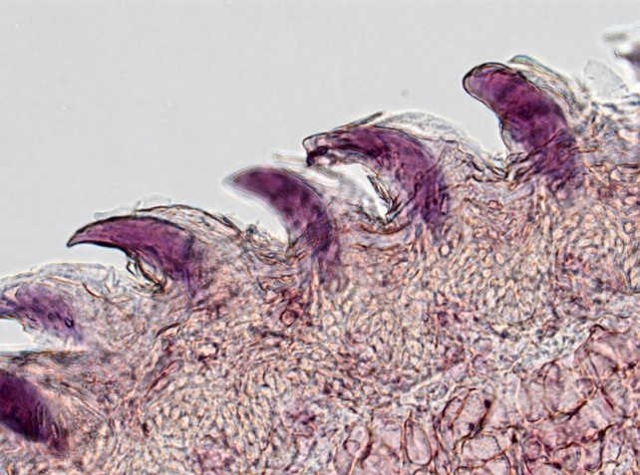
Papillae filiformes
The most abundant and distributed over the entire dorsal surface of the tongue;
Brush-like appearance (0.5-1 mm in height, 0.2-0.3 mm in width);
The stratified squamous epithelium is often cornified
Papillae fungiformes
Mushroom-shape (0.5-1.5 in height, 0.5–1.0 mm in width)
Taste buds in epithelium

Slide 35
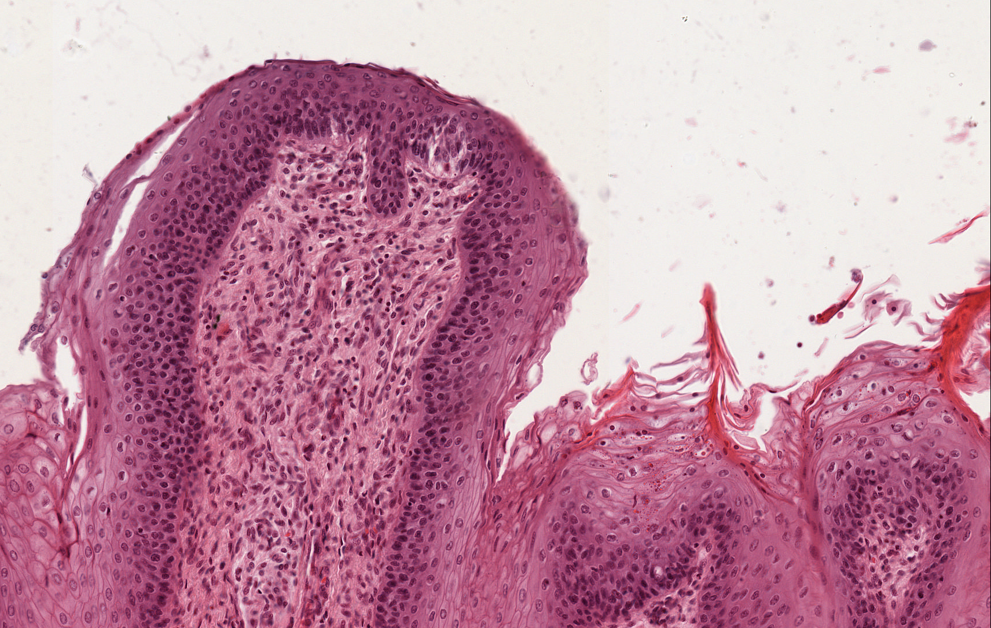
Keratinisation differences
Taste bud

Slide 36
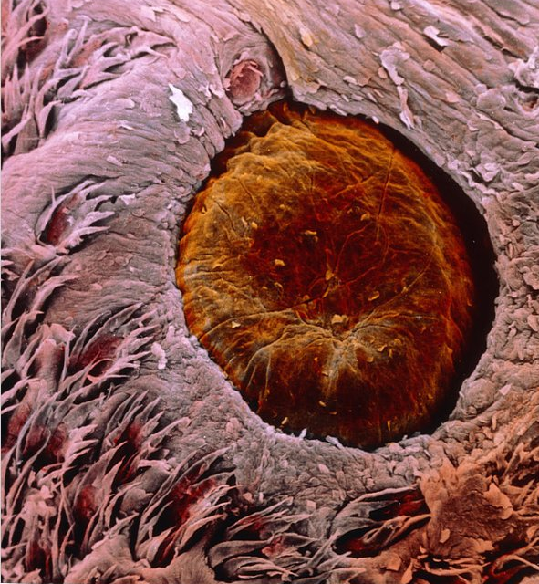
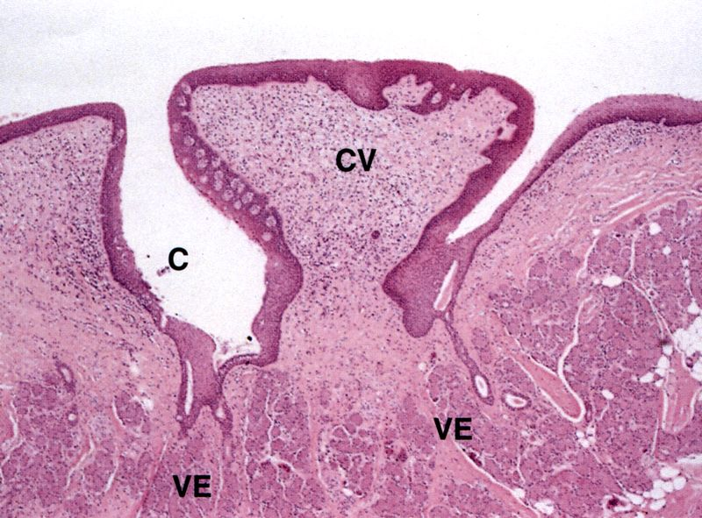
Papillae vallatae (Papila circumvallata)
Largest (1-4 mm in height, 1-3 mm in width), 7–12 just in front of sulcus terminalis, submerged into mucosa. Deep circumpapillary furrow.
Taste buds

Slide 37
Taste bud
Duct (V) of Ebner´s gland opening on bottom of an circumpapillary furrow.

Slide 38
TASTE ?
Basic tastes:
Sweet
Salty
Sour
Bitter
Umami
Suggested:
Fatty
Metalic
sweet, umami, sour, salty, and bitter—the so-called “basic” tastes (Fig. 1). There are likely additional qualities such as fatty, metallic, and others that might also be considered basic tastes.

Slide 39
Samples:
labium oris (1)
palatum molle (5)
apex linguae (2)
papilla vallata (3)

