Slide 1
Salivary glands intro to teeth
Jan Krivanek
24.3.2021

Slide 2
Lecture 2
Overview of the salivary glands of the oral cavity and their microscopic structure
Large salivary glands - topography, structure and description.
Saliva
Phylogenesis and comparative anatomy of teeth
Tooth and periodontium
Hard tissues of the tooth - composition and properties
Overview of methods used to study the microscopic structure of teeth (ground sections, sections of decalcified teeth, SEM, confocal microscopy)

Slide 3
Salivary glands - glandulae salivariae
Exocrine glands with watery, mucous or mixed secretions
Formed by proliferation of the ectoderm of the primitive oral cavity into the ectomezenchyme (composite organ)
Salivary glands classification
According to the type of secretory compartments and the nature of the secretion:
serous - acini
mucinous - tubules
mixed - acini, tubules + tubules with Gianuzzi lunules (tubuloacinary units)
According to size:
large – gl. parotis, gl. submandibularis a gl. sublingualis
small – in tela submucosa, the number of 800 - 1000

Slide 4
General structure of large salivary glands
Ligament capsula fibrosa
septa (+ vessels, nerves, interlobular and larger ducts)
Parenchyma lobes Glandular compartments
(serous acini, mucinous tubules, serous lunules)
Ducts
(intercalated, striated,
interlobular, main)

Slide 5
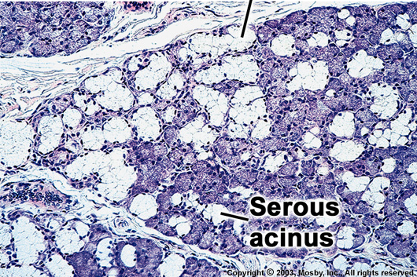
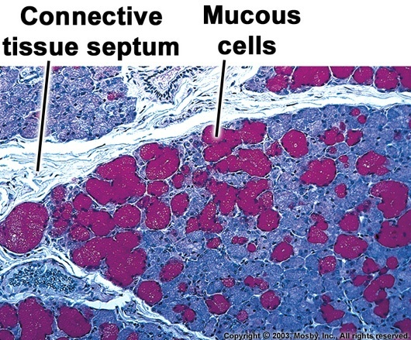
Structural components of the salivary glands
Ligament
gl. parotis and gl. submandibularis ligament forms
capsule
gl. sublingualis and gl. lingualis anterior capsule incomplete septa
Glandular tissue (parenchyma)
The lobules contain:
secretory compartments: serous acins, mucinous tubules or tubules with Gianuzzi lunules +
2 parts of the duct system - intercalated and striated ducts
(interlobular and main - in septal ligament)

Slide 6
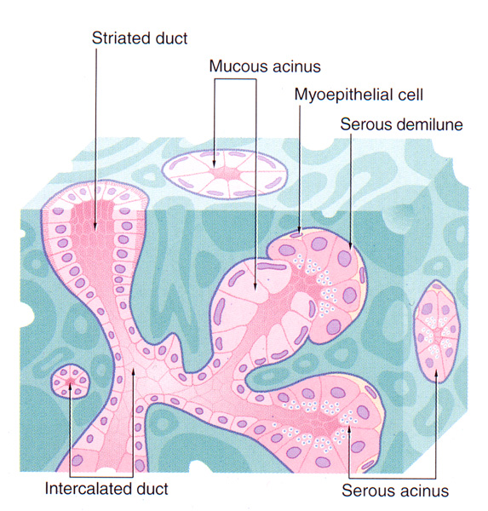
tubules
Wall of secretory compartments:
basement membrane
myoepithelial cells
glandular cells
Wall of intecalated and striated ducts
basement membrane
myoepithelial cells (interalated ducts only)
Epithelial cells

Slide 7
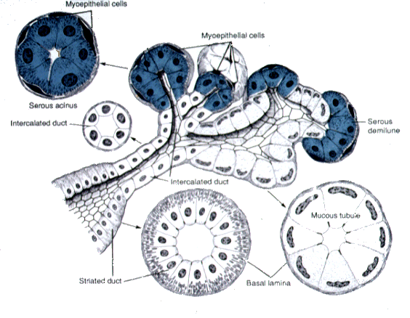
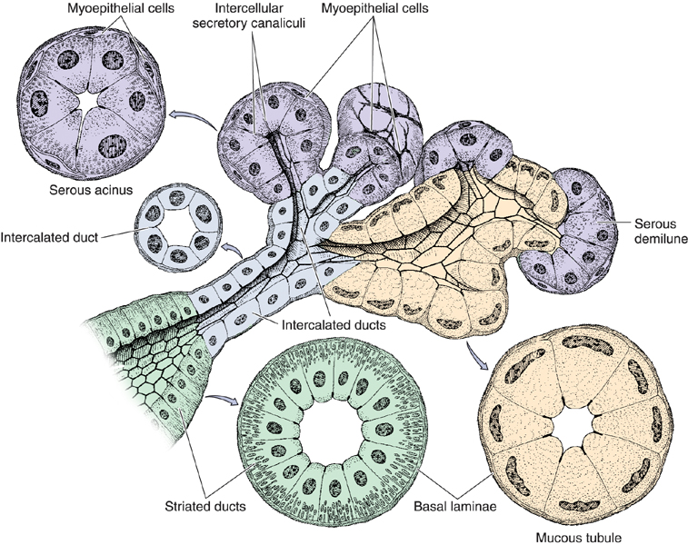

Slide 8
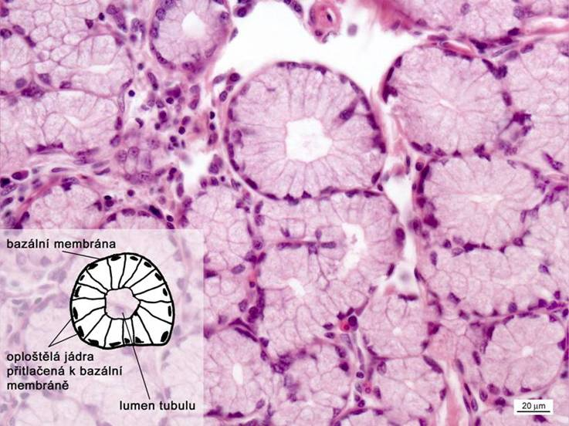
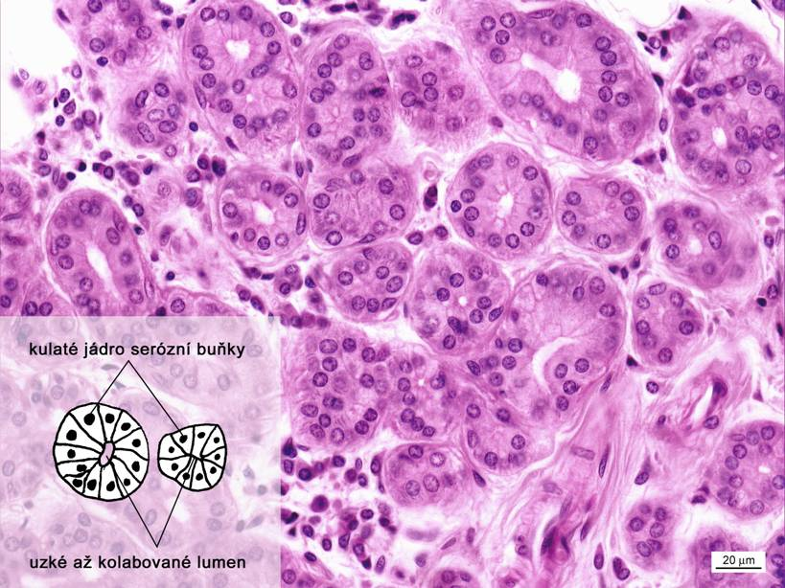
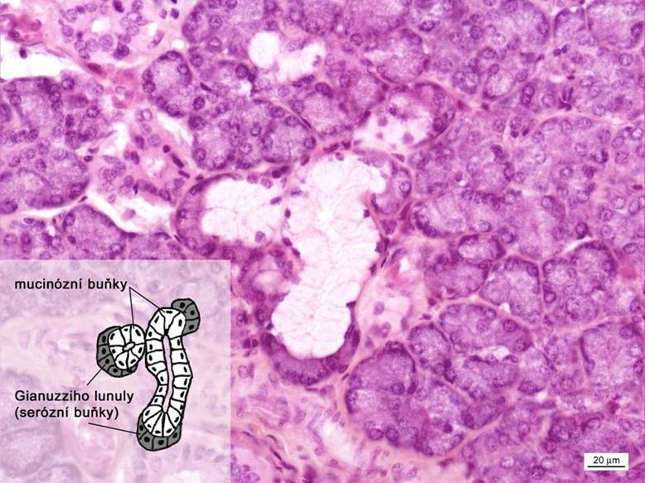
Secretory compartments
Mucinous tubules
Serous acini
Tubules with lunules

Slide 9
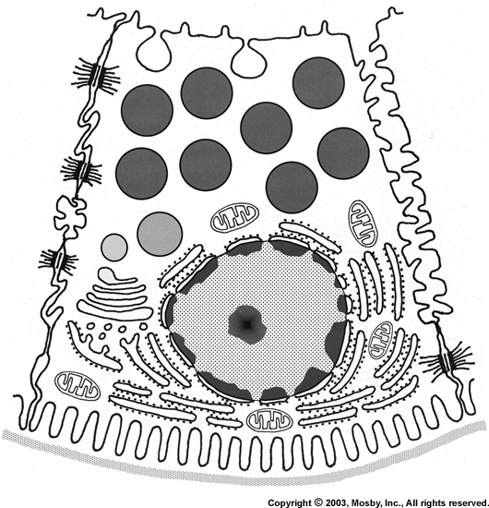
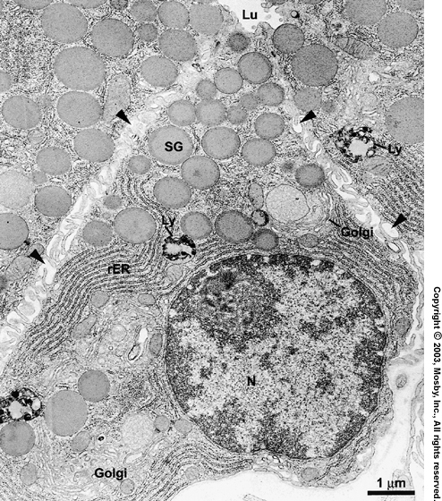
Serous acini
spherical to ovoid sacs (60 - 150 µm) with a narrow lumen
wall: serous cells, myoepithelial cells, basement membrane
Cells
pyramidal shape and spherical nucleus at the base
below the nucleus is a basophilic cytoplasm (rER, mitochondria and ribosomes)
supranuclear - eosinophilic secretory grains / zymogenic = proenzyme
(zymogen = inactive enzyme precursor)
Serózní buňky

Slide 10
Serous acini
Serous cells
Aqueous secretion, rich in proteins and enzymes

Slide 11
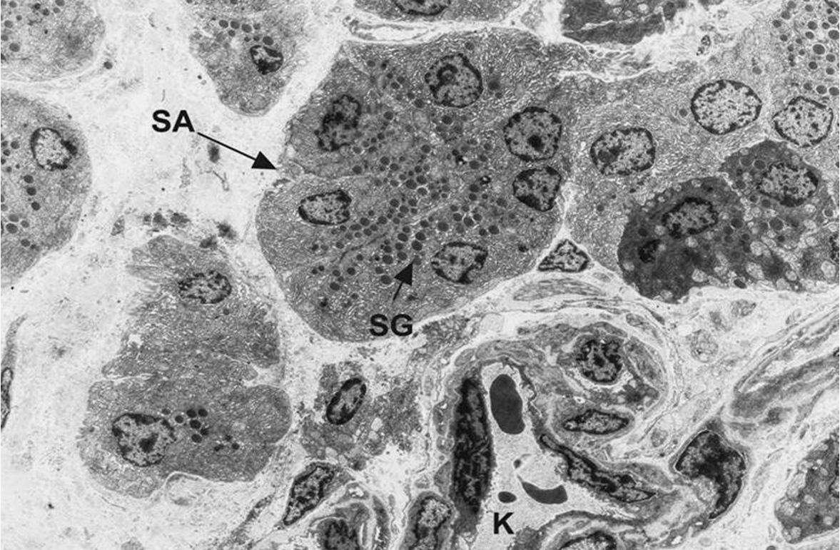
Rat salivary gland parenchyma: SA – serous acinus, SG – secretory granule, K – capillary. TEM, primary magnification 1,500x

Slide 12
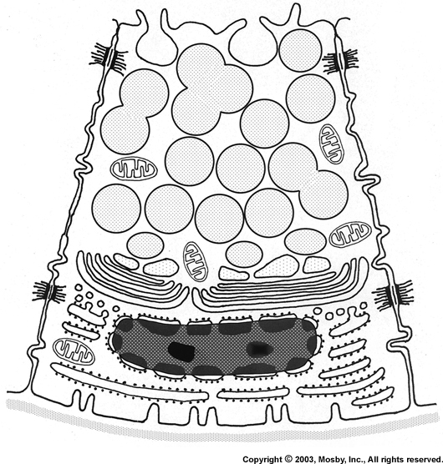
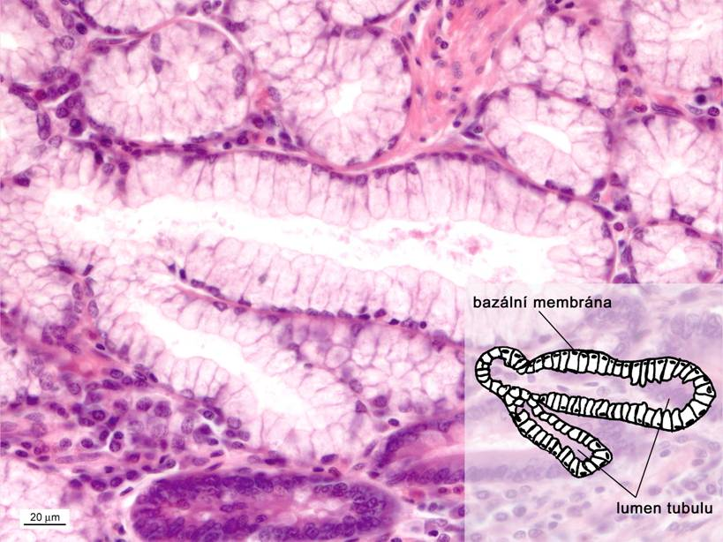
Mucinous tubules
Usually larger diameter than serous acins (about 200 μm), distinct lumen
On sections: transversely or longitudinally sectioned
Wall: cylindrical mucinous cells, myopithelial cells and basement membrane
Flattened nuclei
Apexes - numerous grains of mucinogen
Viscous mucus secretion

Slide 13
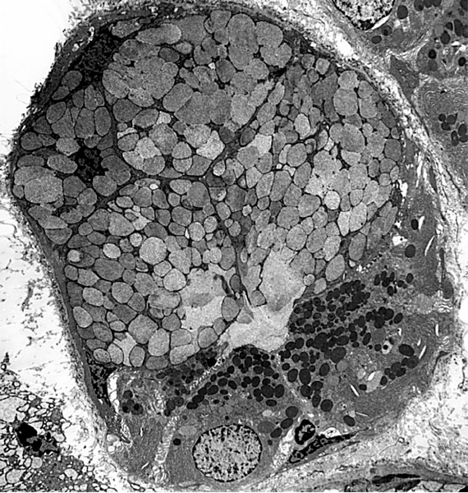
Tubules with lunules (Gianuzzi) - tubuloacinary units
Lunule (demilune) = aggregation of serous cells at one or both ends of a mucinous tube, similar to a demilunes

Slide 14
Secretory compartments
Mucinous tubules
Serous acini
Tubules with lunules

Slide 15
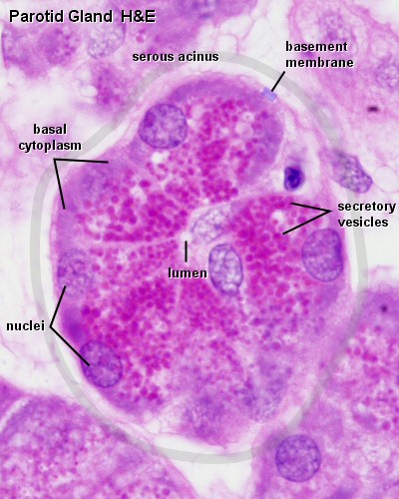
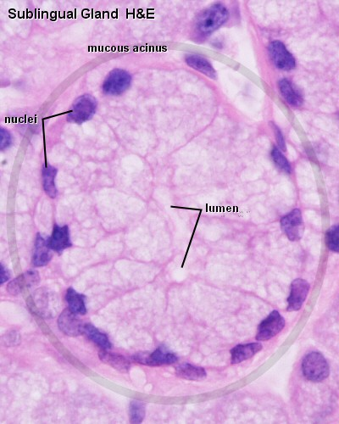
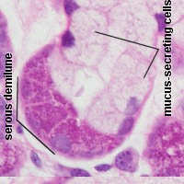
Secretory compartments
Serous acini
Mucinous tubules
Lunules (demilunes)

Slide 16
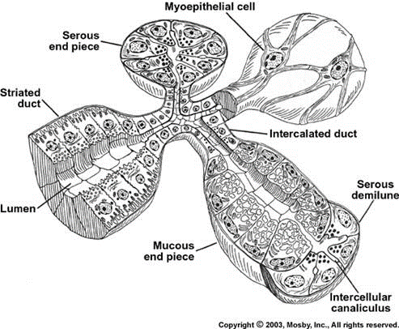
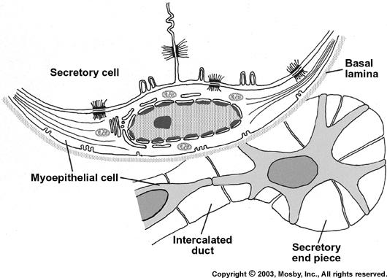
Myoepithelial cells
Capable contractions, Vegetative control
They regulate secretion, control nutrient supply and control electrolytes
Inserted between the bases of secretory cells (acins and tubules) and the basement membrane
Flattened body, several protrusions, between secretory and myoepithelial cells numerous desmosomes or hemidesmosomes
In the cytoplasm actin microfilaments (bundles) + cytokeratin filaments

Slide 17
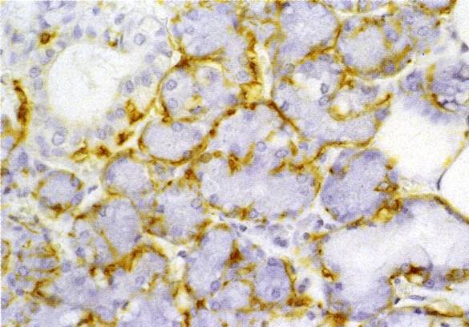
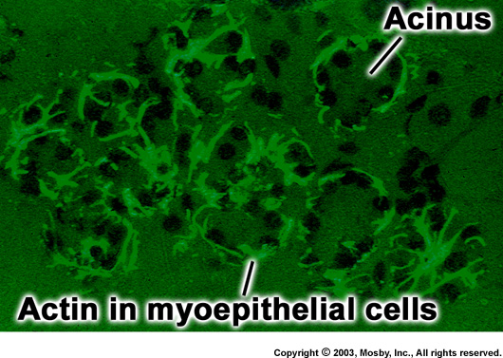
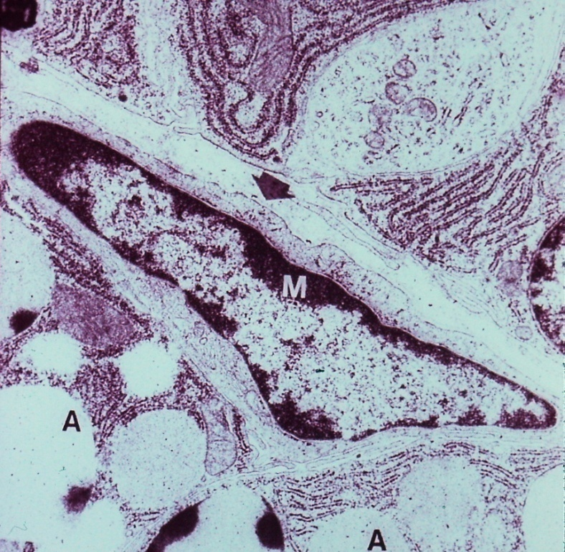
The cells help to release the secretion into the lumen of the secretory compartments and its further passaged through the inserted ducts (in the wall of which they are also present)
Origin: Neural crest, active from the 25th week of development

Slide 18
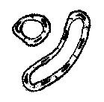
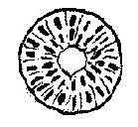
Salivary ducts types
– Intercelual (they do not have their own wall, intercellular space)
– Intercalated (simple squamous ep., only serous and mixed glands)
– Striated (simple cuboidal/low columnar ep.; basal labyrinth➔ striation)
– Interlobular (simple – stratified columnar ep., in septs)
– Main (stratified columnar ep.)
Intercellular
Striated
Main
Ducts
Intercalated
Interlobular

Slide 19
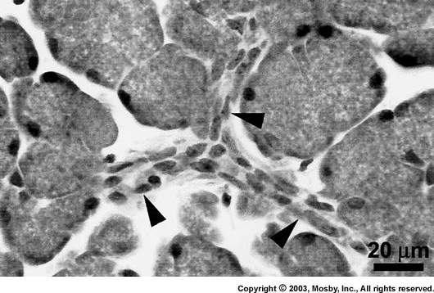
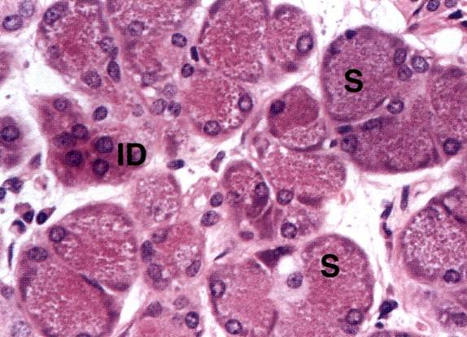
Intercalated ducts
Narrow and thin-walled channel, collapsed on slides
Wall: basal membrame, myoepithelial cells and simple squamouse to low cubic ep.
Numerous in serous type of glands
(cells of intercalated ducts secrete to saliva macromolecular substances: lysozym + lactoferin)

Slide 20
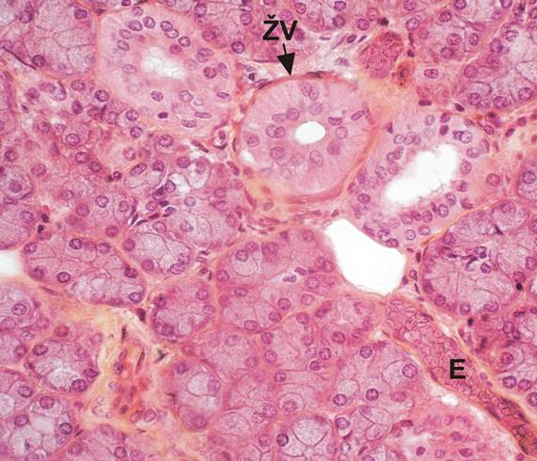
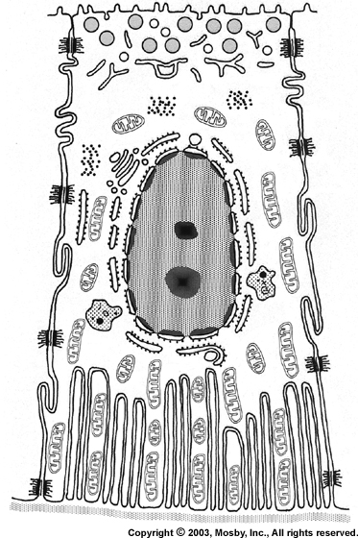
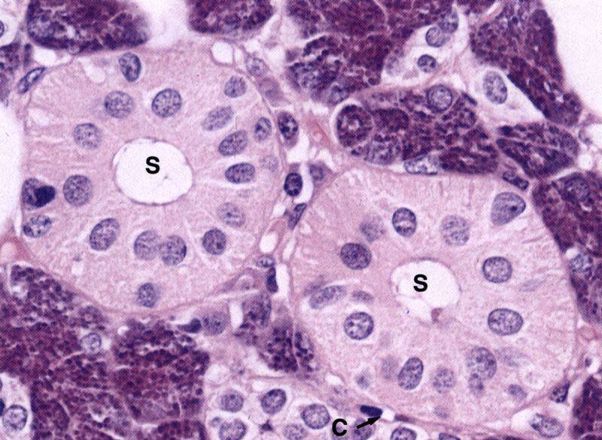
Striated ducts
Wider than the intercalated ducts (easy to find), usually in the middle of lobe
Wall: Basal membrane and simple cuboidal/low columnar ep.
Microvilli on apexes and an bases characteristic striation (basolateral labyrinth)
In the cytoplasm of cytokeratin filaments
The cells of striated ducts regulate the content of water and electrolytes (Na+, K+, Cl-, Ca2+, Mg2+, HCO3-) in the secretion.
Resorption of Na+, and Cl-
Secretion of K+ and HCO3-
nerve control
Glandula submandibularis

Slide 21
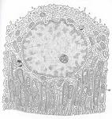
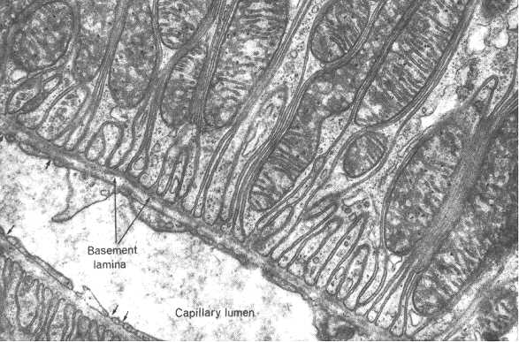
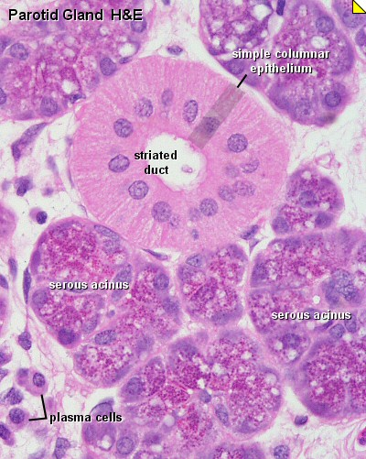
Striated duct – basal labyrinth
Epithelial cell
Base of epithelial cell:
Invagintion of cytoplasmic membrane, numerous mitochondria

Slide 22
Interlobular and main ducts
Interlobular ducts
Located in fibrous septae between the lobes (columnar or stratified columnar epithelium)
They are formed by the connection of several striated ducts
Lined by a high single-layer columnar and in the terminal sections also a stratified columnar epithelium
Main ducts
Stratified columnar ep. with goblet cells
Ductus parotideus
Ductus submandibularis
Ductus sublinguales (major et minores)

Slide 23
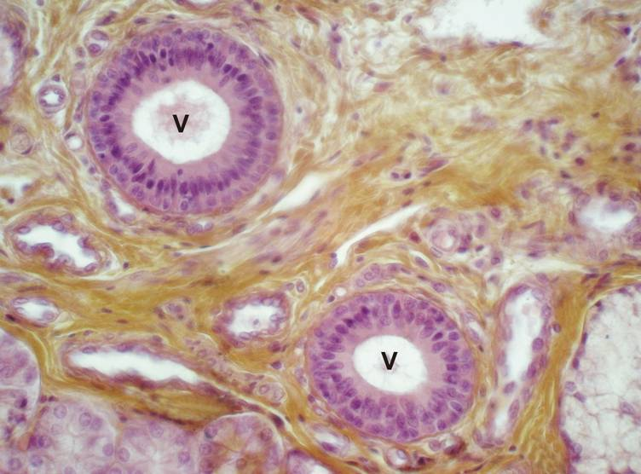
Main ducts
Stratified columnar ep.
In epithelium Goblet cells
Wall supported by the dense collagenous
connective tissue and smooth muscle cells
Ductus Rivini (V) – septum of gl. sublingualis.

Slide 24
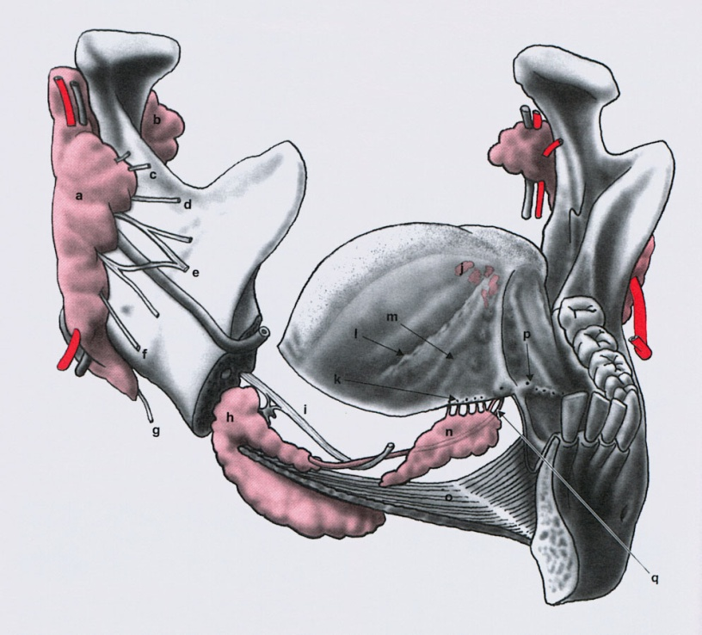
Topography od large salivary glands
Ductus sublinguales (major et minores)
Ductus parotideus
Ductus submandibularis

Slide 25
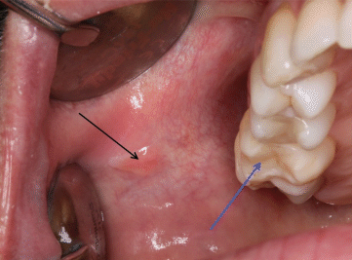
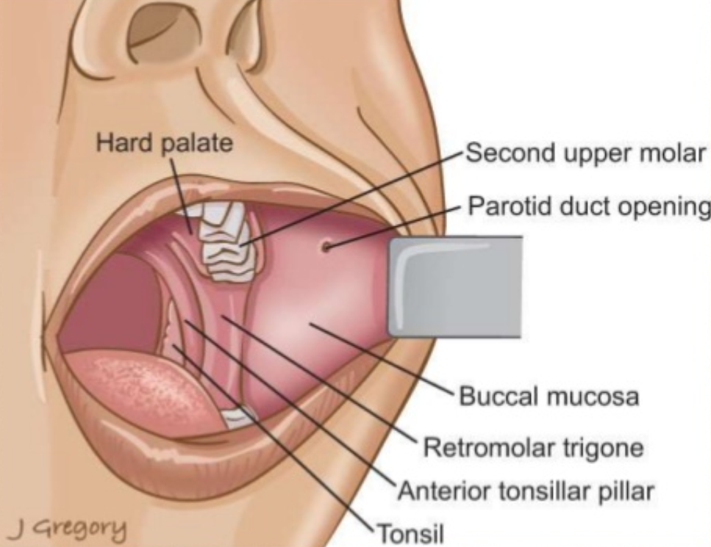
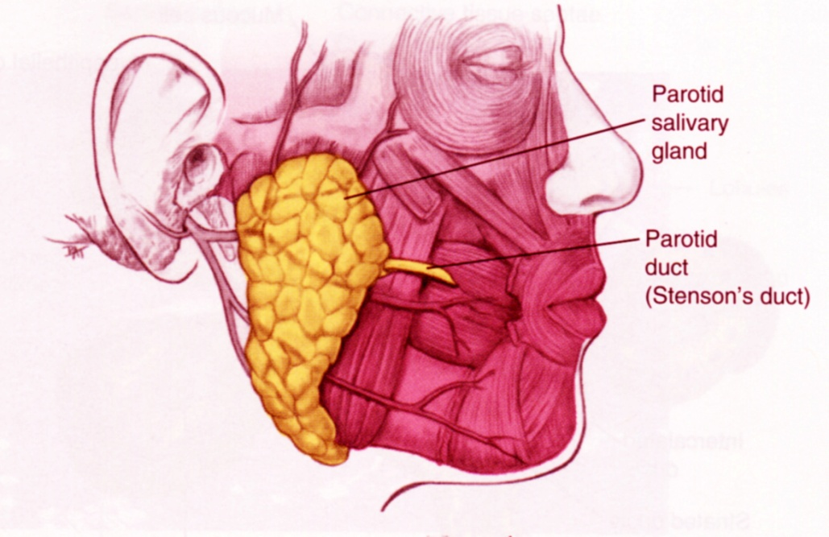
Glandula parotis
SEROUS gland
14 - 28 g
capsule, septs and lobules
Serous acini, ducts: long intercalated ducts, numerous of striated ducts
ductus parotideus (Stenoni) - 2. upper molar (Steno/Stensen, Niels)
adipocytes
Papilla parotidea

Slide 26
Glandula parotis

Slide 27
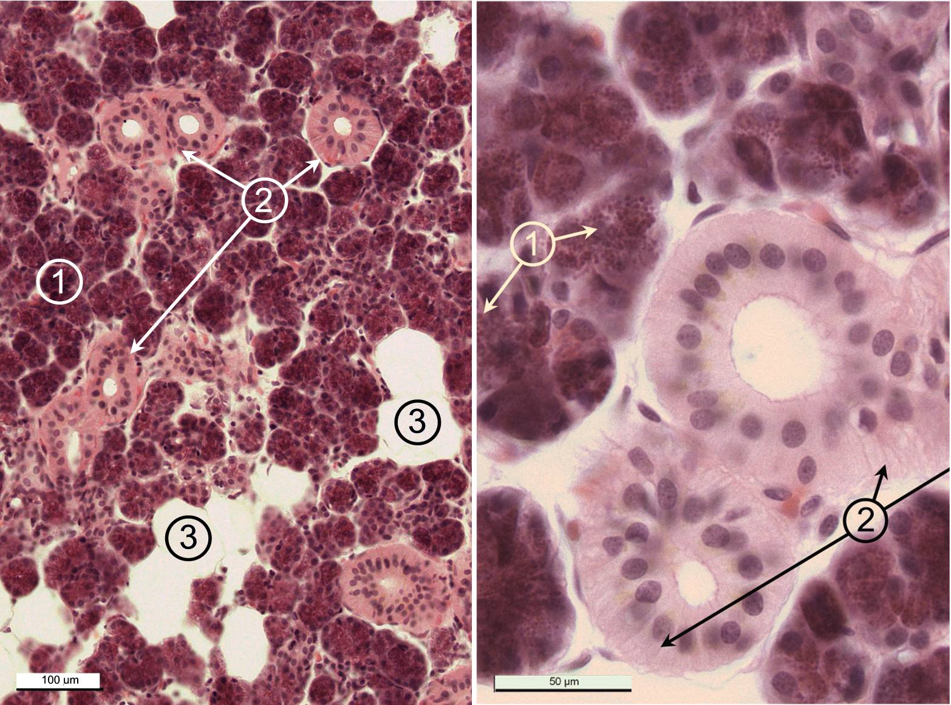

Slide 28
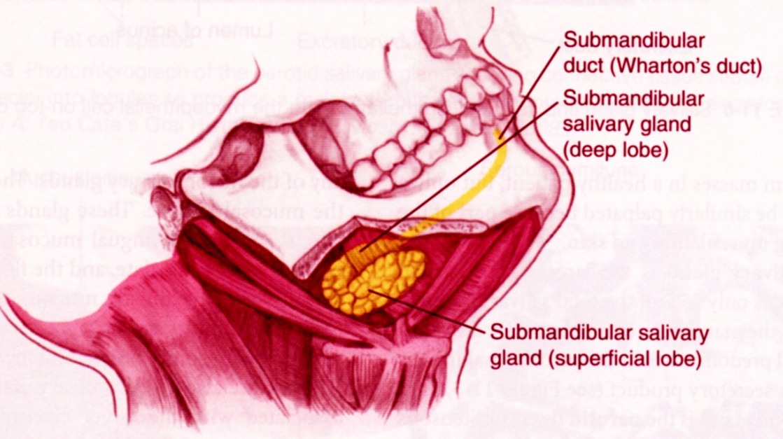
Glandula submandibularis
MIXED tuboalveolar gland, predominantly SEROUS
10-15 g
serous acini - 80 %, rest are mucinous tubules with Gianuzzi demilunes
intercalated and striated ducts
ductus submandibularis (Whartoni) - frenulum linguae
trigonum submandibulare

Slide 29
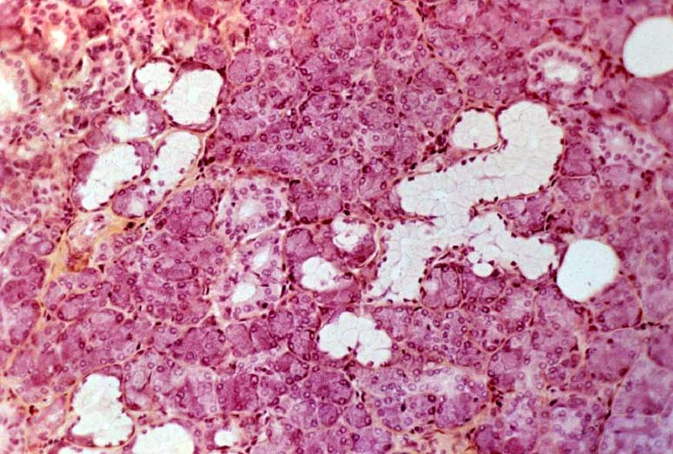
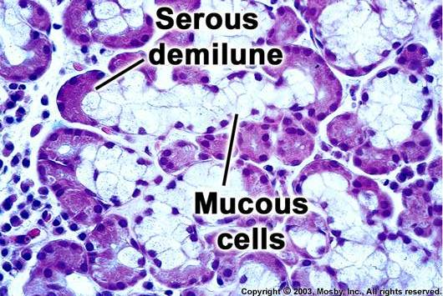
Glandula submandibularis

Slide 30
Glandula sublingualis
MIXED tuboalveolar gland, predominantly MUCOUS
2g
located on the floor of the mouth on mylohyoid muscle near the midline
Mucinous tubules, serous acini are rare, instead of them: Gianuzzi demilunes
Intercalated ducts are missing, striated ducta are present, but are reduced in number and short
ductus sublingualis major (Bartholini)
ductus sublinguales minores (Rivini)
along the crest of the plica sublingualis

Slide 31
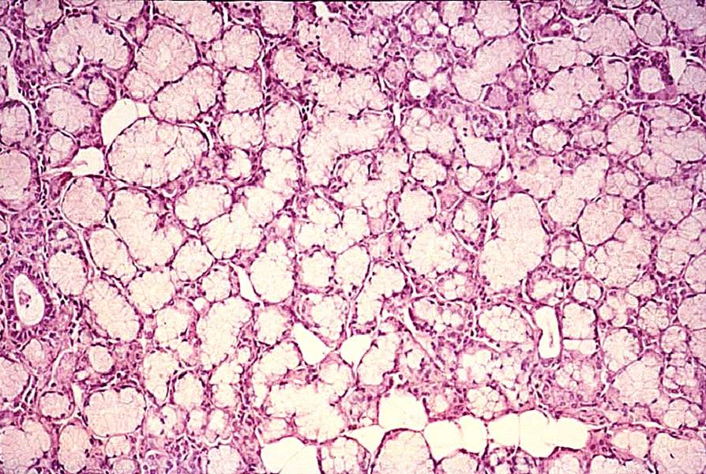
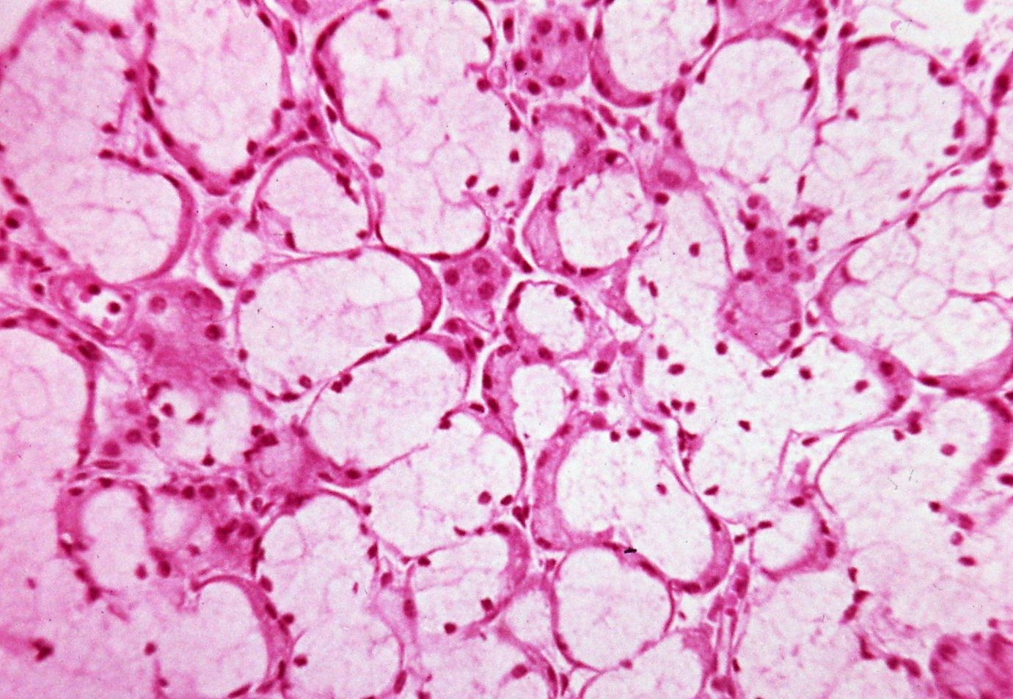
Glandula sublingualis

Slide 32
Comparison of major salivary glands
 | PAROTID | SUBMANDIBULAR | SUBLINGUAL
Size | Largest, encapsulated | Intermediate, encapsulated | Smallest, no capsule
Location | Behind mandibular ramus, anterior and inferior to ear | Beneath the mandible | Floor of the mouth
Main ducts | Parotid duct (Stenson's): opens opposite maxillary second molar on buccal mucosa | Submandibular duct (Wharton's): opens near lingual frenum on floor of mouth | Sublingual duct (Bartholin's): opens at same area as submandibular duct; may have additional ducts (Rivini) at submandibular folds
Striated ducts | Short | Long | Rare or absent
Intercalated ducts | Long | Short | Absent
Feature of gland | True serous | Mixed (the serous component outnumber the mucous) | Mixed (the mucous component outnumber the serous)
% of total saliva volume | 25% | 55-65% | 5-10%

Slide 33
Saliva
Product of all salivary glands of the oral cavity
1.0-1.5 liters / day (0.3-0.6 ml / min)
Small glands 10 % / large glands 90 % (gl. Parotis 25 %, gl. Submand. 60-65 %, gl. Sublingualis 10 %)
Clear or slightly opalescent viscous liquid, slightly acidic pH: 6.8 (6.5 - 7.2)
It consists of a liquid and solid component:
Liquid: water (95%)
ions - Na +, K +, Cl-, Ca2 +, Mg2 +, HCO3-, etc.
proteins: amylase (ptyalin) and maltase, peroxidase, lysozyme, lactoferrin
glycoproteins - mucus (mucin)
immunoglobulins (Ig A, IgG and IgM)
small organic molecules (glucose, amino acids, urea, uric acid, etc.)
Formed: removed dead cells of the epithelium of the oral cavity,
salivary bodies (altered lymphocytes) and
non-pathogenic saprophytic bacteria
2 stages of saliva production: primary saliva (isotonic) – before passing through striated ducts and definitive saliva (hypotonic) - was modified by striated ducts

Slide 34
Saliva function
Protective: forms a thin film on the surface of the mucosa and teeth - a salivary film
stimulates repair processes in the oral cavity
participates in remineralization and maintains tooth integrity
ensures moisture and self-cleaning of the oral mucosa
protects teeth from bacteria
Antimicrobial: proteins with bacteriostatic effect - lysozyme, peroxidase, lactoferrin, etc.
Moisturizing: moisturizes dry food and makes them easier to swallow
Digestive: initiates cleavage of polysaccharides (salivary amylase)
saliva is a sensitive indicator of oral health
(changes during periodontal disease, caries, candidiasis, etc.)

Slide 35
Location |  | Name | Type | Size
Lips |  | gll. labiales sup. et inf. | mixed, pred. mucinous | minor
Cheeks |  | gll. buccales | mixed, pred. mucinous | minor
 |  | gll. molares (retromolares) | mixed, pred. mucinous | minor
 |  | GL. PAROTIS | serous | MAJOR
Palate | hard | gll. palatinae (glandular zone) | mucinous | minor
 | soft | gll. palatinae | mucinous | minor
Tongue | Apex | gl. apicis lingue (Blandini-Nuhni) | mixed, pred. mucinous | minor/ major
 | Terminal sulcus | gll. Ebner‘s (gll. papillae vallatae) | serous | minor
 | Base | gll. Weber‘s (gll. linguales post.) | mucinous | minor
Floor of the mouth |  | GL. SUBMANDIBULARIS | mixed, pred. serous | MAJOR
 |  | GL. SUBLINGUALIS | mixed, pred. mucinous | MAJOR

Slide 36
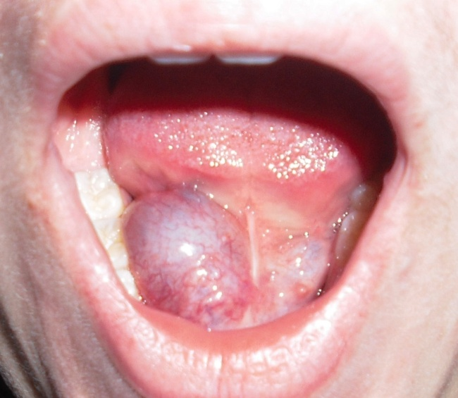
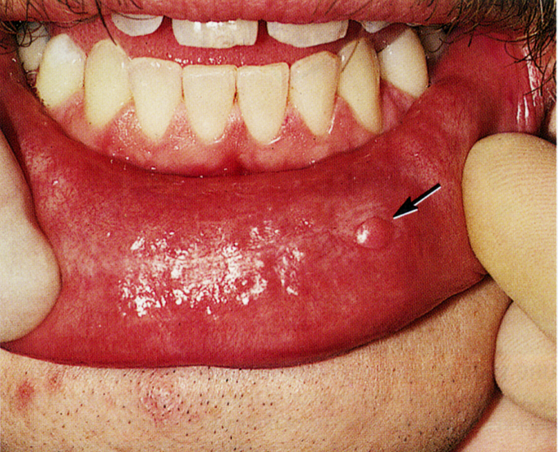
Pathology (diseases) of the salivary glands
Sialadenitis (sialoadenitis) – inflammation of the salivary glands, of bacterial or viral origin
Sialolithiasis - saliva in the ducts becomes a viscous to such an extent that the concentrated secretion can secondary calcify - prevents drainage - impermeability of the outlets
Sialolithiasis in small salivary glands - dilatation of secretory compartments (mucocele), and enlargement of glands
In case of obstruction of the ductus submandibularis - large retention cyst located at the base of the oral cavity - ranula

Slide 37
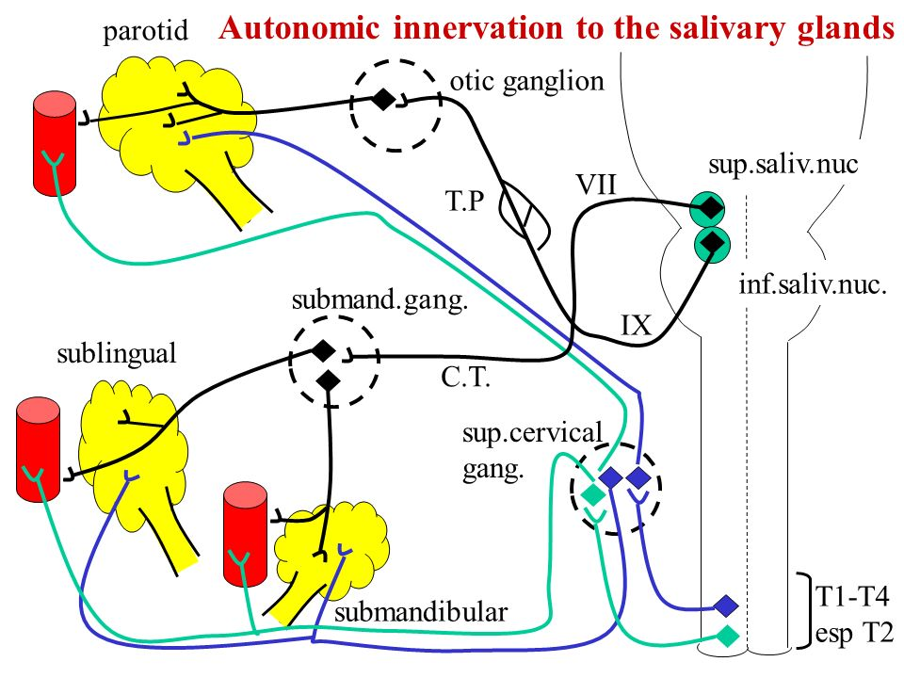
Control of salivary gland function
Autonomic nervous system: efferent fibers enter the glands from the parasympathetic and thoracic sympathetic fibers, forming dense network on the surface of the secretory compartments and ducts
Stimulation of sympathetic fibers reduces saliva production
Stimulation of parasympathetic fibers increases saliva production
small salivary glands secrete constantly
the large salivary glands secrete only on stimulus
(eg chemical, mechanical, etc.).
Atrophy of the glandular parenchyma
atrophy accompanies some systemic diseases,
drug-induced, irradiation
Consequence: hyposalivation - xerostomia ("dry mouth")

Slide 38
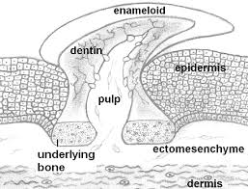
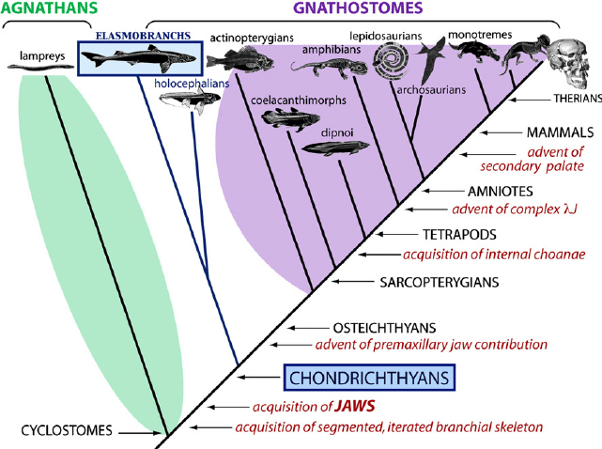
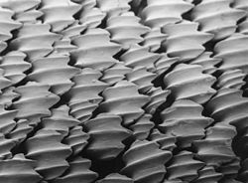
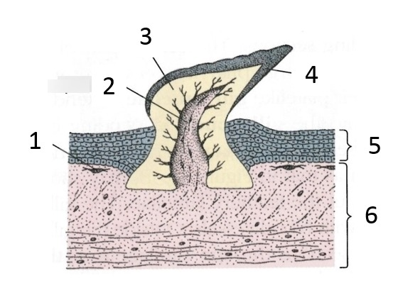
Basics in the phylogenesis and comparative tooth anatomy
Teeth - calcified structures that derive from the ectoderm and ectomezenchyme (neural crest)
Evolutionarily in phylogeny, they appear only in the jawed vertebrates – Gnathostomata
Ancestor of teeth - placoid scales in fishes that covered the surface of the body and the oral cavity

Slide 39
Phylogenetic classification of teeth
According to the shape of the tooth and the shape of the crown:
Haplodontic teeth - shape of simple cones (preserved in some fish and amphibians) - picture C
Protodont teeth - they also have a conical shape, but the crown is distinguished into anterior and posterior humps (fossil marsupials)
Triconodontal teeth - with a crown consisting of 3 bumps, which are placed in one row in the direction of the dental arch (ancestors of mammals) - Fig. D
Tritubercular teeth - crowns also have 3 bumps, which formed 2 rows: buccal and lingual (marsupials, insectivores, beasts and ungulates) - fig.E

Slide 40
Number of teeth - species characteristic, variable, approx. 15 - 170 teeth.
The number of teeth is an important taxonomic feature.
Human: 32
I₁ I₂ C P₁ P₂ M₁ M₂ M₃
permanentní dentice – LH kvadrant

Slide 41
Set of all teeth = dentition

Slide 42
Set of all teeth = dentition
Types of dentition
Shape of teeth: homodont - identical in shape
heterodont - different in shape
(in mammals dentes incisivi, canini, praemolares and molares)
According to the number of replacements (sets of teeth) during life:
monofyodont - e.g., Holocephala - chimeras)
difyodont (dentes decidui, dentes permanentes) – e.g. mammals
polyphyodont - e.g., fish, lower amphibians
According to the attachment of the teeth to the jaw:
acrodont - attach to the jaw from above (bony fish, amphibians)
pleurodont - on the jaw from the side (for reptiles)
thecodont - inserted into dental sockets –
recent mammals (dinosaurs, crocodiles)

Slide 43
Set of all teeth = dentition
Podle typu růstu zubů: Brachyodont - Long root
Hypselodont - No root – continuously-growing
Hypsodont - High crown
Mesodont

Slide 44
Human dentition is:
Heterodont
Thecodont
Diphyodont
Brachydont

Slide 45
Tooth numbering
Several possibilities
Beginning letter
incisors – dentes incisivi I₁, I₂/ i₁ , i₂
canines – dens caninus C / c
premolars – dentes premolares P₁, P₂ / p ₁, p ₂
molars – dentes molares M₁, M₂, M₃ / m₁, m₂, m₃
Number
international marking using "two-digit code"
(ISO System - International Standards Organization Designation system: teeth divided into quadrants (clockwise):
1 - 4 dentes permanentes
5 - 8 dentes decidui

Slide 46
Dentes permanentes
Dentes decidui

Slide 47
Directions
coronal vestibular (labial, bucal)
apical lingual (palatinal)

Slide 48
Distal
(towards the last molar)
Mesial
(towards the midline)
S

Slide 49
Tooth and dental socket, periodontium, gingiva
crown, neck, root

Slide 50
Tooth (dens)
gingiva
TERMINOLOGIE:
Dentes decidui (lactei) 20
Dentes permanentes 28-32
Corona dentis (crown)
Collum (neck)
Radix (root) 1-3
Cavum et canalis radicis dentis (cavity and root canal)
Pulpa dentis (pulp)
Foramen apicis radicis (opening at the tip of the root)
Alveolus
Periodontium

Slide 51
Cavitas dentis passing to canalis radicis dentis
Anatomical vs clinical crown
Anatomical vs klinical root
Foramen apicis radicis Dentis

Slide 52
gingiva
cementum
Periodontal
ligament
alveolus

Slide 53
Tissues of tooth
Enamel - enamel, subst. adamantina (row adamas, adamantos = diamond steel), substantia vitrea (lat. vitrum = glass)
Dentin - dentin, substantia eburnea (l. Ebur = ivory)
Cementum - substantia ossea, crusta petrosa
Dental pulp - pulpa dentis

Slide 54
Comparison of the hard tooth tissues (and lamellar bone)
 | Enamel | Dentin | Cementum | Lamellar bone
Colour | White (to light blue) | Ivory | Brown-yellow | Brown-yellow
Inorganic (%) Organic (%) H₂0 (%) | 96 (86) 1 (2) 3 (11) | 70 (45) 20 (30) 10 (25) | 61 (33) 27 (31) 12 (36) | 45 (23) 30 (37) 25 (40)
Collagen fibres | NO | YES (perpendicular to the dentinal tubules) | YES (in all directions) | YES (same direction in lamellas)
Cells | Ameloblasts (missing in adults) | Odontoblasts (on the pulpal side of dentin) | Cementoblasts (cementocytes) | Osteoblasts osteocytes
Blood vessels | NO | NO | NO | YES (in Haversian canals)
Nerves | NO | YES (on entry of dentinal tubules) | NO | YES (in Haversian canals)

Slide 55
Lampres, cyclostomata

Slide 56
Babirusa

Slide 57
Tusks

