Slide 1
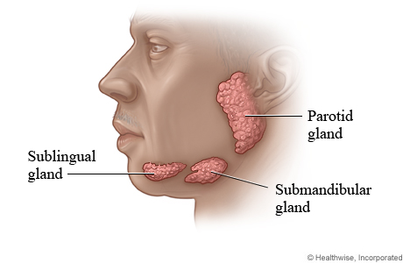
Practice 2
Major salivary glands
Tooth – introduction

Slide 2
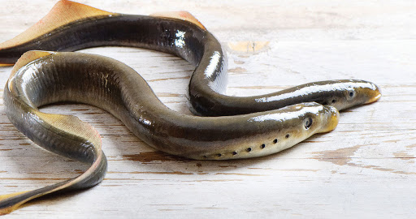
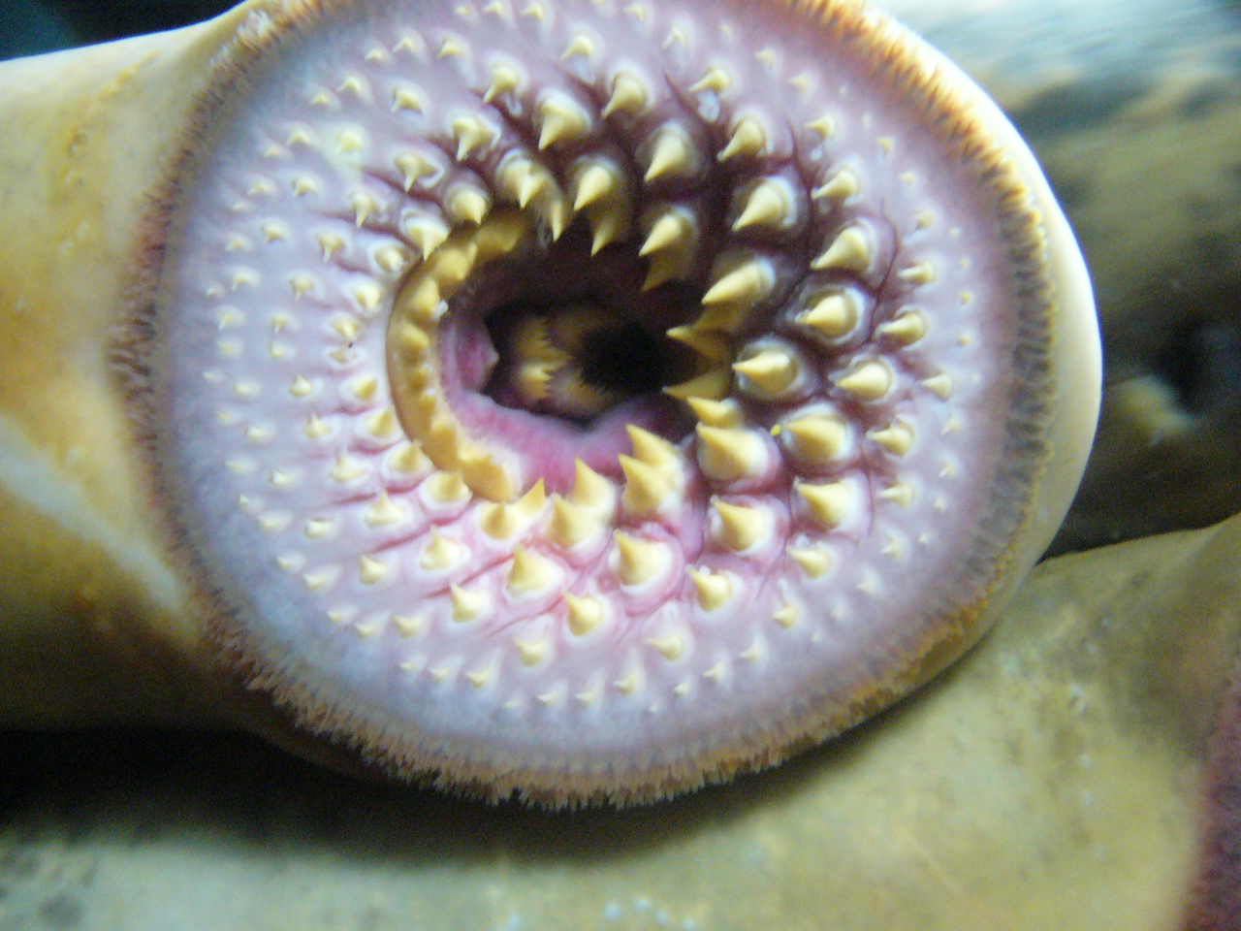
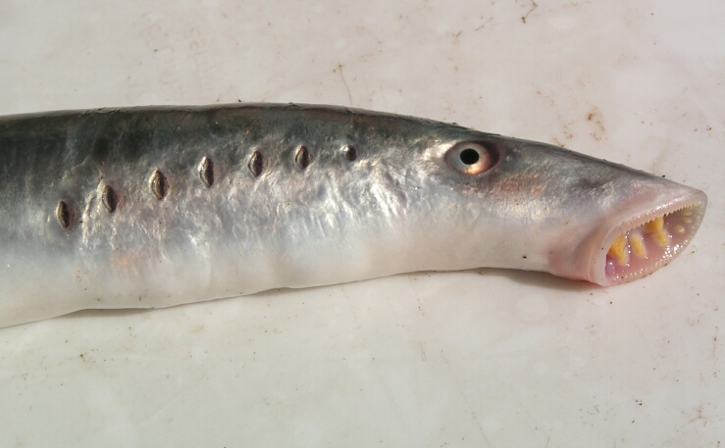
Mihule
(lamprey, cyclostomata)

Slide 3
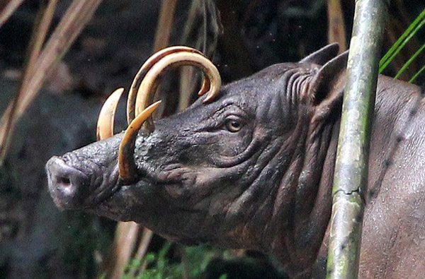
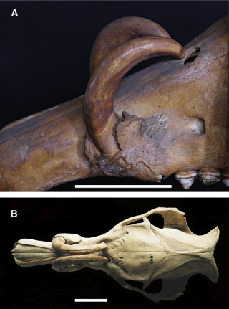
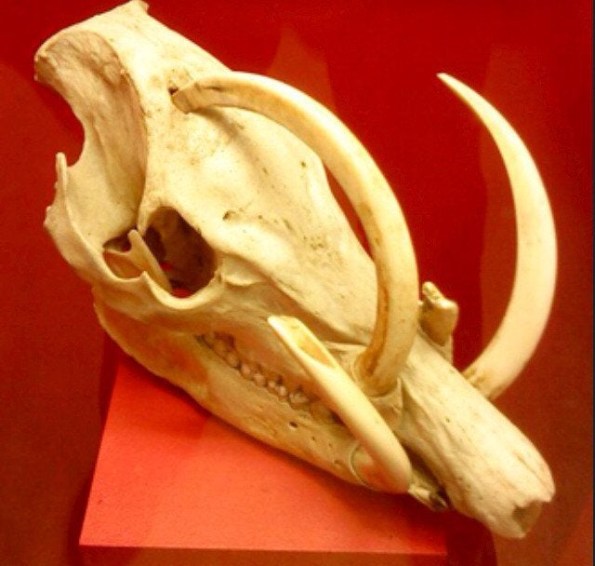
Babirusa

Slide 4
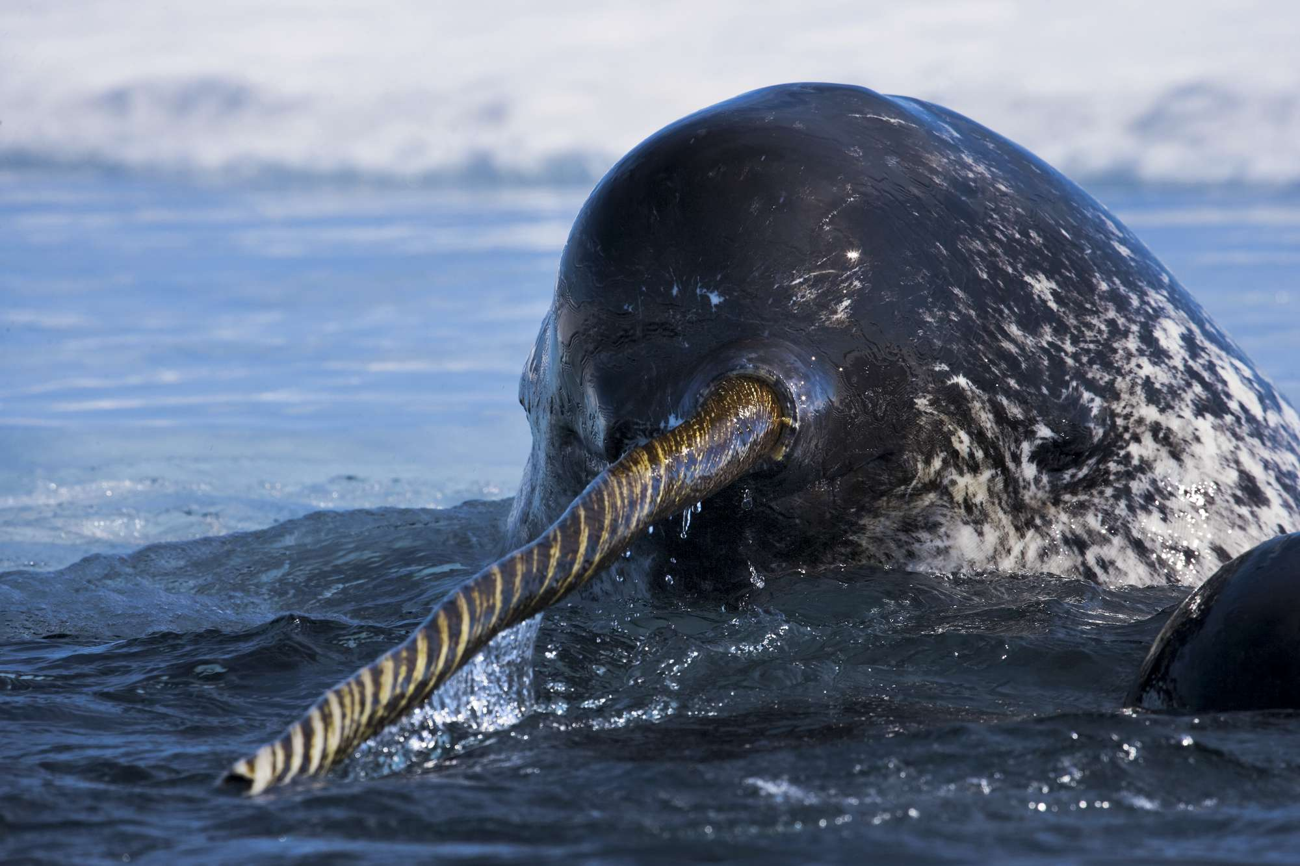
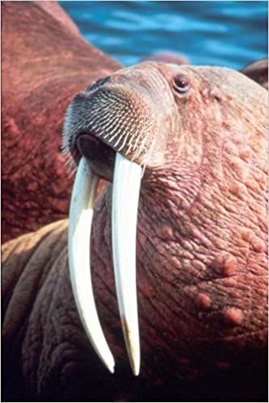
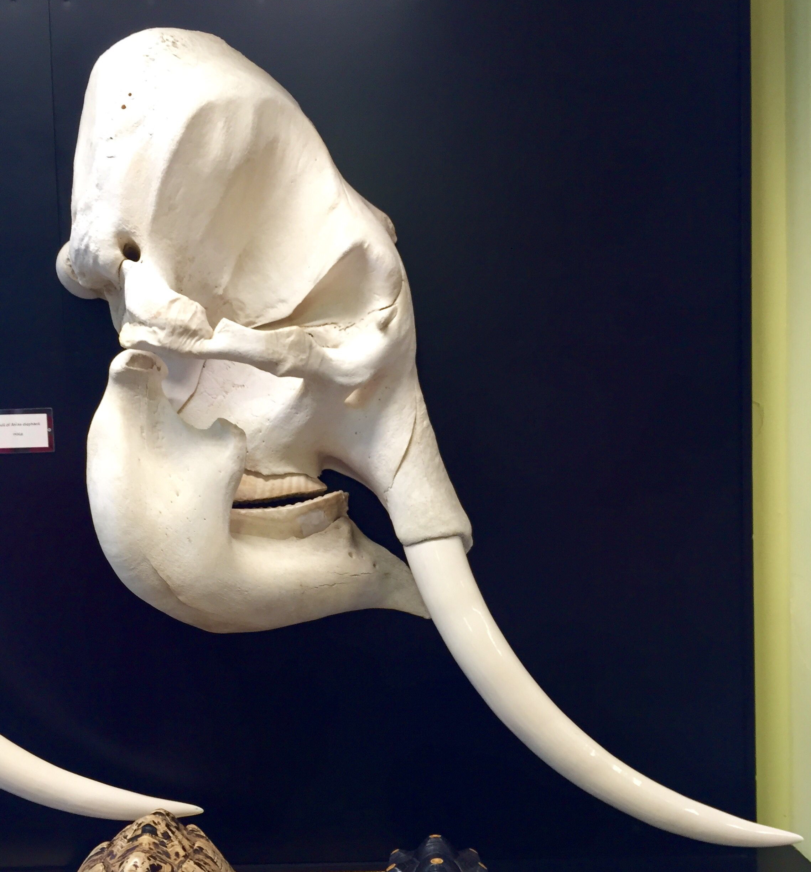
Tusks

Slide 5
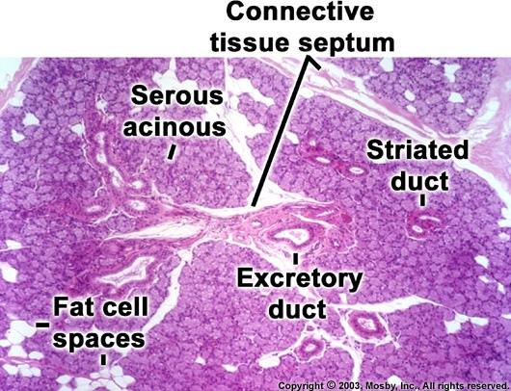
Struktura slinných žláz
Ligaments – capsule, septa, connective tissue
Parenchyma – lobules
- secretory compartments: serous acins, mucinous tubules or tubules with Gianuzzi lunules
- ducts: intercalated and striated ducts (interlobular and main in v septa between lobules)

Slide 6
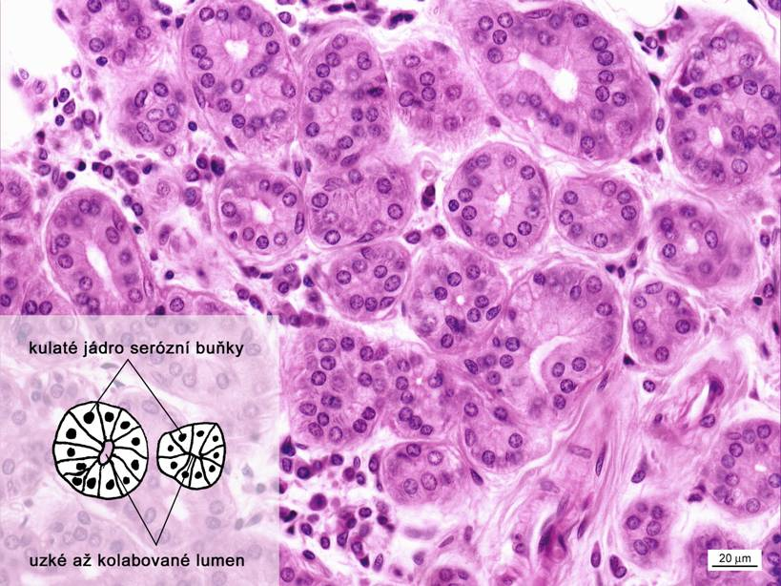
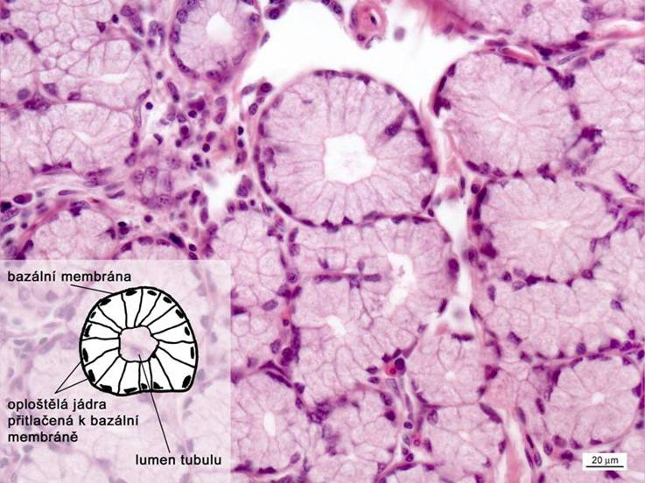
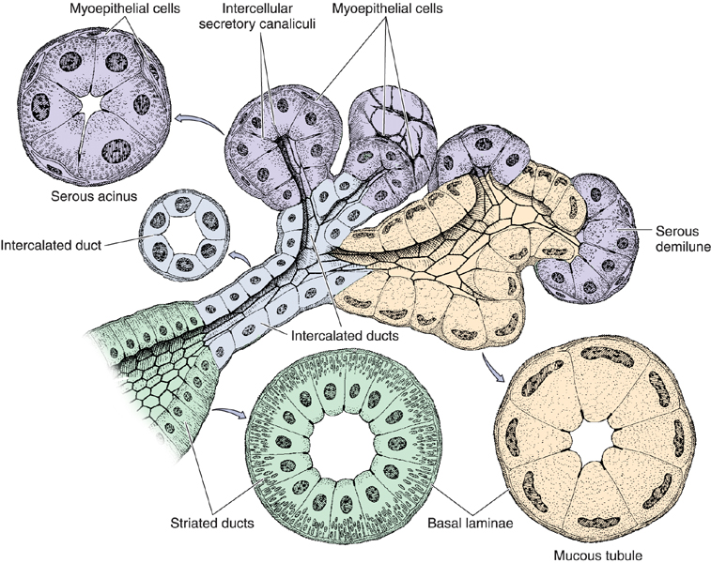
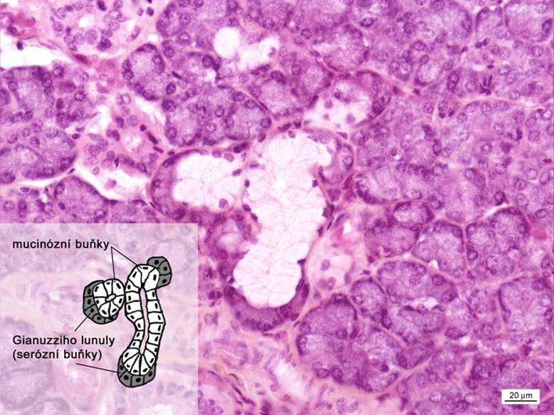
Serous acini
BM, myoepithelial and serous cells
Mucinous tubules
BM, myoepithelial and mucinous cells
Tubules with Gianuzzi demilunes

Slide 7
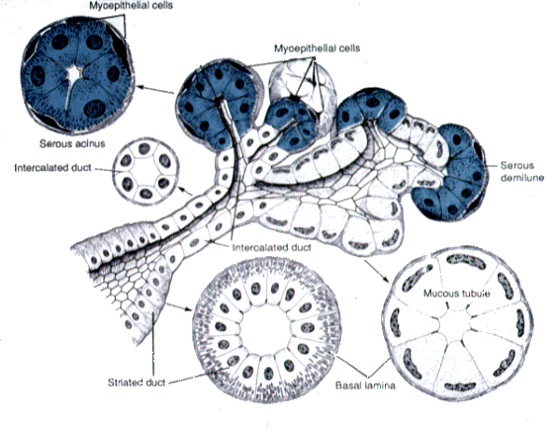

Slide 8
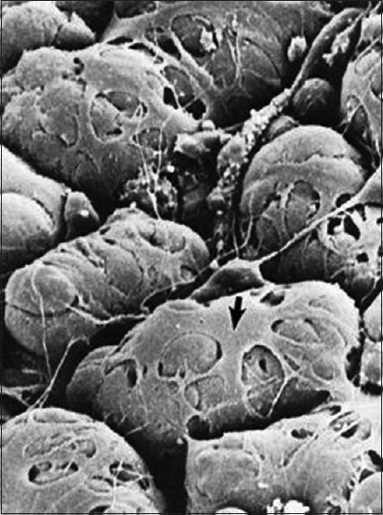
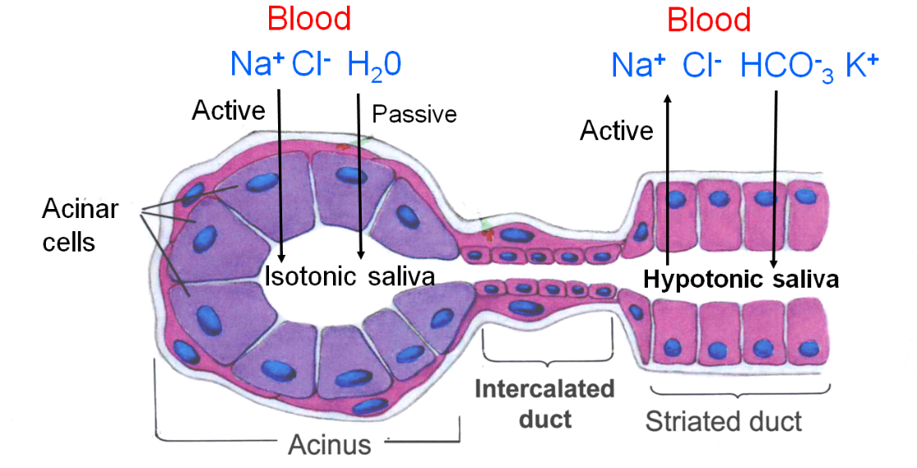
Myoepithelial cells
Ectomesenchymal origin
Contraction
Desmosomes
Vegetative control

Slide 10
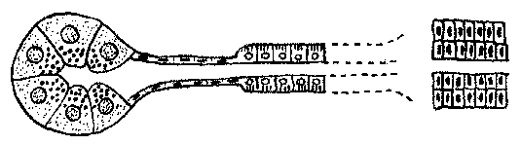
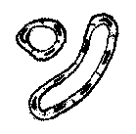

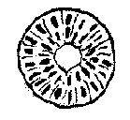
Salivary ducts types
– Intercelual (they do not have their own wall, intercellular space)
– Intercalated (simple squamous ep., only serous and mixed glands)
– Striated (simple cuboidal/low columnar ep.; basal labyrinth➔ striation)
– Interlobular (simple – stratified columnar ep., in septs)
– Main (stratified columnar ep.)
Intercellular
Striated
Main
Ducts
Intercalated
Interlobular

Slide 11
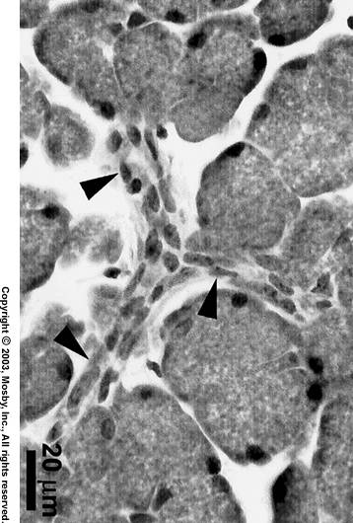
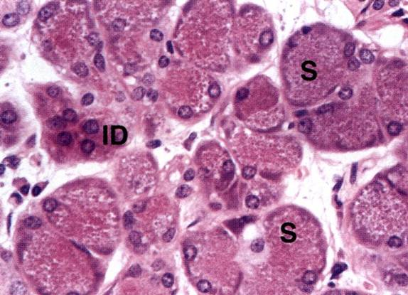
Intercalated ducts
Narrow and thin-walled channel, collapsed on slides
Wall: basal membrame, myoepithelial cells and simple squamouse to low cubic ep.
Numerous in serous type of glands
(cells of intercalated ducts secrete to saliva macromolecular substances: lysozym + lactoferin)

Slide 12
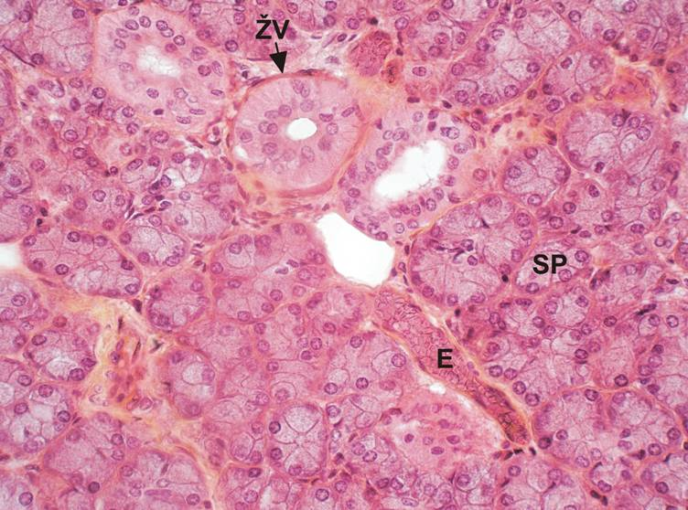
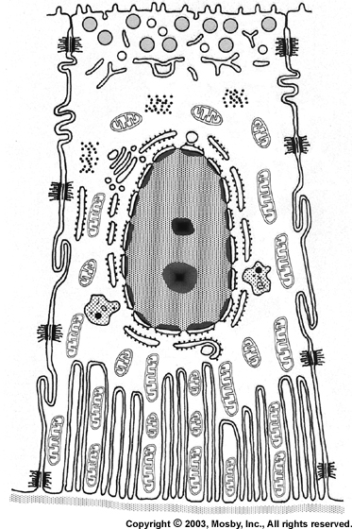
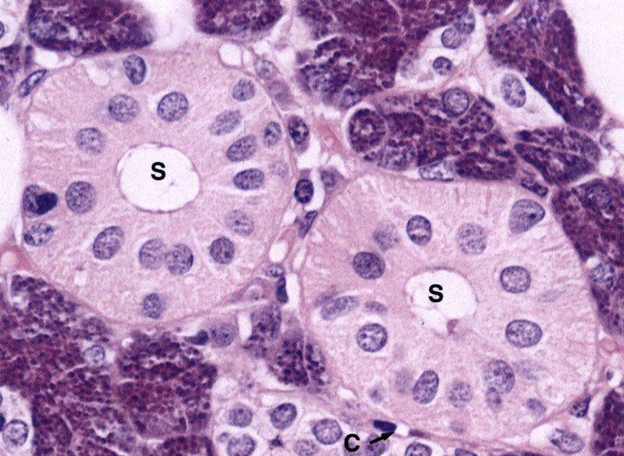
Striated ducts
Wider than the intercalated ducts (easy to find), usually in the middle of lobe
Wall: Basal membrane and simple cuboidal/low columnar ep.
Microvilli on apexes and an bases characteristic striation (basolateral labyrinth)
In the cytoplasm of cytokeratin filaments
The cells of striated ducts regulate the content of water and electrolytes (Na+, K+, Cl-, Ca2+, Mg2+, HCO3-) in the secretion.
Resorption of Na+, and Cl-
Secretion of K+ and HCO3-
nerve control

Slide 13
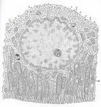
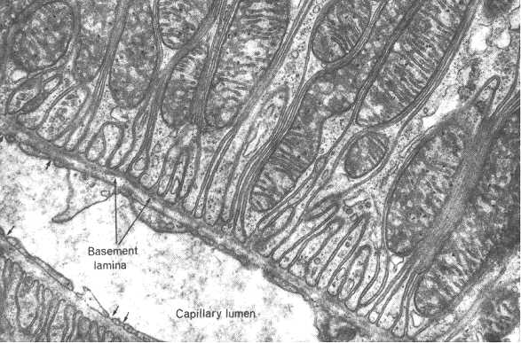
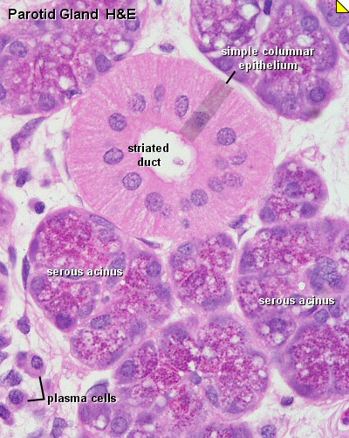
Striated duct – basal labyrinth
Epithelial cell
Base of epithelial cell:
Invagintion of cytoplasmic membrane, numerous mitochondria

Slide 14
Interlobular and main ducts
Interlobular ducts
Located in fibrous septae between the lobes (columnar or stratified columnar epithelium)
They are formed by the connection of several striated ducts
Lined by a high single-layer columnar and in the terminal sections also a stratified columnar epithelium
Main ducts
Stratified columnar ep. with goblet cells
Ductus parotideus
Ductus submandibularis
Ductus sublinguales (major et minores)

Slide 15
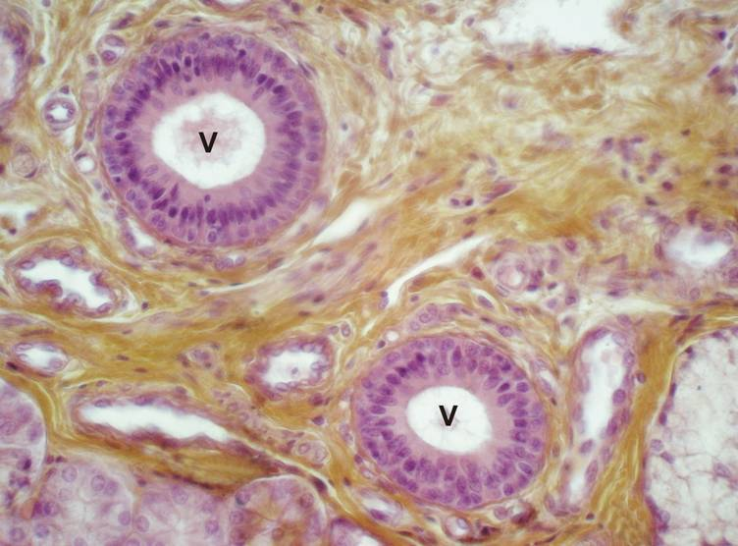
Main ducts
Stratified columnar ep.
In epithelium Goblet cells
Wall supported by the dense collagenous
connective tissue and smooth muscle cells

Slide 16
Intercalated duct
Striated duct

Slide 17
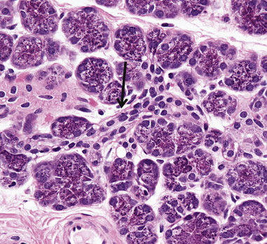
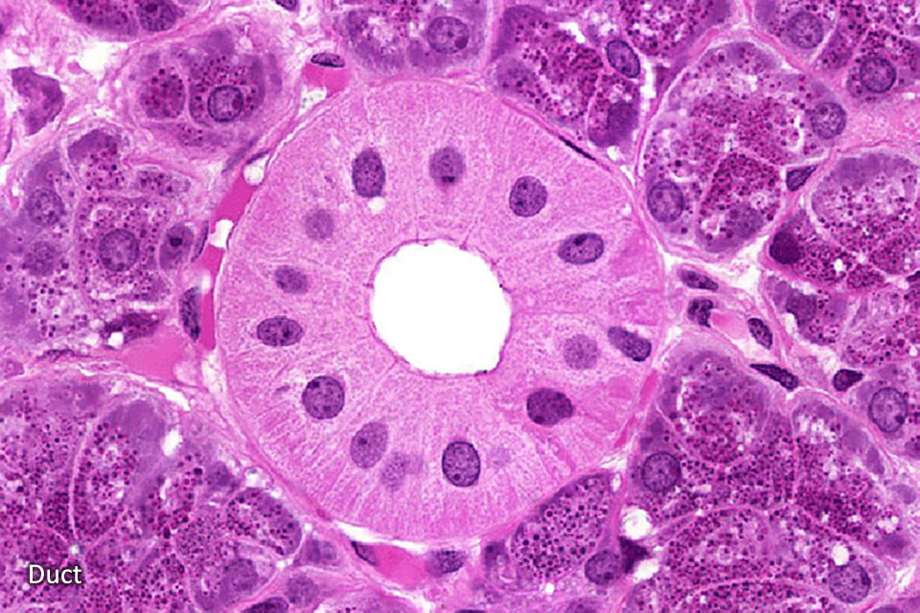

Slide 18
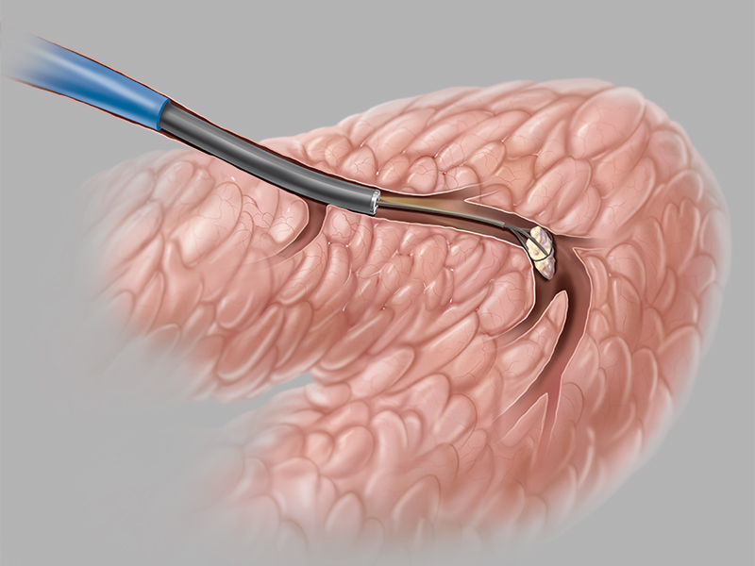
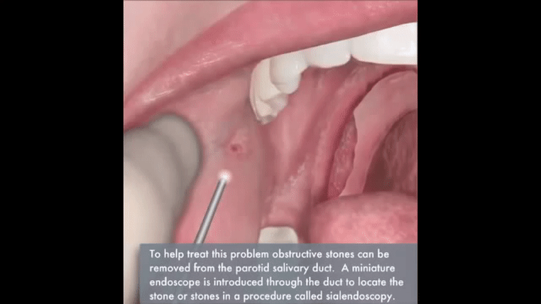
Sialendescopy

Slide 19
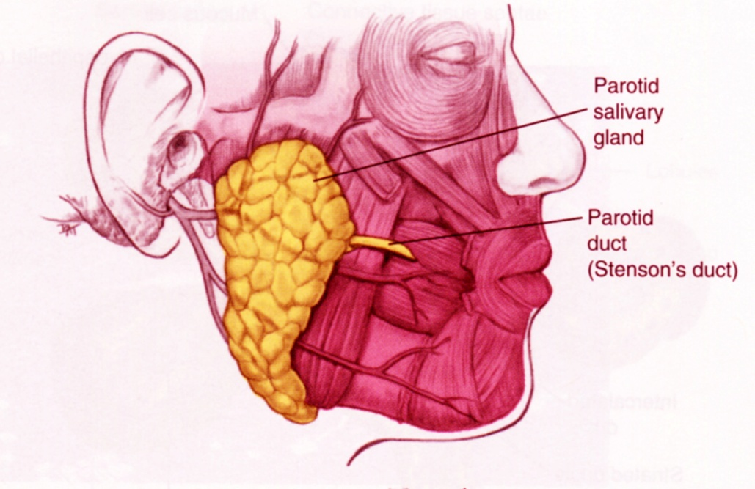
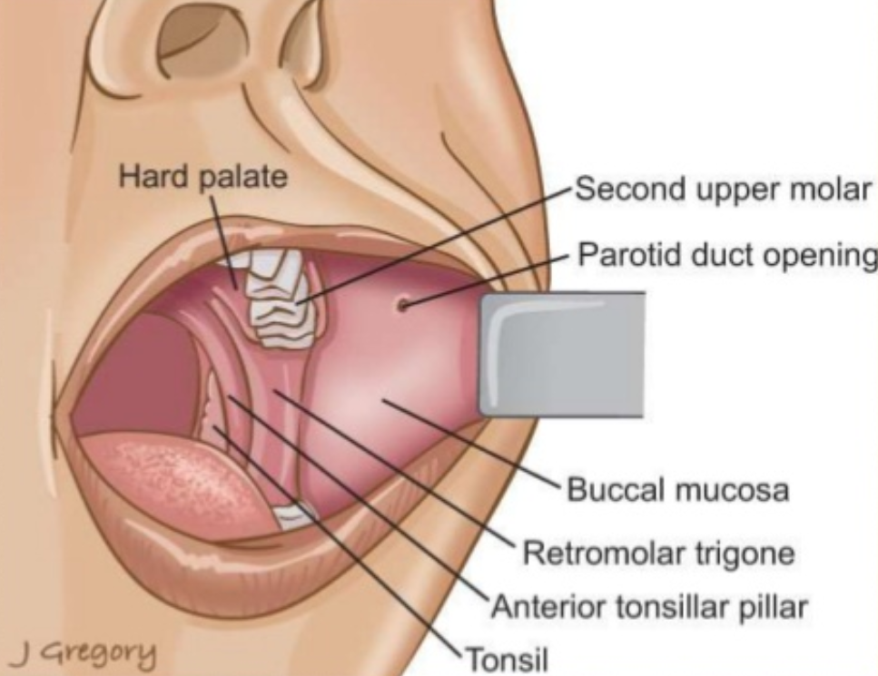
Glandula parotis
SEROUS gland
14 - 28 g
capsule, septs and lobules
Serous acini, ducts: long intercalated ducts, numerous of striated ducts
ductus parotideus (Stenoni) - 2. upper molar (Steno/Stensen, Niels)
adipocytes

Slide 22
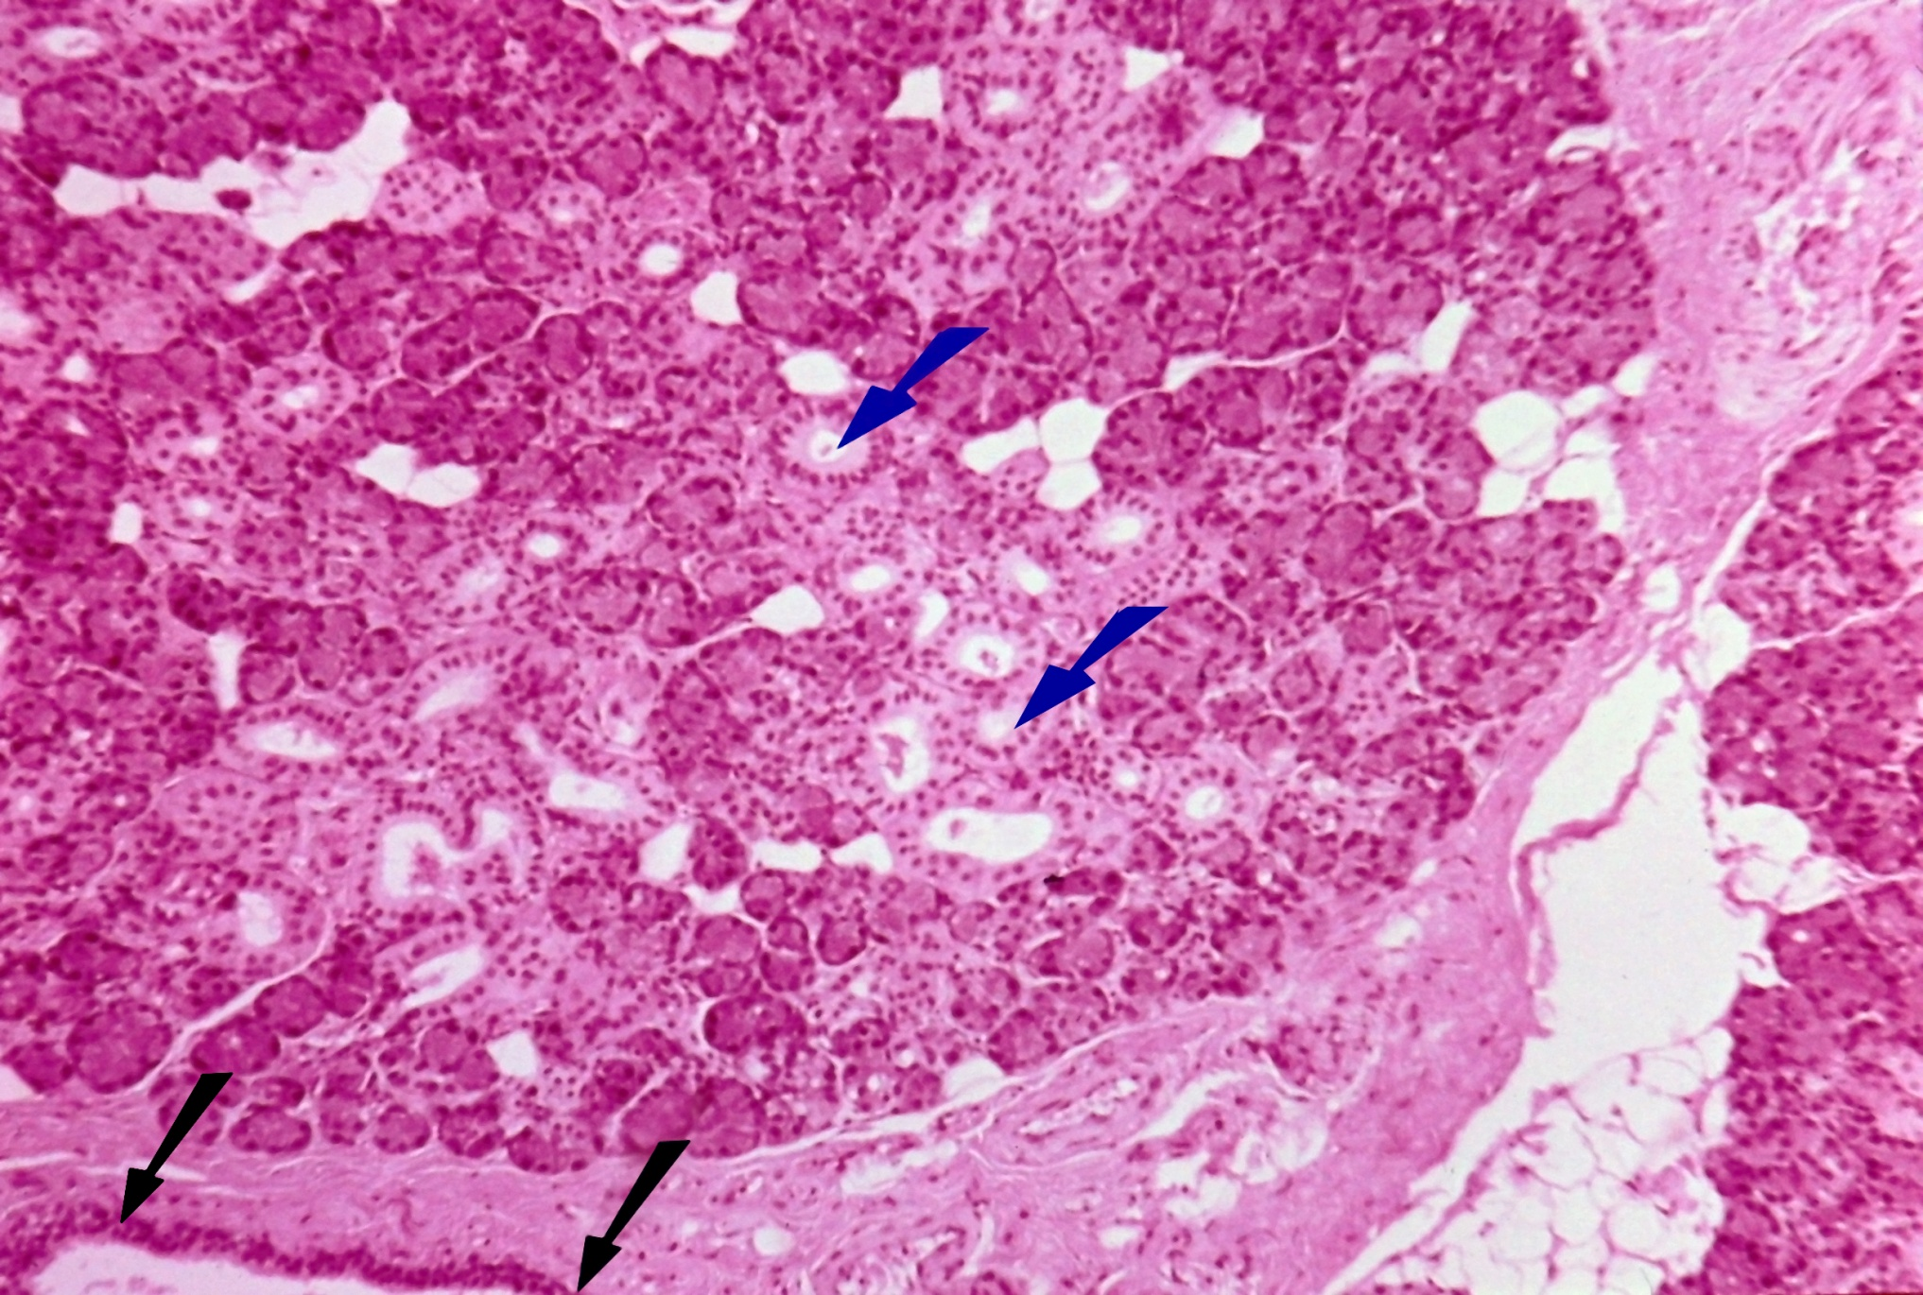
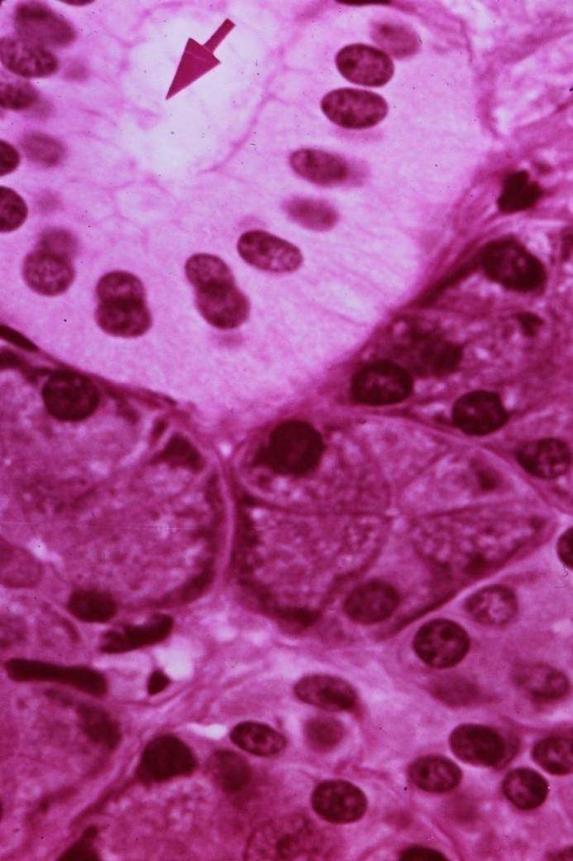

Slide 23
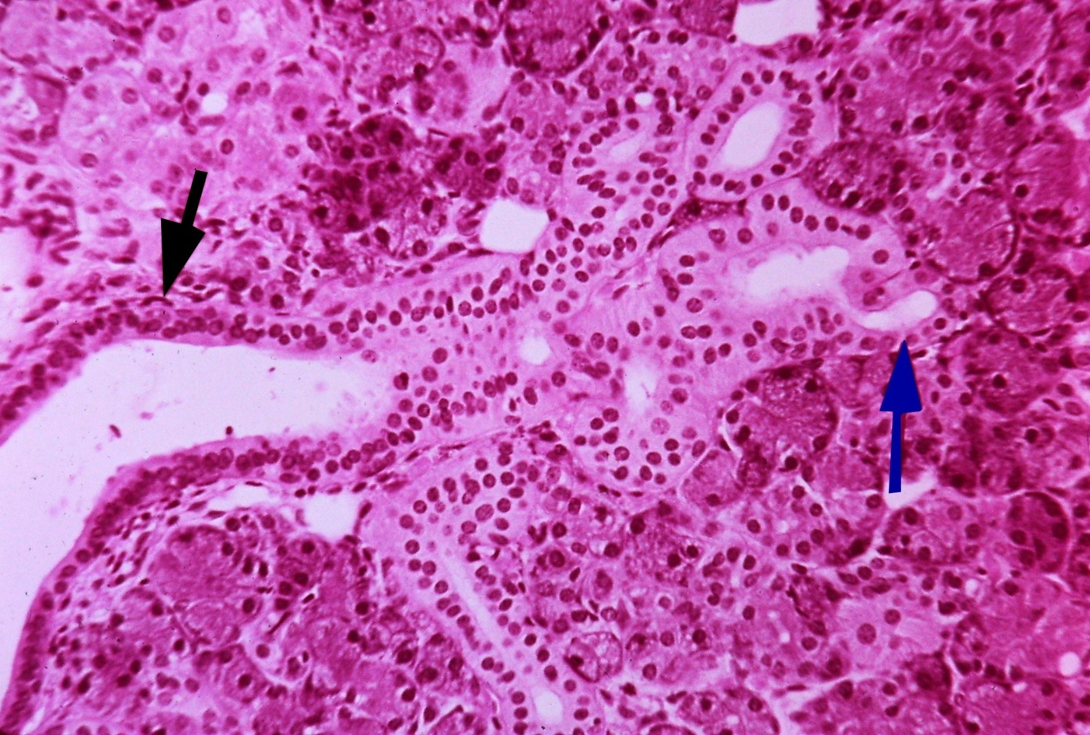

Slide 24
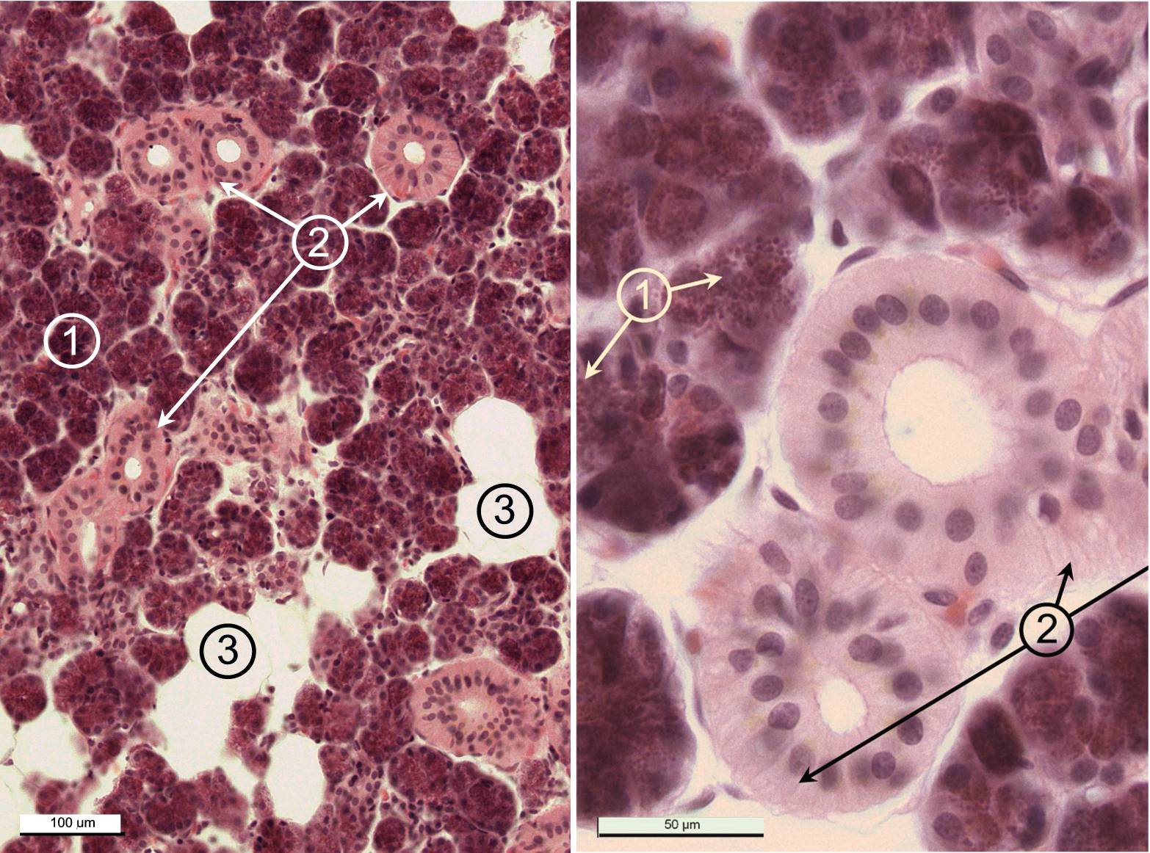

Slide 25
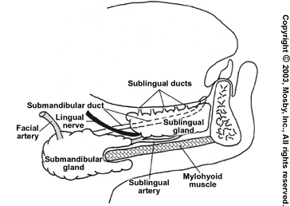
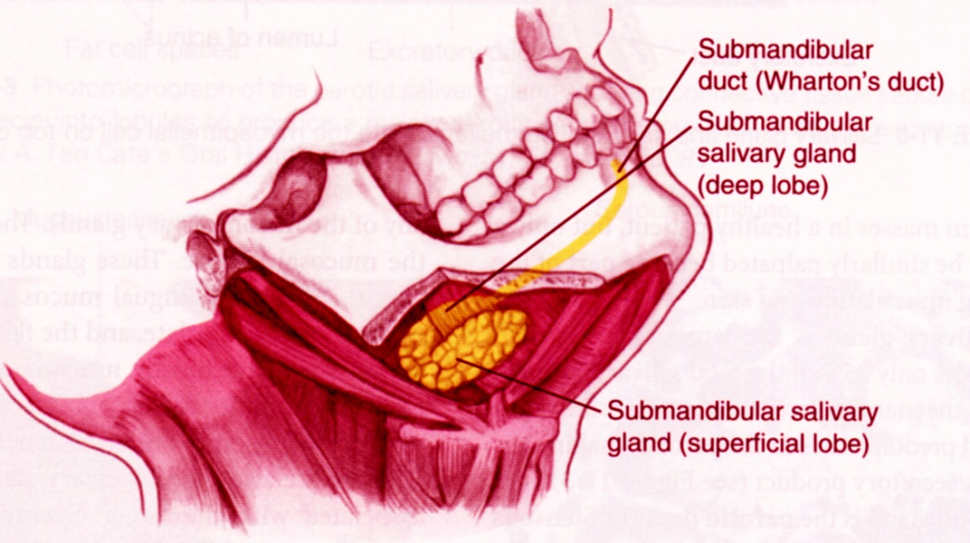
Glandula submandibularis
MIXED tuboalveolar gland, predominantly SEROUS
10-15 g
serous acini - 80 %, rest are mucinous tubules with Gianuzzi demilunes
intercalated and striated ducts
ductus submandibularis (Whartoni) - frenulum linguae
trigonum submandibulare

Slide 26
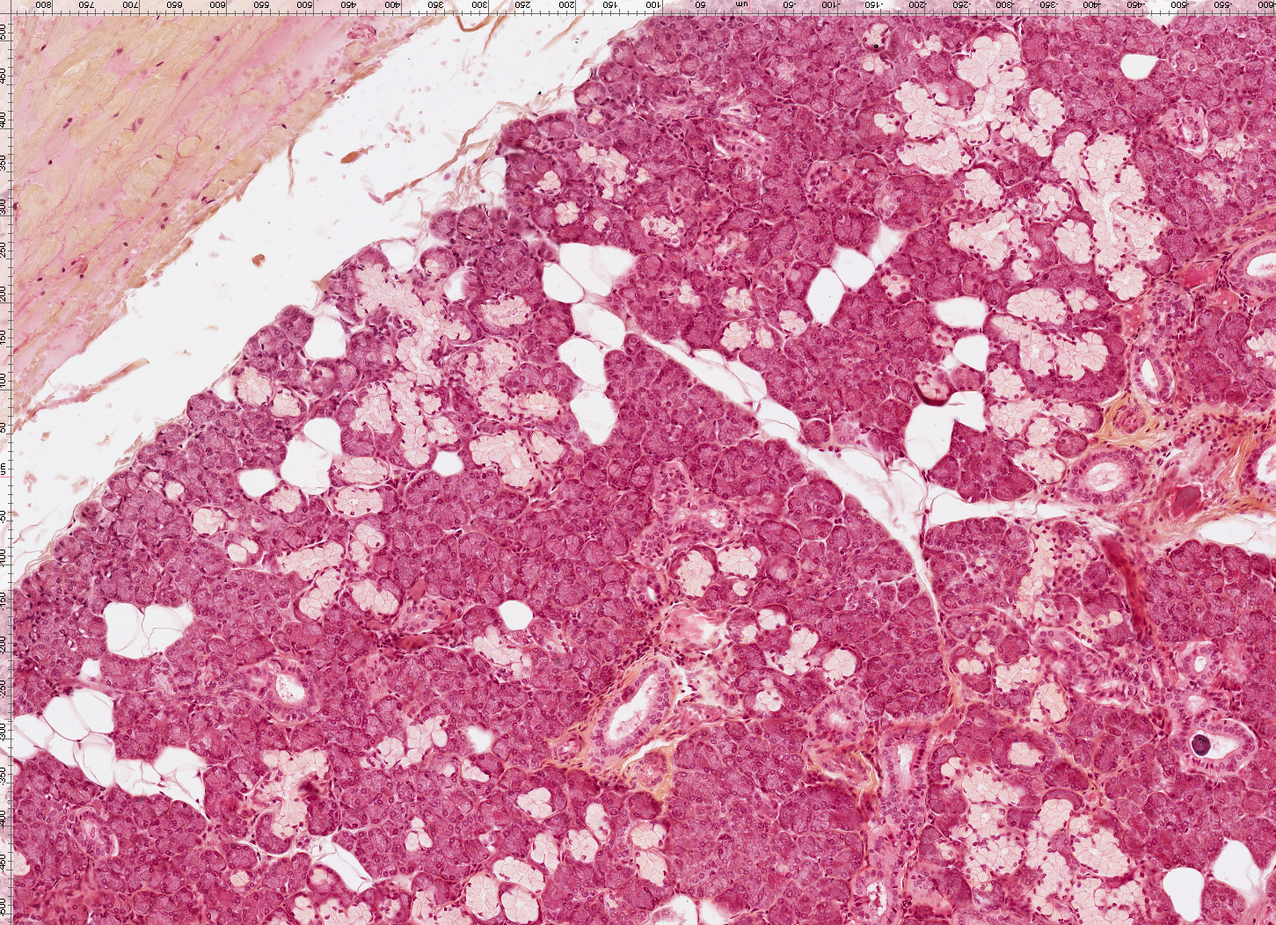

Slide 28
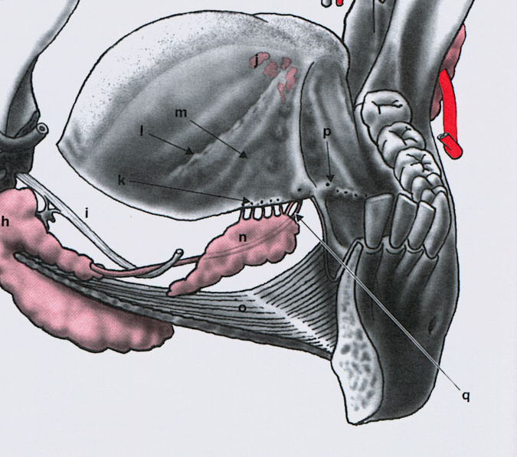
Glandula sublingualis
MIXED tuboalveolar gland, predominantly MUCOUS
2g
located on the floor of the mouth on mylohyoid muscle near the midline
Mucinous tubules, serous acini are rare, instead of them: Gianuzzi demilunes
Intercalated ducts are missing, striated ducta are present, but are reduced in number and short
ductus sublingualis major (Bartholini)
ductus sublinguales minores (Rivini)
along the crest of the plica sublingualis

Slide 29
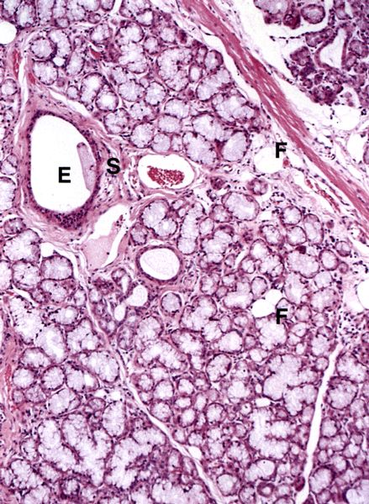
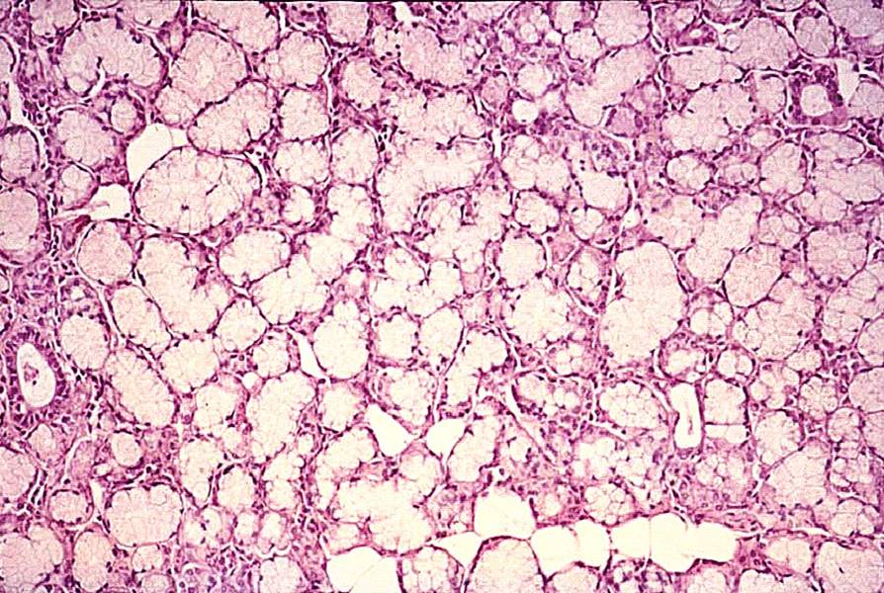

Slide 30
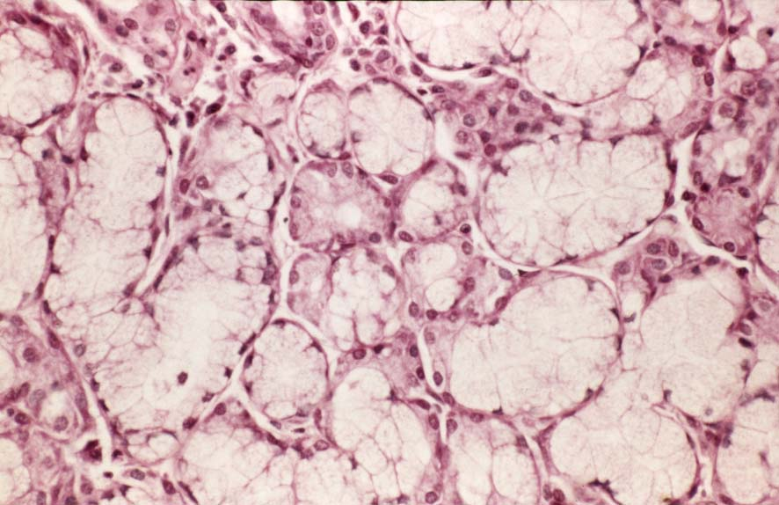
gl. sublingualis

Slide 31
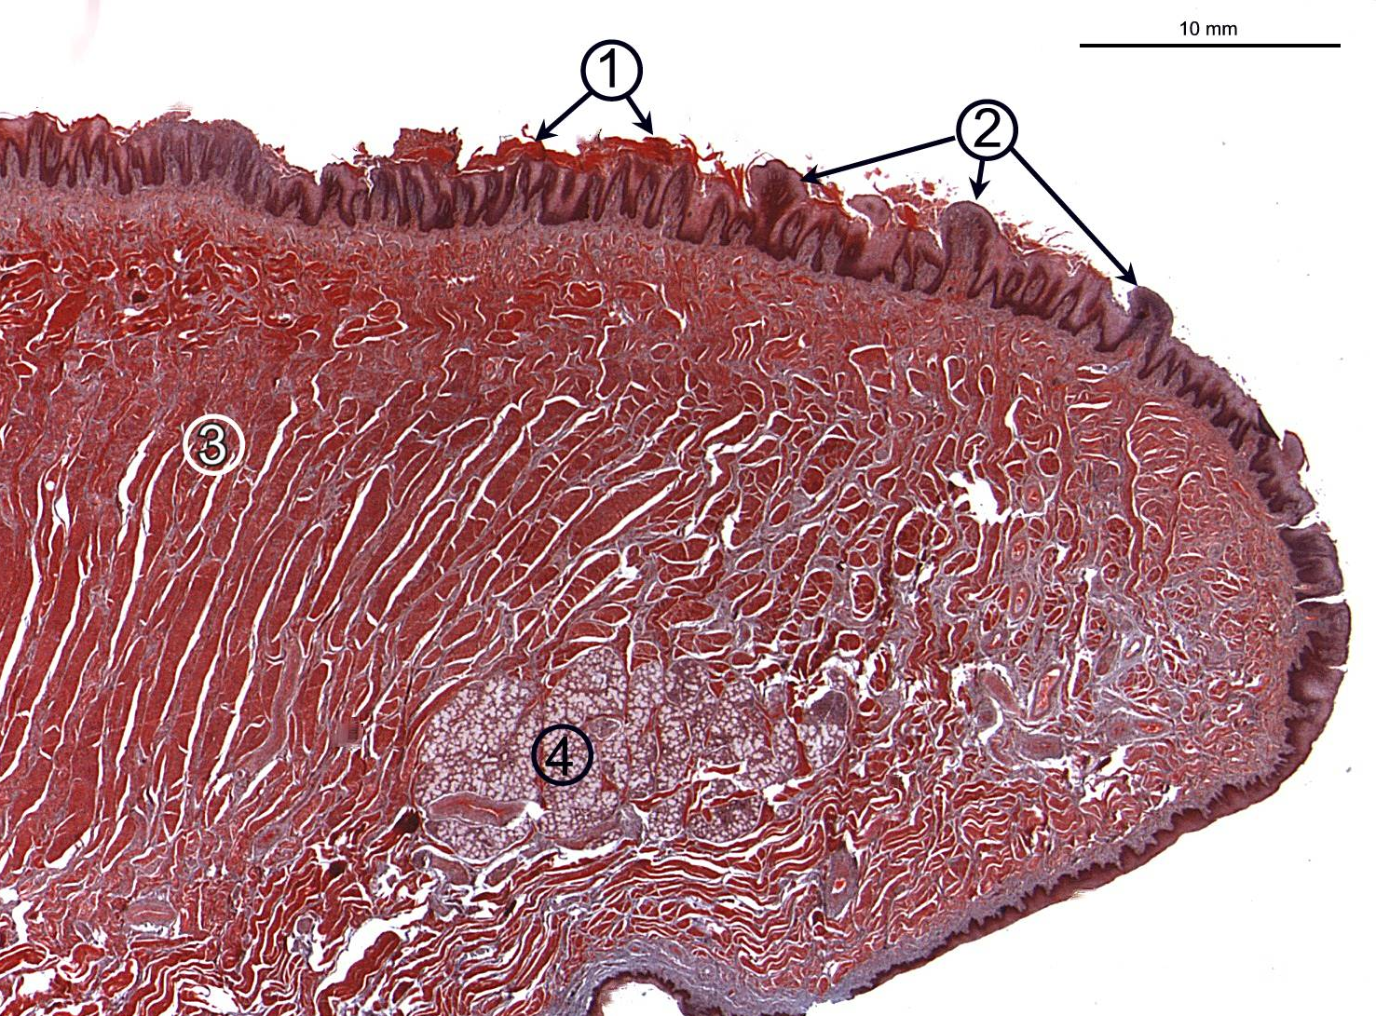
gl. apicis lingue
smíšená, přev. mucinózní

Slide 32
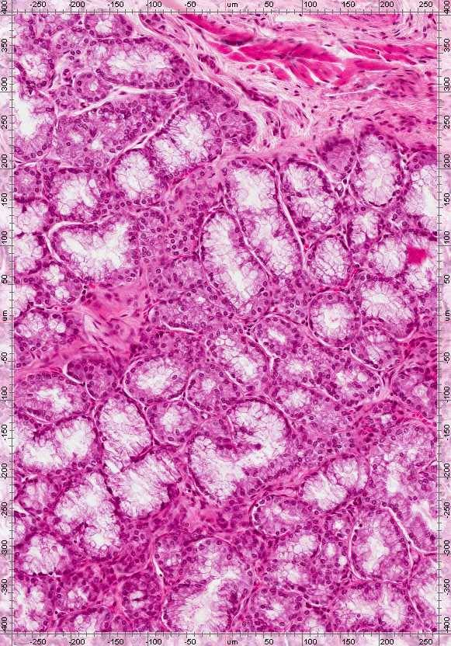
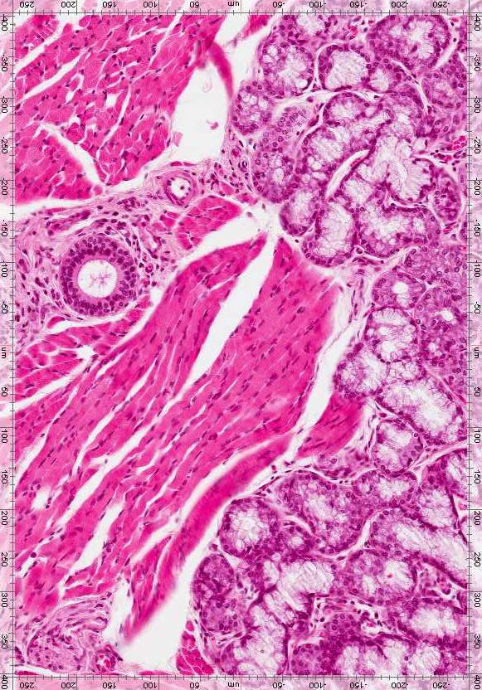

Slide 33
Location |  | Name | Type | Size
Lips |  | gll. labiales sup. et inf. | mixed, pred. mucinous | minor
Cheeks |  | gll. buccales | mixed, pred. mucinous | minor
 |  | gll. molares (retromolares) | mixed, pred. mucinous | minor
 |  | GL. PAROTIS | serous | MAJOR
Palate | hard | gll. palatinae (glandular zone) | mucinous | minor
 | soft | gll. palatinae | mucinous | minor
Tongue | Apex | gl. apicis lingue (Blandini-Nuhni) | mixed, pred. mucinous | minor/ major
 | Terminal sulcus | gll. Ebner‘s (gll. papillae vallatae) | serous | minor
 | Base | gll. Weber‘s (gll. linguales post.) | mucinous | minor
Floor of the mouth |  | GL. SUBMANDIBULARIS | mixed, pred. serous | MAJOR
 |  | GL. SUBLINGUALIS | mixed, pred. mucinous | MAJOR

Slide 34

Samples
gl. parotis 8
gl. submandibularis 9
gl. sublingualis 10
gl. apicis linguae 2

Slide 35
Comparison of the hard tooth tissues (and lamellar bone)
 | Enamel | Dentin | Cementum | Lamellar bone
Colour | White (to light blue) | Ivory | Brown-yellow | Brown-yellow
Inorganic (%) Organic (%) H₂0 (%) | 96 (86) 1 (2) 3 (11) | 70 (45) 20 (30) 10 (25) | 61 (33) 27 (31) 12 (36) | 45 (23) 30 (37) 25 (40)
Collagen fibres | NO | YES (perpendicular to the dentinal tubules) | YES (in all directions) | YES (same direction in lamellas)
Cells | Ameloblasts (missing in adults) | Odontoblasts (on the pulpal side of dentin) | Cementoblasts (cementocytes) | Osteoblasts osteocytes
Blood vessels | NO | NO | NO | YES (in Haversian canals)
Nerves | NO | YES (on entry of dentinal tubules) | NO | YES (in Haversian canals)

Slide 36

Procedures used to study the microscopic structure of teeth
2 basic methods of hard tissue processing are used in light microscopy:
  1. Ground sections
  2. Decalcified samples (and staining)
1. Ground sections
50 ‑ 70 µm discs made by grinding
(saw, carborundum wheel, fine grinders, abrasive powders and pastes during grinding, the disc must be water-cooled, the finished cut is sealed in a Canadian balm,
which heats up when mounted above the flame - so all the cavities and channels are preserved in the cut-out The preparation of the cut-out requires great skill)

Slide 37





Slide 38


Slide 39
2. Stained sections of decalcified tooth
Long preparation: decalcification of the tooth, embedding, staining
Decalcification: dacalcification agents convert insoluble calcium salts (phosphate and carbonate) to water-soluble salts. The time required for descaling depends on the size of the object and the type of decalcifying fluid: from several days to weeks and months
Decalcification agents:
  Acids (e.g. 5% nitric acid, 5% trichloroacetic acid and 22-23% formic acid) - 1 week
  Chelating agents – EDTA: 4 weeks - 3 months preserves well the structure of the tissue and enable the staining
Embedding – paraffin, resins
Sectioning – cryotome, microtome (decalcified); staining

Slide 40

Stained slice of dacalcified tooth
!
Soft tissues are not preserved on ground sections
Enamel is missing on decalcified teeth

Slide 41

Tooth - root
Periodontium
Cementum
Dentin
Predentin
odontoblasts
Pulp

Slide 42


Sulcus gingivalis
Gingiva libera (1)
Gingiva affixa (2)
1
2

Slide 43

Dentin, SEM, 1 500x

Slide 44

Dentin, SEM, 1 500x

Slide 46


Slide 47


