Slide 1
Examination techniques in ophthalmology
V. Matušková

Slide 2
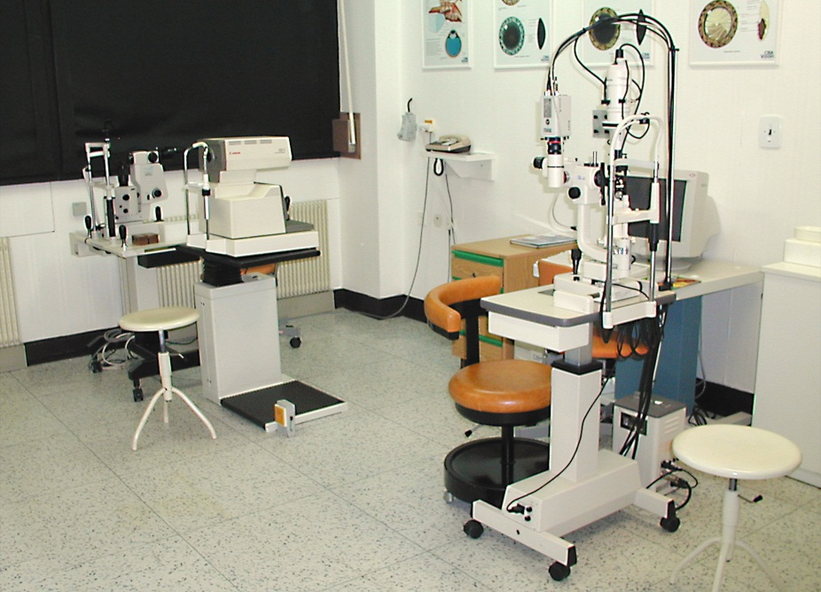
Basic examination techniques
Visual acuity (natural, best corrected)
Measurement of intraocular pressure
Slit lamp examination
Fundus examination

Slide 3
Visual acuity
Visual acuity (natural, best corrected)
Distance vision
Near vision
Charts
Snellen
Landolt ring
Pictures
ETDRS
Jaeger

Slide 4
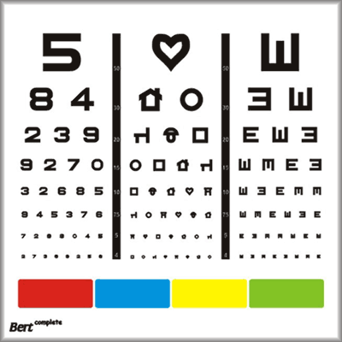
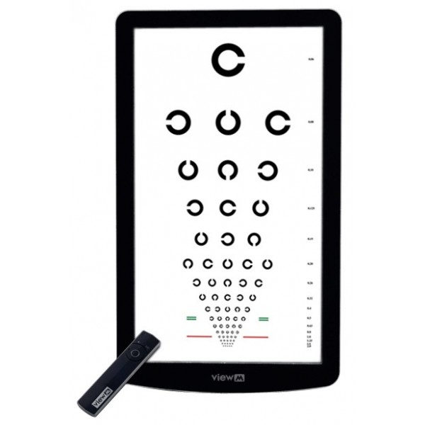
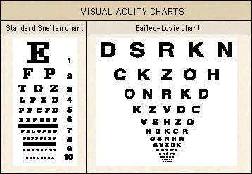
Charts

Slide 5

Near vision
Jaeger chart

Slide 6

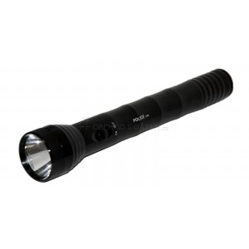
Visual acuity
Counting finger (metres )
Hand movement
Light perception

Slide 7
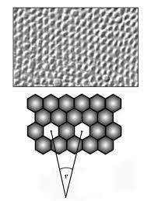
Visual Acuity
5/50 (metres, feet 20/200)
0,1
Minimum separabile – minimum angle of resolution

Slide 8
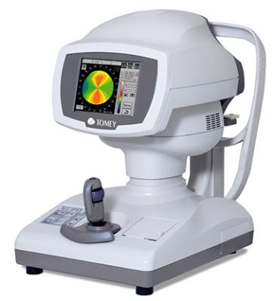
Refraction
Refractive error is an optical abnormality in which the shape of the eye fails to bring light into sharp focus on the retina, resulting in blurred or distorted vision.
In optometry, a "refraction" procedure is the measurement of refractive error
Autorefractor

Slide 9
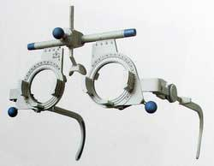
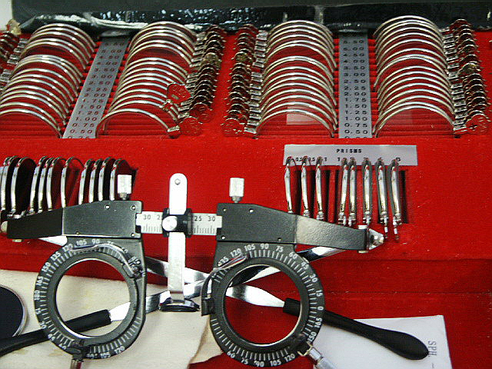
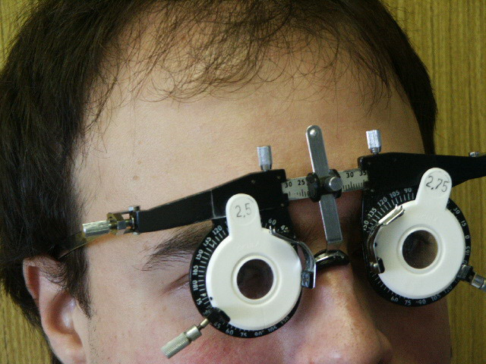
Visual acuity
Frame
Lenses

Slide 10
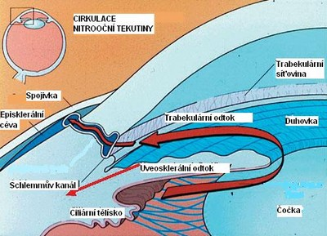
Tonometry
Contact techniques
Schiötz tonometry
Goldmann applanation tonometry
Non contact techniques
Jet air (air puff)

Slide 11
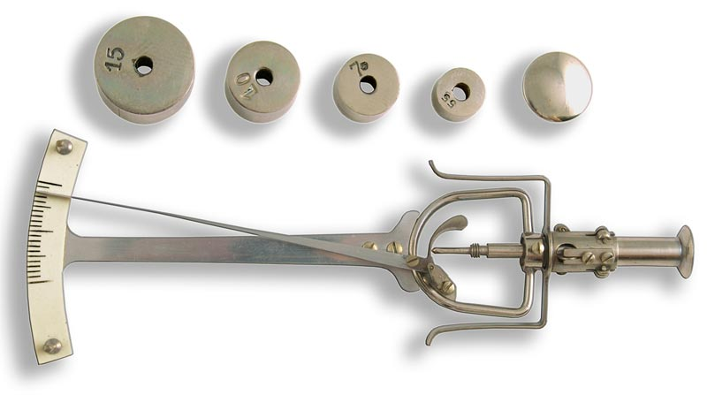
Schiötz tonometry
7/7,5
Topical anestesia

Slide 12
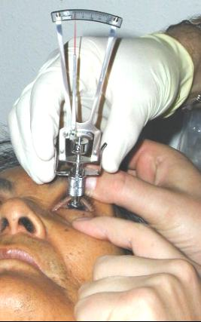
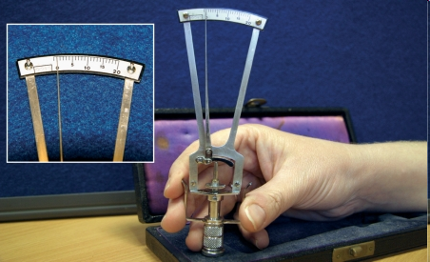
Schiötz tonometry

Slide 13

Goldmann tonometry
The normal range is 10-21 mmHg
Topical anestesia, fluorescein
Force required to flatten the cornae

Slide 14
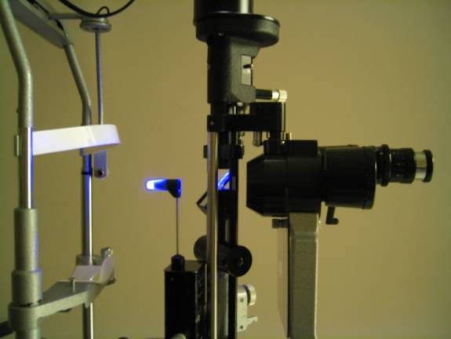
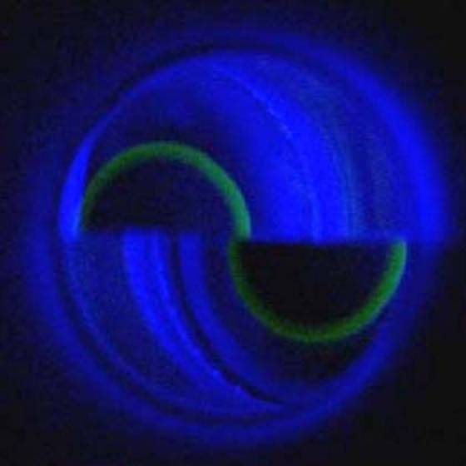
Goldmann tonometry

Slide 15
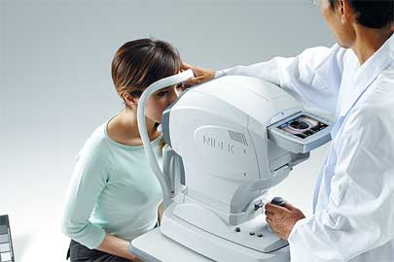
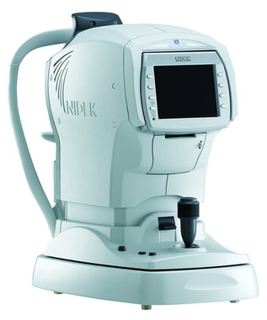
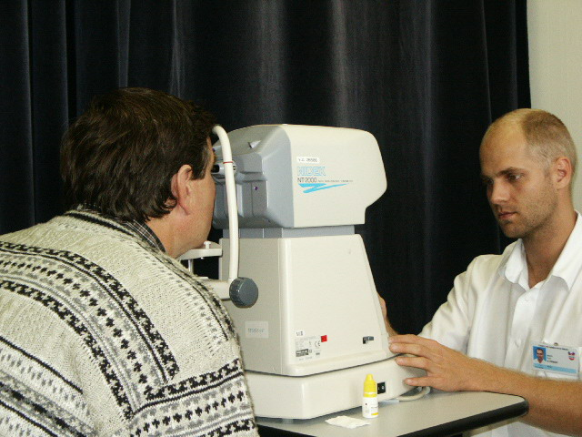
Non contact tonometry

Slide 16
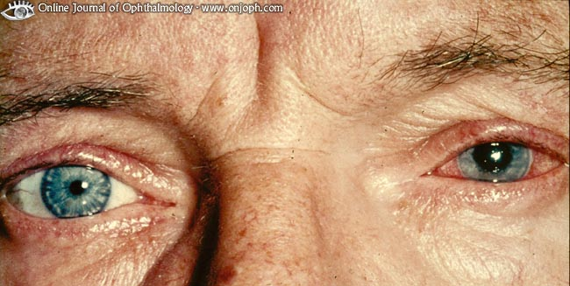
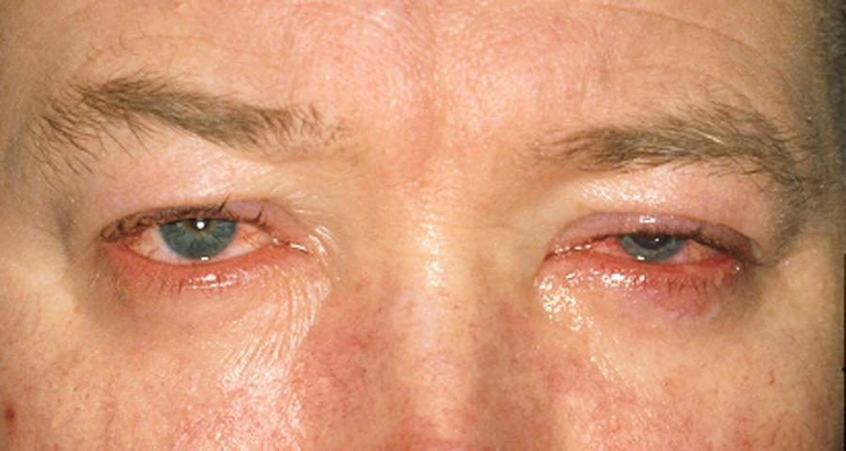
Examination of anterior segment
Aspection

Slide 17
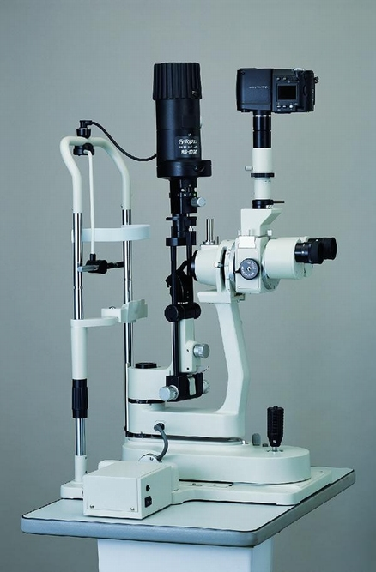
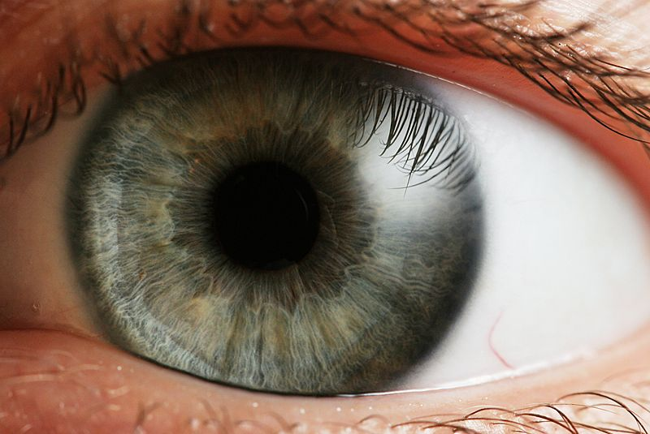
Slit lamp biomicroscopy
table mounted microscope with a special adjustable illumination source attached

Slide 18
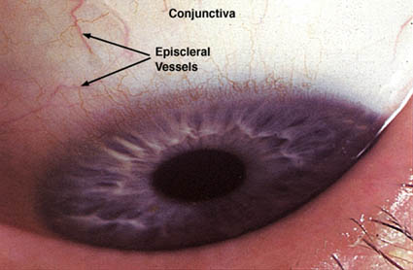
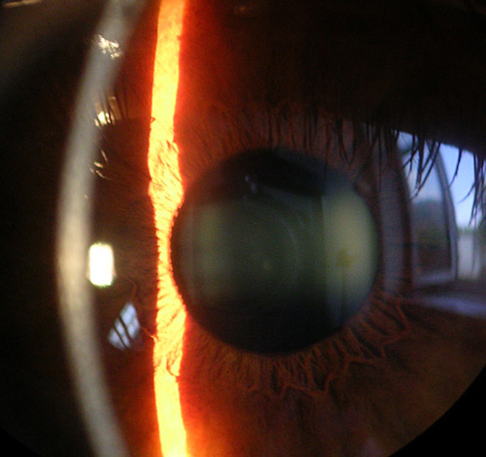
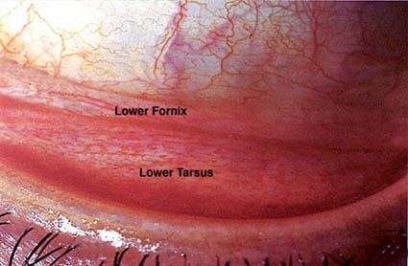
Slit lamp biomicroscopy
duhovka

Slide 19
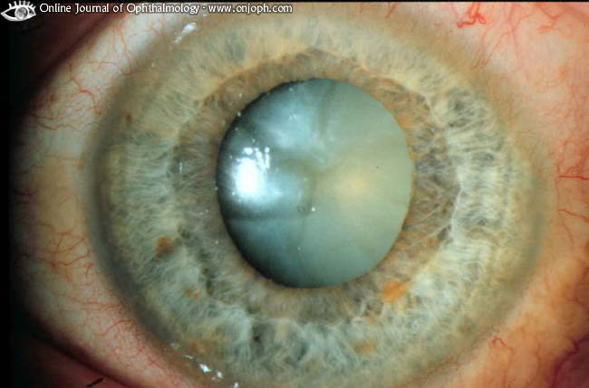
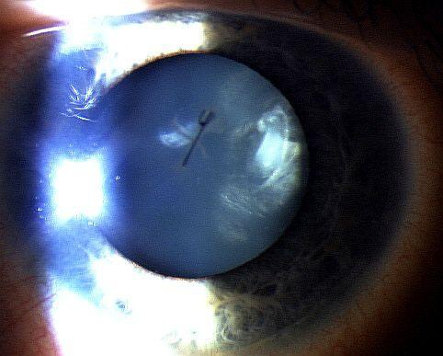
Slit lamp biomicroscopy
,

Slide 20
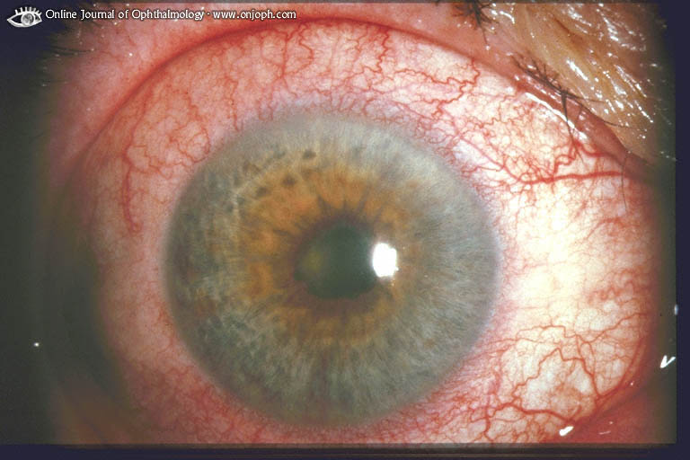
Synechiae posterior

Slide 21
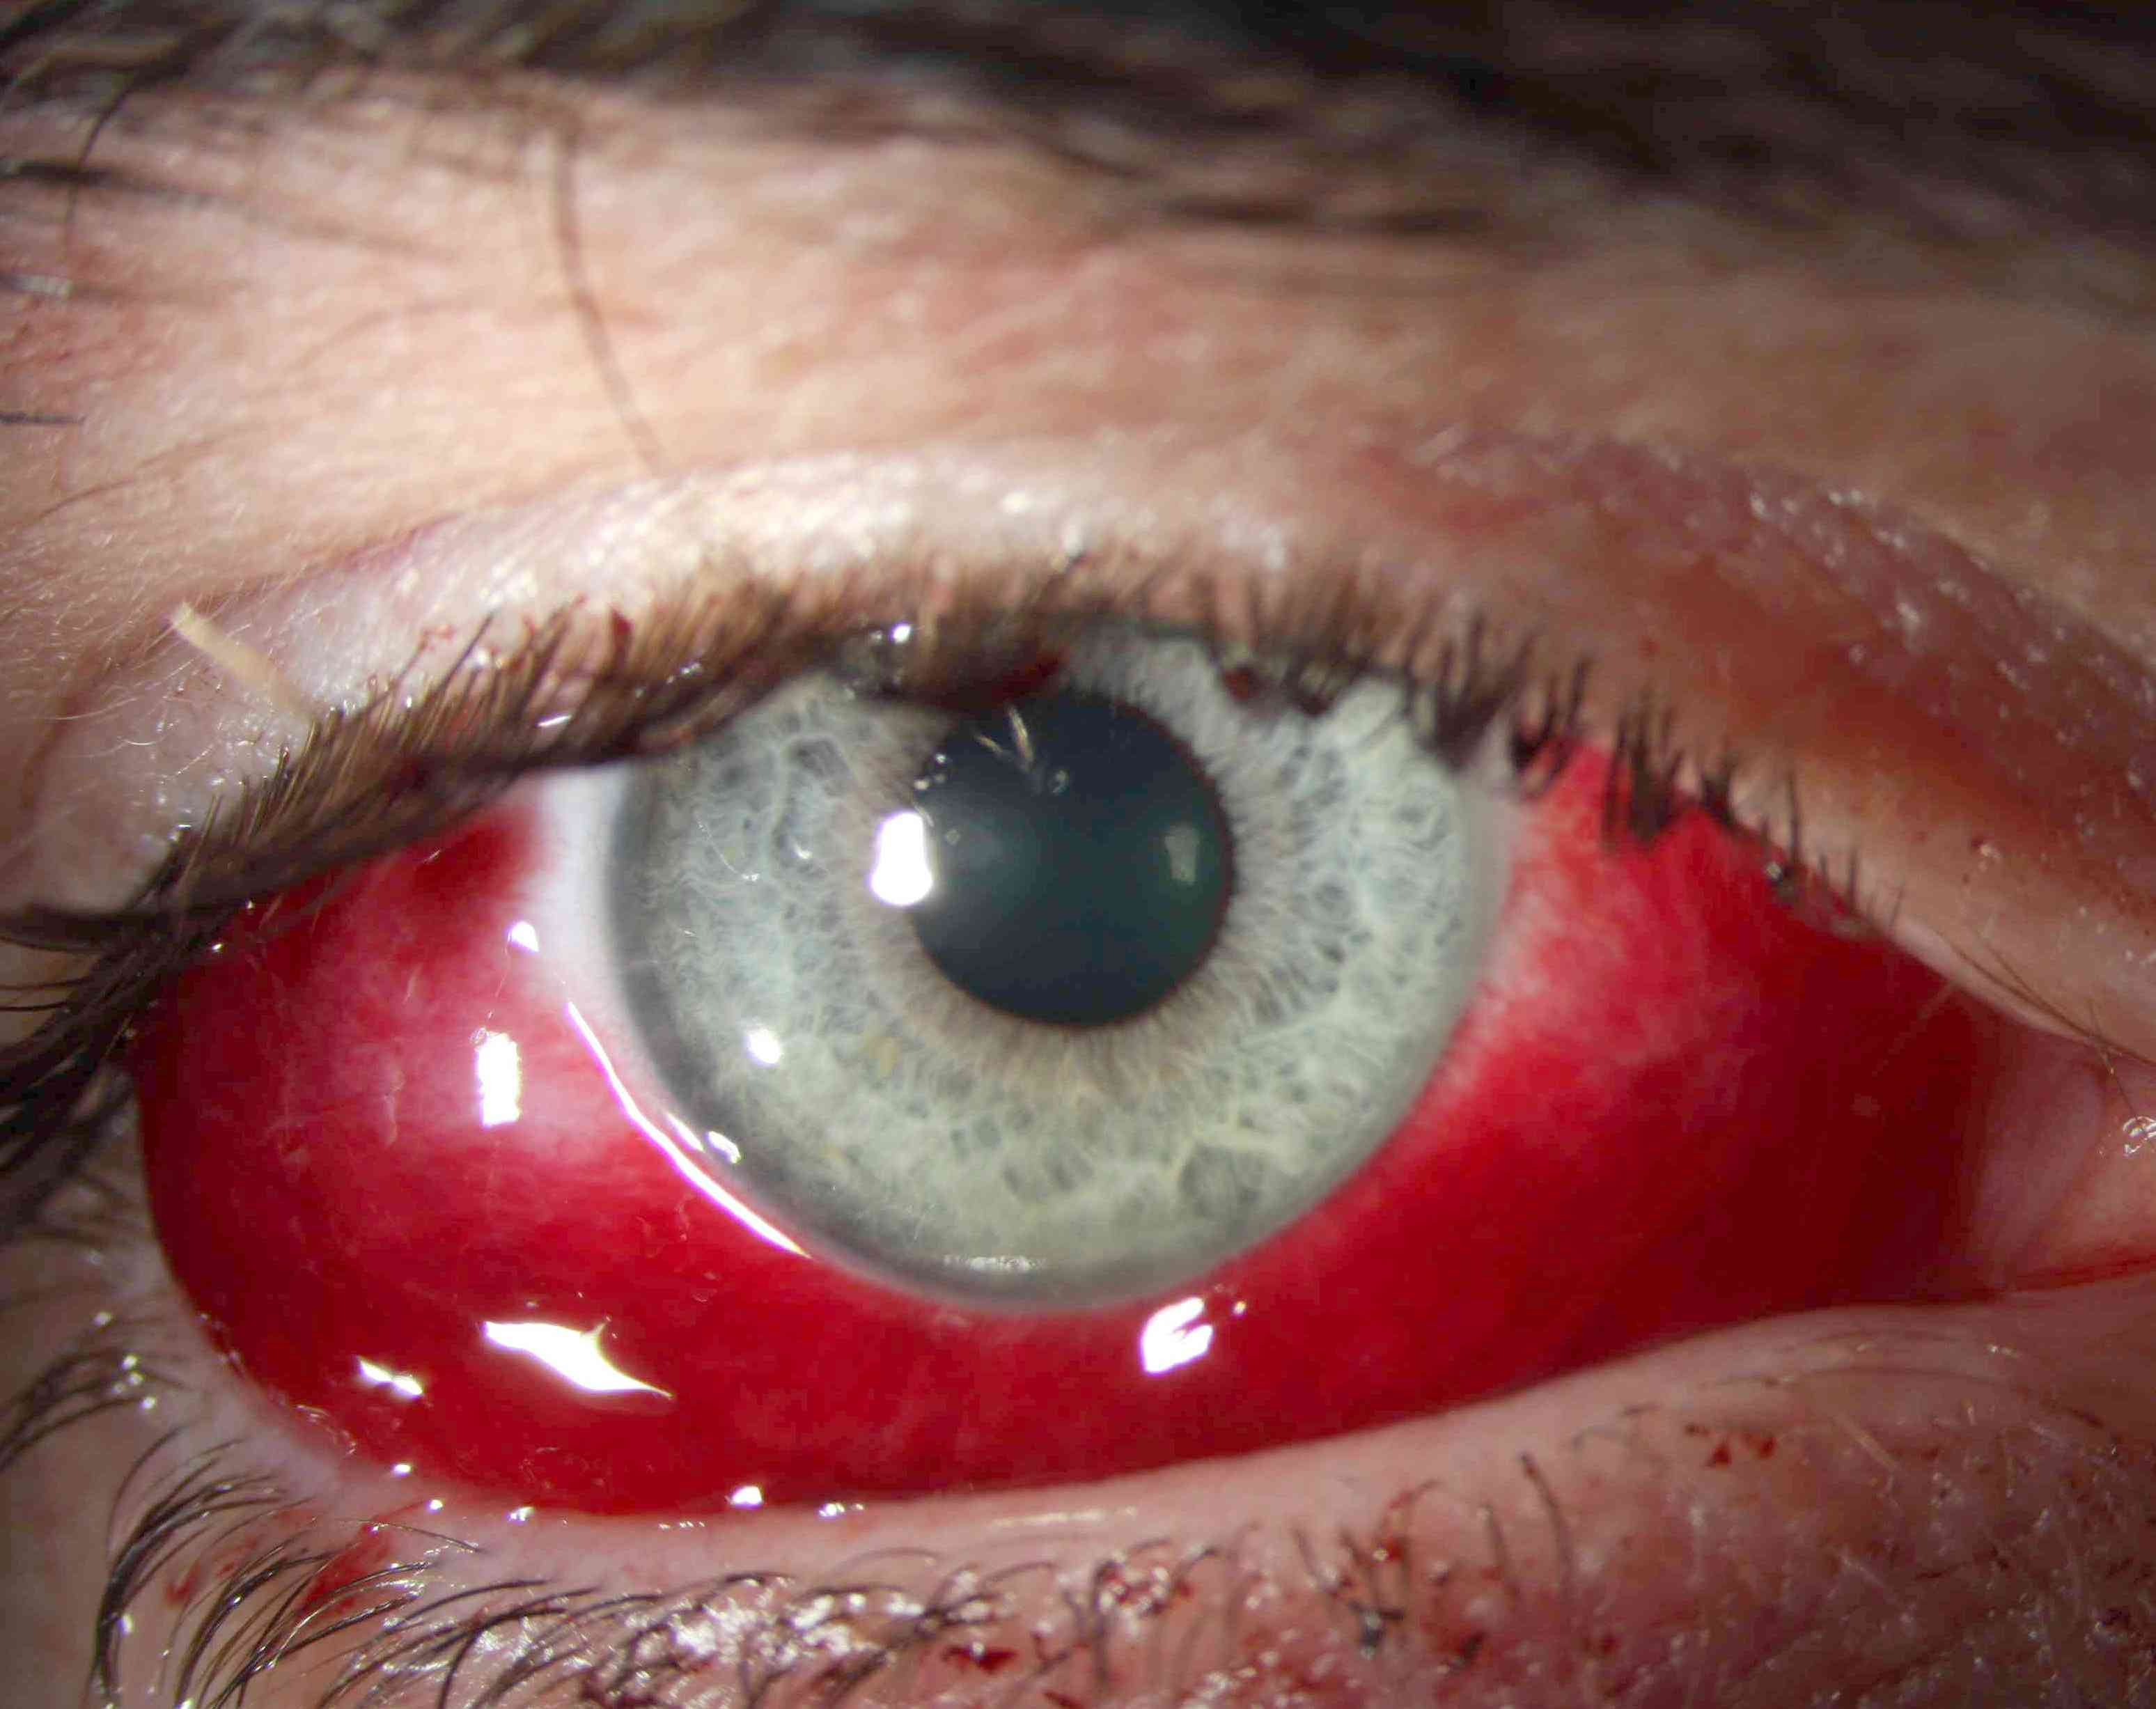
Sunconjunctival haemorrhage

Slide 22
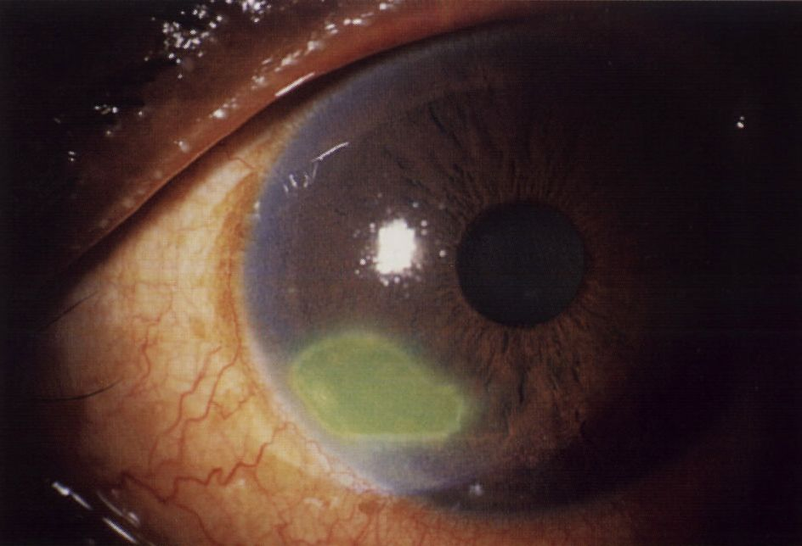
Corneal abrasion

Slide 23
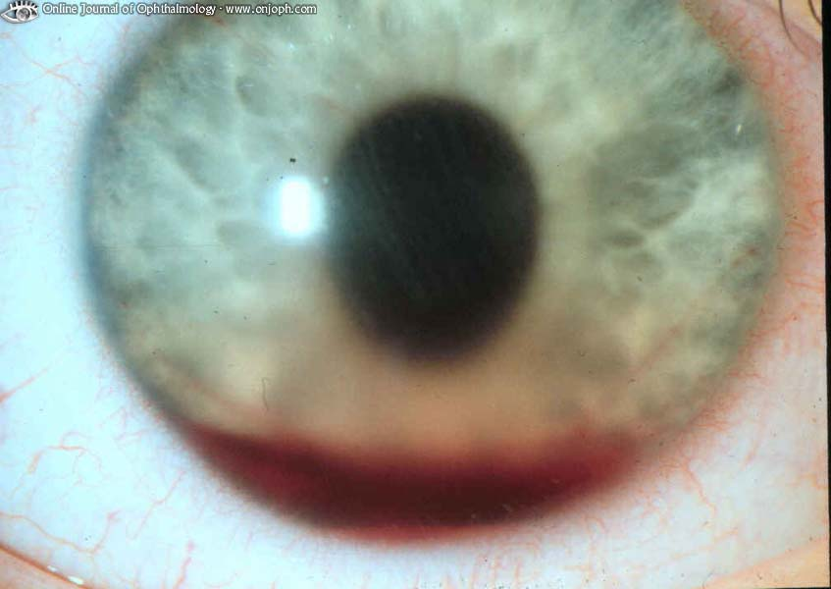
Hyphema

Slide 24
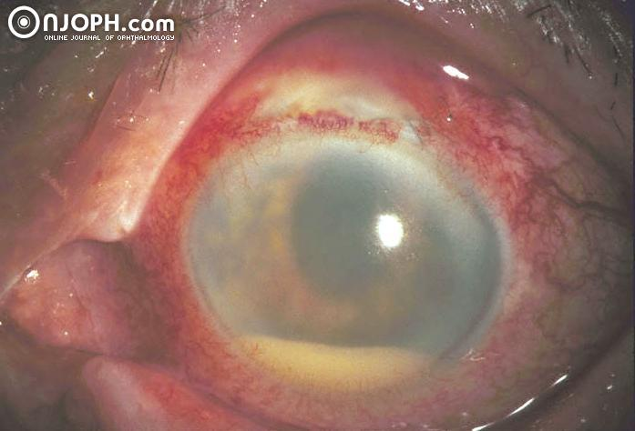
Hypopyon

Slide 25
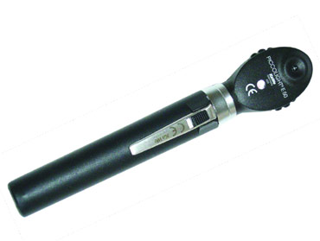
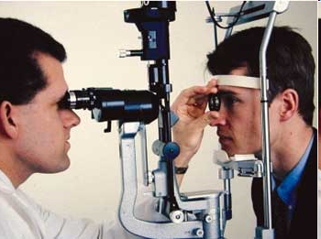
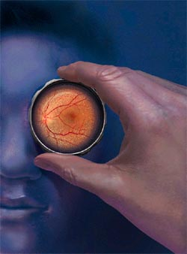
Examination of fundus
Ophthalmoscopy - direct
- indirect
Slit lamp biomicrocsopy
(high power convex lens, the image is vertically inverted
and laterally reversed)

Slide 26

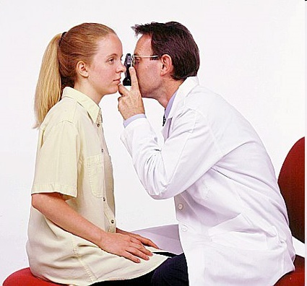
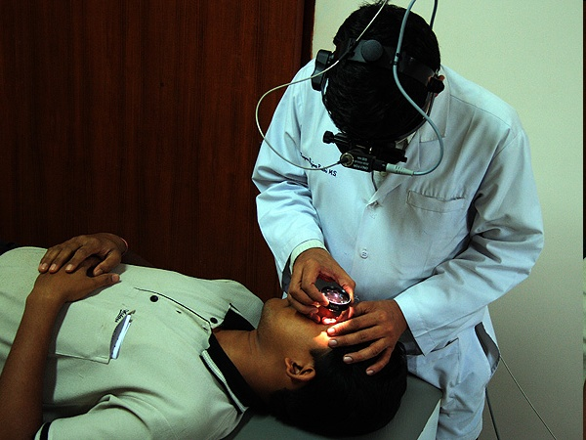
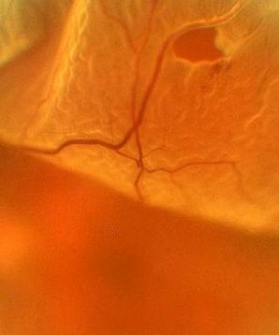
Notes:
26

Slide 27
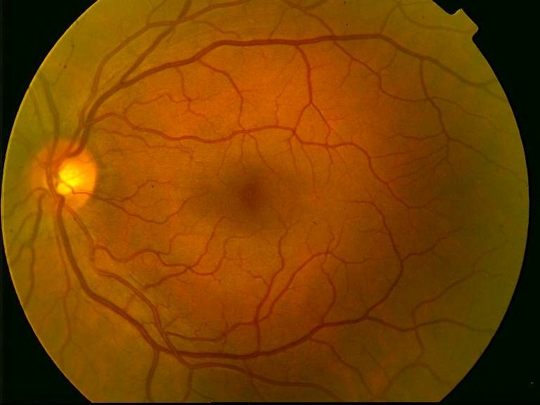
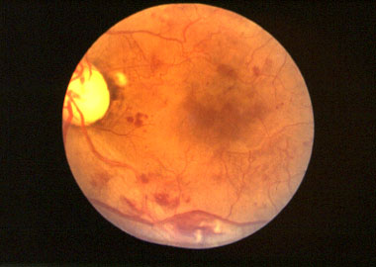
Ocular fundus

Slide 28
Special examination techniques

Slide 29
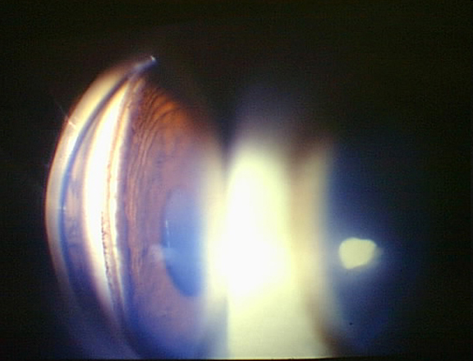
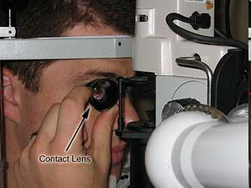
Gonioscopy
Gonio lens ( mirrors)
Angle structures
Fundus examination
Notes:
29

Slide 30
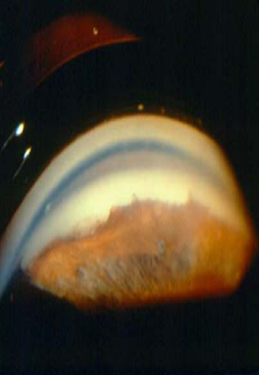
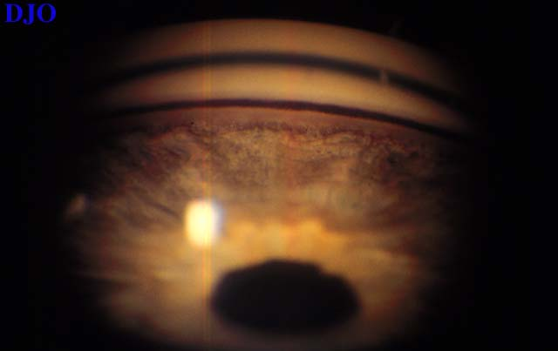
Notes:
30

Slide 31
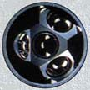
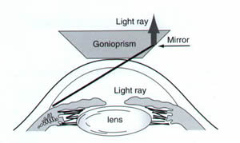
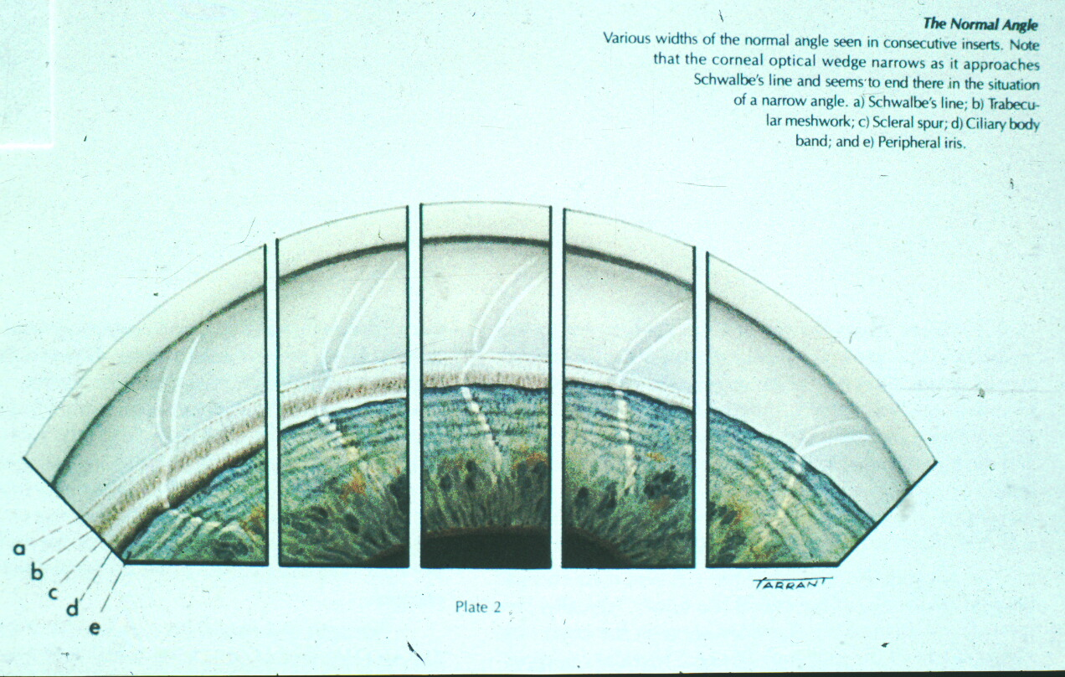

Slide 32
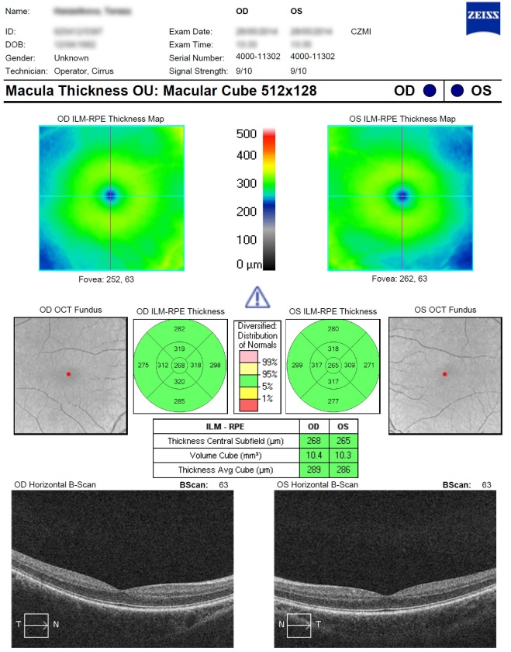
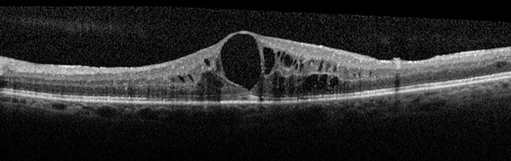


Optical coherence tomography

Slide 33


Fluorescein angiography

Slide 34
Electrophysical tests
ERG (electroretinography)
diagnosis of functional defects of retina
Record of an action potential produced by the retina when it is stimulated by light
VEP (visual evoked potential)
-diagnosis of functional defects of visual pathways
Record of electrical activity of the visual cortex created by stimulation of the retina

Slide 35


Electrophysical tests

Slide 36

Electrophysical tests

Slide 37



Ultrasound

Slide 38


Ultrasound
Non transparent optical media
UBM- high frequency ultrasound – imaging of anterior segment

Slide 39


A scan ( biometry)
B scan

Slide 40





Ultrasound

Slide 41


Color vision – HUE test

Slide 42




Hertl exoftalmometry

Slide 43

Děkuji za pozornost!

