Slide 1

ORTHODONTICS
Diagnostic examination
MUDr. Alena Bryšová, Ph.D.

Slide 2
Diagnostic examination
1. ANAMNESIS
a] Family anamnesis
- dental problems of parents
- orthodontic anomalies of parents
- genetic health problems

Slide 3
Diagnostic examination
1. ANAMNESIS
b] health anamnesis of the patient
- medicaments
- allergy
- facial and dental injury
- contagious disease

Slide 4
Diagnostic examination
1. ANAMNESIS
c] special anamnesis of the patient
- frenulectomy
- adenotomy
- habits
- mouth breathing

Slide 5
Diagnostic examination
2. CLINICAL EXAMINATION
a] extraoral examination
profile [convex, concave, straight]
face symmetry
temporomandibular joints

Slide 6
Diagnostic examination
2. CLINICAL EXAMINATION
b] intraoral examination
Status of dentition, caries, fillings
Anomalies of the relationship of dental arches – Angles classification
Overjet, overbite
Status of oral soft tissues, frenulum
Functional examination, centric occlusion
hygiene

Slide 7
Diagnostic examination
3. MODEL EXAMINATION
- space analysis, discrepancy
arch form
dental anatomy
intercuspidation

Slide 8
Diagnostic examination
4. RADIOGRAPHS
a] Panoramic
detection of congenital absences of teeth
detection of supernumerary teeth
evaluation of the dental health of the permanent teeth
assessment of trauma to the teeth after injury
determination of dental age of the patient
calculation of root resorption
condyles

Slide 9
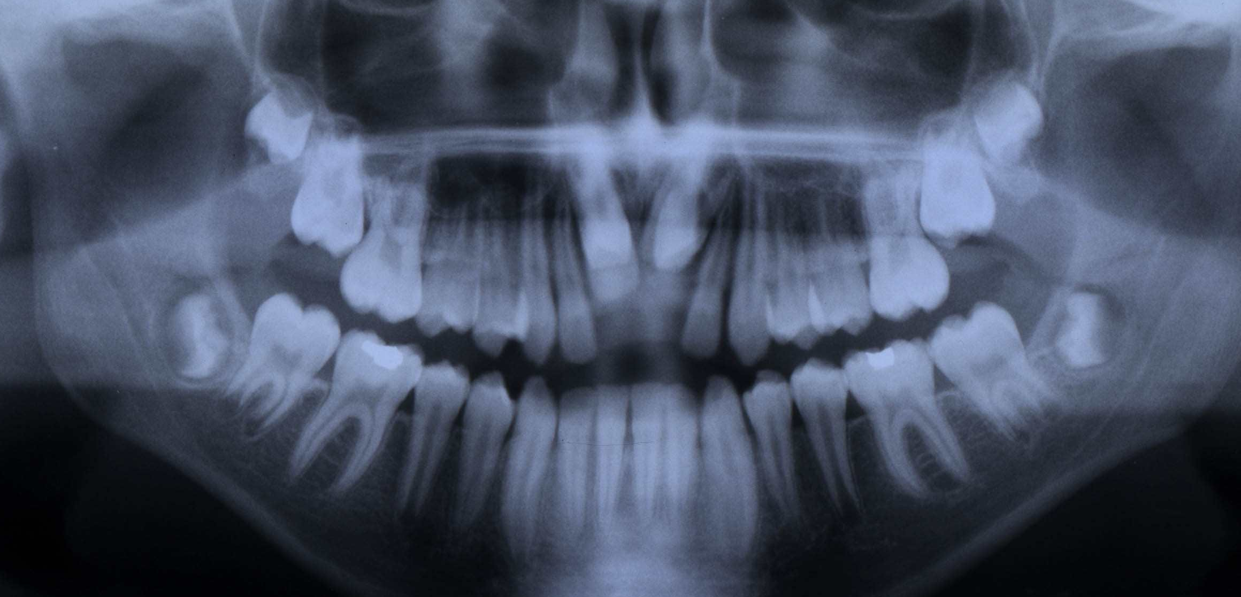

Slide 10
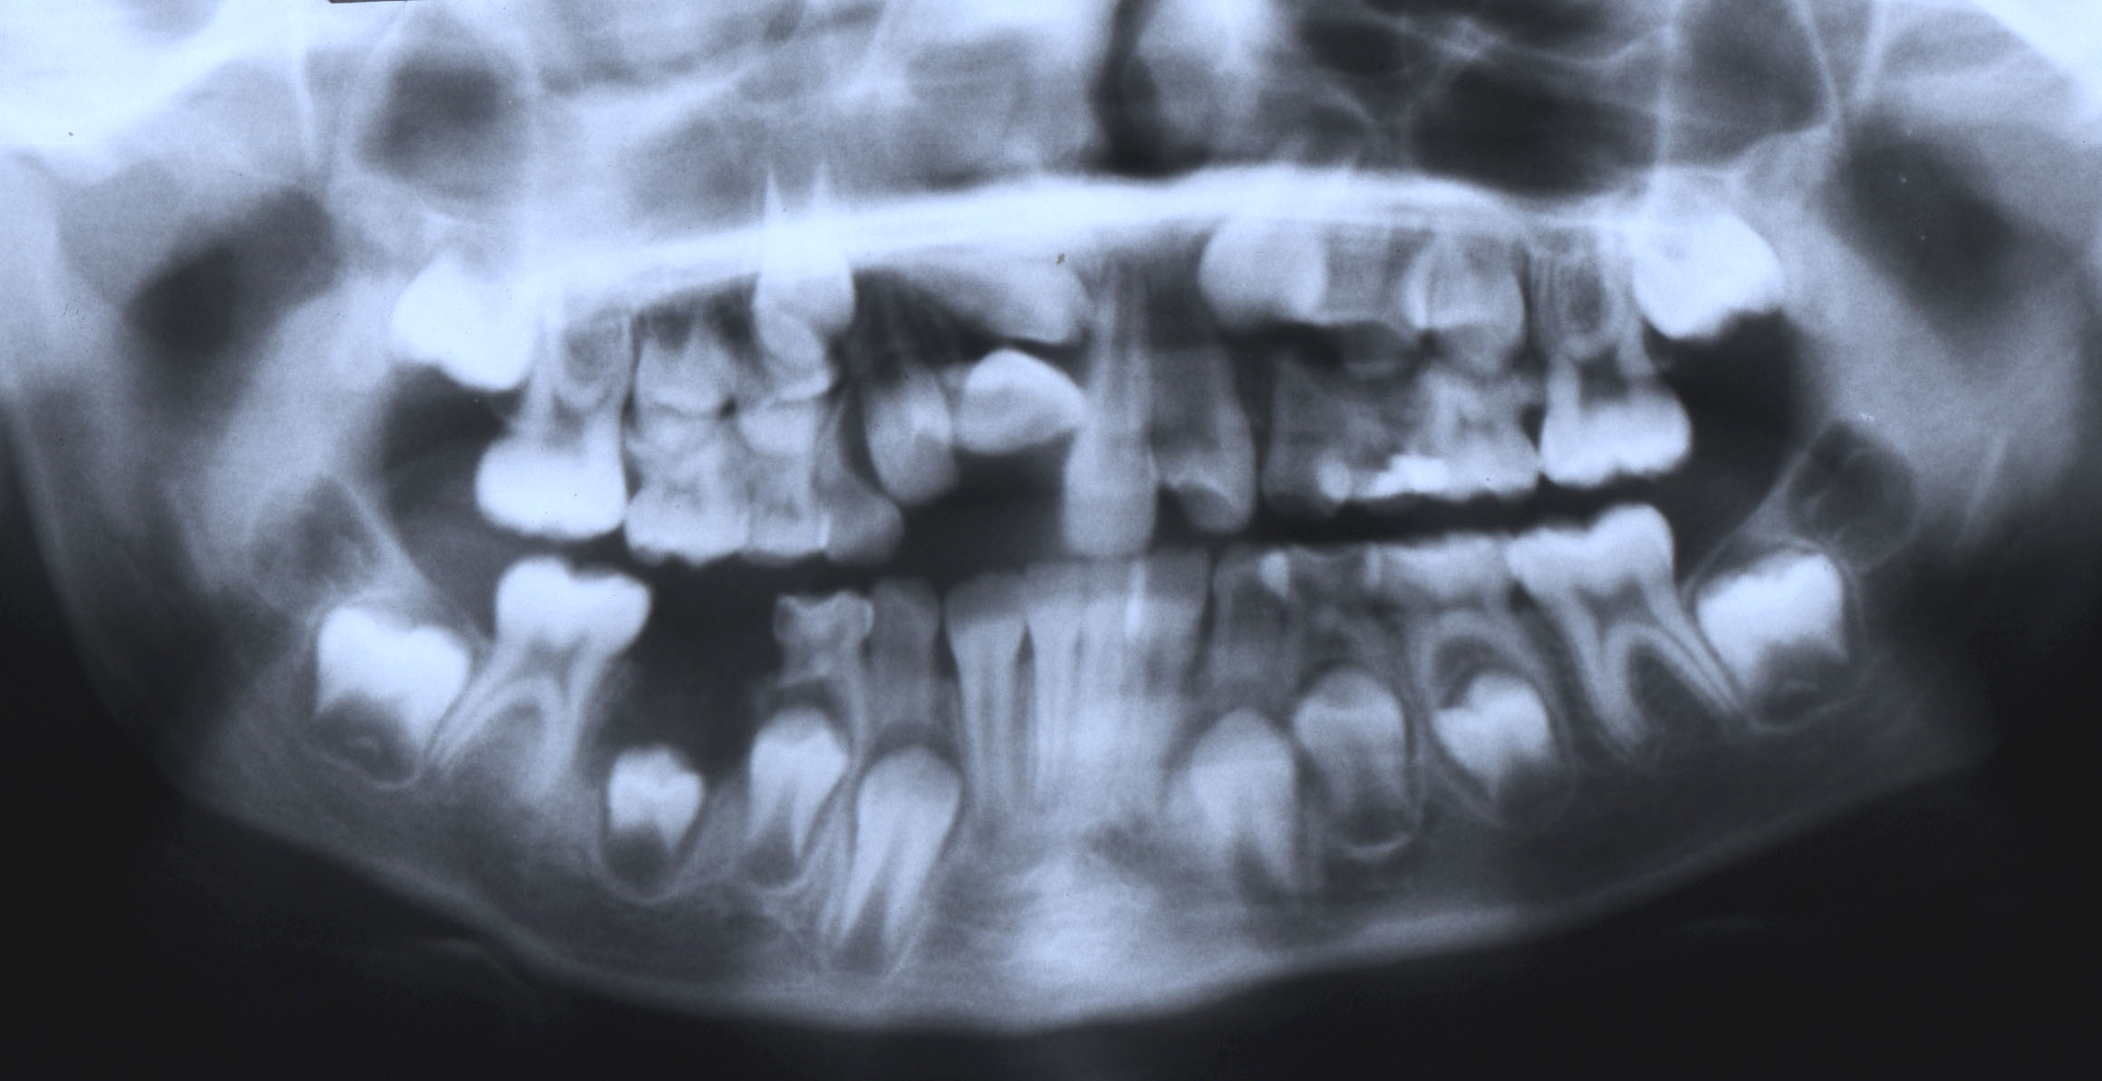

Slide 11
Diagnostic examination
4. RADIOGRAPHS
b] Cephalometric radiographs
evaluation of craniofaciodental relationship
assessment of the soft tissue matrix
determination of mandibular position
prediction of growth and development
detection of skeletal age

Slide 12
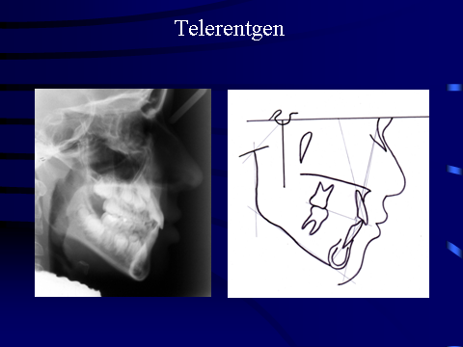

Slide 13
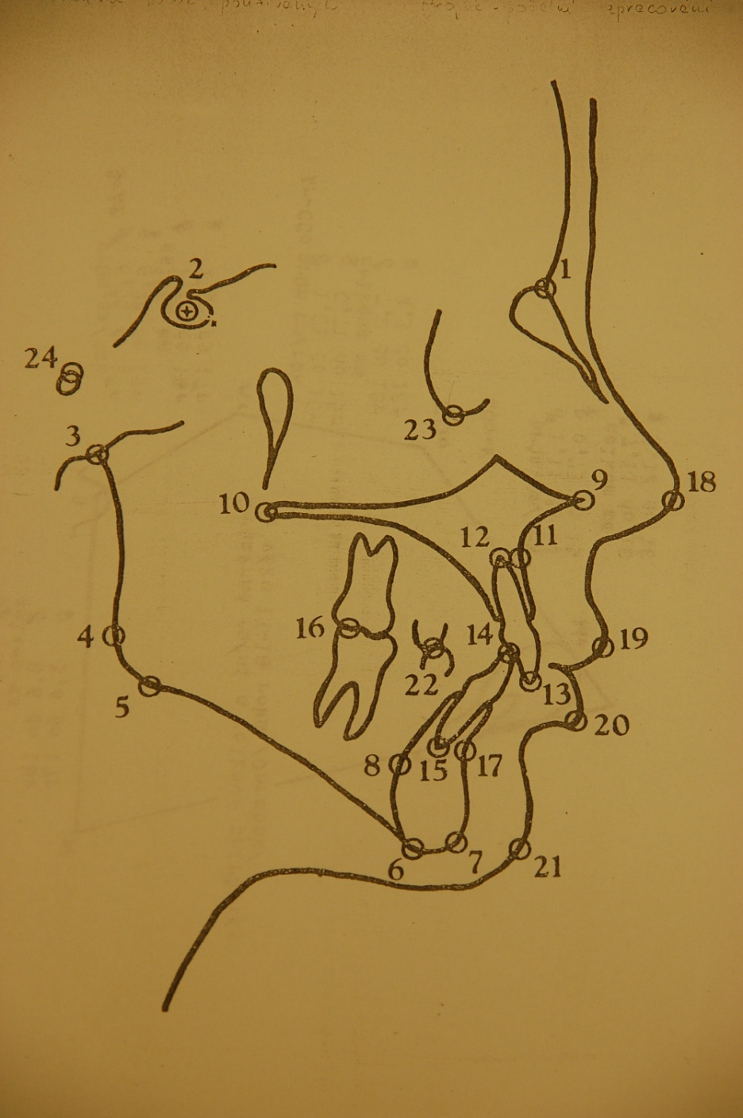
ANALÝZA KEFALOMETRICKÉHO SNÍMKU
N - nasion (1)
S – sella (2)
a – articulare (3)
Me – menton (6)
Po – pogonion (7)
SpA – spina nasalis ant. (9)
SpP – spina nasalis post. (10)
A – bod A (11)
Is´- apex horního středního řezáku (12)
Is – incisale superius (13)
Ii – incisale inferius (14)
Ii´- apex dolního řezáku (15)
B – bod B (17)
Go – gonion (kontr. bod: 1. a-4, 2. ML)
Gn – gnation (konstr. bod: 1. N-Po, 2. ML)
ML – mandibulární linie (Me-5)
FOL – funkční okluzální linie
Notes:
13

Slide 14
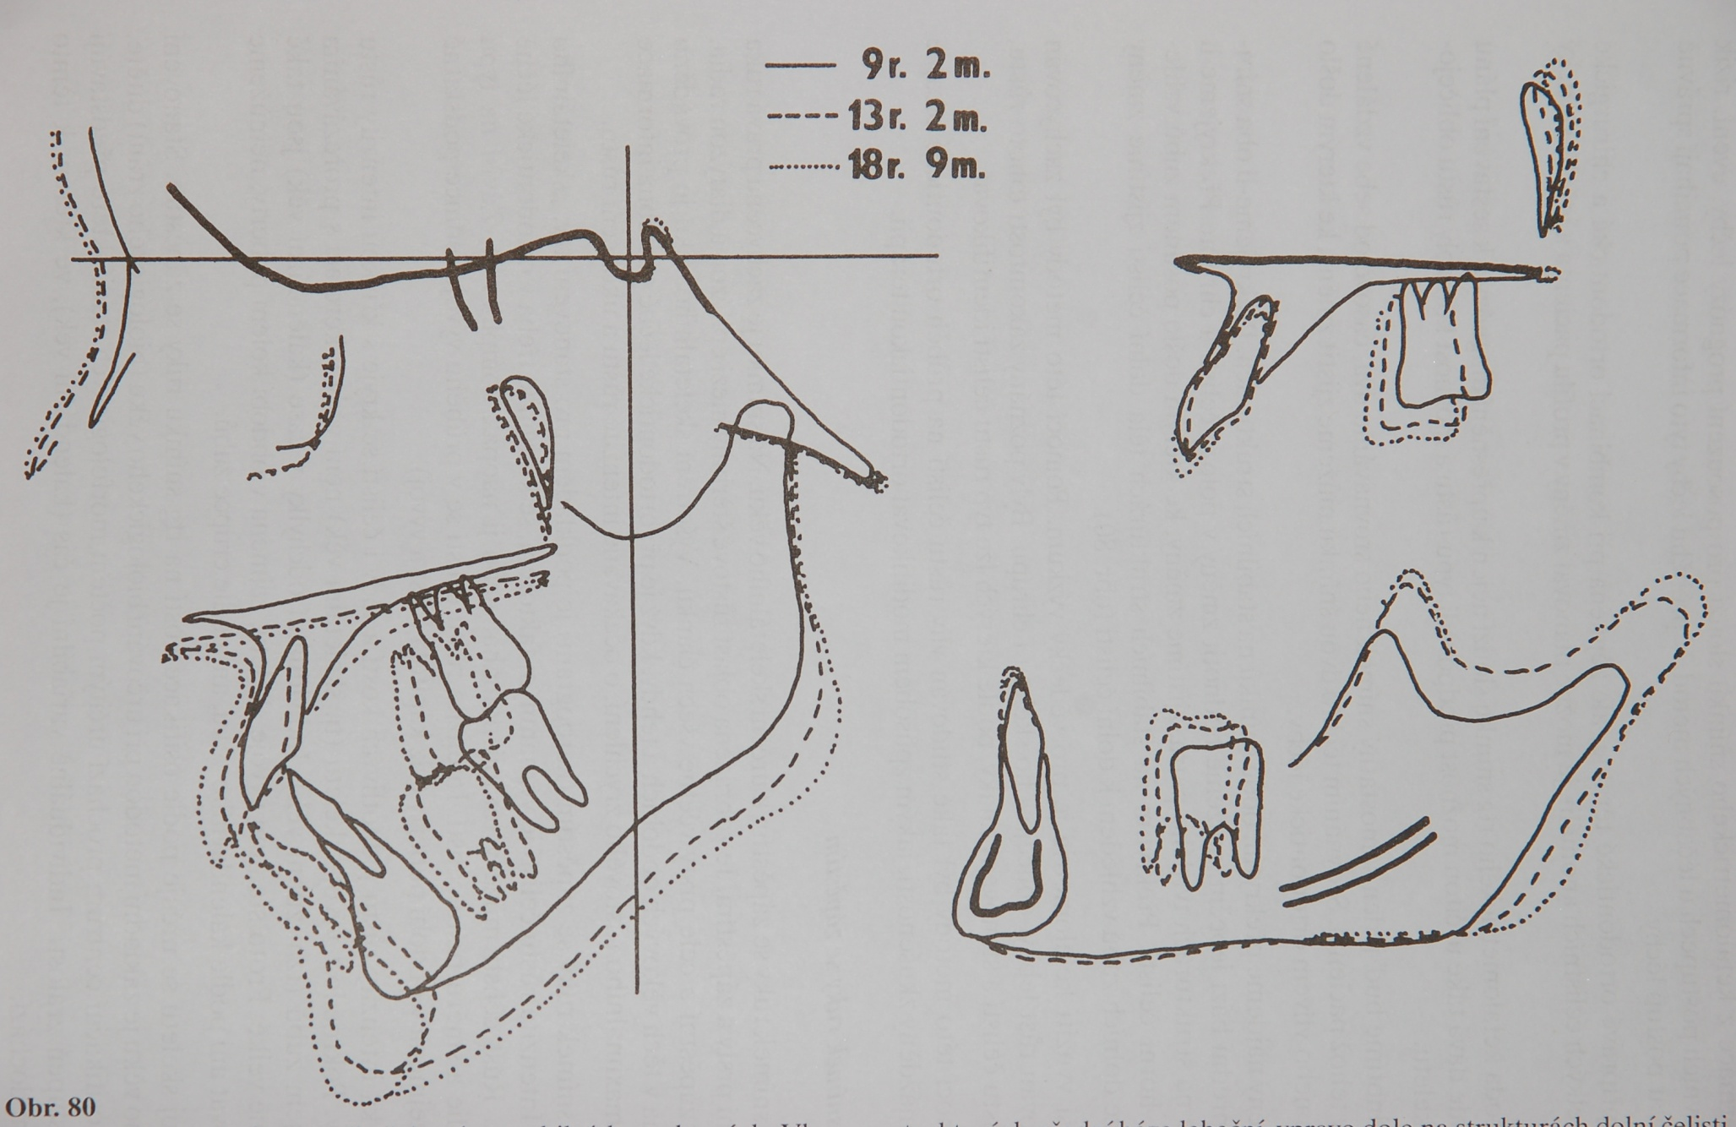
Notes:
14

Slide 15
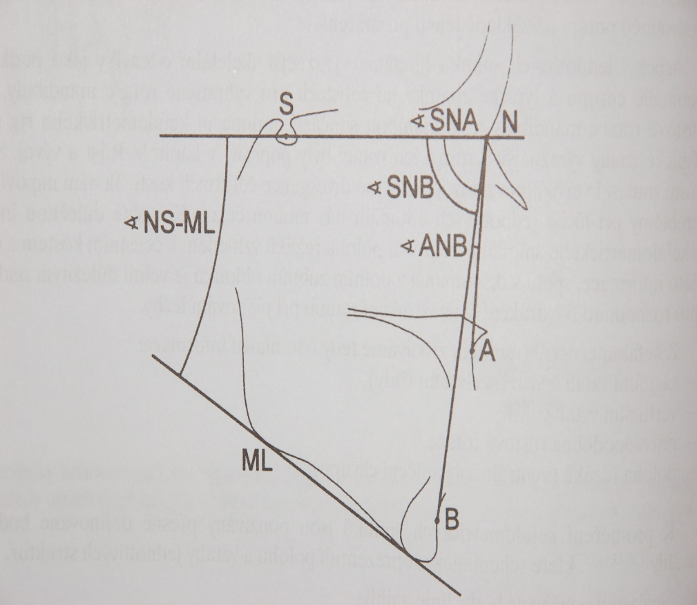
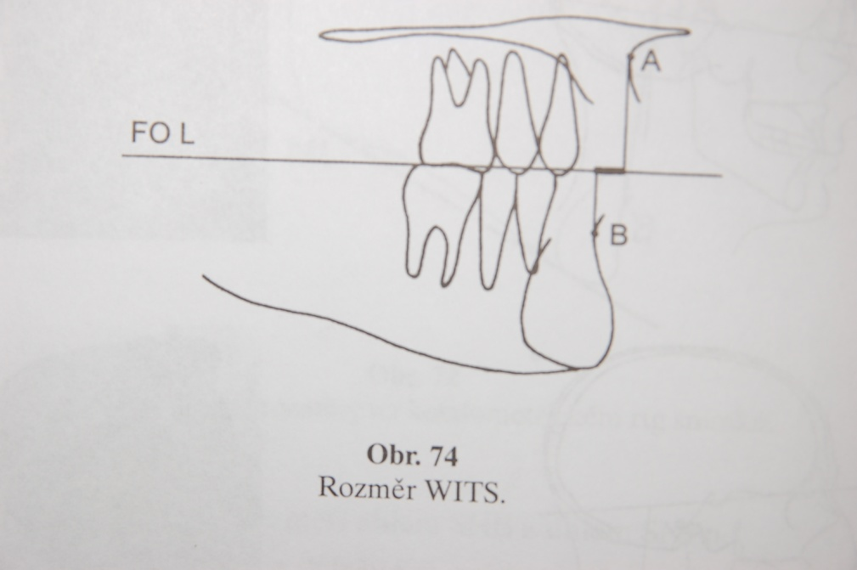
skeletal analysis
ANB (-1 až +5 stupňů)
WITS (-2 až +2)
Notes:
15

Slide 16
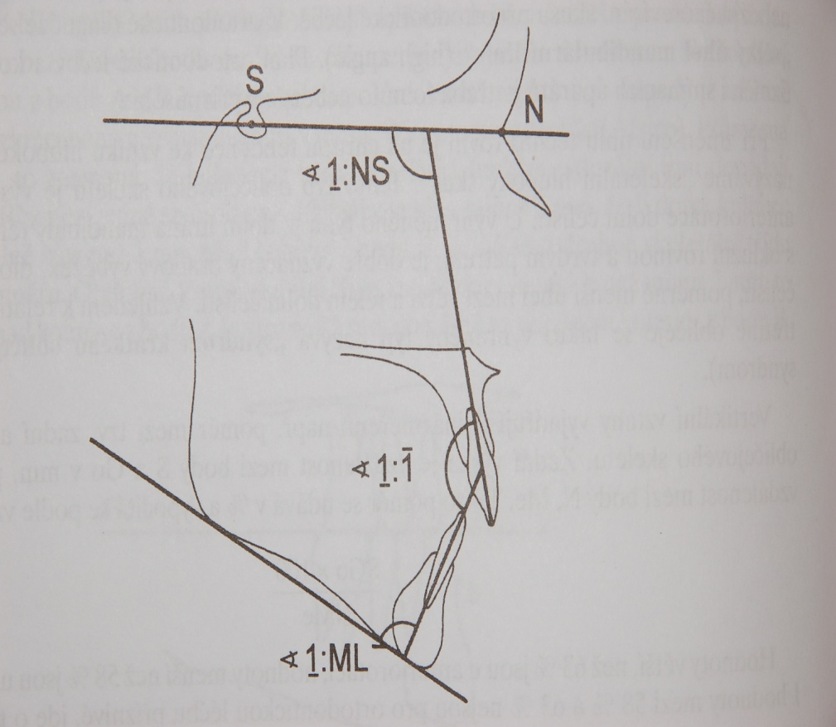

Slide 17
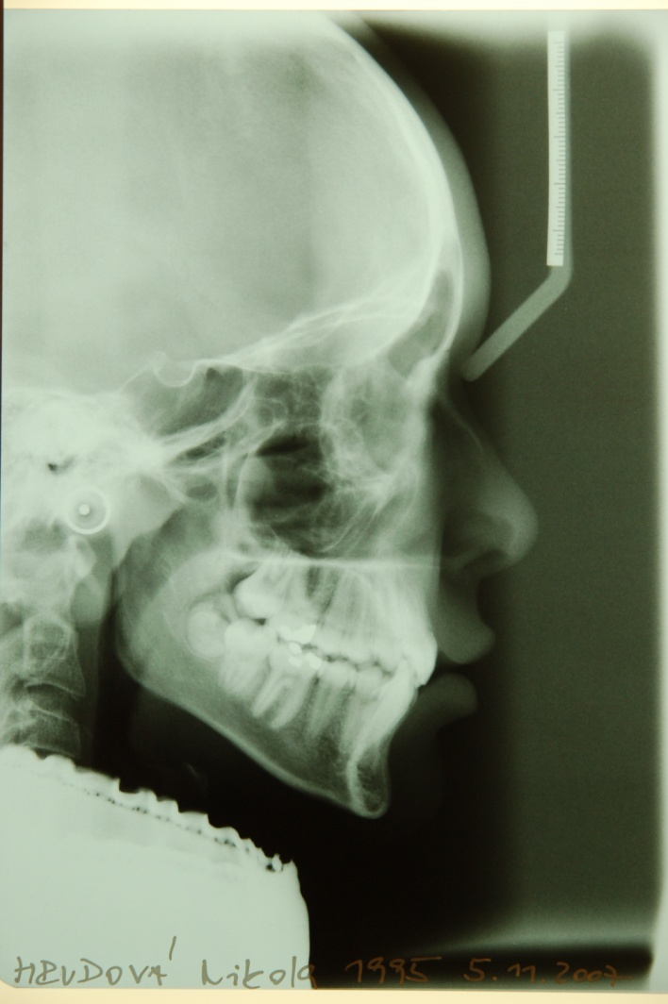
Skeletal class I
Notes:
17

Slide 18
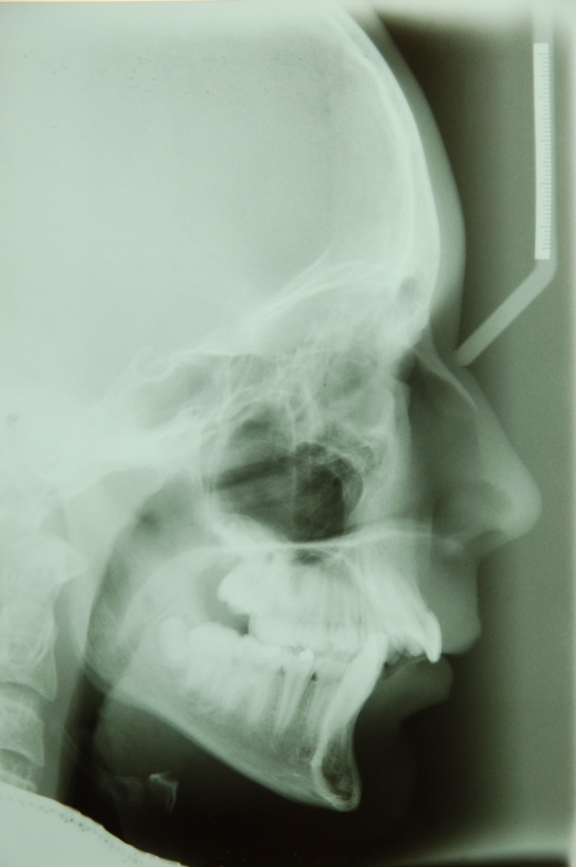
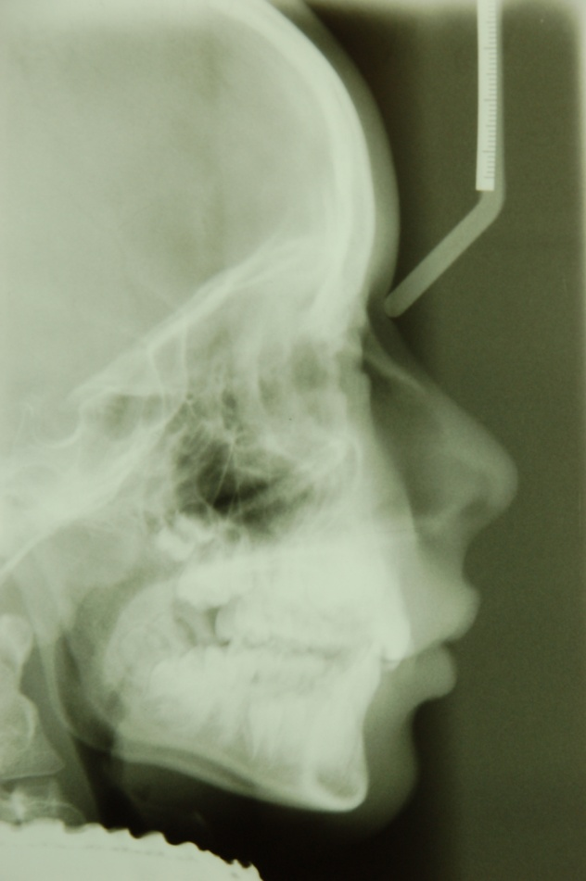
Skeleal class II
div. 1 with protrusion
div. 2 – with retrusion
Notes:
18

Slide 19
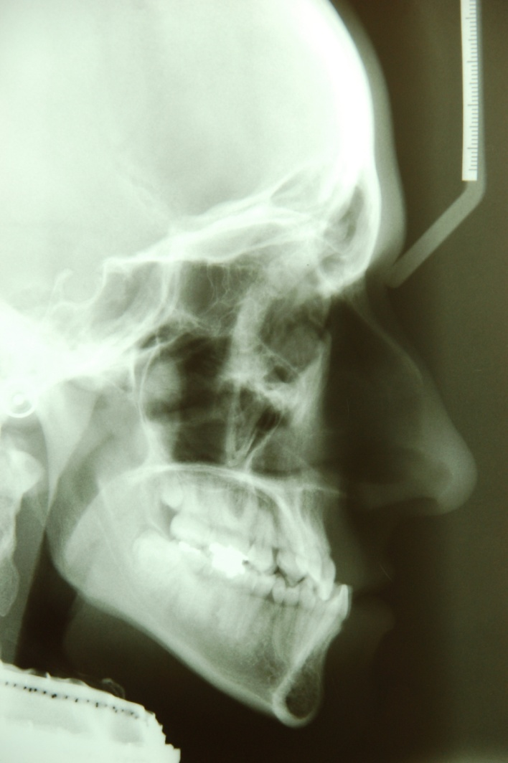
Skeletal class III
Notes:
19

Slide 20
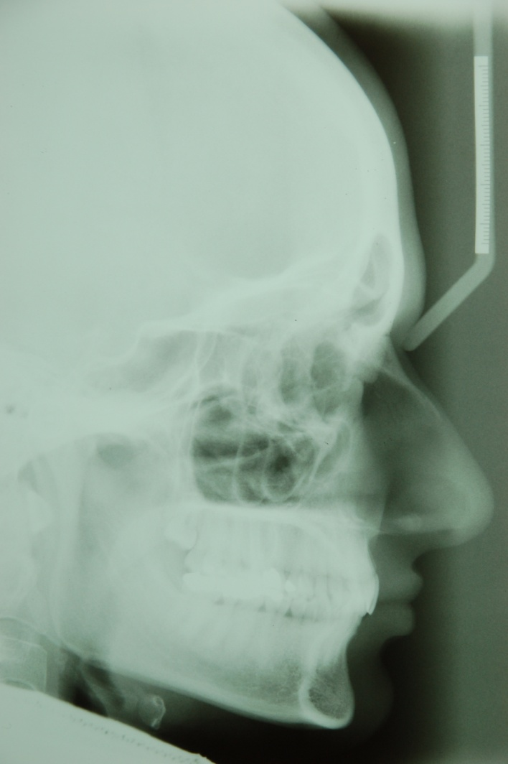
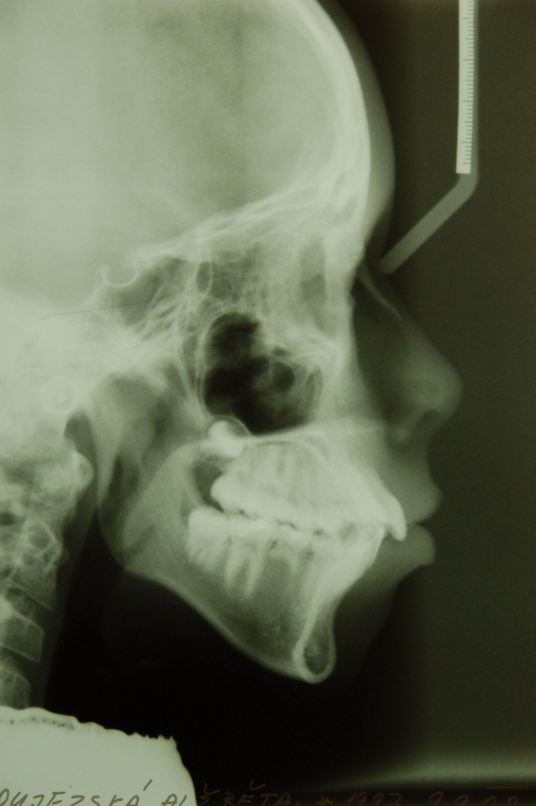
Bimaxilary protrusion
Notes:
20

Slide 21
Diagnostic examination
4. RADIOGRAPHS
c] Other radiographs
Bitewing – caries detection
Hand wrist – detection of skeletal age
Computer tomography –CT scan [impacted tooth, ankylosed tooth, difficult skeletal anomalies
Digital imaging – computer generated model reconstructed from the initial imaging data

Slide 22
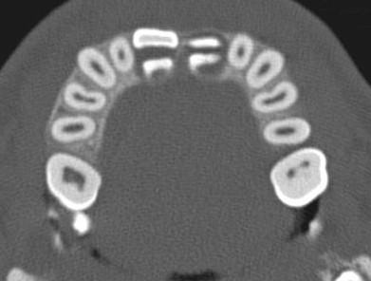
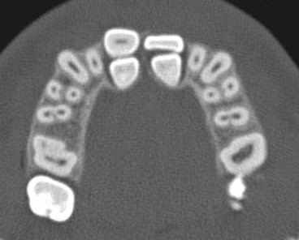
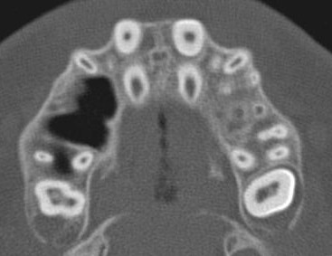
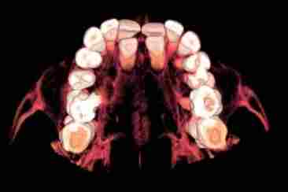
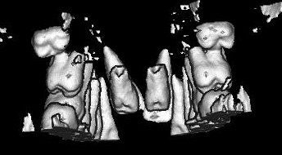
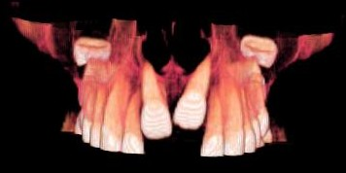

Slide 23
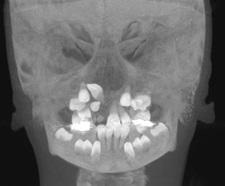
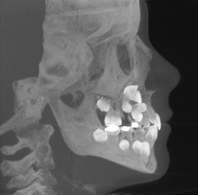
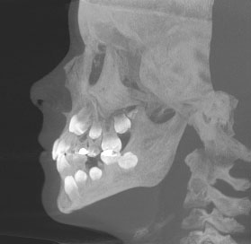

Slide 24
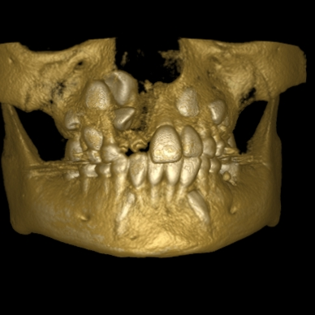
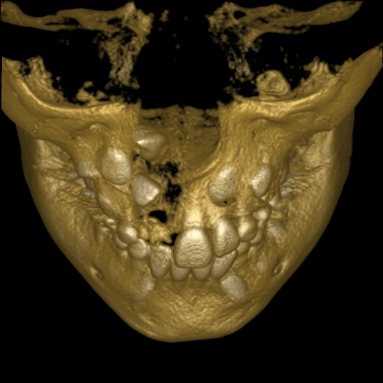
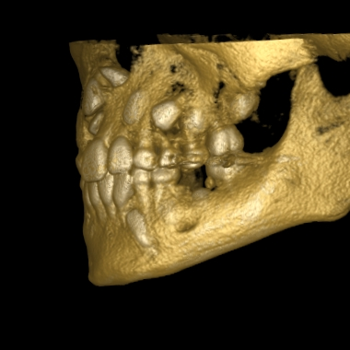
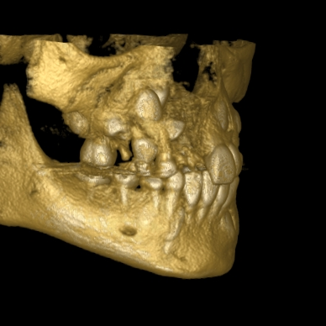
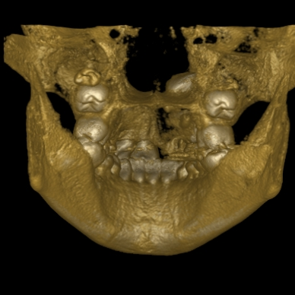

Slide 25
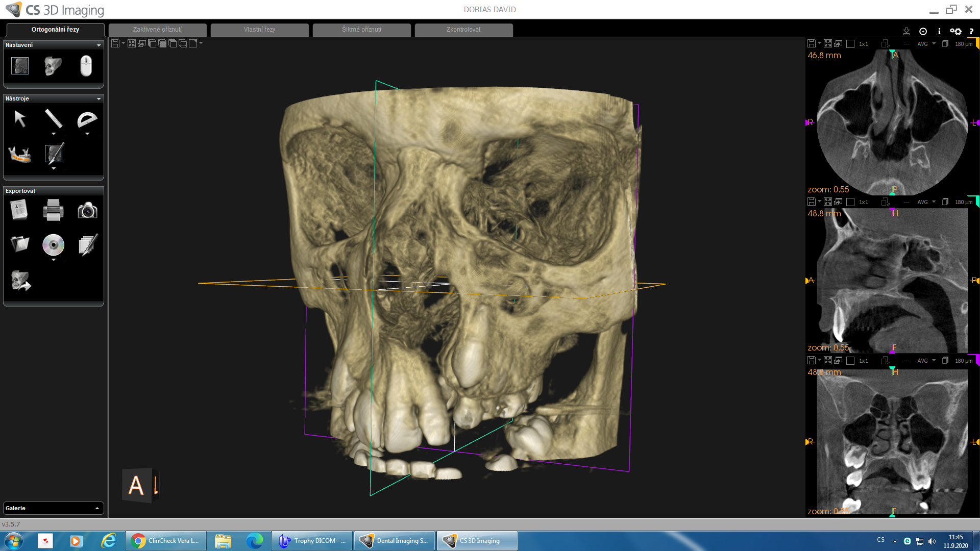
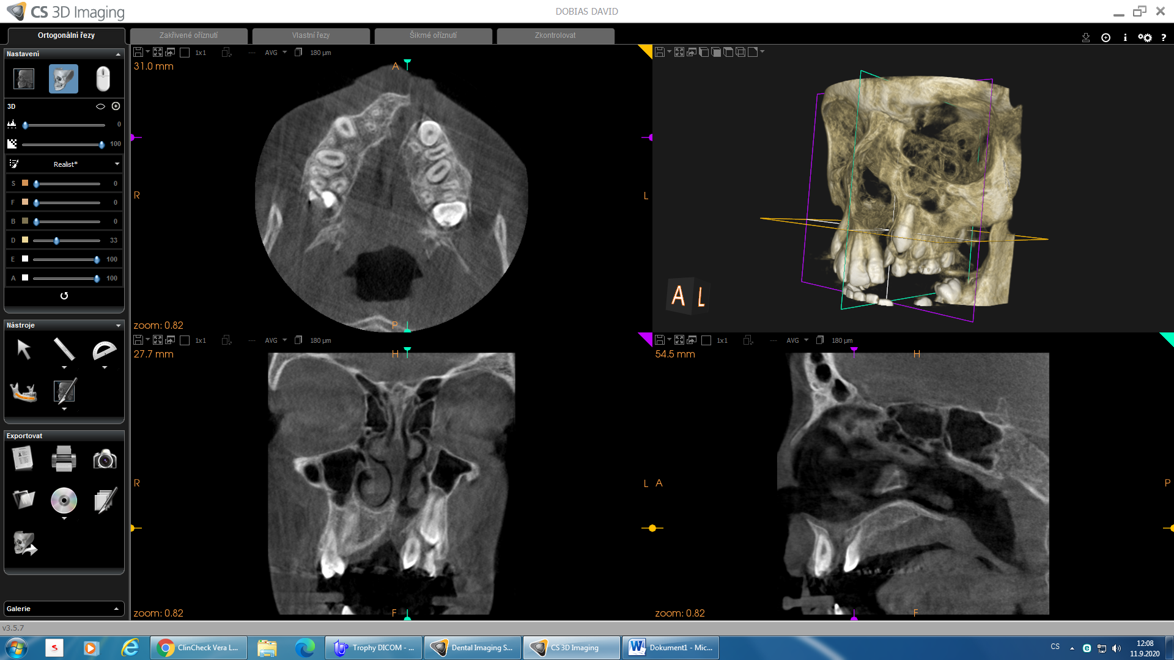

Slide 26
Diagnostic examination
5. PHOTOGRAPHS
- extraoral photographs - frontal
- profile
- smile
Intaoral photographs - frontal teeth
- right and left side
- upper and lower arch

Slide 27
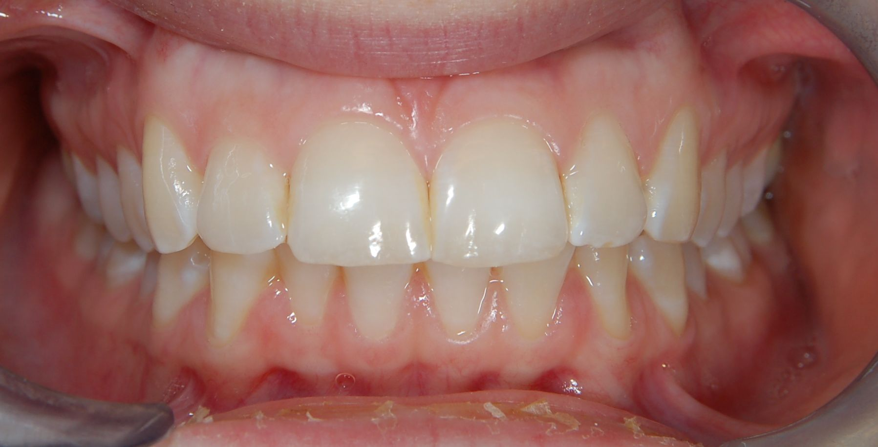
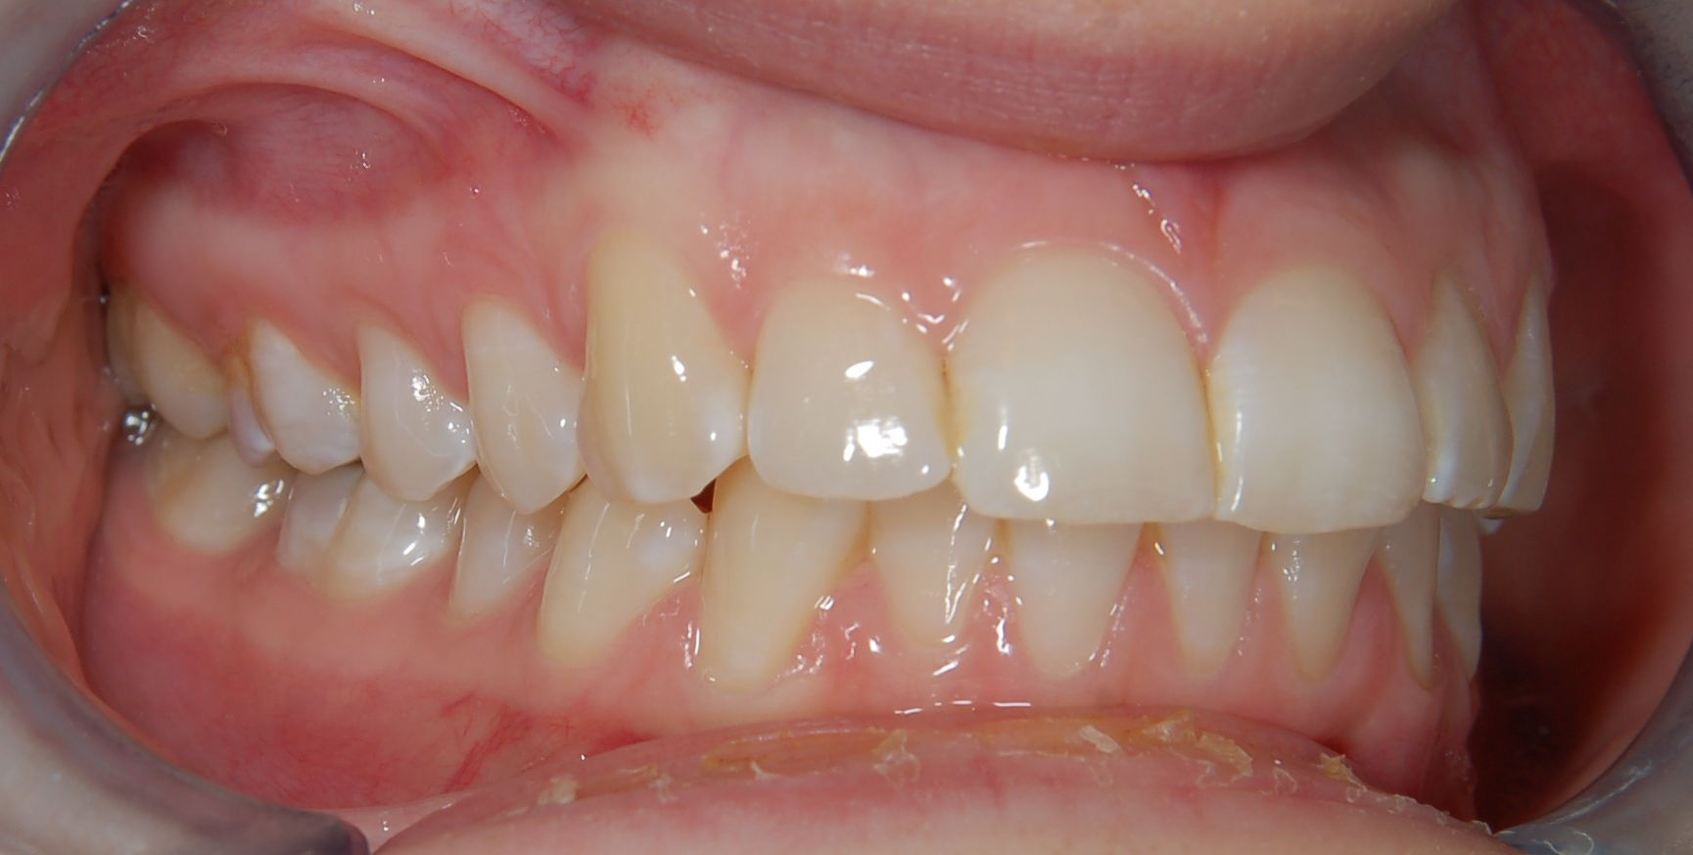
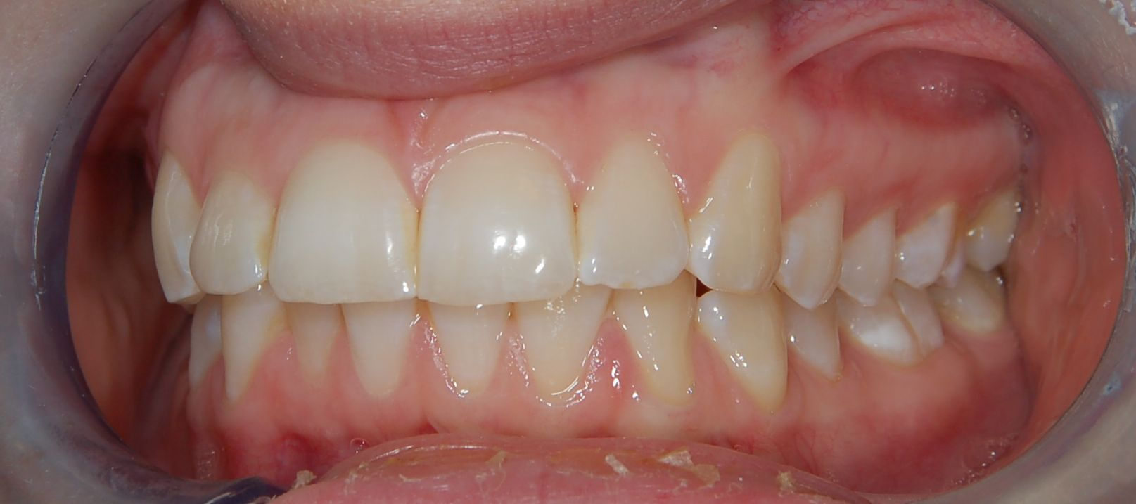
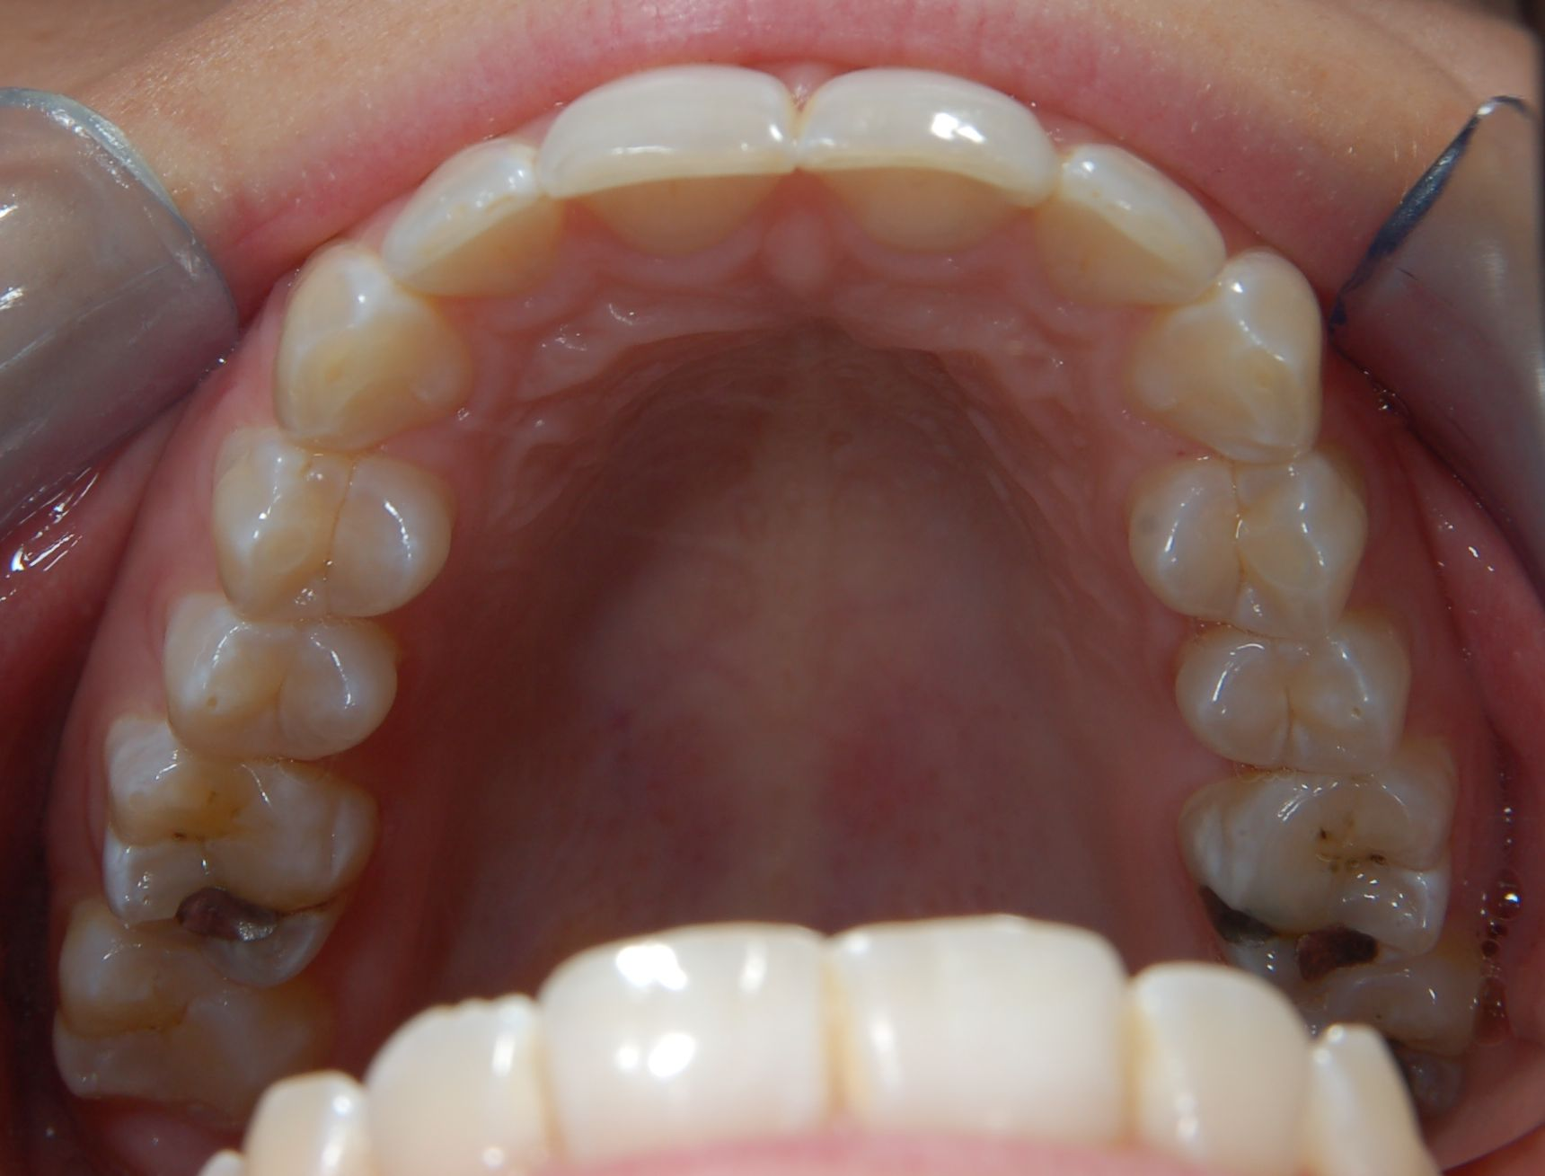
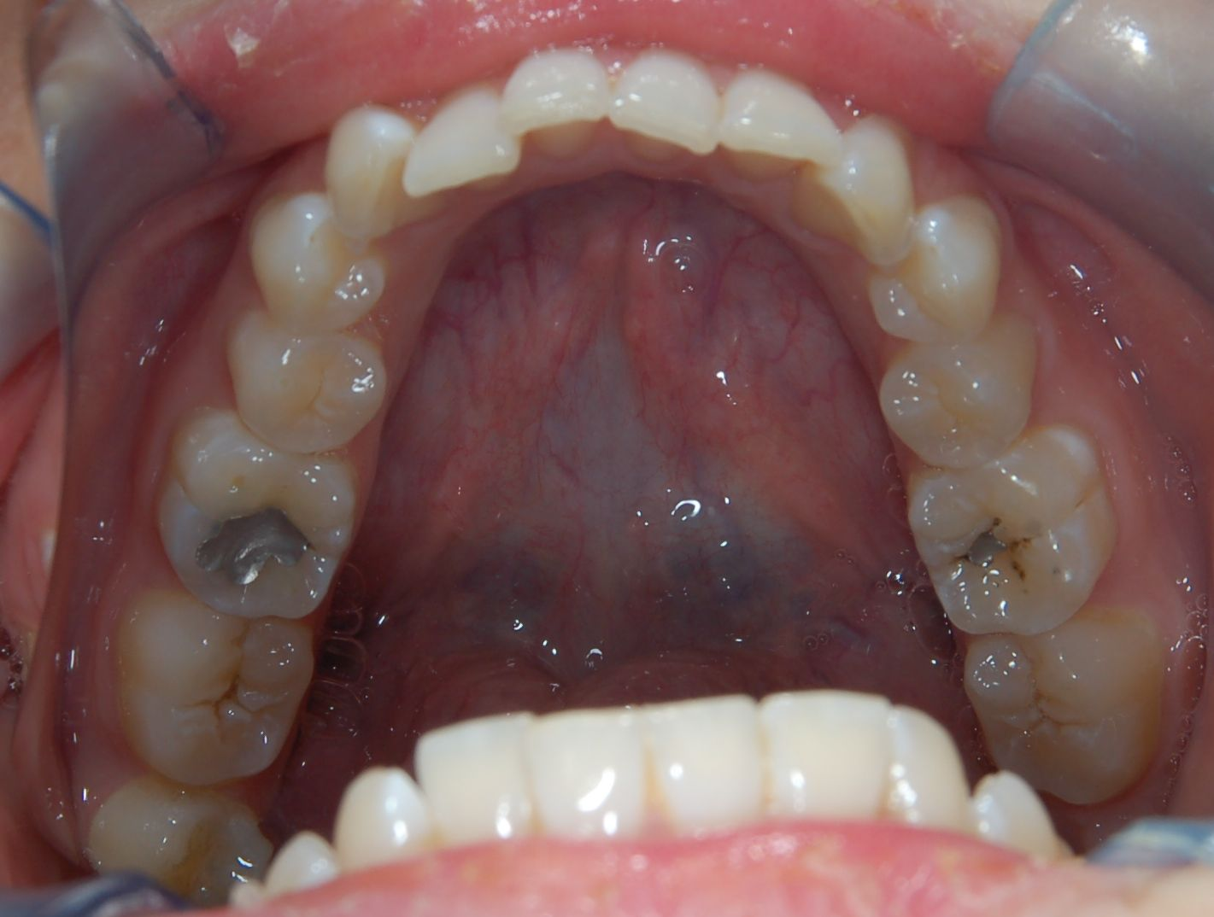

Slide 28
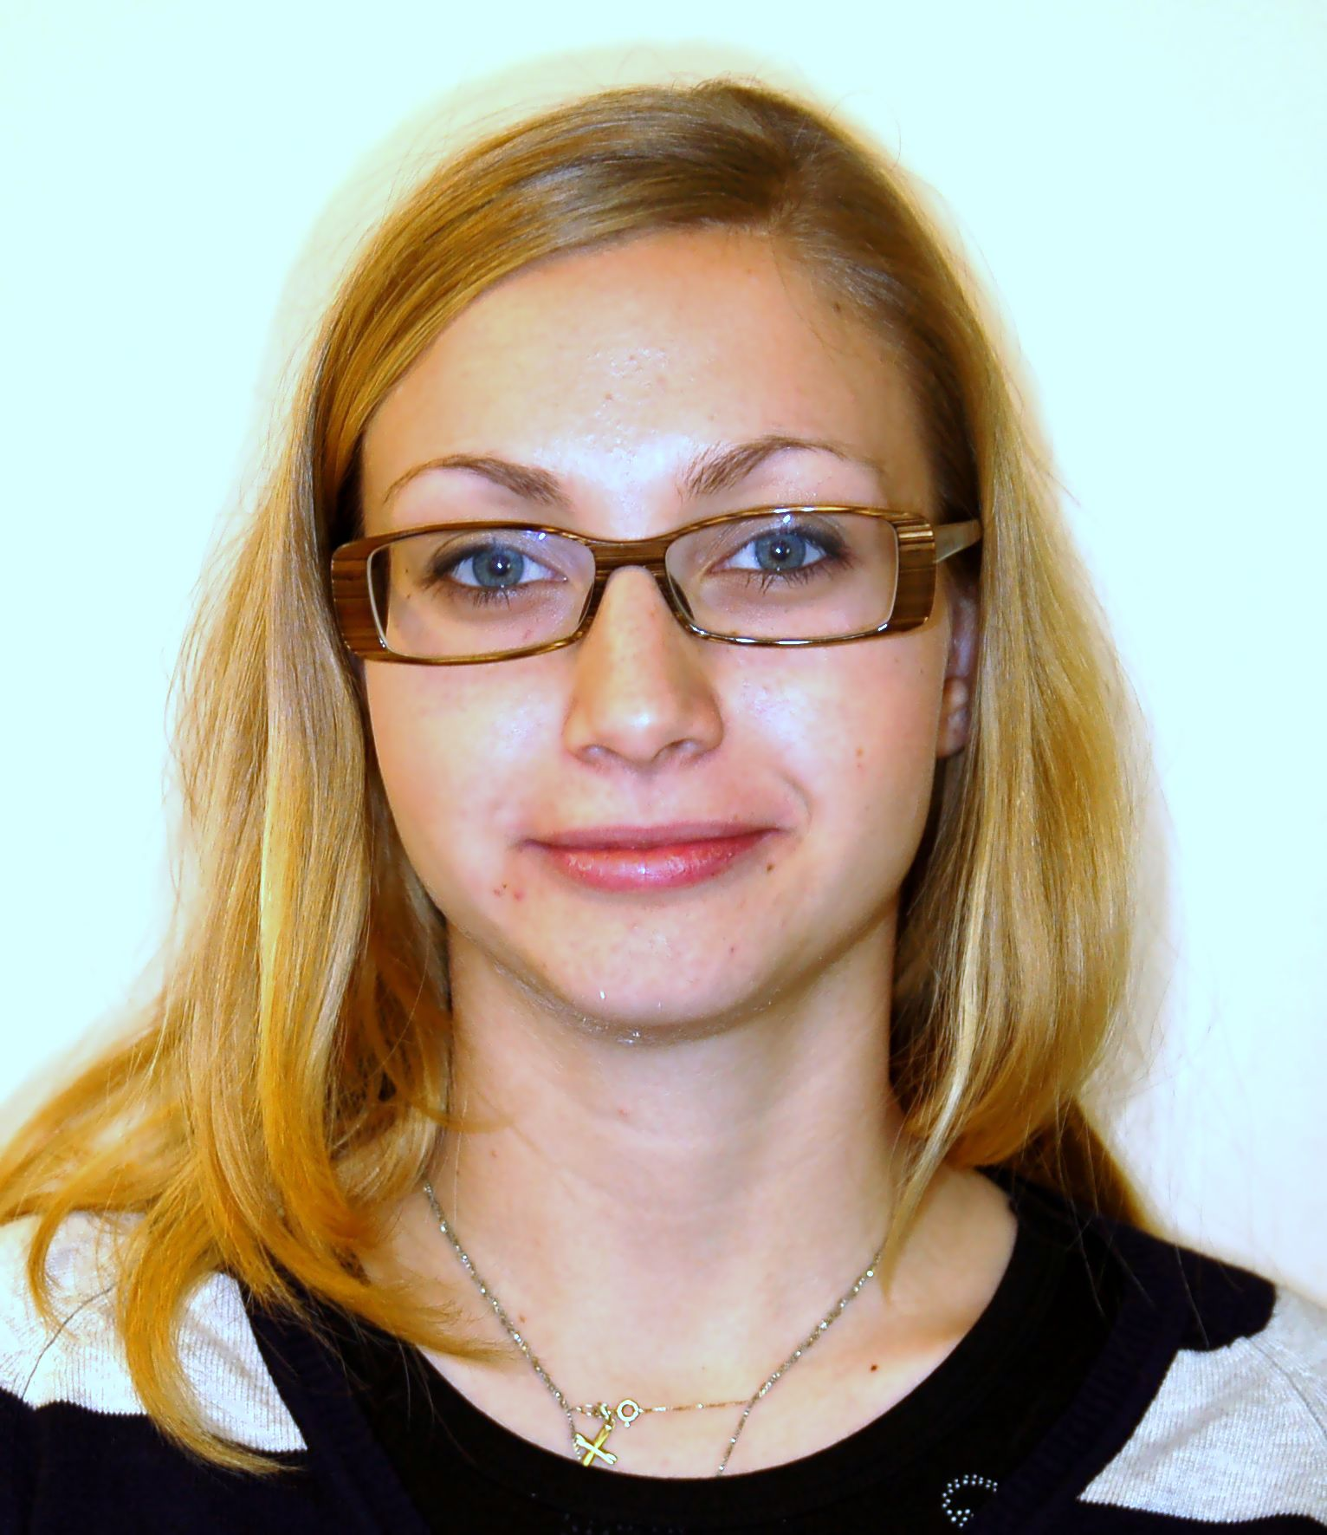
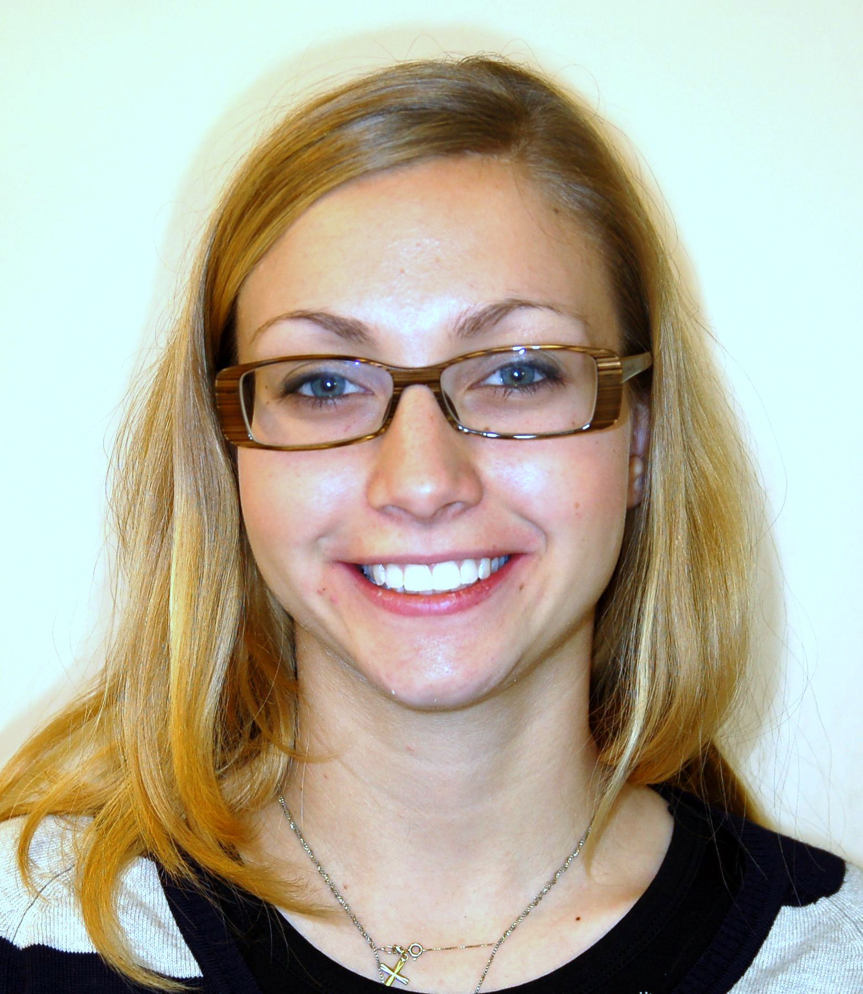
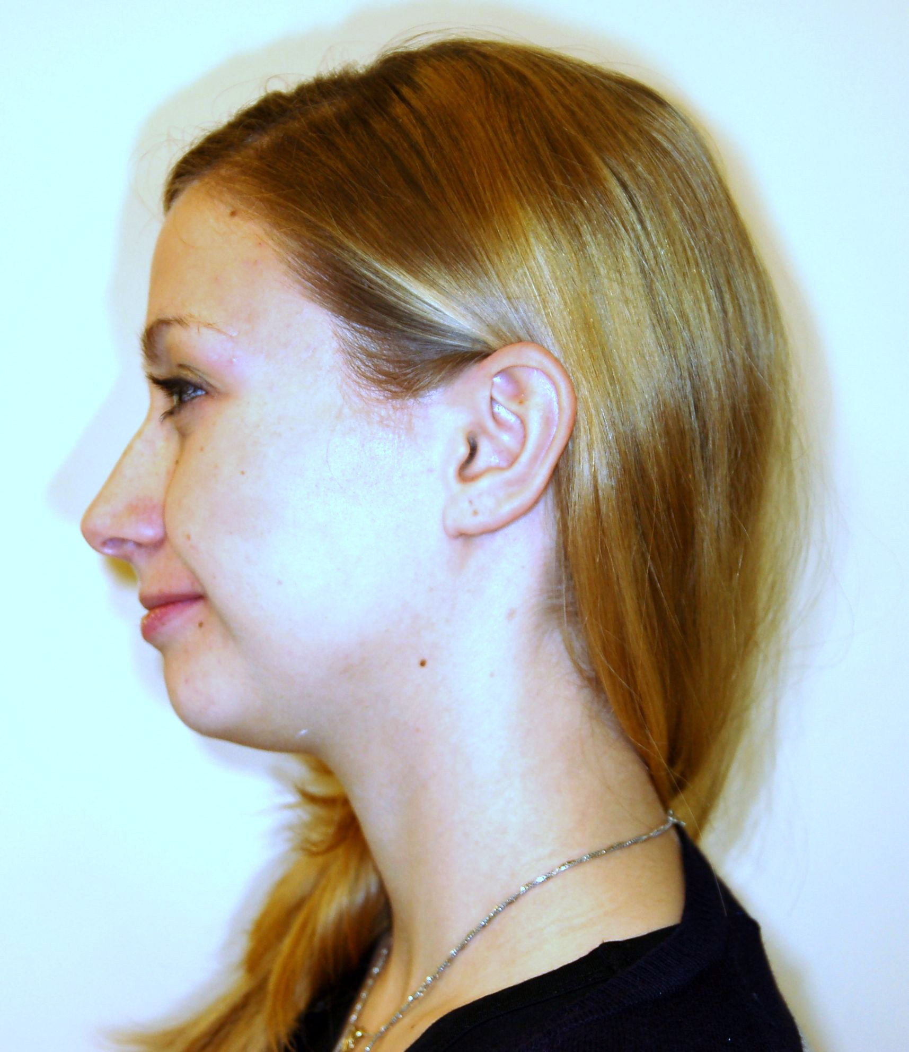

Slide 29
try to diagnose orthodontic anomalies
?

Slide 30
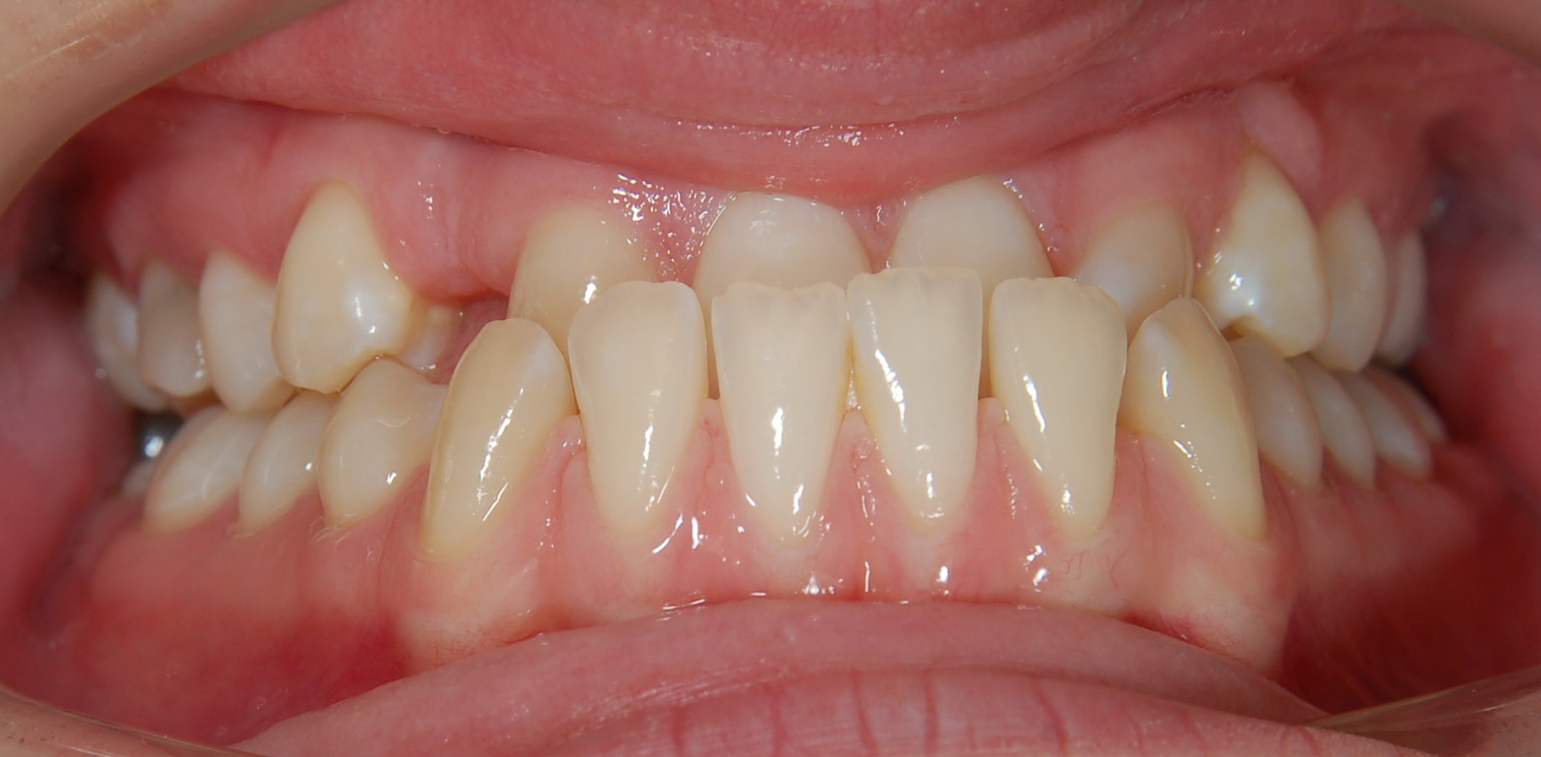
Case 1- ?

Slide 31
Case 1
Inverted bite
Shifted midline
Missing 13,23

Slide 32
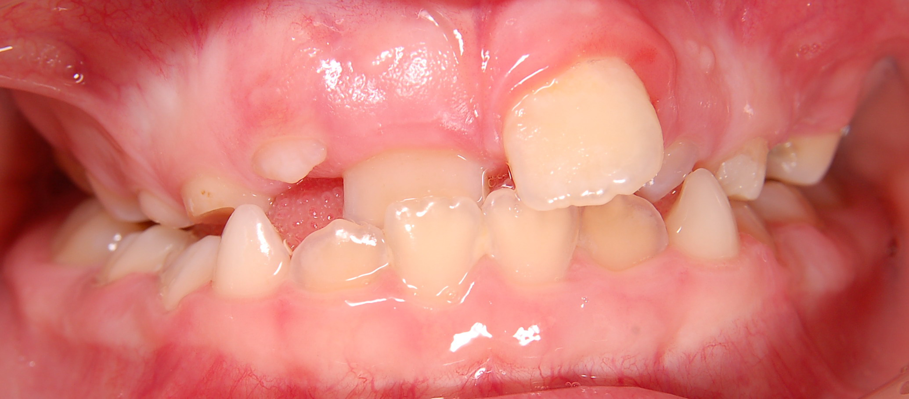
Case 2 -?

Slide 33
Case 2
Anterior cross bite 11, 22
Protrusion of 21
Mixed dentition

Slide 34
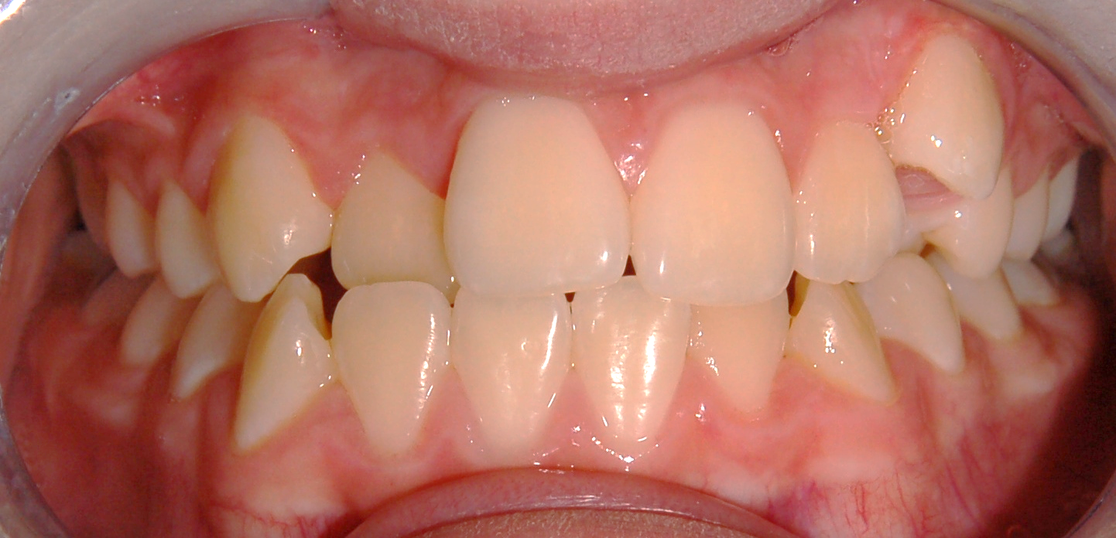
Case 3 - ?

Slide 35
Case 3
Crowding
Shifted midline
Vestibular eruption 23
Anterior cross bite 12

Slide 36
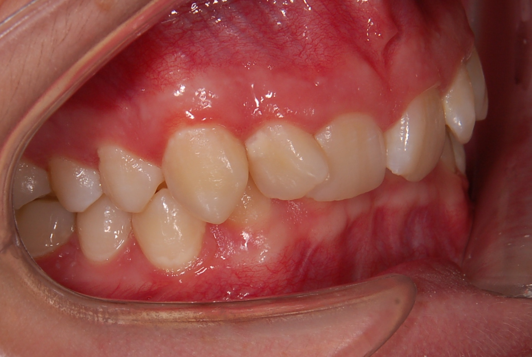
Case 4 -?

Slide 37
Case 4
Deep bite
Angle class I
Crowding
Mesial inclination 12, 21

Slide 38
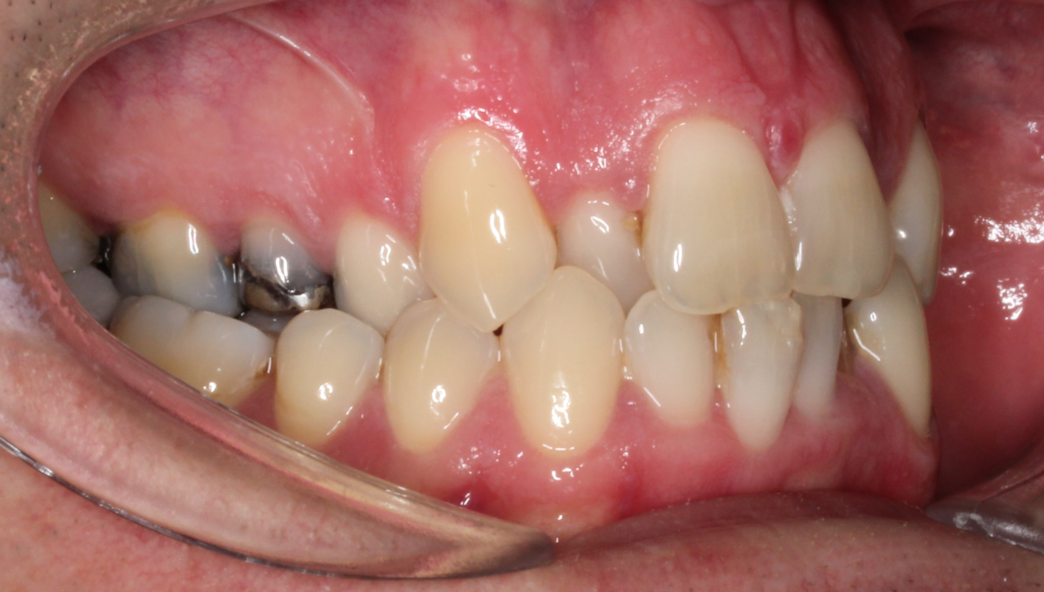
Case 5 - ?

Slide 39
Case 5
Lateral Cross bite
Crowding
Angle class I

Slide 40
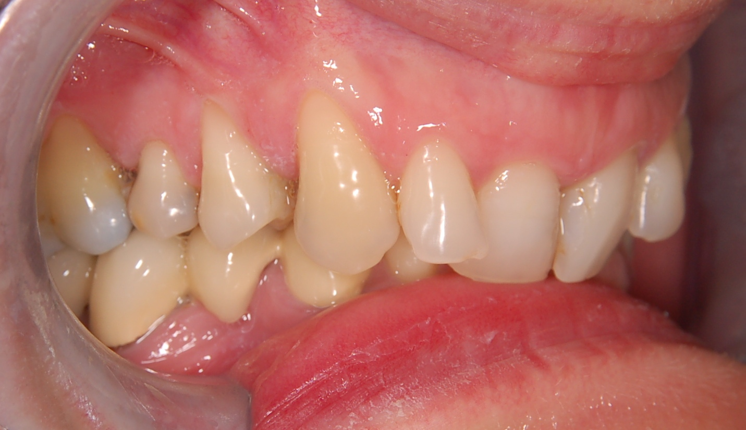
Case 6 - ?

Slide 41
Case 6
Deep bite
Angle class I
Retrusion 11, 21

Slide 42
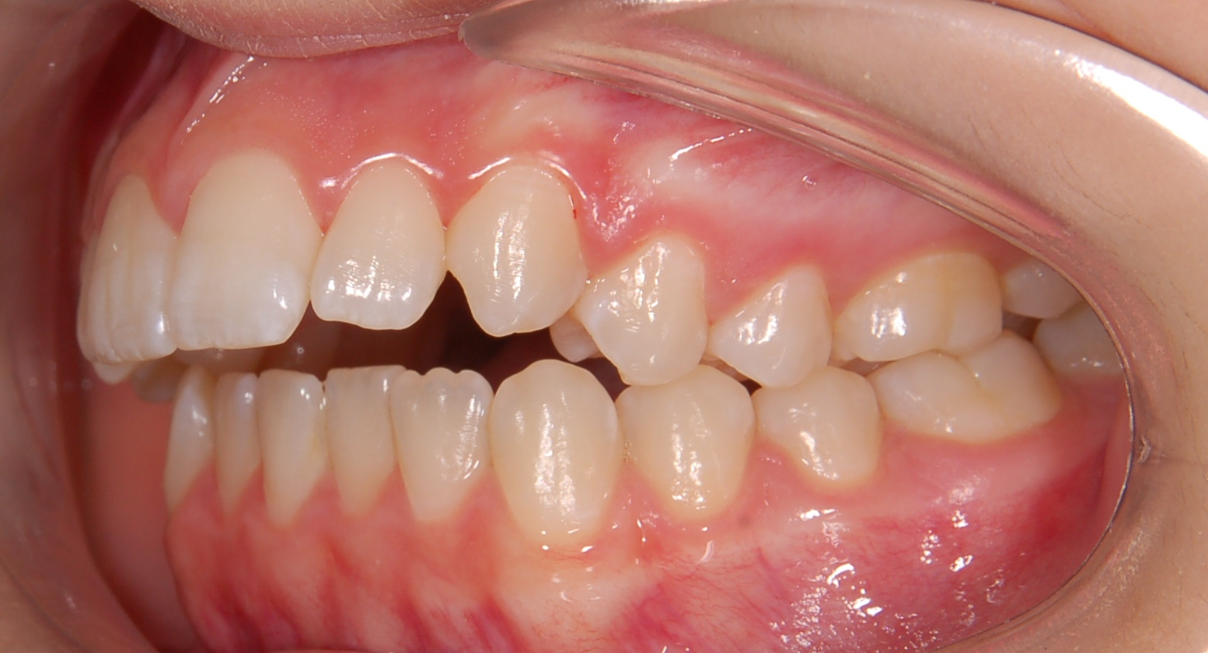
Case 7 - ?

Slide 43
Case 7
Open bite
Angle Class II
Protrusion upper incisors

Slide 44
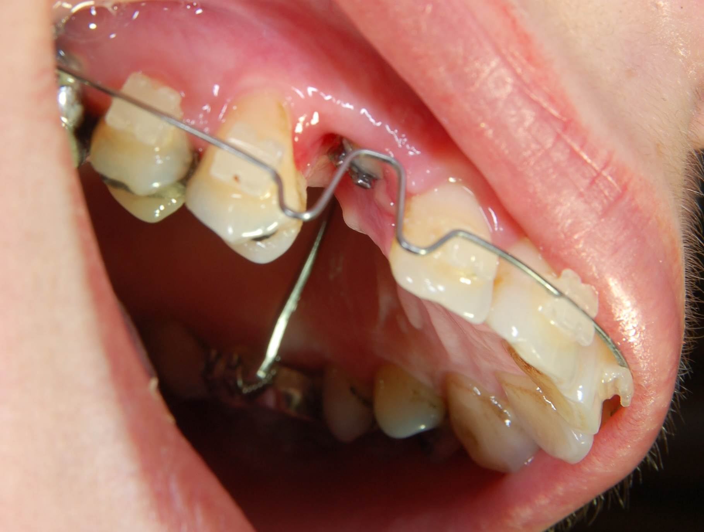
Case 8 - ?

Slide 45
Case 8
Retention of 13

Slide 46
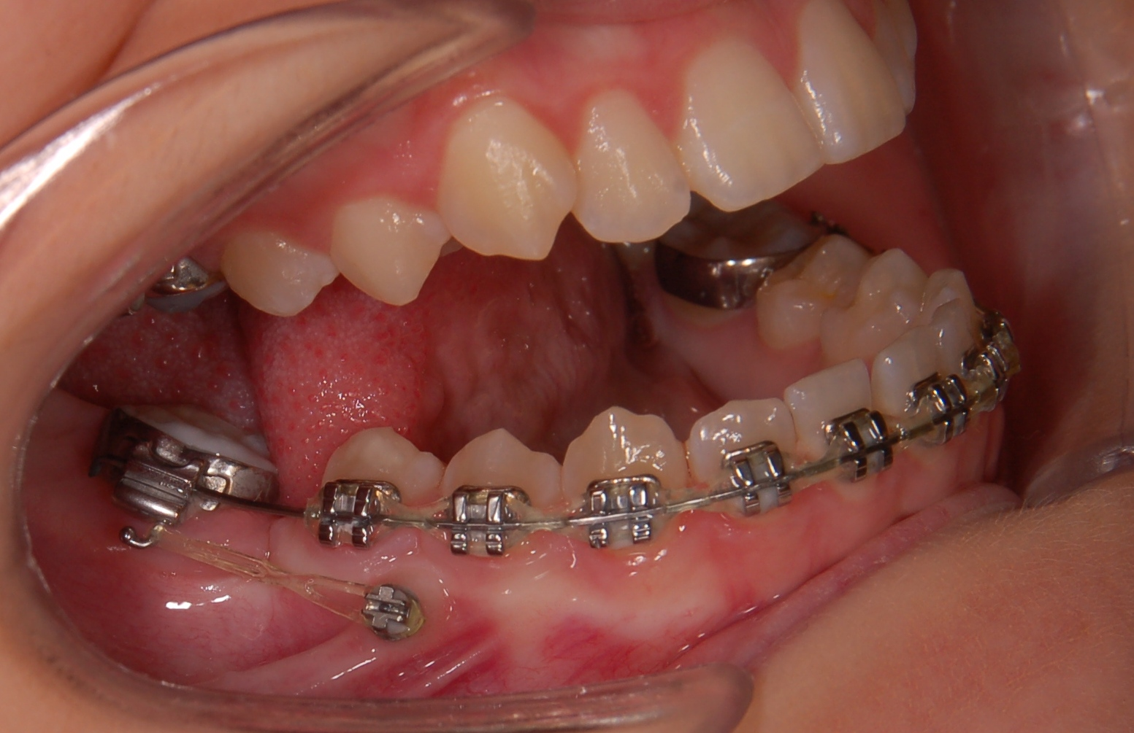
Mezialization 47 on the 46 position with minisrew – space closure

Slide 47
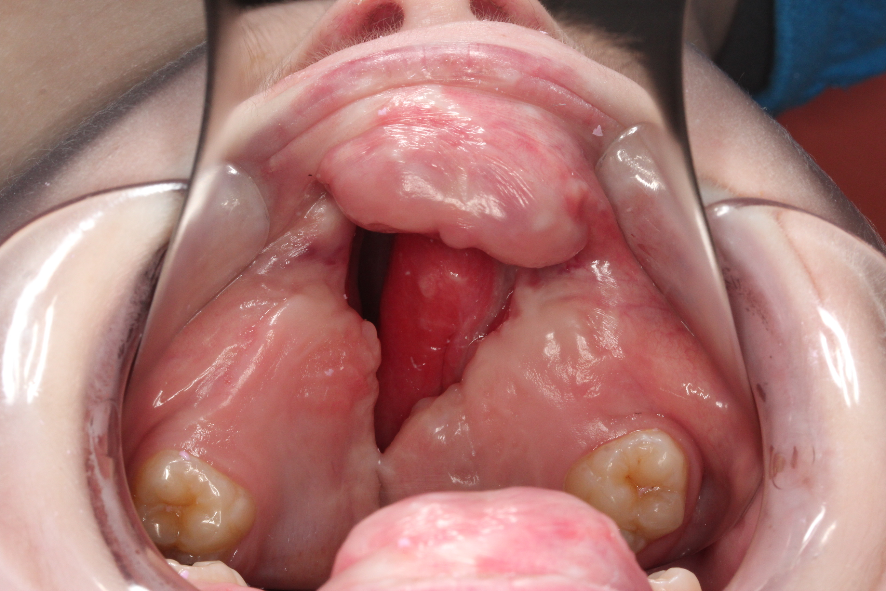
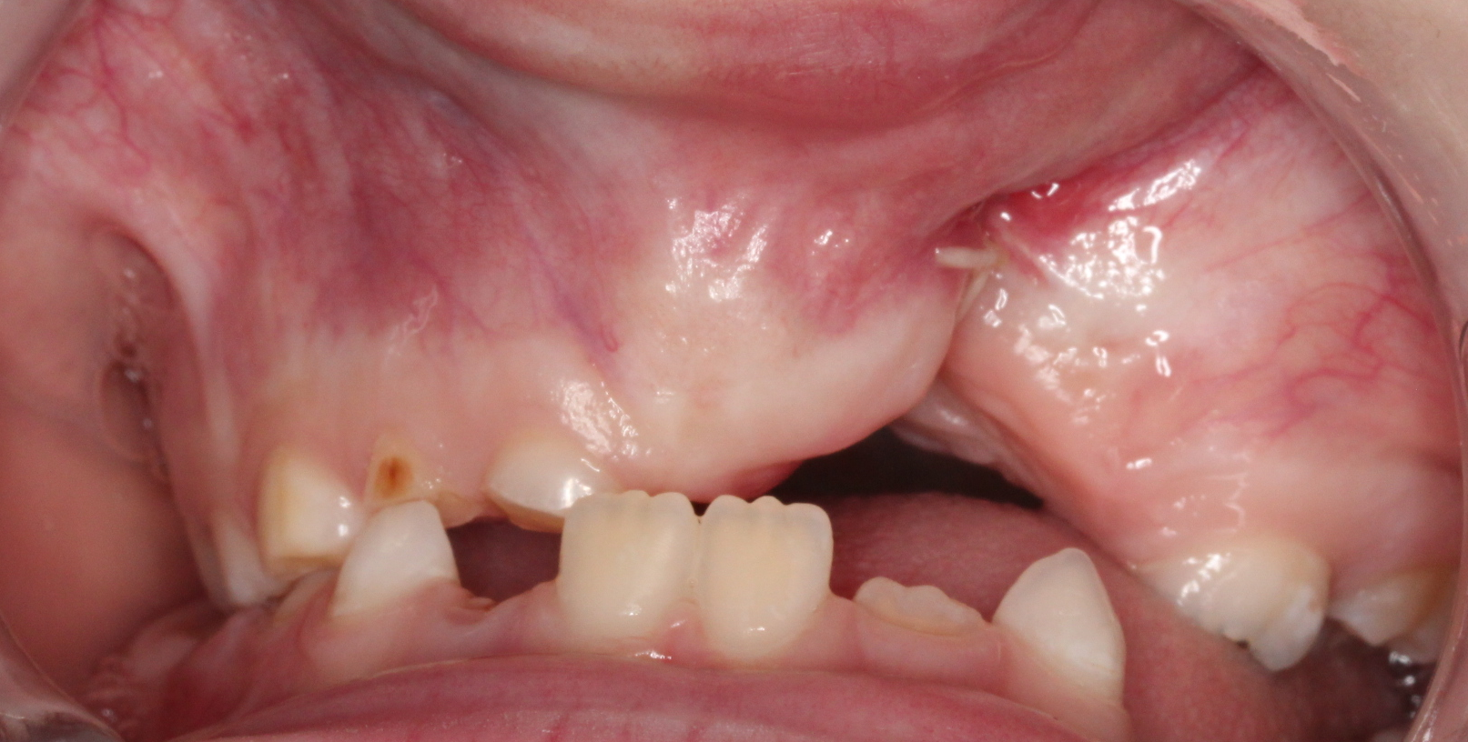
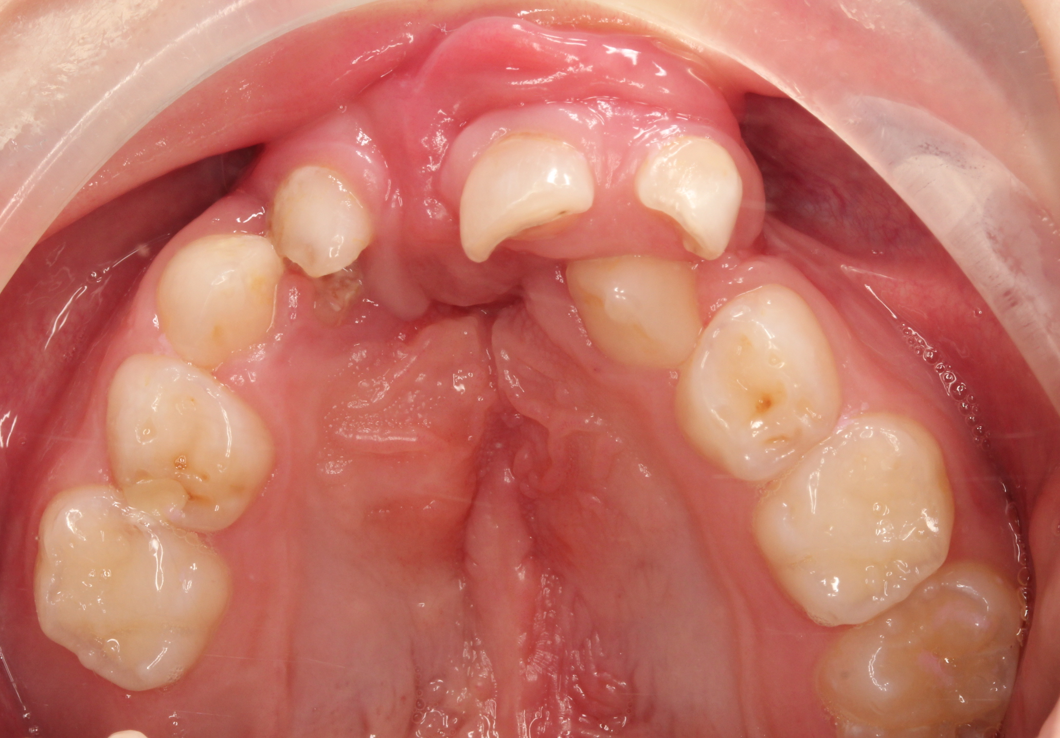

Cleft lip and palate patients

Slide 48

Gummy smile, inclined occlusal plane

Slide 49


Skeletal class II, protrusion upper incisors

Slide 50

Skeletal class II

Slide 51

Skeletal class III

Slide 52



Skeletal class III, open bite, inverted bite

Slide 53


Thank You four Your attention
Questions – email – alena.brysova@fnusa.cz
Consultation – Orthodontic department - St. Anne's Hospital, building D2b – Thursday 1-2 p.m.

