Slide 1

Orthodontic treatment fixed appliances
MUDr. Alena Bryšová, Ph.D.

Slide 2
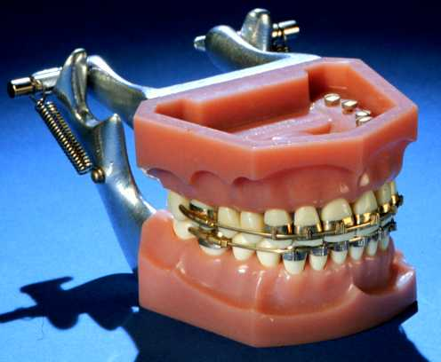
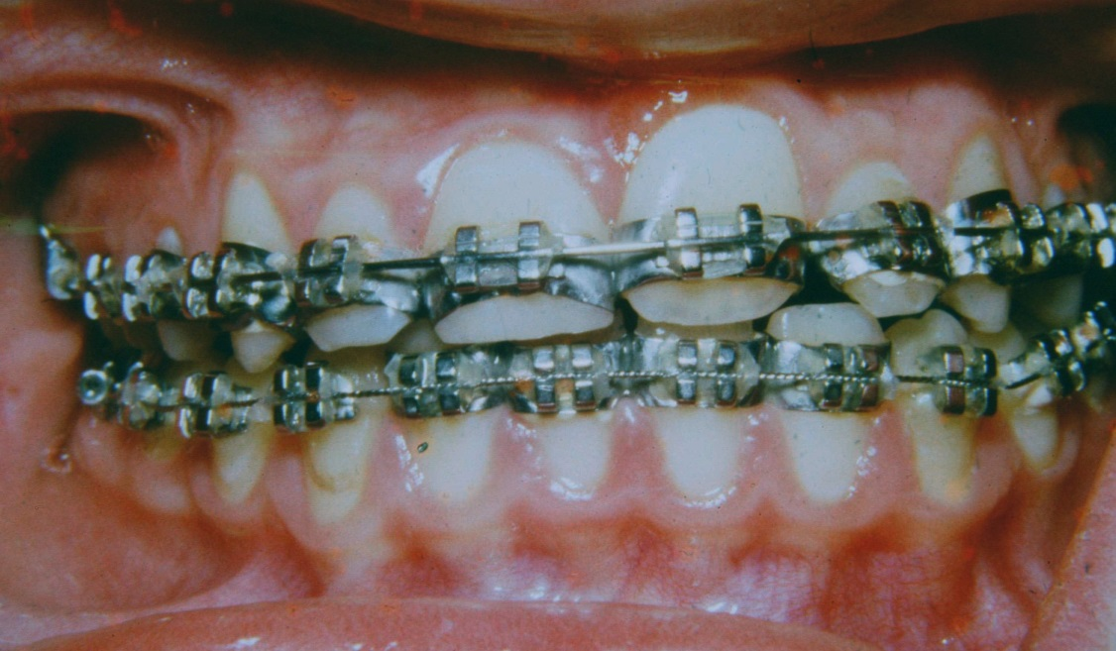
Fixed appliances
-History

Slide 3
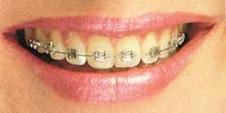
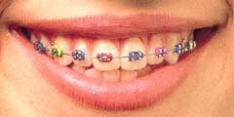
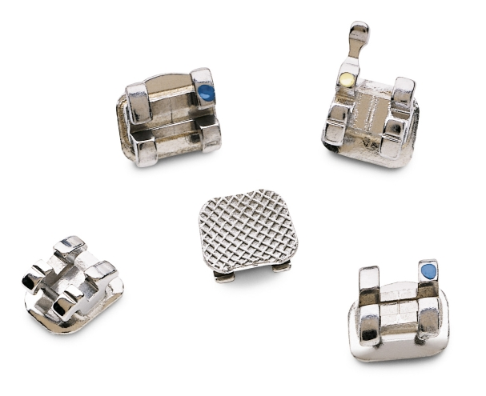
Orthodontics brackets
Stainless steel brackets
Advantages Disadvantages:
- strong, do not crack - Aesthetic
- smooth, low profile
- recyclable
- low friction
- price

Slide 4
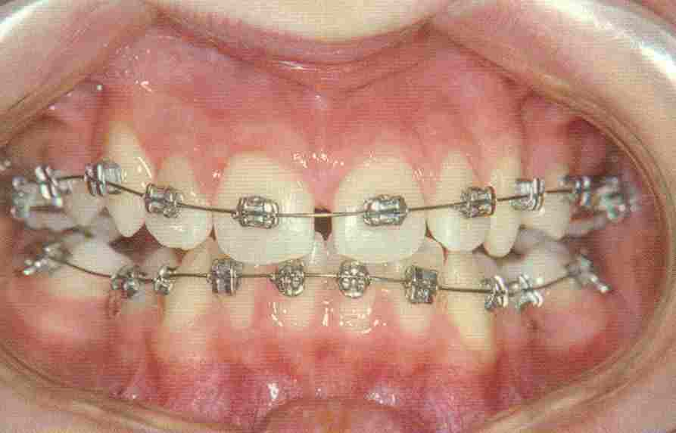
Stainless steel brackets

Slide 5
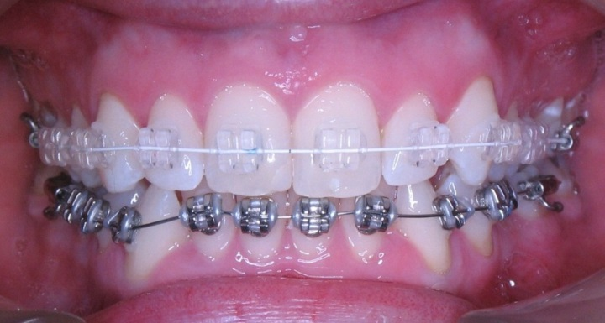
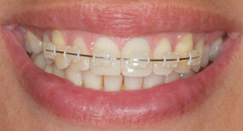
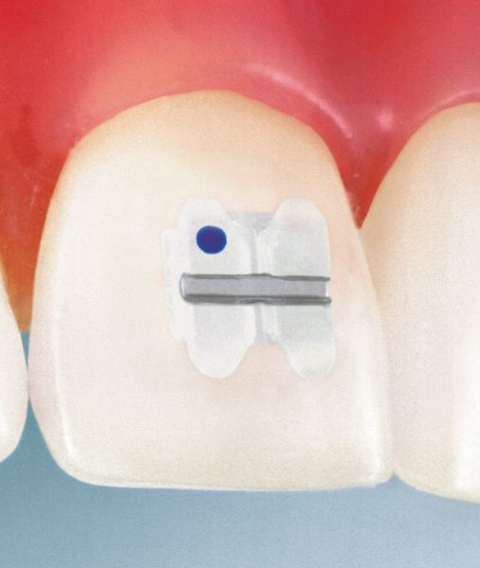
Orthodontics brackets
Ceramic brackets
Advantages: Disadvantages:
- Aesthetics - repeated bonding problem
- robust
- crack
- higher friction (avoid metal slot)
- price

Slide 6
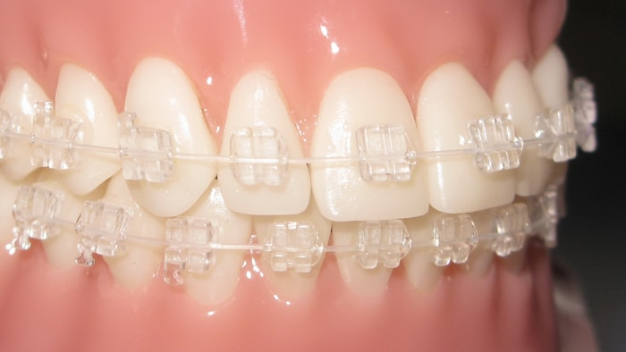
Ceramic brackets

Slide 7
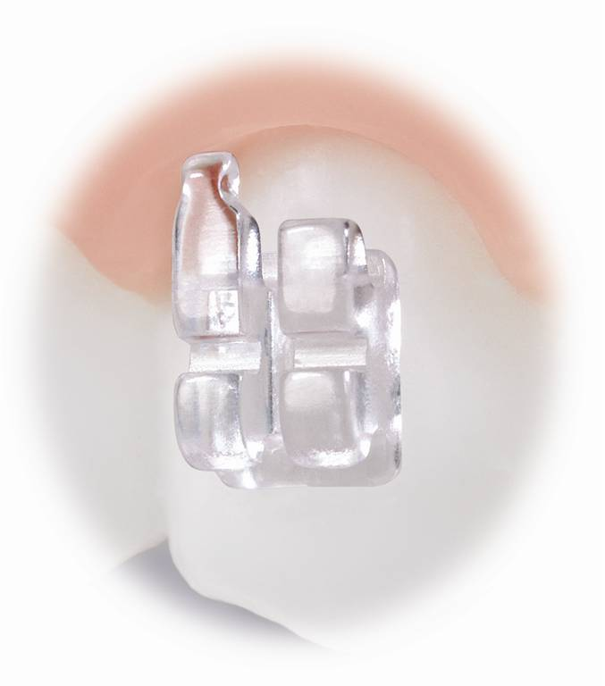
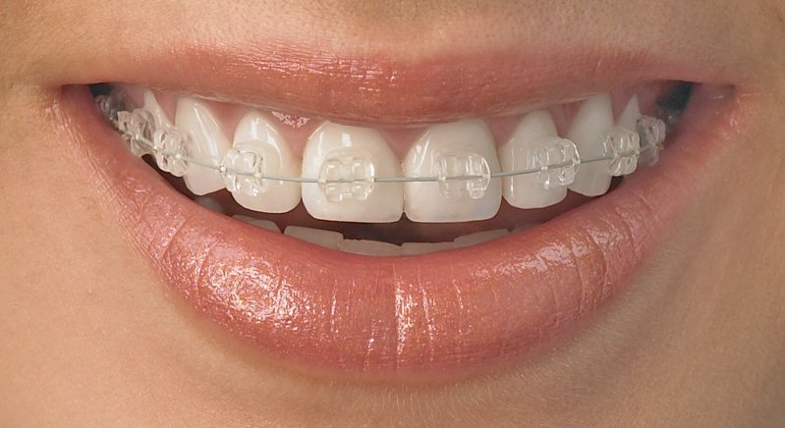
Orthodontics brackets
Sapphire brackets
Advantages Disadvantages:
- aesthetic - repeated bonding problem
- robust
- crack
- higher friction (avoid metal slot)
- price

Slide 8
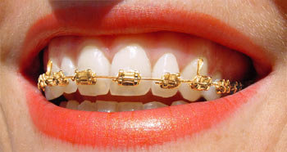
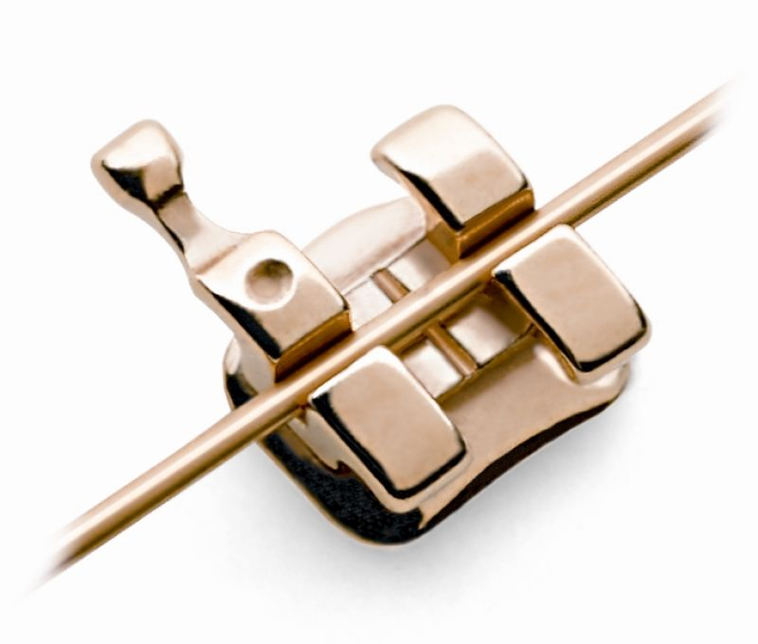
Orthodontics brackets
Gold-coated brackets
Advantages: Disadvantages:
- suitable for allergy sufferers - price
- strong, do not crack
- smooth, low profile
- recyclable
- Low friction
- Aesthetics

Slide 9
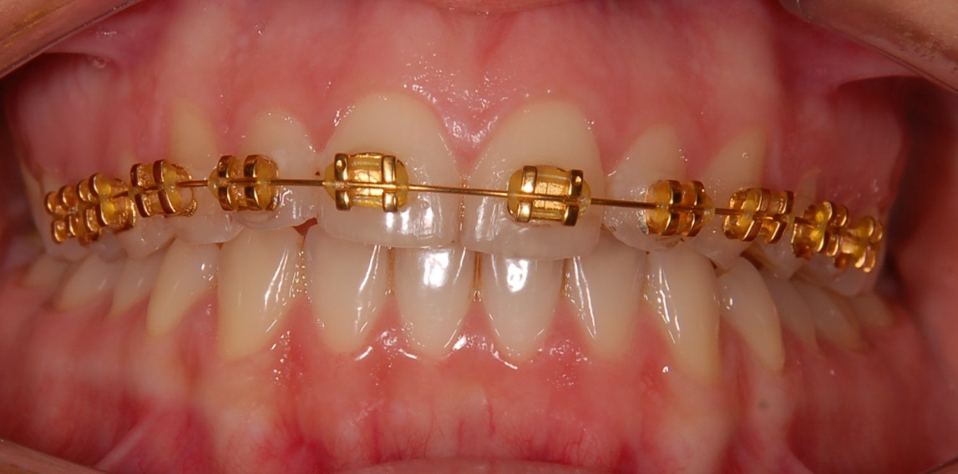
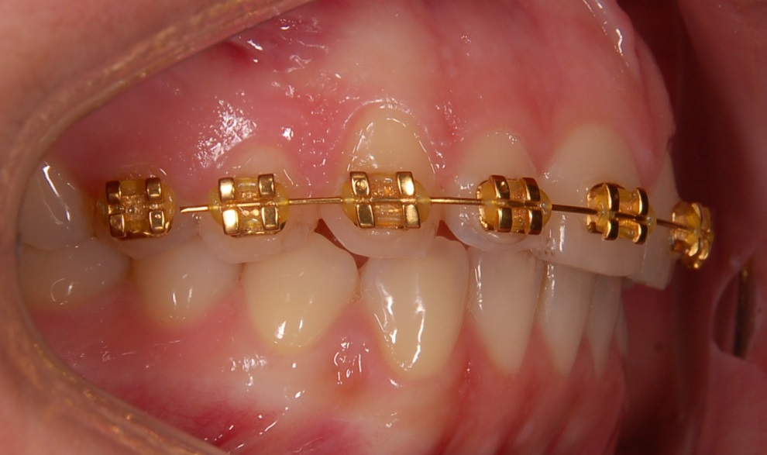
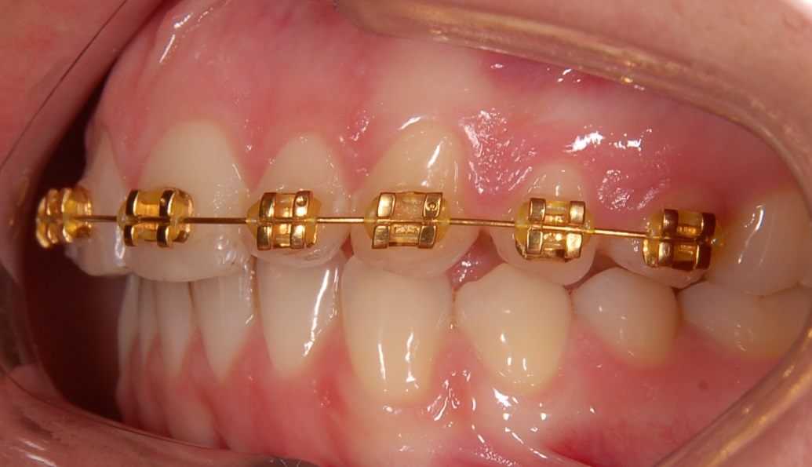

Slide 10
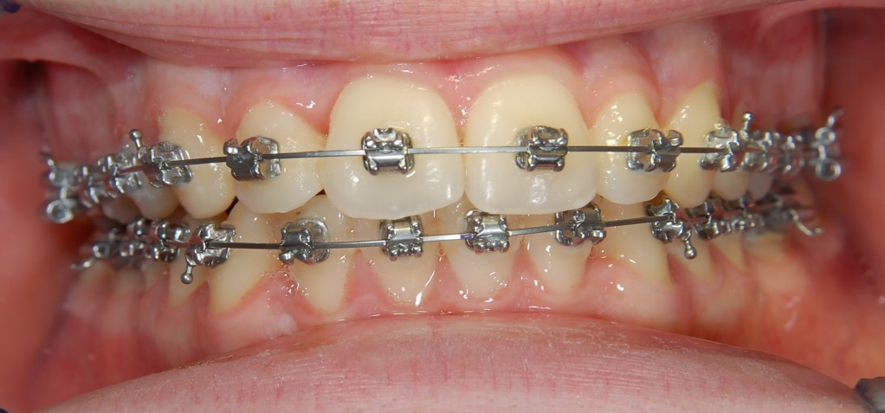
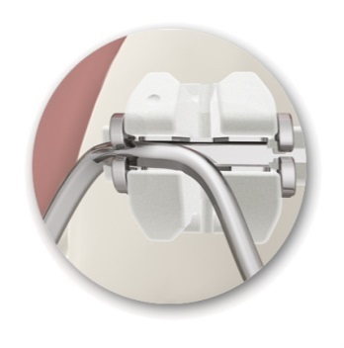

Orthodontics brackets
Selfligating brackets – metal and ceramic
Advantages: Disadvantages:
- not suitable for all
- minimum friction types of defects
- low power
- faster treatment
- fewer office visits

Slide 11

Selfligating stainless steel brackets

Slide 12
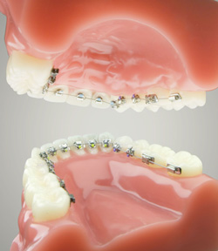
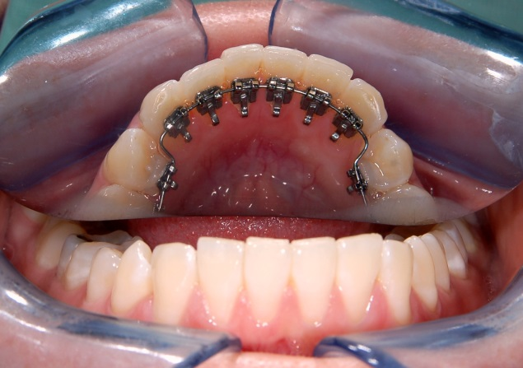
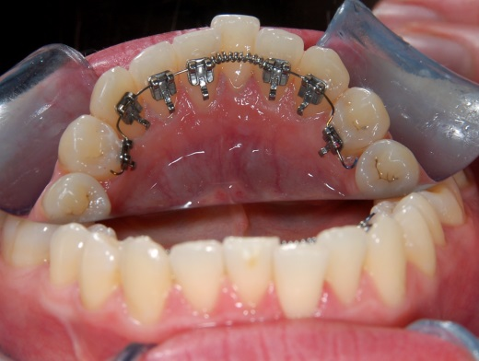
Orthodontics brackets
Lingual brackets – 2D,3D
Advantages: Disadvantages:
- Aesthetics - unsuitable for all types of defects
- Difficulty hygiene
- (patient discomfort)

Slide 13


Lingual bracket

Slide 14
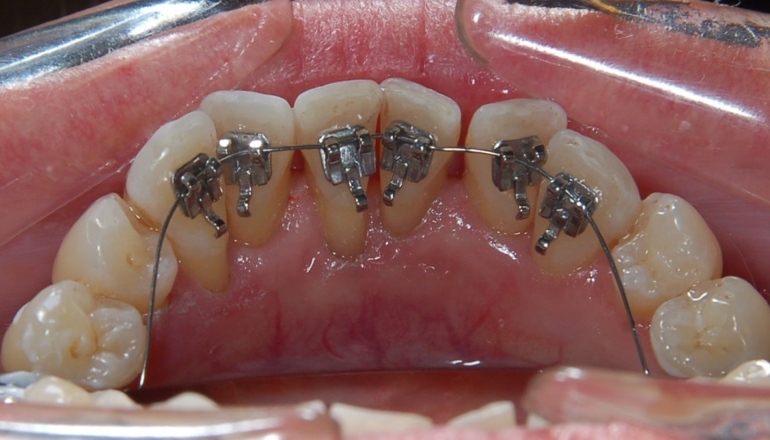
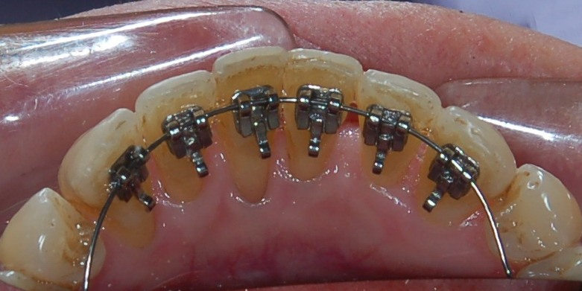
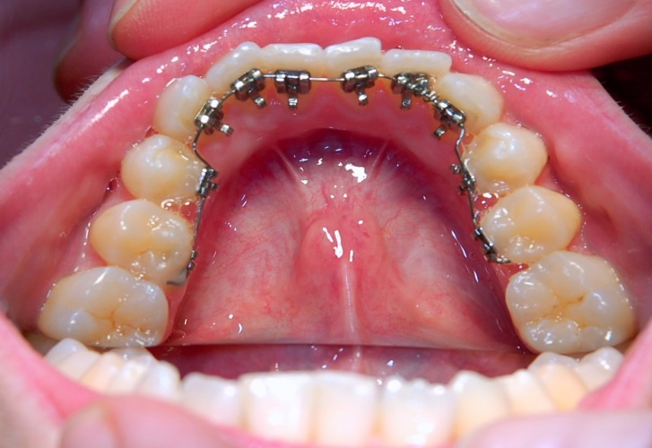
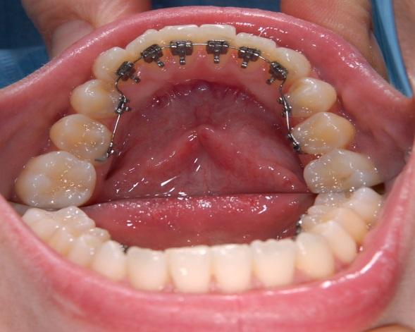

Slide 15

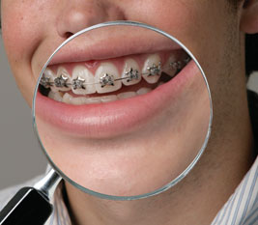
Orthodontics brackets
Decorative brackets

Slide 16
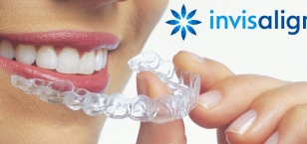
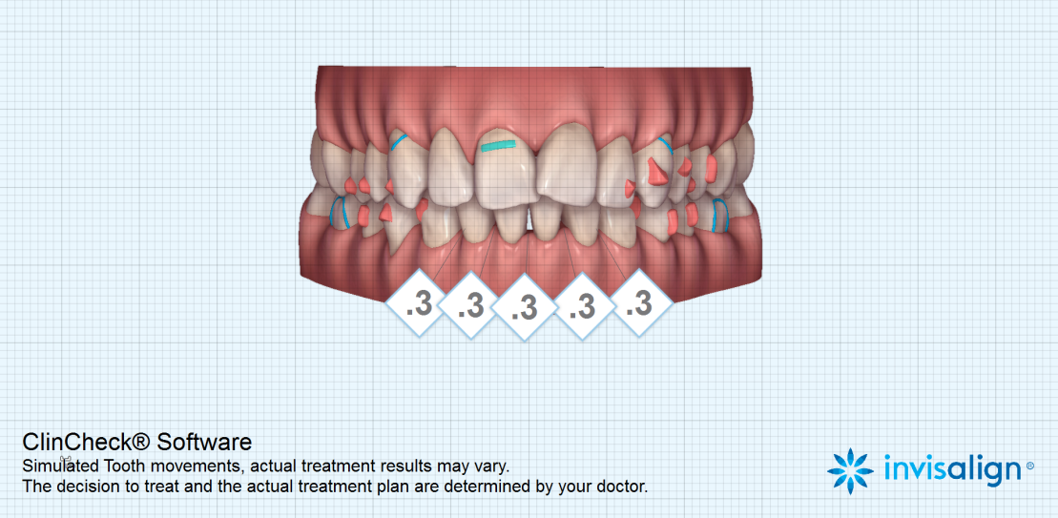

Slide 17
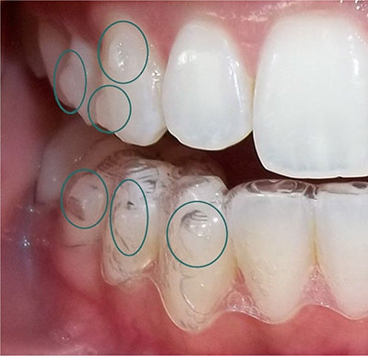
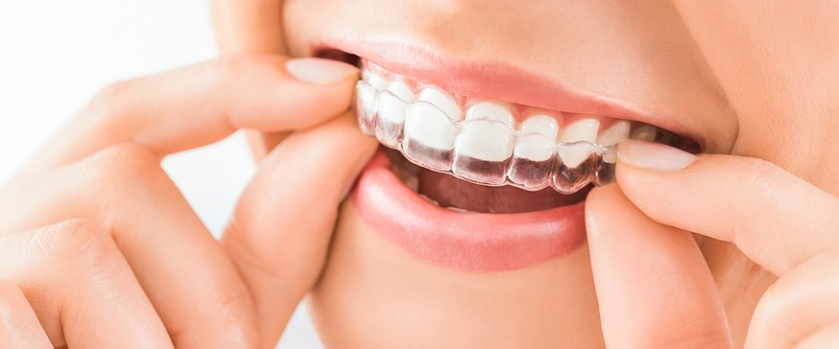

Slide 18
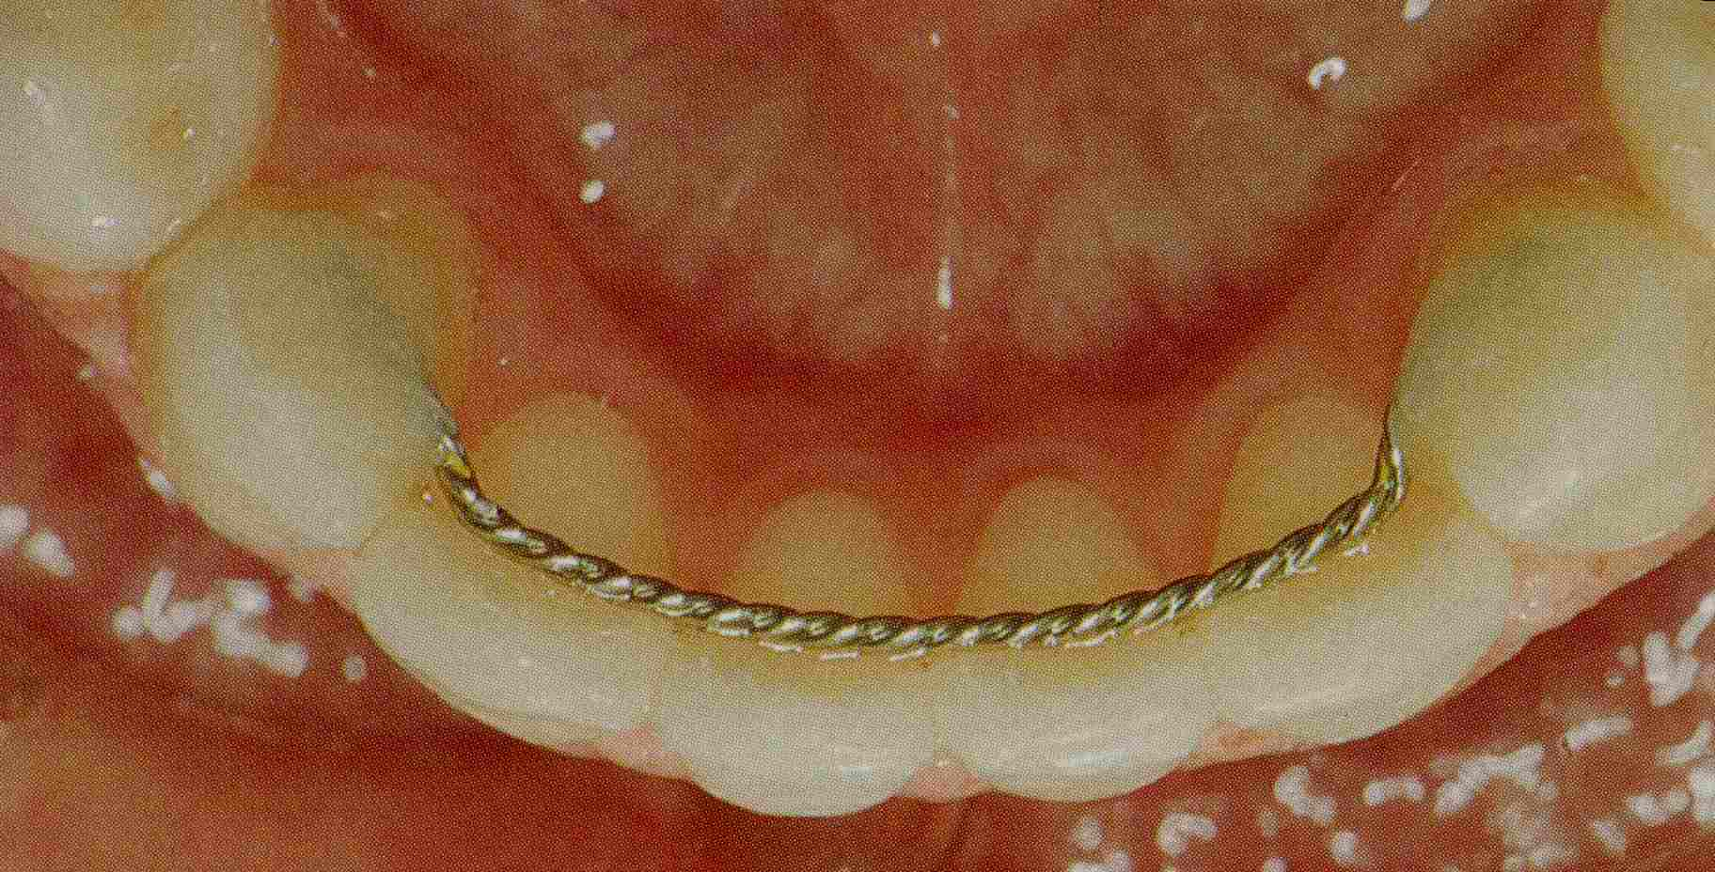
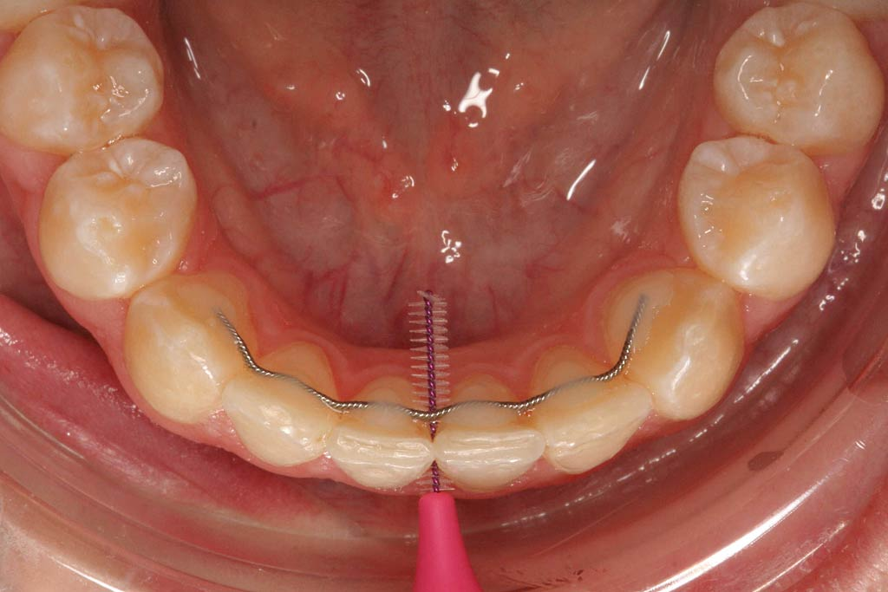
Fixed lingual retainer

Slide 19
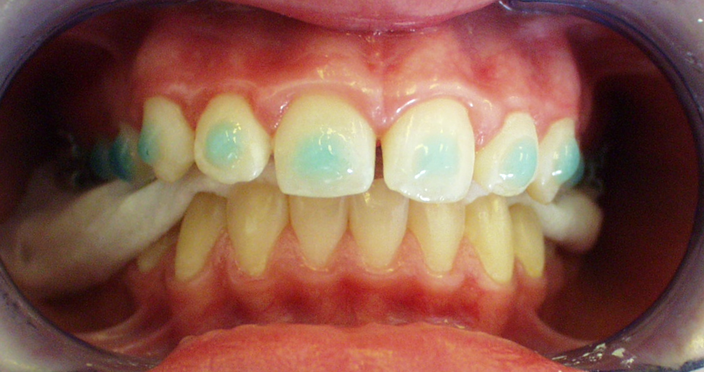
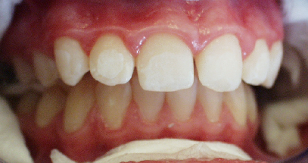
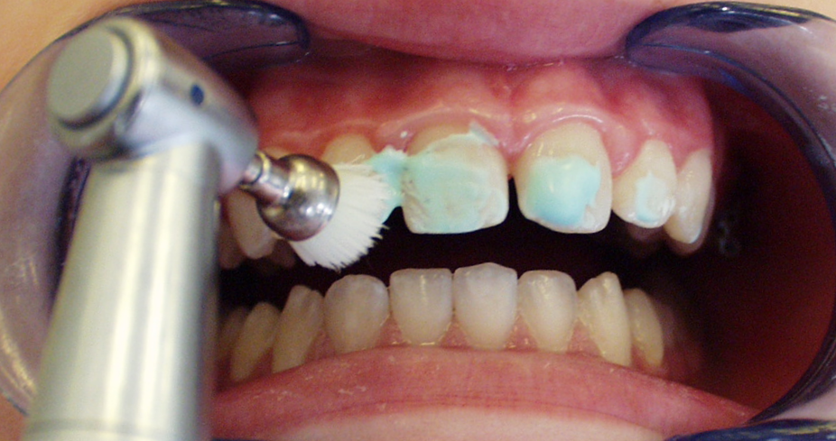
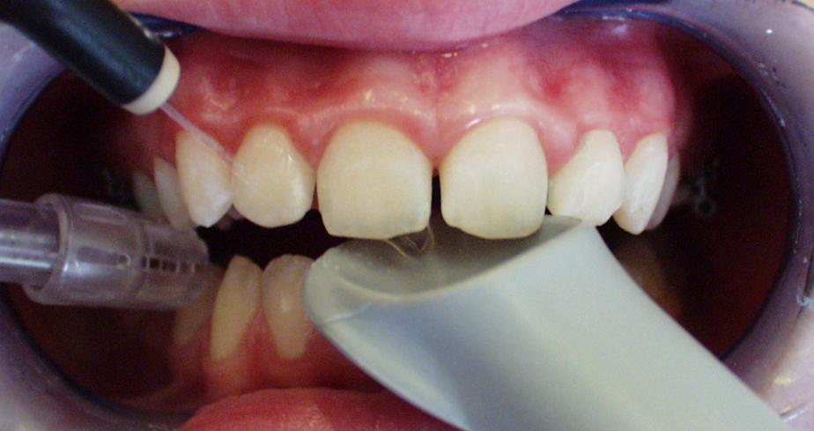
Direct bonding
1.cleaning 2. etching
3.rinse 4. drying

Slide 20
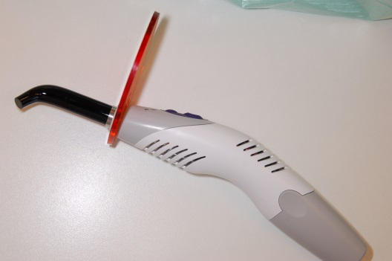
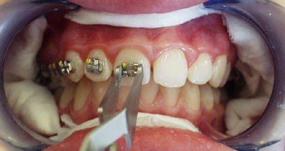
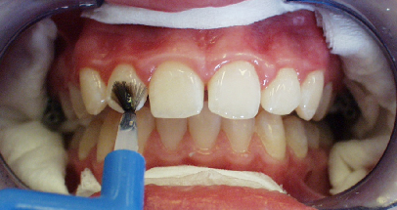
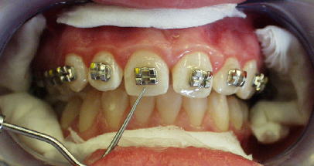
Direct bonding
5. primer 6. bonding
7. remove excess 8. light or chemically cured

Slide 21
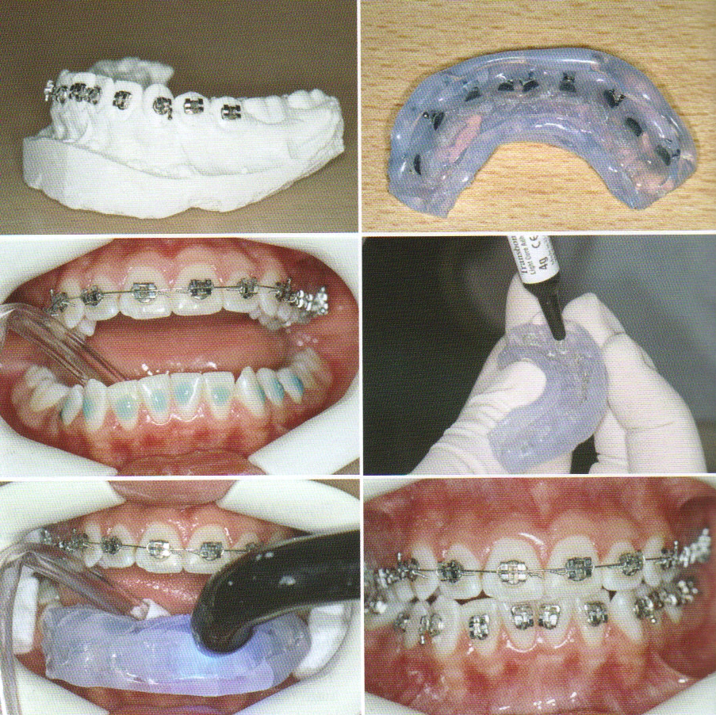
Indirect bonding

Slide 22
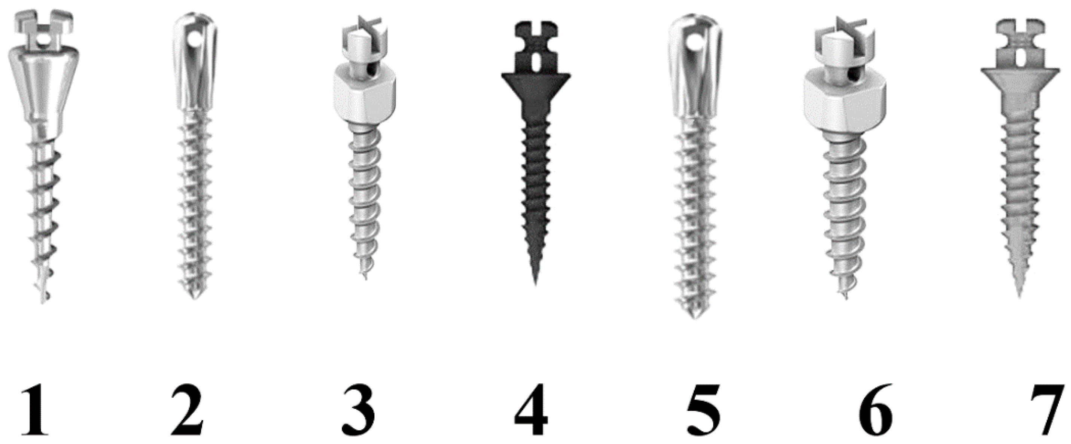
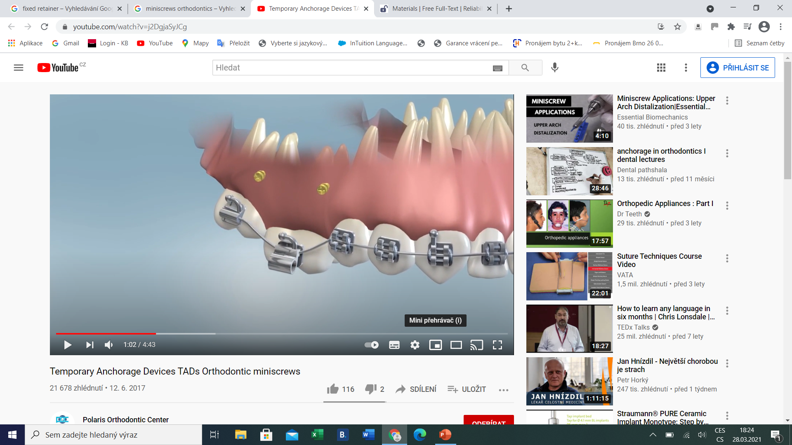
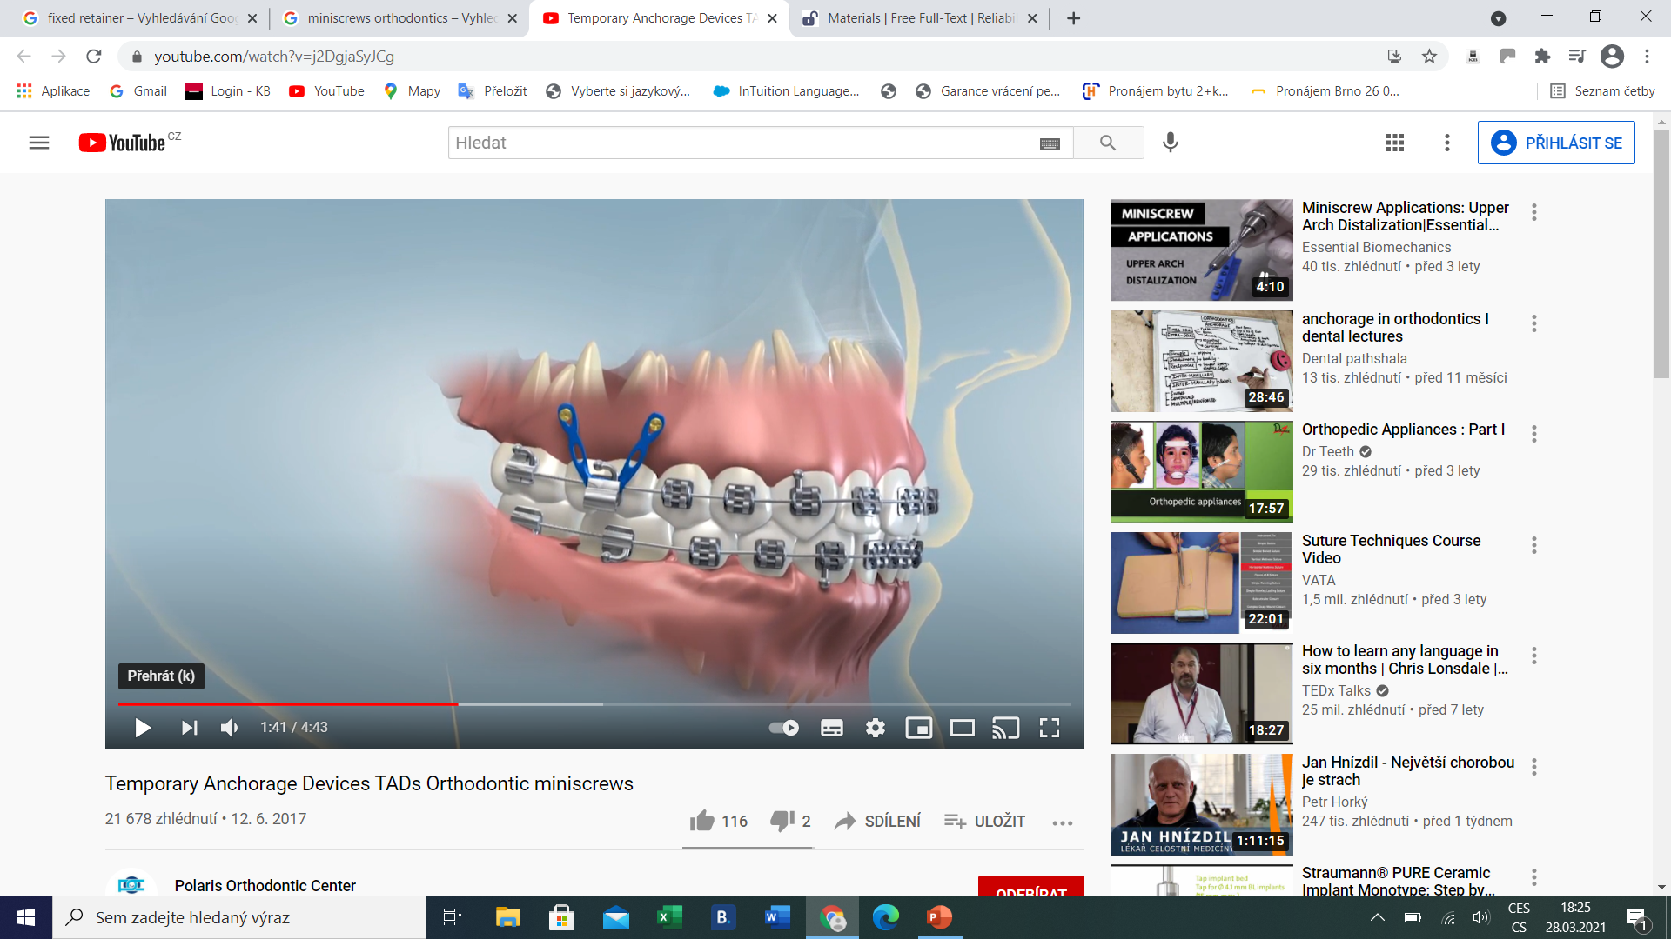
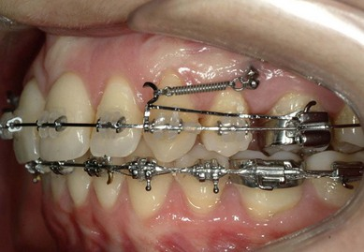
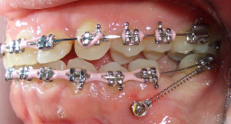
TAD – Temporary Anchorage Devices –
Mini Srew, Implants

Slide 23
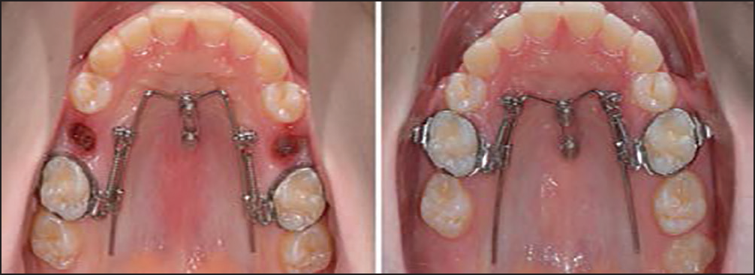
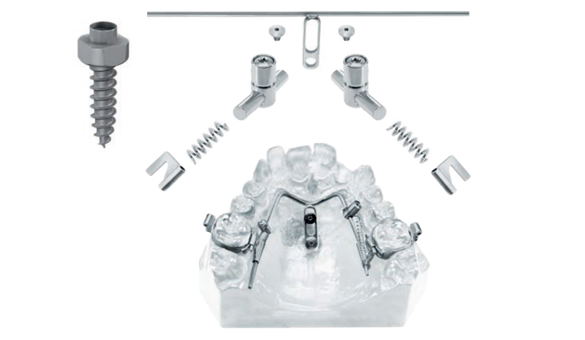
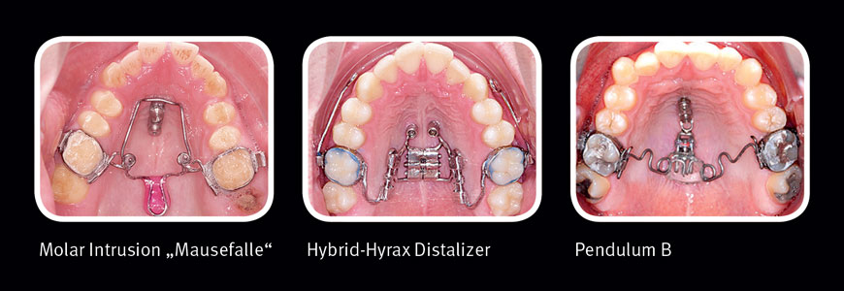
TAD – Temporary Anchorage Devices –
Mini Srew, Implants
Benefit Systém, hybrid hyrax

Slide 24





Haas Hyrax with Face mask

Slide 25
cases

Slide 26




Slide 27


Slide 28



Slide 29







Slide 30
Treatment time – 11 months

Slide 31




Slide 32


Slide 33


Slide 34







Slide 35




Slide 36


Slide 37




Slide 38





Slide 39


Treatment time – 16 months

Slide 40






Slide 41







Slide 42







Slide 43







Slide 44








Slide 45







Slide 46






Slide 47







Slide 48







Slide 49







Slide 50






Slide 51







Slide 52








Slide 53






Before treatment
After treatment

Slide 54






Before Treatment
After Treatment

Slide 55




Slide 56




Slide 57




Slide 58


Thank You four Your attention
Questions – email – alena.brysova@fnusa.cz
Consultation – Orthodontic department - St. Anne's Hospital, building D2b – Thursday 1-2 p.m.

