Slide 1

Orthodontic treatment
MUDr. Alena Bryšová, Ph.D.

Slide 2
Orthodontic treatment
MALOCCLUSION is a manifestation of genetic and environmental interaction on the development of the orofacial region

Slide 3
GOALS OF TREATMENT:
Ideal functional occlusion
Ideal soft tissue proportions and adaptation
Ideal jaw, skeletal and dental relationship

Slide 4
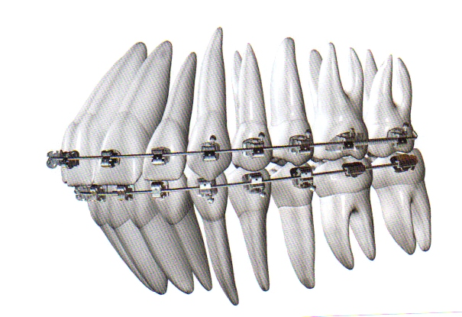
Ideal occlusion
correct relationship of molars
correct overjet and overbite
correct angulation,inclination of teeth
no rotated teeth
no spacing
flat plane of occlusion

Slide 5
Objectives of orthodontic treatment
Aesthetics
Treatment of impacted teeth
Prevention of dental injuries
Before prosthetic treatment
Decay prevention
Prevention and treatment of chewing malfunction and jaw joint disorders

Slide 6
Methods of orthodontic treatment
Orthodontics movement of teeth
Orthopedic movement – effects of growth
Myofunctional therapy
Serial extraction, controlled extraction
Ortho – prosthetic treatment
Ortho – surgical treatment

Slide 7
Orthodontic treatment
1. Orthodontic treatment by infants
- clefts
- syndromes and defects that complicate nutrition and breathing
We use - individual removable plates

Slide 8
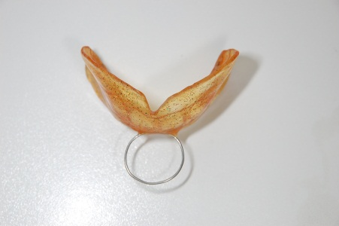
Orthodontic treatment
2. Deciduous teeth
We treat - bite defects
inverted bite
cross bite
- bad habits
We use – removable appliances

Slide 9
Orthodontic treatment
3. 6-9 years [ 1. phase of mixed dentition]
The best time for treatment :
- cross bite
- inverted bite
- impacted incisors
- diastema more than 3 mm
- big primary crowding
We use : removable appliances
small fixed appliances
face mask for inverted bite by class III

Slide 10
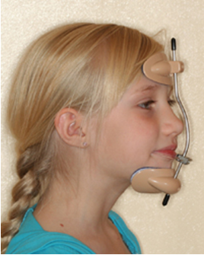
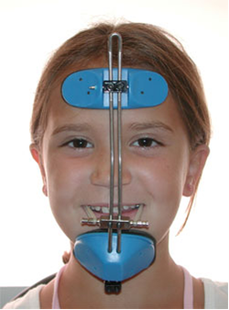
Face mask

Slide 11
Orthodontic treatment
4. 9-12 year [second phase of mixed dentition]
Large forming ability of the tissues
We can use and influence the growth
Growth mandible from the joints
We treat: - previous untreated anomalies
- crowding
- Angle class II – div. 1 and 2
- overjet more than 5 mm
- deep bite
- movements teeth after the early loss of teeth and anodontia
- Controlled tooth eruption
- Suspected retention of canines, premolars
The best time for functional appliances
- removable appliances
- Small fixed appliances
- Headgear appliance

Slide 12
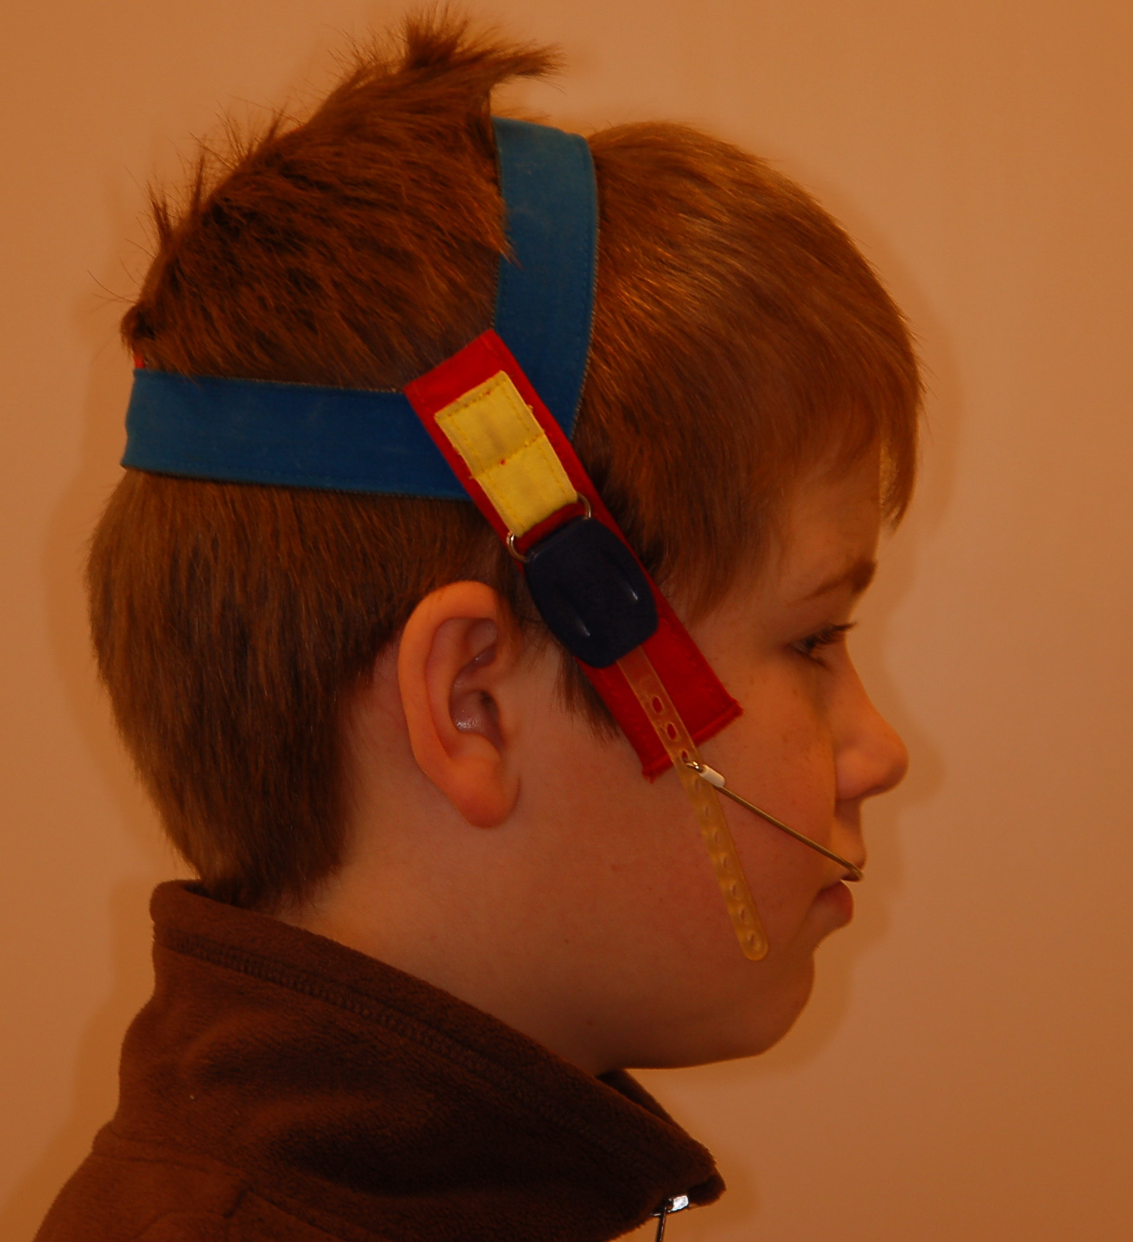
headgear

Slide 13
Orthodontic treatment
5. Permanent teeth
We treat:
All anomalies, previous untreated anomalies,
Angle class III
Crowding
Open bite, deep bite
Impacted tooth
Skeletal anomalies
Adult therapy – periodontics problems, preprosthetic therapy
- problems with TMJ
- bruxism
We use : fixed appliances
extraction
surgical treatment by big skeletal anomalies

Slide 14
Therapy of ortodontical anomalies
Conservativ
orthodontical appliances :
removable
fixed
Surgical
extraction of teeth
surgical expositions of crowns of retined tooth
surgical movements of maxila, mandible

Slide 15
Othodontic treatment
Removable appliances:
Active
Passive
Functional

Slide 16
Active removable appliances
-Treatment of anomalous position of teeth [inclination, rotation of incisors]
-Treatment the dental arch shape
Individual resin plates
Active elements : springs, screws, wire bows

Slide 17
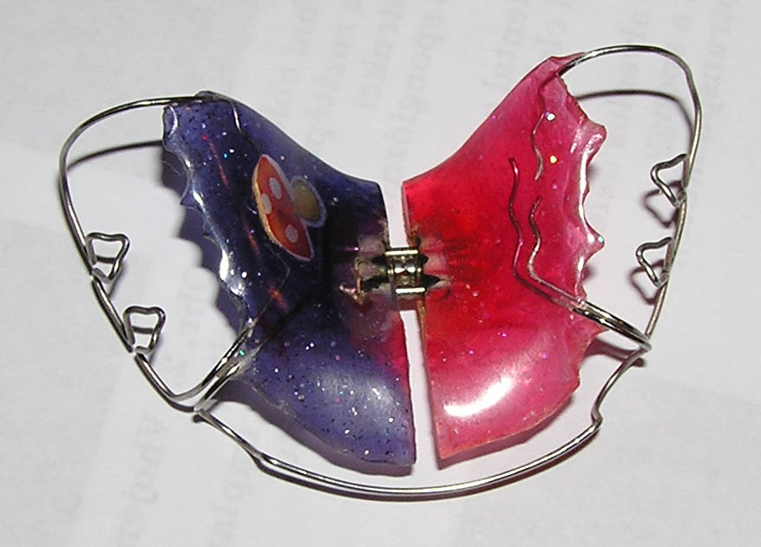
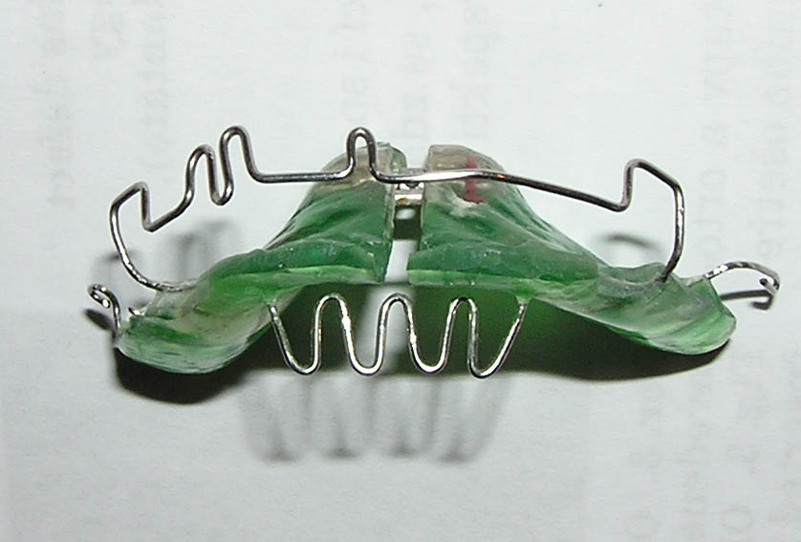
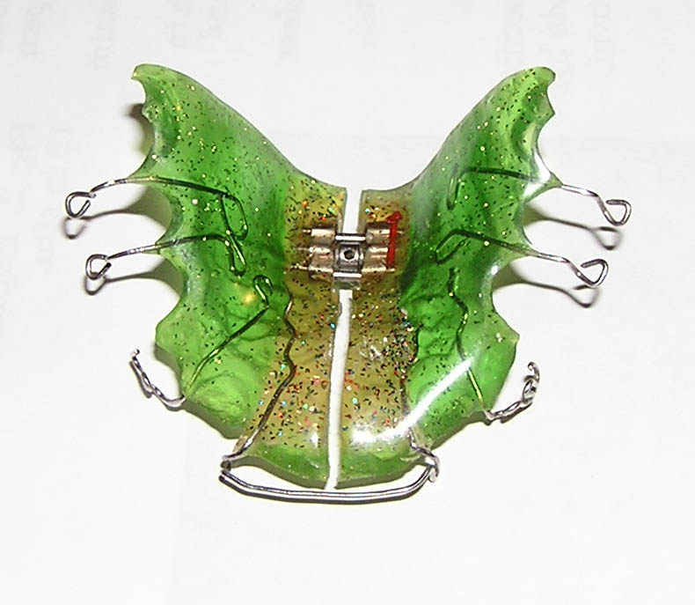
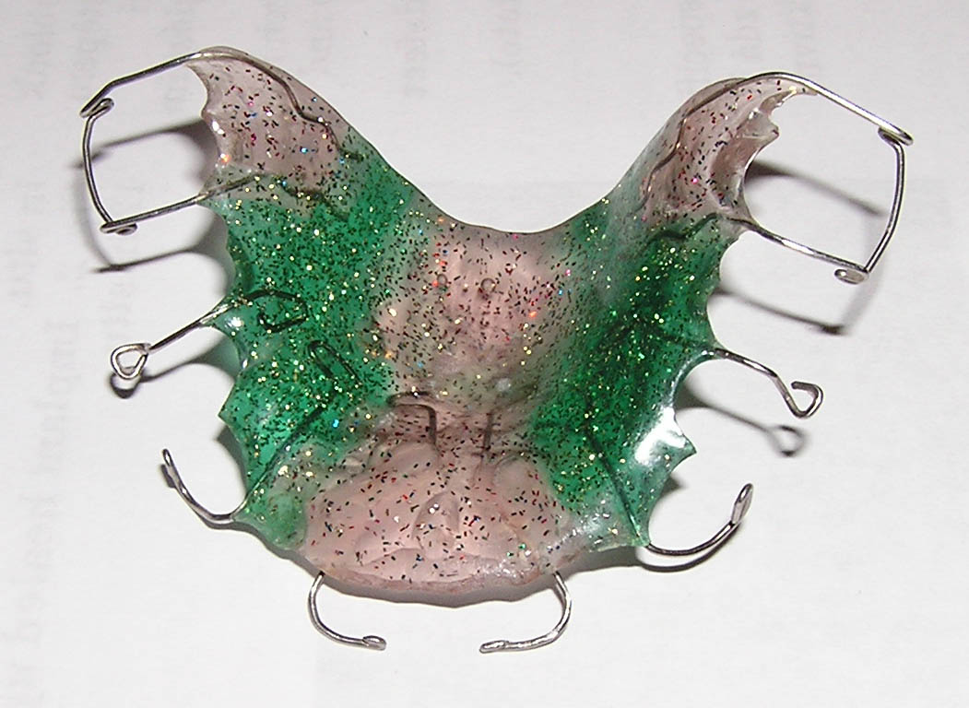
Removable active appliances

Slide 18
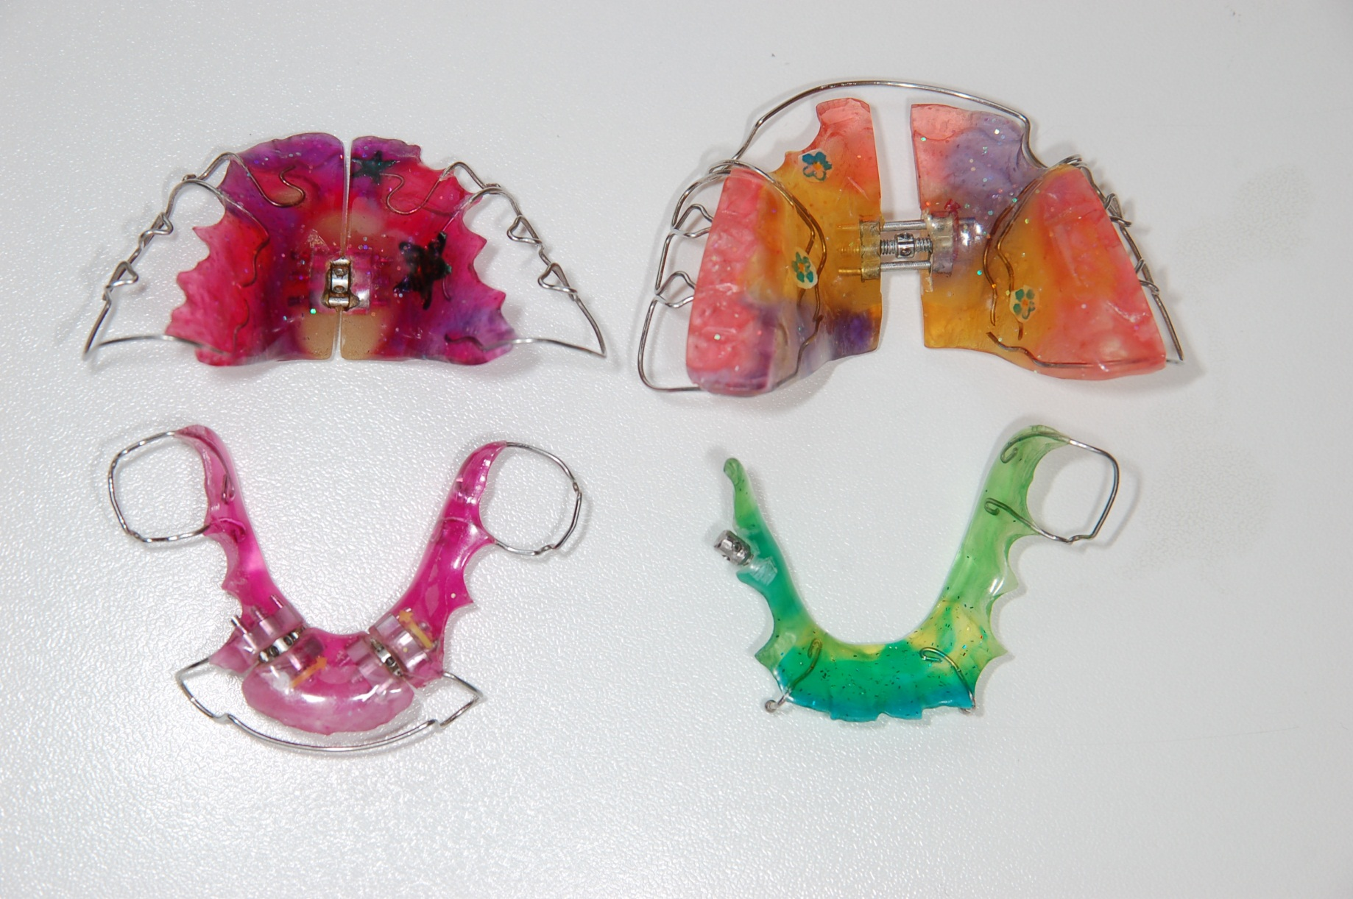
Removable appliances - active

Slide 19
Functional appliances
modifiyng extent and direction of orofacial growth
exploit muscular activity and soft tissue stretch to stimulate dental and bone changes
operates at the time of maximum growth of orofacial region = 9-12 years old children
We need construction bite
Type of functional appliances :
Bionator, Klampt, Maxilator – class II and open bite
Fränkel appliance – class III

Slide 20
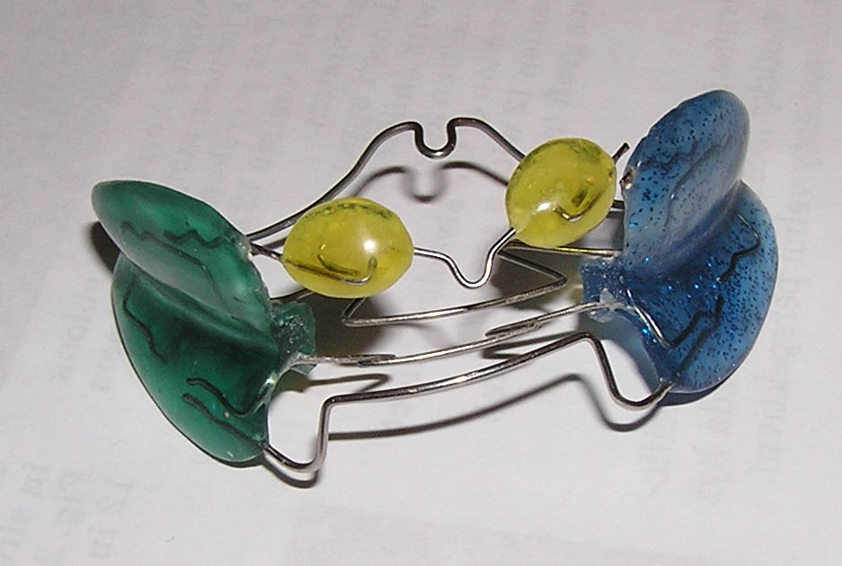
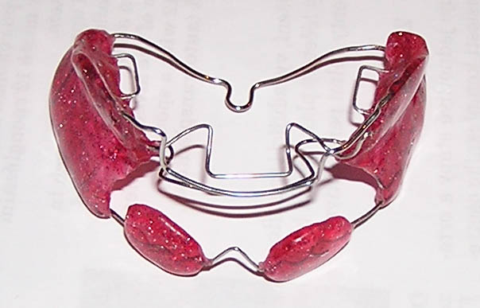
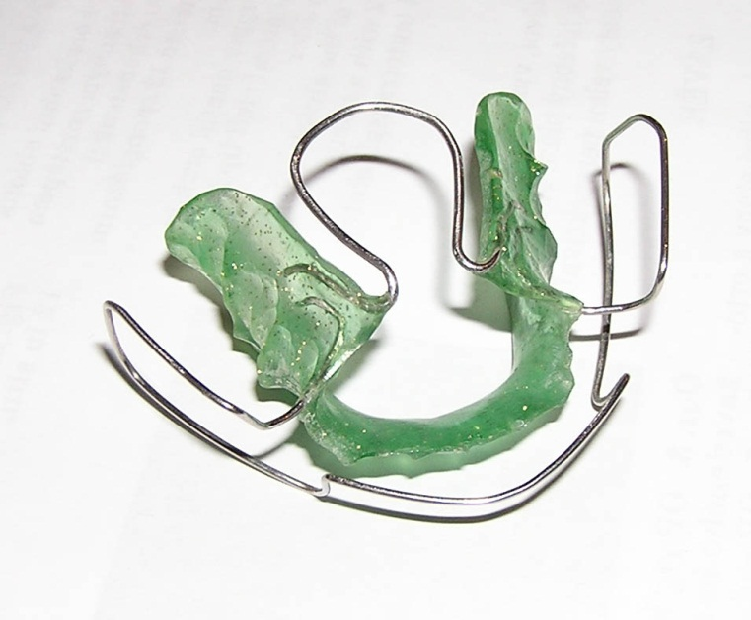
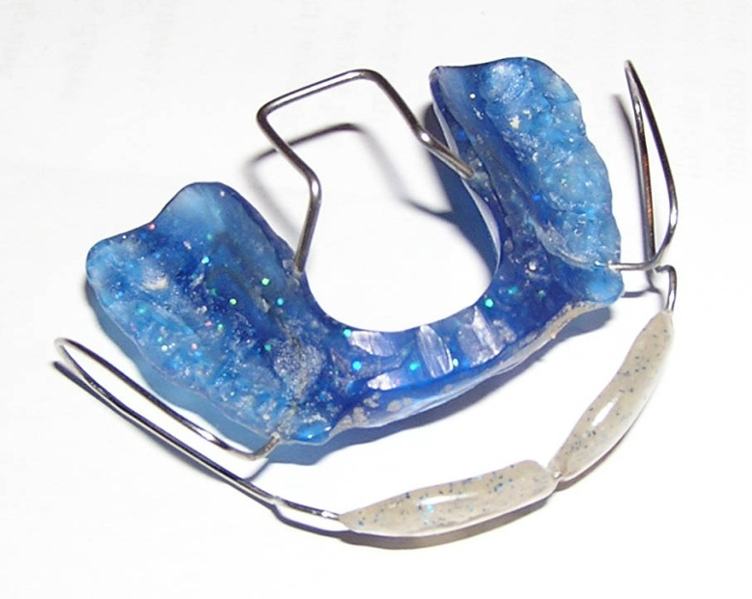
Removable functional appliances

Slide 21
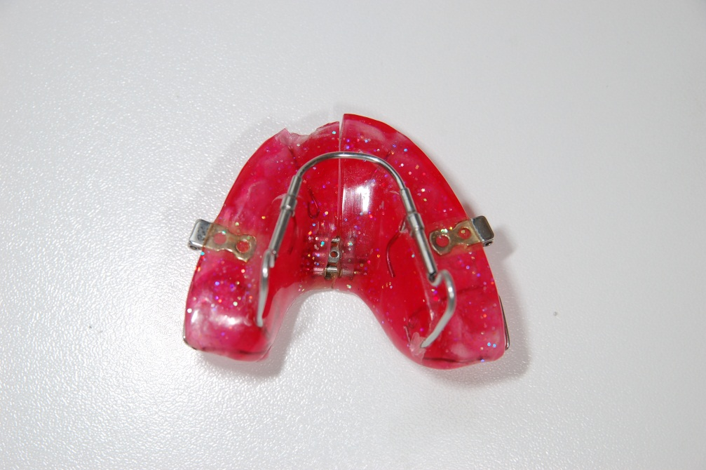
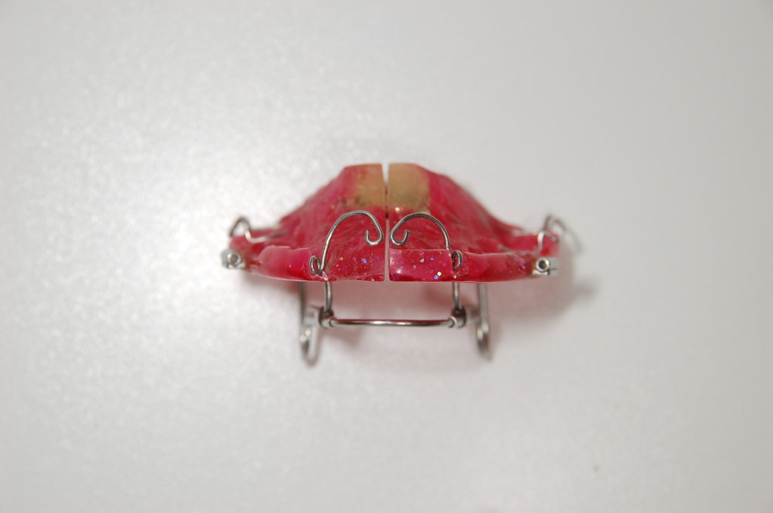
Functional appliances-Maxilator

Slide 22
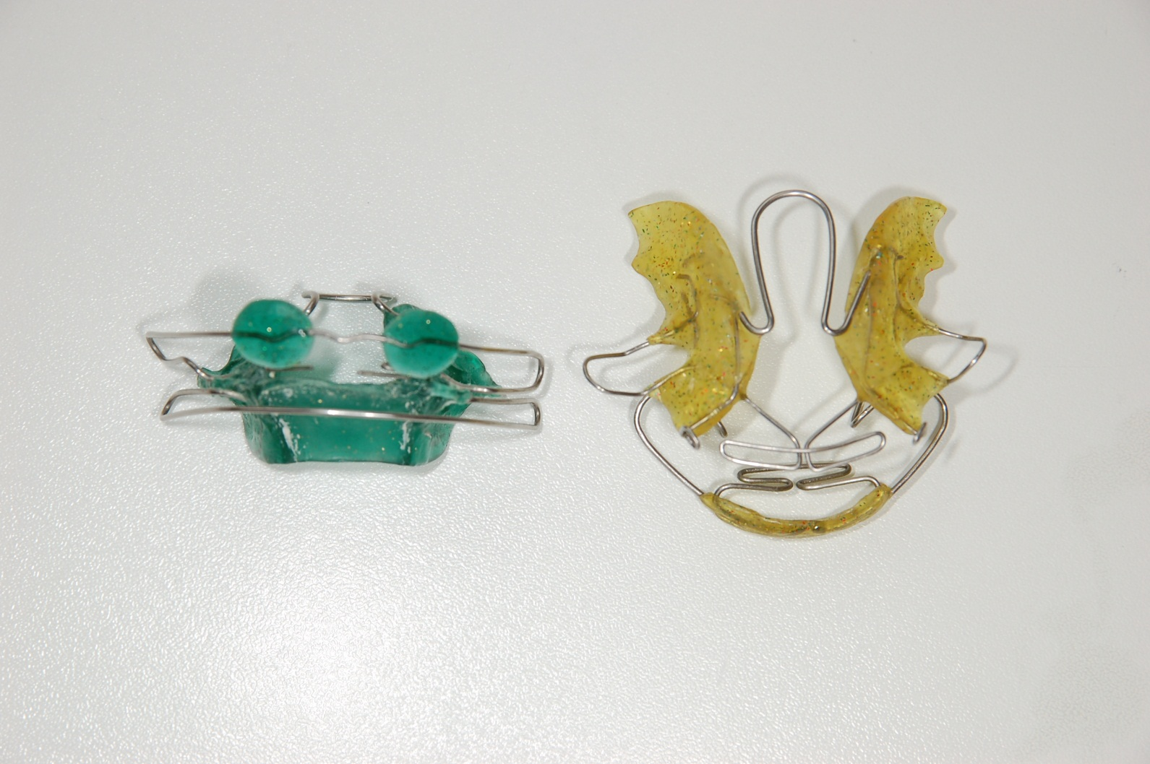
Functional appliances - Klampt

Slide 23
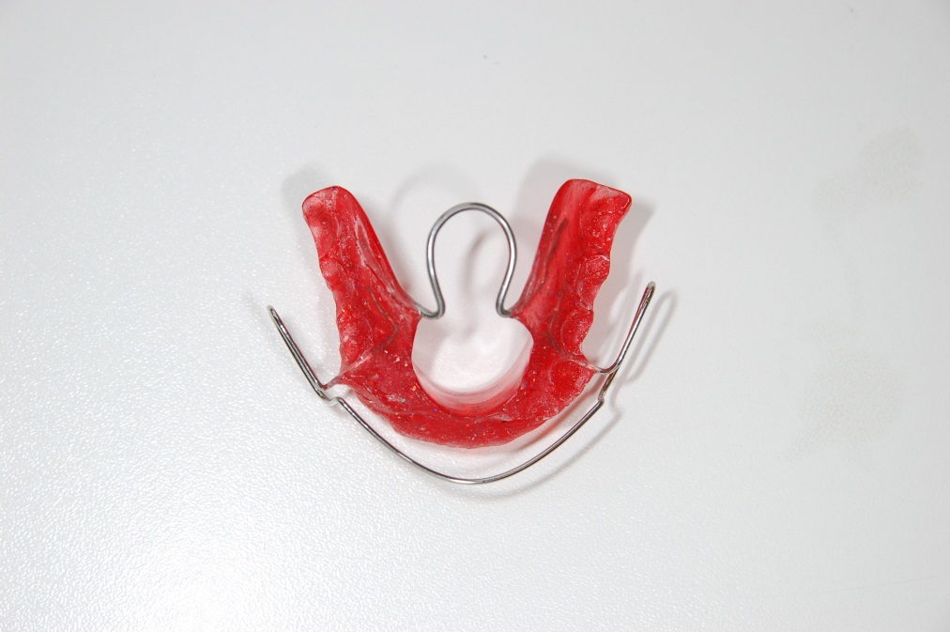
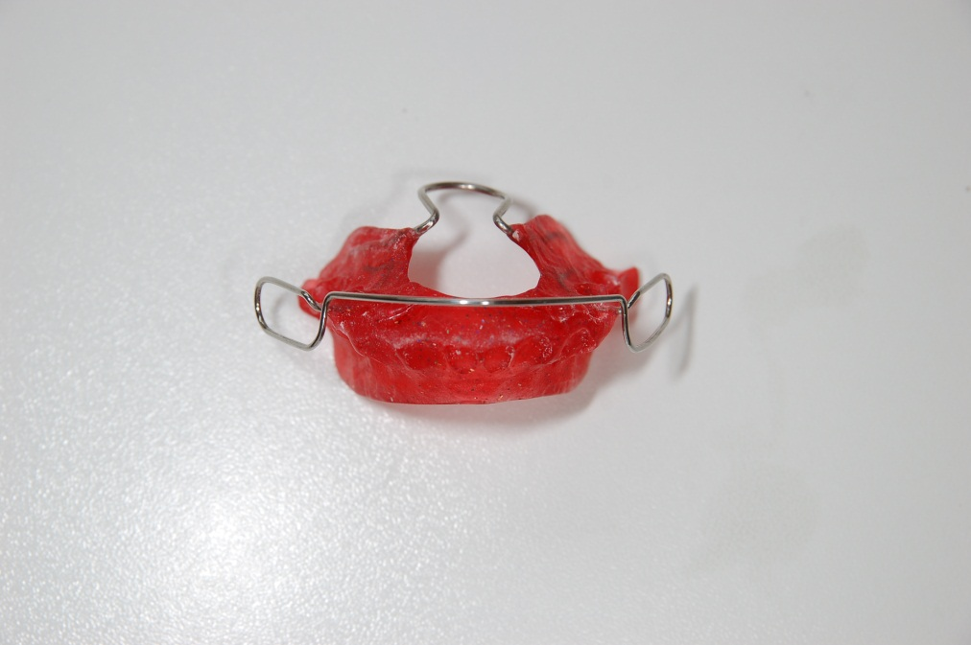
Functional appliances - Bionator

Slide 24
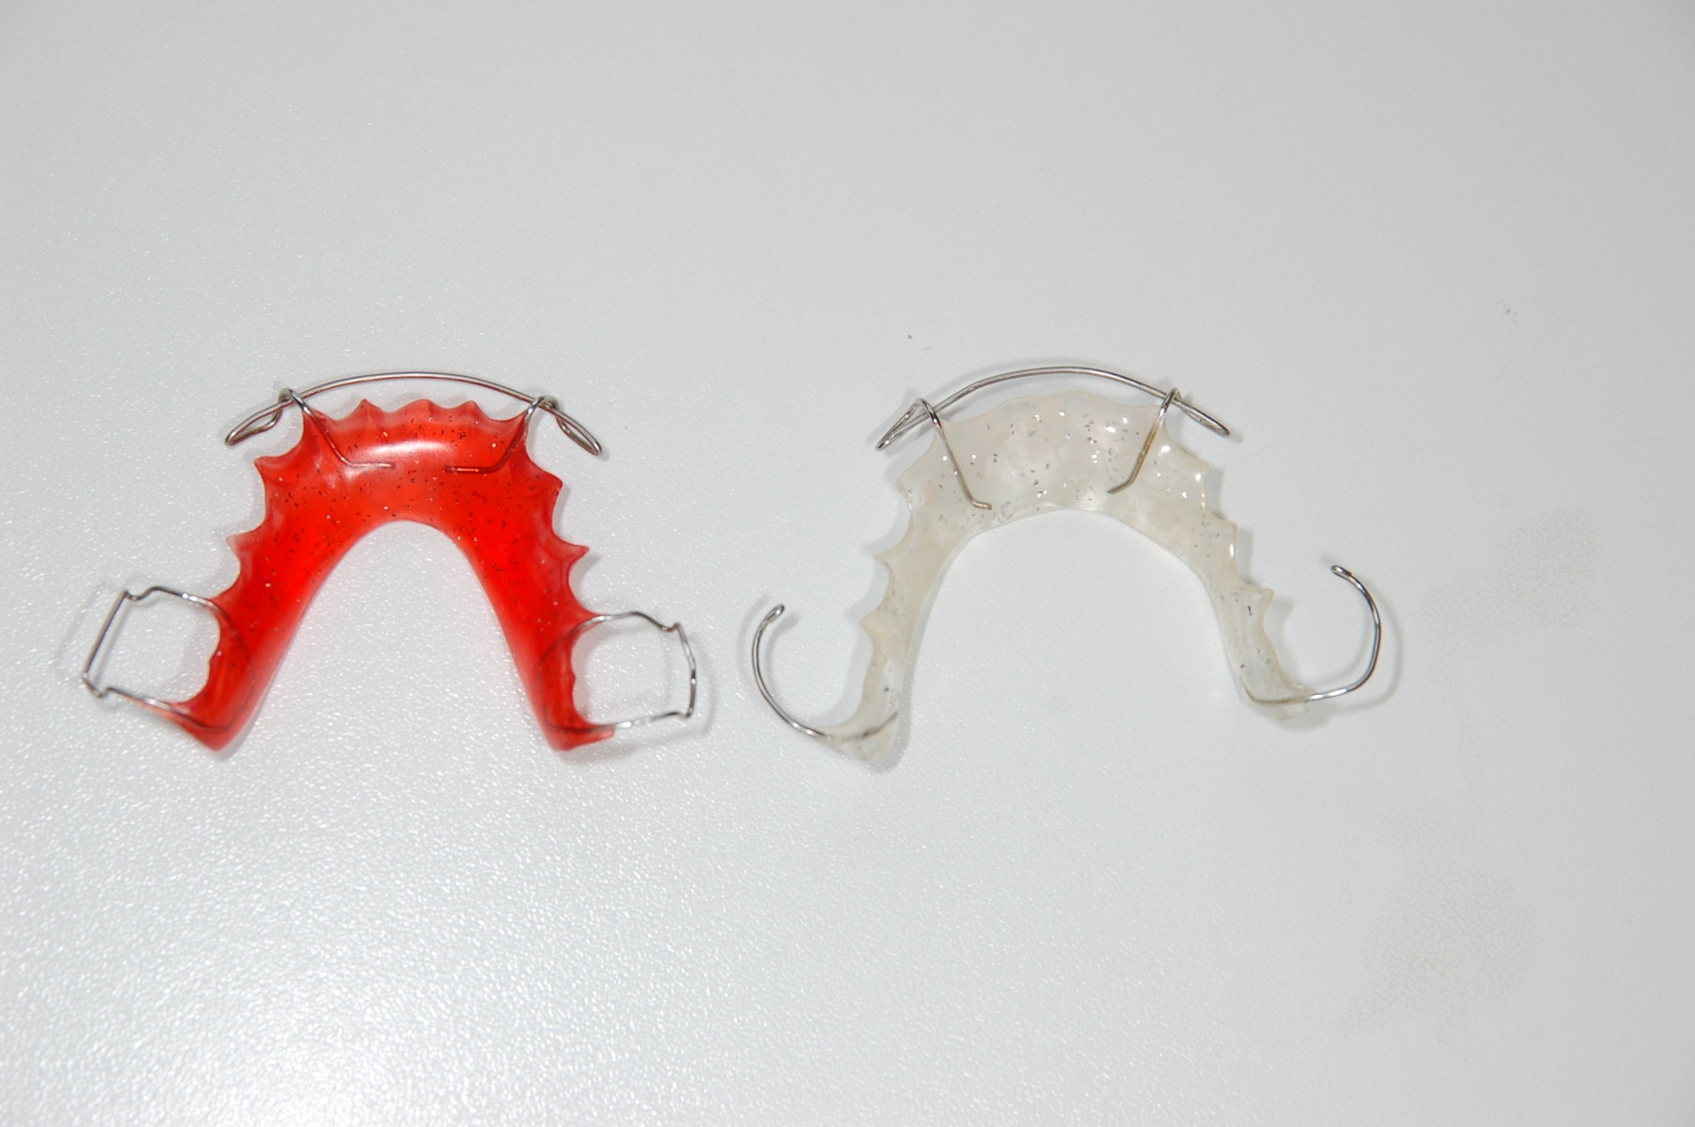
Removable appliances-passive

Slide 25
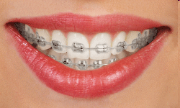
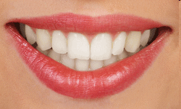
Thank You four Your attention
Questions – email – alena.brysova@fnusa.cz
Consultation – Orthodontic department - St. Anne's Hospital, building D2b – Thursday 1-2 p.m.

