Slide 1
Oral Epidemiology (1/2)
Public Health in Dentistry I

Slide 2
Lecture Outline I. Oral Epidemiology II. Epidemiological Studies: Preparation III. Epidemiological Studies: Design IV. Epidemiological Studies: Appraisal

Slide 3
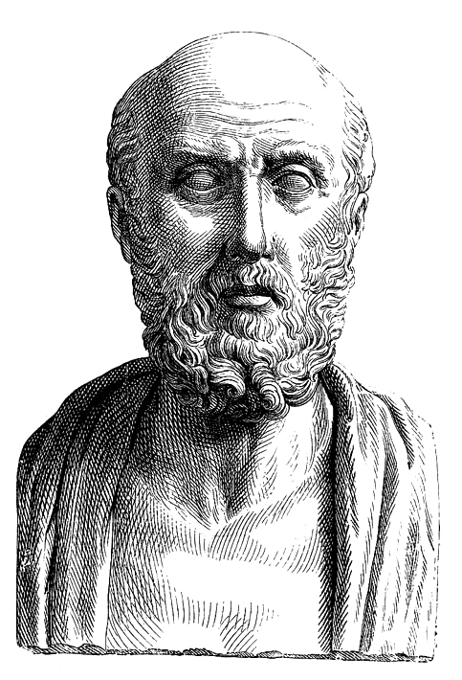
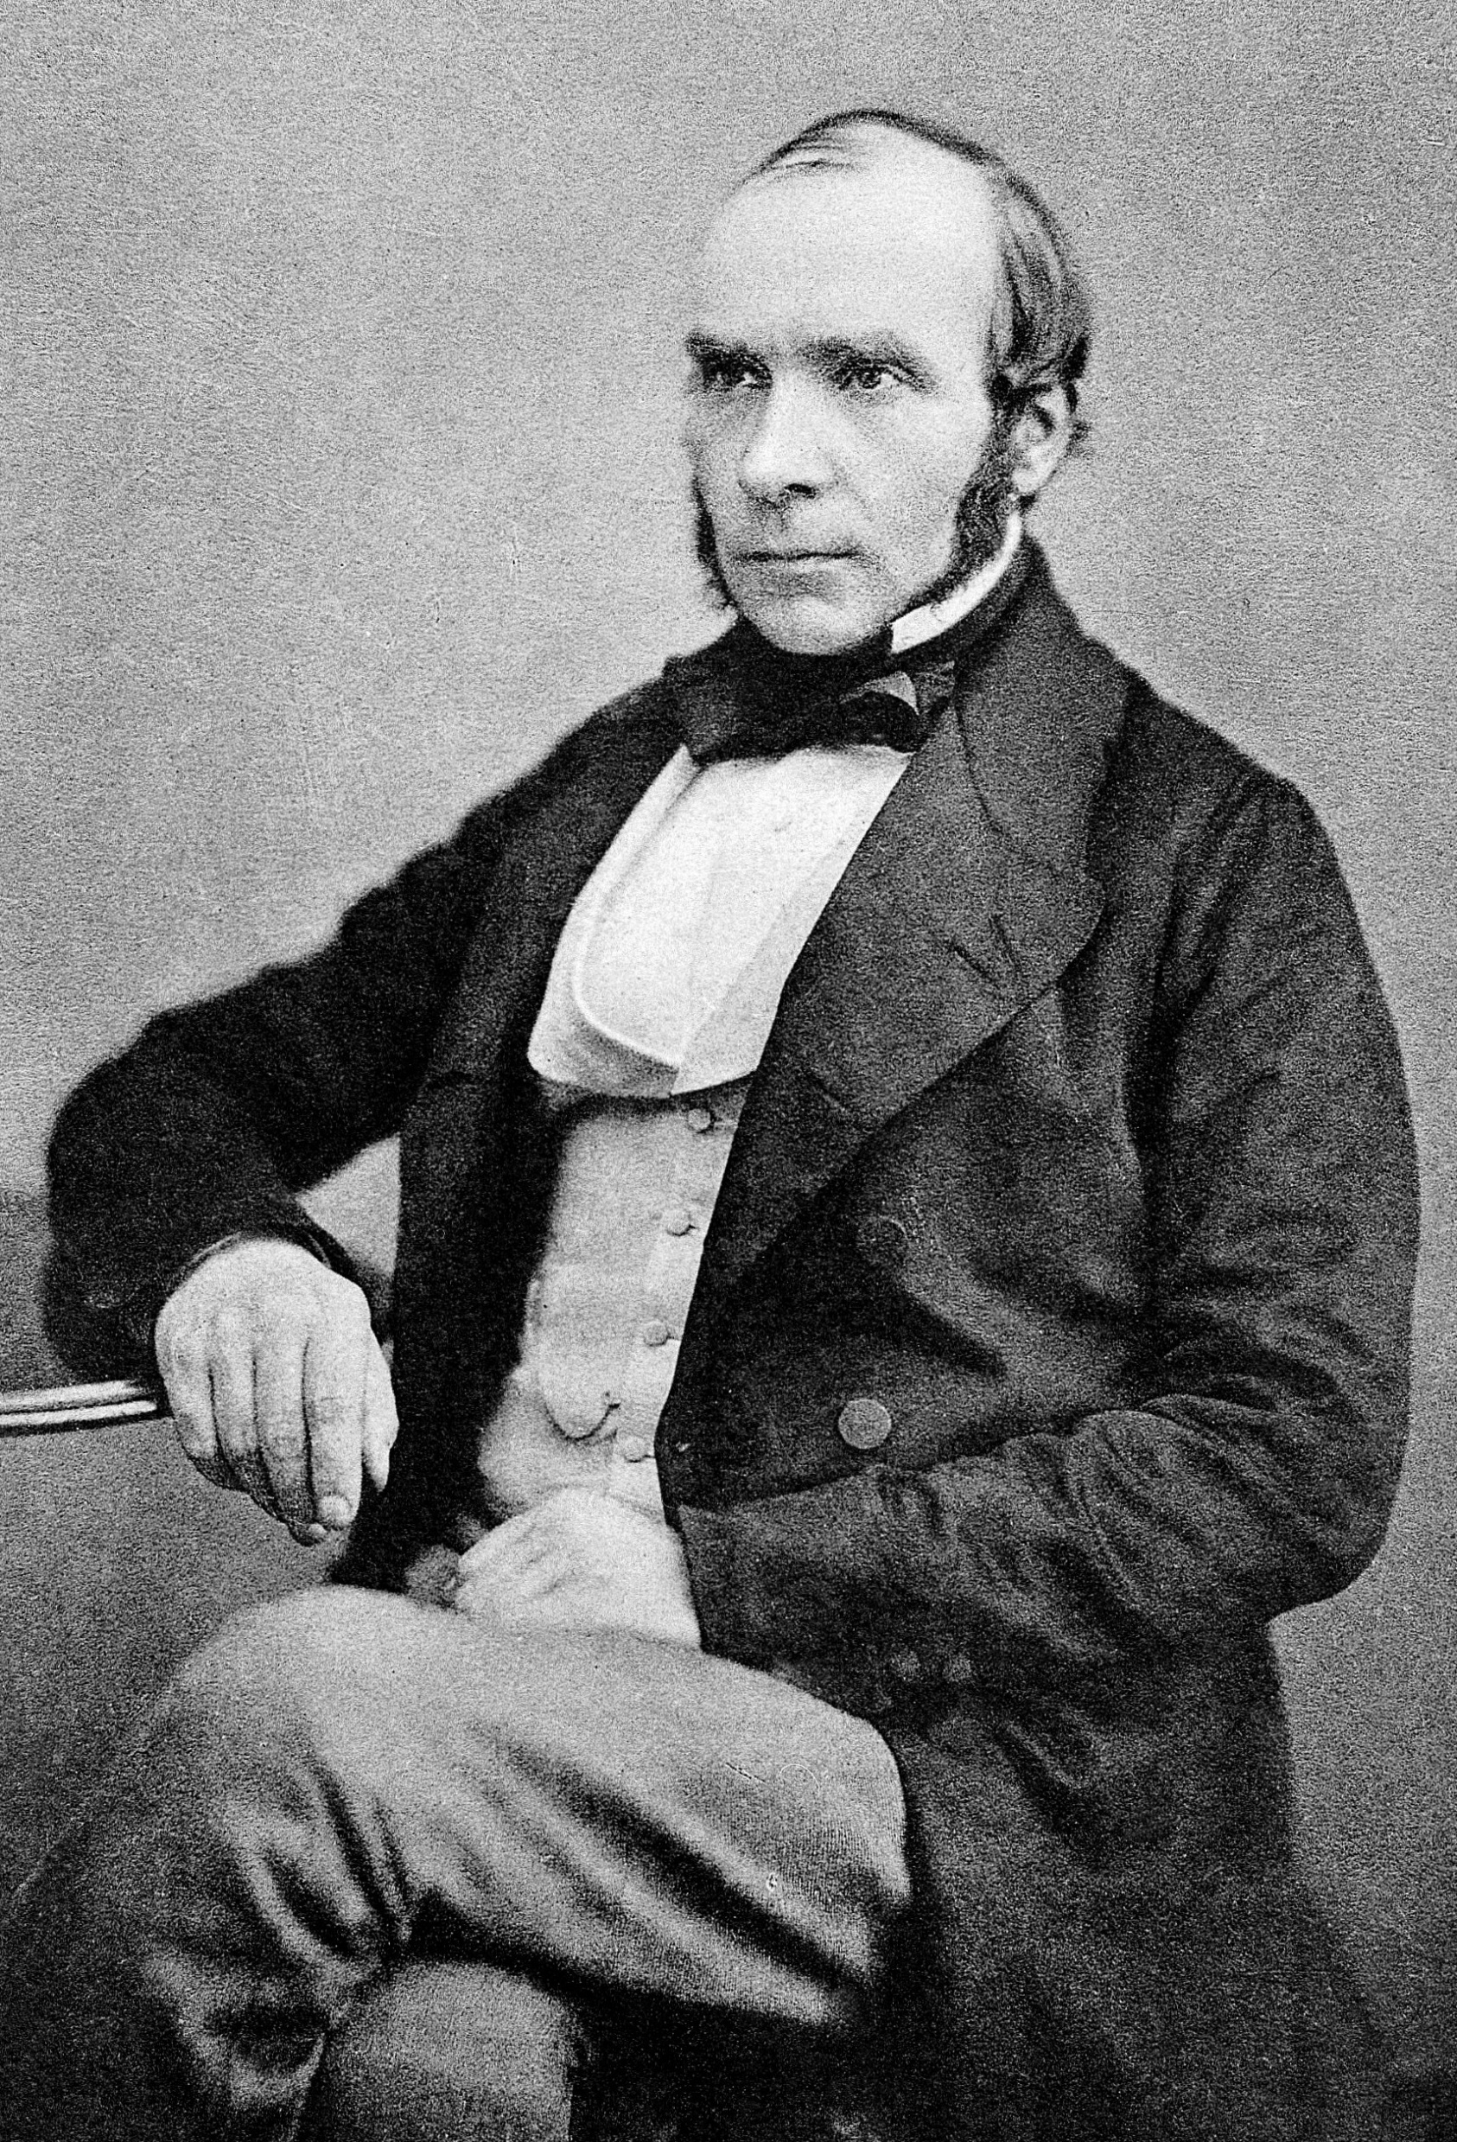
Epidemiology
Medicine: This is my dad!
Epidemiology: My dad is younger!
epi = on / upon / above
demos = people
logos = study
NOT ME
Epidemiology is the study of the distribution and determinants of health-related states or events in specified populations, and the application of this study to the control of health problems.

Slide 4
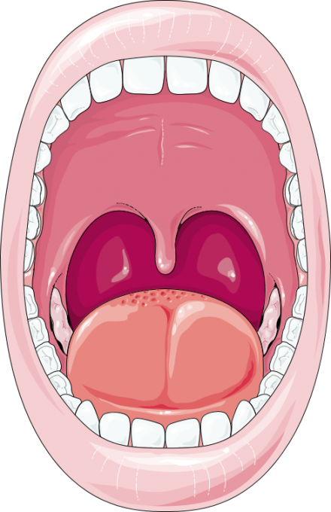
Epidemiology
Functions of Oral Epidemiology
measurement of dental disease among groups within the population in order to understand factors that influence the distribution;
identification of factors that cause conditions;
evaluation of effectiveness of new materials and treatment in clinical trials and assessment of needs and requirements for dental services within the community.

Slide 5
Preparation Phase
To ensure the study is well though through and adequately planned.
To allow the study to be evaluated for scientific and ethical factors prior to starting.
To ensure that investigators complete the study as planned.
To allow others to complete the study for the original investigator, if necessary.
To enable others to repeat the study.
Merit
Appropriateness
Review
1. Protocol
Collaboration
Reproducibility

Slide 6
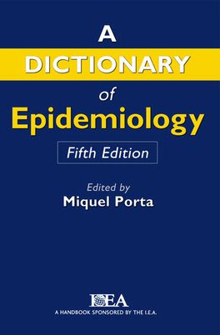
Preparation Phase
A supposition, arrived at from observation or reflection, that leads to refutable predictions.
alt.
Any conjecture cast in a form that will allow it to be tested and refuted.
2. Literature Review
3. Hypothesis
An idea or explanation for something that is based on known facts but has not yet been proved.

Slide 7
Null Hypothesis
Prevalent knowledge
Common proposition
Old theory
No effect
No difference
The first step in testing for statistical significance in which it is assumed that the exposure is not related to disease.
H₀
Alternative Hypothesis
Research hypothesis
New theory
The hypothesis, to be adopted if the null hypothesis proves implausible, in which exposure is associated with disease.
H_{a}
There is difference
There is association
Effective drug

Slide 8
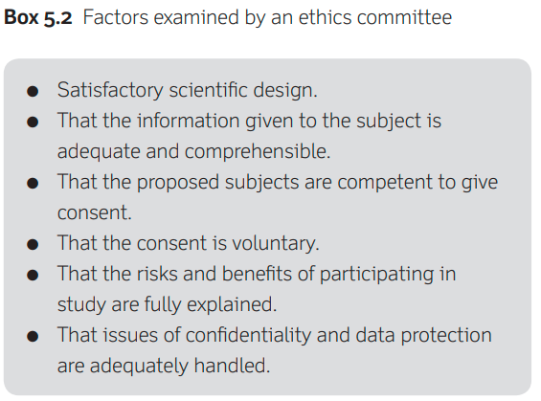
Preparation Phase
4. Ethical Clearance
5. Governance

Slide 9
Epidemiological Studies
Observational
Experimental
Descriptive
Analytical

Slide 10
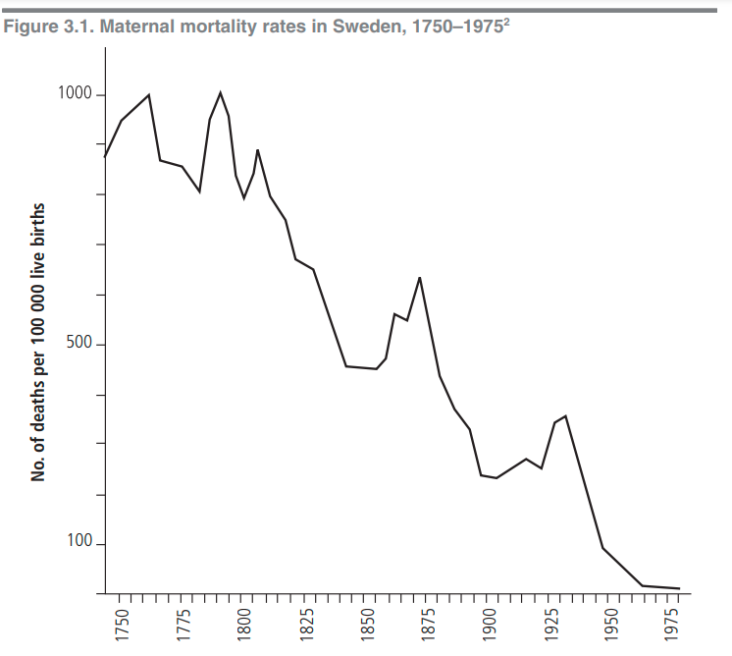
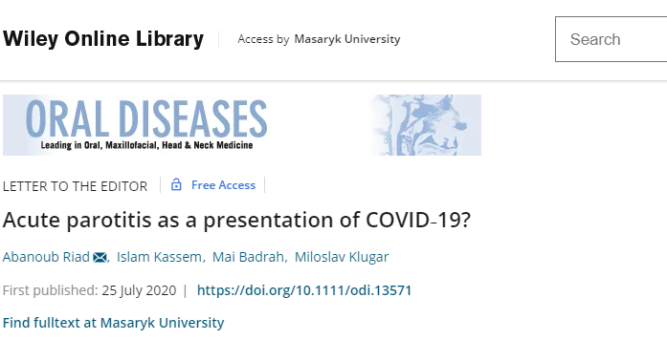
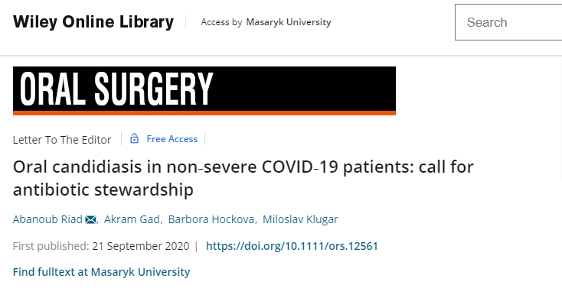
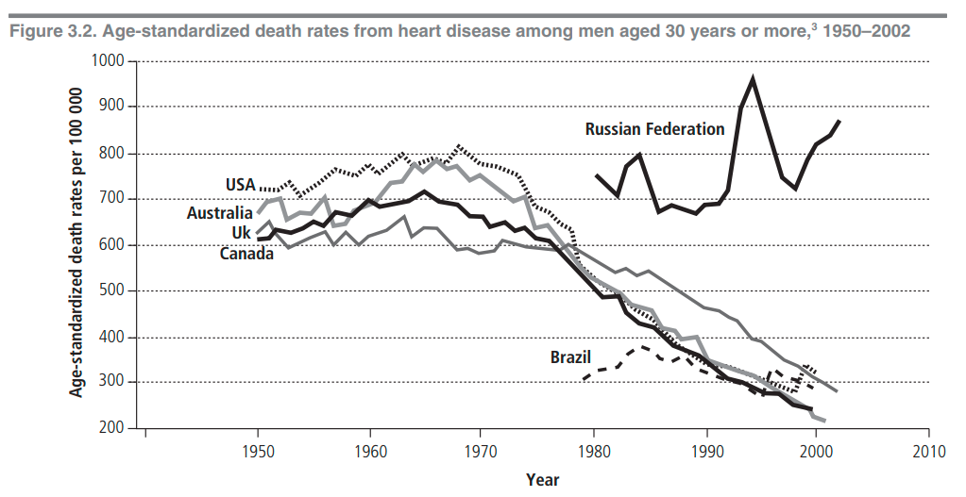
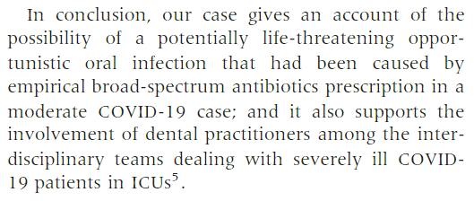
Descriptive Studies
Case Report
Case Series
A simple description of the health status of a community, based on routinely available data or on data obtained in special surveys.

Slide 11
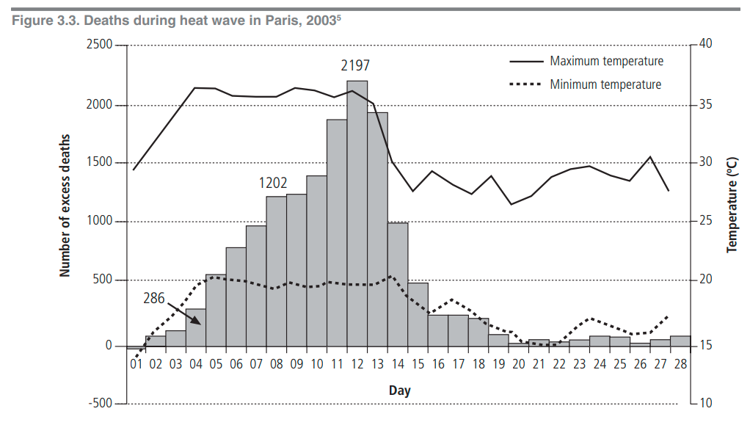
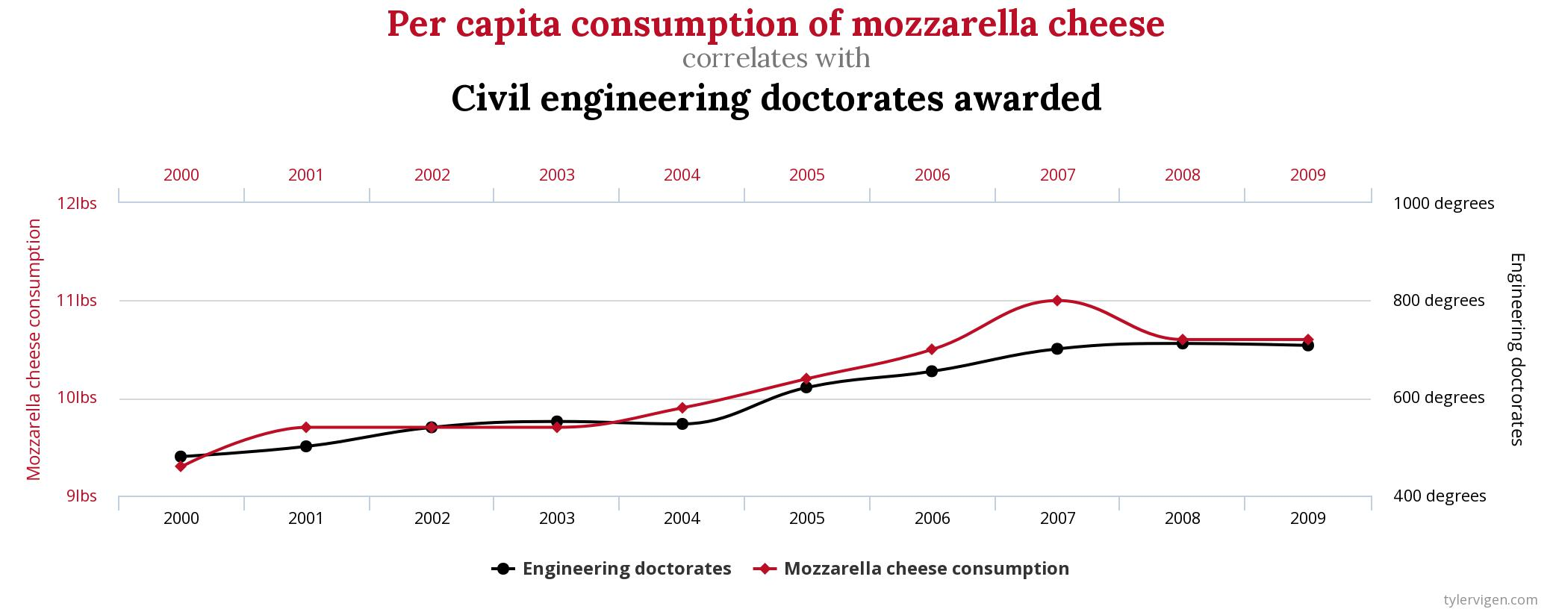
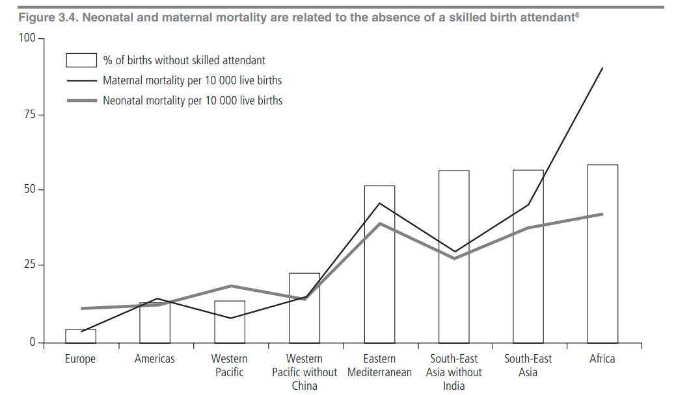
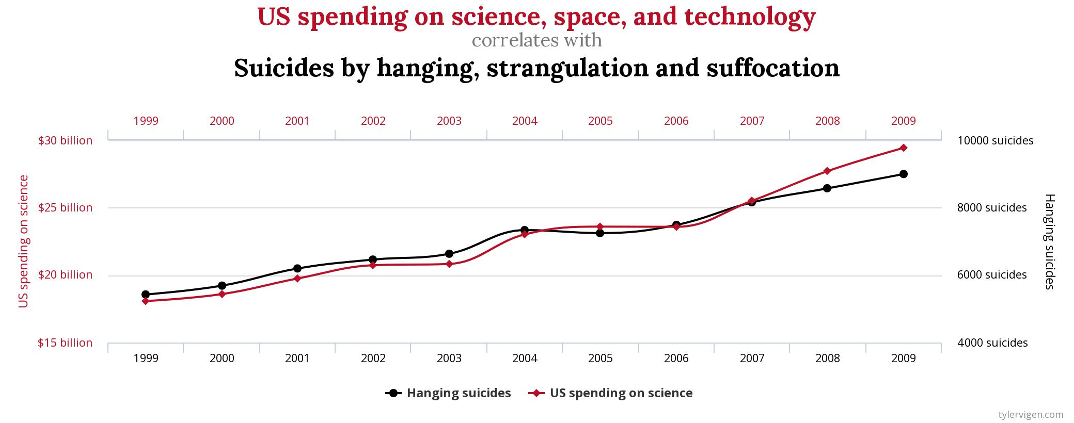
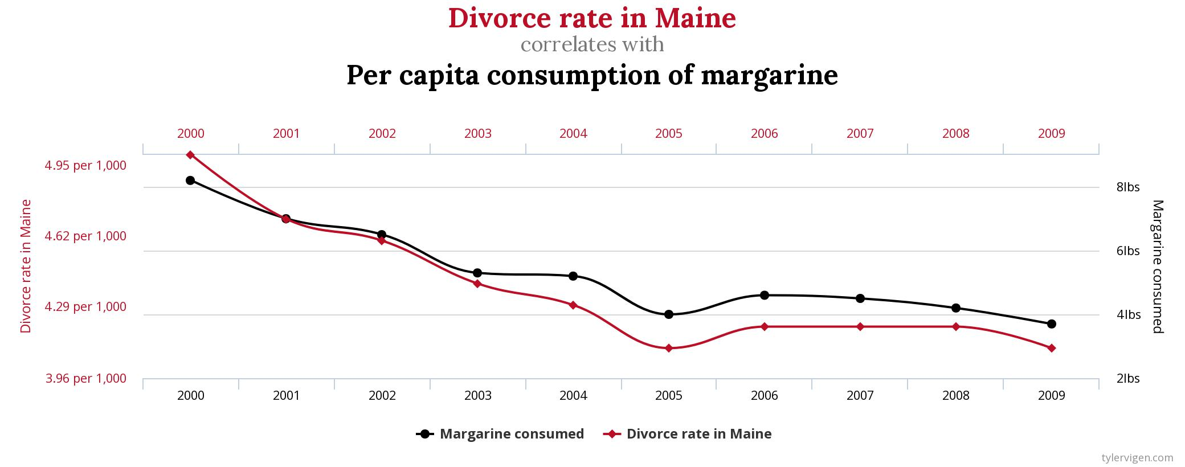
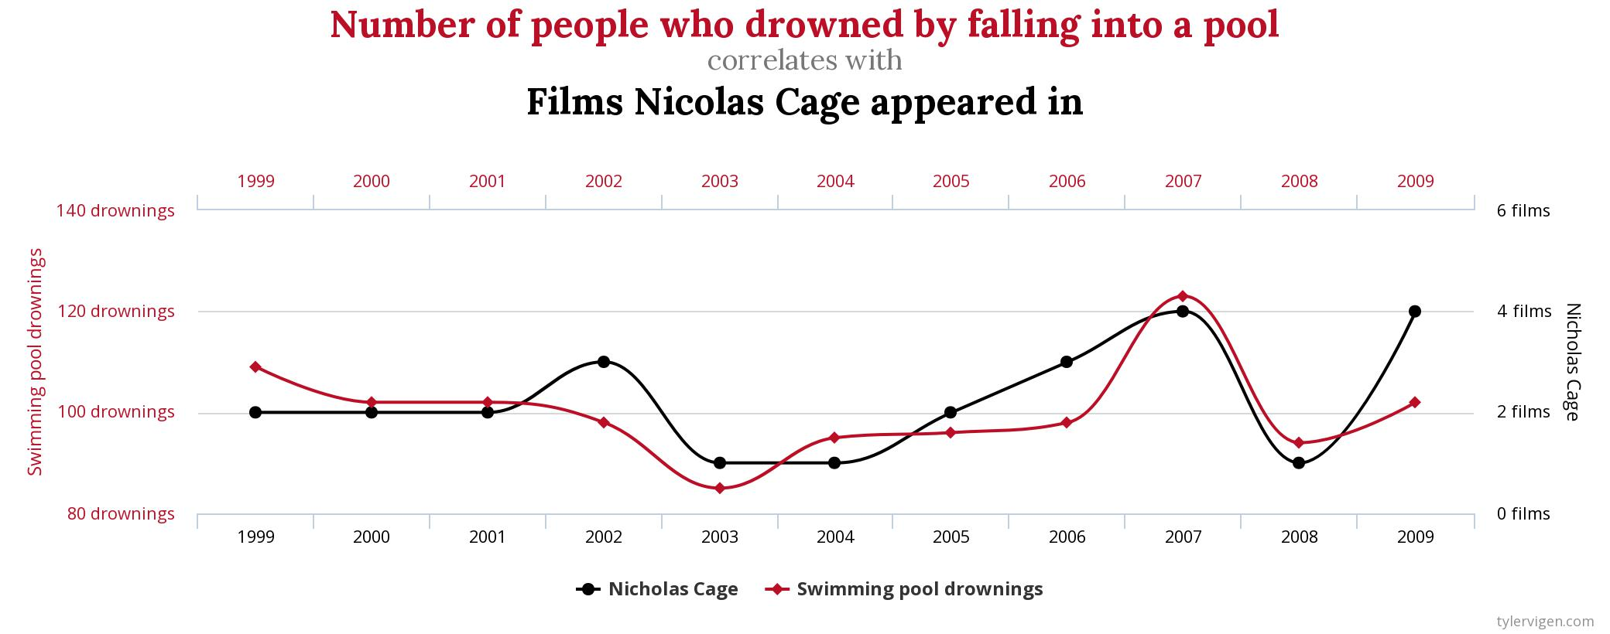
Ecological Studies
Spurious Correlation
Ecological Fallacy
Correlational Studies
Ecological studies are useful for generating hypotheses. In an ecological study, the units of analysis are groups of people rather than individuals.
Although simple to conduct and thus attractive, ecological studies are often difficult to interpret since it is seldom possible to examine directly the various potential explanations for findings.
Ecological studies usually rely on data collected for other purposes; data on different exposures and on socioeconomic factors may not be available.

Slide 12
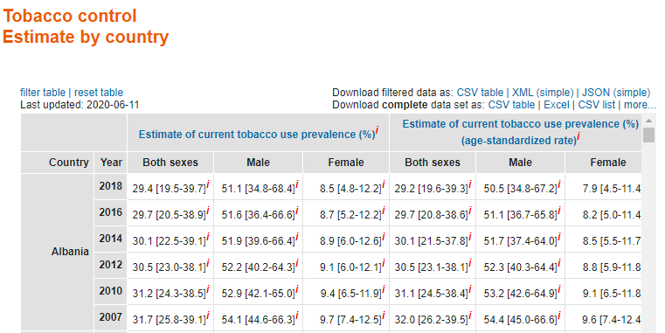
Cross-sectional Studies
Global Health Observatory (GHO)
https://www.who.int/data/gho
Cross-sectional studies measure the prevalence of disease and thus are often called prevalence studies.
In a cross-sectional study the measurements of exposure and effect are made at the same time.
Many countries conduct regular cross-sectional surveys on representative samples of their populations focusing on personal and demographic characteristics, illnesses and health-related habits.

Slide 13
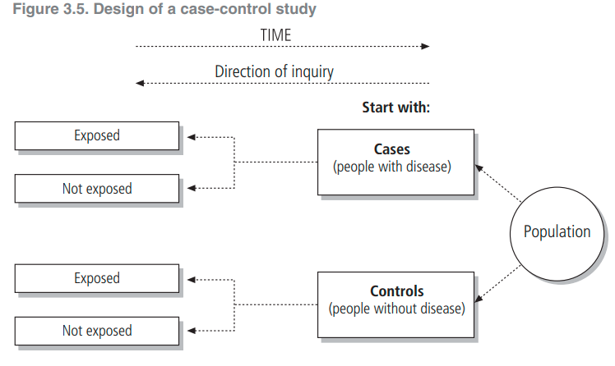
Case-control Studies
Case-control studies provide a relatively simple way to investigate causes of diseases, especially rare diseases.
Case-control studies are longitudinal, in contrast to cross-sectional studies.
The investigators collect data on disease occurrence at one point in time and exposures at a previous point in time.
Case-control studies have been called retrospective studies since the investigator is looking backward from the disease to a possible cause.

Slide 14
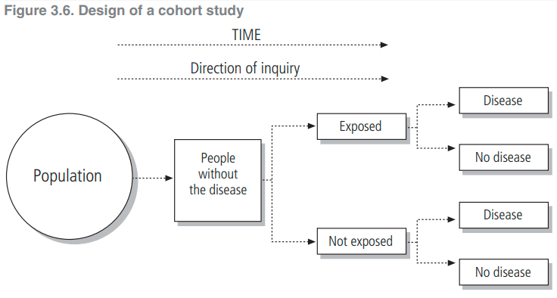
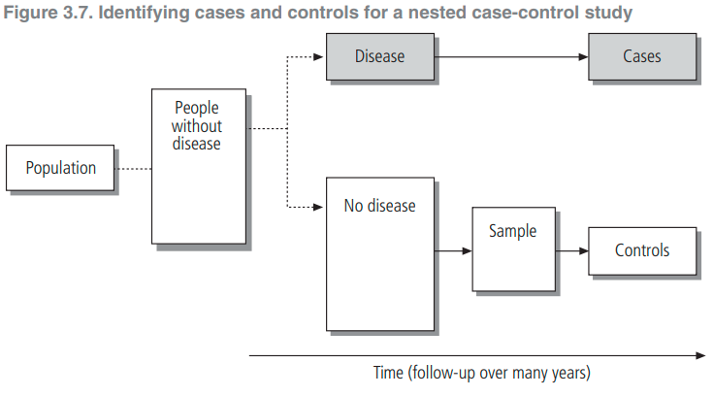
Cohort Studies
Cohort studies, also called follow-up or incidence studies, begin with a group of people who are free of disease, and who are classified into subgroups according to exposure to a potential cause of disease or outcome.
Cohort studies have been called prospective studies, but this terminology is confusing and should be avoided.
Although conceptually simple, cohort studies are major undertakings and may require long periods of follow-up since disease may occur a long time after exposure.
Retrospective Cohort Studies
Historical Cohort Studies
This type of investigation is called a historical cohort study, because all the exposure and effect (disease) data have been collected before the actual study begins.
Nested Case-control Studies

Slide 15
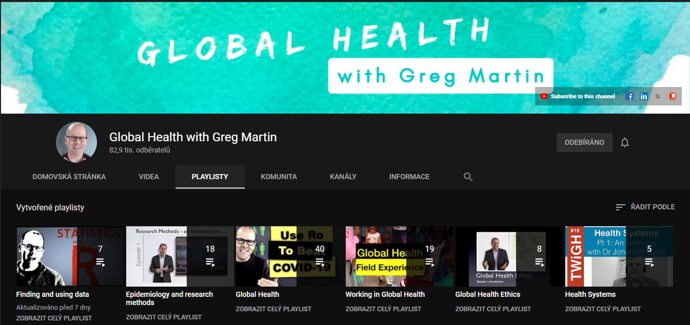
RECOMMENDED
15

Slide 16
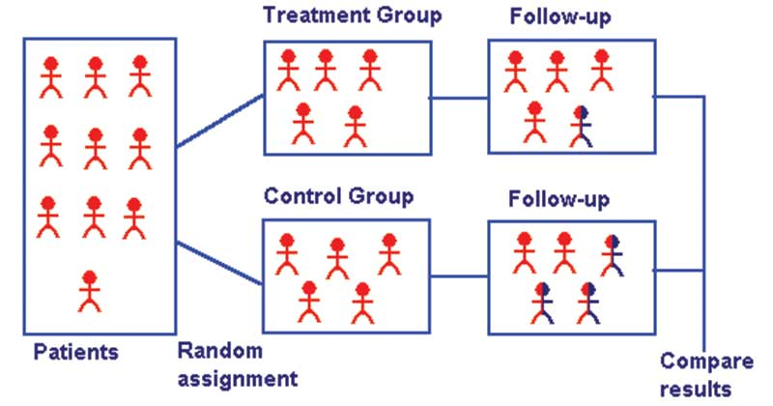
Randomized Controlled Trials
RCTs
Subjects in the study population are randomly allocated to intervention and control groups, and the results are assessed by comparing outcomes.
To ensure that the groups being compared are equivalent, patients are allocated to them randomly.

Slide 17
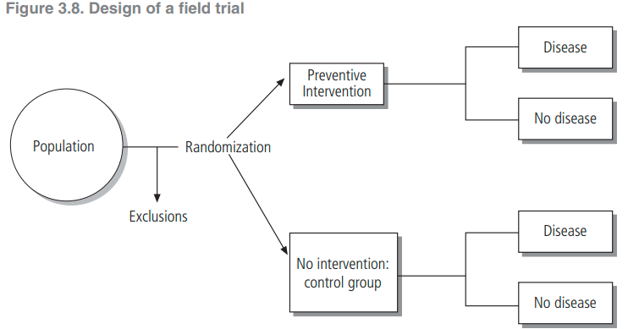
Field Trials
Field trials, in contrast to clinical trials, involve people who are healthy but presumed to be at risk; data collection takes place “in the field,” usually among non-institutionalized people in the general population.
Community Trials
In this form of experiment, the treatment groups are communities rather than individuals.
This is particularly appropriate for diseases that are influenced by social conditions, and for which prevention efforts target group behaviour.

Slide 18
Error in Epidemiology
Random
Systematic
Individual Variation
Measurement Error
Selection Bias
Classification Bias
Sampling Error

Slide 19
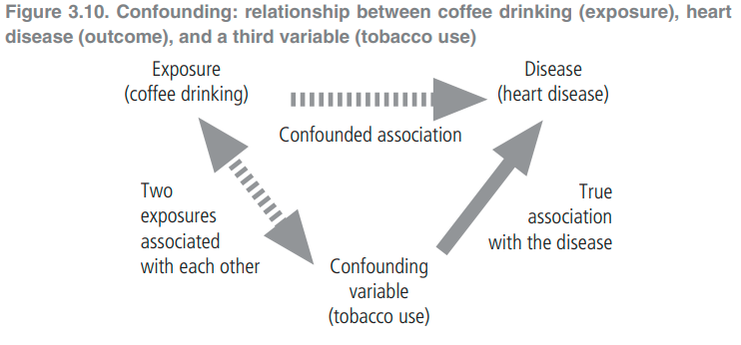
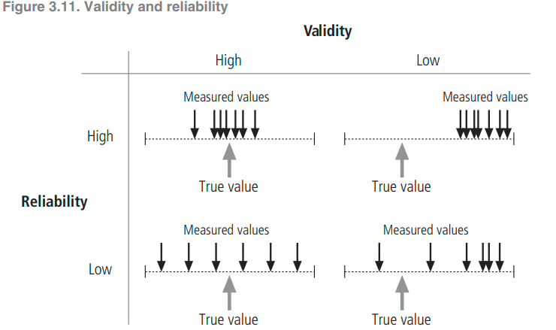
Confounding
Design
Analysis
Validity vs. Reliability
Randomization
Stratification
Restriction
Statistical Modeling
Matching

Slide 20
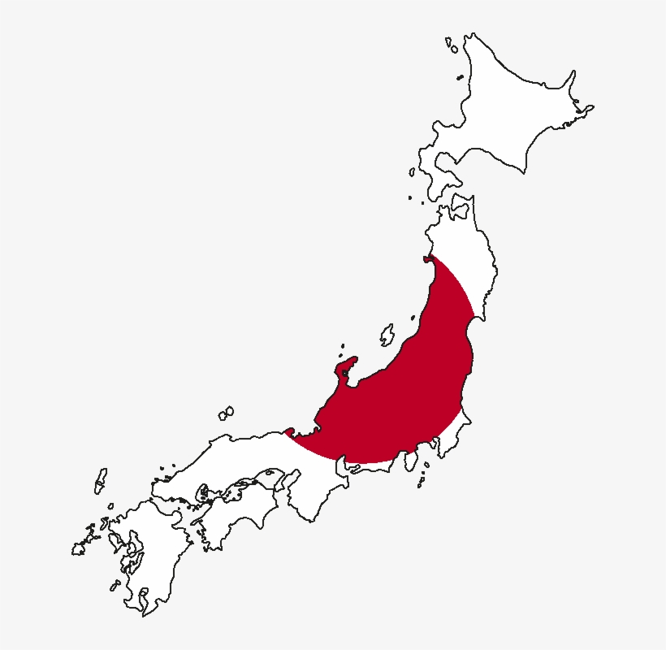
Secondary Evidence
1945
1986
Natural Experiments
“epidemiological studies under exceptional circumstances”
Meta Research
Systematic Reviews
Scoping Reviews
Umbrella Reviews
etc >> next week

Slide 21
THANK YOU
abanoub.riad@med.muni.cz
Office Consultation (Upon Request)
Public Health in Dentistry I

