Slide 1
Lecture 2 : NGS libraries and basic data quality control
Modern Genomic Technologies (LF:DSMGT01 )
Vojta Bystry
vojtech.bystry@ceitec.muni.cz

Slide 2
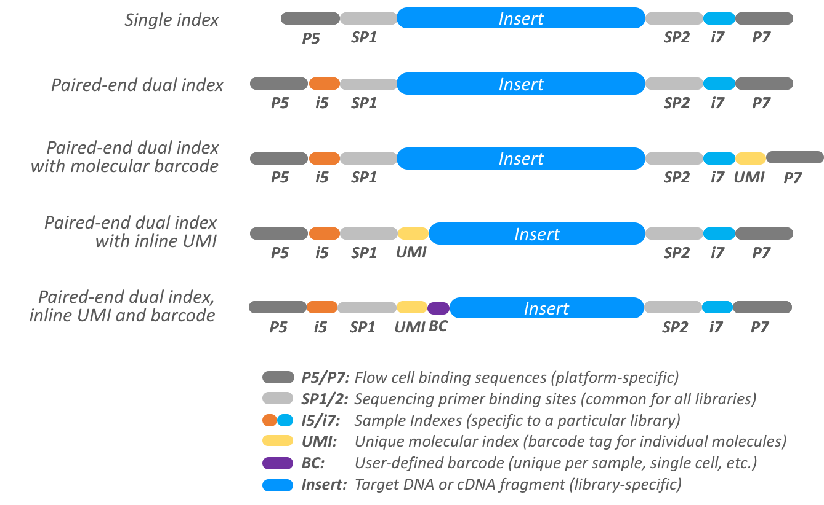
De-multiplexing
Bcl2fastq tool
Needs sample sheet with indexes
Number of barcode mismatches
Check undetermined

Slide 3
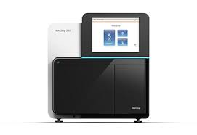
NGS data analysis
Raw data
.fastq
Experiment design
de-multiplexing
QC
Not known
reference
Not ”classic” reference
Genome/Transcriptome Reference Mapping
.bam
Metagenomics
Reference assembly
Immunogenetic
VDJ-genes
CRISPR
sgRNA
QC
Methylation
Bisulfide-seq
Interaction
analysis
CHIP-seq
Expression analysis
RNAseq
Variant analysis
WES
…
3

Slide 4
Primary data – fastq file

Slide 5
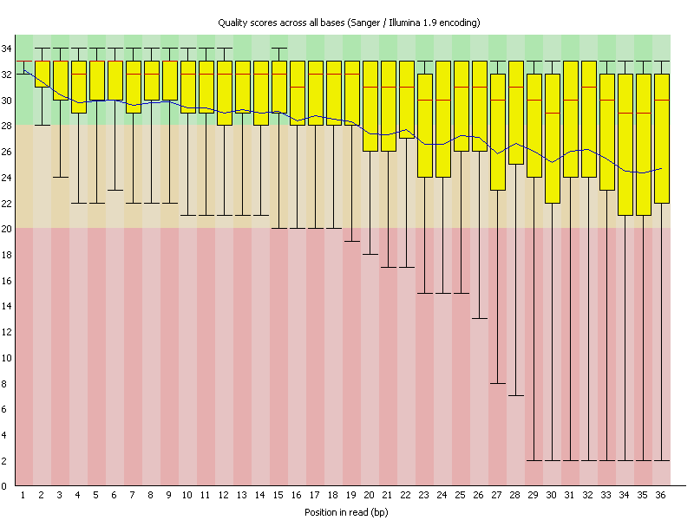
Fastq format - quality
Fastq - q stands for quality – coded phred score
CFFFFEFFGCEEGECFGGGGAFF87@E:++6C<++3:,8,33,,:,,,:,,:,,,
Quality | Error probability
5 | 31%
10 | 10%
20 | 1%
30 | 0.1%
Very good for early problem detection
Reasonable for trimming and read filtering
RNA seq - above phred score 5

Slide 6
Fastq – quality control
Fastqc - tool

Slide 7
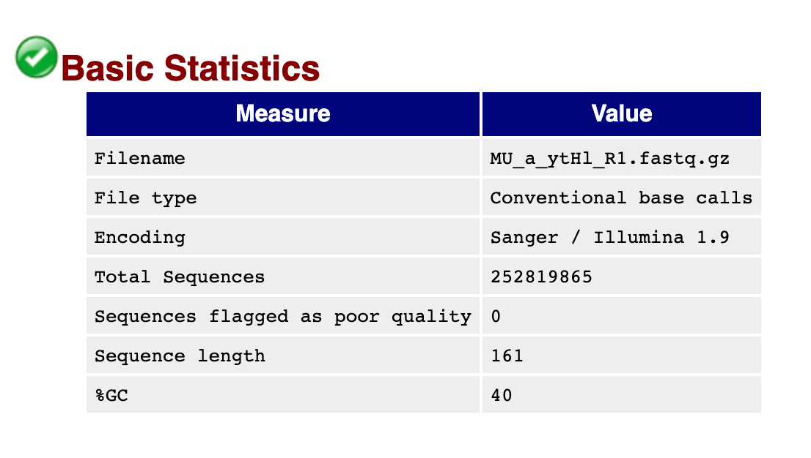
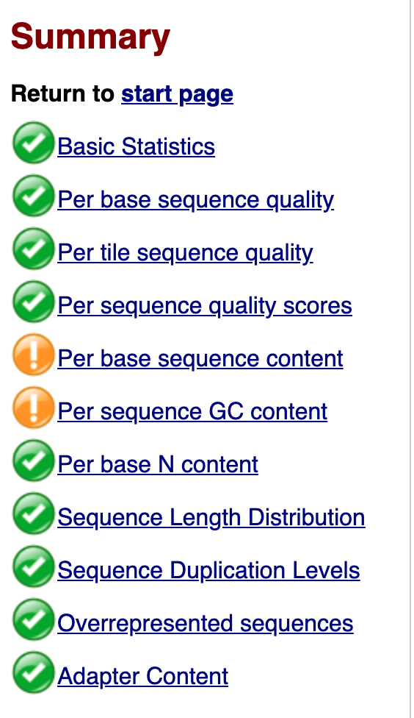
FastQC Report

Slide 8
NGS data analysis
Raw data
.fastq
Experiment design
de-multiplexing
QC
Not known
reference
Not ”classic” reference
Genome/Transcriptome Reference Mapping
.bam
Metagenomics
Reference assembly
Immunogenetic
VDJ-genes
CRISPR
sgRNA
QC
Methylation
Bisulfide-seq
Interaction
analysis
CHIP-seq
Expression analysis
RNAseq
Variant analysis
WES
…
8

Slide 9
CEITEC
@CEITEC_Brno
Thank you for your attention!
Vojta Bystry
vojtech.bystry@ceitec.muni.cz
www.ceitec.eu

