Slide 1
Physical Therapy After Pelvic Injuries, Vertebral Column Injury
Mgr. Alena Sedláková

Slide 2
Pelvic Fractures
Introduction
Mechanism typically high energy blunt trauma
Mortality rate 15-25% for closed fractures, as much as 50% for open fractures
Associated injuries
  chest injury in up to 63%
  long bone fractures in 50%
  sexual dysfunction up to 50%
  head and abdominal injury in 40%
  spine fractures in 25%
Prognosis
  high prevalence of poor functional outcome and chronic pain

Slide 3
Tile Classification
  A: stable
    A1: fracture not involving the ring (avulsion or iliac wing fracture)
    A2: stable or minimally displaced fracture of the ring
    A3: transverse sacral fracture
  B - rotationally unstable, vertically stable
    B1: open book injury (external rotation)
    B2: lateral compression injury (internal rotation)
      B2-1: with anterior ring rotation/displacement through ipsilateral rami
      B2-2-with anterior ring rotation/displacement through contralateral rami (bucket-handle injury)
    B3: bilateral
  C - rotationally and vertically unstable
    C1: unilateral
      C1-1: iliac fracture
      C1-2: sacroiliac fracture-dislocation
      C1-3: sacral fracture
    C2: bilateral with one side type B and one side type C
    C3: bilateral with both sides type C

Slide 4
Young-Burgess Classification
The Young-Burgess classification system is based on mechanism of injury: anteroposterior compression type I, II and III, lateral compression types I, II and III, and vertical shear, or a combination of forces.
Lateral compression (LC) fractures involve transverse fractures of the pubic rami, either ipsilateral or contralateral to a posterior injury.
Grade I – Associated sacral compression on side of impact
Grade II – Associated posterior iliac ("crescent") fracture on side of impact
Grade III – Associated contralateral sacroiliac joint injury

Slide 5
Stable Fractures
There is often only one break in the pelvic ring and the broken ends of the bones line up adequately
Low-energy fractures are often stable fractures
Stable pelvic fracture patterns include: Iliac wing fracture, Sacrum fracture, Superior and inferior pubic ramus fracture

Slide 6
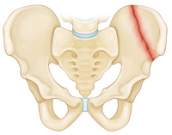
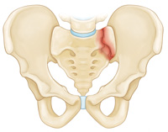
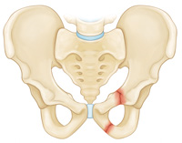
Stable Fractures
Iliac wing fracture
Sacrum fracture
Superior and inferior pubic ramus fracture

Slide 7
Unstable Fractures
There are usually two or more breaks in the pelvic ring and the ends of the broken bones do not line up correctly (displacement)
This type of fracture is more likely to occur due to a high-energy event
Unstable pelvic fracture patterns include: Anterior-posterior compression fracture, Lateral compression fracture, Vertical shear fracture

Slide 8
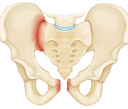
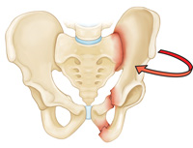
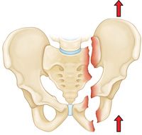
Unstable Fractures
Anterior-posterior compression fracture
Lateral compression fracture - in this fracture, the pelvis is pushed inward
Vertical shear fracture - in this fracture, one half of the pelvis shifts upward

Slide 9
Pelvic Fractures, Classification
Both stable and unstable pelvic fractures can also be divided into:
Open fractures - the bone fragments stick out through the skin, risk of infection
Closed fractures - the skin is not broken

Slide 10
Mechanism of Pelvic Fractures
High-Energy Trauma
Car or motorcycle collision
Crush accident
Fall from a significant height
Bone Insufficiency
A pelvic fracture may also occur due to weak or insufficient bone
Most common in older people whose bones have become weakened by osteoporosis
In these patients, a fracture may occur even during a fall from standing or a routine activity such as getting out of the bathtub or descending stairs
These injuries are typically stable fractures that do not damage the structural integrity of the pelvic ring, but may fracture an individual bone

Slide 11
Treatment
Treatment is based on a number of factors, including:
The specific pattern of the fracture
How much the bones are displaced
Patient‘s overall condition and associated injuries
CONSERVATIVE treatment – stable fractures without displacement or minimally displaced, pelvic binder
SURGICAL treatment – unstable pelvic fractures

Slide 12
Surgical Treatment
External fixation - to stabilize the pelvic area, metal pins or screws are inserted into the bones through small incisions into the skin and muscle. The pins and screws project out of the skin on both sides of the pelvis where they are attached to carbon fiber bars outside the skin. The external fixator acts as a stabilizing frame to hold the broken bones in proper position
In some cases, an external fixator is used to stabilize the bones until healing is complete
In some cases, it is converted to internal fixation

Slide 13
Surgical Treatment
Open reduction and internal fixation - during this operation, the displaced bone fragments are first reduced into their normal alignment. They are then held together with screws or metal plates attached to the outer surface of the bone
Unstable pelvic fractures and dislocations are complex and potentially devastating injuries
Early surgical realignment and stabilization of pelvic fractures decreases related bleeding, provides patient comfort and facilitates patient mobility

Slide 14
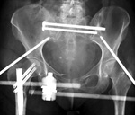
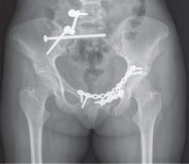
Surgical Treatment
External fixator
ORIF
https://www.youtube.com/watch?v=Ty4eibxAG3U

Slide 15
Rehabilitation
Rehabilitation is initiated as soon as possible in acute phase during period of bed rest
Physical therapy may also help a fracture heal more quickly than immobilization alone. Exercise increases blood flow, which delivers more oxygen and nutrients to injured parts of the bone, aiding in healing
Restoration of leg motion while maintain pelvic fractures stability is the goal of rehabilitation treatment
The treatment has to respect the time needed to heal the tissues and the physician‘s decision regarding the permitted loading of the affected side
Following conservative or surgical treatment, patients follow the decreased weight-bearing status for three to four months

Slide 16
Goals of rehabilitation
Prevent post-operative complications (pneumonia, deep vein thrombosis)
Prevent decubitus
Prevent joint stiffness and muscle contractions or weakness
Prevent deconditioning
Improve bed mobility
Gradually training of sitting, stability in sitting position
Gait training with assistive devices such as walker, underarm or forearm crutches

Slide 17
Physical Therapy Approaches
Cryotherapy (application of ice reduces swelling), limb elevation, balling free parts
Circulatory exercises (ankle pumps)
Respiratory rehabilitation
Repositioning (semisupine, supine position)
Active range of motion exercise and resistance exercise upper extremities
Isometric exercises lower extremities
Gentle ROM exercises - PROM or AAROM exercise lower extremities
Continous passive motion machine CPM

Slide 18
Functional mobility training – includes bed mobility and transfer training such as rolling to an unaffected side, moving up or down the bed - scooting, transitions from lying to sitting in bed or on the edge of bed (when no risk of displacement)
Gait training with assistive devices such as walker, underarm or forearm crutches – it depands on patient condition
More severe pelvic fractures (bilateral fractures) require a wheelchair – training transfers from bed to wheelchair

Slide 19
Weight bearing on leg of the affected side is recommanded by physician – non WB (toe-touch WB) with progression to PWB and gradually to FWB within 3 to 4 months
ADL training
Prepare patient to hospital descharge

Slide 20
Following Rehabilitation
Self-sufficient patients are discharged from hospital and follow rehabilitation in physiotherapy clinic
Patients who require 24-hours nurse care, follow therapy and practicing independence in rehabilitation setting

Slide 21
Goals of Following Rehabilitation
Relieve pain
Improve ROM
Improve muscle strength
Improve or maintain physical fittness
Improve balance, improve coordination
Enable ambulation
Patient‘s return to their normal activities

Slide 22
Physical Therapy Approaches
Modalities – magnet therapy (promotes fracture healing), hydrotherapy – whirpool (reduces swelling and relieves pain)
Soft tissues mobilization (PIR, balling) – to release contracted muscles, tendons and fascia (lumbal area, pelvic area, hip joints)
Joint mobilization – to restore joint play
Scare care
AAROM, AROM exercise
Resistance exersice to improve muscle strength (overball, theraband, weights)

Slide 23
Sensorimotor training – to improve balance skills and joint stability (includes simple exercises such as toe-standing, standing hip flexion, standing side leg raise following modifications doing exercise with eyes closed; balance training aids such as balance discs, unstable platform)
Gait training without assistive devices, gait pattern correction
Posture correction
Aquatic exercises

Slide 24
Vertebral Column Injury
Vertebral column injury without spinal cord injury (Whiplash injury, vertebral fractures)
Vertebral column injury with spinal cord injury

Slide 25
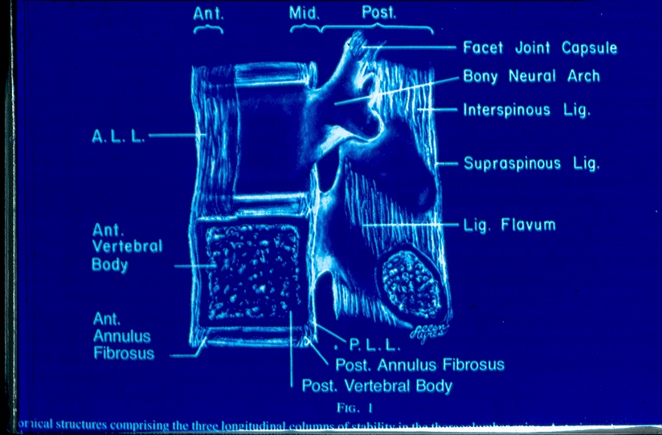

Slide 26
Whiplash injury
Neck strain or neck sprain
Car accidents, any impact or blow that causes the head to jerk forward or backward
The sudden force stretches (neck strain) and tears (neck sprain) the muscles, tendons and ligaments in the neck
Symptoms - Pain, decreased range of motion, and tightness in the neck, the muscles may feel hard, tenderness, headache, dizziness
Treatment - cryotherapy to reduce pain and swelling as soon as possible after the injury for 2 days, painkillers, neck brace, later (3rd day) heat application
Rehabilitation – when acute symptoms subside to initiate balling, gentle soft tissues techniques, PIR, training of deep postural stabilization of the spine, modalities such as ultrasound and heat apllication

Slide 27
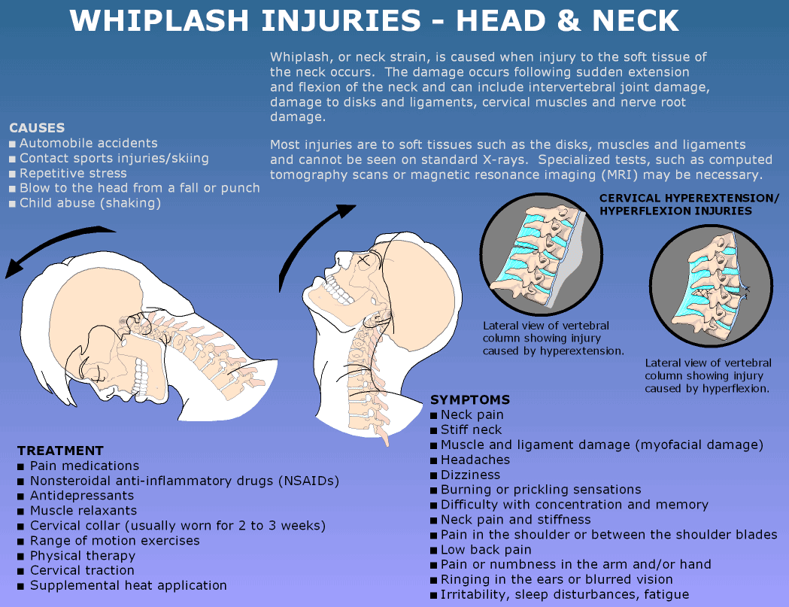

Slide 28
Vertebral Compression Fractures
When the vertebrae collaps (most commonly in the thoracic and lumbal spine)
Causes - fall from a tall height in which the person lands on his or her feet or buttocks, car accidents, pathologic fractures and people with osteoporosis (little or no trauma)
Treatment – CONSERVATIVE - pain medications, decreasing activity, orthosis, physical therapy
- SURGICAL (internal fixation, spongioplasty) – to stabilize the fractured vertebra in case of sudden and serious instability of the spine (if the fracture leads to a loss of 50% of the vertebral body's height)

Slide 29
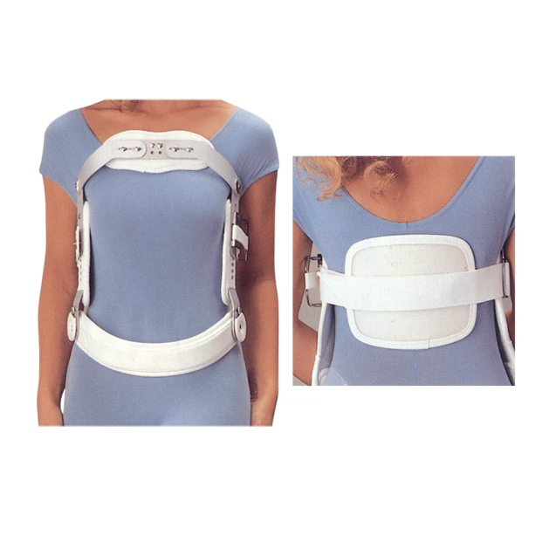
Jewett Brace
The orthosis supports the back and restricts movement such as bending forward and rotation
It holds the spine in straightening, than normal
This takes most of the pressure off the fractured vertebral body, and allows the vertebrae to heal
It also protects the vertebra and stops further collapse of the bone

Slide 30
Rehabilitation
Goals
Prevent complications such as pneumonia, deep vein thrombosis
Prevent decubitus
Prevent joint stiffness and muscle contractions or weakness
Prevent deconditioning
Improve bed mobility
Gradually training of sitting and standing with orthosis
Gait training (with walker if needed in case of bad stability)

Slide 31
Rehabilitation
Acute phase – during relative bed rest
Respiratory physical therapy
Circulary exercises
Repositioning
Functional mobility training – includes bed mobility and transfer training such as bridging, rolling to the sides, log-rolling, moving up or down the bed - scooting
Active range of motion exercise and resistance exercise of upper and lower extremities
Isometric exercises
Training of deep postural stabilization of the spine
Precautions – restricted movements (bending forward, rotation)
Application of orthosis (for 3 months)

Slide 32
Rehabilitation
Subacute phase
Continue with physical therapy in bed
Training of sitting and standing with orthosis
Gait training with orthosis (if needed with walker at the beginning)
Sensorimotor training – to improve balance skills and joint stability (includes simple exercises such as toe-standing, standing hip flexion, standing side leg raise following modifications doing exercise with eyes closed; balance training aids such as balance discs, unstable platform)
Back school
ADL training

Slide 33
Spinal Cord Injury
Spinal cord injury is one of the most devastating health injuries
Loss of mobility or sensation in the trunk and extremities
Autonomic nervous system dysfunctions, including urinary and bowel deficits, sexual function deficits and other possible complications
Spinal cord damage is most often caused by an injury involving a compromise of the spinal canal by a subluxated vertebra or bone fragments
Spinal injuries involving the spinal cord are mainly caused by car accidents, falls from a significant height and sport injuries
The average age of such injured patients is usually between 30-35 years
Paraplegia develops with a lesion distal to the T2 level
Quadriplegia with a lesion at TI and above
Pentaplegia - includes simultaneous involvement of the diaphragm, hence a lesion above the C4 level

Slide 34
Complete spinal cord discontinuity - it is a complete transverse spinal cord lesion
Incomplete transverse spinal cord lesion - preservation of partial movement or sensation below the level of the lesion
The neurological progression of a spinal cord injury involves a period of spinal shock, which begins immediately following the spinal cord lesion and lasts most often around 6 weeks
During spinal shock - complete atonia, areflexia and anesthesia
Not uncommon, after the spinal shock subsides, sensitivity or movement can be renewed to a _{certain extent}

Slide 35
Systematic Approach to Treatment
Spondylosurgical facility - patients with a spinal cord injury caused by a trauma are urgently transported to their regional spondylosurgical facility where they undergo surgery
The surgery consists of two parts - spinal decompression or spinal cord release by repositioning the dislocated vertebra and removing bone fragments. - spinal stabilization - this is significant so that the injured segments can be loaded, intensive and comprehensive rehabilitation can begin
Specific medications - anti-inflammatories, anti-depressants, analgesics and antithrombotics
Intensive rehabilitation is already initiated at the spondylosurgical department or even in the intensive care unit (ICU)
_{Spinal cord injury unit –} stable patient (cardiac and pulmonary) are transferred to a spinal cord injury unit _{providing} comprehensive nursing, medical, rehabilitation and psychological care
Rehabilitation facility (in the Czech Republic: Kladruby, Luze-Kosumberk, Hrabyne) providing intensive rehabilitation for another 5-6 months. After that, the patient is provided with assistive devices and aids and is discharged to a home setting or an Institute of Social Care

Slide 36
Medical Consequences of SCL and Complications
Autonomic dysreflexia
Orthostatic hypotension
Deep vein thrombosis
Urinary dysfunction
Bowel dysfunction
Sexual dysfunction
Skin complications and pressure sores
Painful conditions
Septic conditions
Spasticity
Para-articular ossification
Osteoporosis

Slide 37
Rehabilitation
Physical therapy and occupational therapy dominate in the treatment of patients with a spinal cord injury
Patienťs health and the level of the spinal lesion play the main role in the selection of an appropriate physical therapy technique
In the spinal cord unit, the patient should undergo individual physical therapy twice a day during work days in addition to exercising on equipment, verticalization, modalities and occupational therapy
_{Respirator y physical therapy}
_{Passive movements}
_{Active movements}
Soft tissues techniques and mobilization
_{Verticalization}
_{Modalities}
_{Occupational therapy}
_{Social rehabilitation}

Slide 38
Respiratory Physical Therapy
Patients with a spinal cord injury always show changes in breathing mechanics
In patients with a cervical spinal cord injury, expectoration is affected
In patients with a thoracic spinal cord lesion, an injury to the thorax and the lungs often occurs simultaneously and some patients undergo artificial pulmonary ven- tilation or have a tracheostomy cannula
All patients are prone to an increased risk of atelectasis or bronchial pneumonia
Respiratory pathway hygiene is one of the main goals of therapy
Pulmonary physical therapy utilizes passive and active techniques
Passive techniques include positional drainage, relaxation of the thorax, manual vibration during expiration, massage of the intercostal spaces and passive respiratory gymnastics
Active techniques include mainly the practice of expiration against resistance, self-drainage and deep breathing with reflex stimulation developed by Vojta. Tools used in pulmonary physical therapy that utilize resistance during expiration and vibration include Flutter and Acapella

Slide 39
Passive Movements
Prevent contractures and maintain movement in individual joints
Intervention is especially necessary for patients with quadriplegia who are at greater risk for upper extremity contractures and frequent shoulder joint pain
Movements must be slow and smooth and, in the acute phase, should not exceed two thirds of physiological range to decrease the risk of soft tissue injury and the development of periarticular ossifications
_{Decrease spasticity}
The centration of joints, particularly the shoulder and hip joints involving continuous pressure of the extremity in the direction of its axis into the joint socket. This causes stimulation of pressure receptors located within the joint socket and sends afferent impulses to the area of the spinal cord disruption with a potential for repair
MotoMed is used to exercise cyclic passive extremity movements. This equipment also al- lows for active exercise with an option to assess muscle strength. MotoMed can be used in sitting or in bed. Repeated passive movement significantly improves blood circulation in the extremities and increases the stimulation of muscle and joint receptors that send afferent impulses to the spinal cord

Slide 40
Active Movements
During active movements, physical therapy focuses on the muscles and muscle groups that show completely or partially preserved function
Renewal of muscle strength, activation of muscles within correct muscle patterns and gradual control of certain positions
Various physical therapy methods and concepts are utilized, such as Vojtas method, PNF, the neurodevelopmental treatment (Bobath), sling exercise therapy (S-E-T) approach (exercising in slings with RedCord equipment formerly known as the TerapiMaster)
Most commonly used physical therapy tools include resistance bands, balls. rolls and balance boards

Slide 41
Vertikalization
As soon as the patienťs overall condition allows, verticalization into sitting and standing is initiated following the injury
Various types of verticalization beds, verticalization tables and stands can be used
Transfer skills such as moving from bed to wheelchair, from wheelchair to toilet or tub, from floor to wheelchair
_{Lokomat machine} - is a new and modern piece of medical equipment that serves as a method of manually assisted gait training utilizing a moving belt (treadmill). The equipment consists of a suspension system, treadmill and robotic orthoses. Synchronization is controlled by a computer and the orthoses contain sensors that scan the actual movement activity of the lower extremities. The equipment can be set to individual specifications for each patient with respect to their demands and gait pattern. For patients with a spinal cord injury, intense and specific locomotor training increases the potential for supraspinal plasticity of the CNS motor centers linked to locomotor functions. Lokomat is used mainly by patients with an incomplete spinal cord lesion

Slide 42
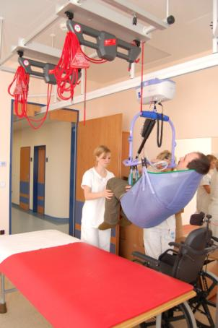
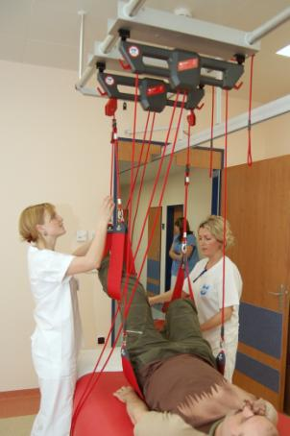
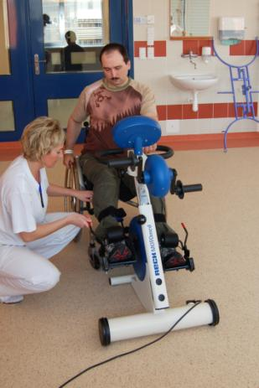
RedCord MotoMed

Slide 43
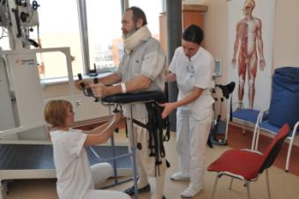
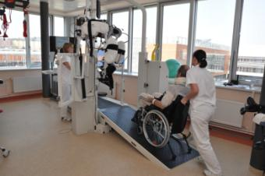
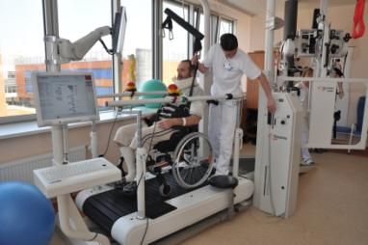
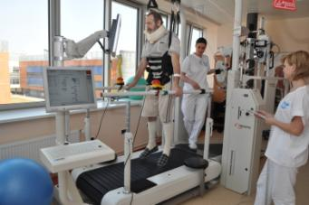
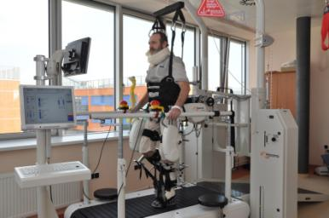
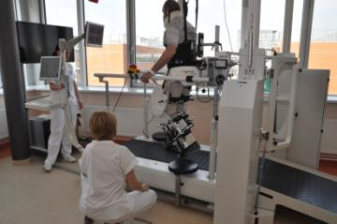
Lokomat

Slide 44
Modalities
Treatment neuromuscular pain, tenosynovitis, arthropathies, and to improve skin defects and scars
Electrotherapy, ultrasound, magnetic therapy, biolamp, distance electrotherapy treatments are the most commonly used modalities
Various forms of aquatic therapy are also appropriate. If the patient is relatively continent, mobility exercises can be performed in the pool

Slide 45
Occupational Therapy
Occupational therapy occurs daily in coordination with physical therapy
Occupational therapy focuses on the practice of independent and common daily activities (dressing, transfers, personal hygiene, food intake, etc.)
Functional grasp training for patients
Appropriate selection of assistive devices for the patient to use in a home setting, such as a wheelchair, cushion, positioning bed, tools for personal hygiene and other compensatory aids
Consultations in regards to home, car driving and work station modifications for handicapped patients

Slide 46
Social Rehabilitation
Social rehabilitation already occurs during hospitalization in the spinal cord injury unit and later during one‘s stay in a rehabilitation hospital
The goal is to prepare the patient for life with a handicap while surrounded by family and strangers
An important factor is cooperation of the patienťs family, which should serve as a strong support system for the patient
Options are explored to address the patienťs home, modifications or changes in occupation, worksite modifications and patienťs transfers or transportation with minimal dependence on others
The patient should not be limited in social activities. The patient can become involved with various non-profit organizations that deal with their disability such as, in the Czech Republic, Centrum Paraple
Following discharge from a rehabilitation hospital, each patient should seek to be integrated into work and social activities as soon as possible

Slide 47
Resume
The patients should also develop long-term individual rehabilitation goals aimed at maintaining their physical condition and preventing contractures, edema, osteoporosis, etc.
However, a patient should not expect to continue an intensive (multiple hours per day) rehabilitation program for several years even though some patients expect they will. In general, improvement in mobility or sensation can be achieved during the initial year after the injury.

