Slide 1
Exercise therapy
osteoartrosis

Slide 2
Osteoartrosis
Compensated: less pain, no swelling,
limited distance to walk
Decompensated: pain in rest, swelling,
synovialitis, effusion
limited ROM, contractures

Slide 4
Effusion in the knee joint

Slide 5
Physiotherapy in osteoarthrosis
Compensated Decompensated
Exercise for condition Resistance exercise | - rest, handling
Muscle balance | - Isometric exercise
ROM | - Exercise with support
Sensomotor exercise | - verticalisation, walking aids
Physical therapy: magnetoterapy warm, etc. | - Physical therapy: analgetic items

Slide 6
Physioterapy– phases
Acute : cryotherapy, analgetics, positioning, crutches
Subacute: active exercise, NSA local, limited weightbearing
Chronic: warm, physical therapy, resistance exercise

Slide 7
Physiotherapy after operations
Preop.: breathing , start to walk on crutches, , training daily activities
Postop. : in ITU- breathing, vessels exercise, handling.
In hospital : mobilisation, walking with cruthes, ROM
Late phase: balneotherapy, regime measurements, recommended exercise

Slide 16
Verticalisation

Slide 17
Activites of daily living after THA
Walking aids
Reliable shoes
Rucksack
Sitting on elevated chairs, WC
Meassurement againts slipping
Condition exercise

Slide 18
Peripheral osteoarthrosis

Slide 19
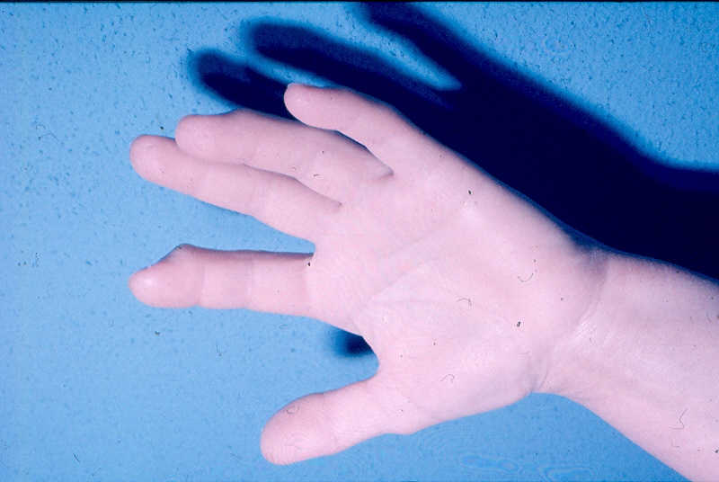
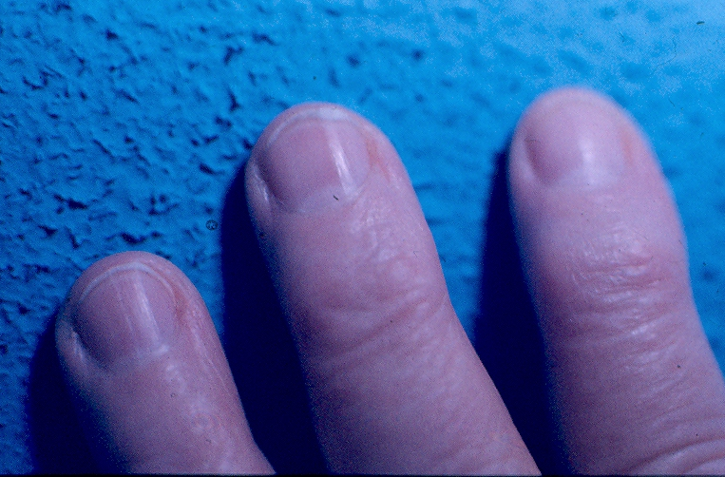
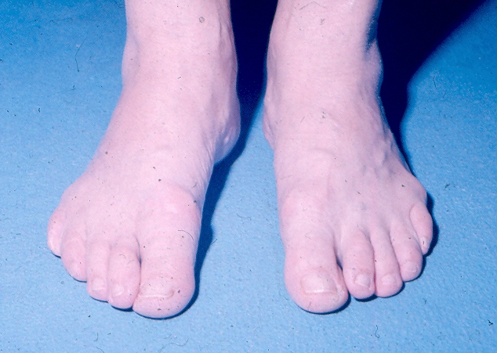

Slide 20
Warm- parafin

Slide 22
Physical therapy

Slide 23
Laser therapy

Slide 24
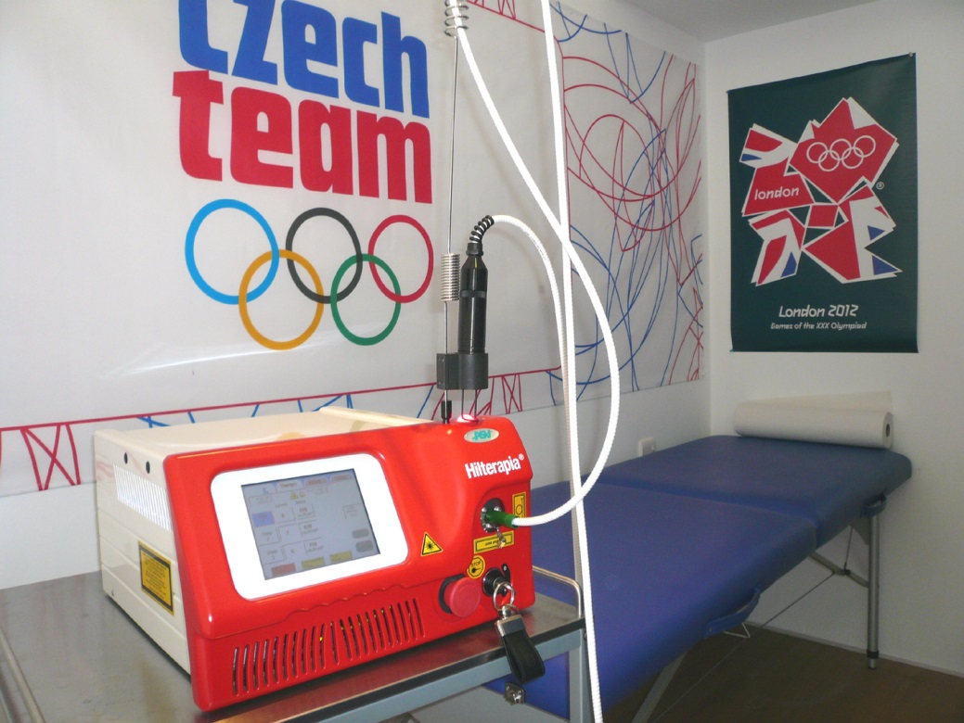
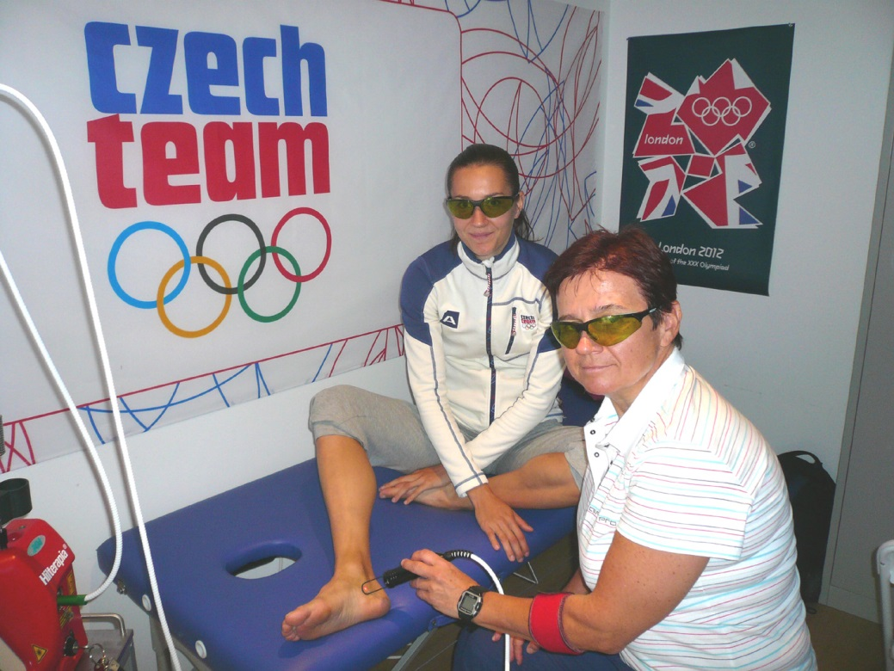
Hiltherapy

Slide 25
Summary
Complex physiotherapy and regime meassurement play a great rolein osteoarthrotis
Stages of osteothrosis ( comp, decomp.) are important in physioterapy
Complex physiotherapy and regime meassurement play a great role
in osteoarthrosis
Stages of osteothrosis ( comp, decomp.) are important in physioterapy

