Slide 1
Physical Therapy After Crus And Foot Injuries
Mgr. Alena Sedláková

Slide 2
Musculosceletal Injuries
Injuries of soft tissues (meaning ligaments, tendons and muscules)
Injuries of bones- fractures

Slide 3
Sprain
Is a trauma to a joint that involves stretching or tearing the ligaments
Three degrees:
GRADE 1 – MILD SPRAIN – there is some stretching or perhaps tearing of the ligamentous fibers with very little or no joint instability. Mild pain, little swelling and joint stiffness may be apparent

Slide 4
Sprain
GRADE 2 – MODERATE SPRAIN – there is some tearing and separation of the ligamentous fibers and moderate instability of the joint. Moderate pain, swelling and joint stiffness.
GRADE 3 – SEVERE SPRAIN – there is complete rupture of ligament with gross instability of the joint, severe swelling, inability to bear weight on the extremity

Slide 5
Muscle Strains
Is a less serious injury involving overstretching or tearing of muscle fibers
Muscle strains occur frequently in the hamstrings and quadriceps muscles in the athletes
PRICE principle – Protection, Rest, Ice, Compression, Elevation – can be applied to reduce swelling, relieve pain

Slide 6
Muscle Soreness
Usually resulting from some strenuous physical activity to which we are unaccustomed
Muscle soreness may be best prevented by beginning a moderate level of activity and gradually progressing the intensity of the exercise over time
Treatment of sore muscles usually involves some type of stretching activity and ice application

Slide 7
Fractures, Classifications
Complete and incomplete fractures
Traumatic, fatigue (stress) and pathologic fractures
Closed or open fractures (the bone protrudes through an open wound in the skin)
Nondisplaced and displaced (translated, angulated, rotated, shortened)
Simple, multiple and comminuted fractures
Fracture pattern: linear, transverse, oblique, spiral, compression, impacted, avulsion

Slide 8
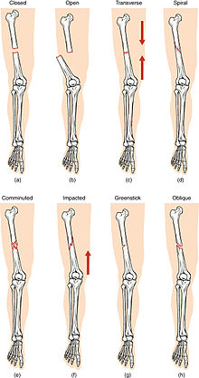
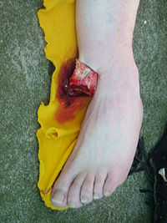

Slide 9
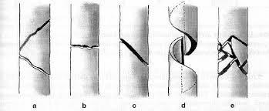
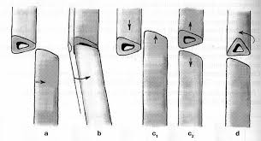

Slide 10
Treatment Of Fractures
CONSERVATIVE - Closed reduction – is placing the bone back to its normal position without a surgical intervention and application of a cast to immobilize the injured bone. Non-operative treatmenet results in prolonged immobilization
SURGICAL - Open reduction – involves surgery –
ORIF (open reduction/internal fixation) – intramedullary (insertion of nails, screws) and extramedullary (insertion of plats)
External fixator

Slide 11
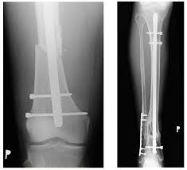
ORIF

Slide 12
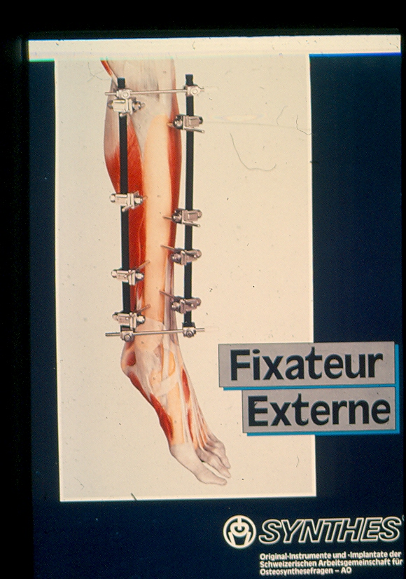

Slide 13
Compartment Syndrome
Complication when vessels and nerves are compressed by oedema or a plaster leading to increase pressure in the compartement
Symptoms – oedema, pain, sensory disturbances, motion disturbances
Intrafascial pressure over 60mm H2O – indication to emergency surgical correction - fasciotomy
If untreated, the lack of blood supply leads to permanent muscle and nerve damage and can result in the loss of function of the limb

Slide 14
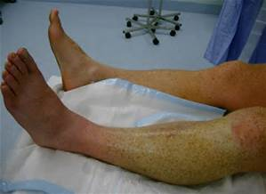
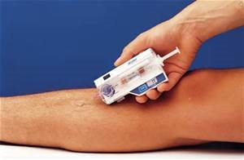
Compartment Syndrome

Slide 15
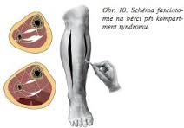
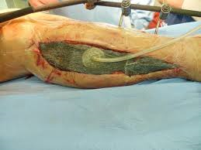
Crus Fasciotomy

Slide 16
Crus Fractures
TIBIA fractures (Tibial plateau fracture, Pilon fracture, Fractures of tibial diaphysis)
FIBULA fractures (Fractures of proximal aspect, of diaphysis and distal aspect)
Combined tibia and fibula fractures (Malleolar fractures)

Slide 17
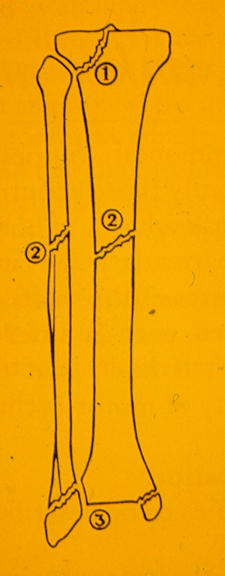
1)Proximal aspect
2)Diafysis
3)Distal aspect

Slide 18
Foot Fractures
Calcaneal fracture
Thalus fracture
Metatarsal fractures
Finger fractures

Slide 19
Physical Therapy
A) CONSERVATIVE TREATMENT
Phase 1 – Acute Phase - during immobilization
Phase 2 – Rehabilitative Phase - after removing plaster
B) SURGICAL TREATMENT
Phase 1 – Acute Phase – during committal
Phase 2 – Rehabilitative Phase –
in physiotherapy clinic

Slide 20
A1 Rehabilitation During Immobilization
GOALS
Prevent oedema and compartment syndrome
Prevent deep vein trombosis
Prevent joint stiffness and muscle contractions or weakness of unaffected limbs
Prevent deconditioning
Gait training with assistive devices such as underarm or forearm crutches

Slide 21
A1
PHYSICAL THERAPY
Cryotherapy (application of ice reduces swelling), limb elevation
Circulatory exercises
Active range of motion and resistance trainning unaffected limbs
Isometric exercises affected limb
Exercises non-immobilizated parts of limb
Gait training – gait pattern (two/three/four point gait) – depands on full weight-bearing or non-weight-bearing (toe-touch weight-bearing, partial weight-bearing, weight-bearing as tolerated) – recommended by physicians

Slide 22
A2 Rehabilitaion To Restore Mobility
Inpatient rehabilitation or physiotherapy clinic
After removing plaster there is often oedema, pain, limited movement, joint stiffness, lower muscle strength of affected area
GOALS - decrease oedema, relieve pain, improve ROM, improve muscle strenght
GOALS – improve or maintain physical fittness, improve balance, improve coordination, enable ambulation

Slide 23
A2
PHYSICAL THERAPY
Modalities – cryotherapy, magnet therapy (promotes fracture healing), hydrotherapy – whirpool (reduces swelling a relieves pain)
Soft tissues mobilization (PIR, balling) – to release contracted muscles, tendons and fascia
Joint mobilization – to restore joint play
PROM – passive range of motion exercises, AAROM – active assisted range of motion, AROM – active range of motion

Slide 24
A2
Resistance exersice to improve muscle strength
Sensorimotor training – to improve balance skills and joint stability (includes simple exercises such as toe-standing, standing hip flexion, standing side leg raise following modifications doing exercise with eyes closed; balance training aids such as balance discs, unstable platform)

Slide 25
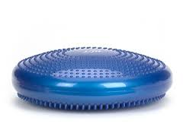
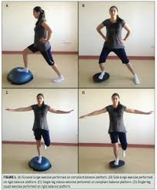
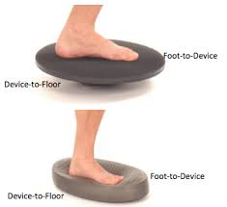
Balance Training Aids

Slide 26
A2
Gait training without assistive devices, gait pattern correction
Posture correction
Apropriate sports - stacionary bike, cycling, swimming, walking, jogging

Slide 27
B1 Rehabilitation After Surgury During Committal
GOALS
Prevent oedema and compartment syndrome
Prevent deep vein trombosis
Prevent respiratory complications
Prevent joint stiffness and muscle contractions or weakness of unaffected limbs
Prevent deconditioning
Improve bed mobility
Gait training with assistive devices such as walker, underarm or forearm crutches

Slide 28
B1
PHYSICAL THERAPY
Cryotherapy (application of ice reduces swelling), limb elevation, balling free parts
Circulatory exercises
Respiratory rehabilitation
Active range of motion exercise and resistance exercise unaffected limbs (upper and lower limbs)
Isometric exercises affected limb
PROM or AAROM exercise of operated limb

Slide 29
B1
Functional mobility training – includes bed mobility and transfer training such as bridging, rolling to the sides, moving up or down the bed -scooting, transitions from lying to sitting in bed or on the edge of bed, from sitting to standing transfers from bed to chair/wheelchair
Gait training with assistive devices such as walker, underarm or forearm crutches – it depands on patient condition
Stair climbing

Slide 30
B1
Full weight-bearing or non-weight-bearing (toe-touch weight-bearing, partial weight-bearing 25/50/75%, weight-bearing as tolerated) – recommended by physicians
ADL training (washing, dressing)
Scare care – after stitches extraction
Instruction patient to follow exercise at home

Slide 31
B2 Rehabilitation In Physiotherapy Clinic
Full weight bearing stadium approx. after 6-8 weeks
GOALS
decrease oedema
relieve pain
improve ROM
improve muscle strenght
improve or maintain physical fittness
improve balance, improve coordination
enable ambulation

Slide 32
B2
PHYSICAL THERAPY
Modalities – cryotherapy, magnet therapy (promotes fracture healing), hydrotherapy – whirpool (reduces swelling a relieves pain)
Soft tissues mobilization (PIR, balling) – to release contracted muscles, tendons and fascia
Joint mobilization – to restore joint play
Scare care

Slide 33
B2
PROM – passive range of motion exercises, AAROM – active assisted range of motion, AROM – active range of motion
Resistance exersice to improve muscle strenght
Sensorimotor training – to improve balance skills and joint stability (includes simple exercises such as toe-standing, standing hip flexion, standing side leg raise following modifications doing exercise with eyes closed; balance training aids such as balance discs, unstable platform)

Slide 34
B2
Gait training without assistive devices, gait pattern correction
Posture correction
Aquatic exercises
Apropriate sports - stacionary bike, cycling, swimming, walking, jogging
Instruction patient to follow exercise at home

Slide 35
Malleolar Injuries
Ankle sprains
Ankle fractures

Slide 36
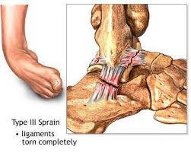
Ankle Sprains
Grade 1 – mild ankle sprain – a stretch of the ligament with no macroscopic tear, little swelling or tenderness, minimal or no functional impairment, and no joint instability
Grade 2 – moderate ankle sprain – involves a partial tear of the ligament with moderate swelling and tenderness, some loss of joint function, mild joint instability
Grade 3 – severe ankle sprain – a complete tear of the ligaments (ATFL, CFL) with severe swelling and tenderness, inabilty to bear weight on the extremity and mechanical joint instability

Slide 37
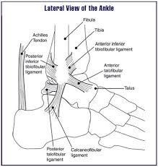
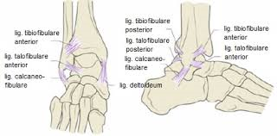
Ankle Sprain

Slide 38
Rehabilitation Protocol After Ankle Sprains (Lateral Collateral Ligaments)
Phase 1: Acute Phase
Timing
Grade 1 sprain: 1-3 days
Grade 2 sprain: 2-4 days
Grade 3 sprain: 3- 7 days
Goals
Decrease swelling
Decrease pain
Protect from reinjury
Maintain appropriate weight-bearing status
Protection Options
Taping
Functional bracing
Removable cast boot (some grade 2 and most grade 3sprains)
Rest (crutches to promote ambulation without gait deviation)

Slide 39
Ice
Cryocuff ice machine
Ice bags
Light Compression
Elastic wrap
Elevation
Above the heart (combined with ankle pumps)
Phase 2: Subacute Phase
Timing
Grade 1 sprain: 2-4 days
Grade 2 sprain: 3-5 days
Grade 3 sprain: 4-8 days
Goals
Decrease swelling
Decrease pain
Increase pain-free ROM
Begin strengthening
Begin non-weight-bearing proprioceptive training
Provide protective support as needed

Slide 40
Modalities to Decrease Pain and Swelling
Ice or contrast baths
Electrical stimulation (high-voltage galvanic or interferential)
Ultrasound
Weight-bearing
Progress weight-bearing as symptoms permit
Partial weight-bearing to full weight-bearing if no signs of antalgic gait are present

Slide 41
Therapeutic Exercises
Active ROM exercises – Dorsiflexion, Inversion, Foot circles, Plantar flexion, Eversion
Strength exercises - Isometric in pain-free range, Toe curls with towel, Pick up objects with toes (tissue, marbles)
Proprioceptive training
Stretching - Passive ROM-only dorsiflexion and plantar flexion in pain free range, not eversion or inversion, Achilles tendon stretch, Joint mobilizations

Slide 42
Phase 3 – Rehabilitative Phase
Timing
Grade 1 sprain: 1 wk
Grade 2 sprain: 2 wk
Grade 3 sprain: 3 wk
Goals
Increase pain-free ROM
Progress strenghtening
Progress proprioceptive training
Increase pain-free activities of daily living
Pain-free full weight-bearing and uncompensated gait

Slide 43
Therapeutic exercise
Stretching – Gastrocnemius and Soleus with increased intensity, Joint mobilization
Strengthening – Weight-bearing exercises (heel raises, toe raises, stair steps, quarter squats), Eccentric/concetric and isotonics (with Theraband inversion, eversion, plantar flexion, dorsiflexion)
Proprioceptive training – single-leg balance activities stable to unstable surfaces (balance disc, trampoline)
Continue modalities as needed
Supportive taping, bracing or orthotics used as needed

Slide 44
Phase 4 – Return to Activity or Functional Phase
Timing
Grade 1: 1-2 wk
Grade 2: 2-3 wk
Grade 3: 3-6 wk
Goals
Regain full strength
Normal biomechanics
Return to participation
Protection and strengthening of any mild residual joint instability

Slide 45
Therapeutic exercise
Continue progression of ROM and strengthening exercises
Appropriate sports/activities: jogging, running, cycling, swimming
Phase 5: Prophylactic Phase
Goal
Prevent injury
Therapeutic Exercises
Functional drills
Multidirectional balance board activities
Prophylactic strengthening (emphasis on peroneal eversion)
Prophylactic protective support as needed

Slide 46
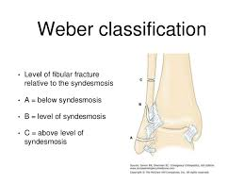
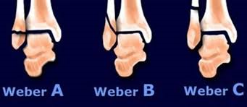
Ankle Fractures

Slide 47
Ankle Fractures - Treatment
CONSERVATIVE – only simple undisplaced fractures, immobilization for 6wk, first 3 wk without weight-bearing, then partial weight-bearing recommended by physician, removing plaster and inititation of physical therapy after 6 wk
PHYSICAL THERAPY
Modalities – cryotherapy, magnet therapy (promotes fracture healing), hydrotherapy – whirpool (reduces swelling and relieves pain)
Soft tissues mobilization (PIR, balling) – to release contracted muscles, tendons and fascia
Joint mobilization – to restore joint play
PROM – passive range of motion exercises, AAROM – active assisted range of motion, AROM – active range of motion

Slide 48
Resistance exersice to improve muscle strength
Sensorimotor training – to improve balance skills and joint stability (includes simple exercises such as toe-standing, standing hip flexion, standing side leg raise following modifications doing exercise with eyes closed; balance training aids such as balance discs, unstable platform)
Gait training without assistive devices, gait pattern correction
Posture correction
Apropriate sports - stacionary bike, cycling, swimming, walking, jogging

Slide 49
Ankle Fracture - Treatment
SURGICAL – displaced fractures, post-operative cast immobilization for 3-4wk without weight-bearing
PHYSICAL THERAPY – Acute Phase
Cryotherapy (application of ice reduces swelling), limb elevation, balling free parts
Circulatory exercises
Respiratory rehabilitation
Active range of motion exercise and resistance exercise unaffected limbs (upper and lower limbs)
Isometric exercises affected limb
PROM or AAROM exercise of operated limb

Slide 50
Functional mobility trainig – includes bed mobility and transfer trainig such as bridging, rolling to the sides, moving up or down the bed -scooting, transitions from lying to sitting in bed or on the edge of bed, from sitting to standing, transfers from bed to chair/wheelchair
Gait training with assistive devices such as walker, underarm or forearm crutches – it depands on patient condition
Stair climbing
Weight-bearing (toe-touch weight-bearing, partial weight-bearing 25/50/75%, weight-bearing as tolerated) – recommended by physicians
ADL trainig (washing, dressing)
Scare care – after stitches extraction
Instruction patient to follow exercise at home

Slide 51
Ankle Fractures - Treatment
PHYSICAL THERAPY – Rehabilitative Phase
Modalities – cryotherapy, magnet therapy (promotes fracture healing), hydrotherapy – whirpool (reduces swelling a relieves pain)
Soft tissues mobilization (PIR, balling) – to release contracted muscles, tendons and fascia
Joint mobilization – to restore joint play
Scare care
PROM – passive range of motion exercises, AAROM – active assisted range of motion, AROM – active range of motion
Resistance exersice to improve muscle strength
Sensorimotor training – to improve balance skills and joint stability (includes simple exercises such as toe-standing, standing hip flexion, standing side leg raise following modifications doing exercise with eyes closed; balance training aids such as balance discs, unstable platform)
Gait training without assistive devices, correction of gait pattern
Posture correction
Aquatic exercises
Apropriate sports - stacionary bike, cycling, swimming, walking, jogging
Instruction patient to follow exercise at home

Slide 52
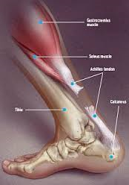
Acute Achilles Tendon Rupture
Occurs most often in a degeneratively altered tendon, approximately 2-5 from its insertion (there is minimal vascular supply)
Most common in middle age men
Occurs during athletic activity involving a sudden acceleration, sudden change in direction of movement
Typical sports include tennis, squash, volleyball, basketball
Clinical presentation: loud pop is heard, sharp pain, able to bear weight, but unable to stand on toes on affected limb
Objective findings: edema, hematoma, a defect can be palpated, +Thompson‘s test (https://www.youtube.com/watch?v=wCdOoTSm3Vg)

Slide 53
Rehabilitation Protocol
After Surgical Repair of Acute Achilles Tendon Rupture in Athletes
Well-padded 20-degrees of plantar flexion splint with plaster postoperative
Non-weight-bearing with crutches for 4 wk.
Progress to partial weight-bearing with crutch-assisted ambulation in a short-leg fiberglass cast
For High-level Compliant Athletes
Initially use cam boot with 15-20 degrees of equinus (plantar flexion) dialed in, using a heel lift and ankle angle boot setting of 20 degrees of plantar flexion
Active non-weight-bearing ROM exercises can be started as early as 7 days after surgery. Incision must be well healed before inititation of exercises
Initial exercise consists of very gentle passive plantar flexion and active dorsiflexion limited to 20 degrees, two sets of five, three times a day
Use walking boot for 6-8 wk, then make the transition to normal shoes when using the smaller heel lifts
Stationary bicycling (no resistance) and swimming initiated at 6 wk

Slide 54
Rehabilitation Protocol
After Surgical Repair of Acute Achilles Tendon
For lower-demand Athletes
Use a short-leg non-weight-bearing gravity equinus cast for 6-8 wk followed by l-cm heel lift in a removable boot for 1 mo.
Progressive non-weight-bearing resistance exercises are started at 8- 10 wk.
Stationary bicycling and swimming at approximately 8 wk.
Return to some athletic activity (light running) at 5-6 mo if strength is 70% of uninvolved leg
Generally, return to full level takes 1 yr, can take up to 18 mo.

