Slide 1
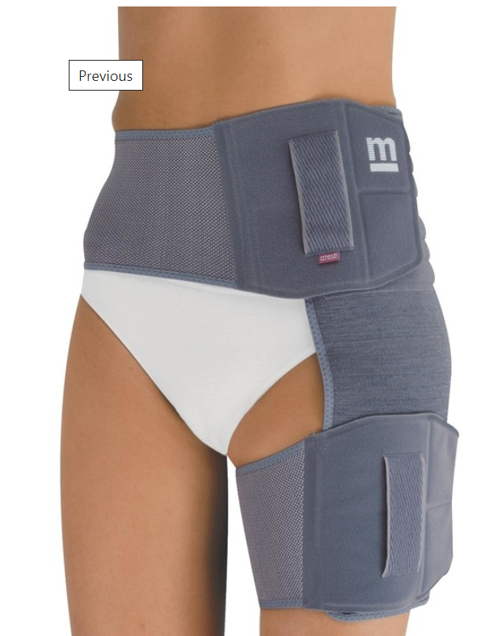
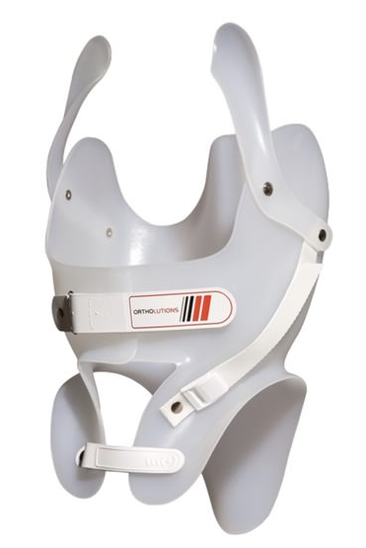
Ortotics
= restoration of lost body functions
weakened / lost function
Orthoses:
  mass produced vs. individual
  trunk vs. extremities

Slide 2
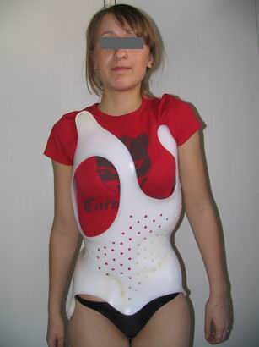
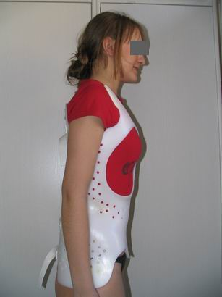
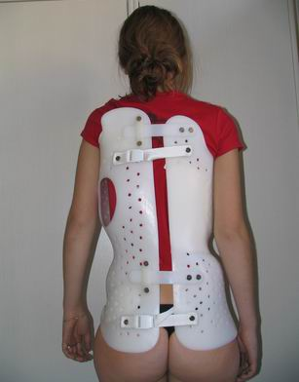

Slide 3
Ortoses:
Static:
  Rigid without movement, relieve pain, stabilize the limb
Dynamic:
  Controlled movement, they replace lost or weakened functions of muscles and joints

Slide 4
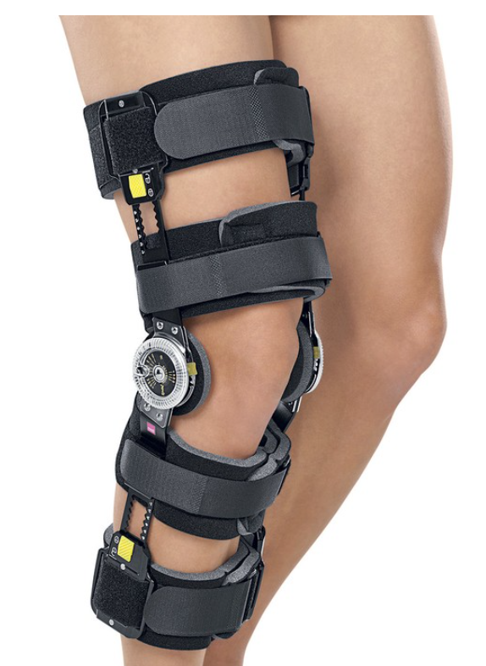
Ortotses:

Slide 5
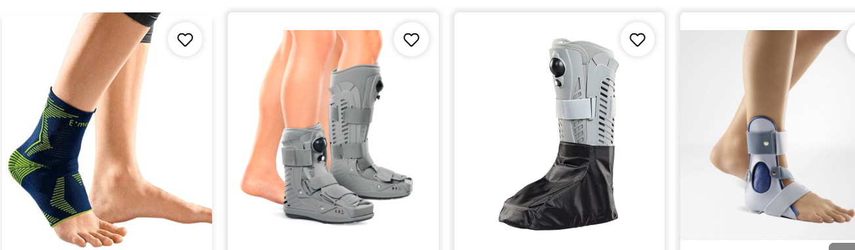

Slide 6
Support devices
Limb motion trainers, eg. after operations
Walkers: walking practice :

Slide 7
Support devices
Crutches: support function
four-point, French, children's elbow crutch,
armpits, walking sticks
height-adjustable, folding walking sticks

Slide 8
HIP JOINT & FEMUR

Slide 9
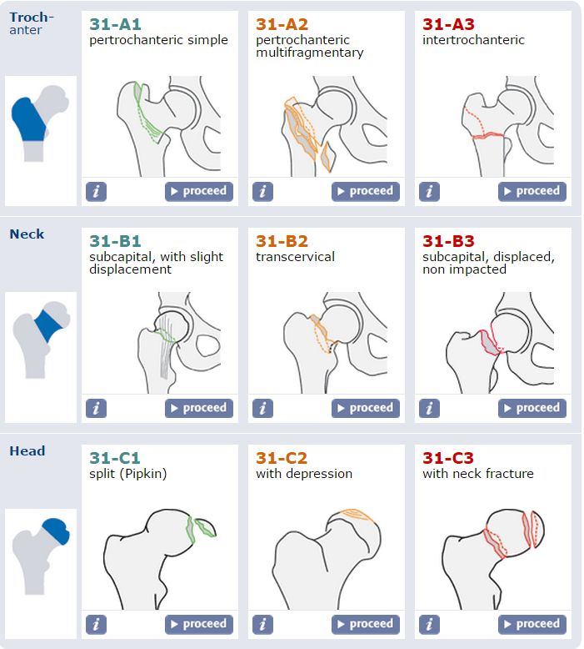
AO classification

Slide 10
Femoral neck fractures
6% of all fractures
2 typical groups –
  females, older age (max. about 78 yrs), minimum stress
  males, younger, high energy injury – traffic accidents, falls
diagnostics –
  anamnesis
  clinical exam – external rotation, shortening, pain during motion
  X-ray – pelvis + injured hip
2 types –
  intracapsular – subcapital, mediocervical, transcervical
  extracapsular – basicervical, lateral
Notes:
http://www.achot.cz/detail.php?stat=427

Slide 11
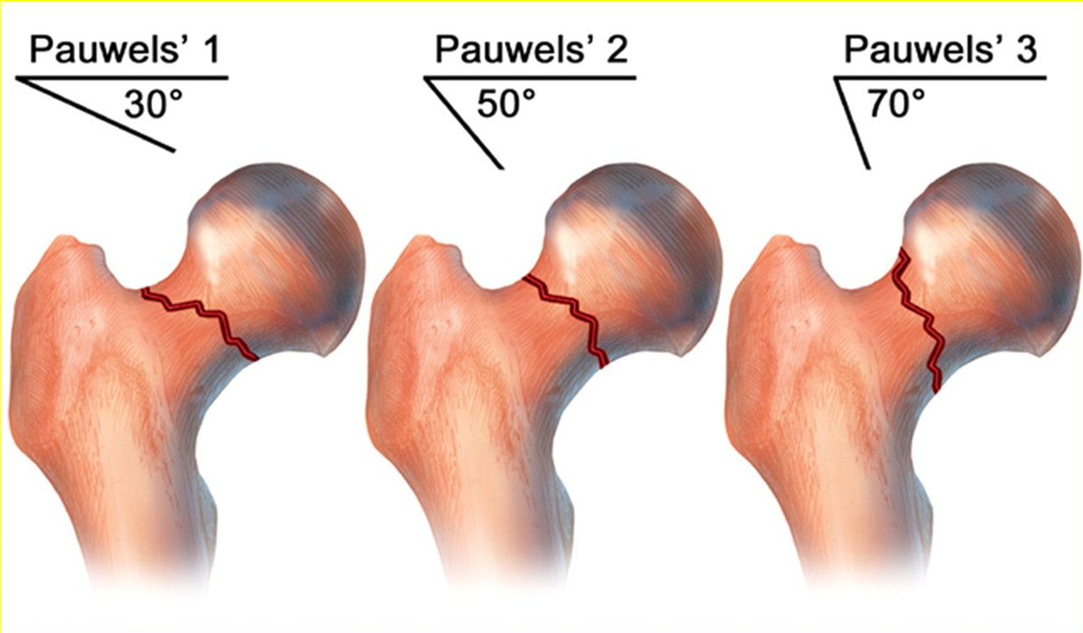
Pauwels classif. (1951)

Slide 12
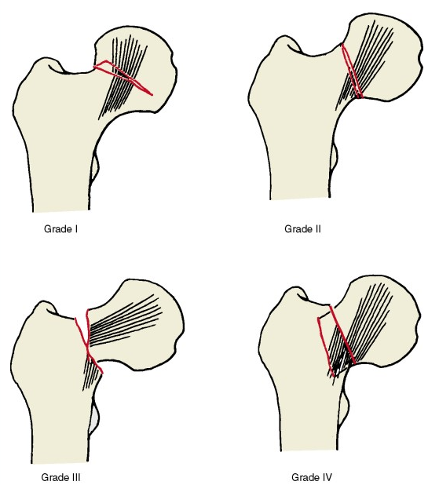
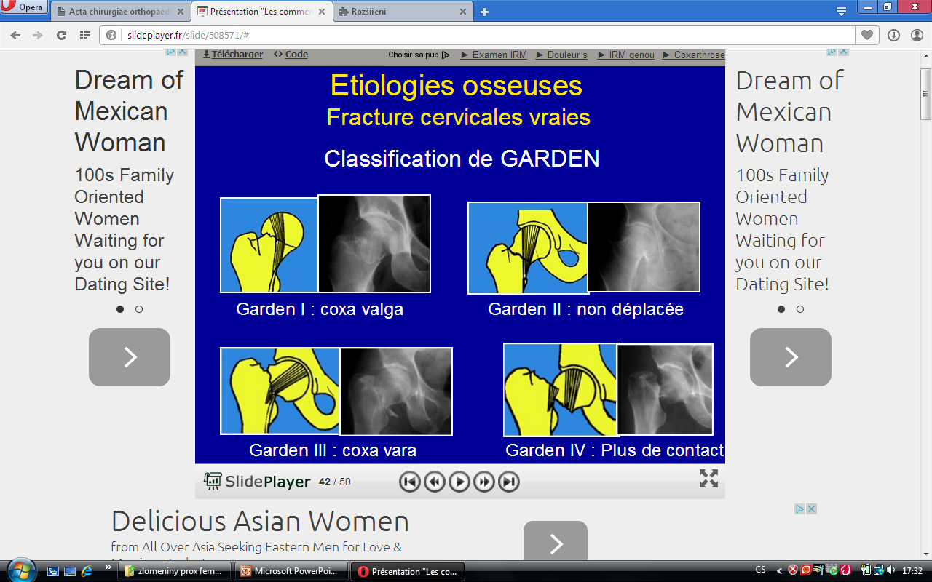
Garden classif. (1961)
Notes:
http://slideplayer.fr/slide/508571/
https://www.aofoundation.org/Structure/resource/AO-OTA-Fracture-Dislocation-Classification/Pages/AO-OTA-Fracture-Dislocation-Classification-Long-Bones.aspx

Slide 13
Therapy
Conservative
Without dislocation + impact fractures
Short life expectancy
immobile pts before injury
Contraindication of surgery
Bed rest with gradual carefull physiotherapy

Slide 14
Therapy
Osteosynthesis
Non dislocated a partially dislocated fract. without degenerative arthritis
dislocated fract. In young pts without degener. arthritis
Options
DHS (dynamic hip screw)
Lag screws
PFN (proximal femoral nail)
130° condylar plate + lag screw

Slide 15
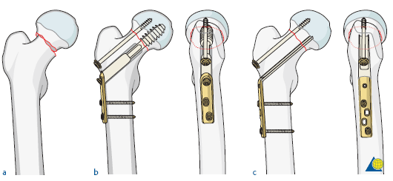
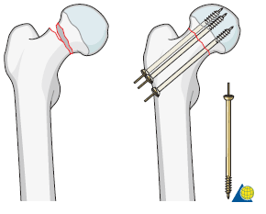
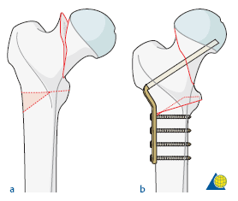
osteosynthesis
valgisation osteotomy, AO plate –
Abandoned

Slide 16
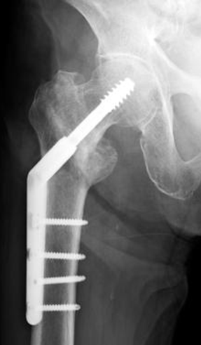
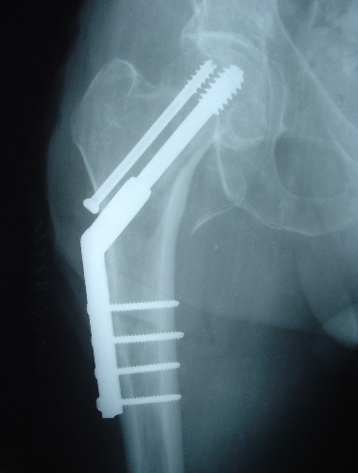
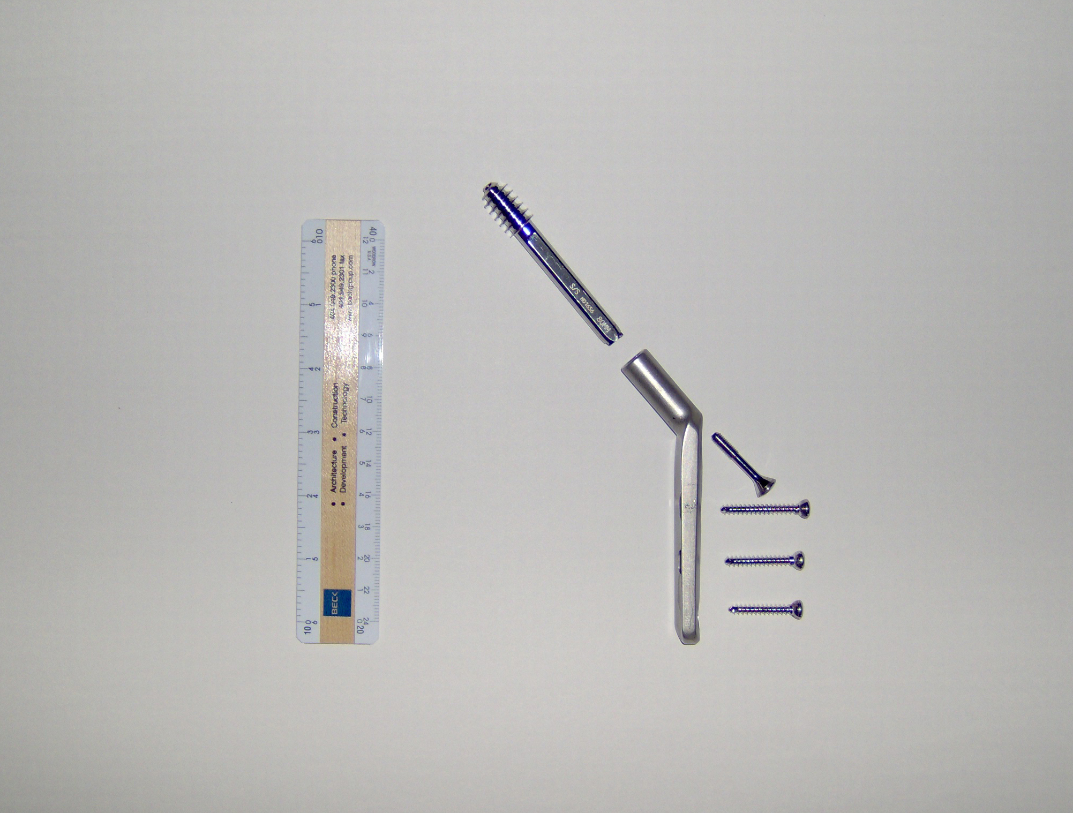
DHS
Dynamic hip screw
1962 Massie
Richard Manufacturing Co., USA

Slide 17
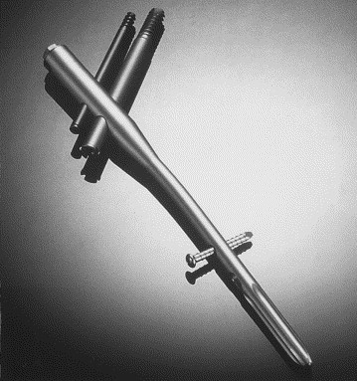
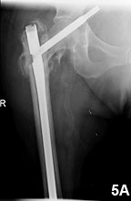
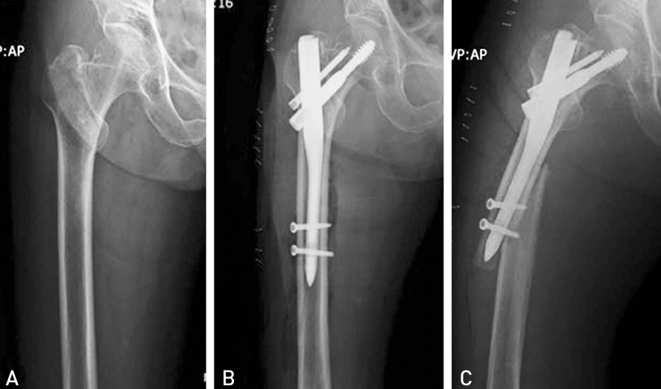
PFN – proximal femoral nail

Slide 18
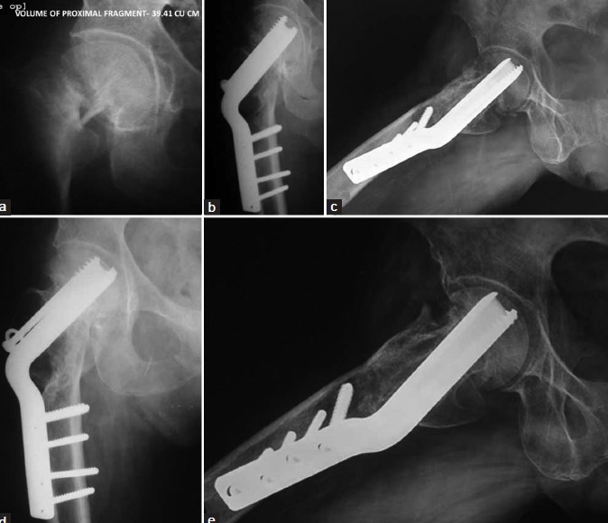
130° condylar plate

Slide 19
Therapy
Alloplasty
  Older pts with degenerative arthritis
  dislocated fract
  Longer time span after inj
  Head avascular necrosis or pseudoarthrosis
Options
  CKP
  THA

Slide 20
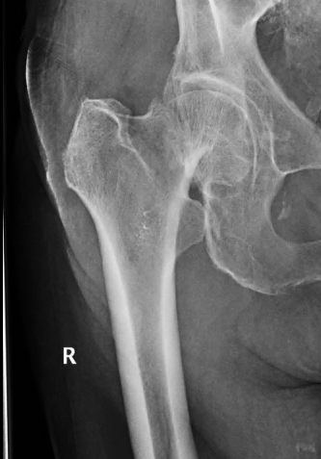
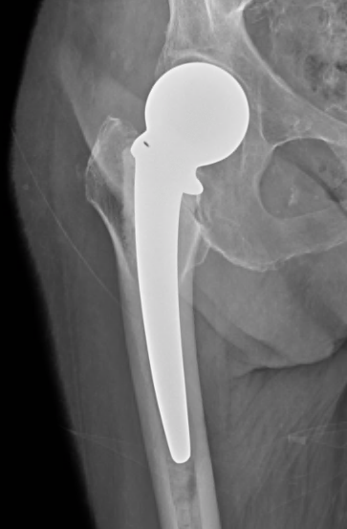
F, 86 yrs

Slide 21
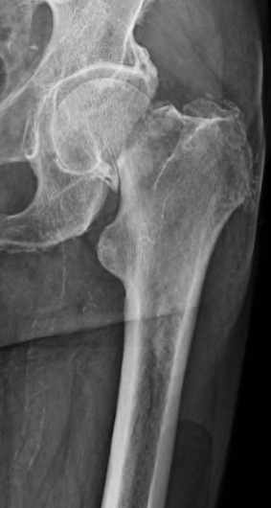
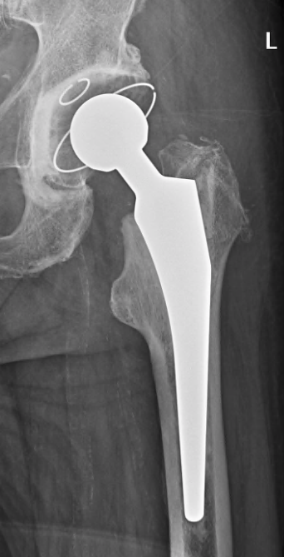
M, 80 yrs

Slide 22
Osteosynthesis of the femur

Slide 23
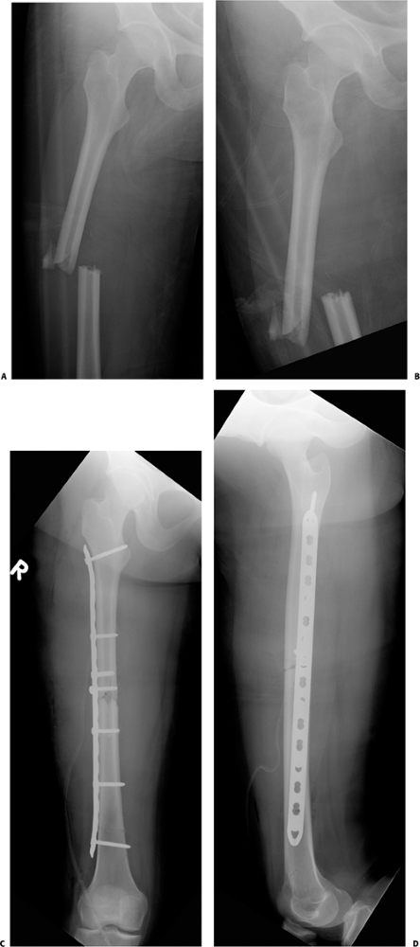
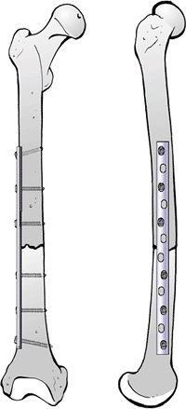
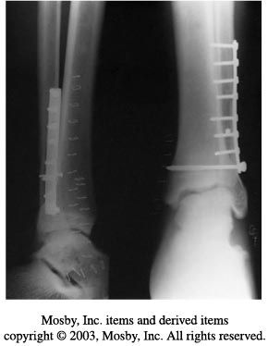
OS with plate + screws

Slide 24
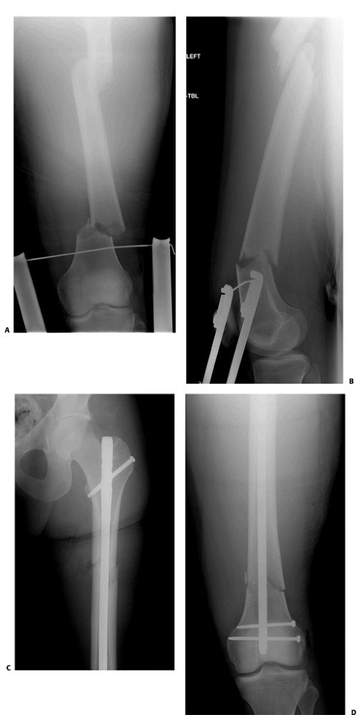
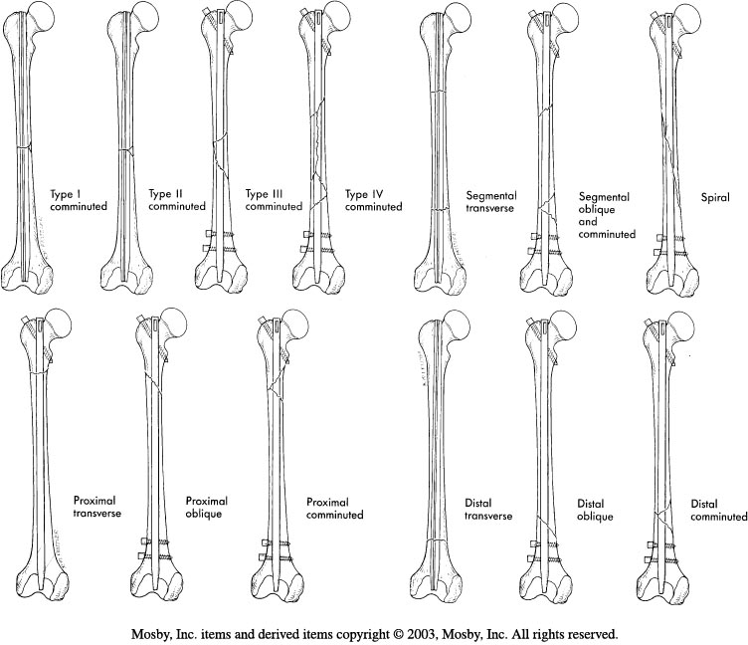
OS w. intramedelar nail

Slide 25
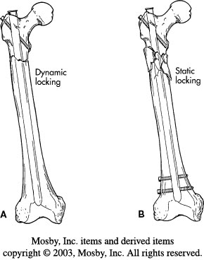
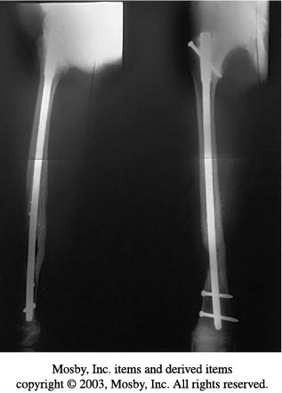
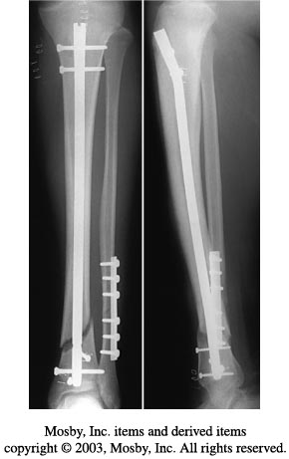

Slide 26
Hip degeneration
Osteoartrosis
= non-inflammatory degenerative joint disease characterized by degradation of articular cartilage hips, knees, arms and small joints of the spine

Slide 27
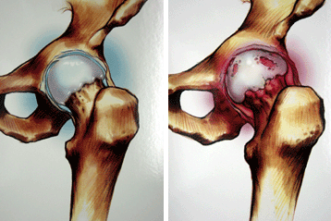
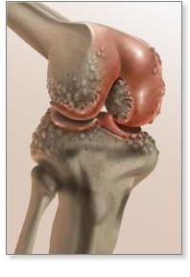
Osteoartrosis
Signs:
narrowing of the joint space
loos of bone mass & sclerotization
soft tissue changes
Coxartrosis
Gonartrosis

Slide 28
Coxartrosis, Gonartrosis
Risc factors:
Age
Sex
Genetic predispozition
Trauma
Obesity

Slide 29
Coxartrosis, Gonartrosis
Therapy:
Regime measures (activity, adequate body weight)
Farmakologic (analgetics, chondroprotectives)
Surgical

Slide 30
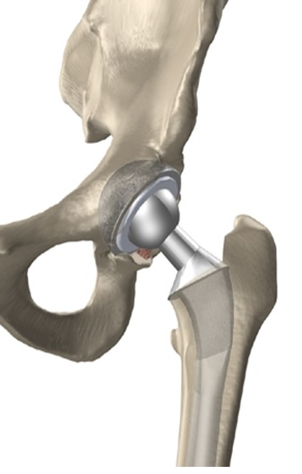
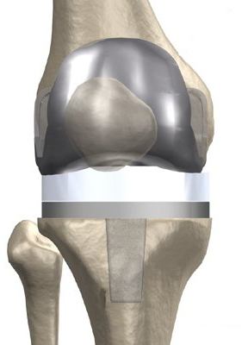
Coxartrosis, Gonartrosis
Therapy:
Surgical – Total Joint Arthroplasty (THA / TKA).

Slide 31
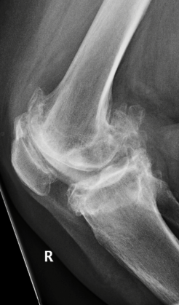
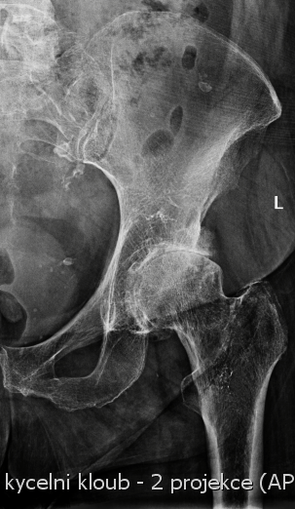
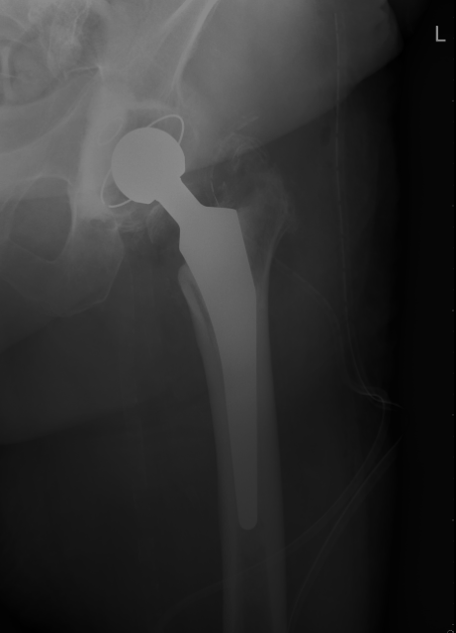
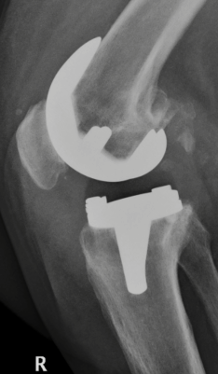

Slide 32
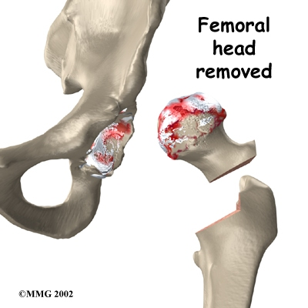
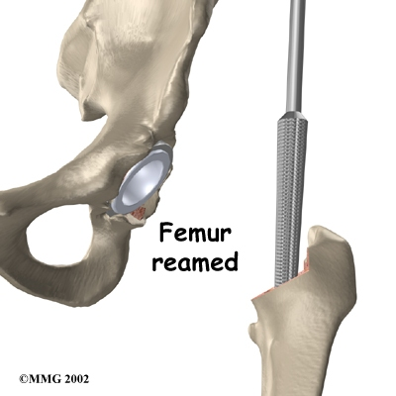
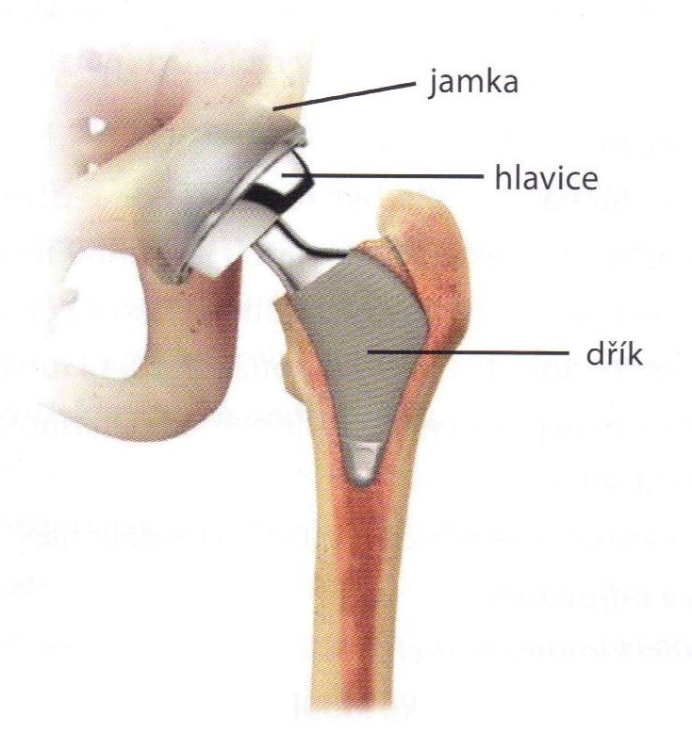
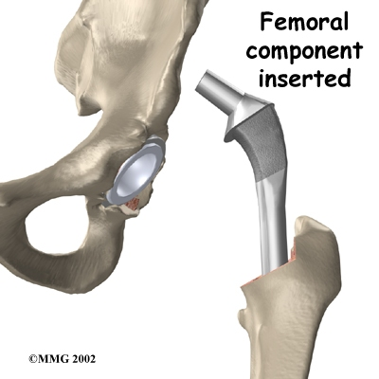
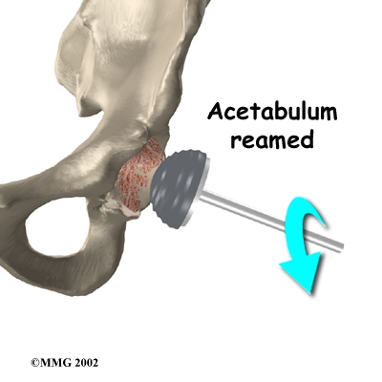
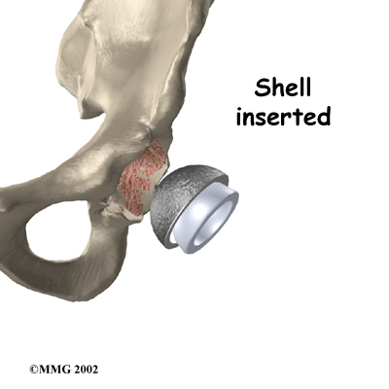
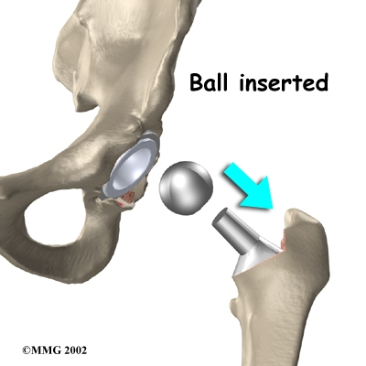
THA

Slide 33
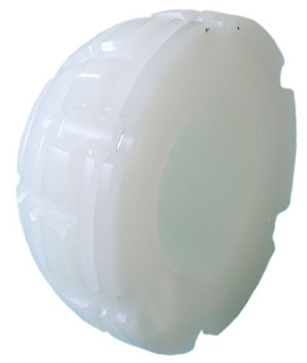
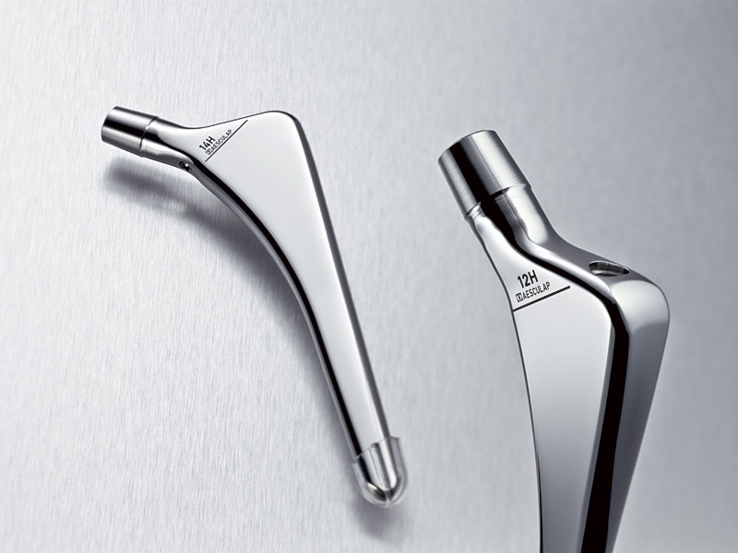





Slide 34

nar. 1952, objednán na TEP

Slide 35

nar. 1980, posttraumatic osteoarthrosis

Slide 36



Slide 37



Uncemented THA - stem

Slide 38


Uncemented THA – cup

Slide 39


Slide 40

hybrid THA
cemented THA

Slide 41

nar. 1935, 14 let poop., bez opotřebení jamky (Poldi Kladno)

Slide 42

nar. 1932
po předělání jamky i dříku

Slide 43



Slide 44


Revision – Burch-Schneiderova augmentaplate

Slide 45
Dislocation of endoprosthesis
the patient is at risk at any time, even years after surgery
necessity to comply with the regime measures postoperatively !!

Slide 46



Slide 47
Solution of hip THA complications
luxation:
articulation without / with anesthesia, surgery
orthosis, event. plaster spike
reoperation (replacement of components)
TEP extraction
infection
flush drainage, antibiotics
temporary removal of TEP, rinsing or carrier with antibiotic, possibly. spacer
permanent removal of the endoprosthesis

Slide 48
Infect - septic release of the endoprosthesis

Slide 49



Infection loosening of THA
spacer (cement with gentamicin) introduced after extraction

Slide 50



Extraction of THA
SPACER
reimplantationce THA uncemented

Slide 51


Extracted THA

Slide 52

Periprotetic fx.

Slide 53


Slide 55

Meralgia paresthetica
Compression of the cutaneus femoris lateralis during passage to the thigh in the fibrous canal of the fascia lata medially from SIAS
Burning pain and
hypesthesia on the external
thigh area
Disposition - obesity, tight clothing
Therapy - regime measures,
NSAID, cortioid injection,
(surgical resection)

Slide 56


Pyriformis syndrom
=iritation of n.ischiadicus
rare
nerve compression by m.piriformis rigid fibers as it passes through the foramen infrapiriforme
Buttock pain, tingling with propagation along the back of the thigh and lower leg

Slide 57




Slide 58


Bursitis and enthesopathy in the hip area
Trochanter maior
Tuber ossis ischii
Bursa ileopectinea
Gracilis syndrom (natažené tříslo)
Spina iliaca ant. sup.
Spina iliaca ant inf.
Obr. 9
Obr. 10

Slide 59
KNEE

Slide 60
Soft tissues injury of the KNEE

Slide 61


NMR examination

Slide 62


ACL – anterior cruciate lig.
PCL – posterior cruciate lig.

Slide 63

Rupture of ACL
Akutní ACL poranění - diagnóza:
artroskopie
NMR
vyšetření v celkové anestezii

Slide 64

Injury of the soft tissues of the knee
Unhappy trias:
anterior cruciate - rupture
medial collateral - rupture
mediální meniskus - rupture

Slide 65

Injury of the soft tissues of the knee
- meniscal tear

Slide 66



Slide 67


Injury of the soft tissues of the knee
- meniscal tear

Slide 68

Injury of the soft tissues of the knee
- meniscal tear
Normal
meniscus

Slide 69

Artroskopie - meniskus

Slide 70
ACL reconstruction

Slide 71


Injury of the soft tissues of the knee
ACL rupture

Slide 72


Injury of the soft tissues of the knee
ACL rupture

Slide 73

Injury of the soft tissues of the knee
ACL reconstruction
Lachman test – ventral drawier test in 30° flection

Slide 74
Injury of the soft tissues of the knee
ACL rupture
The most difficult diagnosis is in the acute phase!
In 70% of cases of joint bleeding, the anterior cruciate ligament is injured
Acute arthroscopy or long-term follow-up
Indications for cruciate ligament surgery are limited

Slide 75
Injury of the soft tissues of the knee
ACL rupture
  autograft (bone-tendon-bone graft from ligamentum patellae, or tendon graft)
  Alo- graft (cadaver)
  artificial material (dacron, ribbon)
  xenograft (animal graft - abandoned)

Slide 76



Injury of the soft tissues of the knee
ACL reconstruction
Reconstr. with m. semitendinosus
autograft

Slide 77



Injury of the soft tissues of the knee
ACL reconstruction
„GOLD standard“ = bone-tendon-bone (BTB) graft from ligamentum patellae

Slide 78

Injury of the soft tissues of the knee
ACL reconstruction
B-T-B graft

Slide 79



Injury of the soft tissues of the knee
ACL reconstruction

Slide 80

nar. 1971, 14 let po plastice ACL, artrotické obtíže.

Slide 81

nar. 1944, po plastice 15 let

Slide 82

nar.1969, bilat. plastika ACL před mnoha lety

Slide 83


Slide 84


Slide 85



Slide 86



Slide 87


Slide 88

Postoperative fixation –
LIMITED MOTION CAST

Slide 89
Degenerative knee disease

Slide 90


Gonartrosis- TKA

Slide 91






TKA

Slide 92





Slide 93


TKA instrumentarium

Slide 94

TKA
instrumentarium

Slide 95


Total knee arthroplasty implantation

Slide 96


Total knee arthroplasty implantation

Slide 97

Total knee arthroplasty implantation

Slide 98


Slide 99


Slide 100


Slide 101


Slide 102


Slide 103
Complications of TKA
technical error during operation
nerve paresis after surgery (n. peroneus)
vascular postoperative complications
knee instability after surgery
deep infection early or late
restriction of movement (stiffness)
aseptic release of components
wear of the tibial component

Slide 104


07.11.
26.09.

Slide 105


07.11.
26.09.

Slide 106

CT scan of TEP with signs of tibial component loosening

Slide 107

CT scan of TEP with signs of tibial component loosening

Slide 108


Slide 109


Slide 110

Ortosis after TKA - indications
solution of knee instability
additional treatment during suture of the ligamentum patellae

Slide 111


TKA - failure

Slide 112



Slide 113




Unicondylar TKA - failure

Slide 115


Bursitis in the knee area
Bursitis praepatelaris
Bursitis pedis anserini
Bakerská cysta
Obr. 11
Therapy:
rest
puncture + loc. Corticosteroids
NSAID
extirpation
Obr. 12

Slide 116

Baker‘s cyst
Burza gastrocnemio- semimembranacea
connects to the articular cavity of the knee
Arching in the fossa poplitea
In adults, it is secondary to the process
inside the knee
Swelling, tension, pain
Restrictions on movement
Oppression of venous trunks
Therapy:
Conservative- puncture, corticoid, NSAID
Operational extirpation

Slide 117



Patelofemoral syndrome

Slide 118

Achillodynia
Painful condition in progress
and the attachment of Achilles' tendon
Causes:
Degeneration
Haemorrhage, cracks
Peritenonitis
Risk of transition to partial
or complete ruptures

Slide 119

Achillodynia
Conservative treatment:
Calmness, taping, antiphlogistics
Heel increase
Physiotherapy
Immobilization
Prohibition of corticosteroids
Surgical treatment:
Peritenonectomy
Excision of necrotic tissue

