Slide 1
Development and teratology of cardiovascular systems
28.2.2022
Anna Mac Gillavry

Slide 2
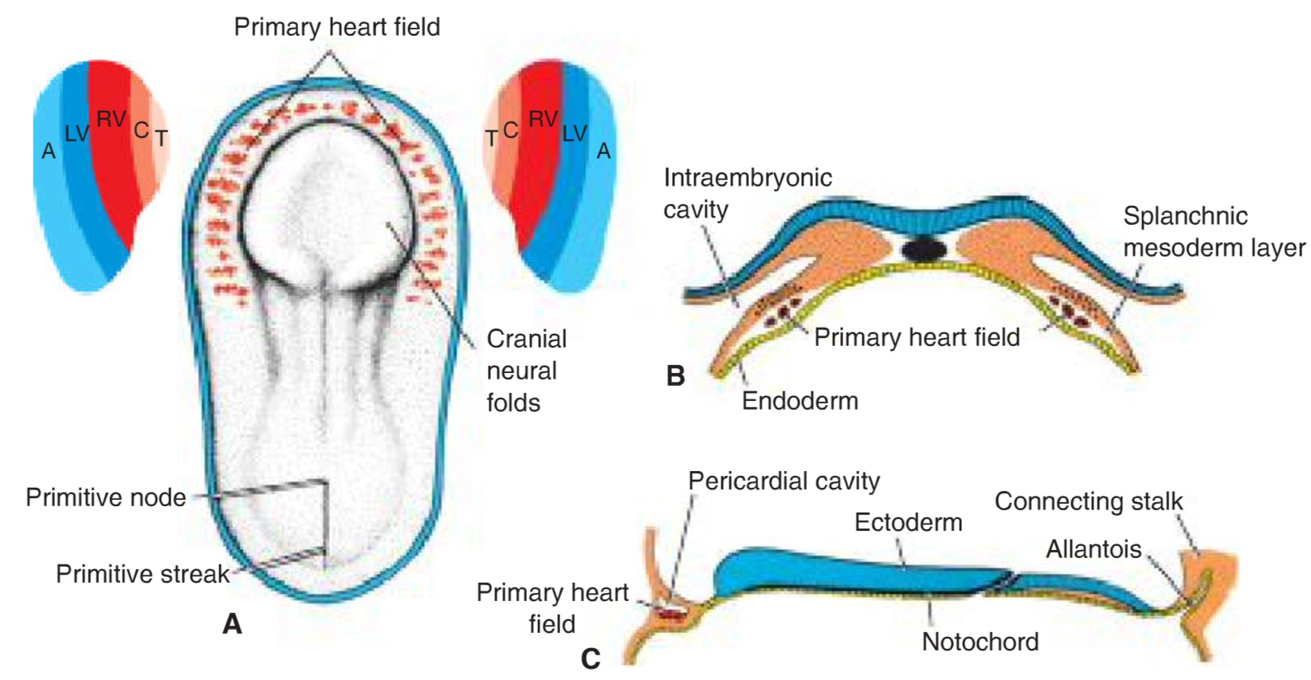
Formation of primary heart field
WHEN? - middle of the 3rd week (day 16)
WHAT? - progenitor heart cells
WHERE? - from epiblast through the primitive streak to the visceral layer of lateral plate mesoderm
DO WHAT? - form PHF
T.W. Sadler, Langman´s medical embryology, 14th edition

Slide 3
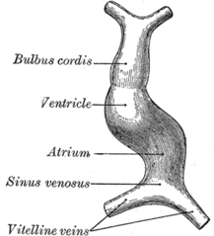
Formation of the heart tube
WHEN? - day 22-28
WHAT? – cells of the PHF
DO WHAT? – form cardiac myoblasts and the blood islands ---> the horseshoe-shaped endothelial-lined tube surrounded by myoblast (=cardiogenic region/field), further the caudal portion fuse except for the caudalmost part

Slide 4
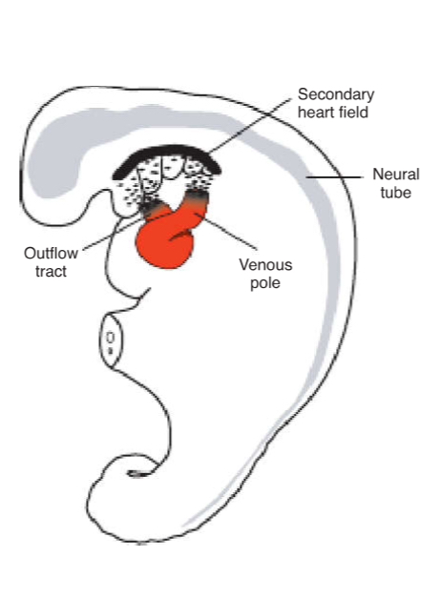
The heart tube lengthening
WHEN? - day 22-28
WHAT? – SHF in splanchnic mesoderm ventrally to the posterior pharynx
WHERE? - thoracic region
DO WHAT? – provides cells to lenghten both poles of the heart tube: atria and sinus venosus, right ventricle and conus cordis and truncus arteriosus
T.W. Sadler, Langman´s medical embryology, 14th edition

Slide 5
https://radiologykey.com/embryology/
Notes:
PHF portion of atria and the entire left ventricle

Slide 6
Looping of the heart
WHEN? - day 23-28
WHAT? - the primitive heart tube
DO WHAT? - cephalic portion bends ventrally, caudally and to the right; caudal portion bends dorsally, cranially and to the left

Slide 7
https://teachmeanatomy.info/the-basics/embryology/cardiovascular-system/

Slide 8
https://youtu.be/a0qyagIgBPw

Slide 9
Formation of the cardiac septa
WHEN? - day 27-37
WHAT? – septum in the common atrium
– septum in the atrioventricular canal
– septum in the truncus arteriosus and conus cordis
– septum in ventricles

Slide 10
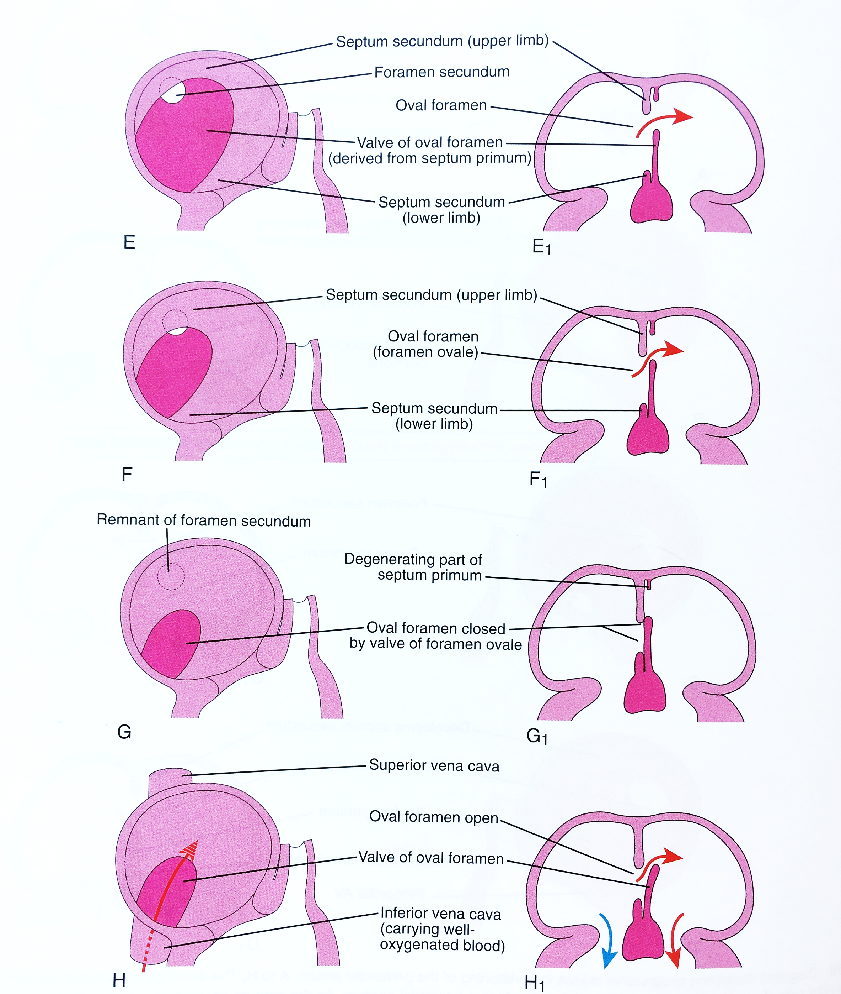
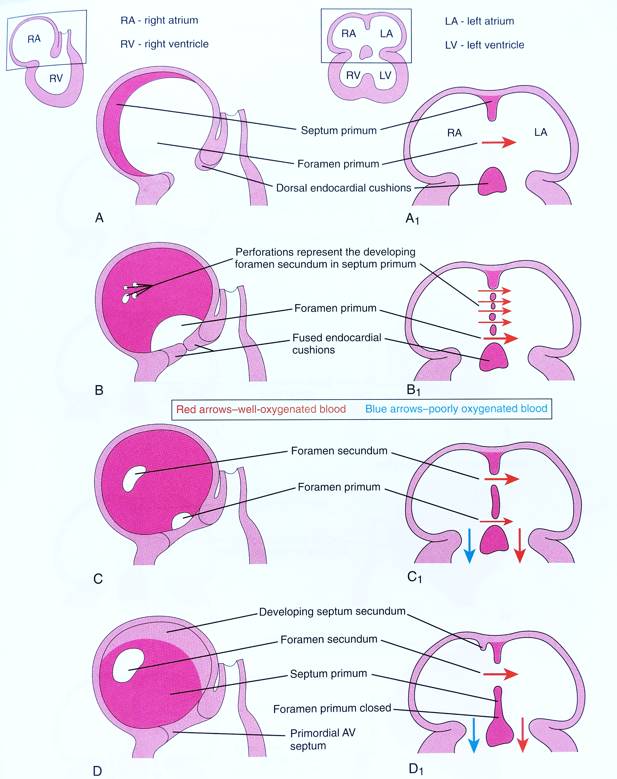
Septum in the common atrium
K. Moor, Before we are born

Slide 11
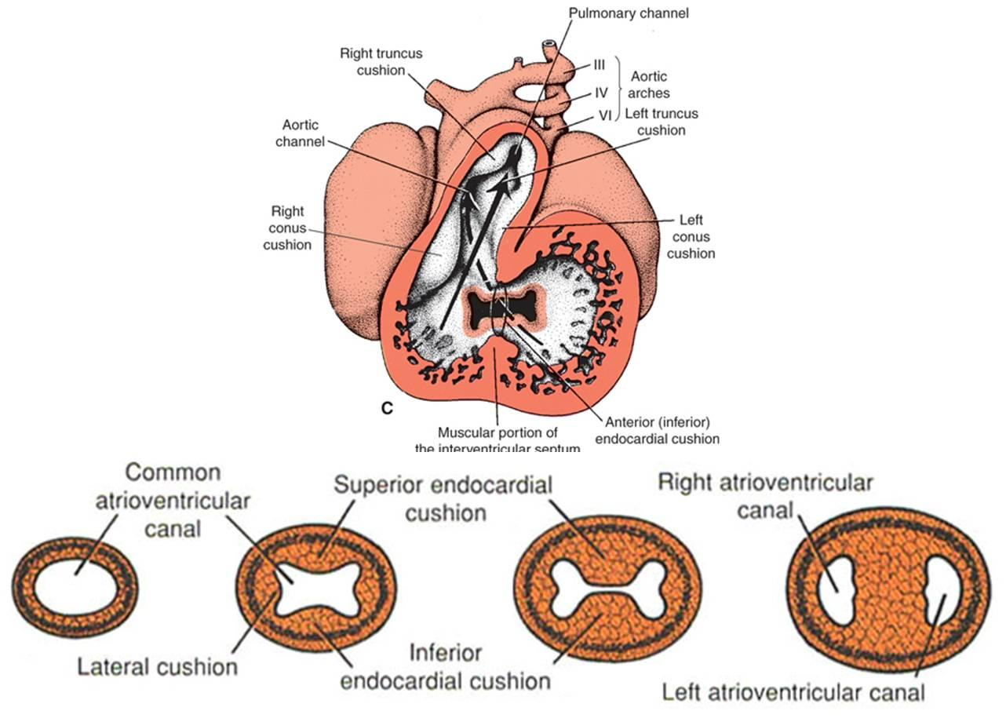
Septum in the atrioventricular canal
T.W. Sadler, Langman´s medical embryology, 12th edition

Slide 12
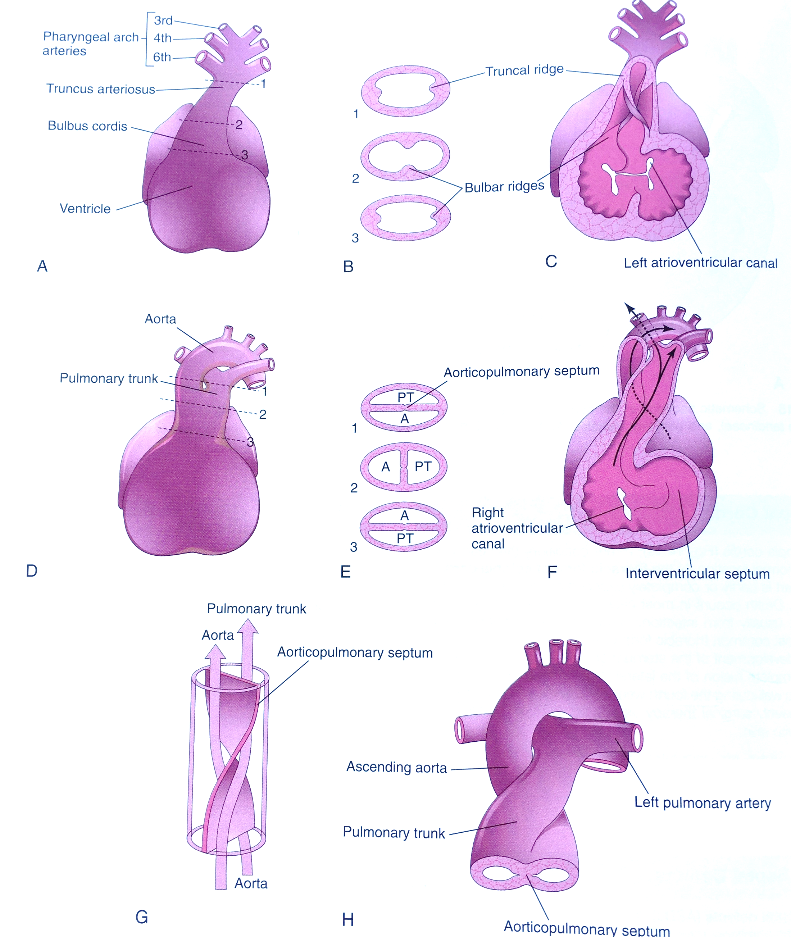
Septum in the truncus arteriosus and conus cordis
K. Moor, Before we are born
Notes:
Right superior truncus swelling grows distally to the left; left inferior truncus swelling grows distally to the right

Slide 13
Congenital heart defects (CHDs)
Dextrocardia
Ventricular inversion
Ectopia cordis
Ventricular septa defects (12/10 000)
Persistent truncus arteriosus (0,8/10 000) – always present with VSD
Atrial septal defects (6,4/10 000; 2:1 prevalence in F to M):
Patent oval foramen
4 clinically significant ASD:
Ostium sekundum ASDs
Endocardial cushion defects with a foramen primum
Sinus venosus ASDs
Common atrium - combination of the above
Transposition of great arteries (4,8/10 000)
Tetralogy of Fallot (9,6/10 000) – displacement of conotruncal septum:
Pulmonary stenosis (obstructed right ventricle outflow)
2. VSD
3. Dextroposition of the aorta
4. Right ventricle hypertrophy (as a result of the pulmonary stenosis)
Aortic stenosis and aotric atresia
Unequal division of TA
Pulmonary atresia, pulmonary stenosis
Notes:
In 1% of live born infants

Slide 14
Notes:
(b) Double outlet right ventricle (DORV). (c) Transposition of the great arteries (TGA). (d) Persistent truncus arteriosus (PTA). (e) Tetralogy of Fallot (TOF).

Slide 15
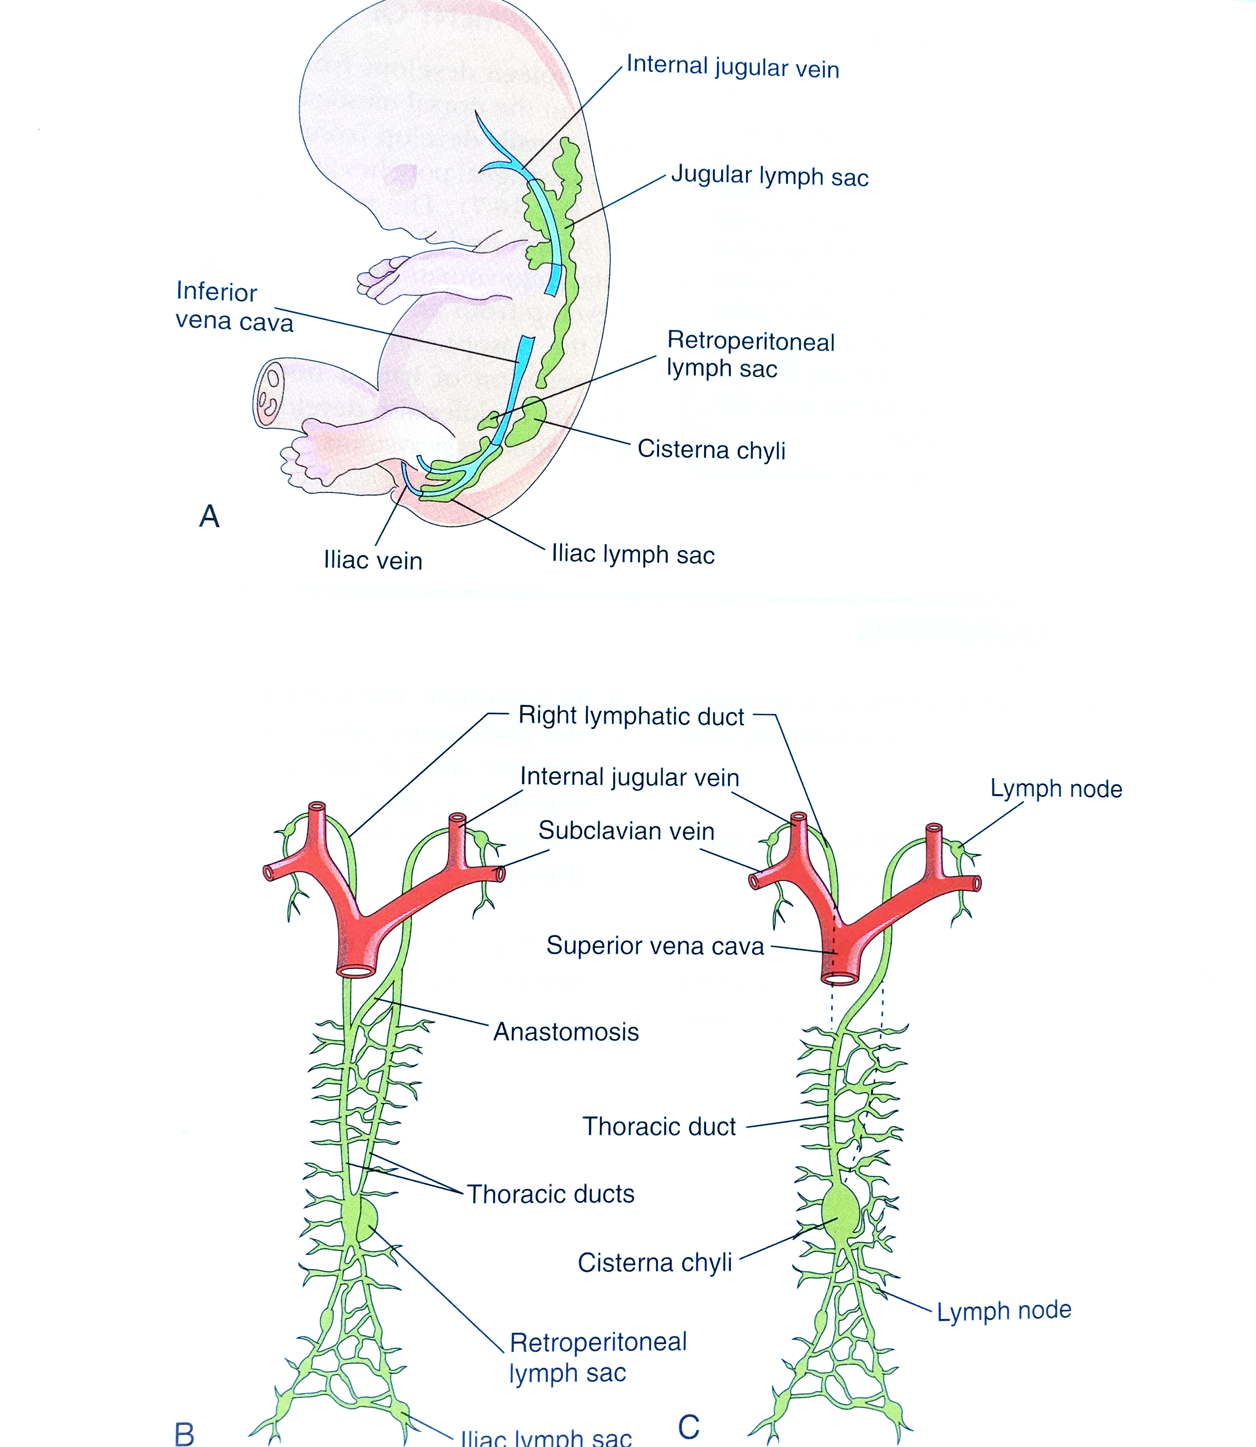
Lymphatic system development
K. Moor, Before we are born

