Slide 1
Development and teratology of digestive system.
Development of facial and cervical region, face clefts.
Anna Mac Gillavry
14.03.2022

Slide 2
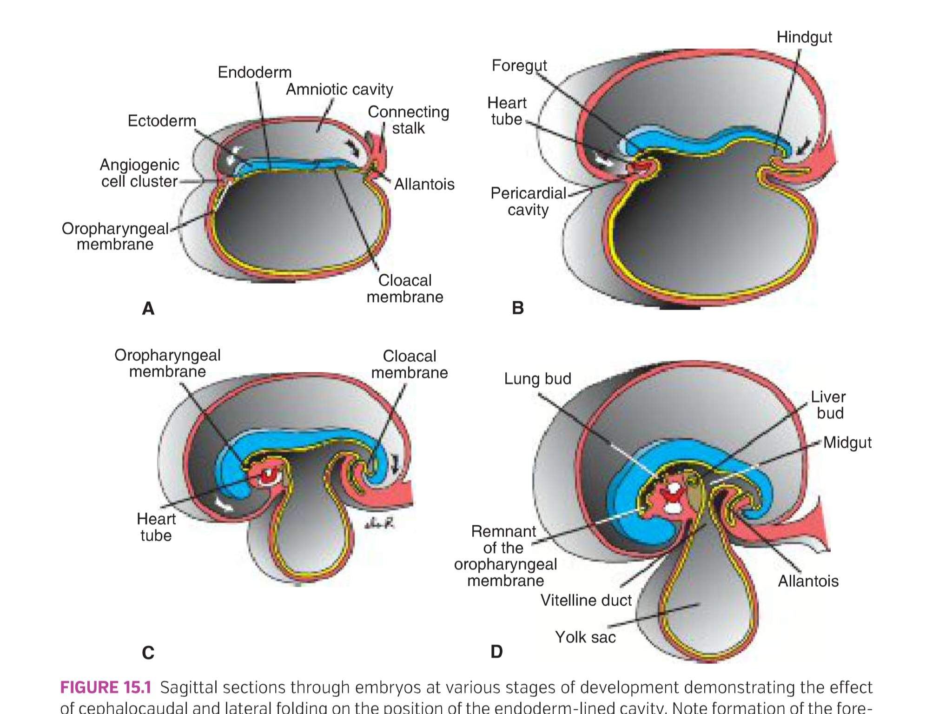
Primitive gut formation results from the lateral folding of the embrio
Foregut, midgut and hindgut
(Yolk sac, allantois)
T.W. Sadler, Langman´s medical embryology, 14th edition

Slide 3
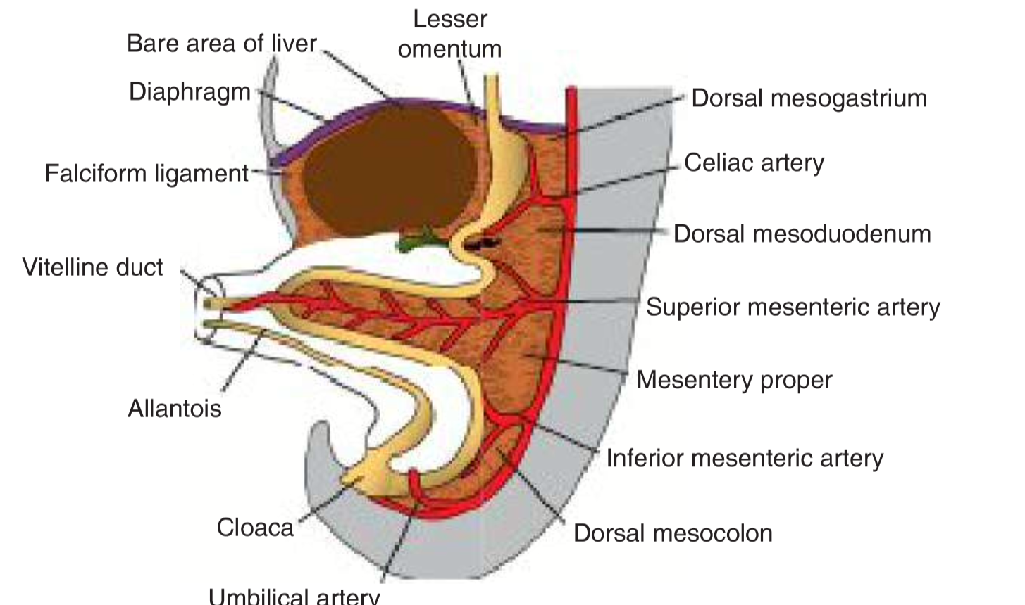
T.W. Sadler, Langman´s medical embryology, 14th edition

Slide 4
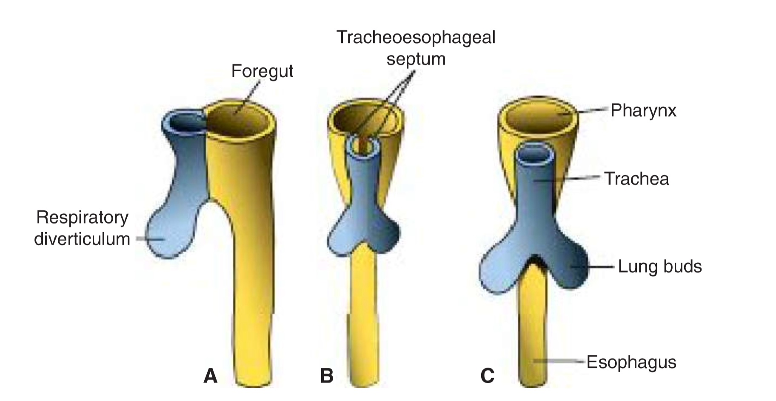
Esophagus
4 weeks
T.W. Sadler, Langman´s medical embryology, 14th edition

Slide 5
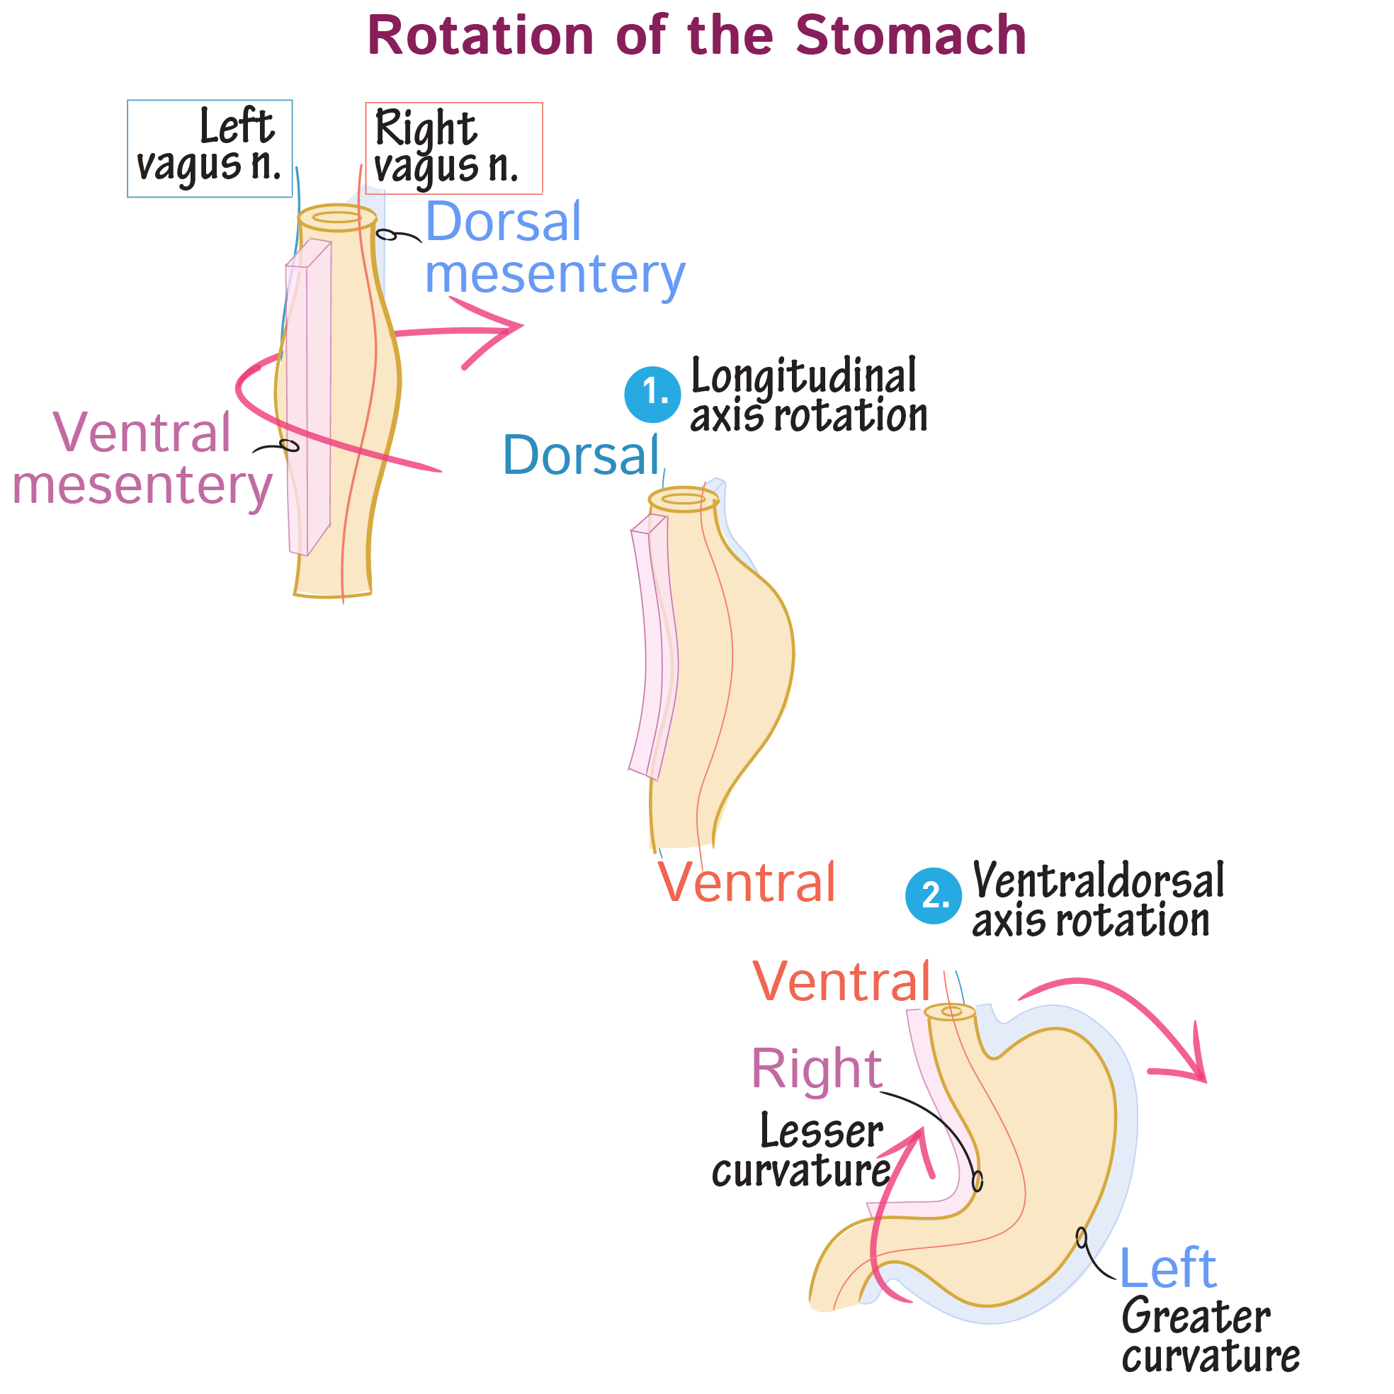
Stomach
https://www.drawittoknowit.com/course/embryology/glossary/developmental-process/rotation-of-the-stomach

Slide 6
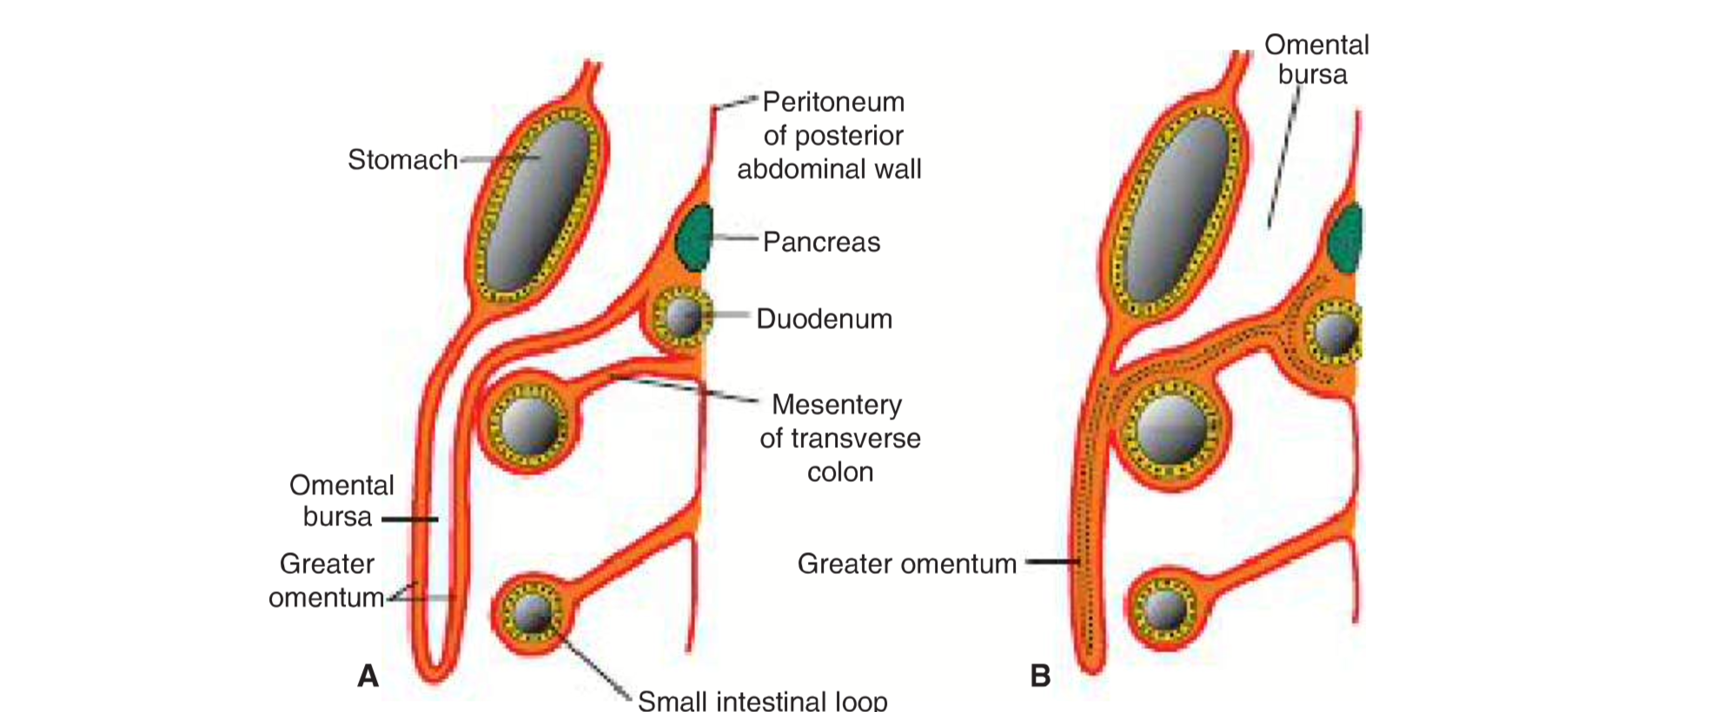
T.W. Sadler, Langman´s medical embryology, 14th edition

Slide 7
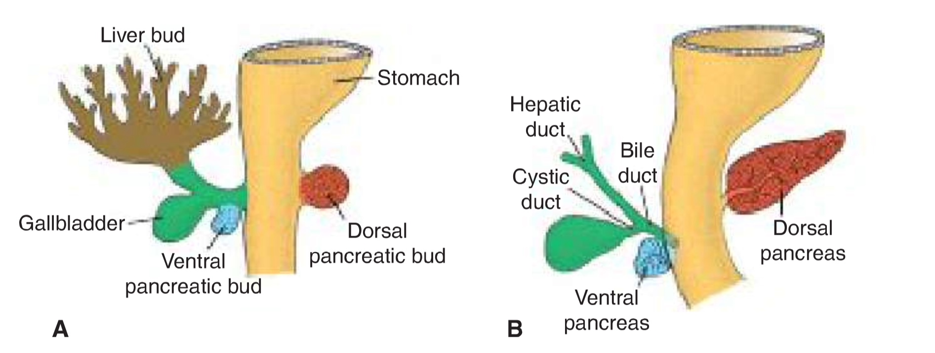
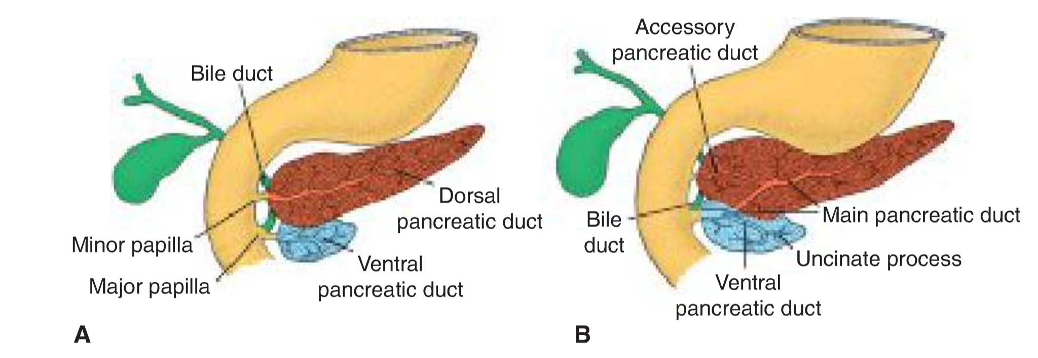
T.W. Sadler, Langman´s medical embryology, 14th edition

Slide 8
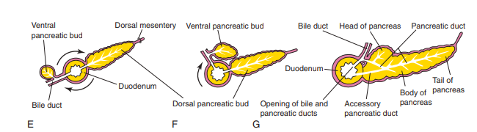
K. Moor, Before we are born, 10th edition

Slide 9
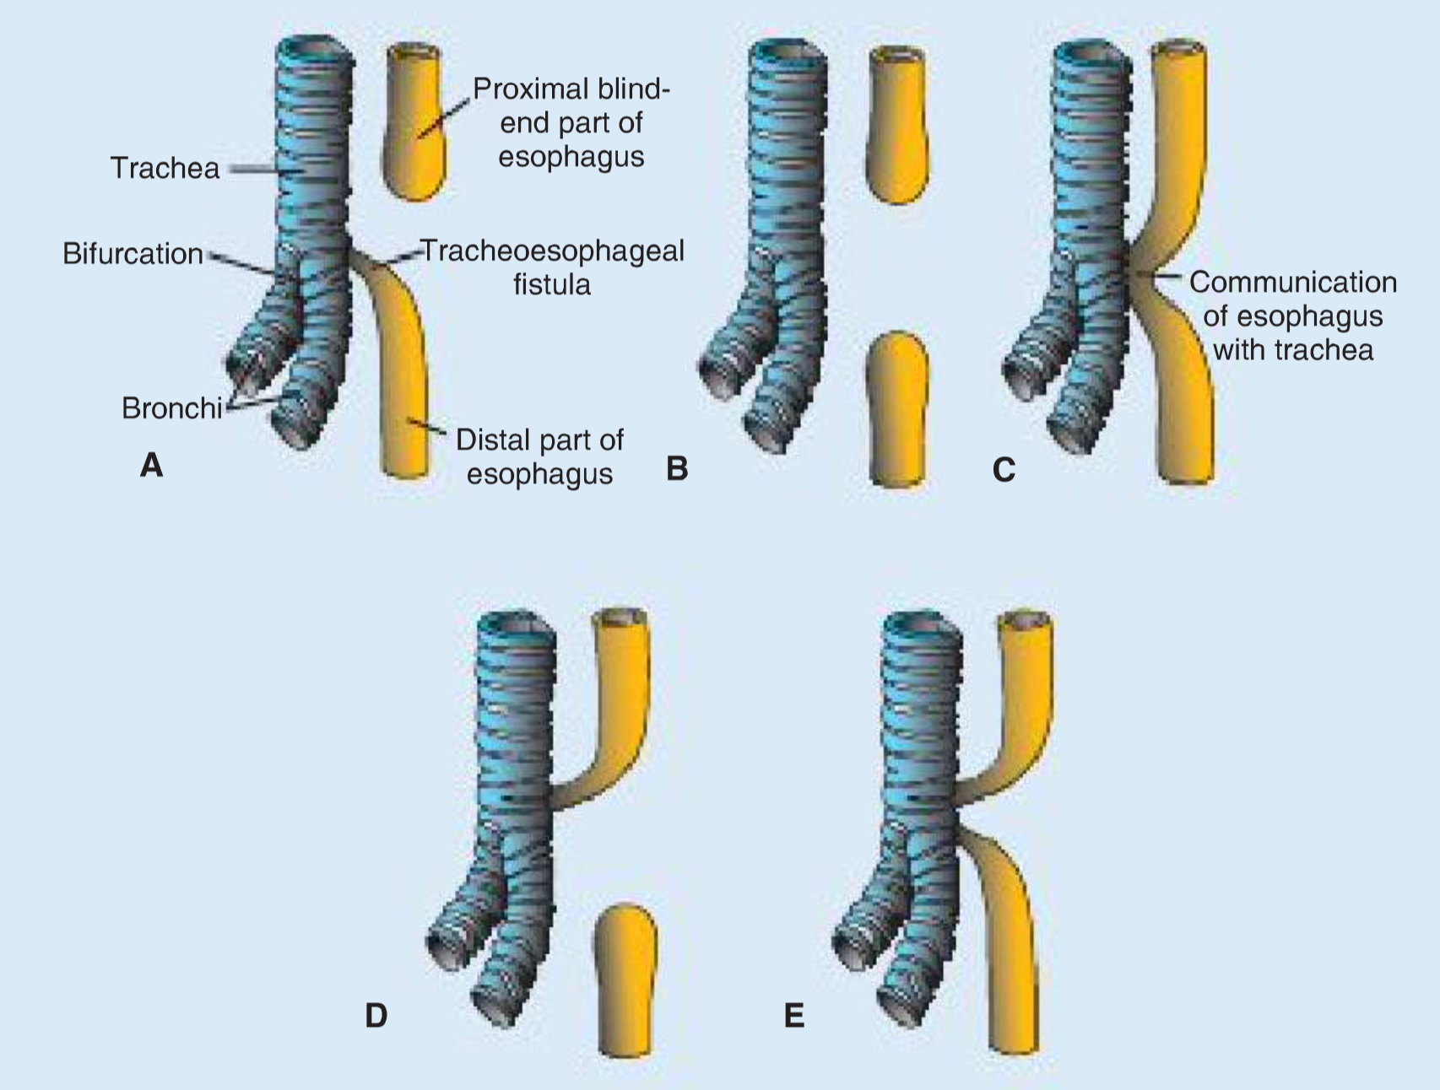
Esophagus:
- esophageal atresia and/or tracheoesophageal fistula
- esophageal stenosis
- congenital hiatal hernia
T.W. Sadler, Langman´s medical embryology, 14th edition

Slide 10
Stomach:
Pyloric stenosis (1 in 150 males, 1 in 750 females) – developes during fetal life, however, can develop as a result of postnatal exposure
Liver - birth deffects are rare:
Accessory hepatic ducts
Gallbladder duplication
Extrahepatic biliary atresia (1/15000)
Intrahepatic biliary duct atresia/hypoplasia (1/100000)
Pancreas:
Annular pankreas
Accessory spleens – in 10 % of population

Slide 11
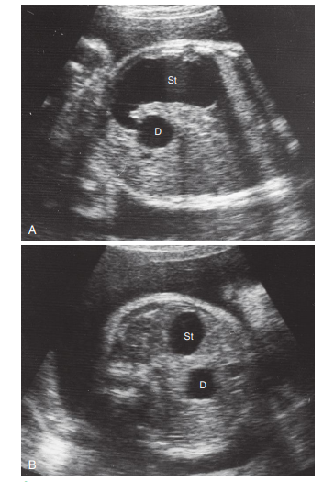
Duodenum:
Duodenal stenosis/atresia – results from incomplete recanalization
Polyhydramnios
„Doble-Bubble“
K. Moor, Before we are born, 10th edition

Slide 12
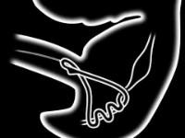
Midgut development. Physiological herniation.
6th – 10th week
https://youtu.be/AscKR_cQExY

Slide 13
Body wall defects
Gastroschisis (3,5/10000) – most common in infants from thin women under 20; usually not associated with chromosomal abnormalities and other severe deffects, thus the mortality rate is low (unless associated with volvulus)
X
Omphalocele (2,5/10000) – up to 25 % mortality rate
Vitelline duct abnormalities
Meckel or ileal diverticulum – in 2 to 4 % of people, 3-5 times more prevalent in males (inflamation symptoms mimic those of appendicites)
Enterocystoma or vitelline cyst
Umbilical or vitelline fistula

Slide 14
Gut rotation defects
Left-sided colon – colon and cecum are the first to return from the umbilical cord cavity as the result of only 90° rotation
Reversed rotation of the intestinal loop
Duplications of intestinal loops and cysts
Gut atresias and stenoses
Most occur in duodenum, fewest in the colon, equal number in jejunum and ileum; in 50 % of cases a region of bowel is missing completely, in 20 % cases the fibrous cord is present; stenoses represent only 5 % of cases
Apple peel atresia - 10 % of atresias: in the proximal jejunum, intestine is short, portion distal to the lesion coiled around remanant of mesenteries

Slide 15
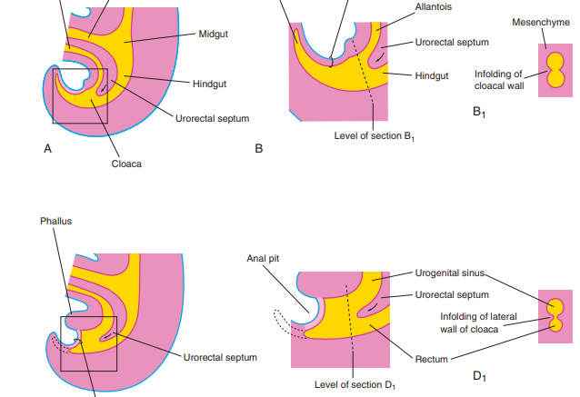
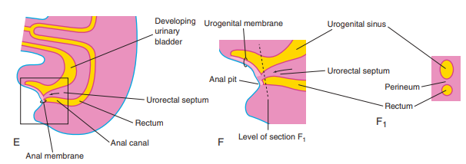
Hindgut
Hindgut derivatives:
Left third of the transverse colon, descending colon, sigmoid colon, rectum, superior part of the anal canal
The epithelium of the urinary bladder and most of the urethra!!!
K. Moor, Before we are born, 10th edition

Slide 16
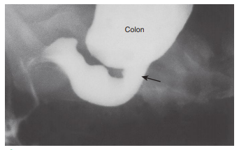
Congenital megacolon
(Hirschsprung disease) – 1/5000, males are affected 4 times more often than females.
Imperforate anus - 1/5000 more common in males than females
Anorectal birth defects
High vs. Low (rectum end superior or inferior to the puborectalis muscle respectively)
Low: anal agenesis, with or without fistula
anal stenosis
membranous atresia of anus
High: anorectal agenesis, with or without
fistula (2/3 of anorectal defects)
rectal atresia
K. Moor, Before we are born, 10th edition

Slide 17
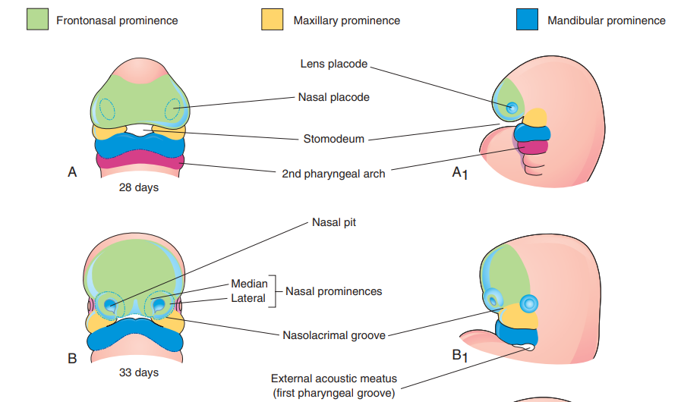
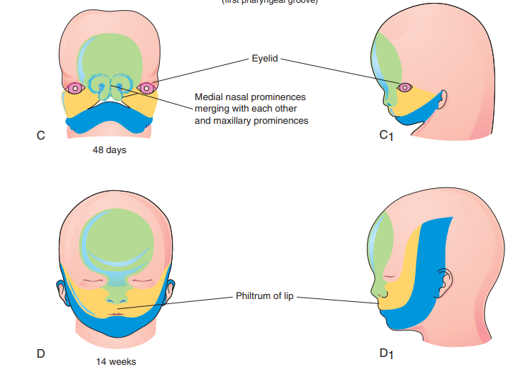
Development of the face
K. Moor, Before we are born, 9th edition

Slide 18
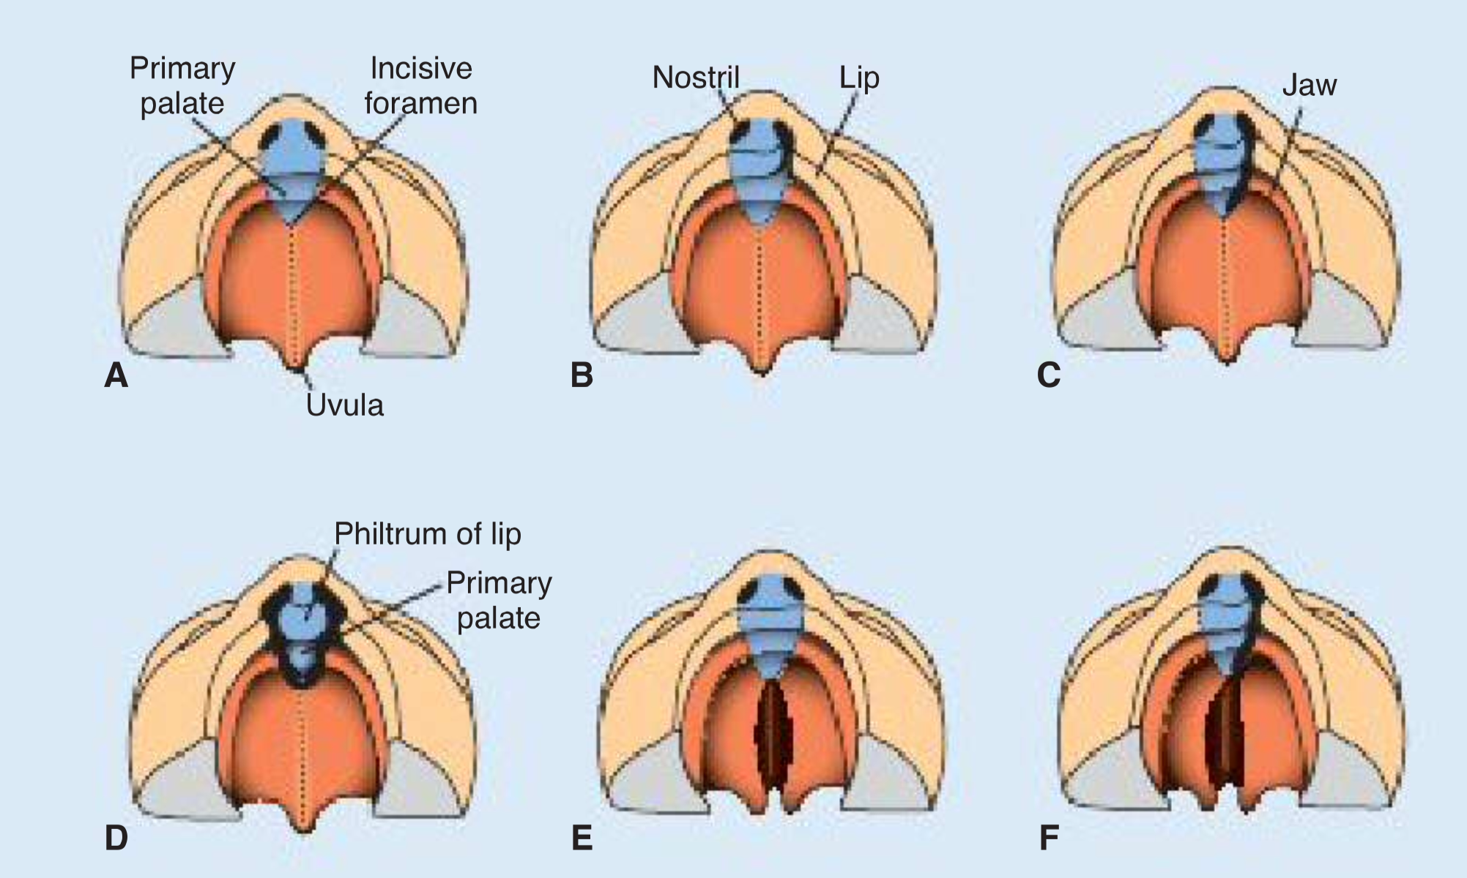
Anterior cleft deformities
Lateral cleft lip (1/700, 65 % -male infants)
Cleft upper jaw
Cleft between the primary and the secondary palates
Posterior cleft deformities
Cleft secondary palate (1/1500, 55 % female infants)
Cleft uvula
T.W. Sadler, Langman´s medical embryology, 14th edition

Slide 19
Van der Woude syndrome – pits in the lower lip in 88 % of patients
Oblique facial cleft
Median cleft lip – incomplete merging of the two medial nasal prominences; different degrees of midline structures loss --------- holoprosencephaly – fusion of lateral ventricles, synophtalmia

Slide 20
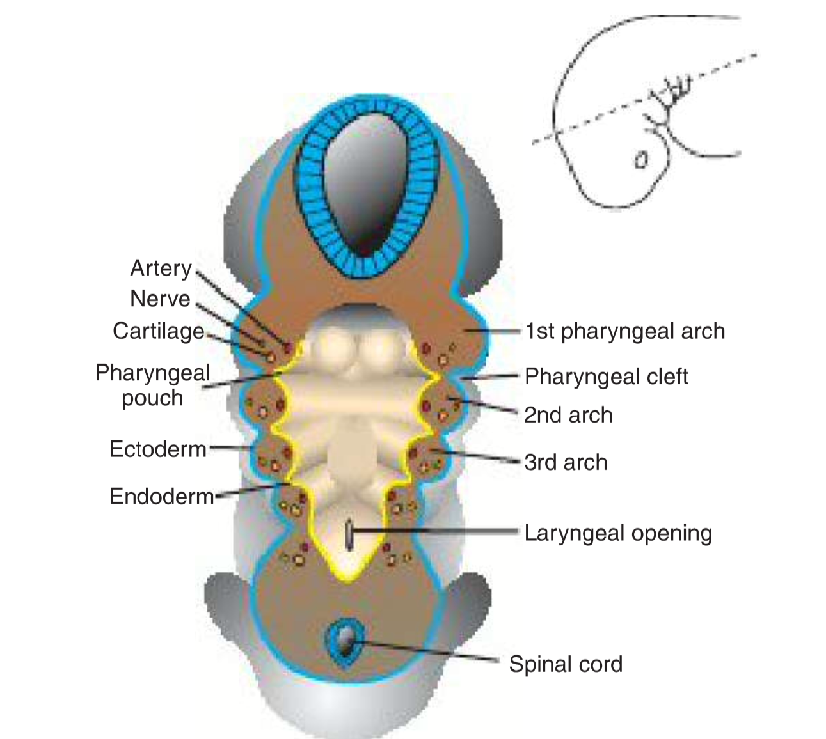
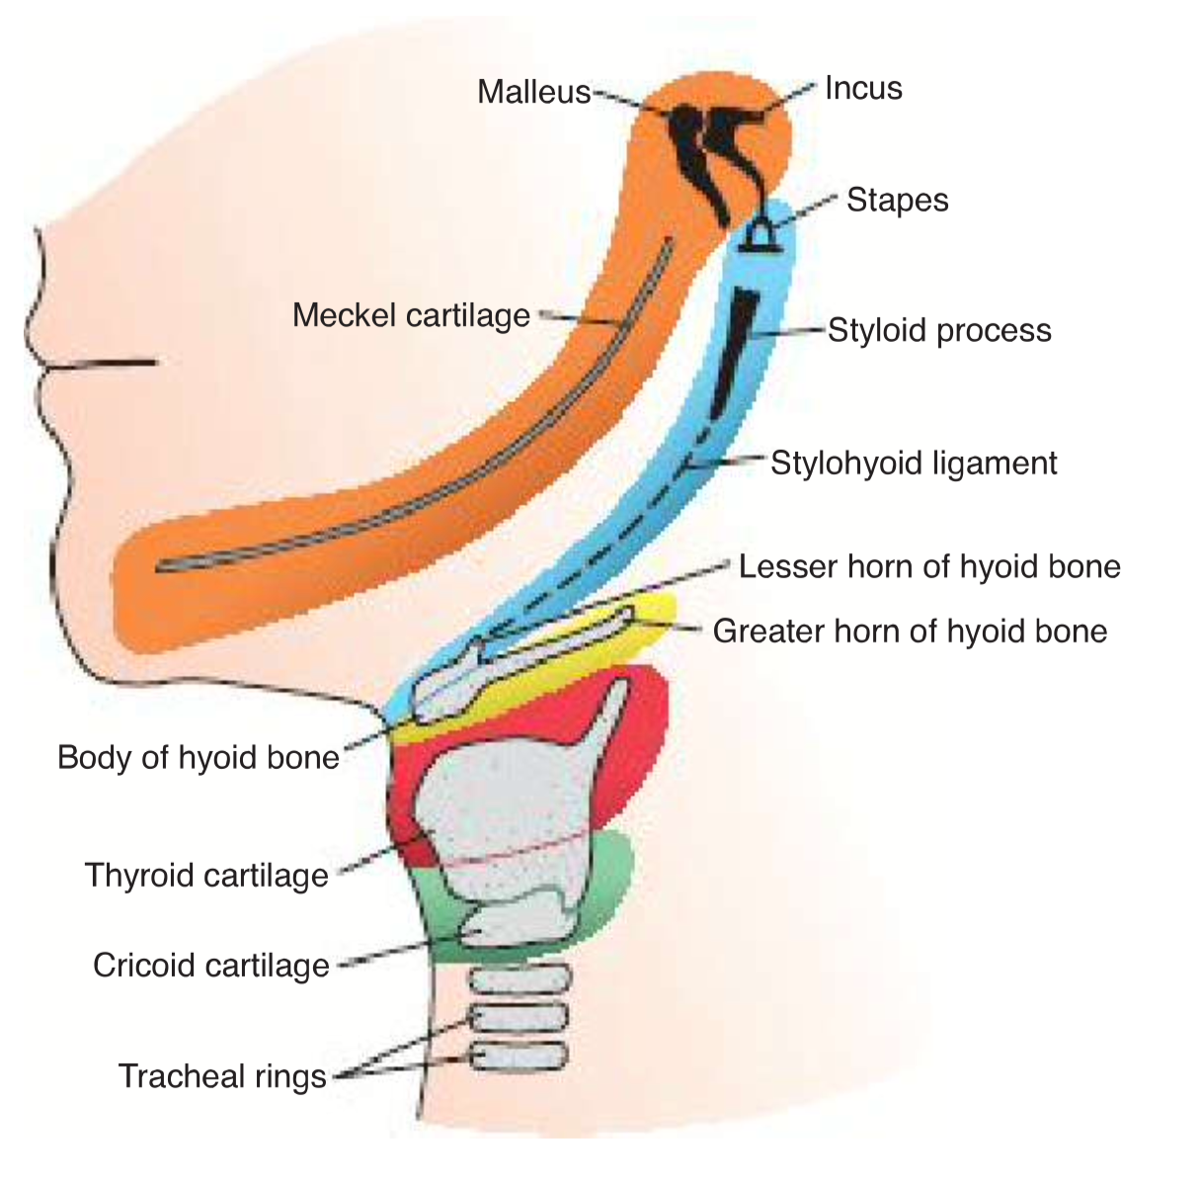
Neck region
T.W. Sadler, Langman´s medical embryology, 14th edition

Slide 21
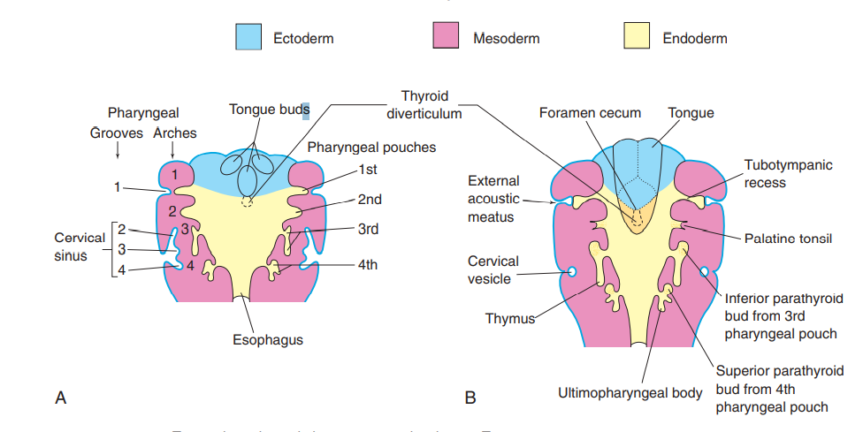
Neck region – pharyngeal apparatus
K. Moor, Before we are born, 9th edition

Slide 22
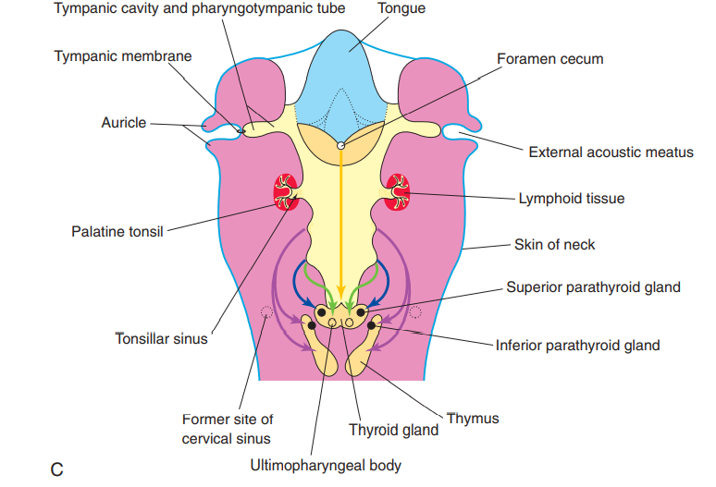
K. Moor, Before we are born, 9th edition

Slide 23
Ectopic thymic and parathyroid tissue
Branchial fistulas: external and internal
Cervical cysts
Craniofacial defects associated with neural crest cells:
Mandibulofacial dysostosis – Treacher Collins syndrome
Robin sequence
DiGeorge syndrome, DiGeorge anomaly, velocardiofacial syndrome etc. - deletion on 22q11.2 (1/4000)
Hemifacial microsomia (oculoauriculovertebral spectrum – Goldenhar syndrome)

