Slide 1
Development and teratology of the endocrine and nervous system
Anna Mac Gillavry Danylevska
9.5.2022

Slide 2
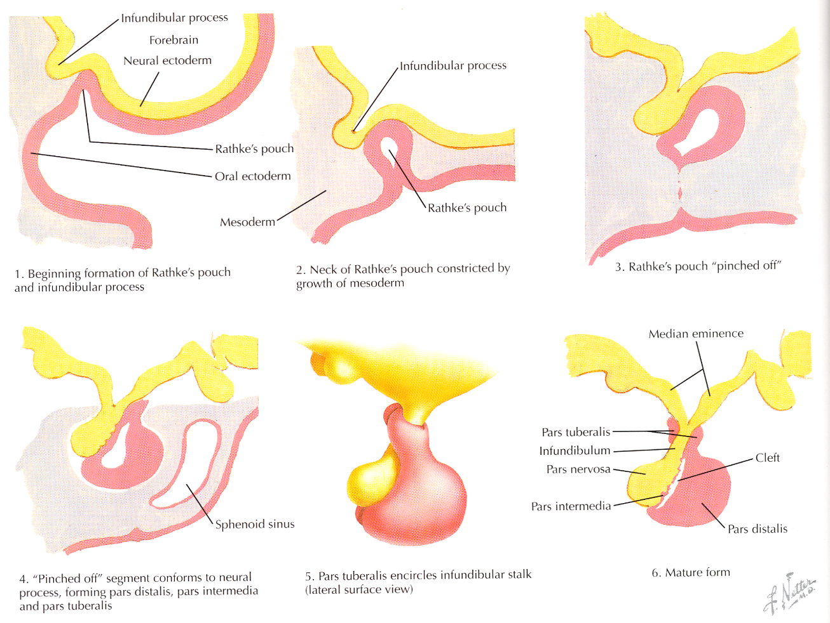
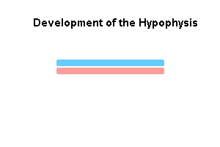
Pituitary gland
Ectoderm (Rathke’s pouch)
Neuroectoderm of ventral wall of diencephalon

Slide 3
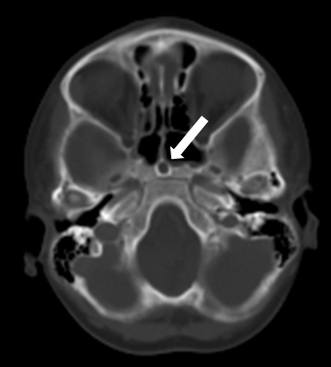
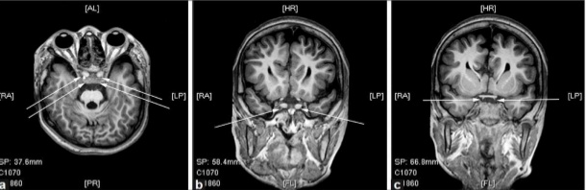
Craniopharyngeal canal
Pharyngeal hypophysis
Agenesis/hypoplasia - agenesis is incompatible with life; panhypopituitarism
Duplication of the gland – very rare
Ectopic posterior pituitary – pituitary dwarfism
Duplication of the pituitary gland associated with multiple blastogenesis defects: Duplication of the pituitary gland (DPG)-plus syndrome. Case report and review of literature - Surgical Neurology International

Slide 4
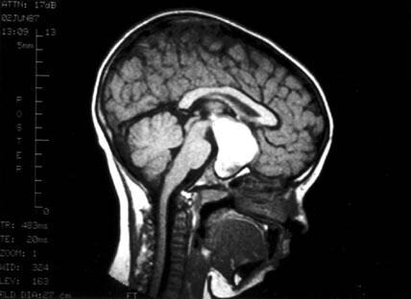
Craniopharyngiomas – usually lie above the sella; cause hydrocephalus, growth failure, diabetes insipidus, lose of peripheral vision
Pediatric Craniopharyngioma: Background, Pathophysiology, Epidemiology (medscape.com)

Slide 5
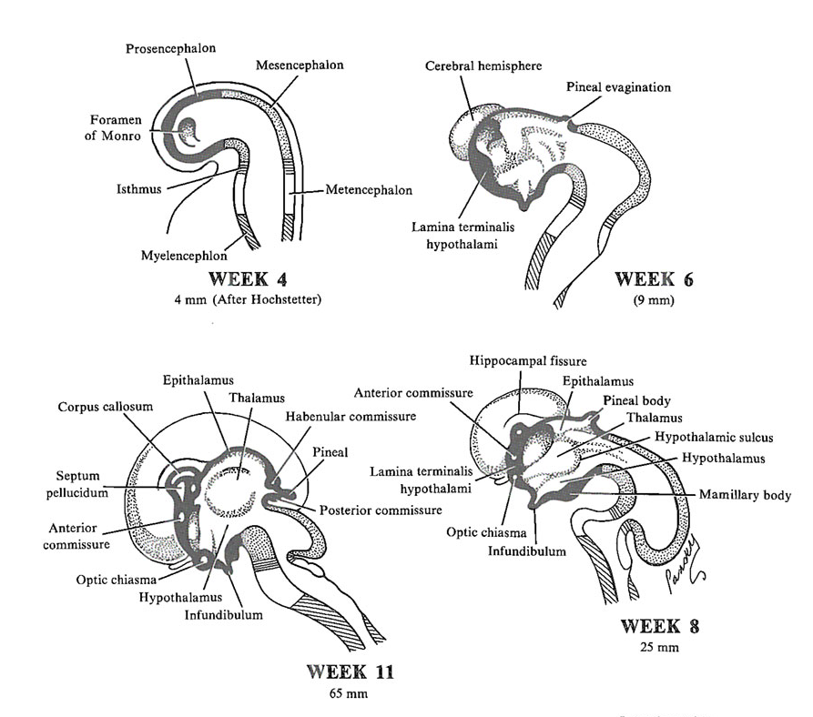
Epiphysis
thickening of caudal part of ependyma that does not contribute to development of choroid plexus at the roof of diencephalon
neuroectoderm

Slide 6
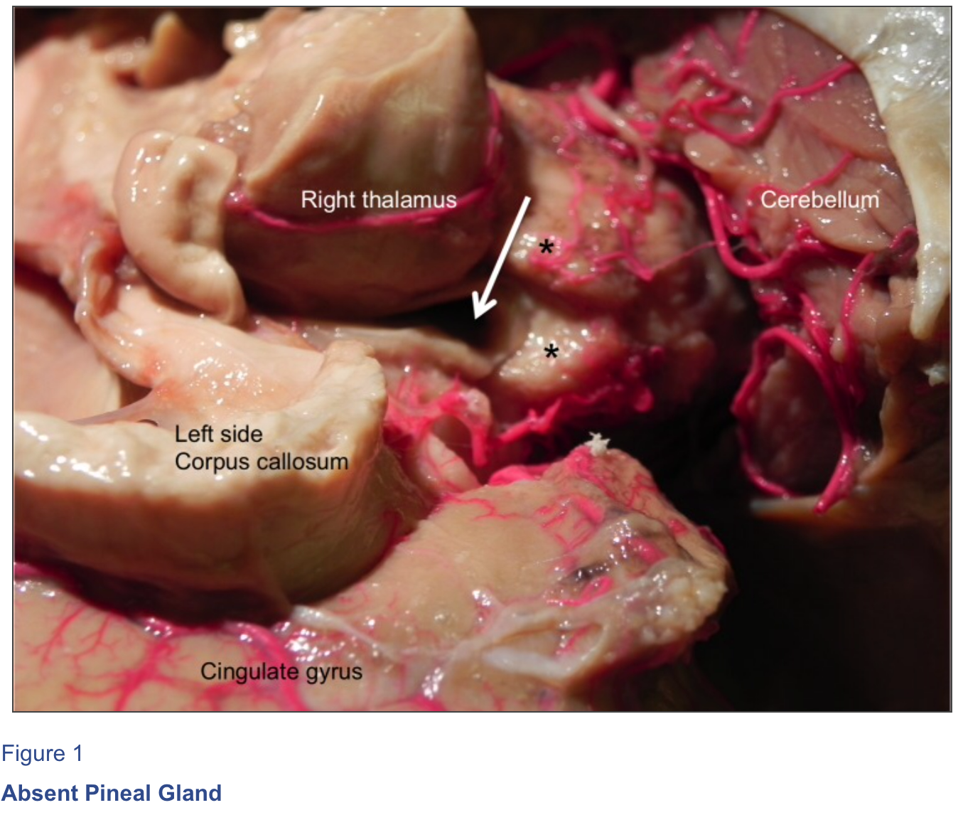
Pineal gland agenesis – mutations PAX6 (paired box gene 6)
Cureus | Pineal Gland Agenesis: Review and Case Illustration

Slide 7
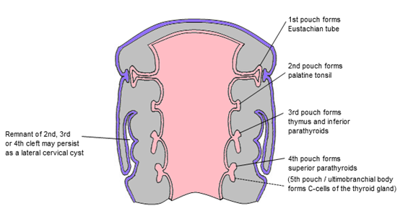
Thyroid gland
endodermal proliferation of pharyngeal floor between tuberculum impar and copula
obliterating ductus thyreoglossus
foramen caecum
bilobed diverticulum
lobus pyramidalis
C-cells
neural crest origin
ultimobranchial body of 5th pharyngeal pouch

Slide 8
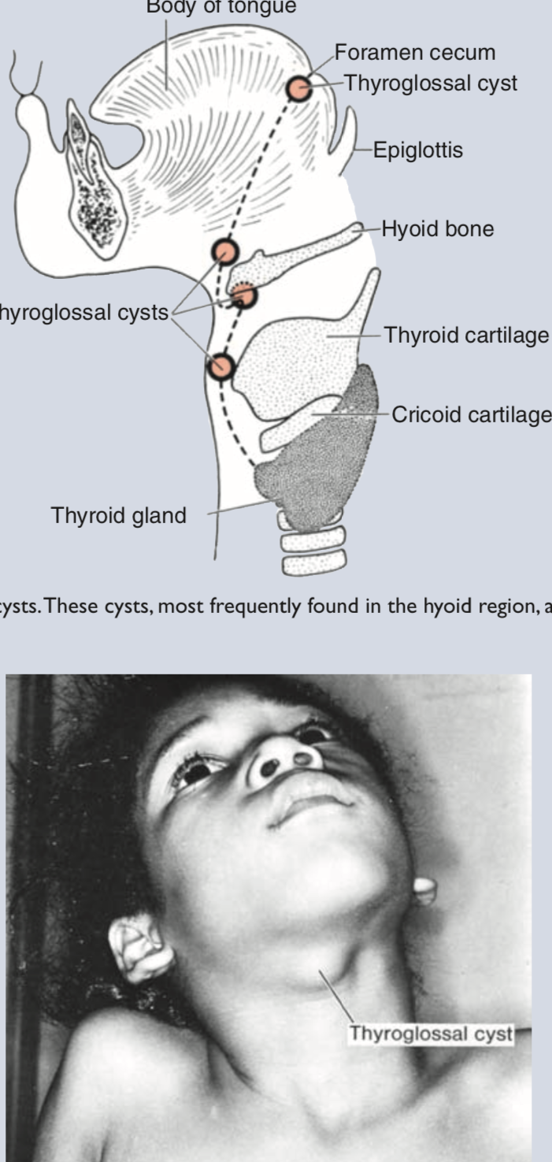
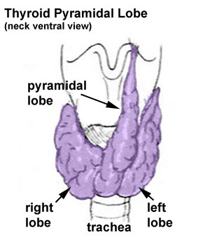
Pyramidal lobe – in 50 % of population
Congenital hypothyroidism (1/3000)
ectopic thyroid
hypoplasia, agenesis
TSH deficiency
Ectopic thyroid gland – in 90 % cases it is lingual thyroid gland; sublingual thyroid gland
Thyroglossal duct cyst – clinically important to distinguish from ectopic thyroid gland!
Thyroglossal fistula
T.W. Sadler, Langman´s medical embryology, 12th edition

Slide 9
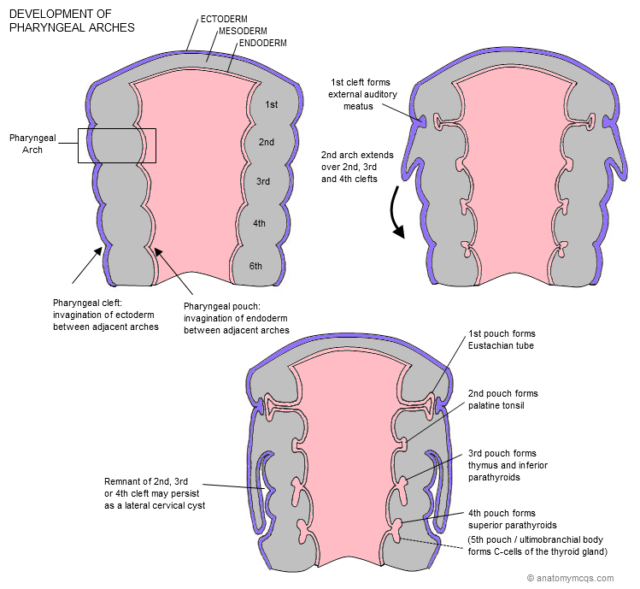
Embryonic development of parathyroid gland
glandulae parathyroideae superiores from endoderm of 4th pharyngeal pouch
glandulae parathyroideae inferiores from dorsal process of 3rd pharyngeal pouch
together with thymus descend to lower poles of thyroid

Slide 10
Ectopic parathyroid tissue – the inferior parathyroids are more variable in their position
Supranumerary parathyroid glands

Slide 11
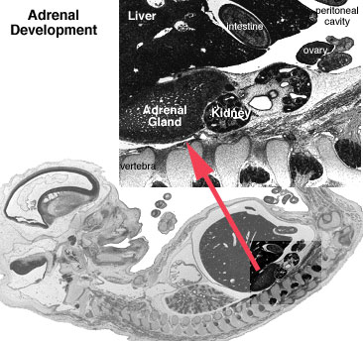
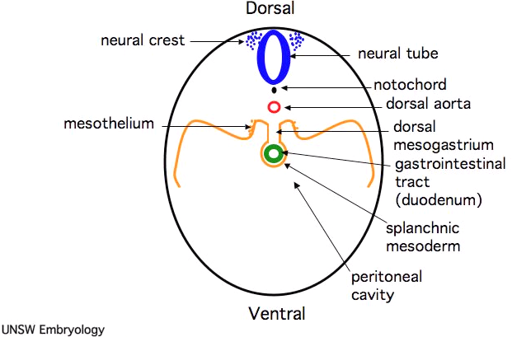
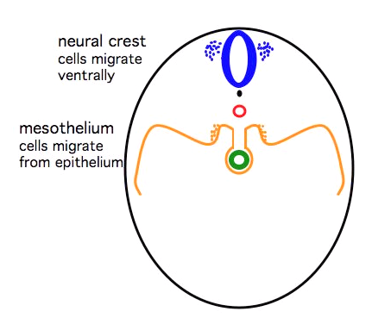
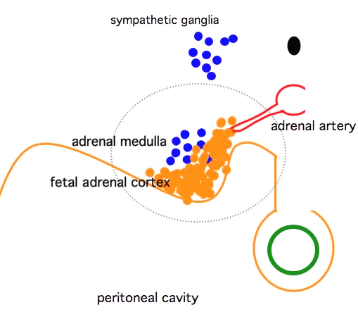
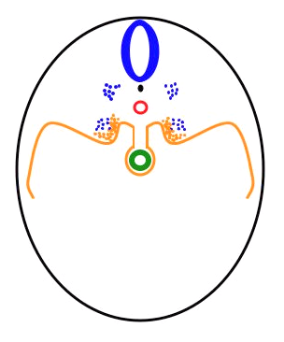
Suprarenal gland
Cortex
Mesoderm ---> coelomic epithelium
primitive fetal cortex 5-6th week
definitive cortex
zona reticularis fully differentiates within 3 years
Medulla
neural crest
Week10 adrenal - Endocrine - Adrenal Development - Embryology (unsw.edu.au)

Slide 12
Congenital adrenal hyperplasia – group of autosomal recessive disorders – excessive production of androgenes: causes rapid growth and accelerated sceletal maturation in both sexes

Slide 13
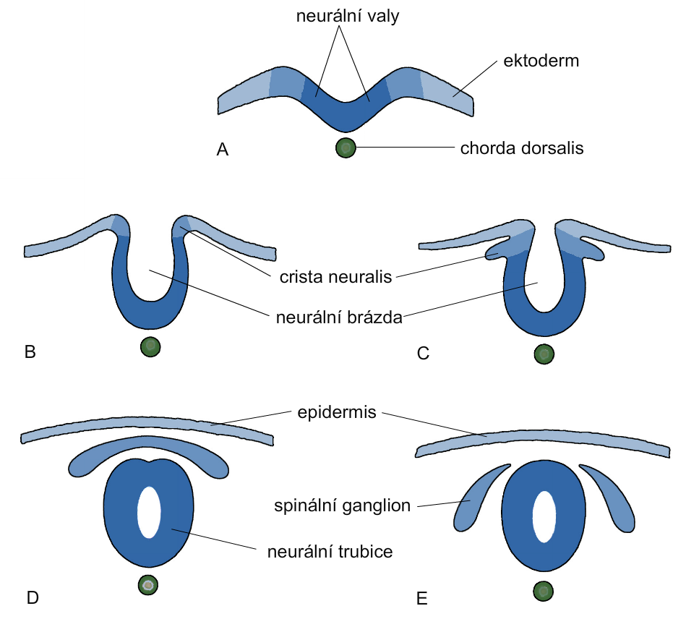
Development of the neural tube
neural folds
ectoderm
neural groove
spinal ganglion
neural tube

Slide 14
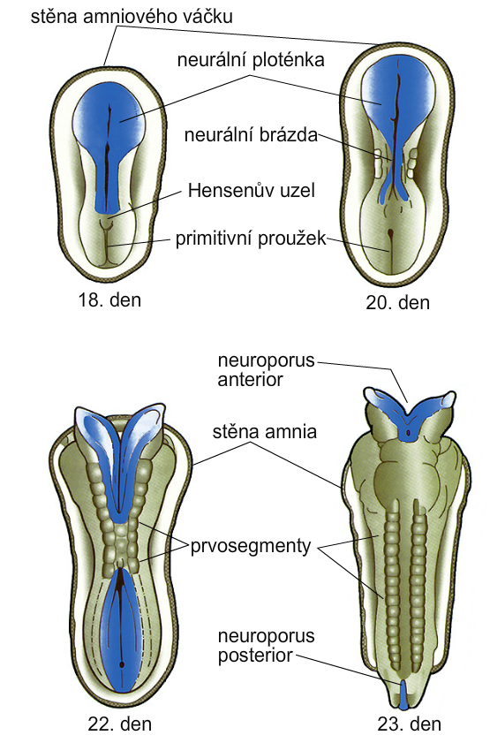
Closing of the neural tube
wall of amnion
neural plate
neural groove
primitive pit
primitive streak
day 18
day 20
wall of amnion
somites
day 22
day 23

Slide 15
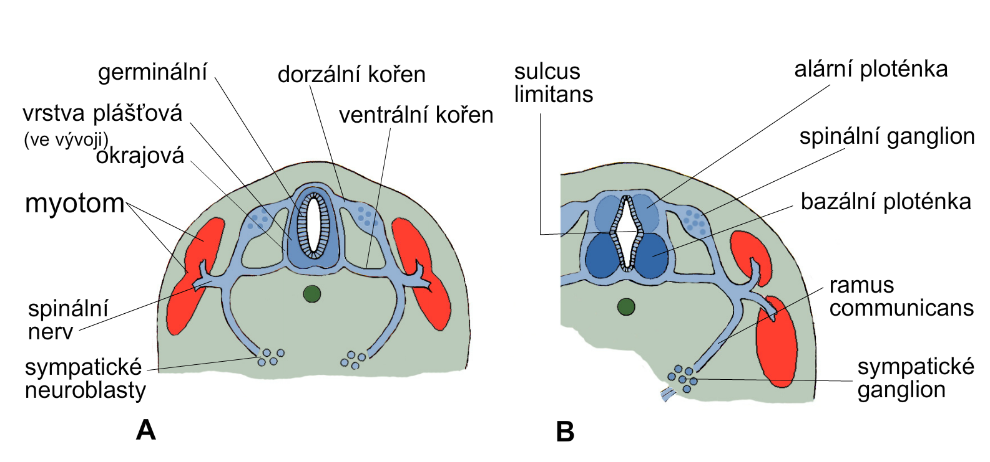
Development of the spinal cord
germinal
dorsal root
sulcus
limitans
alar plate
developing mantle layer
ventral root
spinal ganglion
marginal
myotom
basal plate
ramus communicans
spinal
nerve
sympathetic neuroblasts
sympathetic ganglion
sympathetic ganglion

Slide 16
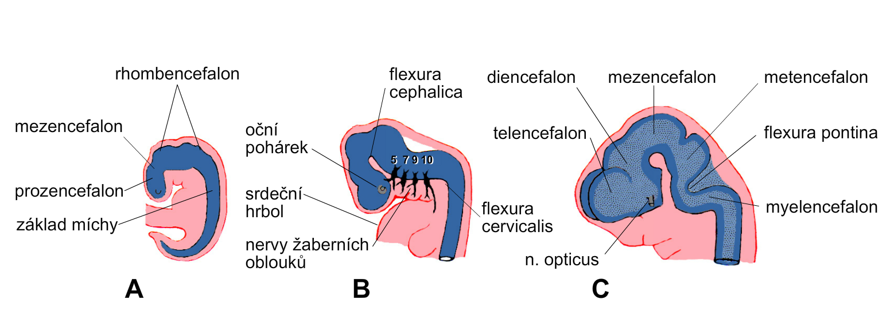
Development of the brain
rhombencephalon
diencephalon
mesencephalon
metencephalon
mesencephalon
eye cup
telencephalon
prosencephalon
developing heart
developing spinal cord
myelenencephalon
nerves of pharyngeal arches

Slide 17
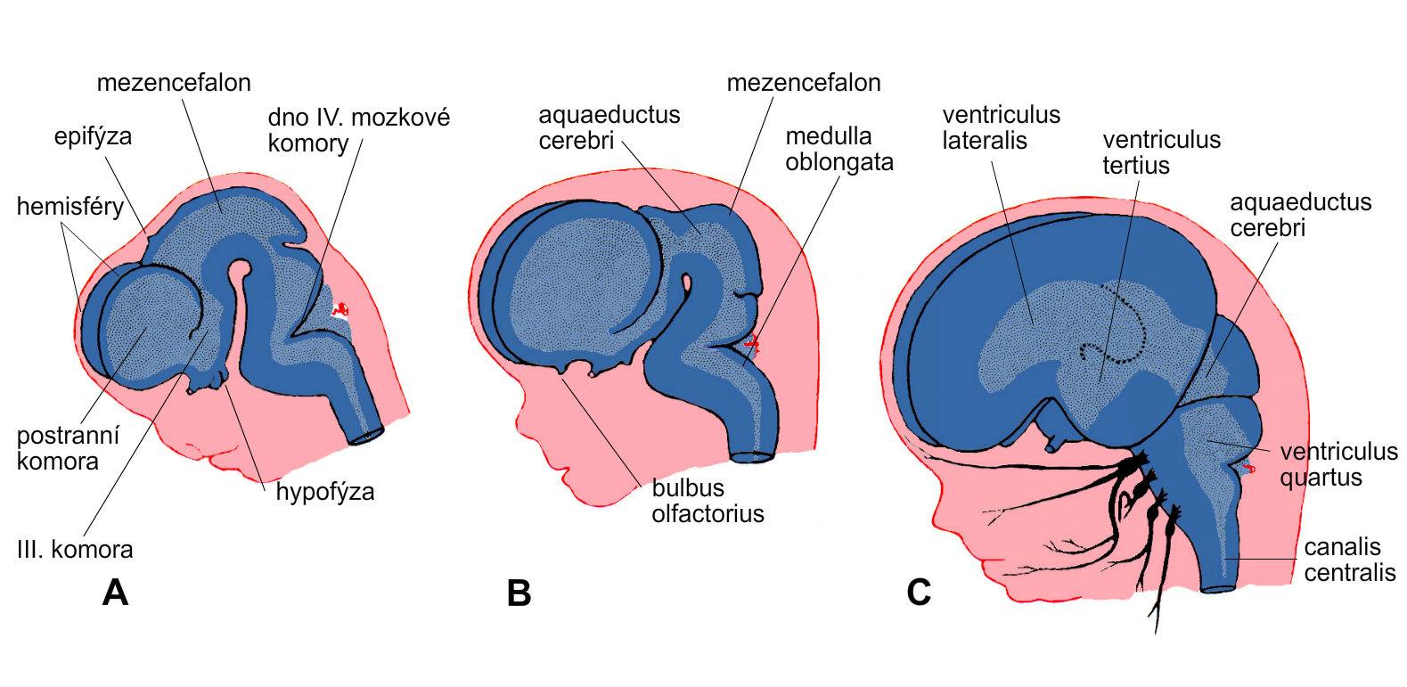
Development of the brain ventricles
mesencephalon
mesencephalon
epiphysis
floor of 4th ventricle
hemispheres
lateral ventricle
hypophysis
3rd ventricle

Slide 18
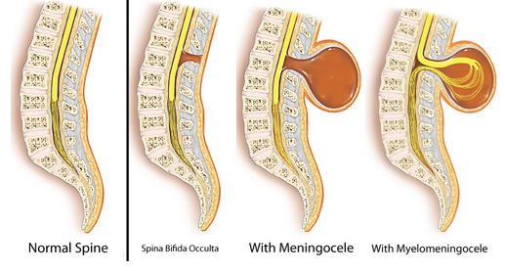
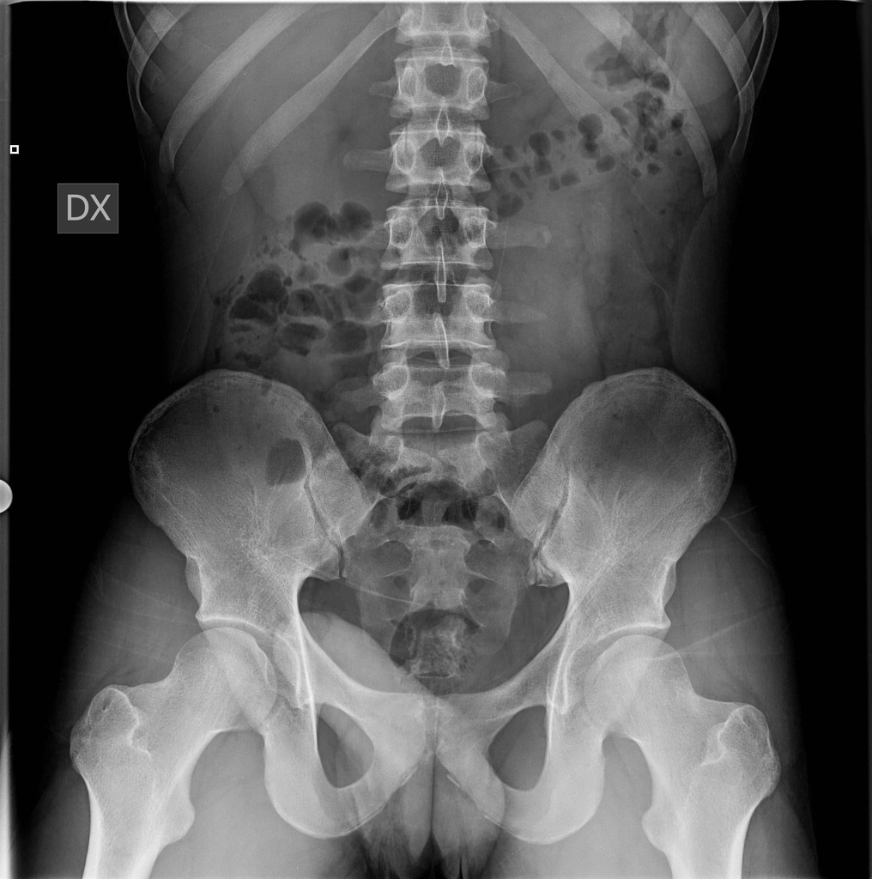
Neural tube defects (NTDs)
Spina bifida: spina bifida occulta – defect of vertebral arches covered with skin and usually does not affect the neural tissue – 10 % of population; meningocele; meningomyelocele
Rachischisis
Hydrocephaly due to Arnold-Chiari malformation

Slide 19
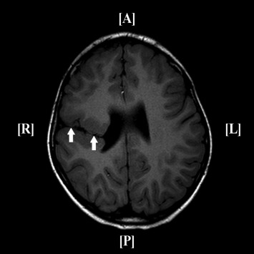
Cranial defects
Schisencephaly
Holoprosencephaly (HPE) – 1 in 15000 (1 in 250 early miscarriage)
Meningocele, meningoencephalocele, meningohydroencepahlocele – 1 in 12000
Exencephaly: anencephaly (=meroencaphaly – 2-4 times more common in female foetuses), craniorachischisis – polyhydramnios
Hydrocephaly – in most cases due to obstruction of the aqeduct of Sylvius (aqueductal stenosis)
Microcephaly
The leading cause of intellectual disability is maternal alcohol abuse!

