Slide 1
Development and teratology of sensory organs
Anna Mac Gillavry Danylevska
9.5.2022

Slide 2
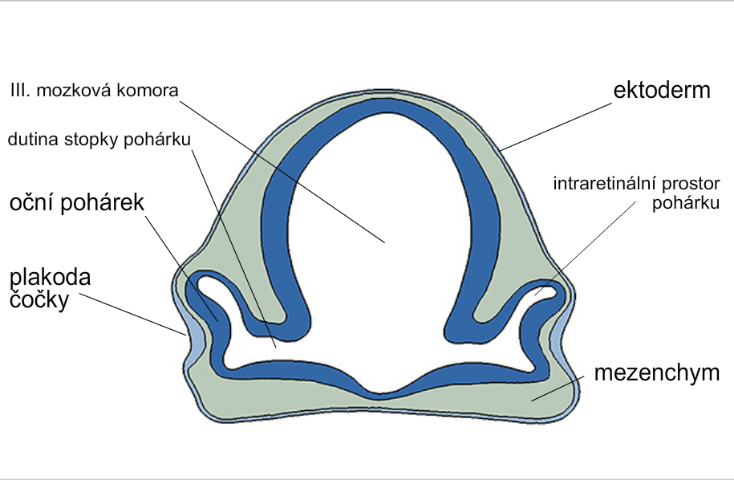
Development of the eye
3rd brain ventricle
ectoderm
stalk of optic cup
intraretinal space
of optic cup
optic cup
lens
placode
diencephalon
mesenchyme

Slide 3
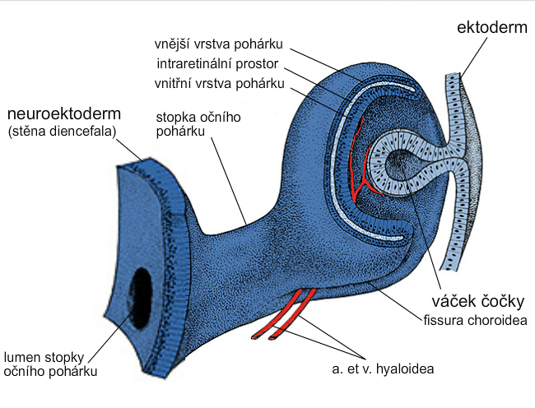
Development of optic cup and lens
ectoderm
outer layer of cup
intraretinal space
inner layer of cup
neuroectoderm
(wall of diencepalon)
stalk of optic cup
lens vesicle
lumen of stalk
of optic cup

Slide 4
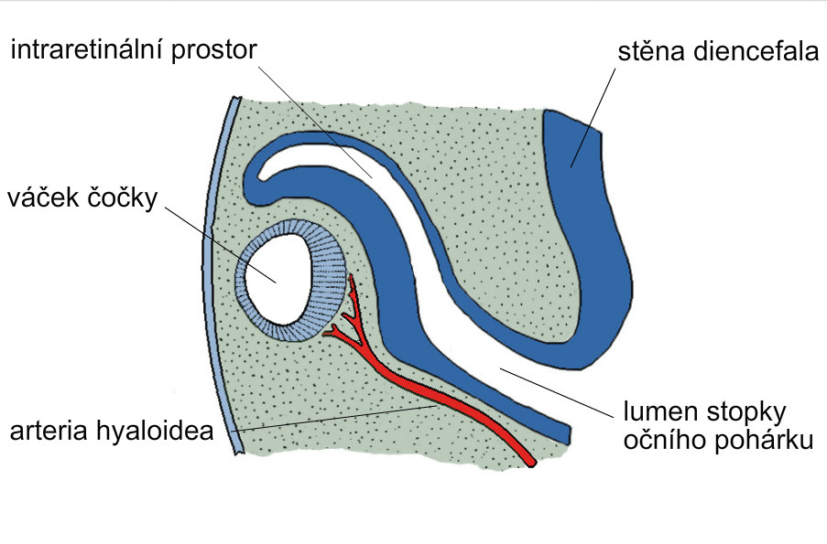
intraretinal space diencephalon wall
lens vesicle
lumen of stalk
of optic cup

Slide 5
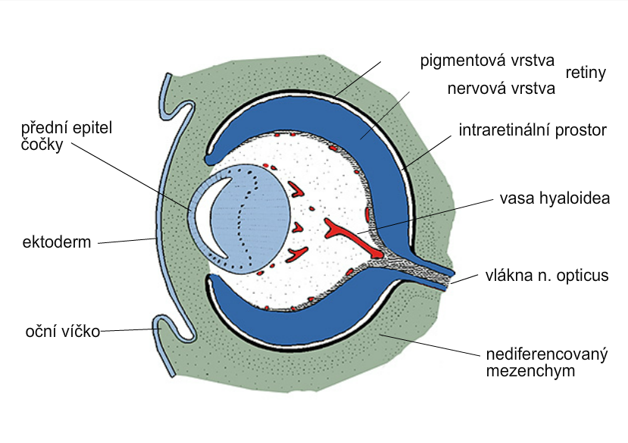
pigmented layer of retina
nervous layer of retina
anterior epithelium
of lens
intraretinal space
ectoderm
eyelid
mesenchyme

Slide 6
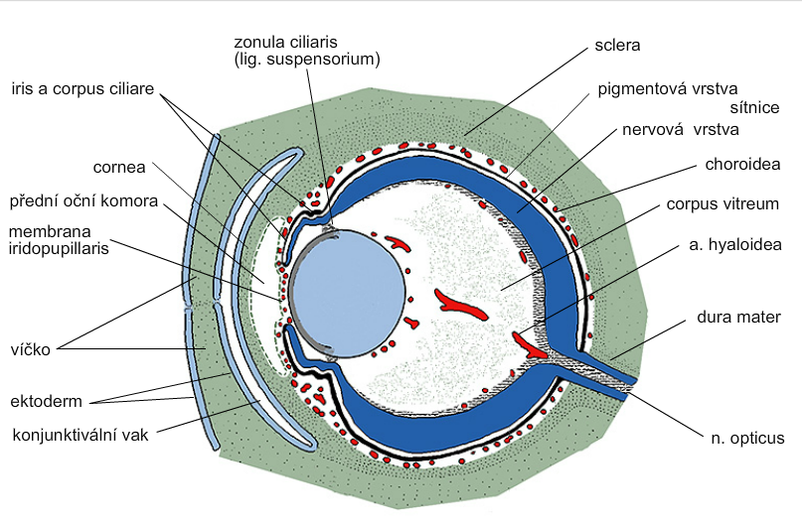
+
retinal pigmented layer
retinal nervous layer
camera oculi ant.
eyelid
ectoderm
conjunctival sac
mesenchyme

Slide 7
Eye abnormalities
Coloboma – in most cases coloboma iridis, frequently associated with other eye abnormalities; optic nerve coloboma is linked to PAX2 gene mutations – renal coloboma syndrome – autosomal dominant
Iridopupillary membrane
Sclerocornea
Peters anomaly
Congenital cataracts – rubella virus!
Persistent hyaloid artery (in 3 % of full term infants) – amblyopia, vitreous haemorrhage, retinal detachment

Slide 8
Microphtalmia – 1,5-1,9 in 10000, cytomegalovirus, toxoplasmosis
Anophtalmia – 0,18-0,4 in 10000
Congenital aphakia/aniridia – mutation in PAX6 results in aniridia; WAGR syndrome – microdeletion in chromosome 11 (PAX6 and WT1)
Cyclopia and synophtalmia (loss of midline tissue - holoprosencephaly) – alcohol, maternal diabetes, mutations in SHH and abnormalities in cholesterol metabolism

Slide 9
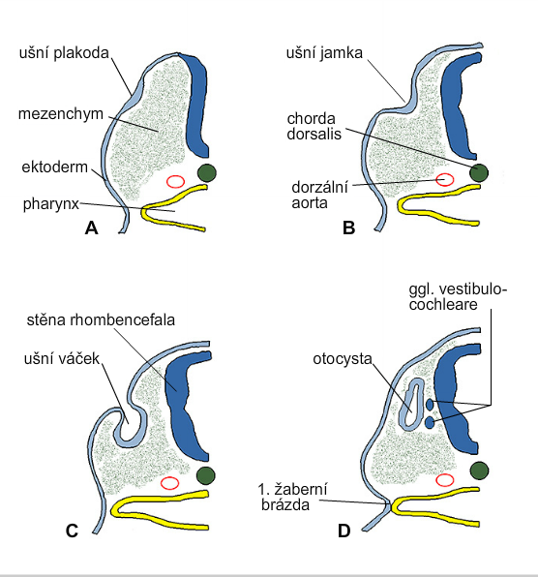
Development of the inner ear
otic placode
otic pit
mesenchyme
ectoderm
dorsal aorta
wall of rhombencephalon
otic pit
otocyst
the 1st
ectodermal
cleft

Slide 10
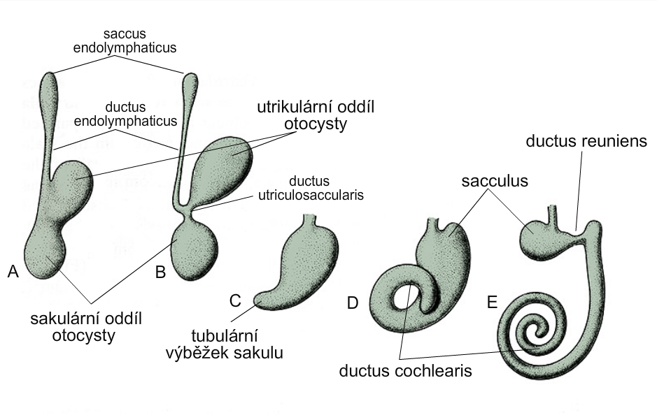
Development of membranous labyrinth
utricular part
of otocyst
saccular part
of otocyst
tubular process
of sacculus
T. W. Sadler, Langman’s medical embryology

Slide 11
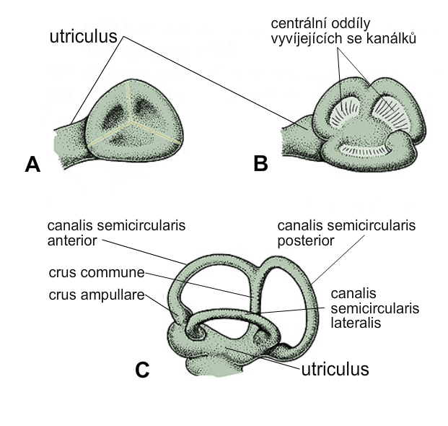
Development of semicircular canals
*central regions of developing
semicircular canals
*these regions
perforate later
T. W. Sadler, Langman’s medical embryology

Slide 12
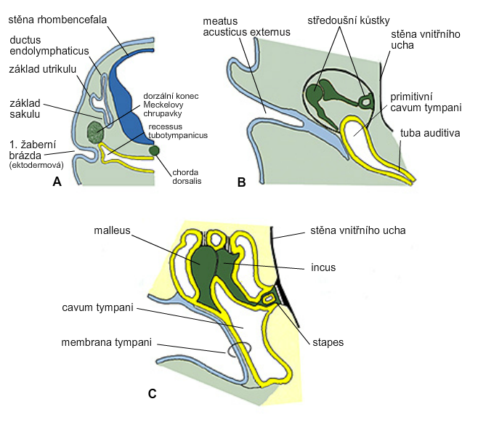
Development of middle ear
middle ear
ossicles
rhombencephalon
wall of inner ear
utriculus
sacculus
Meckel‘s
cartilage
primitive
cavum tympani
1st ectodermal
cleft
wall of inner ear

Slide 13
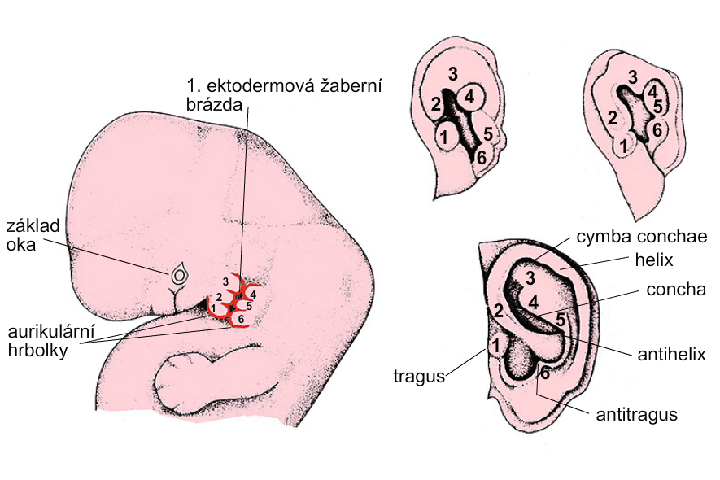
Development of external ear
the 1st ectodermal cleft
basis
of eye
auricular
tubercles
T. W. Sadler, Langman’s medical embryology

Slide 14
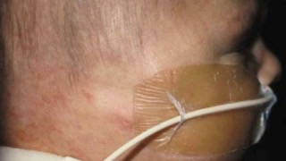
External ear defects
Anotia
Microtia
- (1 in 6000-12000) usually one ear is affected, the external accustic meatus is absent or narrowed – conductive hearing loss
Preauricular appendages and pits
All of the most common chromosomal syndromes and most of the less common have ear anomalies in their characteristics!!! (Langman’s medical embryology, T. W. Sadler, 12th edition, p. 328)
Anotia | Children's Hospital of Philadelphia (chop.edu)

Slide 15
Congenital hearing loss (sensory)
Genetic factors
Rubella virus, cytomegalovirus
Isotretinoin!

