Slide 1
Development and teratology of urinary system
28.3.2022
Anna Mac Gillavry Danylevska

Slide 2
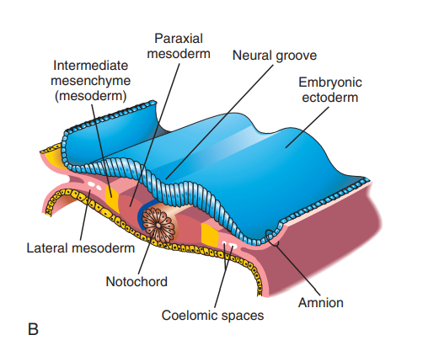

Slide 3
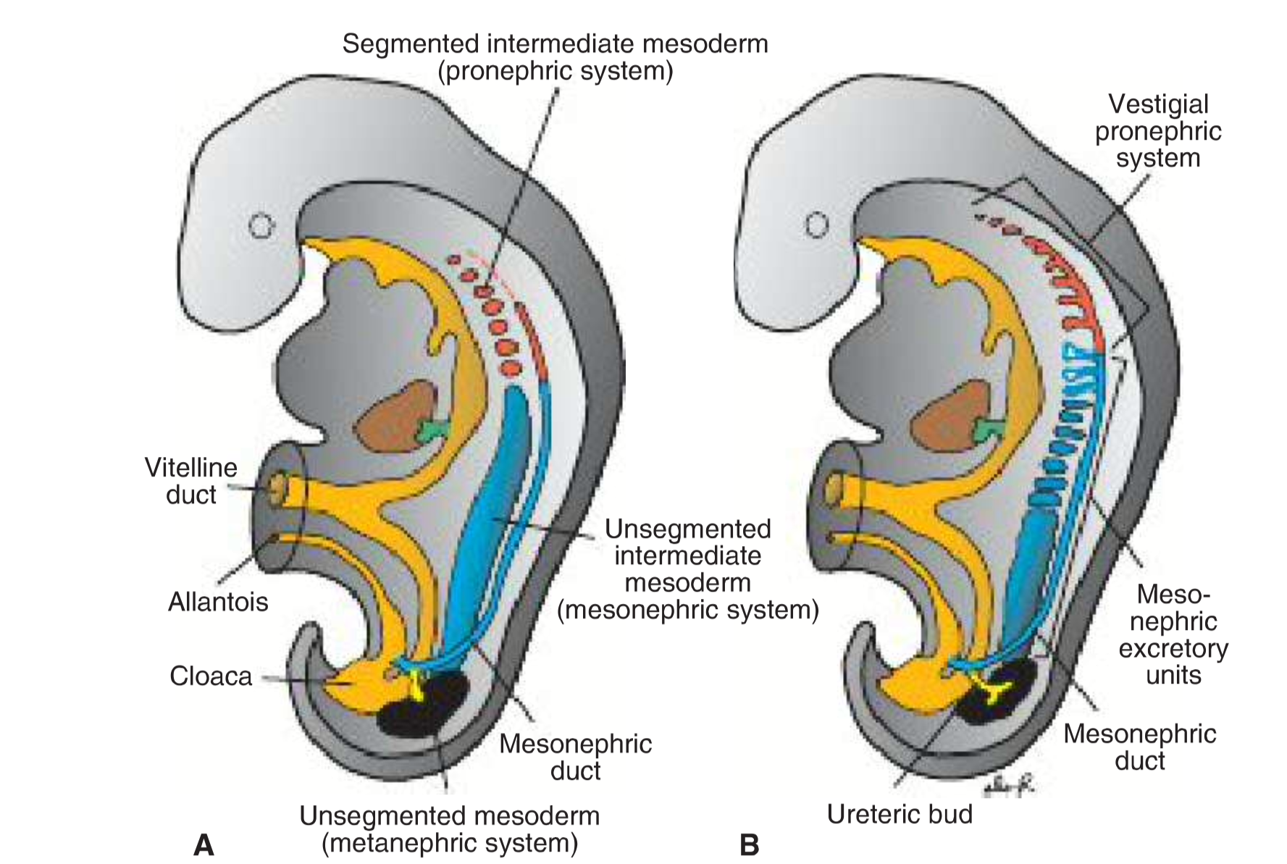
Pronephros: 4th week
Mesonephros: 4th – 10th week (6th – 12th week)
Metanephros: 5th to 9th week (12th week)
T.W. Sadler, Langman´s medical embryology, 12th edition

Slide 4
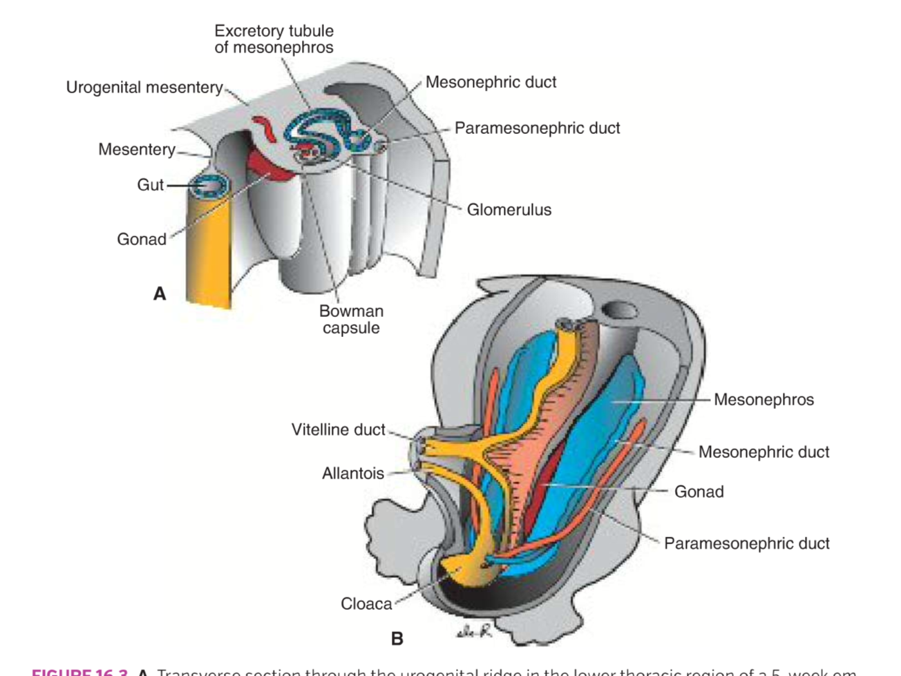
Mesonephros
T.W. Sadler, Langman´s medical embryology, 12th edition

Slide 5
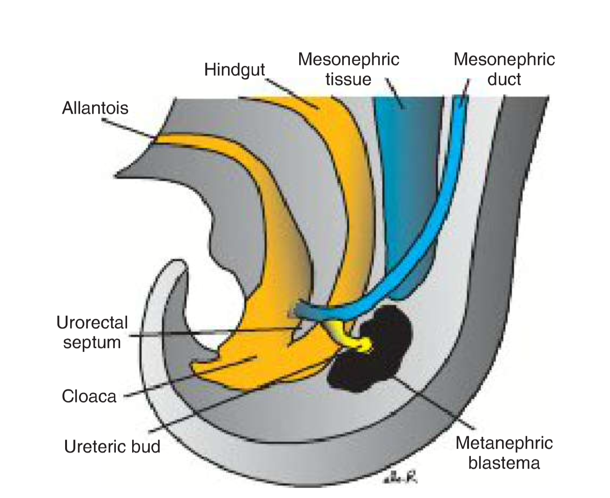
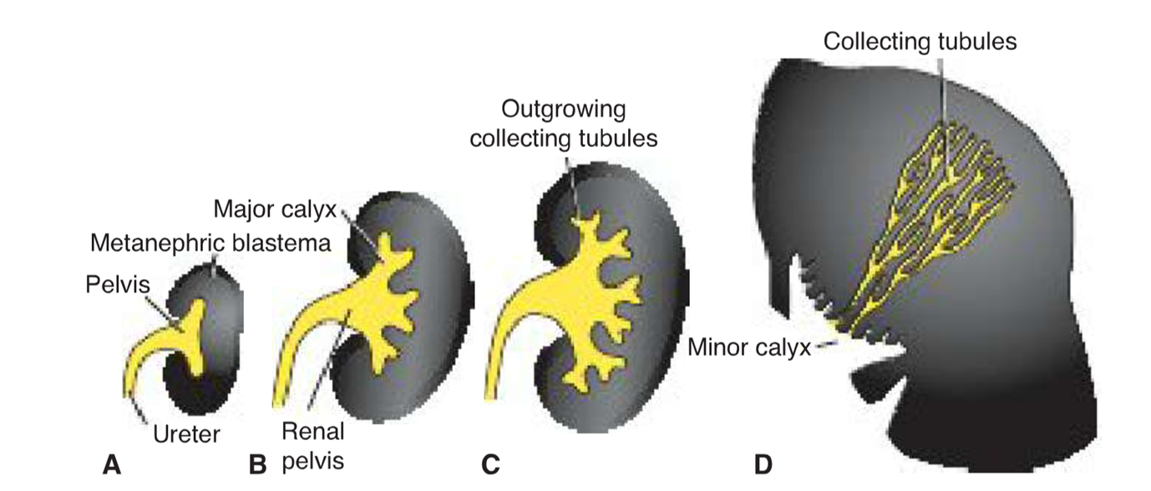
Metanephros
T.W. Sadler, Langman´s medical embryology, 12th edition

Slide 6
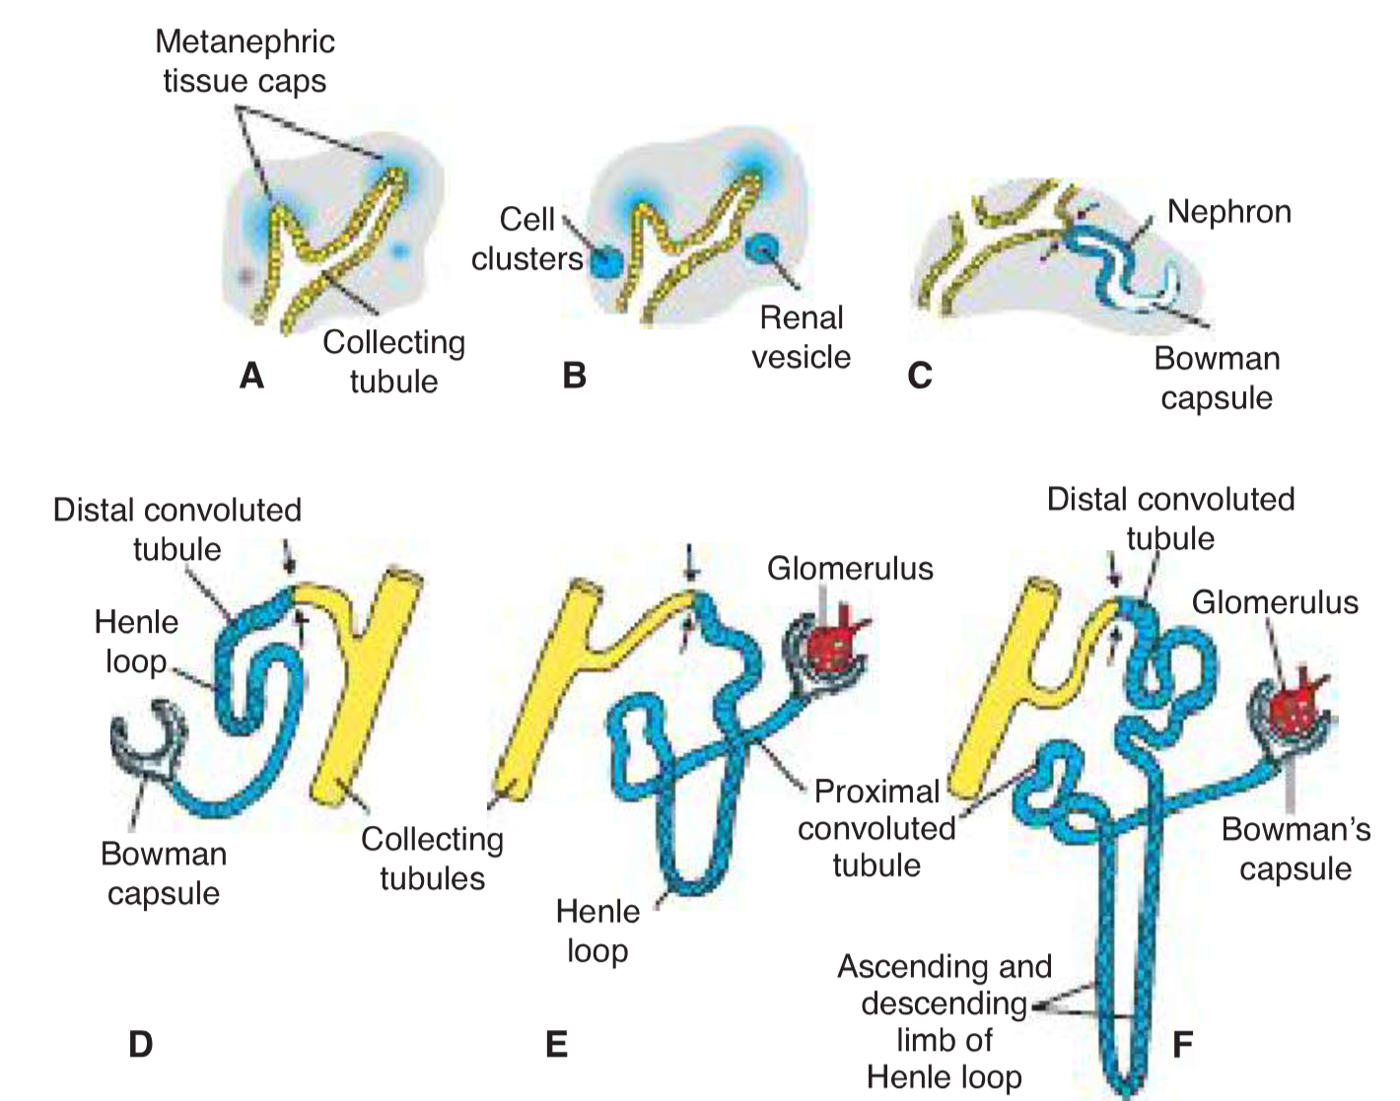
T.W. Sadler, Langman´s medical embryology, 12th edition

Slide 7
Renal defects
Renal agenesis: unilateral (1 in 1000)/bilateral (1 in 3000 – 10000; 3:1 males to females; Potter sequence: anuria, oligohydramnios, pulmonary hypoplasia)
Renal displasia
Multicystic displastic kidney
Congenital polycystic kidney disease: autosomal recessive (1 in 5000)/ autosomal dominant (1 in 500 to 1000) – group of cilliopathties Bardet-Biedl syndrome, Mackel-Gruber syndrom
Wilms tumor – affects children by 5 years of age incl. fetal period – WAGR syndrom, Denis-Drash syndrome

Slide 8
Renal defects
Duplication of the ureter – splitting of the uretric bud
Ectopic ureter – development of two uretric buds
Supernumerary kidney
Abnormal location:
- pelvic kidney
- horseshoe kidney (1/600)
- unilatelar fused kidney
- accessory (suprenumeral) renal arteries – 25% of kidneys have 2 to 4 arteries

Slide 9
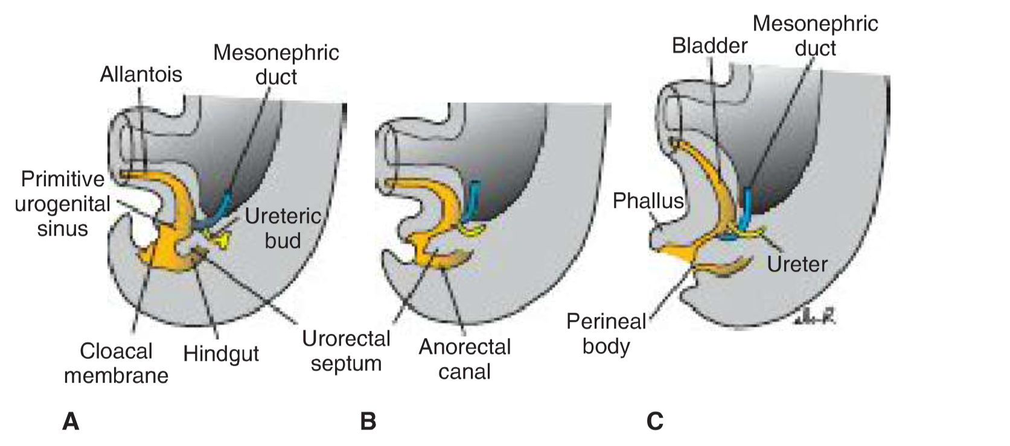
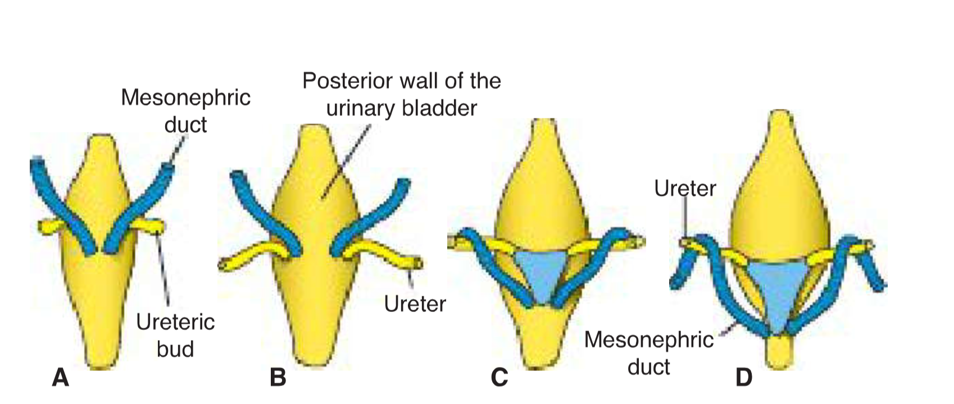
Bladder and urethra
Urogenital sinus:
- vesical part
- pelvic part
- phallic part
T.W. Sadler, Langman´s medical embryology, 12th edition

Slide 10
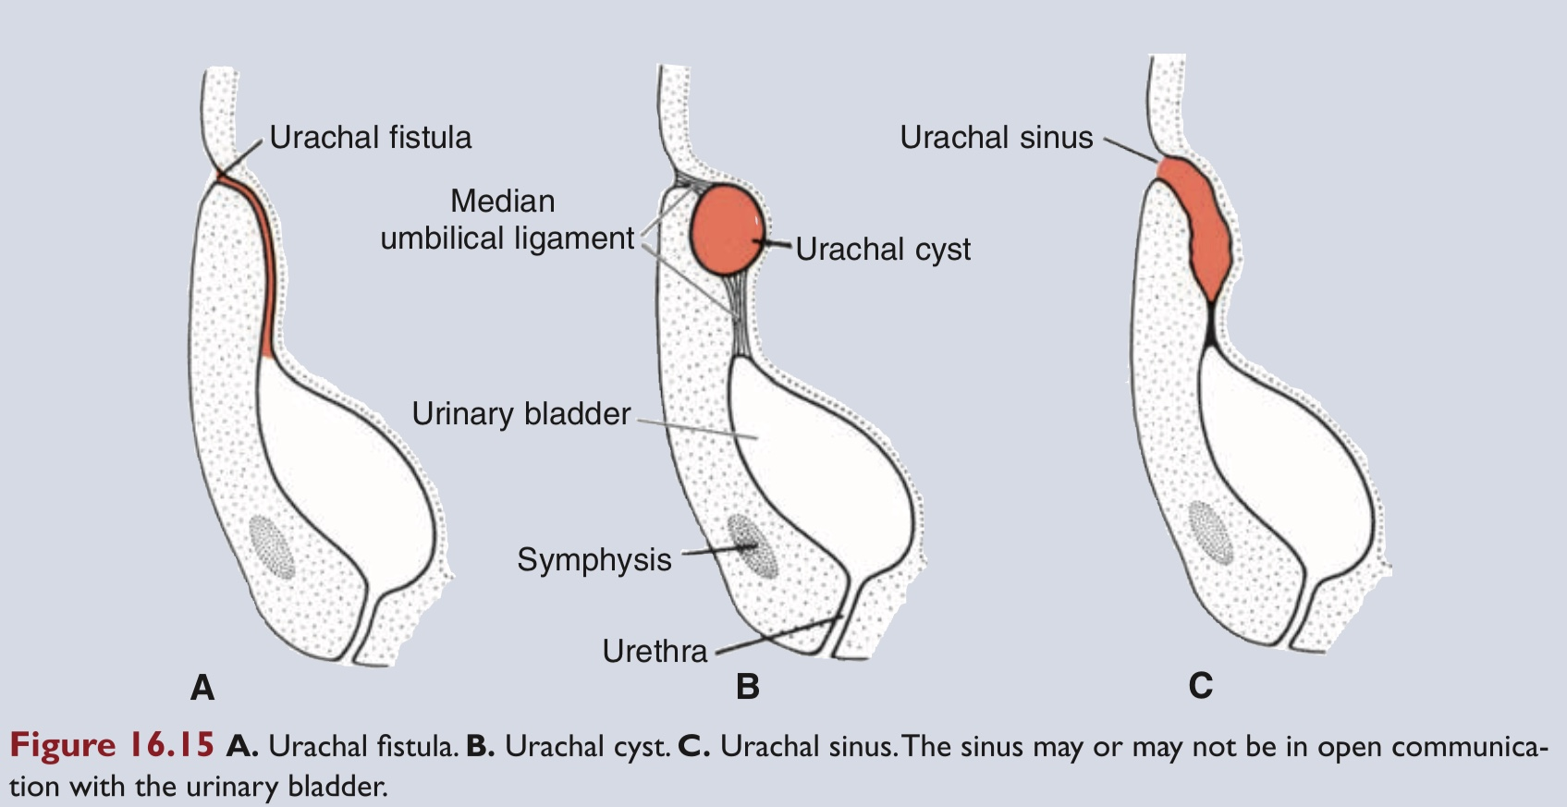
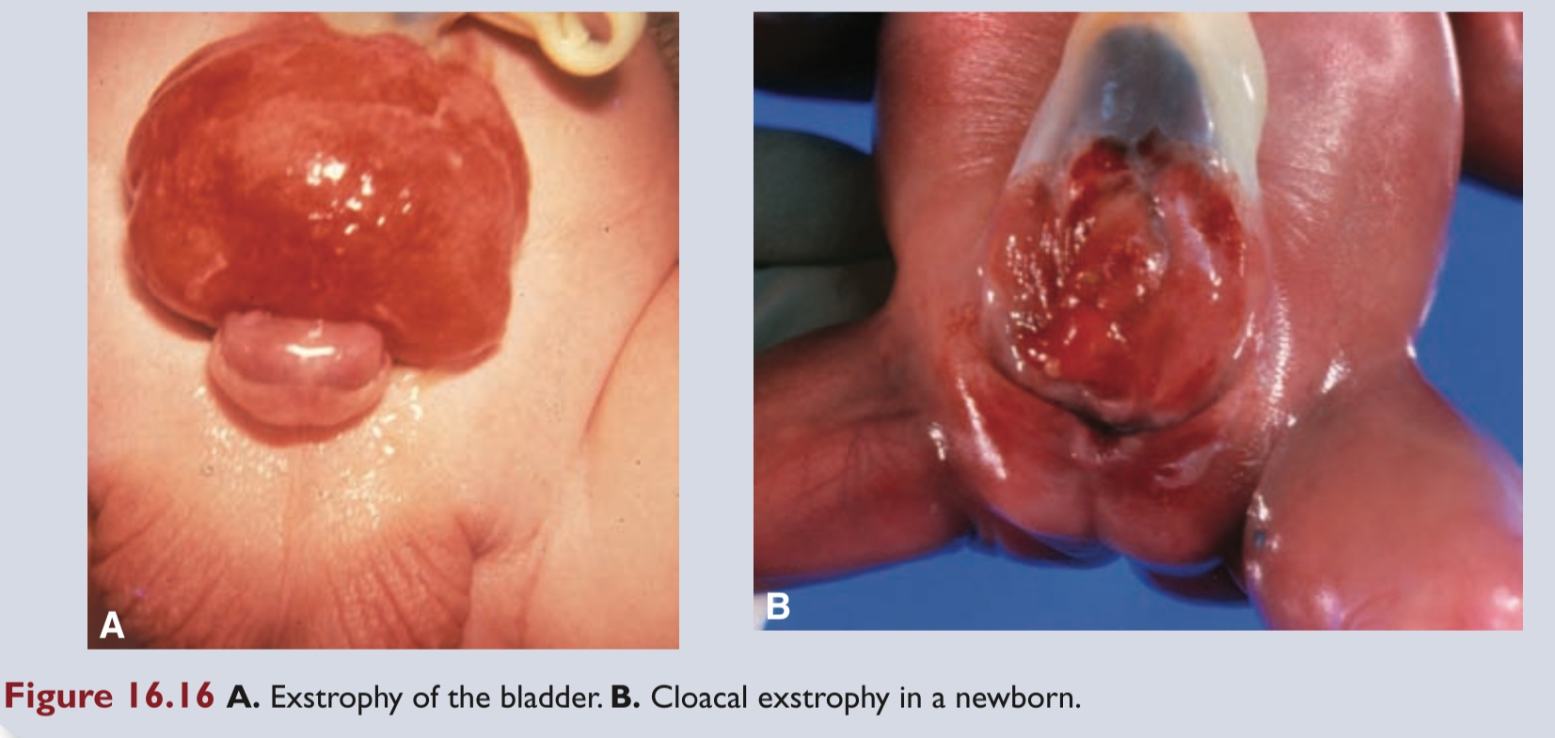
Urachal abnormalities:
urachal sinus
urachal cyst
urachal fistula
Extrophy of the bladder
(1-2/10000-40000)
Extrophy of the cloaca
T.W. Sadler, Langman´s medical embryology, 12th edition

