Slide 1
ECG – Electrocardiography
Practical Exercises in Physiology (Spring semester: 4th - 6th weeks)

Slide 2
Electrocardiography
Definition: recording the cardiac electrical activity from the surface of the body (el. heart activity can also be obtained from the esophageal leads or the heart surface itself, but these methods are used by other names)

Slide 3
Cardiac conduction system
Sinoatrial node (SA)
Atrial preferential ways
SA node
Atrial myocyte
Atrioventricular node (AV)
AV node
His bundle
Tawara branches
His bundle
Purkynje fibers
Ventricular myocyte
Tawara (bundle) branches
Purkynje fibers

Slide 4
Cardiac conduction system
Function: AP formation and preferential conduction
The atriums are separated from the chambers by a non-conductive fibrous septum - the only way is through the AV
Sinoatrial node (SA) - natural frequency 100 bpm (mostly under parasympathetic damping effect), conduction velocity 0.05 m/s
Preferred internodal atrial ways - conduction velocity 0.8 - 1 m / s
Atrioventricular node - single conductive connection between atria and ventricles, natural frequency 40 - 55 bpm, conduction velocity only 0.05 m / s (nodal delay)
His bundle – conduction velocity 1–1,5 m/s
Tawara (bundle) branches – conduction velocity 1–1,5 m/s
Purkynje fibers – conduction velocity 3–3,5 m/s
Sinus rhythm - AP starts at the SA node
Junction rhythm - AP is formed in the AV node or His bundle
Tertiary (ventricular) rhythm - AP is formed in bundle branches or Purkynje fiber
Ventricular myocardial activation - from inside to outside, markedly synchronized, determined by the onset of excitement
Repolarization of ventricular myocardium - in the opposite direction, less sharp, repolarization isles
Note: natural frequency is the frequency of AP formation unaffected by neural and hormonal control
natural frequencies of 20 - 40 bpm, they have slow spontaneous depolarization

Slide 5
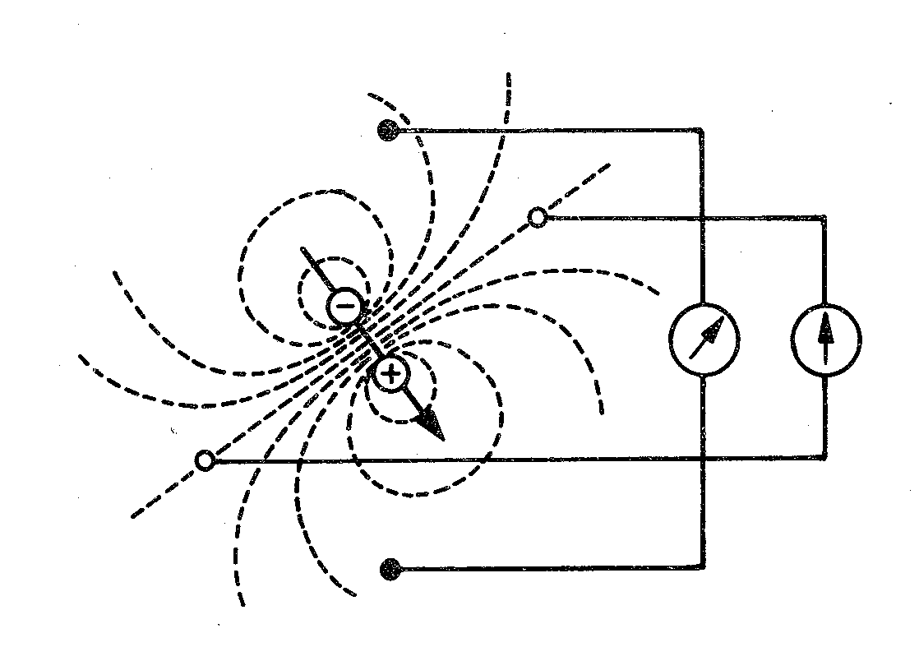
Electric dipole
electrode
Electrode: records electrical potential (Φ)
Electrical lead: connection of two electrodes
It records the voltage between the electrodes
Voltage: difference of el. potentials (V= Φ1- Φ2)
Φ2
lead
Φ1

Slide 6
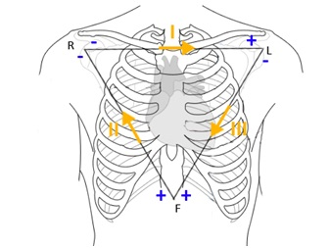
Einthoven triangle (standard, limb, bipolar leads)
Bipolar leads: both electrodes are active (variable electrical potential)
Electrode colors: R: red, L: yellow, F: green
I
R
L
II
III
F

Slide 7
Goldberger leads (augmented, limb, unipolar leads)
Unipolar leads: one electrode is active (variable electric potential) and the other is inactive (constant electric potential, usually 0 mV)
The active electrode is always positive
R
L
avR
aVL
aVF
F

Slide 8
Wilsonova central terminal (W)
It is formed by the connection of limb electrodes through resistors
electrically represents the center of the heart (it is actually led out or it is calculated)
Inactive electrode (constant potential)
+
+
-
Central terminal
-
Real central terminal
+

Slide 9
Chest leads
Chest lead: connection of chest electrode and central terminal
Unipolar leads: chest electrode is active (positive) and central terminal is inactive (0 mV potential)
hrudní elektroda
1
2
3
5
6
4

Slide 10
Leads according to Cabrera
–
I
–
–
R
+
L
–
+
-
+
+
+
–
aVR
aVL
–
aVL
-30°
–
+
-
-
III
II
aVF
I
0°
–
–
+
+
+
aVR
F
+
30°
+
+
II
III
aVF
60°
120°
90°

Slide 11
Analysis of ECG
Heart action
Heart rhythm
Heart rate
Waves, segments and intervals
P wave
PQ interval
QRS complex
ST segment
T wave
QT interval
Electrical heart axis
Ventricular depolarization - QRS
R
Ventricular repolarization
Atrial depolarization
T
P
Svod II
Q
S

Slide 12
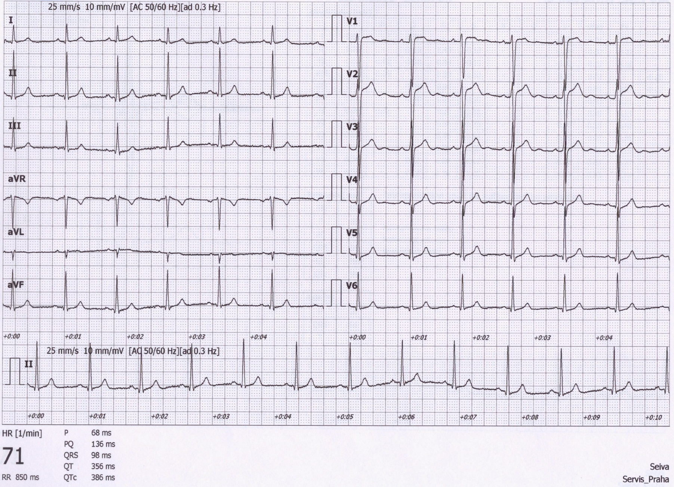
Analysis of ECG
A millimeter grid of paper will help in fast analysis
See the paper speed (here 25 mm / s)v
How many ms is one mm?
It is good to know how much mV is one mm

Slide 13
1) Heart action
Regularity of distances between QRS complexes - RR intervals
Calculate difference: RR – mean RR (you only need to choose the shortest and longest RR in the record)
Regular action: difference < 0,16 s
Irregular action: difference > 0,16 s
Usually pathological
Beware of significant sinus respiratory arrhythmia - it is very physiological. If you are unsure, ask the patient to hold their breath during recording
Note: if one extrasystole is present, but otherwise the action is regular, it is called regular
RR

Slide 14
2) Heart rhythm
Heart rhythm is determined by the source of action potentials that lead to ventricular depolarization ventricular depolarization is crucial, because it determines cardiac output
Sinus rhythm
AP begins in SA node
On ECG: present P wave (atrial depolarization) before QRS
Junction rhythm
AP begins in AV node or His bundle, the frequency is usually 40-60 bpm
P wave is not before QRS, QRS is normal (narrow)
Heart rate is low (40-60 bpm)
Atrial depolarization can be present in the ECG if the ventricular impulses are transferred to the atria - wave is after QRS and has opposite polarity because it runs in opposite direction
Tertial (ventricular) rhythm
AP begins in other parts of the conduction system, frequency 30-40 bpm
QRS has a strange shape (wider), because it spreads in a non-standard direction in the ventricles

Slide 15
3) Heart rate (HR)
Frequency of ventricular contraction (because it determines cardiac output); on ECG - frequency of ventricular depolarizations
HR = 1 / RR bpm
Physiological: 60 - 90 bpm at rest
Tachycardia: > 90 bpm in rest
Can be sinus (increase sympathetic activity, medication, …)
Tachyarrhythmias: rhythm is not sinus
Bradycardia: < 60 bpm
Can be sinus (increase sympathetic activity, sport heart - physiological)
HR < 50 bpm, rhythm probably is not sinus

Slide 16
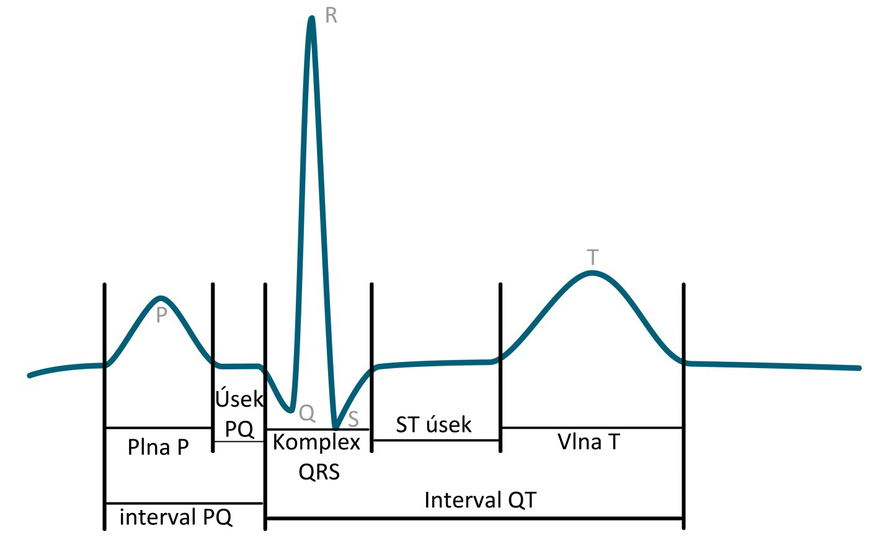
4) Waves, segments, intervals
Name | Norm
wave P | 80 ms
interval PQ (PR) | 120-200 ms
segment PQ (PR) | 50-120 ms
Q | -
complex QRS | 80-100ms
R | -
S | -
segment ST | 80-120 ms
interval QT | < 420ms
wave T | 160 ms
R
T
P
PQ segment
ST segment
Q
S
P wave
QRS complex
T wave
QT interval
Bazett´s formula:$QTc=\frac{QT}{\sqrt{RR}}$
QT depends on RR interval – correction of QT on RR
PQ interval

Slide 17
4) Waves, segments, intervals
name | Place and description | Physiological bacground | Norm
wave P | First round wave (negative or positive) | Atrial depolarization | 80 ms
Interval PQ (PR) | Interval from beginning of P to beginning of Q (or R, if Q is not present) | Time interval from SA node activation to the Purkynje fibers activation | 120-200 ms
segment PQ (PR) | From P wave end to beginning of Q (or R, if Q is not present) | Complete atrial depolarization, AP transfer from AV to ventricles | 50-120 ms
Q | First negative deflection | Depolarization of septum and papilar muscles | -
complex QRS | From beginning of R to end of S | Ventricular depolarization | 80-100ms
R | Positive deflection | Main ventricular depolarization | -
S | Negative deflection after positive deflection. |  | -
segment ST | Interval of isoelectric line between end of QRS and beginning of T wave | Complete depolarization of ventricles | 80-120 ms
Interval QT | From beginning of Q (or R) to the end of wave T | Electrical systole | < 420ms
wave T | Second round wave (negative or positive) | Ventricular repolarization | 160 ms

Slide 18
4) Waves
Wave P:
Is present?
Is positive/negative, one-peak/two-peak, high(>0,25mV)/normal/low?
QRS:
Q: first negative deflection
R: first positive deflection
S: negative deflection after positive deflection
small deflection (pod 0,5 mV) – small letter
Strong deflection – capital letter
Second positive deflection (‘)
Wave T:
Is positive/negative/bipolar?
Does it have the same polarity as the strongest QRS deflection?
Yes: concordant (ok), No: discordant (pathology)
Bipolar T:
Preterminal negative (-/+)
Terminal negative (+/-)
Examples:
RS
Ventricular depolarization - QRS
R
qRs
rSr‘
Ventricular repolarization
Atrial depolarization
T
P
Lead II
Q
S

Slide 19
5) Electrical heart axis
Electrical heart axis: average direction of the electric heart vector during ventricular depolarization (QRS complex) (can also be determined for atrial depolarization: P, or ventricular repolarization: T, but in practice we will analyse ventricular depolarization)
El. heart axis
–
–
–
+
+
aVL
-30°
Heart axis is physiologically directed down, left, back - refers to the real placement of the heart in the chest.
- Here we solve only the frontal plane (limb leads)
–
+
I
0°
Physiological range:
Middle type 0° – 90°
Left type -30° - 0°
Right type 90° - 120°
Pathological range:
Right deviation: > 120 ° (P ventricular hypertrophy, dextrocardia)
Left deviation: < -30° (L ventricular hypertrophy, pregnancy, obesity)
–
–
aVR
+
30°
+
+
II
vectocardiogram
III
aVF
60°
120°
the axis is also changed when Tawara branches are blocked or after IM, missing el. activity of part of chambers
90°

Slide 20
Electrical heart axis - evaluation
Because the el. axis is related to ventricular depolarization in the frontal plane, use QRS in limb leads: I, II, III.
Calculate the sum of QRS oscillations in leads I, II, III. When the oscillation is down, it is negative. When the oscillation is up, it is positive. Use a millimeter grid
Lead I: Q_{I}=-1; R_{I}=6; S_{I}=0; QRS_{I}=5
Lead II: Q_{II}=-1; R_{II}=17; S_{II}=-1; QRS_{II}=15
Lead IIII: Q_{III}=0; R_{III}=10; S_{III}=-1; QRS_{III}=9

Slide 21
Electrical heart axis - evaluation
Draw the Einthoven Triangle with Goldberger augmented Leads
Mark the angles around the triangle (in the circle)
Lead I:
0 at lead I is in the center of lead
QRS_{I} = 5, so from 0, measure 5mm towards the positive electrode, make a mark (or any other units, ratio is important)
If the sum of QRS is negative, you will go towards the negative electrode
Run a line from the mark perpendicular to the I lead (parallel to the aVF lead)
I
–
0
5
+
-30°
–
–
0°
II
III
0
0
9
30°
15
+
+
120°
60°
90°

Slide 22
Electrical heart axis - evaluation
Lead II:
0 at lead II is again in the center of lead
QRS _{II} = 15, so from 0, measure 15 mm towards the positive electrode, make a mark (again, if the sum of QRS is negative, you will go towards the negative electrode)
Run a line from the mark perpendicular to the II lead (parallel to the aVL lead)
I
–
0
5
+
-30°
–
–
0°
II
III
0
0
9
30°
15
+
+
120°
60°
90°

Slide 23
Electrical heart axis - evaluation
Lead III:
The same way draw line for QRS _{III} = 9
Draw an arrow that starts at the center of the triangle and passes the cross of the drawn lines
This arrow shows the direction of the cardiac electrical axis in the frontal plane
Note. logically, only lines from two leads are sufficient
I
–
0
5
+
-30°
–
–
0°
II
III
0
0
9
30°
The cardiac electrical axis for ventricular depolarization in the frontal plane is 70 °
15
+
+
120°
60°
90°

Slide 24
Leads II a aVR
Note the appearance of the ECG in lead II and aVR. Both leads look at electrical cardiac activity from a similar angle (deviation only 30 °), but the aVR has the opposite polarity (it looks at the heart upside down compared to II).Therefore, leads II and aVR are similar, only mirror-inverted.
–
–
–
+
+
aVL
-30°
–
+
I
0°
qRs
–
–
aVR
+
30°
+
rSr‘
+
II
III
aVF
60°
aVR usually has negative T and P
120°
90°
Due to its different appearance, QRS has different description in lead aVR and II.

Slide 25
QRS in limb leads and axis
amplitudes of Q, R, and S
Sum of QRS
description of QRS
Q = -1
R = 6
S = 0
QRS = 5
qR
Q = -1
R = 17
S = -1
QRS = 15
qRs
Q = 0
R = 10
S = -1
QRS = 9
Rs
Q = 1
R = -11
S = 0
QRS = -10
rS
Q = 0
R = -3
S = 0
QRS = -3
q
Q = -1
R = 13
S = -1
QRS = 11
qRs

Slide 26
amplitudes of Q, R, and S
Sum of QRS
Electric axis estimation
Find the lead with the largest and smallest sum of QRS (just by eye) - these leads will be perpendicular to each other. The angle of lead with the largest sum of QRS will determine approximately el. heart axis. It is not be perfectly accurate, but it is sufficient in practise.
Q = -1
R = 6
S = 0
QRS = 5
–
Q = -1
R = 17
S = -1
–
–
QRS = 15
+
+
aVL
-30°
Q = 0
R = 10
S = -1
QRS = 9
–
+
0°
Q = 1
R = -11
S = 0
I
QRS = -10
–
Q = 0
R = -3
S = 0
–
QRS = -3
aVR
30°
+
+
Q = -1
R = 13
S = -1
El. cardiac axis slightly more than 60 °
III
+
II
QRS = 11
aVF
60°
120°
90°

Slide 27
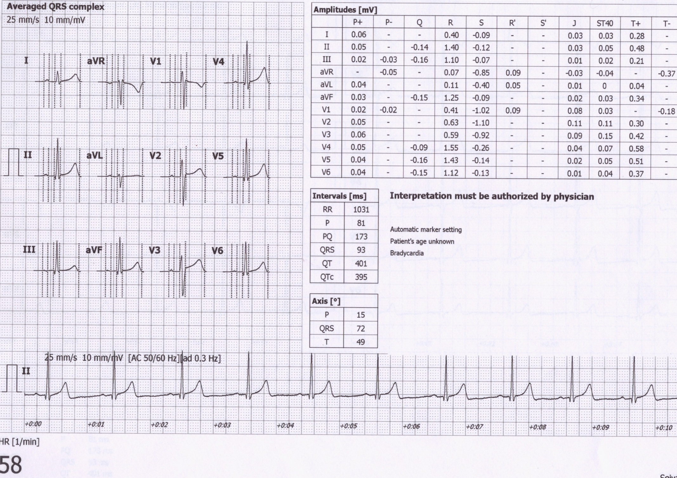
Electric axis calculation by software
Electrical axis for atrial depolarization
72°
Electrical axis for ventricular depolarization
Electrical axis for ventricular repolarization

Slide 28
Diagnostic use of ECG

Slide 29
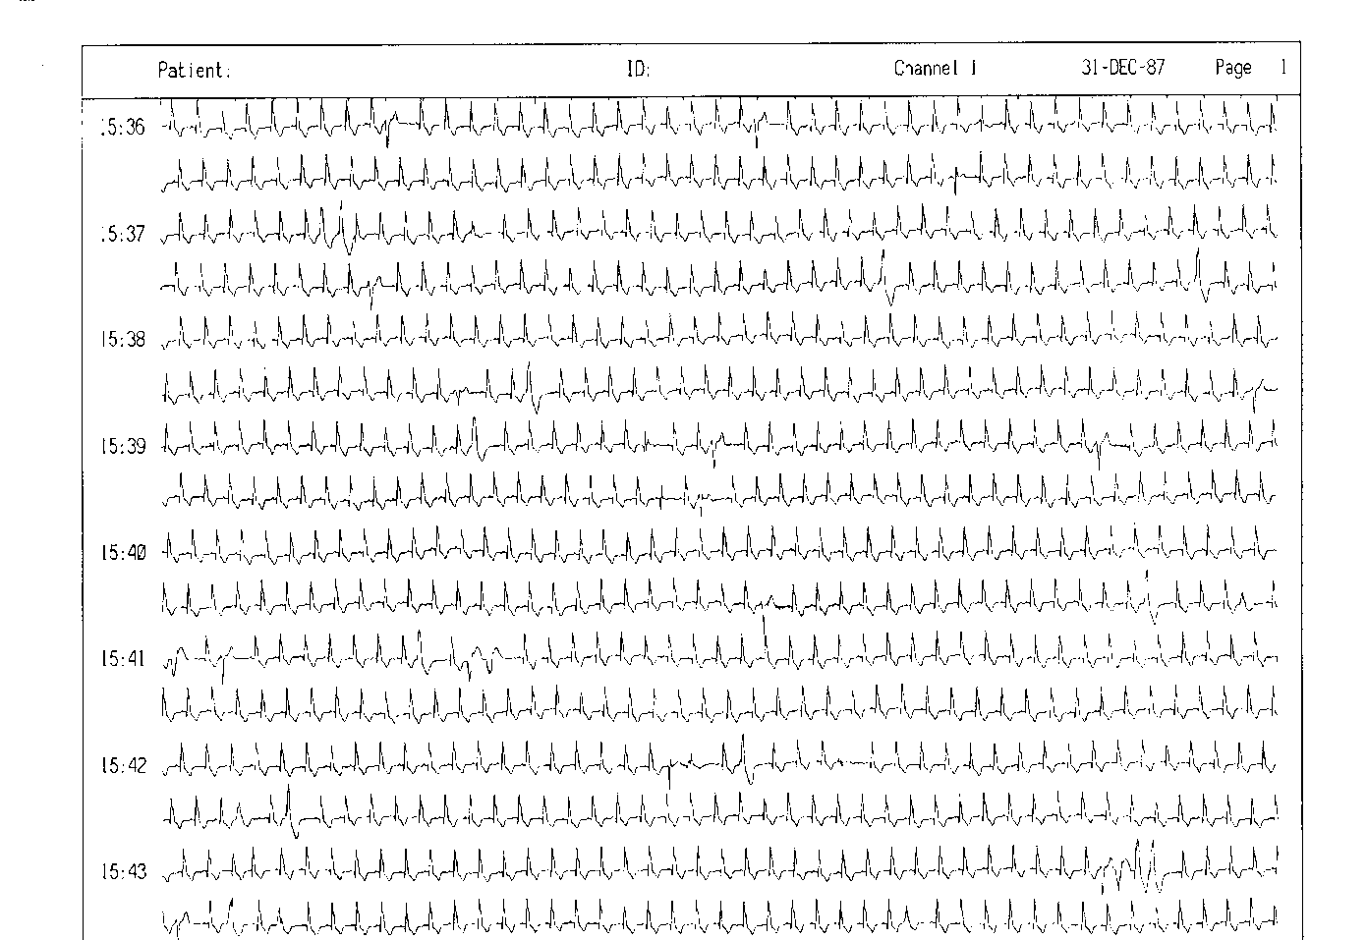
ECG Holter
24-hour monitoring of ECG

Slide 30
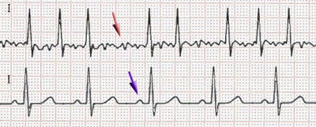
Fibrillation
Arrhythmia: a disorder of heart rhythm, formation or conduction of the excitation
Fibrillation: unsynchronized cardiomyocyte activity. Cardiac muscle is „shaking“
Atrial – missing P, slightly irregular "serrated" isoline, irregular RR (usually), frequency 80 - 180 bpm. QRS is normaly shaped. It is not life threatening. Ventricular refraction time protects ventricles from HR higher than 180 bpm, but it still exhausts the heart. Heart activity is not regulated. Risk of trombembolia
Fibrillation
Normal ECG
Ventricular – the heart does not function as a pump (cardiac arrest), zero cardiac output, brain damage after 3 - 5 minutes of fibrillation, without early defibrillation the cardiomyocytes become exhausted → asystole
Asystole – no electrical activity of cardiomyocytes, non-defibrillable
→ Cardio-Pulmonary Resuscitation (CPR), early defibrillation (adrenalin and amiodaron)
Video: https://www.youtube.com/watch?v=lU3NHrjw-lA&ab_channel=NerdDoctor
→ CPR and adrenalin

Slide 31
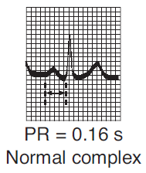
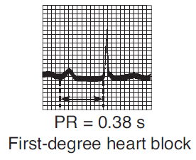
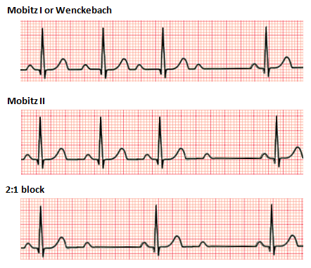
Atrioventricular block (heart block)
AV block: disorder of the transmission of depolarization from the atria to the ventricles
AV block I. degree
AV block II. degree
prolongation of the transfer of depolarization from the atrium to the ventricles, prolonged PQ
AV block III. degree
some atrial depolarizations do not transfere: occurrence of P, which is not followed by QRS
A complete blockage of the transfer of depolarization from the atria to the ventricles, P and QRS are not synchronized
Pulse rate possibly very low → insufficient cardiac output
https://upload.wikimedia.org/wikipedia/commons/thumb/6/64/Afib_ecg.jpg/400px-Afib_ecg.jpg http://www.qureshiuniversity.com/Ventricular%20Fibrillation.gif
https://ekg.academy/ekgtracings/313.gif

Slide 32
Artial flutter
Regular „teeth“ between the QRS.
Regular RR, tachycardia.
The basis is the atrial re-entry.
The regularity is given by the number of "turns" of atrial depolarization per transfer to the chambers (in the picture: 3 turns per 1 transfer to the chambers, ie 3:1).
If the flutter does not disappear, it changes into atrial fibrillation
Danger of the deblocked flutter 1:1 (each atrial turn is transfered in ventricles) – exhaustion of ventricles
Risk of trombembolia

Slide 33
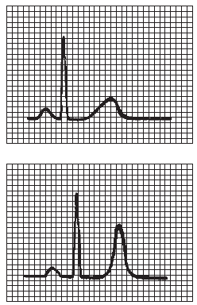
Diagnostic use of ECG
Cardiac ischemia, myocardial infarction
Electrolyte dysbalance - hyperkalemia
normal
ST elevation,
sign of ischemia
Large QRS, hight T
A
B
C
D
E
ischemia
Time

Slide 34
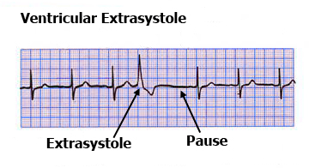
Extrasystoles - ectopic excitements
Supraventricular – atrial
normal shape of QRS (depolarization spreads normaly in ventricles),
P wave does not have a normal shape (it can be negative or covered by QRS),
may have a postextrasystolic pause (re-propagation of depolarization through the atria)
Ventricular
Large, non-normal shape of QRS
at a slow heart rate there is no compensatory pause (extrasystole is interspersed between normal QRS)
or contains a compensating pause if the next depolarization coming from the SA node comes at a time when the ventricles are still refractory
Atrial extrasystole
T+P
P
P
P
P
P
P
P
https://www.stefajir.cz/supraventrikularni-extrasystola-ekg https://www.techmed.sk/predsienova-extrasystola/
https://thoracickey.com/atrial-ectopic-beats/

Slide 35
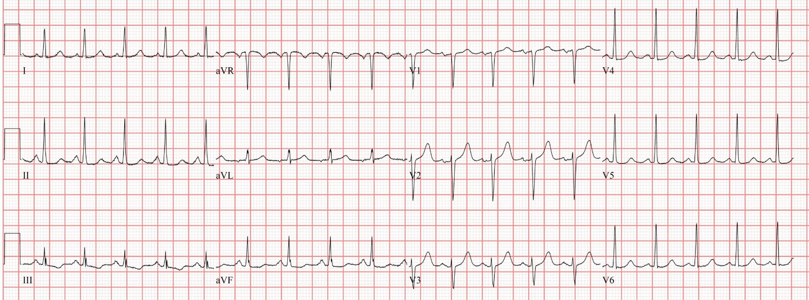
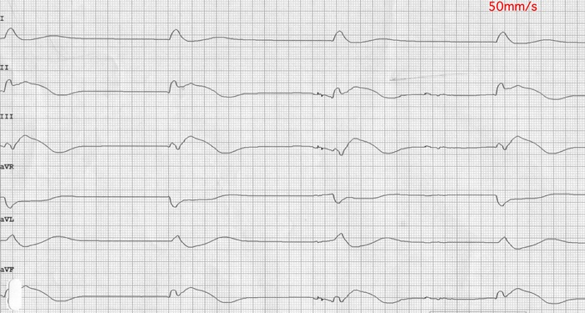
PEA – pulseless electrical activity
PEA refers to cardiac arrest in which the electrocardiogram shows a heart rhythm that should produce a pulse, but it does not. PEA can look almost like normal ECG activity. Pulseless electrical activity is found initially in about 55% of people in cardiac arrest.
Under normal circumstances, electrical activation of muscle cells precedes mechanical contraction of the heart (known as electromechanical coupling). In PEA, there is electrical activity but insufficient cardiac output to generate a pulse and supply blood to the organs.
PEA is classified as a form of cardiac arrest.
non-defibrillable, therapy: Cardio-Pulmonary Resuscitation and adrenalin
Important !: Regular electrical activity on ECG does not mean maintained circulation. Always check for a central arterial pulse.
https://www.researchgate.net/publication/334071817_Impact_of_Transitory_ROSC_Events_on_Neurological_Outcome_in_Patients_with_Out-of-Hospital_Cardiac_Arrest/figures?lo=1, https://www.stefajir.cz/bezpulzova-elektricka-aktivita-ekg, https://medcourse.in/learn/lesson/asystole-and-pulseless-electrical-activity-pea/, https://en.wikipedia.org/wiki/Pulseless_electrical_aktivity,

Slide 36
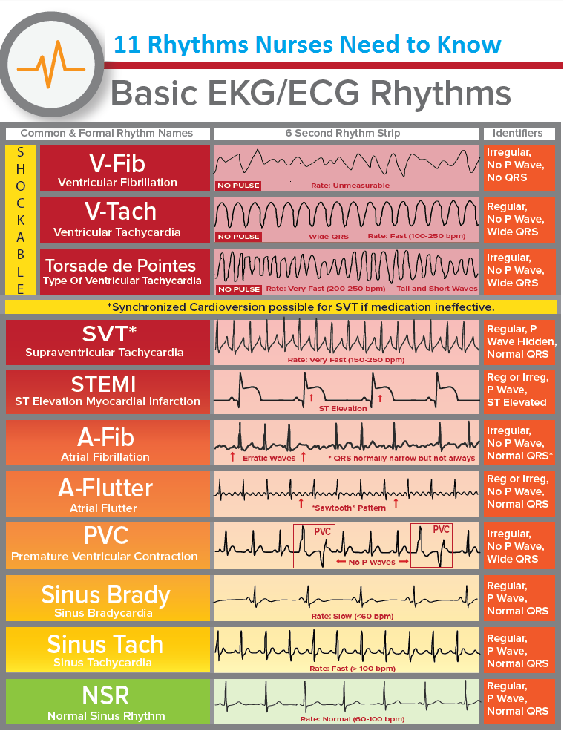
https://www.medicalestudy.com/basic-ecgekg-rhythms-nclex-cheat-sheet/

