Slide 1
Global Burden of Disease
Global Health

Slide 2
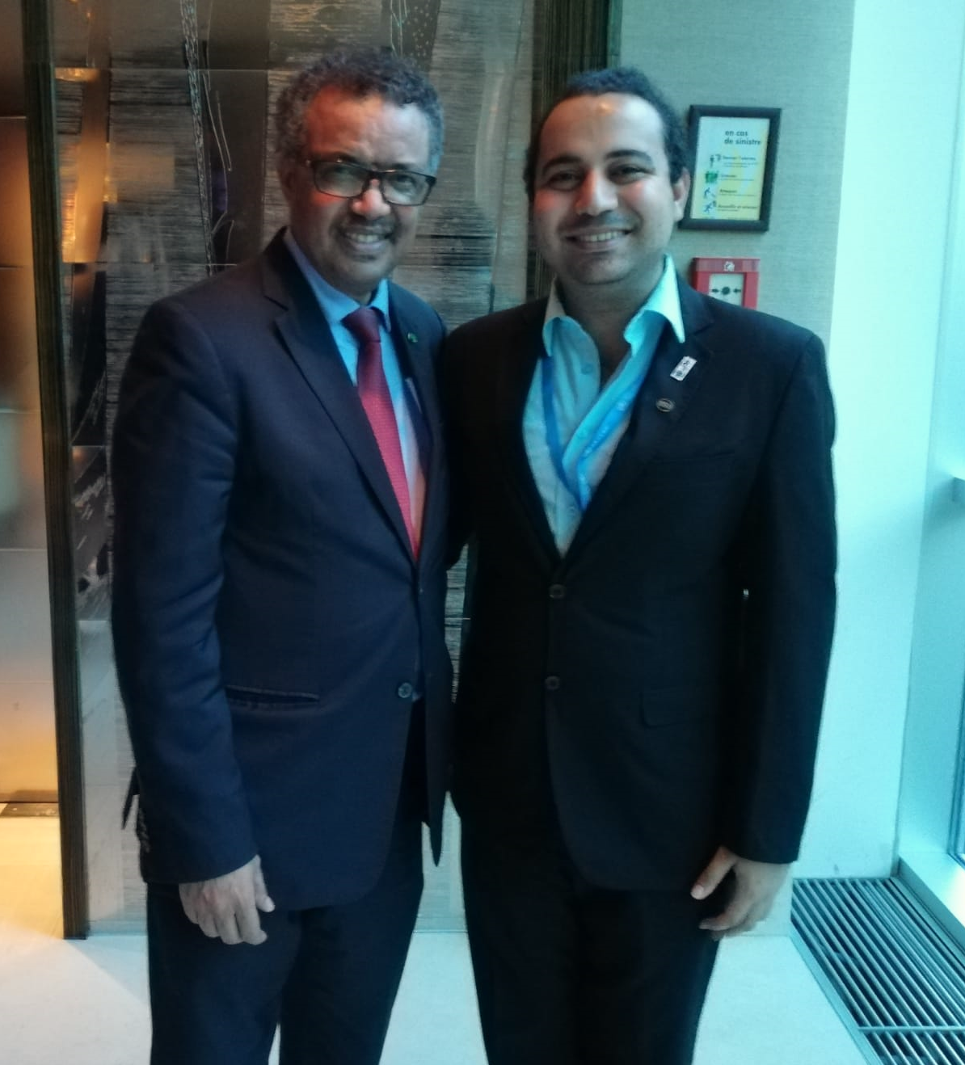
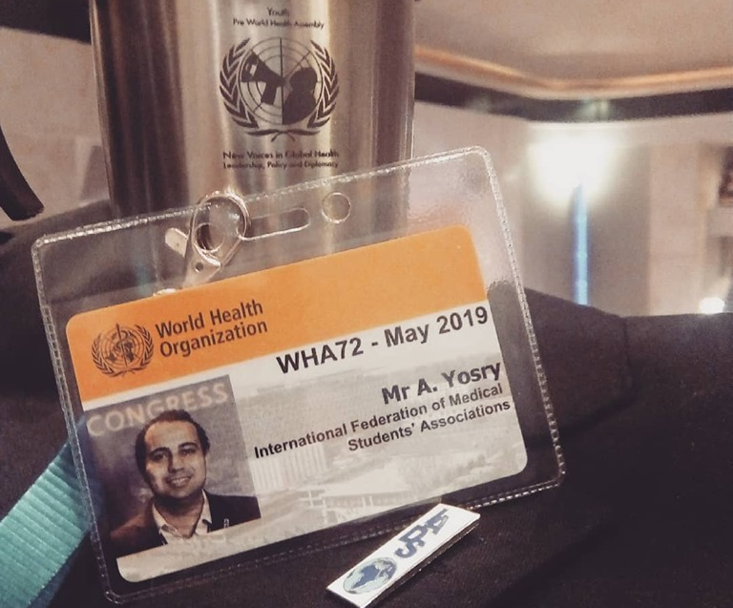
Dr. Abanoub RIAD, DDS
Affiliations / Disclosures
Instructor at the Department of Public Health, Faculty of Medicine, Masaryk University (MED-MUNI)
Acting Deputy Director of Cochrane Czech Republic
Research Fellow at the Czech National Centre of Evidence-based Healthcare and Knowledge Translation (CEBHC-KT)
Doctoral Candidate of Hygiene, Preventive Medicine and Epidemiology (HPME)

Slide 3
Disclosure Member of the Global Burden of Disease (GBD) Collaborators Network.

Slide 4
Seminar Outline I. Overview of GBD II. Methodology and Results of GBD BREAK III. Infectious Diseases & Immunization BREAK IV. Neglected Tropical Diseases V. Non-Communicable Diseases

Slide 5
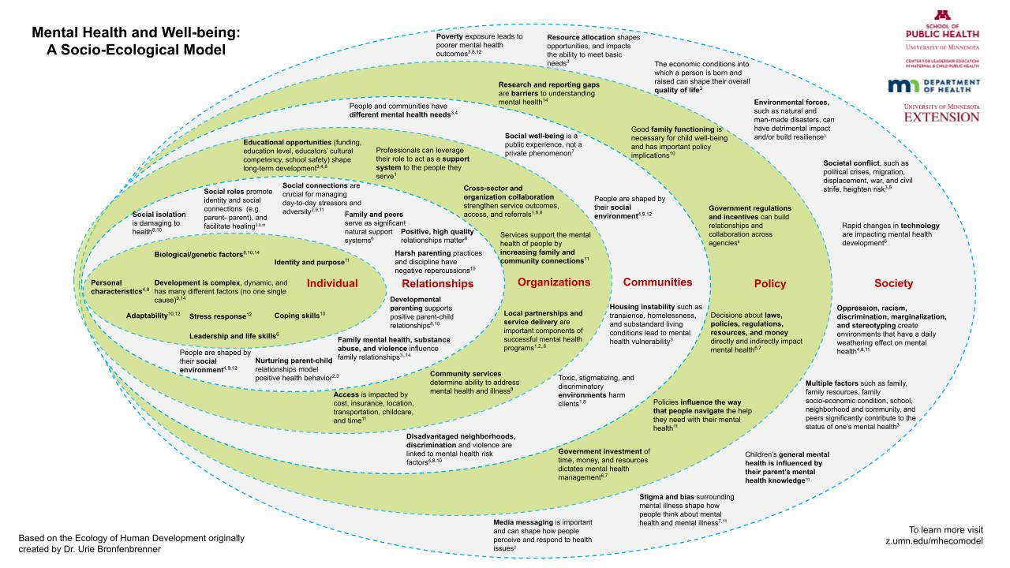
What is Disease Burden?
Same Demographics (Age, Sex)
Same Anamnesis (Health Status)
Same Outcome (Arrive at the same time)
Same Demographics (Age, Sex)
Same Anamnesis (Health Status)
Different Outcome. Why?
Burden!

Slide 6
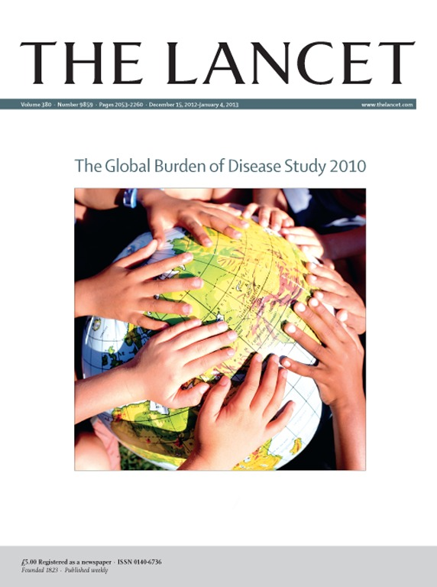
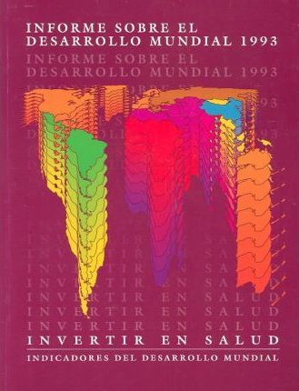
Timeline Global Burden of Disease (GBD)
GBD 1990
107 diseases
8 regions
5 age groups
> 11,000 citations
GBD 2019
369 diseases & injuries
87 risk factors
204 countries
> 5,000 collaborators
GBD 2004
136 diseases
1990
1993
1998
2010
2020
GBD 2000 – GBD 2001 – GBD 2002
World Development Report 1993
WHO created a Disease Burden Unit

Slide 7
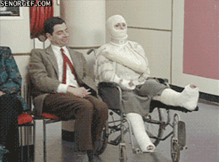
Measures Health-related Demographics
Health Outcome (5 Ds)
Dissatisfaction
Discomfort
Disability
Disease
Death
Destitution
Death = Discrete Event
(Yes / No)
Quantitative
Birth (Natality)
Measures
Qualitative
Death (Mortality)
Measures
Morbidity
Measures

Slide 8
Mortality Measures Health-related Demographics
All-cause Mortality Rate
Crude Mortality Rate = Total number of deaths during a given time interval / Mid-interval population
Cause-specific Mortality Rate = Number of deaths assigned (attributed) to a specific cause during a given time interval / Mid-interval population
Maternal Mortality Rate = Number of deaths assigned to pregnancy-related causes during a given time interval / Number of live births during the same time interval

Slide 9
Morbidity Measures Health-related Demographics
Sources of Morbidity Data
Surveillance Systems of Infectious Diseases
Sentinel Networks
Specific Disease Registries (e.g. CVD, Cancer, etc)
Hospital Records
General Practice Records
Insurance Statistics
Common Measures
Years of potential life lost (PLL) based on the years of life lost through premature death (before an arbitrarily determined age);
Healthy life expectancy (HALE);
Disability-free life expectancy (DFLE);
Quality-adjusted life years (QALYs);
Disability-adjusted life years (DALYs).

Slide 10
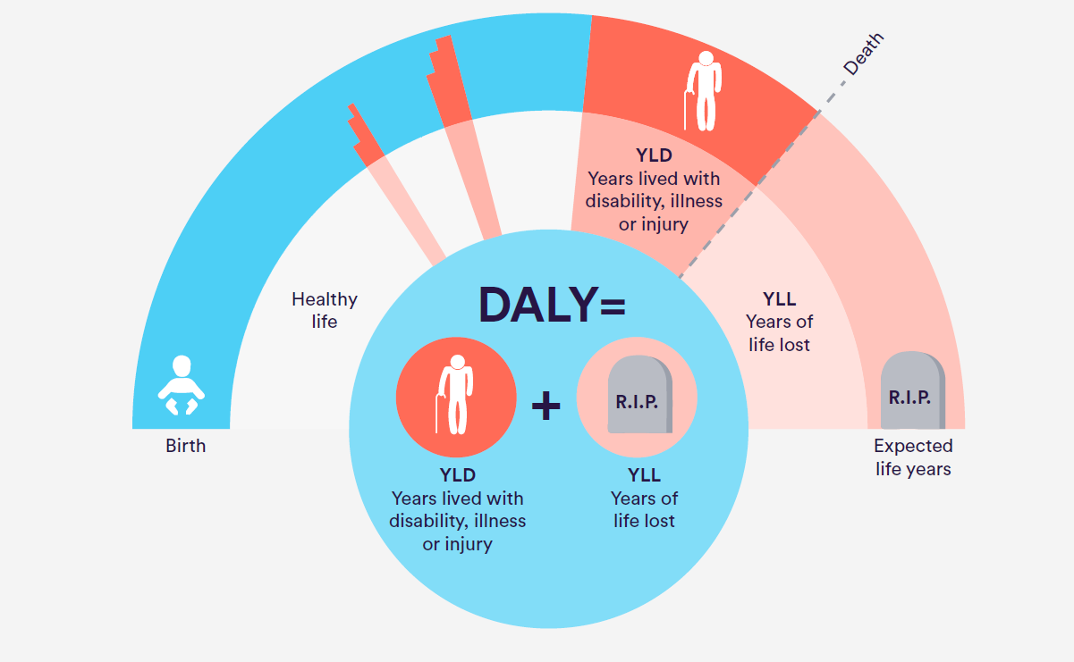
DALY Health-related Demographics
50
10 * 0.5 =
5 DALYs
60
10 DALYs
DALY = YLL + YLD
DALYs for a disease or health condition are the sum of the years of life lost to due to premature mortality (YLLs) and the years lived with a disability (YLDs) due to prevalent cases of the disease or health condition in a population.
70
5 + 10 = 15 DALYs

Slide 11
DALY Health-related Demographics
YLL = N * L
N = number of cause-related death.
L = standard life expectancy at age of death.
YLD = I * DW * L
I = number of incident (new) cases.
DW = disability weight.
L = average duration of cause until death.

Slide 12
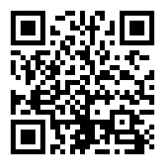
Exercise Global Burden of Disease (GBD)
Go to: https://vizhub.healthdata.org/gbd-compare/
Form 4 groups, and select 1 person to present on behalf of your group to the others.
Duration: 15 minutes.
Notes:
From 1990 – 2019: What happened to IDs? STIs? Resp. infec.? NCDs, especially CVD and cancers?
In 2019: What are key differences between males vs. females? Age groups?
In 2019: What are key differences between Low SDI vs. High SDI?
From 1990 – 2019: What happened in Low SDI? High SDI?
Examples of certain geographic regions or countries.

Slide 13
Exercise Global Burden of Disease (GBD)
Comparing DALY causes in Czechia by year between 1990 and 2019 combining age groups. What happened to Infectious diseases? noncommunicable diseases (cancer, cardiovascular disease, mental disease)? sexually transmitted diseases (STIs)?
In 2019: What are key differences in DALY, YLD and DEATH causes in Czechia comparing: by sex, age group, socioeconomic index.
In 2019: What are key differences in DEATH causes between Low SDI vs. High SDI?
Comparing differences in DALY causes by year between 1990 and 2019 in combining age groups: Select 1 low- or low-middle income country(LIC/LMIC), Select 1 high income country (HIC)
Notes:
From 1990 – 2019: What happened to IDs? STIs? Resp. infec.? NCDs, especially CVD and cancers?
In 2019: What are key differences between males vs. females? Age groups?
In 2019: What are key differences between Low SDI vs. High SDI?
From 1990 – 2019: What happened in Low SDI? High SDI?
Examples of certain geographic regions or countries.

Slide 14
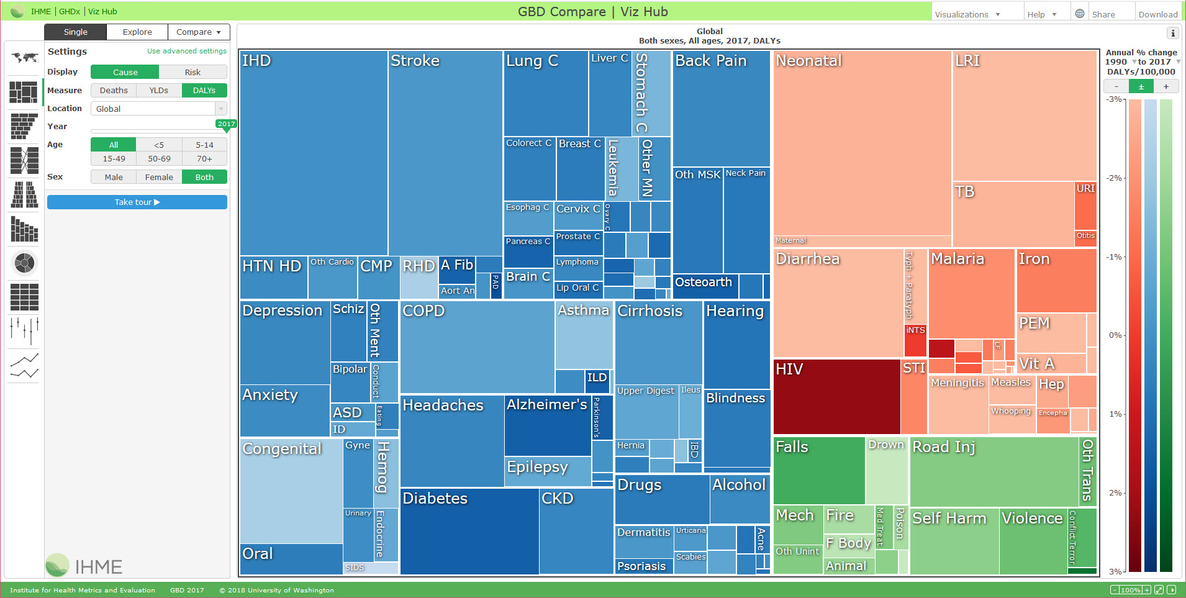
Exercise Global Burden of Disease (GBD)
Notes:
From 1990 – 2019: What happened to IDs? STIs? Resp. infec.? NCDs, especially CVD and cancers?
In 2019: What are key differences between males vs. females? Age groups?
In 2019: What are key differences between Low SDI vs. High SDI?
From 1990 – 2019: What happened in Low SDI? High SDI?
Examples of certain geographic regions or countries.

Slide 15
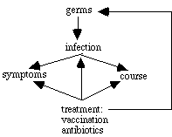
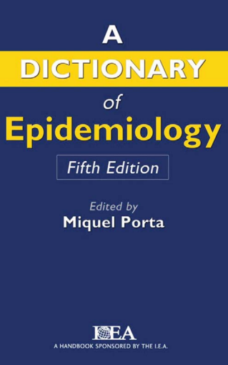
Infectious Diseases
Transmissible Diseases
Communicable Diseases
Germ Theory
L. Pasteur
Infection: The entry and development or multiplication of an infectious agent in the body of man or animals.
Infectious Disease: An illness due to a specific infectious agent or its toxic products that arises through transmission of that agent or its products from an infected person, animal or reservoir to a susceptible host, either directly or indirectly through an intermediate plant or animal host, vector, or the inanimate environment.
Infectious Agents:
Bacteria (TB; Tetanus; Diphtheria; Plague)
Viruses (AIDS/HIV; Influenza; Measles; COVID-19)
Fungi (Candidiasis; Histoplasmosis; Tinea pedis)
Protozoa (Amebiasis; Malaria)
Parasites (Hookworm; Schistosomiasis)

Slide 16
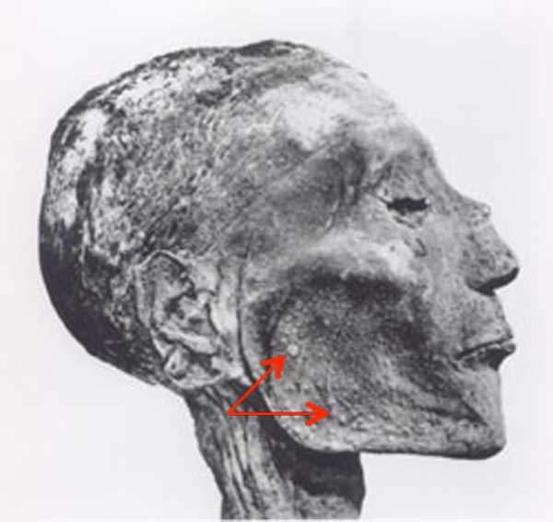
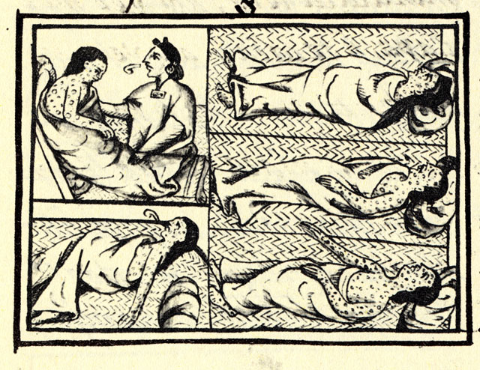
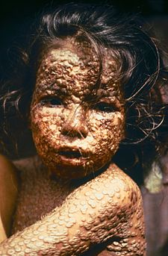
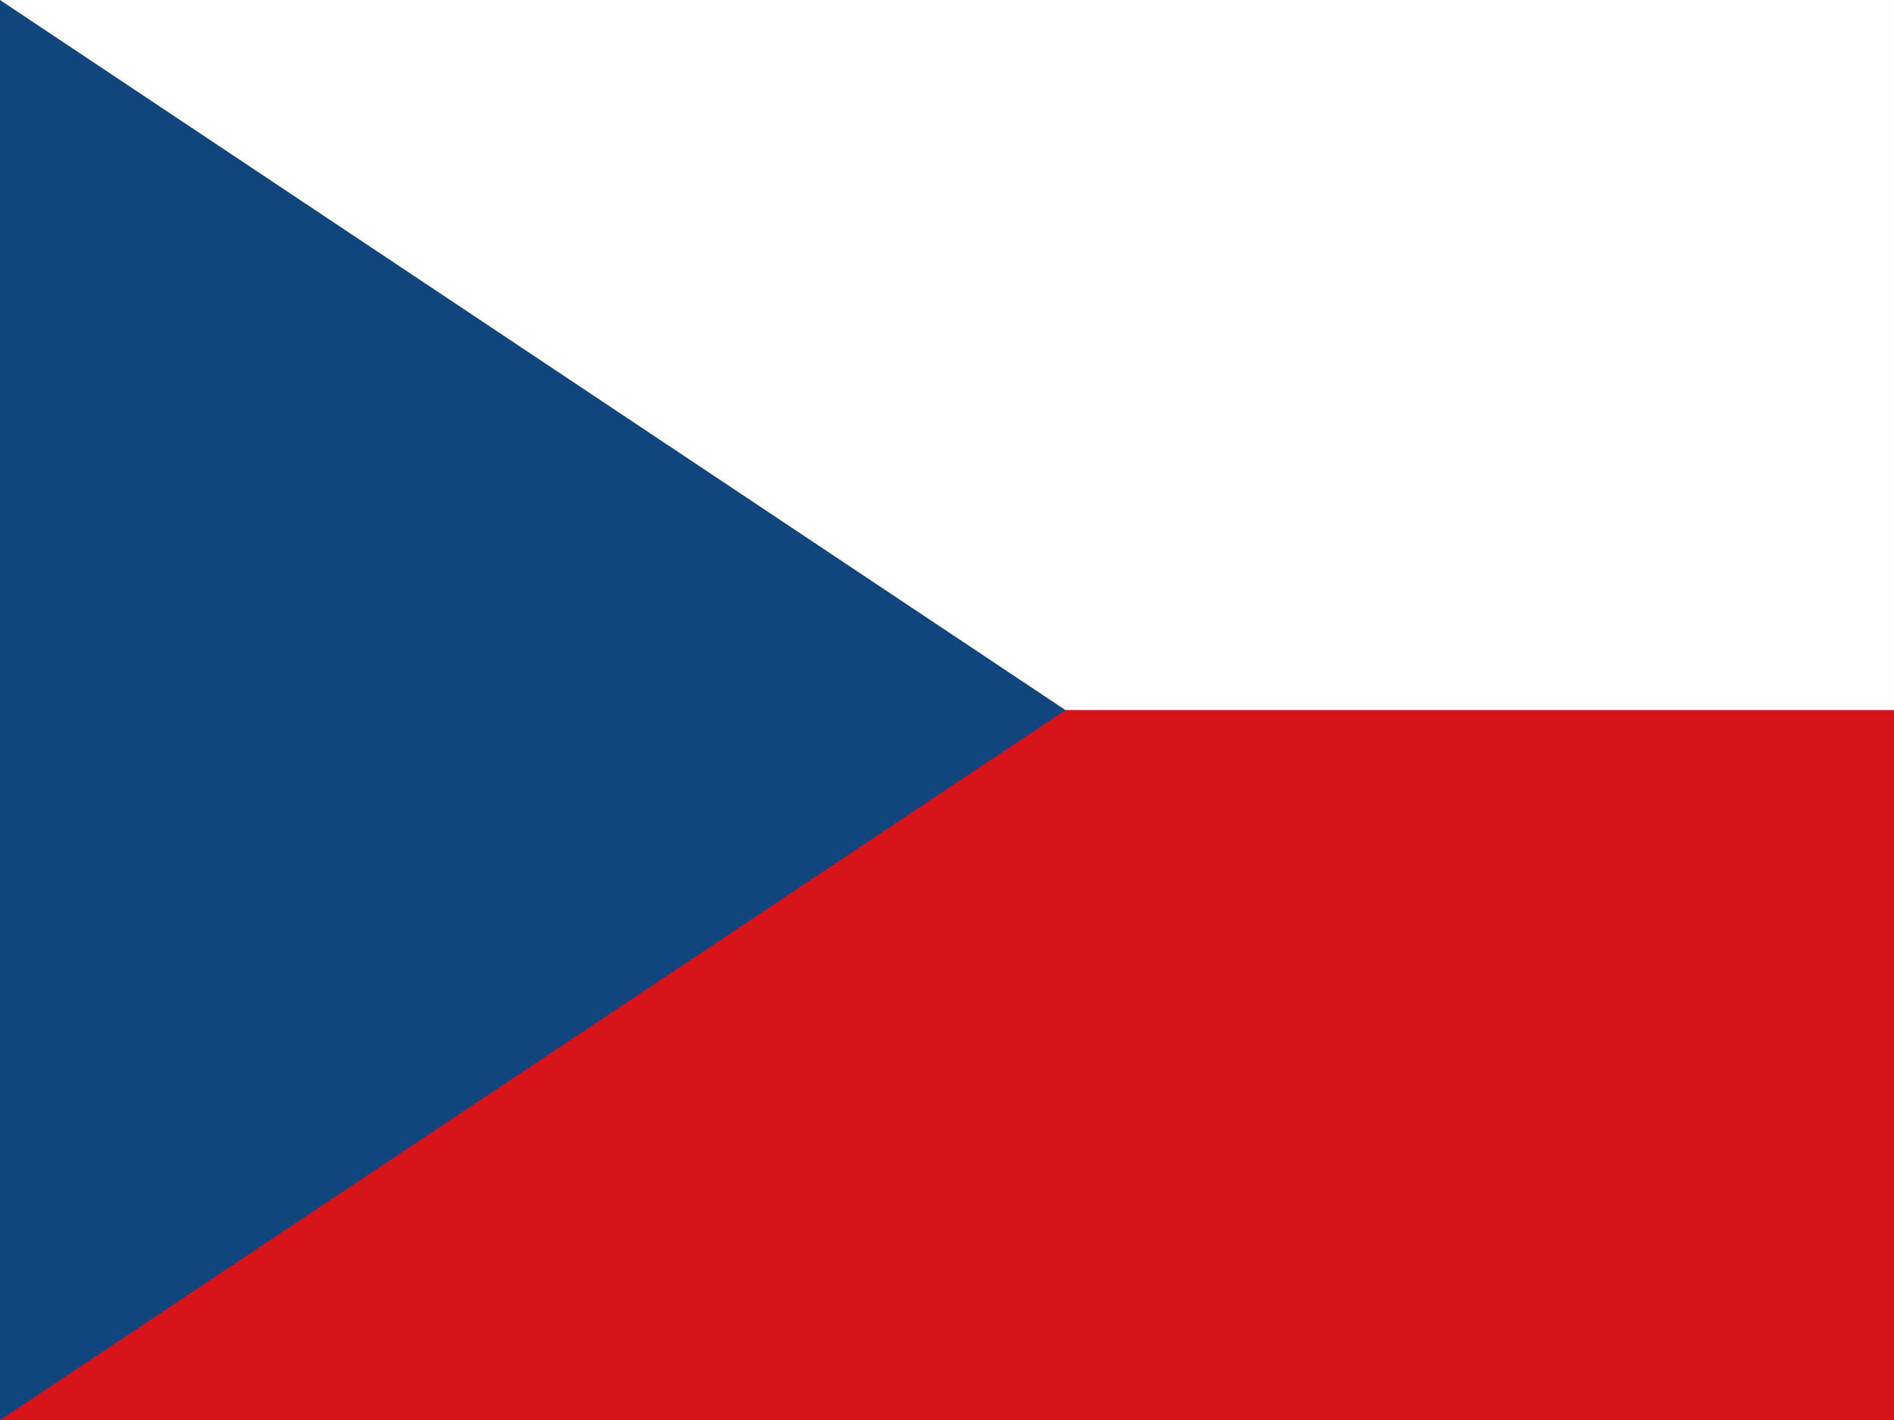
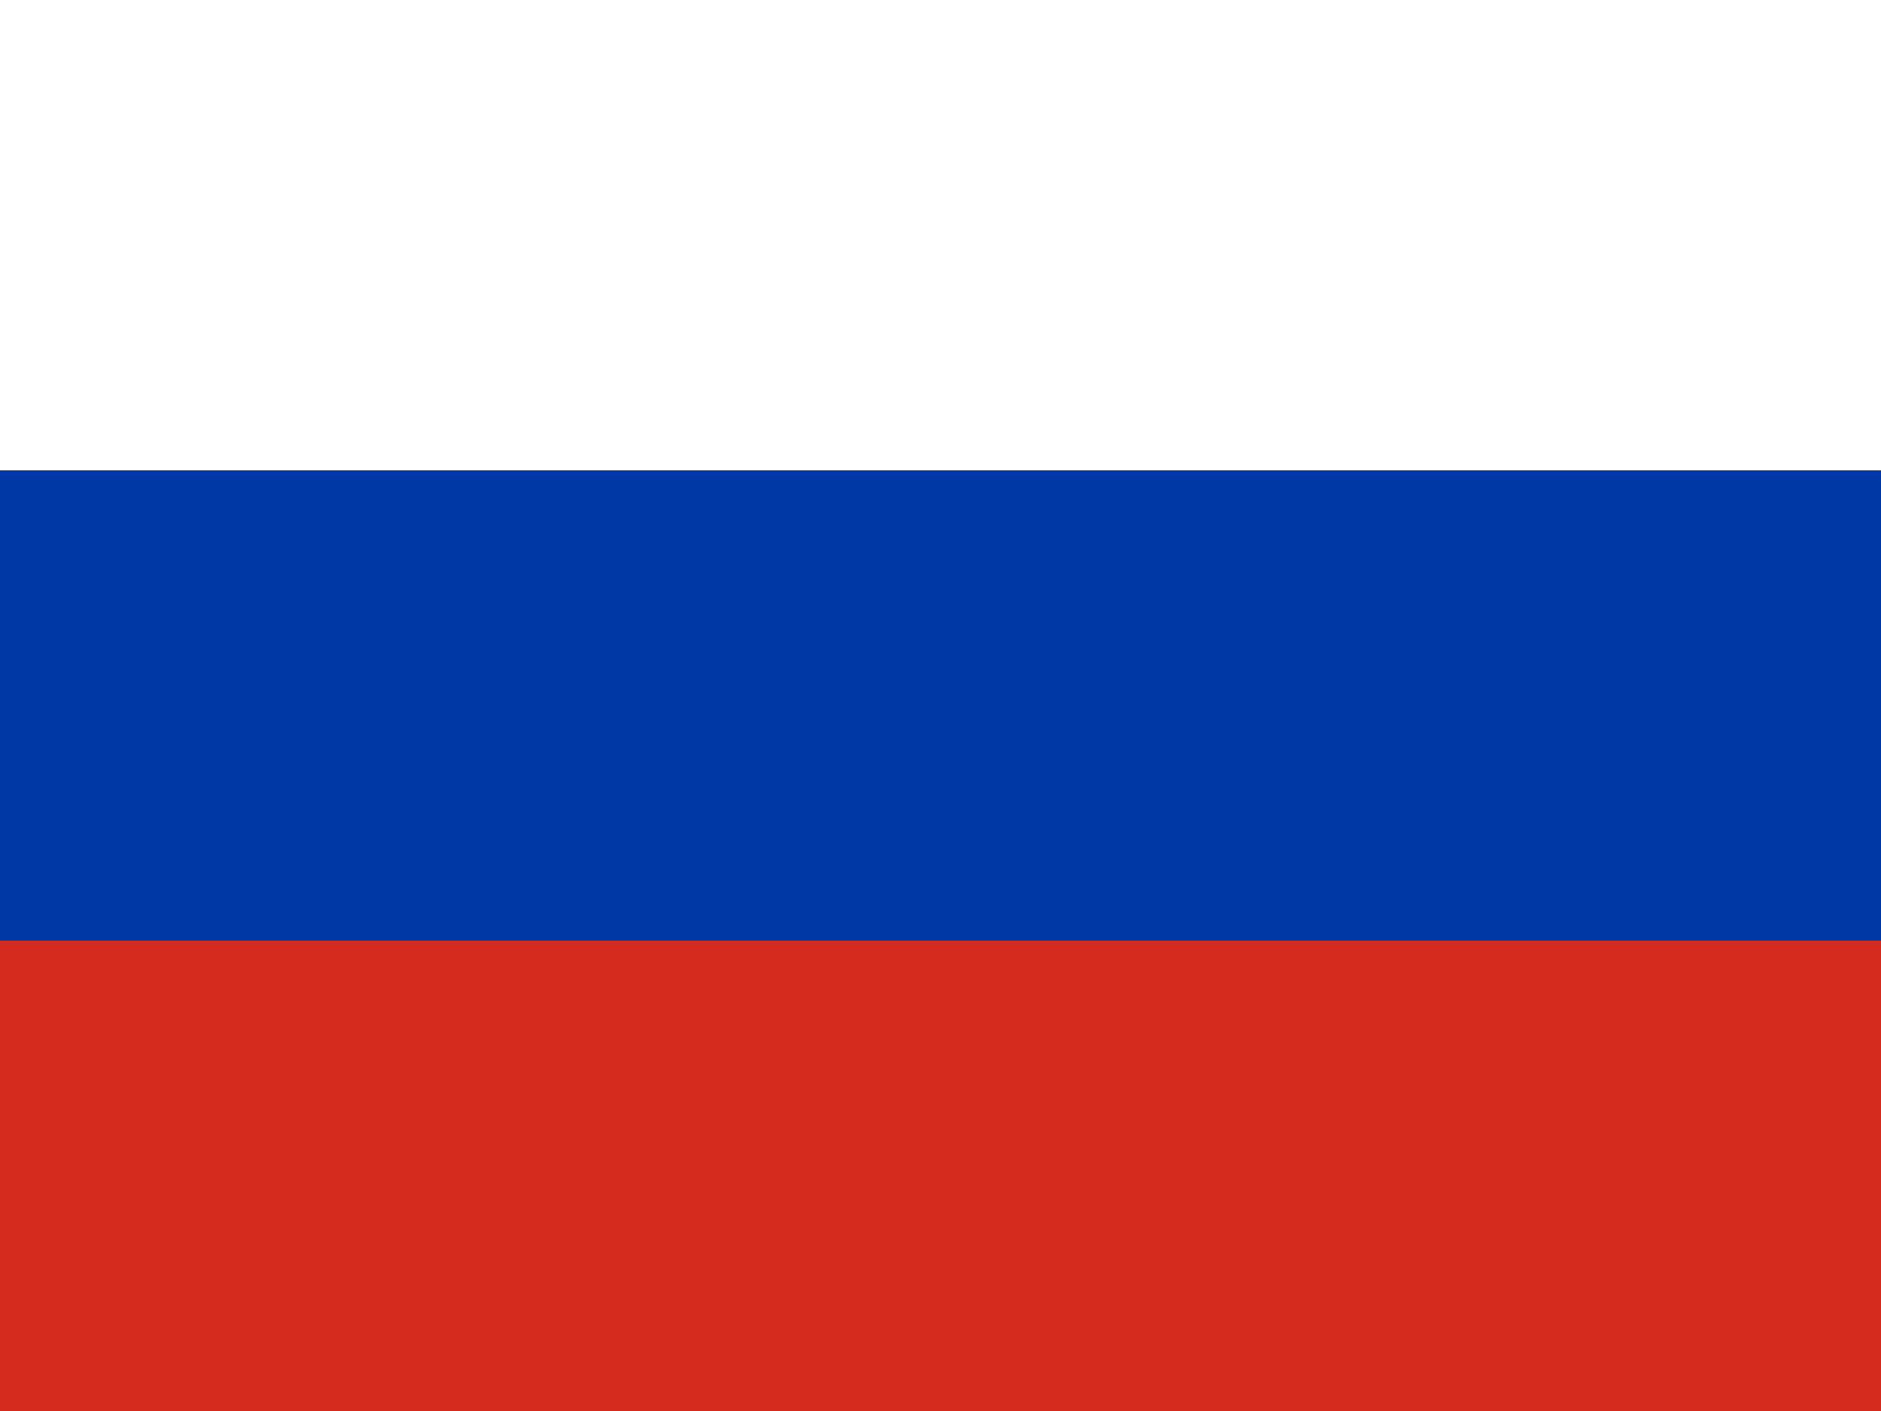
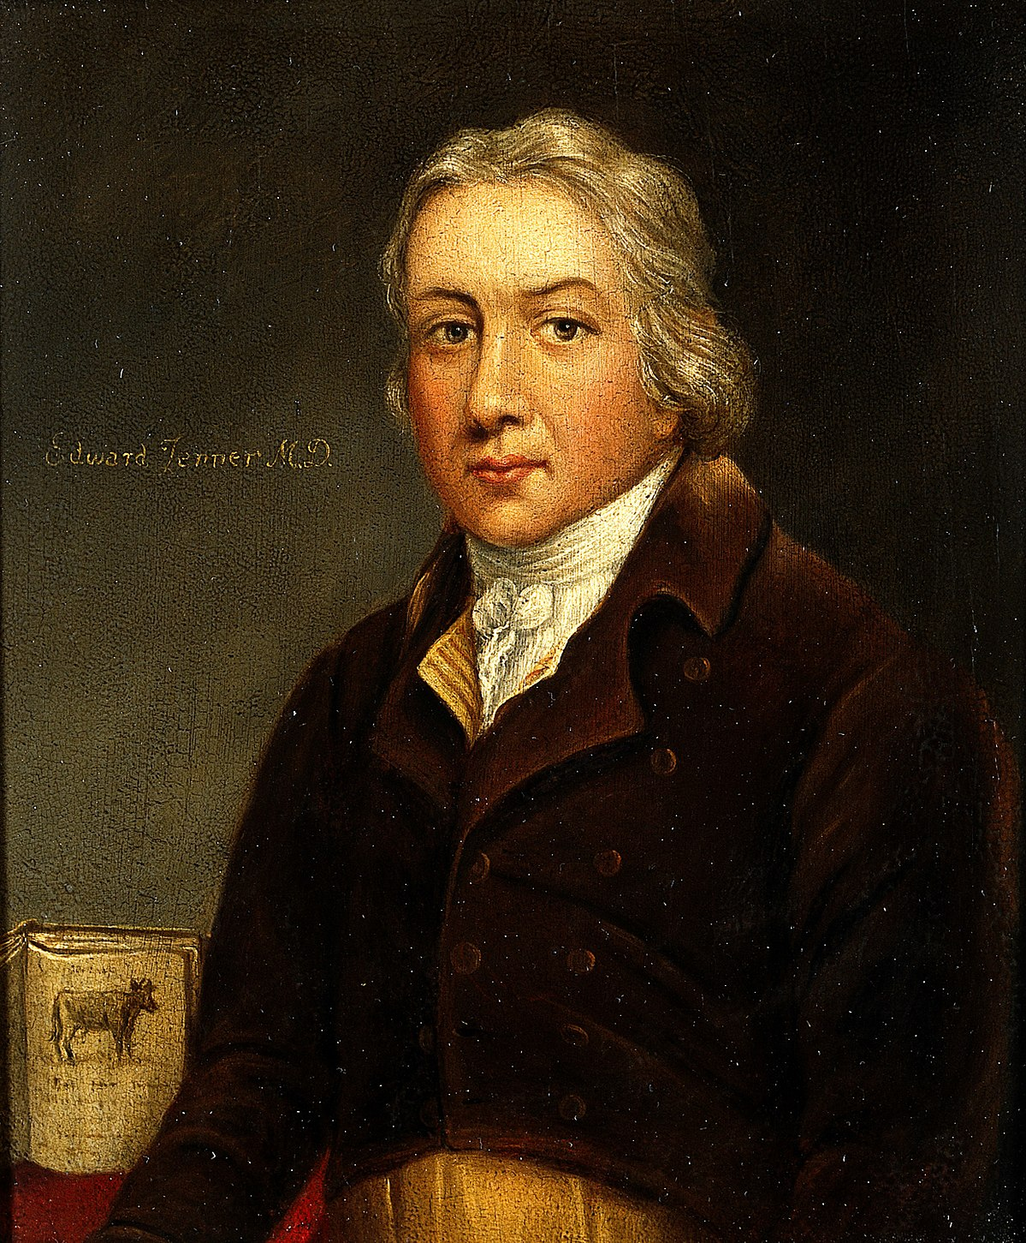
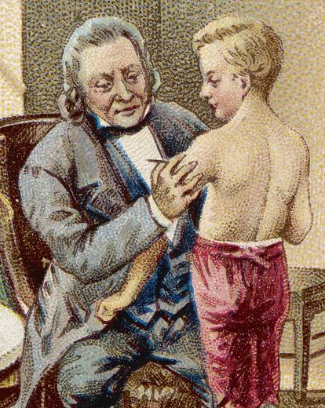
Smallpox
Ramesses V
1149 – 1145 BC (20th Dynasty)
Neštovice
Rõuged
Viruela
Variole
Vaiolo
Оспа
جدري
Smallpox is an acute contagious disease caused by the variola virus, a member of the orthopoxvirus family.
It was one of the most devastating diseases known to humanity and caused millions of deaths.
It is believed to have existed for at least 3000 years.
The smallpox vaccine, created by Edward Jenner in 1796, was the first successful vaccine to be developed.
He observed that milkmaids who previously had caught cowpox did not catch smallpox and showed that a similar inoculation could be used to prevent smallpox in other people.

Slide 17
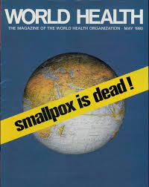
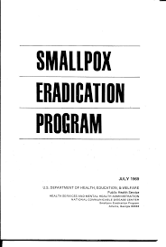
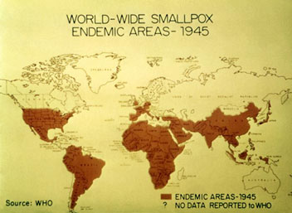
Smallpox
The World Health Organization launched an intensified plan to eradicate smallpox in 1967.
Widespread immunization and surveillance were conducted around the world for several years.
The last known natural case was in Somalia in 1977.
In 1980 WHO declared smallpox eradicated – the only infectious disease to achieve this distinction.
This remains among the most notable and profound public health successes in history.

Slide 18
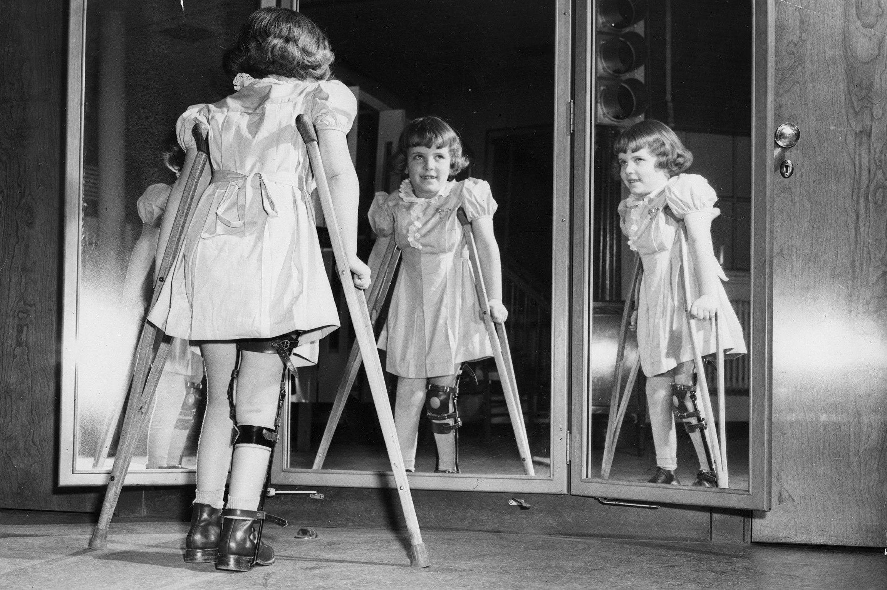
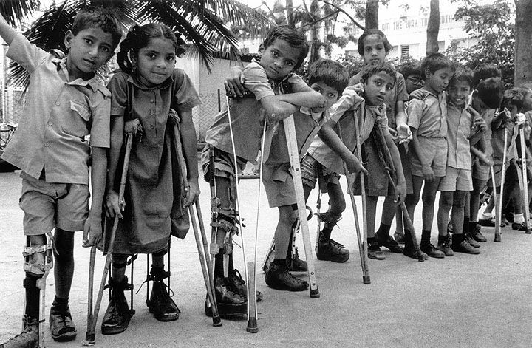
Polio
Poliomyelitis (polio) is a highly infectious viral disease that largely affects children under 5 years of age.
The virus is transmitted by person-to-person spread mainly through the faecal-oral route or, less frequently, by a common vehicle (e.g. contaminated water or food).
In 1988, the WHA adopted a resolution for the worldwide eradication of polio, marking the launch of the Global Polio Eradication Initiative, spearheaded by national governments, WHO, Rotary International, the US Centers for Disease Control and Prevention (CDC), UNICEF, and later joined by the Bill & Melinda Gates Foundation and Gavi, the Vaccine Alliance.
Wild poliovirus cases have decreased by over 99% since 1988, from an estimated 350 000 cases in more than 125 endemic countries then to 175 reported cases in 2019.

Slide 19
Polio

Slide 20
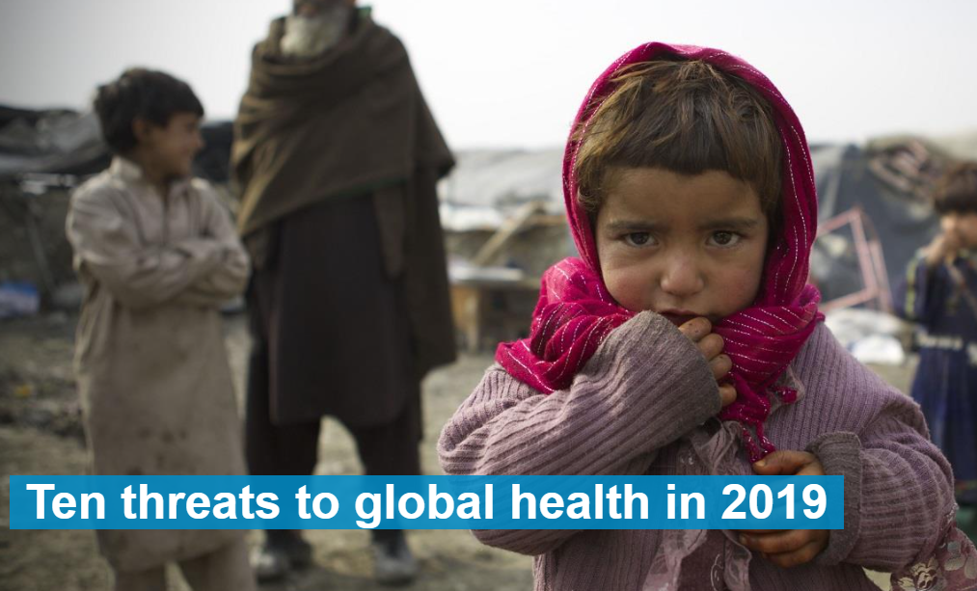
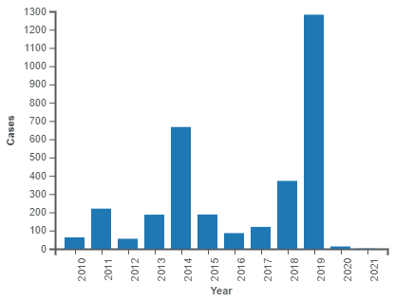
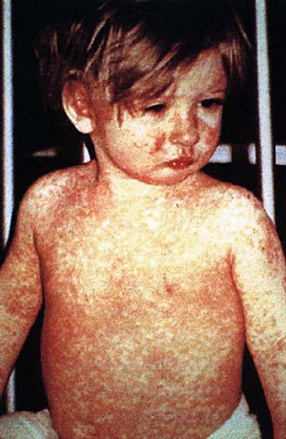
Measles
Measles is a highly contagious, serious disease caused by a virus.
Before the introduction of the measles vaccine in 1963 and widespread vaccination, major epidemics occurred approximately every 2–3 years leading to 2.6 million deaths each year.
Measles was declared eliminated from the United States in 2000 by WHO due to the success of vaccination efforts.
However, it continues to be reintroduced by international travelers, and in recent years, anti-vaccination sentiment has allowed for the reemergence of measles outbreaks.
Vaccine Hesitancy (VH) is defined as the delay in acceptance, or refusal of vaccines despite the availability of vaccine services.
U.S. Centers for Disease Control and Prevention (CDC) reported measles cases in the United States by year, as of June 7, 2021.

Slide 21
BREAK

Slide 22
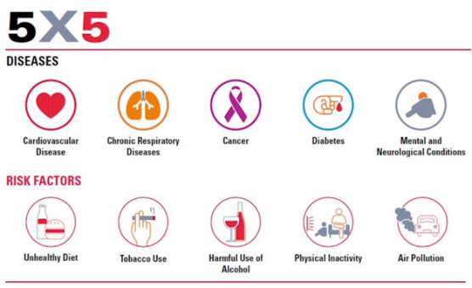
Non-communicable Diseases (NCDs)
71% of all deaths that occur annually worldwide are attributed to NCDs.
77% of NCD-related deaths are in low- and middle-income countries.
The United Nations (UN) High-Level Meeting (HLM) dedicated its agenda three times for the NCDs (2011, 2014, 2018).

Slide 23
Non-communicable Diseases (NCDs)

Slide 24
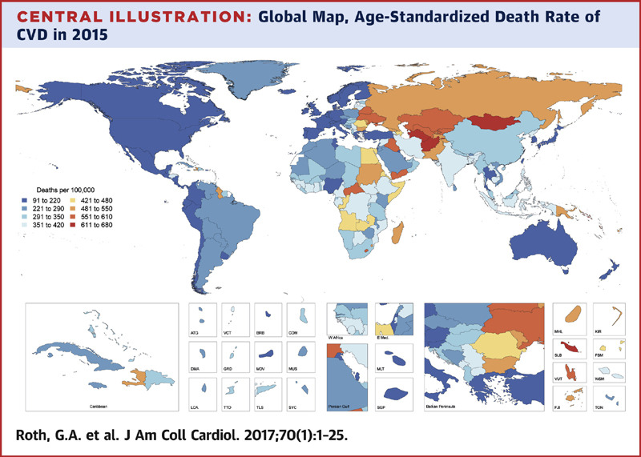
Cardiovascular Diseases Non-communicable Diseases (NCDs)
CVD are the leading cause of mortality today!
17.9 million deaths annually; 32% of all deaths worldwide.
> 75% of CVD deaths occur in low- and middle-income countries.
85% of all CVD deaths are due to heart attacks and strokes.

Slide 25
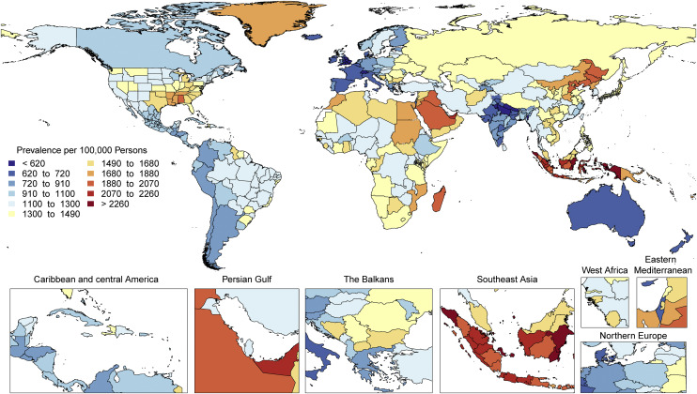
Cardiovascular Diseases GBD 2019

Slide 26
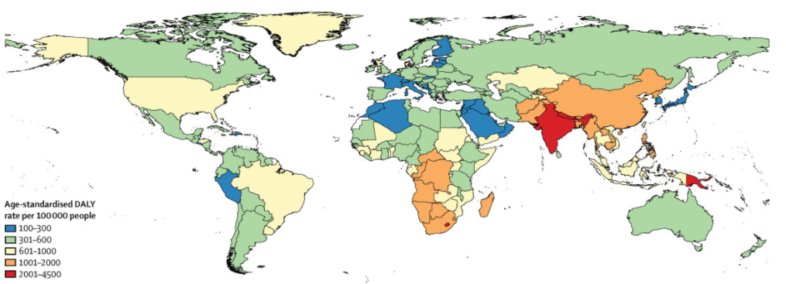
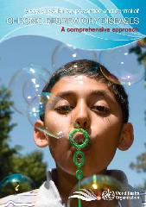
Chronic Respiratory Diseases Non-communicable Diseases (NCDs)
Chronic respiratory diseases (CRDs) are diseases of the airways and other structures of the lung.
Some of the most common are chronic obstructive pulmonary disease (COPD), asthma, occupational lung diseases and pulmonary hypertension.
235 million people suffer from asthma, especially children worldwide.
> 90% of COPD deaths occur in low- and middle-income countries.
> 3 million people die annually from COPD, an estimated 6% of all deaths worldwide.

Slide 27
Cancer Non-communicable Diseases (NCDs)
Cancer is a large group of diseases that can start in almost any organ or tissue of the body when abnormal cells grow uncontrollably, go beyond their usual boundaries to invade adjoining parts of the body and/or spread to other organs.
Cancer is the second leading cause of death globally.
9.6 million people die from cancer worldwide (2018).
300,000 new cases of cancer diagnosed annually among children aged 0-19 years.
30 – 50 % of cases can be prevented. 1.6 US$ trillion is total annual economic cost of treating cancer.

Slide 28
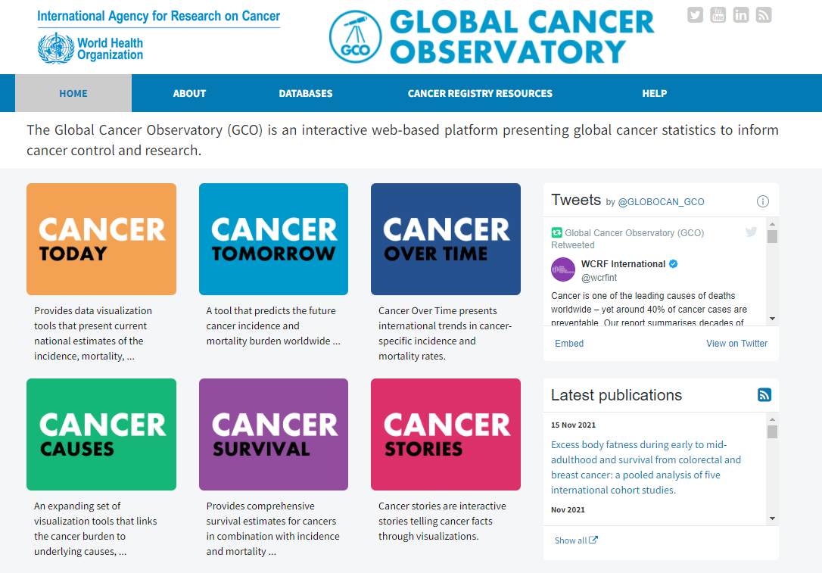
Cancer Non-communicable Diseases (NCDs)
The International Agency for Research on Cancer (IARC) is an intergovernmental agency forming part of the World Health Organization of the United Nations.
Its role is to conduct and coordinate research into the causes of cancer.
It also collects and publishes surveillance data regarding the occurrence of cancer worldwide.

Slide 29
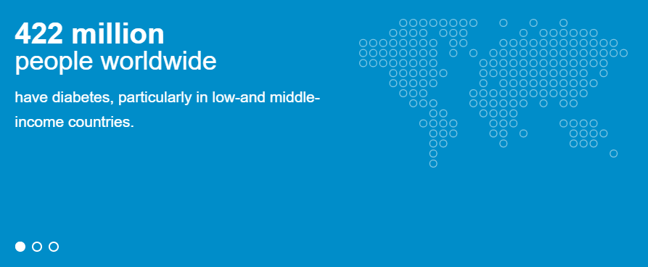
Diabetes Non-communicable Diseases (NCDs)
Diabetes is a chronic, metabolic disease characterized by elevated levels of blood glucose (or blood sugar), which leads over time to serious damage to the heart, blood vessels, eyes, kidneys and nerves.
The most common is type 2 diabetes, usually in adults, which occurs when the body becomes resistant to insulin or doesn't make enough insulin. In the past three decades the prevalence of type 2 diabetes has risen dramatically in countries of all income levels.
Type 1 diabetes, once known as juvenile diabetes or insulin-dependent diabetes, is a chronic condition in which the pancreas produces little or no insulin by itself. For people living with diabetes, access to affordable treatment, including insulin, is critical to their survival.

Slide 30
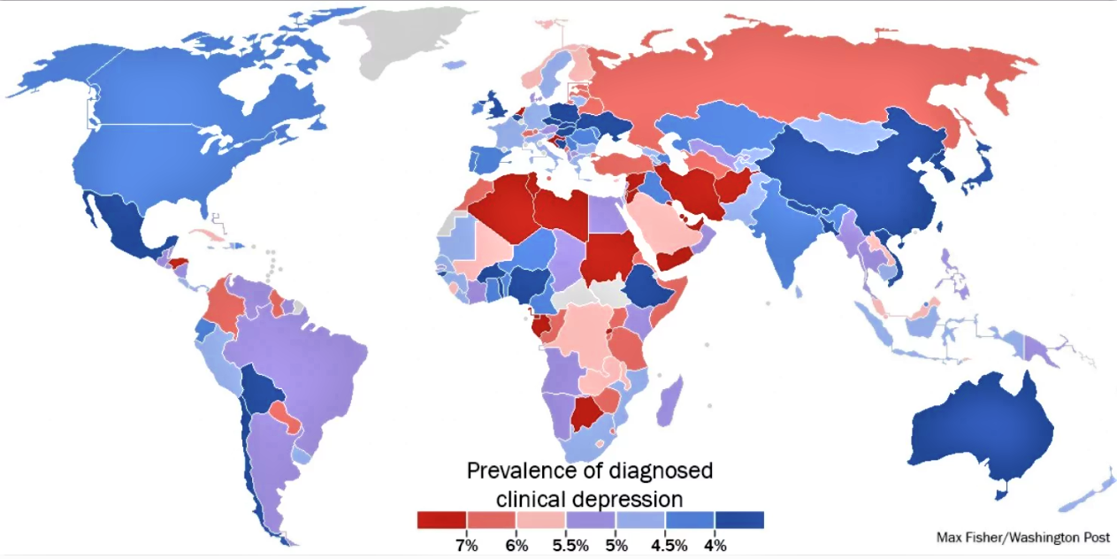
Mental Health Non-communicable Diseases (NCDs)
Depression is one of the leading causes of disability, with an estimated 264 million cases worldwide.
Suicide is the second leading cause of death among 15-29-year-olds.
People with severe mental health conditions die prematurely – as much as two decades early – due to preventable physical conditions.
Despite progress in some countries, people with mental health conditions often experience severe human rights violations, discrimination, and stigma.

Slide 31
Causal Factors
Enabling (or Disabling) Factors
These are factors affect health through environmental factor in either a positive or negative way.
Living conditions – Societal support – Services
Precipitating Factors
These are essential factors to the development of diseases, injuries, conditions, disabilities and death.
Predisposing Factors
These are the factors or conditions already present in a host that produce a susceptibility or disposition to a disease or condition without actually causing it.
Exposure to Pathogen – Lack of Seat Belt Use
Reinforcing Factors
These are factors which have the ability to support the production and transmission of disease or conditions.
Age – Gender – Previous illness
Repetitive Patterns of Behavior: Smoking – Alcoholism – Physical Inactivity (negative) vs. Peer Education – Family Counseling – Support Groups (positive)

Slide 32
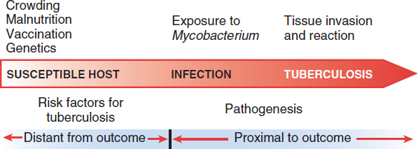
Proximity of Cause to Effect

Slide 33
Exercise Disease Risk Factors
The same 4 groups, select 1 person to present on behalf of your group to the others.
Duration: 10 minutes.
You will receive one case study to analyze the following questions.
Notes:
From 1990 – 2019: What happened to IDs? STIs? Resp. infec.? NCDs, especially CVD and cancers?
In 2019: What are key differences between males vs. females? Age groups?
In 2019: What are key differences between Low SDI vs. High SDI?
From 1990 – 2019: What happened in Low SDI? High SDI?
Examples of certain geographic regions or countries.

Slide 34
Exercise Case I: Disease Risk Factors
Juan is 35 years old, his BMI is 34.2, he loves to eat French fries and drink coke. He has been suffering recently from anxiety and depression due to losing his grandfather due to pulmonary cancer.
What are the potential risk factors this person is exposed to?
Which type of risk factors are these?
What noncommunicable and communicable diseases might this person suffer from.
Notes:
From 1990 – 2019: What happened to IDs? STIs? Resp. infec.? NCDs, especially CVD and cancers?
In 2019: What are key differences between males vs. females? Age groups?
In 2019: What are key differences between Low SDI vs. High SDI?
From 1990 – 2019: What happened in Low SDI? High SDI?
Examples of certain geographic regions or countries.

Slide 35
Exercise Case II: Disease Risk Factors
Amir is a 62-years old construction worker from Cairo. He smokes regularly 1 pack of cigarettes a day and eats when he feels hungry. He has been suffering from chest pain recently but he is pushing through and working 12 hours a day as usual.
What are the potential risk factors this person is exposed to?
Which type of risk factors are these?
What noncommunicable and communicable diseases might this person suffer from.
Notes:
From 1990 – 2019: What happened to IDs? STIs? Resp. infec.? NCDs, especially CVD and cancers?
In 2019: What are key differences between males vs. females? Age groups?
In 2019: What are key differences between Low SDI vs. High SDI?
From 1990 – 2019: What happened in Low SDI? High SDI?
Examples of certain geographic regions or countries.

Slide 36
Exercise Case III: Disease Risk Factors
Regina is a single mother with 4 kids living in rural Argentina. She has been recently prescribed antidepressants and she has started to gain weight which makes her unhappy.
What are the potential risk factors this person is exposed to?
Which type of risk factors are these?
What noncommunicable and communicable diseases might this person suffer from.
Notes:
From 1990 – 2019: What happened to IDs? STIs? Resp. infec.? NCDs, especially CVD and cancers?
In 2019: What are key differences between males vs. females? Age groups?
In 2019: What are key differences between Low SDI vs. High SDI?
From 1990 – 2019: What happened in Low SDI? High SDI?
Examples of certain geographic regions or countries.

Slide 37
Exercise Case IV: Disease Risk Factors
Alina is a 23 year old woman living in the outskirts of St. Petersburg. She is currently fighting with a drug addiction but is failing to do so as she still goes to parties with her friends at least 2 times a week. She has been suffering from headaches and pain in the mouth recently.
What are the potential risk factors this person is exposed to?
Which type of risk factors are these?
What noncommunicable and communicable diseases might this person suffer from.
Notes:
From 1990 – 2019: What happened to IDs? STIs? Resp. infec.? NCDs, especially CVD and cancers?
In 2019: What are key differences between males vs. females? Age groups?
In 2019: What are key differences between Low SDI vs. High SDI?
From 1990 – 2019: What happened in Low SDI? High SDI?
Examples of certain geographic regions or countries.

Slide 38
Exercise Case V: Disease Risk Factors
Peter is a 51-year-old man suffering from chest pain that he thinks is “indigestion.” He was well until 2 weeks ago, when he noticed tightness in the center of his chest after a large meal and while walking uphill. He gave up smoking 1 pack of cigarettes per day 3 years ago and has been told that his blood pressure is “a little high.”
What are the potential risk factors this person is exposed to?
Which type of risk factors are these?
What noncommunicable and communicable diseases might this person suffer from.
Notes:
From 1990 – 2019: What happened to IDs? STIs? Resp. infec.? NCDs, especially CVD and cancers?
In 2019: What are key differences between males vs. females? Age groups?
In 2019: What are key differences between Low SDI vs. High SDI?
From 1990 – 2019: What happened in Low SDI? High SDI?
Examples of certain geographic regions or countries.

Slide 39
THANK YOU
abanoub.riad@med.muni.cz

