Slide 1
Planetary Health & AMR
Global Health

Slide 2
Lecture Outline
I. What is planetary health?
II. Environmental changes and health
III. Climate change and its impact on human and animal health
IV. Antimicrobial resistance (AMR): the silent pandemic!

Slide 3


Slide 4
What is planetary health?
“Planetary health is the health of human civilisation and the state of the natural systems on which it depends”
Horton R, Lo S. Planetary health: a new science for exceptional action. The Lancet. 2015;386(10007):1921-1922. doi:10.1016/s0140-6736(15)61038-8
‌

Slide 5

What is planetary health?
A field
A scientific paradigm
A policy framework
A communication strategy
A moral imperative
Prof. Howard Frumkin, MD, DrPH

Slide 6


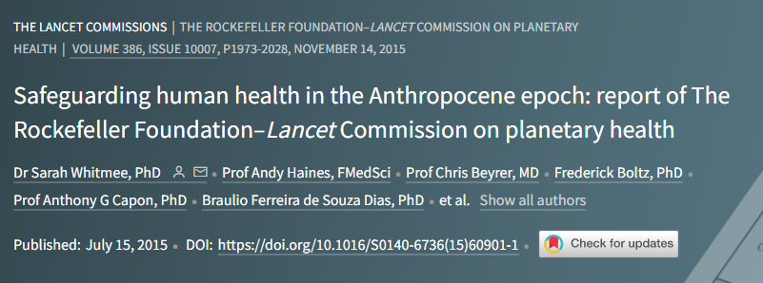
What is planetary health?
The concept of planetary health is based on the understanding that human health and human civilisation depend on flourishing natural systems and the wise stewardship of those natural systems. However, natural systems are being degraded to an extent unprecedented in human history

Slide 7
What is planetary health?
Environmental threats to human health and human civilisation will be characterised by surprise and uncertainty. Our societies face clear and potent dangers that require urgent and transformative actions to protect present and future generations.

Slide 8
What is planetary health?
The present systems of governance and organisation of human knowledge are inadequate to address the threats to planetary health. We call for improved governance to aid the integration of social, economic, and environmental policies and for the creation, synthesis, and application of interdisciplinary knowledge to strengthen planetary health.

Slide 9
What is planetary health?
Solutions lie within reach and should be based on the redefinition of prosperity to focus on the enhancement of quality of life and delivery of improved health for all, together with respect for the integrity of natural systems. This endeavour will necessitate that societies address the drivers of environmental change by promoting sustainable and equitable patterns of consumption, reducing population growth, and harnessing the power of technology for change.

Slide 10
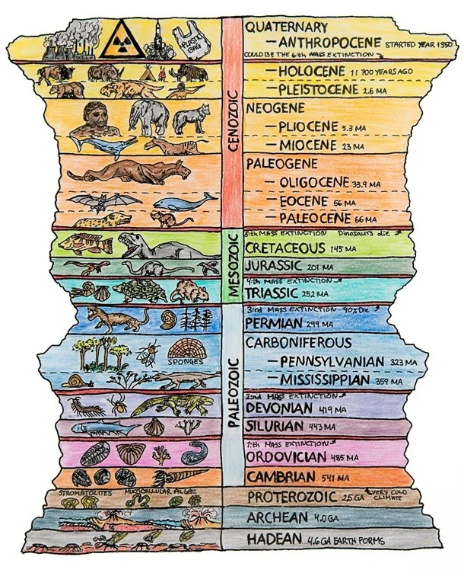
The Anthropocene
a proposed geological epoch dating from the commencement of significant human impact on Earth's geology and ecosystems, including, but not limited to, anthropogenic climate change.
Paul J. Crutzen, Noble laureate

Slide 11
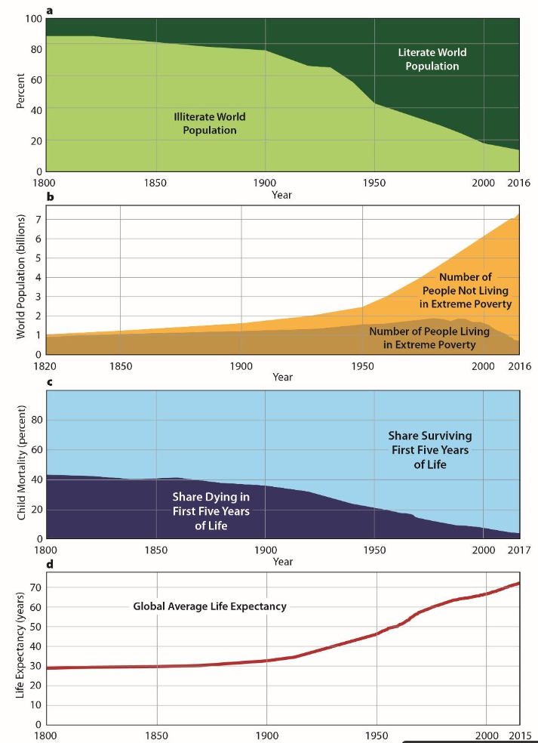
The Anthropocene
Humanity has made tremendous public health gains by traditional measures such as global child mortality and life expectancy
Yet the Earth’s natural systems have been disrupted leading to environmental changes:
  Biodiversity shifts
  Changing biogeochemical flows
  Changing land use and land cover
  Global pollution
  Climate change
  Depletion of natural resources
Figure. Measures of human development over time reveal extraordinary improvements over the 20thcentury in literacy (a), wealth (b), child survival (c) and life expectancy (d). (Our World in Data)

Slide 12
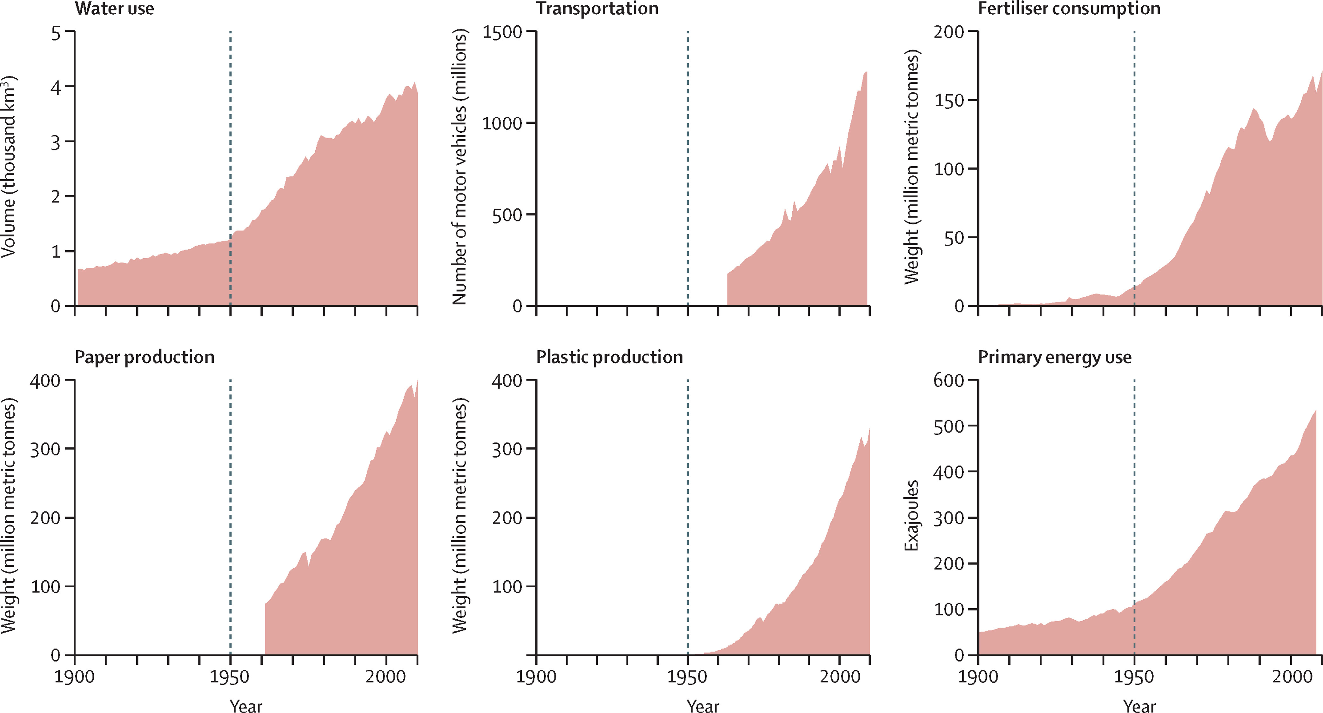
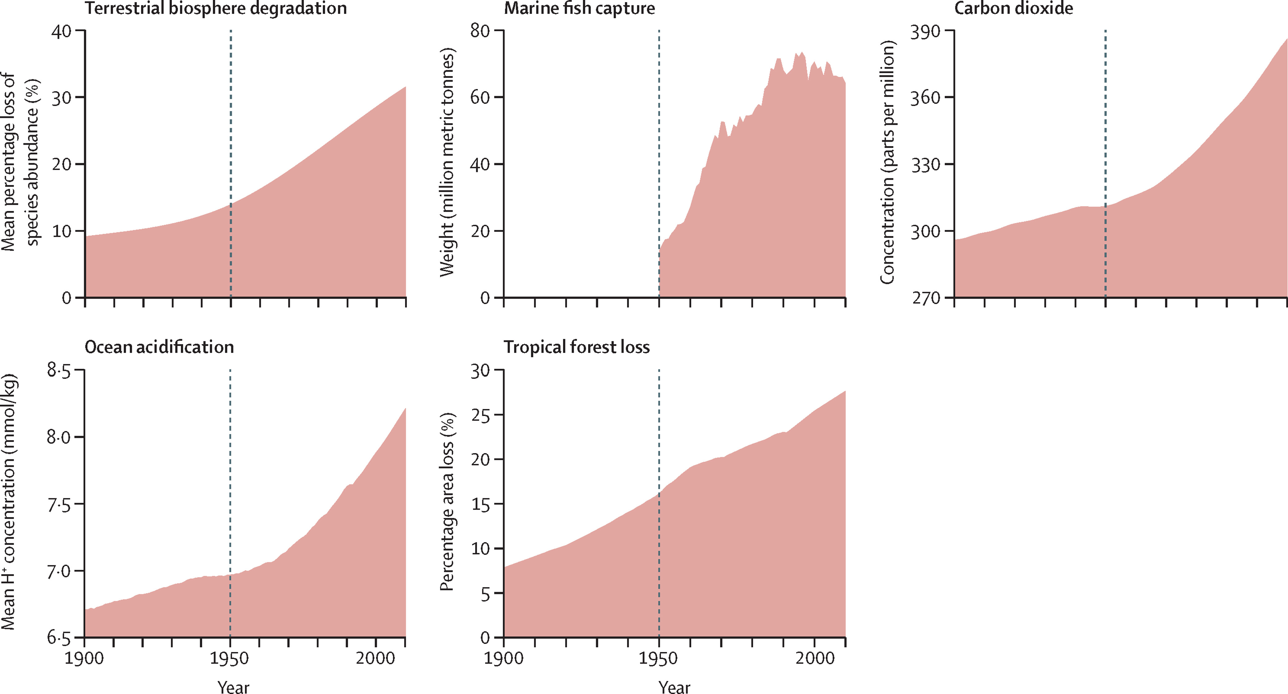
The Great Acceleration
Figure. Measures of consumption over time (Myers, S. 2017)
Figure. Measures of human impact on natural systems (Myers, S. 2017)

Slide 13
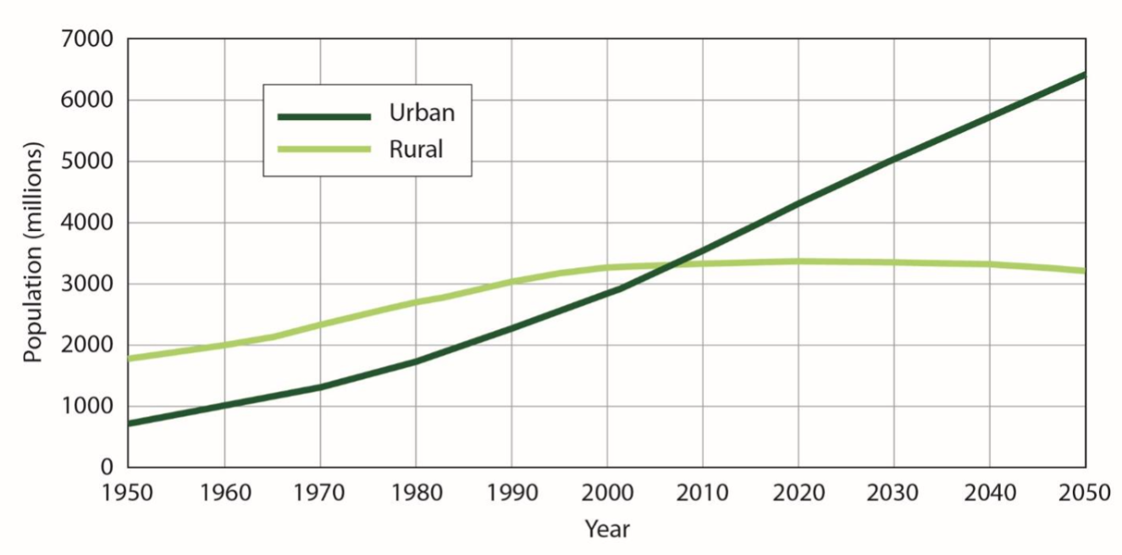
Urbanization
Figure. Number of people living in urban versus rural settings, historical and projected (UN World Population Prospects 2019)

Slide 14
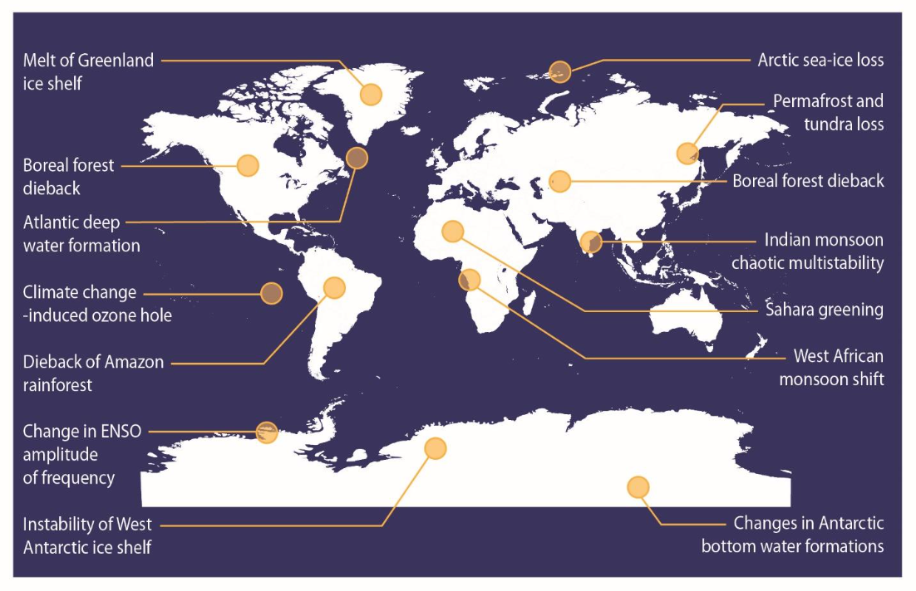
Potential climate tipping points
Figure. Potential climate tipping points due to environmental change (Myers, 2020)

Slide 15
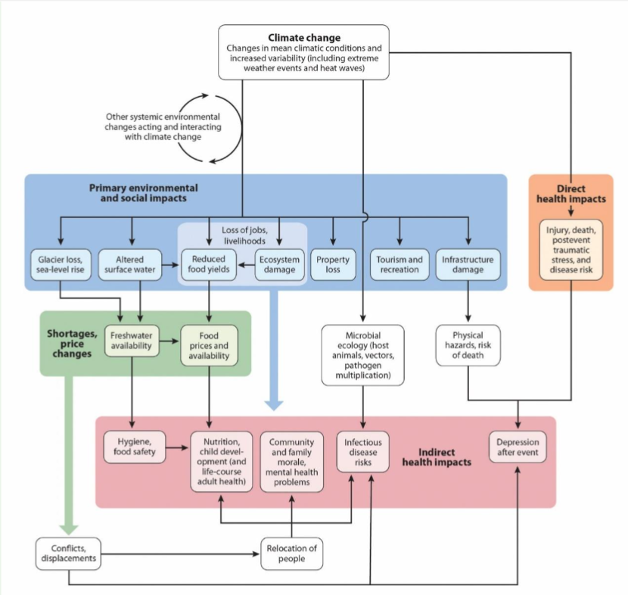
Climate Change & Public Health
Figure. Pathways from climate change to health outcomes. (Frumkin, H. 2019)

Slide 16
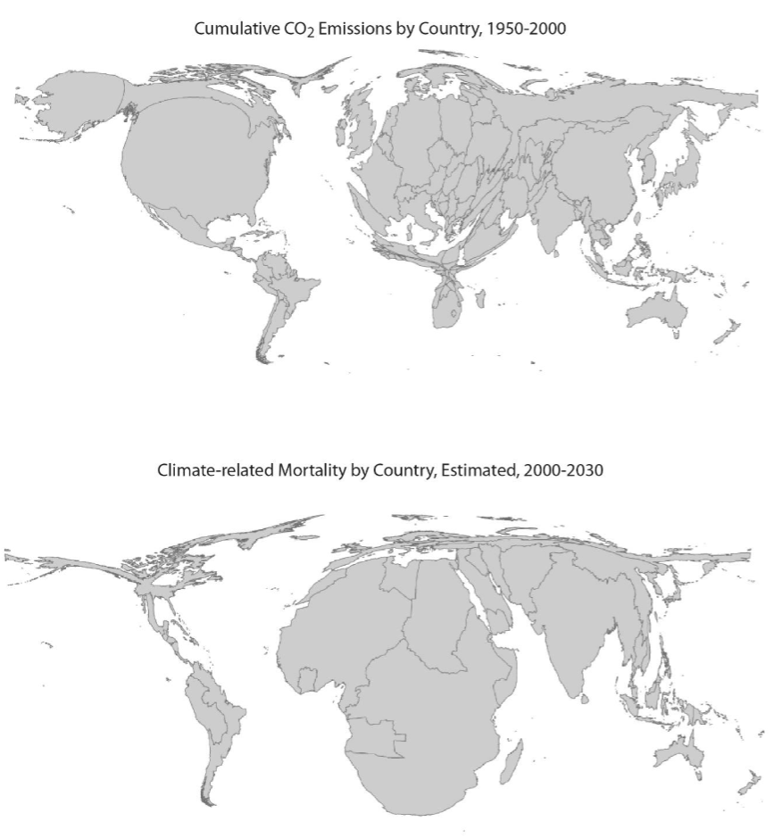
Where lies the burden?
Cumulative national carbon dioxide emissions, 1950-2000 (upper panel).
Distribution of four climate-related causes of death (malaria, malnutrition, diarrhea, and flood-related fatalities) (lower panel).
In this cartogram, each nation’s size is proportional to its impact.
(Patz, JA.,et al. 2007)

Slide 17
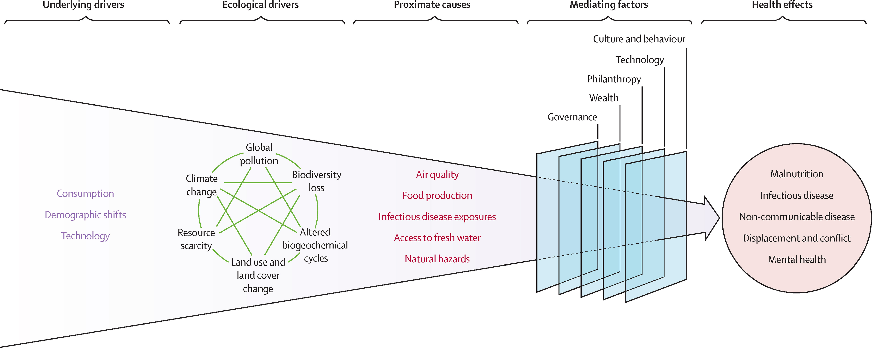
“Growing evidence that, indeed, the pace and scale of human disruption of Earth's natural systems is driving an increasing share of the global burden of disease has given rise to a new field of research: planetary health.” (Myers, S. 2017)
Figure. Schematic illustrating impacts of anthropogenic change on human health (Myers, S. 2017)

Slide 18
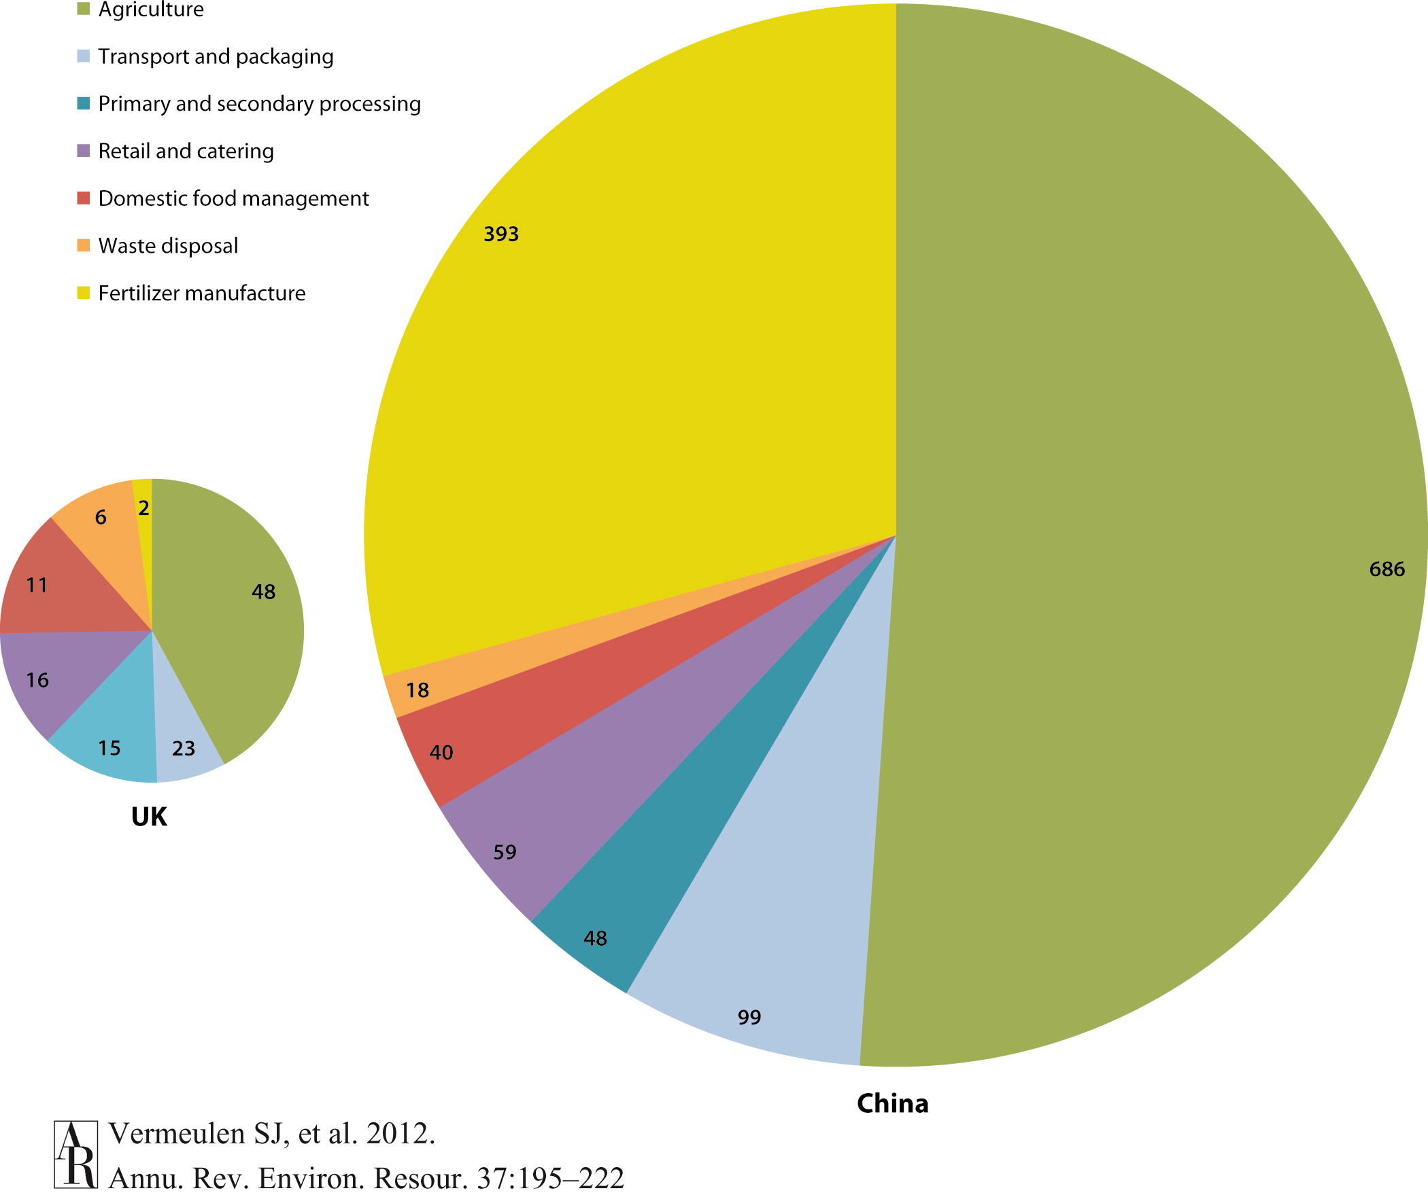
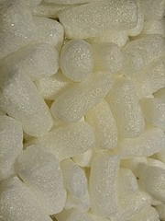
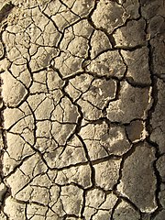
Food Systems & Climate Change
Impacts of food systems on climate change:
  food system activities give rise to production of greenhouse gases (GHGs) accounting for between 19% and 29% of the total global anthropogenic emissions.
Impacts of global climate change on food systems:
  direct impacts of weather on plant and animal physiology
  downstream impacts on prices, reliability of delivery, food quality, and food safety
  further extrapolation of malnutrition
  (Vermeulen, S., et al. 2012)
<>
Figure. Partitioning of production-based food chain greenhouse gas emissions, excluding land-use change, for China and United Kingdom. The estimated megatonnes of carbon dioxide equivalent for 2007 are indicated.

Slide 19
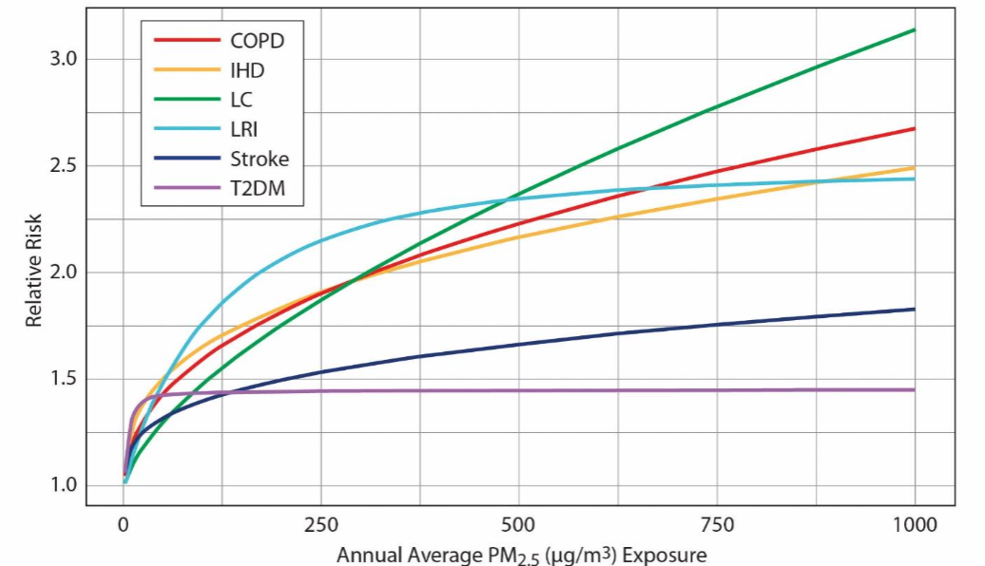
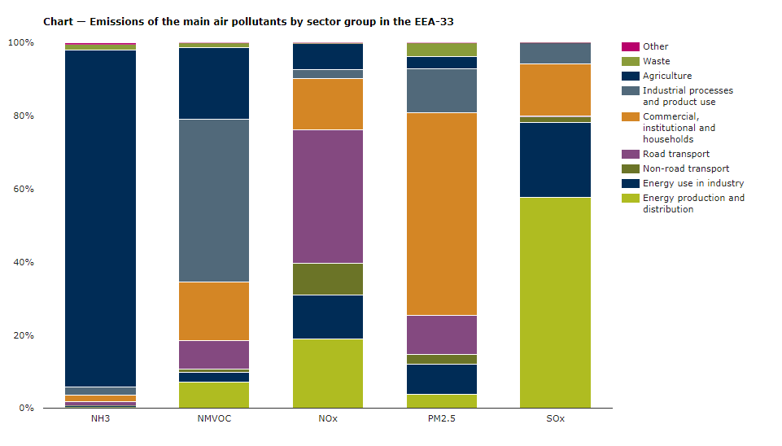
Air Quality
Air pollution kills an estimated seven million people worldwide every year with low- and middle-income countries suffering most from the highest exposures
More than 70 % of EU citizens live in urban areas (Eurostat, 2016), where high population densities and economic activities cause high levels of air pollution. Such exposure is linked to adverse health effects, such as respiratory and heart problems, and cancer (WHO, 2014).
According to the Commission's report, pollution caused 21% of deaths from cardiac disease, 23% of deaths from stroke, 8% of deaths from chronic obstructive pulmonary disease, and 25% of deaths from lung cancer. (Myers, 2017)
Figure. Integrated exposure response curves depict relationship between annual exposure to PM2.5 and relative risk of lower respiratory infection (LRI), chronic obstructive pulmonary disease (COPD), ischemic heart disease (IHD), lung cancer (LC), Type 2 Diabetes Mellitus (T2DM), and stroke. (Burnett RT. 2012)
Figure. Emissions of main air pollutants in the EEA region by sector group. (European Environment Agency)

Slide 20
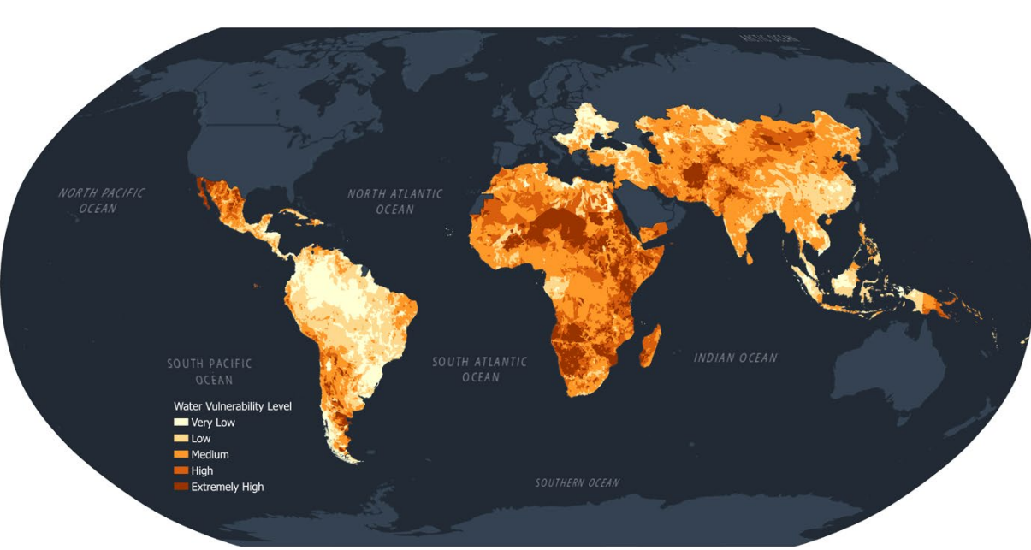
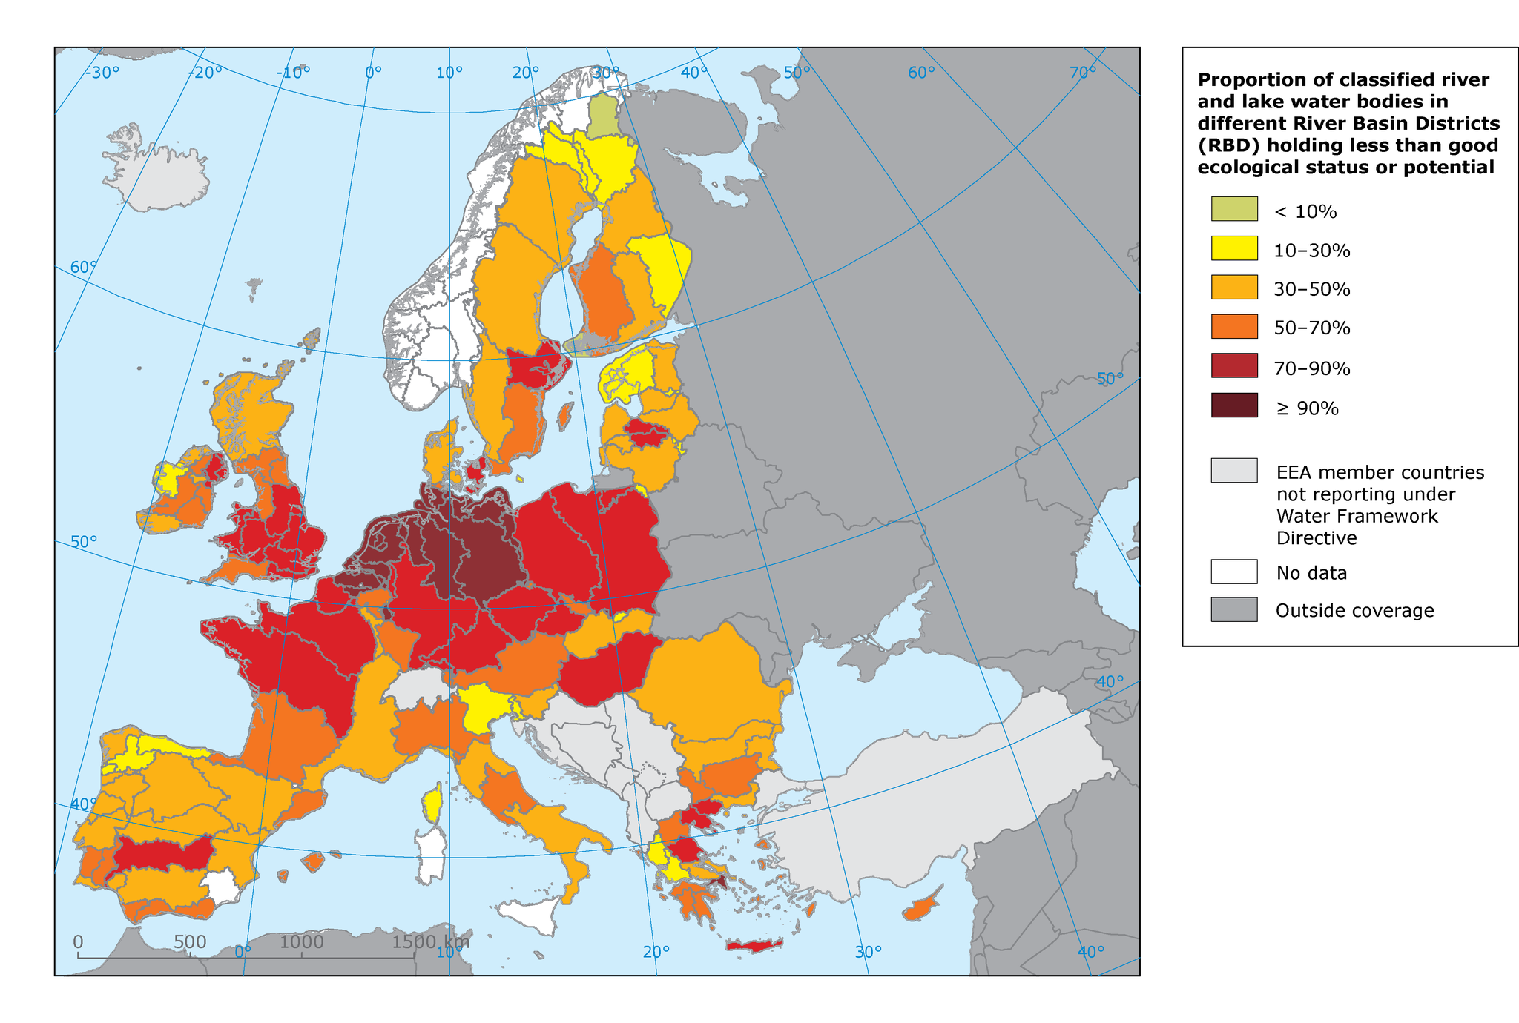
Access to Fresh Water
Around 74% of natural disasters between 2001 and 2018 were water-related, including droughts and floods. The frequency and intensity of such events are only expected to increase with climate change.
When disasters hit, they can destroy or contaminate entire water supplies, increasing the risk of diseases like cholera and typhoid to which children are particularly vulnerable.
Rising temperatures can lead to deadly pathogens in freshwater sources, making the water dangerous for people to drink.
Around 450 million children live in areas of high or extremely high water vulnerability. This means they do not have enough water to meet their everyday needs.
Contaminated water poses a huge threat to children’s lives. Water and sanitation related diseases are one of the leading causes of death in children under 5 years old.
Every day, over 700 children under 5 die from diarrhea linked to inadequate water, sanitation and hygiene.
Climate change exacerbates water stress – areas of extremely limited water resources – leading to increased competition for water, even conflict.
By 2040, almost 1 in 4 children will live in areas of extremely high water stress.
(Source: UNICEF)
Figure. Map of areas of high or extremely high water vulnerability.(UNICEF, 2021)
Figure. Freshwater quality in European countries. (European Environment Agency)

Slide 21
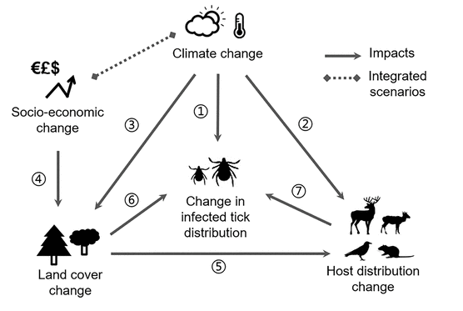
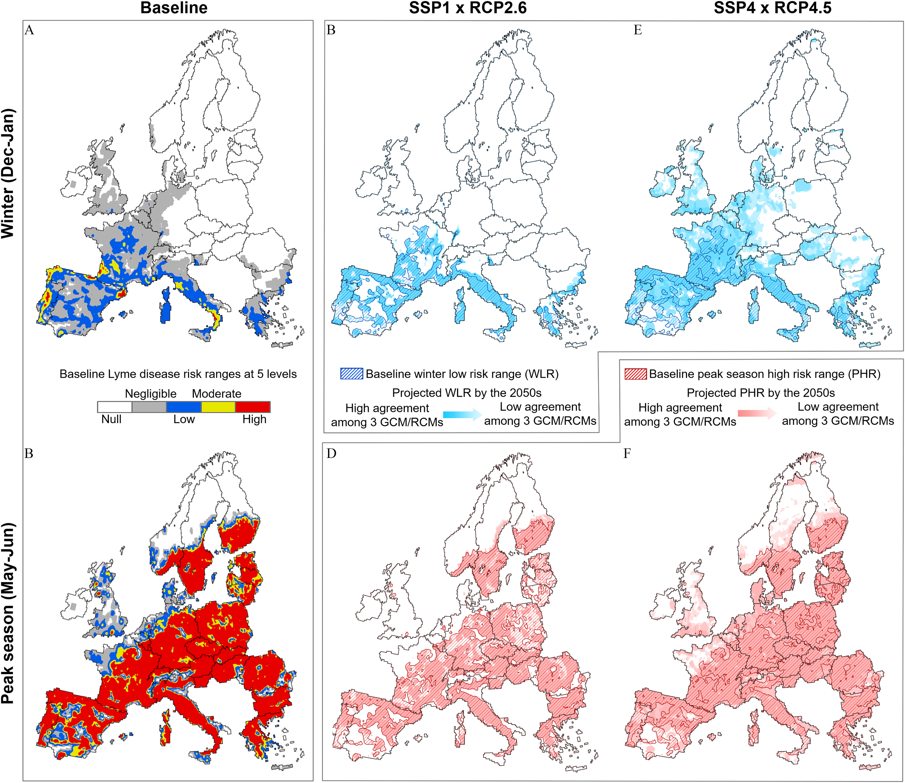
Infectious Disease Exposures
Non-climate drivers (Rocklöv, J., & Dubrow, R. 2020)
  globalization and environment
  socio-demographics
  public health systems
  vector and pathogen characteristics
Climate drivers (Myers, 2017):
  Changes in the habitat, life cycles, and feeding behavior of vectors
  Deforestation, dams, and irrigation projects have had large impacts on exposure to malaria, schistosomiasis, and other infectious diseases.
  Human encroachment into wildlife habitat, including bushmeat hunting and agricultural expansion, has increased risk of exposure to zoonotic diseases such as HIV and Ebola.
Figure. Theoretical framework and key drivers of Lyme disease risk dynamics (Gilbert, et al. 2019).
Figure. Projected baseline and future Lyme disease risk ranges (Gilbert, et al. 2019).

Slide 22
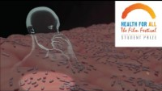

Slide 23
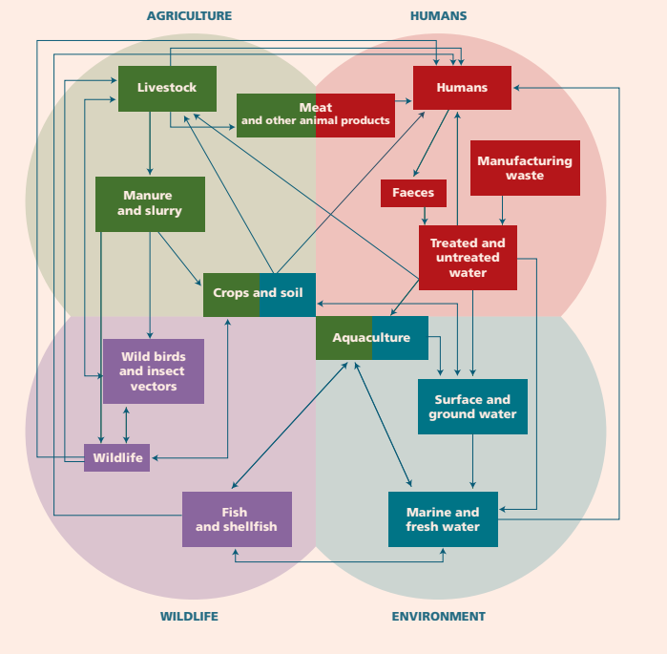
Antimicrobial Resistance
WHO has declared that AMR is one of the top 10 global health threats facing humanity.
Misuse and overuse of antimicrobials are the main drivers in the development of drug-resistant pathogens.
Antibiotic resistance is a natural phenomenon.
There has been and continues to be a massive use of antibiotics within the health care, veterinary and agricultural sectors, which has created a strong selection pressure for resistant bacteria.
Figure. Potential transmission pathways of antimicrobial-resistant bacteria, resistance genes and antimicrobial residues, at the agriculture-human-environment-wildlife interface (Wellington, et al. 2013)

Slide 24
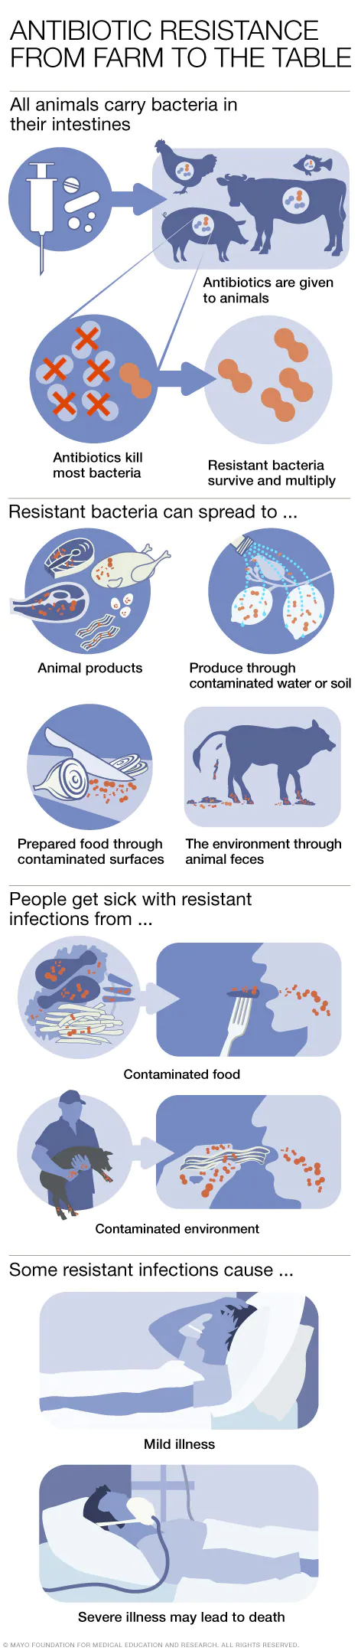
Animal Husbandry
“The consequences of the recent dramatic global changes in food consumption, international trade, agricultural production systems, and human travel in terms of AMR spread and circulation are as yet scarcely known.” (FAO, 2016)
Antibiotic-resistant bacteria can then spread from farm animals to:
Other animals raised in the same location
Animal products people eat, such as chicken and steak
Produce, such as fruits and vegetables, through unclean water or soil
The environment, through animal feces
Prepared food, through unclean surfaces, such as a cutting board that's used to cut chicken and then chop vegetables and not washed between uses

Slide 25

Antibiotics Quality
Antimicrobial drugs are the largest category of falsified and substandard drugs. (ReAct)
There are many ways in which antibiotics can be of poor quality:
Low antibiotic content
Poor formulation
Containing impurities, intermediary compounds or isomers
Poor quality antibiotics can lead to resistance (ReAct)
Access to quality-assured antimicrobials is regarded as part of the human right to health, yet universal access is often undermined in low-income and middle-income countries.
(Mendelson, M, 2016)
Figure. Street vendor selling medicines (National Geographic)

Slide 26
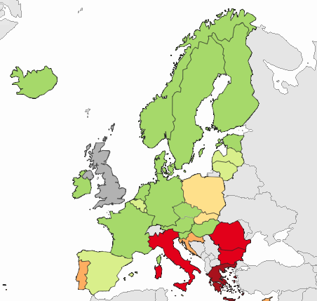
AMR in Europe
There are large intercountry variations in the proportions of resistant bacteria in the EU and these variations, often showing a North-to-South gradient, can be observed for most antimicrobial-resistant bacteria surveyed by the European Antimicrobial Resistance Surveillance System (EARSS);
There are also large variations in antibiotic use among EU Member States
Member States that use the most antibiotics for outpatients, i.e. Greece and Cyprus, use approximately three times more per inhabitant and per year than the Member State that uses the least, i.e. the Netherlands;
Six Member States (i.e. France, Belgium, Slovakia, Czech Republic, Slovenia and Sweden) recently reported decreasing trends in antibiotic use in outpatients;
The impact of the COVID-19 pandemic on AMR is apparent in many ways.
(ECDC)
Figure. Antimicrobial resistance to carbapenems in the EU countries based on data from 2020. (ECDC)

Slide 27

The EU Commission launched in October 2021 five new EU missions, a new and innovative way to work together and improve the lives of people in Europe and beyond.
EU missions aim to tackle big challenges in health, climate and the environment, and to achieve ambitious and inspiring goals in these areas.
Adaptation to Climate Change: support at least 150 European regions and communities to become climate resilient by 2030;
Cancer: working with Europe's Beating Cancer Plan to improve the lives of more than 3 million people by 2030 through prevention, cure and solutions to live longer and better;
Restore our Ocean and Waters by 2030;
100 Climate-Neutral and Smart Cities by 2030;
A Soil Deal for Europe: 100 living labs and lighthouses to lead the transition towards healthy soils by 2030.

Slide 28
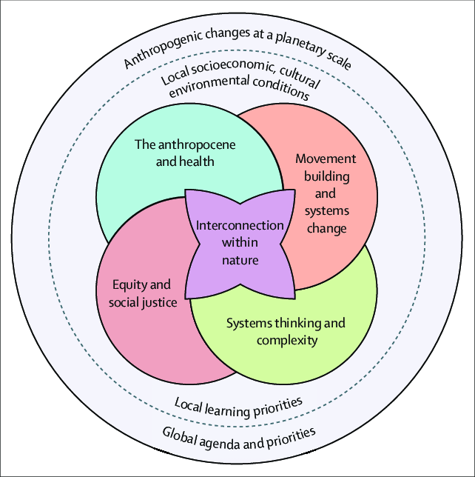
Planetary Health Education
People around the world are increasingly facing the pressing challenges of today’s interconnected environmental, social, and health crises.
The COVID-19 pandemic has been an important wake-up call reminding us that we need a healthy planet to ensure the health of all people.
There are 5 foundational domains that comprise the essence of planetary health knowledge
(Guzmán, C., et al. 2021)

Slide 29


THANK YOU
abanoub.riad@med.muni.cz

