Slide 1
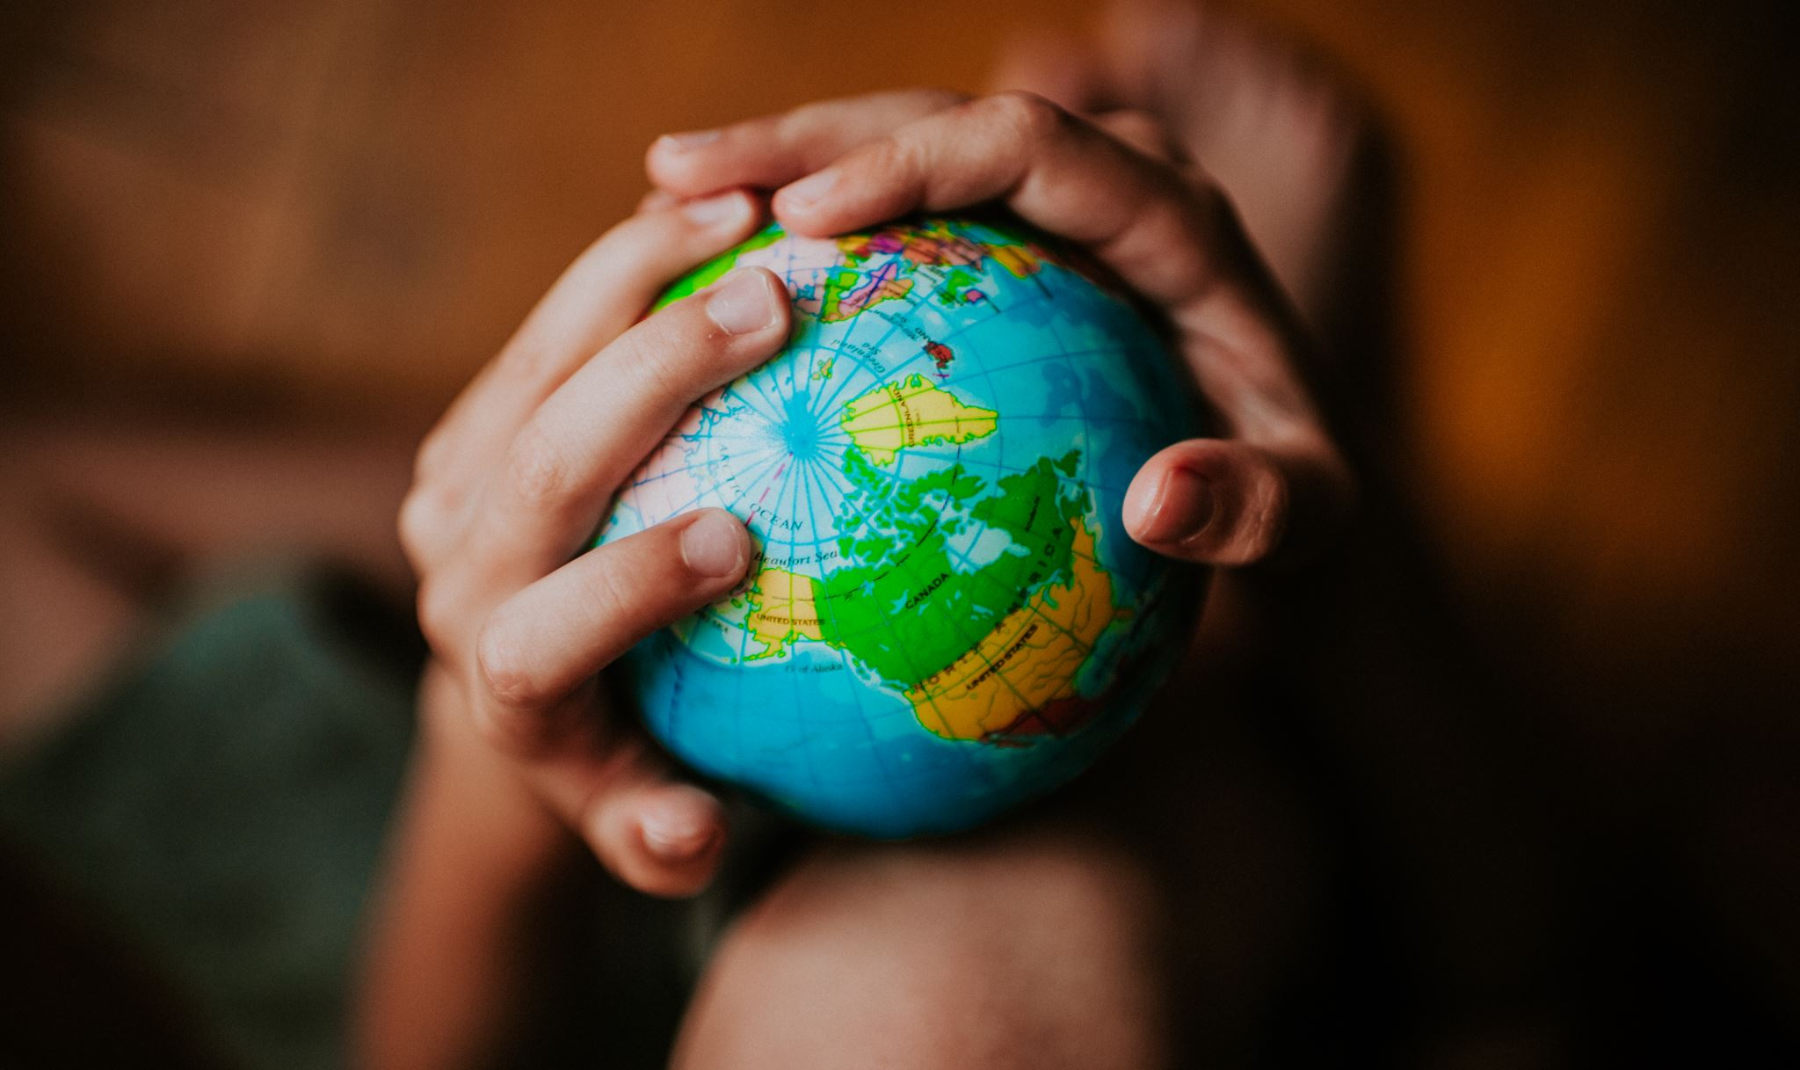
Equity in global health

Slide 2
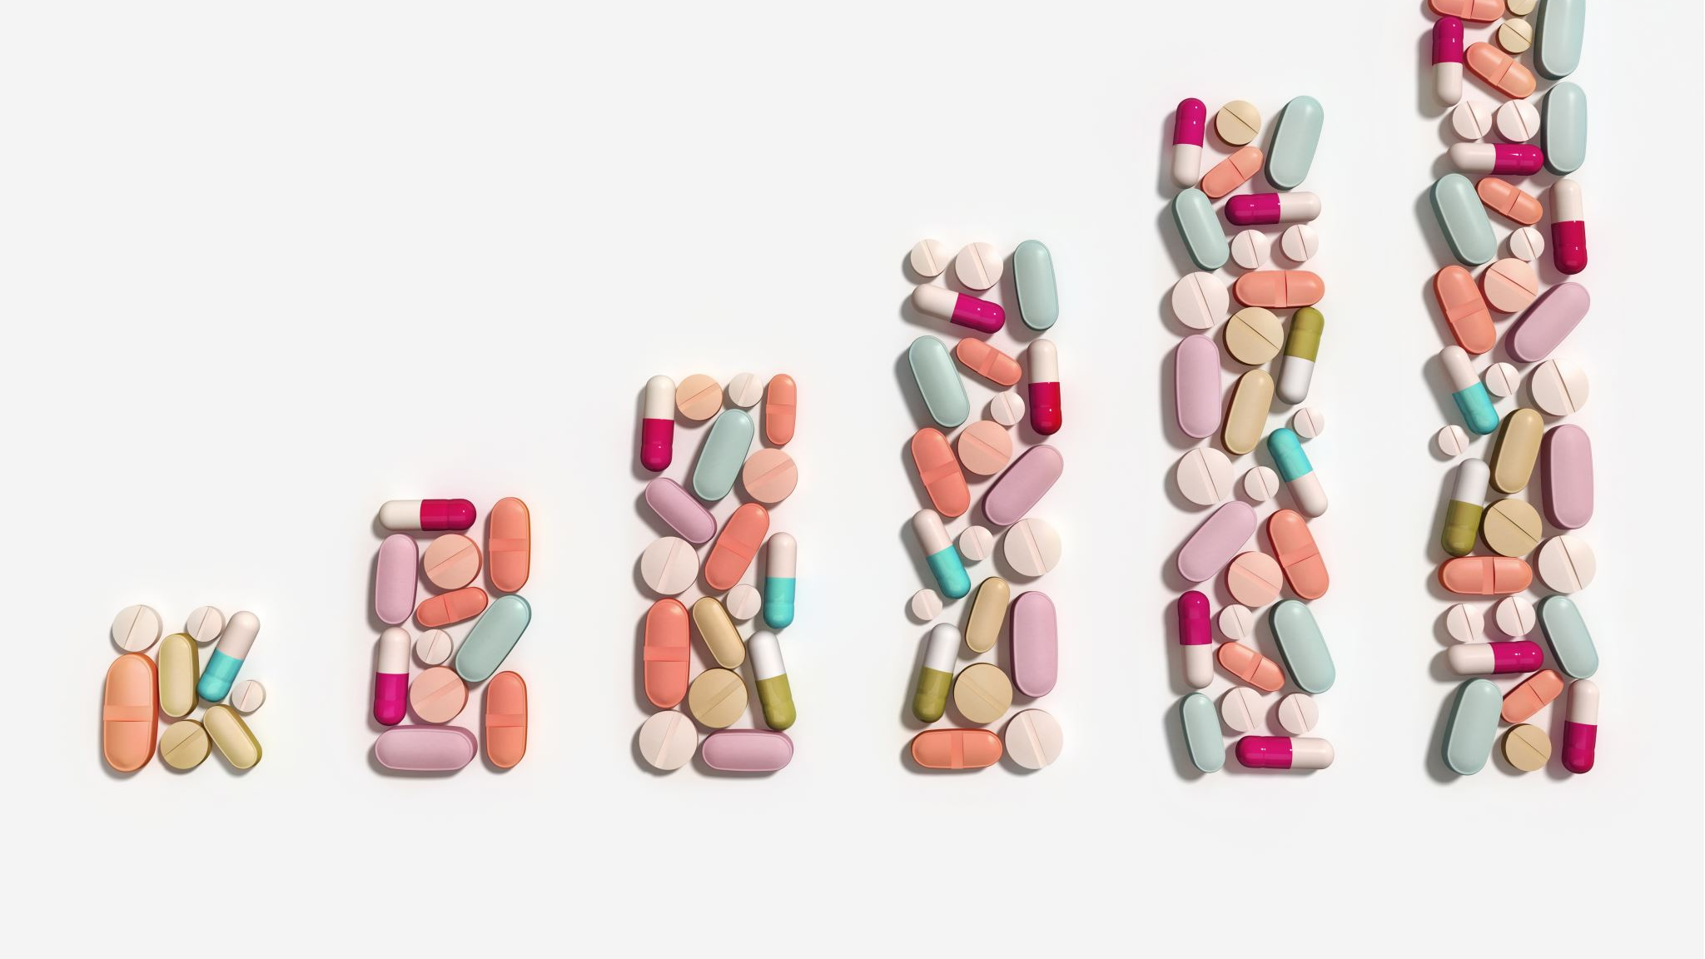
Health inequities
Health inequities are systematic differences in the health status of different population groups. These inequities have significant social and economic costs both to individuals and societies.

Slide 3
Health inequities are systematic differences in health outcomes
Health inequities are differences in health status or in the distribution of health resources between different population groups, arising from the social conditions in which people are born, grow, live, work and age. Health inequities are unfair and could be reduced by the right mix of government policies.

Slide 4
Every day 16 000 children die before their fifth birthday
They die of pneumonia, malaria, diarrhoea and other diseases. They are 14 times more likely to die before the age of five in sub-Saharan Africa than the rest of the world. Furthermore, children from rural and poorer households remain disproportionately affected. Children from the poorest 20% of households are nearly twice as likely to die before their fifth birthday as children in the richest 20%.

Slide 5
Maternal mortality is a key indicator of health inequity
Maternal mortality is a health indicator that shows the wide gaps between rich and poor, both between and within countries. Developing countries account for 99% of annual maternal deaths in the world. Women in Chad have a lifetime risk of maternal death of 1 in 16, while a woman in Sweden has a risk of less than 1 in 10 000.

Slide 6
Tuberculosis is a disease of poverty
Around 95% of TB deaths are in the developing world. These deaths affect mainly young adults in their most productive years. Contracting the disease makes it even harder for these adults to improve their personal economic condition and that of their families.

Slide 7
87% of premature deaths due to noncommunicable diseases occur in low- and middle-income countries
In low-resource settings, health-care costs for noncommunicable diseases (NCDs) can quickly drain household resources, driving families into poverty. The exorbitant costs of NCDs are forcing millions of people into poverty annually, stifling development.

Slide 8
Life expectancy varies by 34 years between countries
In low-income countries, the average life expectancy is 62 years, while in high-income countries, it is 81 years. A child born in Sierra Leone can expect to live for 50 years while a child born in Japan can expect to live 84 years.

Slide 9
There are alarming health inequities within countries, too
For example, in the United States of America, African Americans represent only about 13% of the population but account for almost half of all new HIV infections. There is no biological or genetic reason for these alarming differences in health.

Slide 10
Health disparities are huge in cities
In Glasgow, male life expectancy ranges from 66.2 years in Ruchill and Possilpark to 81.7 years in Cathcart and Simshill – a difference of 15.5 years. In London, when travelling east from Westminster, each tube stop represents nearly one year of life expectancy lost according to the findings of the London Health Observatory.

Slide 11
Health inequities have a significant financial cost to societies
The European Parliament has estimated that losses linked to health inequities cost around 1.4% of gross domestic product (GDP) within the European Union – a figure almost as high as the EU's defense spending (1.6% of GDP). This arises from loses in productivity and tax payments, and from higher welfare payments and health care costs.

Slide 12
Persistent inequities slow development
Close to 1 billion people in the world live in slum conditions, representing about one quarter of the world's urban population. The likelihood of meeting the Sustainable Development Goal 3 on good health and well-being is closely linked to the targets of goal 11 on sustainable cities and communities.

Slide 13
The reason for inequity
- Health Determinants

Slide 14
Major groups of health determinants
Biology and genetics
Physical determinants
Social determinants
Health services
Public policies
Individual behaviour

Slide 15
Taxonomy of health determinants
Not universal
Each country/reagion agency has its own terminology
The principle is not contested and questioned

Slide 16
Social Factors
Availability of resources to meet daily needs, such as educational and job opportunities, living wages, or healthful foods
Social norms and attitudes, such as discrimination
Exposure to crime, violence, and social disorder, such as the presence of trash
Social support and social interactions
Exposure to mass media
Socioeconomic conditions, poverty
Quality schools
Transportation options
Public safety
Residential segregation
Physical determinants
Natural environment, such as plants, weather, or climate change
Built environment, such as buildings or transportation
Worksites, schools, and recreational settings
Housing, homes, and neighborhoods
Exposure to toxic substances and other physical hazards
Physical barriers, especially for people with disabilities
Aesthetic elements, such as good lighting, trees, or benches
Healthcare
Lack of availability
High cost
Lack of insurance coverage
Limited language access
Individual Behavior
Diet
Physical activity
Alcohol, cigarette, and other drug use
Hand washing

Slide 17
USA (healthypeople.gov)
CANADA (canada.ca/en/public-health)
Social Factors
Physical determinants
Healthcare
Individual Behavior
Income and social status
Employment and working conditions
Education and literacy
Childhood experiences
Physical environments
Social supports and coping skills
Healthy behaviours
Access to health services
Biology and genetic endowment
Gender
Culture
Race / Racism

Slide 18
WHO taxonomy
the social and economic environment,
the physical environment, and
the person’s individual characteristics and behaviours.

Slide 19
European perspective

Slide 20
EUROPE
Basic facts
750 million people
6 time zones
50 sovereign states
Each responsible for its own health policy
Vast differences among individual regions
Living standards
Lifestyle
Diet
Life expectancy
No common public health policy

Slide 21
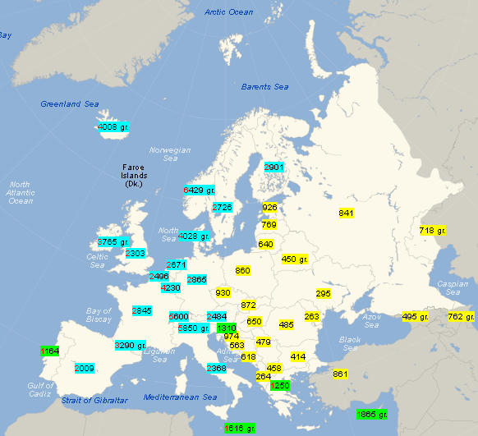
European gap in life expectancy/income

Slide 22
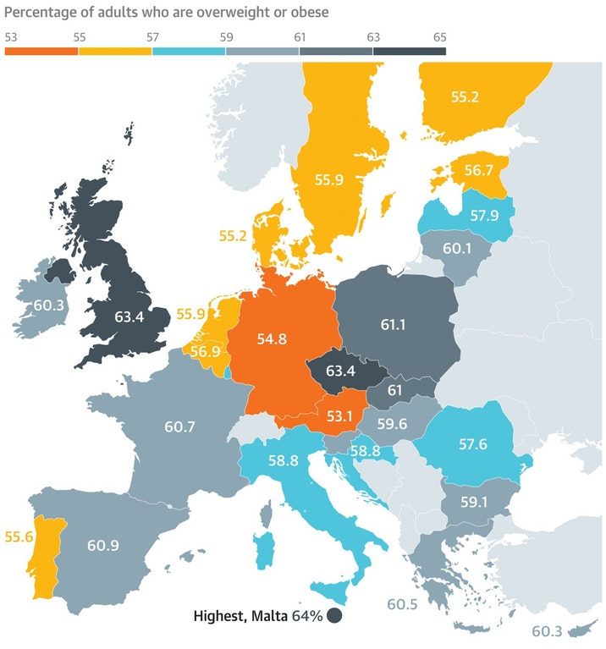
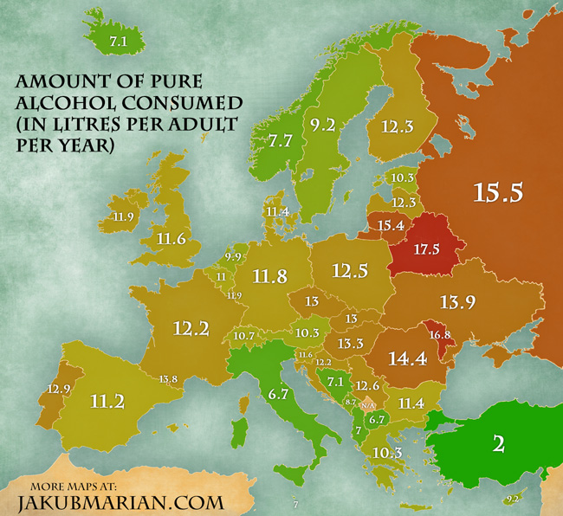
Other lifestyle differences

Slide 23
What do European states have in common /healthcare and public health perspective/
Christian tradition
catholic and orthodox church used to be a major healthcare provider
Hospitals were established in monasteries,
Medical schools were run by churches
Welfare state
Concept from 19th century
Solidarity, social policies, welfare spending
Result
Health is (mistakenly) percieved to be a public service
Much higher emphasis is on the provision of healthcare than public health
All European countries guarantee free (or heavily subsidized) access to Healthcare
Public (and obligatory) health insurance

Slide 25
European union perspective

Slide 26
European union
Basic facts
27 countries
550 million citizens
It is not a state but …
Union of sovereign states
Common policies in certain areas
Free movement of citizens, goods, services
Common currency (in most countries)

Slide 27
Public Health Objectives and challenges

Slide 30
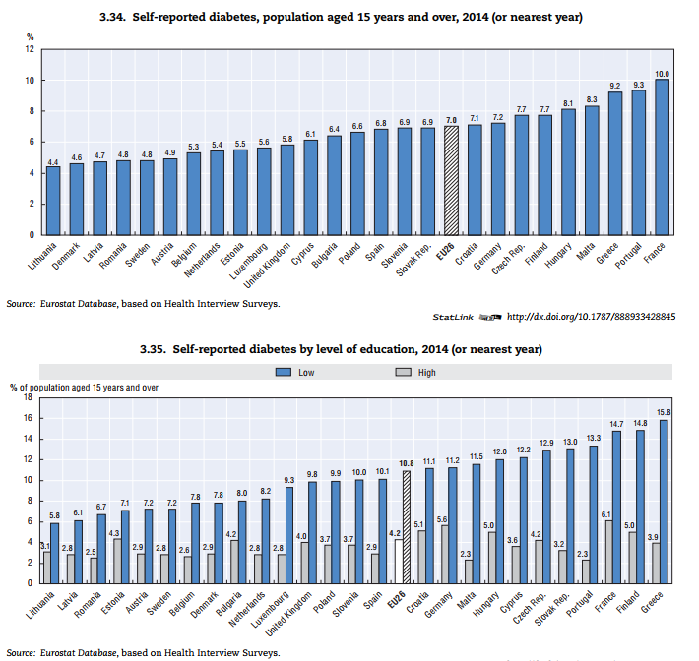
The regional differences are again huge

Slide 31
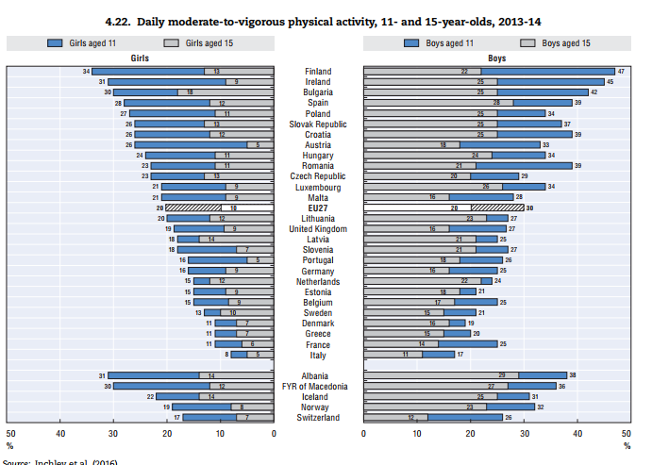
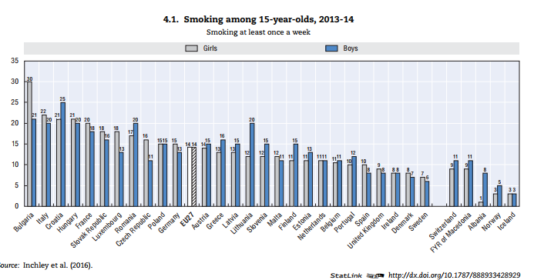
Health determinants are completely different

Slide 32
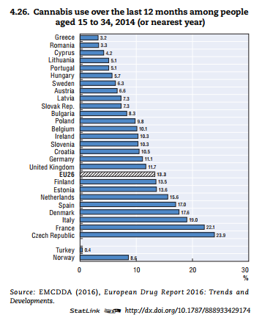

Slide 33
Gender (in)equity in health
Men- worse health outcomes but higher healthy self-perception
Women- live longer but spend less years in good health
“Feminised poverty”
Men are more vulnerable to COVID-19
Women are more likely to be exposed to the virus
Health systems should better respond to the role of gender in the uptake of (un)healthy behaviour
Data to assess gender equality should go beyond the gender employment gap

Slide 36
What can we do to change health determinants?
… we have to change society …..

Slide 37
Will the society accept the changes?

Slide 38
International action

Slide 39
International organisations – Global Health
World Health Organization (WHO)
The directing and coordinating authority for health within the United Nations system, responsible for providing leadership on global health matters, including shaping the health research agenda.
World Bank
A vital source of financial and technical assistance to developing countries around the world to fight poverty, including making investments to improve health.
UNICEF
United Nations Children's Fund, an agency of the United Nations responsible for providing humanitarian and developmental aid to children worldwide.
The agency is among the most widespread and recognizable social welfare organizations in the world, with a presence in 192 countries and territories.

Slide 40
Agencies on EU level
Consumers, Health and Food Executive Agency (Chafea) –
European Centre for Disease Prevention and Control (ECDC) –
European Environment Agency (EEA)
European Monitoring Centre for Drugs and Drug Addiction (EMCDDA)
European Medicines Agency (EMA) –
European Chemicals Agency (ECHA) –
European Food Safety Authority (EFSA) –
European Agency for Safety and Health at Work (EU-OSHA) –
Eurofound
implements the EU Health Programme, Consumer Programme and Better Training for Safer Food initiative.
works to strengthen Europe's defences against infectious diseases.
provides reliable, independent information on the environment.
supplies comprehensive information on drugs and drug addiction in Europe.
protects and promotes public and animal health by evaluating medicines for human and veterinary use.
ensures chemical substances are registered, evaluated, authorised and restricted consistently across the EU.
provides independent scientific advice and clear communication on risks to food and feed safety.
supplies information needed by EU employers and workers to address safety and health issues.
– provides expertise on living and working conditions, industrial relations and managing change for key EU social policy actors.

Slide 41
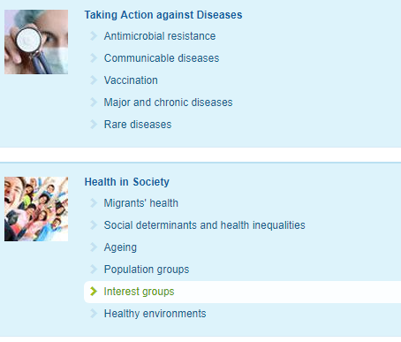
Where is EU taking action (?)

Slide 42
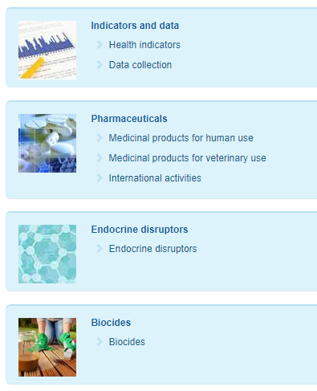

Slide 43
Further actions
Movement of workforce
Health professional
Movement of goods
Safety standards
Marketing rules
Cross-border provision of healthcare

