Slide 1
Migrant and refugee health
Dr. Anton Drobov, MD

Slide 2
Outline of the lecture:
Overview
Migration and outbreaks of vaccine-preventable diseases in Europe
Impact of COVID-19 on refugees and migrant health
COVID-19 immunization in refugees and migrants
Break
Migrant and refugee mental health
Ukraine emergency

Slide 3
Kahoot.it
Kahoot game

Slide 4
The right to health as laid down in the WHO (World Health Organization) Constitution applies to every person, including refugees and migrants

Slide 5
Refugee is any person who...
Asylum-seeker is...
Migrant is any person who...
owing to well-founded fear of being persecuted for reasons of race, religion, nationality, membership of a particular social group or political opinion, is outside the country of his/her nationality and is unable or owing to such fear, is unwilling to avail himself of the protection of that country
or who, not having a nationality and being outside the country of his former habitual residence as a result of such events, is unable or, owing to such fear, is unwilling to return to it
- a person who has left their country and is seeking protection from persecution and serious human rights violations in another country, but who hasn’t yet been legally recognized as a refugee and is waiting to receive a decision on their asylum claim. Seeking asylum is a human right. This means everyone should be allowed to enter another country to seek asylum.
There is no universally accepted definition of the term “migrant”.
Migrants may remain in the home country or host country (settlers), move on to another country (transit migrants), or move back and forth between countries (circular migrants, such as seasonal workers)

Slide 6
Refugee camp in Tanzania
Refugee camp in Sweden

Slide 7
Statistics on migrants and refugees globally
According to the UNHCR (The United Nations High Commissioner for refugees) statistics, today there are some one billion migrants globally, about one in seven of the global population (as of 10 November 2021).
Source: UNHCR (The United Nations High Commissioner for refugees) statistics.

Slide 8
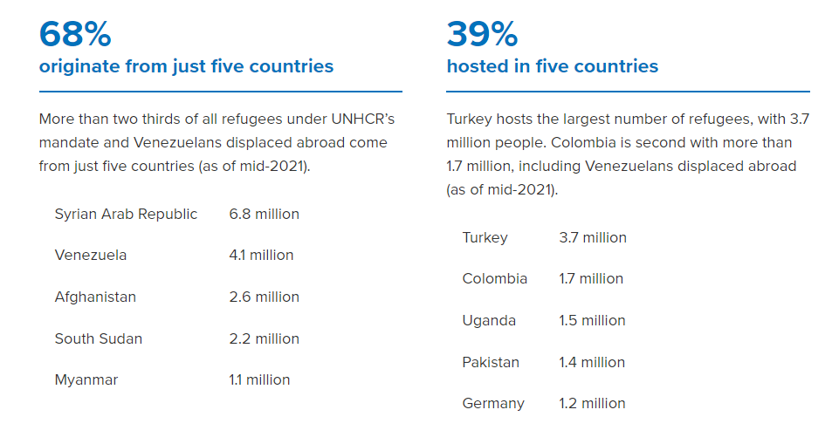
Statistics on migrants and refugees globally
World Migration Report 2022
Source: UNHCR (The United Nations High Commissioner for refugees) statistics.

Slide 9
Main stages of the migration process

Slide 10
Problems that might be experienced by migrants and refugees
Refugees and migrants remain among the most vulnerable members of society
This group faces xenophobia, discrimination; poor living, housing and working conditions; inadequate access to health services, despite frequently occurring physical and mental health problems.
This may result in increased vulnerability to infectious diseases, non-communicable diseases and mental health issues.
The COVID-19 pandemic has posed additional challenges both in terms of increased risk of infection and death and has highlighted existing inequities in access to and utilization of health services (including COVID-19 immunization).
Refugees and migrants have also suffered the negative economic impact of lockdown and travel restrictions.

Slide 11
WHO's Global Action Plan: Promoting the health of refugees and migrants 2019-2023
Six key priorities:
Promote the health of refugees and migrants through a mix of short-term and long-term public health interventions
Promote continuity and quality of essential health care
Advocate the mainstreaming of refugee and migrant health into global, regional and country agendas and the promotion of refugee-sensitive and migrant-sensitive health policies and legal and social protection
Enhance capacity to tackle the social determinants of health and to accelerate progress towards achieving the Sustainable Development Goals, including universal health coverage
Strengthen health monitoring and health information systems
Support measures to improve evidence-based health communication and to counter misperceptions about migrant and refugee health

Slide 12
New Pact on migration and asylum presented by the European commission in September 2020
The objective is to strike a new balance between the principles of fair sharing of responsibility and solidarity and to build confidence through a more comprehensive approach and modernised procedures.
Health and healthcare of migrants is also included in the Pact through the introduction of health checks that will allow an early identification of migrant’s potential needs.

Slide 13
What is the EU doing to help?
Provides financial support
Supports the EU countries facing particularly high levels of migration
Works with the European Centre for Diseases Prevention and Control, the World Health Organization Regional Office for Europe and the International Organization for Migration to better identify and address the needs of the EU countries and refugees
Develops training programmes and training materials for healthcare and other professionals working with migrants

Slide 14
Migration and outbreaks of vaccine-preventable diseases in Europe
Measles
Mumps
Rubella
Diphtheria
Pertussis
Polio
Hepatitis A
Varicella
Neisseria meningitidis
Haemophilus influenzae

Slide 15
Caseload of vaccine-preventable disease outbreaks involving migrants by reported location, in accordance with the research conducted in October 2021
Adult and child migrants living in temporary shelters, camps, or detention centres are at high risk from vaccine-preventable disease outbreaks, particularly of measles, varicella, and hepatitis A
Migrants can face barriers to vaccination on arrival, including exclusion from vaccination systems, with important implications for COVID-19 vaccine delivery going forward. A better understanding of vaccine uptake and demand issues in migrant groups is urgently needed, alongside a greater focus on co-designing vaccine uptake strategies in close collaboration with affected migrant communities.
Source: Migration and outbreaks of vaccine-preventable disease in Europe: a systematic review. Study Group for Infections in Travellers and Migrants. 2021

Slide 16
Impact of COVID-19 pandemic on refugee and migrant health
Although everyone is affected by the COVID-19 pandemic, the impact is not shared equally
Data from the UN High Commissioner for Refugees (UNHCR) between April 2020, and February 2021, indicate a gradual rise in reports of COVID-19 cases among displaced populations.

Slide 17
The pandemic exacerbated pre-existing vulnerabilities and generated new ones.
Refugees and migrants at greater risk include:
Migrants in an irregular situation
Asylum seekers
Those who are in immigration centers or confined in camps
Exploited migrant workers and victims of human trafficking

Slide 18
COVID‑19 pandemic has had a disproportionately hard impact on the populations of migrants and refugees:
Exposed to the virus with limited tools to protect themselves, and public health measures do not always reach them
Women may face the threat of violence and lack access to sexual and reproductive health services and social and financial protection
Fear of the virus is exacerbating already elevated levels of xenophobia, racism and stigmatization and has even given rise to attacks against refugees and migrants

Slide 19
Survey “Apart together” conducted by WHO in 2020
Aim: to identify how the new coronavirus SARS-CoV-2 (COVID‑19) has impacted refugees and migrants around the world, as experienced and reported by them, especially for social and public health aspects.
Number of respondents: 30000.
Source: ApartTogether survey: preliminary overview of refugees and migrants self-reported impact of COVID-19. 2020.

Slide 20
Summary of the regions of birth (origin) and regions of residence for respondents indicating migration flows
Source: ApartTogether survey: preliminary overview of refugees and migrants self-reported impact of COVID-19. 2020.

Slide 21
Main highlights of the survey:
overall, on a scale of 0 to 10 (where 1- no impact and 10 – hard impact), nearly three quarters of the respondents indicated that COVID‑19 impacted them at a scale of 7 or higher
respondents living on the streets or in insecure accommodation and in asylum centres and irregular migrants reported suffering the worst impact of COVID‑19 on their daily lives and were less likely to seek care for suspected COVID‑19-symptoms
main reasons for not seeking a healthcare are financial constraints (35%) and fear of deportation (22%)
50 % reported greater level of depression, worry, anxiety and loneliness
one in five respondents also expressed deterioration of mental health in terms of increased use of drugs and alcohol
experienced significant discrimination.

Slide 22
To build health system capacities and resilience in the face of the pandemic policy makers in every country must:
identify and counter stigmatizing and discriminatory practices
achieve equitable access to essential health services
remove financial and other barriers to COVID‑19 testing and treatment services
mitigate the adverse social and economic impacts

Slide 23
COVID-19 immunization in refugees and migrants
The global community has an obligation to address the human rights claim to vaccines for all those living in countries who cannot, without assistance, meet their needs
As of 30 August 2021, 57.30% of the populations of high-income countries had been vaccinated compared with 2.14% of those in low-income countries
Source: Global dashboard for vaccine equity [website]. New York: United Nations Development Programme; 2021

Slide 24
Source: Provided by WHO SAGE Values Framework for the Allocation and Prioritization of COVID-19 Vaccination

Slide 25
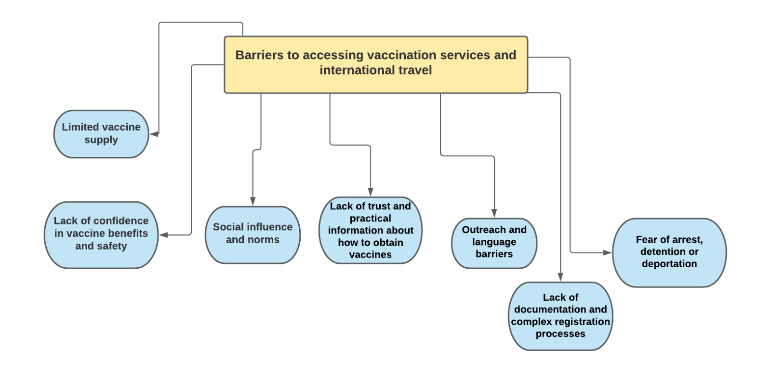
Source: Data for action: achieving high uptake of COVID-19 vaccines. Geneva. World Heatlh Organization; 1 April 2021

Slide 27
A recent study in the United Kingdom reported that 72% of the refugees and migrants contacted felt hesitant about accepting a COVID-19 vaccine.
Reasons:
concerns over vaccine content,
side effects,
lack of information or low perceived need.
Source: Deal A, Hayward SE, Huda M, Knights F, Crawshaw AF, Carter J et al. Strategies and action points to ensure equitable uptake of COVID-19 vaccinations: a national qualitative interview study to explore the views of undocumented migrants, asylum seekers, and refugees. J Migration Health. 2021

Slide 28
Key considerations regarding immunization in refugee and migrants
Ensure universal and equal access to the COVID-19 vaccine for refugees and migrants regardless of migration status, with access the same as for nationals
Addressing barriers that prevent refugees and migrants from accessing COVID-19 vaccination services and international travel
Promoting vaccine uptake and addressing vaccine hesitancy
Engaging communities in COVID-19 vaccination planning and implementation and enhancing effective communication to build trust and counter misinformation
Develop innovative approaches and vaccination strategies for refugees and migrants living in hard-to-reach areas

Slide 29
Migrant and refugee mental health
Migrants and refugees can be exposed to various stress factors which affect their mental health and well-being before and during their migration journey and during their settlement and integration.

Slide 30
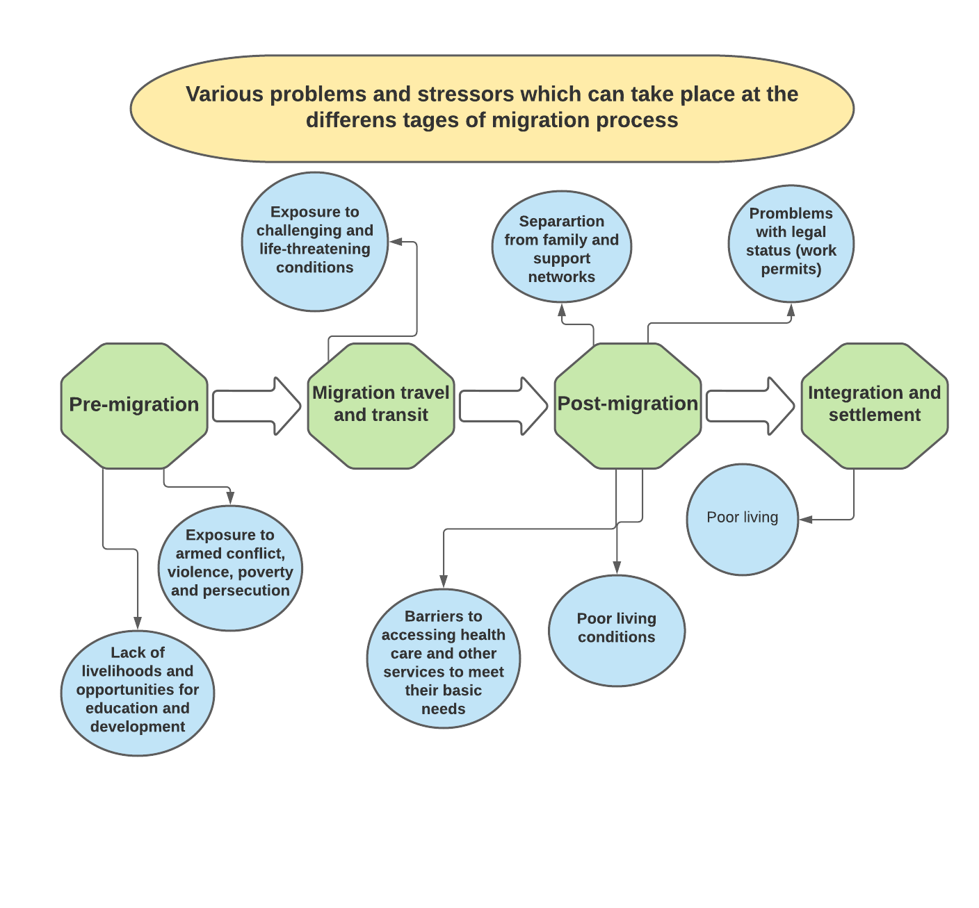

Slide 31
Prevalence of mental health conditions
Some studies show that the prevalence of common mental disorders (depression, anxiety and post-traumatic stress disorder (PTSD)) is higher among migrants and refugees than among host populations.
Asylum seekers tend to be at elevated risk of suicide.
There is also consistent evidence that the incidence of psychoses is higher among migrant populations in several countries, and this has been linked with the cumulative effect of social disadvantages before, during and after migration.
The impact of stressors can be buffered by protective factors such as access to employment and services, social support, proficiency in the language of the host country, and family reunification.
Source: World Health Organization. Mental Health and forced displacement. 31 August 2021.

Slide 32
Responding to the mental health needs of migrants and refugees
A comprehensive, multi-disciplinary and inclusive approach is needed to address the mental health needs of migrants and refugees.

Slide 33
Overcoming barriers to receiving mental health care
provision of clear information on mental health care entitlements and how to receive services
outreach to at-risk groups
facilitation of affordable and non-discriminatory access to care
facilitation of communication
providing person-centred care
facilitating the engagement of multiple sectors and systems.

Slide 34
Integrating mental health in primary health care
- help identify migrants and refugees with mental health conditions and can make care more accessible and cost effective
Ensuring continuity of care
-the continuity and quality of mental health care of migrants and refugees on the move can be improved by creating international protocols for assuring continuity of care, improving communication among different social and mental health service providers and providing key written information tailored to their needs that migrants and refugees can take with them and share with different providers
Addressing social determinants and promoting social integration and inclusion

Slide 35
Ukraine emergency
UNHCR has declared Ukraine a Level 3 emergency – the highest level that exists.
An escalation of the conflict in February 2022 has turned an already volatile situation into a full-scale emergency. People are fleeing their homes to try to find safety elsewhere within the country and are crossing borders into neighbouring countries. The situation remains extremely dangerous for anyone inside Ukraine and the vulnerability of those forced to flee is increasing rapidly, with more in need of immediate support. Since 24 February 2022, the number of refugees fleeing Ukraine is over 5 millions (as for 25 April 2022).
Source: UNHCR (The United Nations High Commissioner for refugees) statistics.

Slide 36
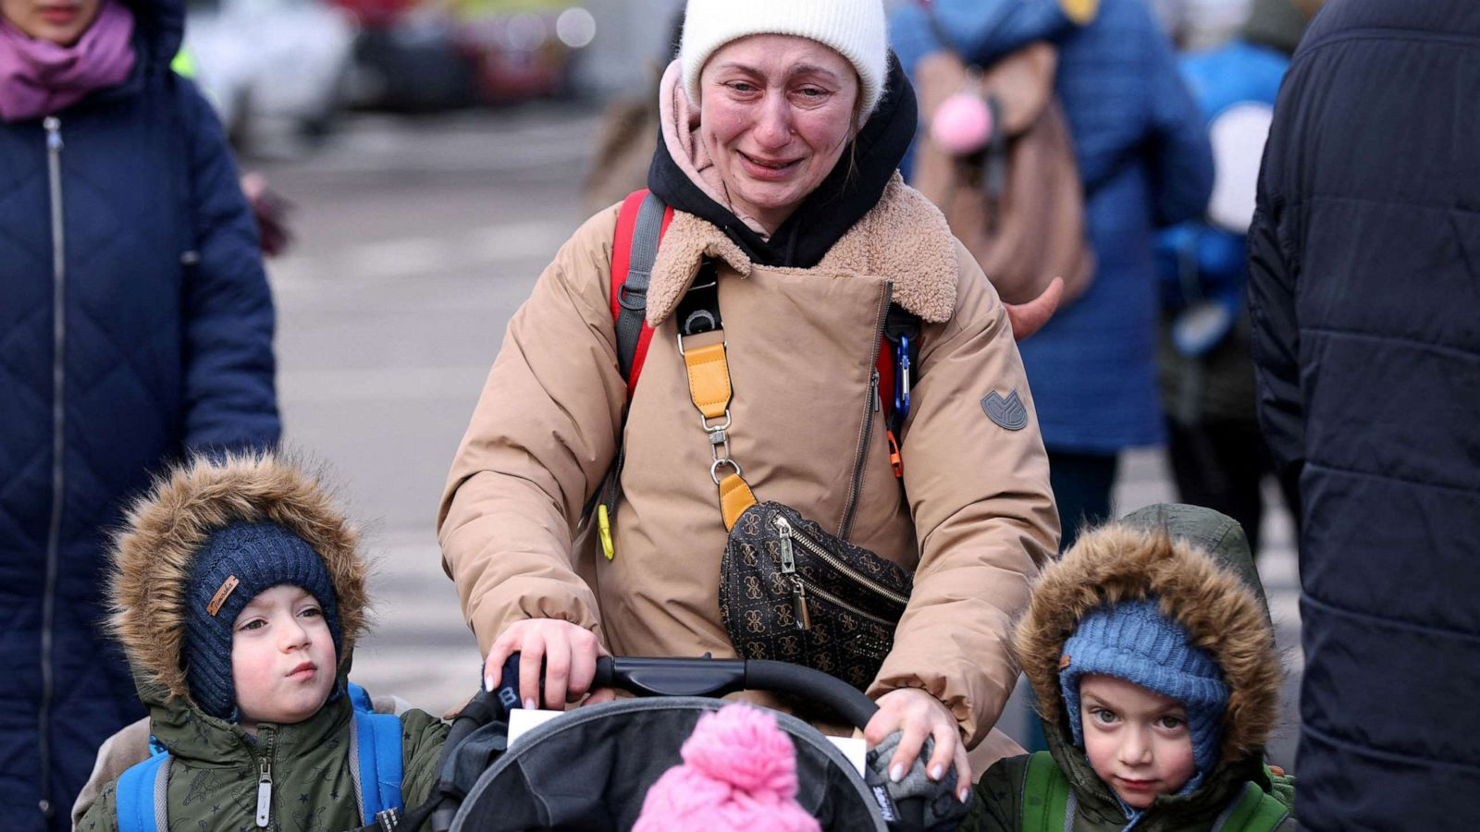
Ukraine emergency
An additional 7 million people have been displaced internally within Ukraine and over 14 million more have been affected in the areas hardest hit by the war. Humanitarian needs are increasing exponentially.
Many people remain trapped in areas of escalating conflict and, with essential services disrupted, are unable to meet their basic needs including food, water and medicines.
The number of civilian casualties across Ukraine continues to rise.
The intensity of the fighting, and notably the indiscriminate airstrikes hitting civilians and civilian infrastructure, continues to trigger large-scale displacement, while simultaneously exacerbating the humanitarian needs of those who are internally displaced or remain in heavily affected areas.
The humanitarian situation in Mariupol remains dire. Mariupol’s City Council reports that 50-100 artillery shells hit the city every day.

Slide 37
Possible response in Ukraine
What can be done to support Ukraine?
To provide cash assistance for basic needs
To target among internally displaced people those who are with specific needs (women at risk gender-based violence (GBV) and trafficking, older persons, minorities, unaccompanied and separated children, and persons with disabilities)
To launch different ways of communication (social media channels) in order to help people to get the most reliable information, overcoming language barriers
To provide core relief items such as tarpaulin, blankets, hygiene kits, kitchen sets, blankets, mattresses, folding beds and sleeping mats, bedsheets
To provide emergency shelter assistance, accommodation opportunities
To provide access to the healthcare (treatment for tuberculosis, HIV), mental health support, vaccination programmes (including COVID-19)
To help with an employment, registration, recognition of education, ID provision
Set up Blue Dot hubs, which offer refugee families on the move a safe space and vital services, children’s play areas, protection, and counselling.

Slide 38
Priority public health concerns
Conflict-related trauma and injuries
Maternal and newborn health
Food security and nutrition
Risk of emergence and spread of infectious diseases
Management of chronic diseases and noncommunicable diseases (NCDs)
Technological hazards and health risks
Mental health and psychosocial health
Protection issues: risk of human trafficking and escalated risk of sexual and gender-based violence

Slide 39
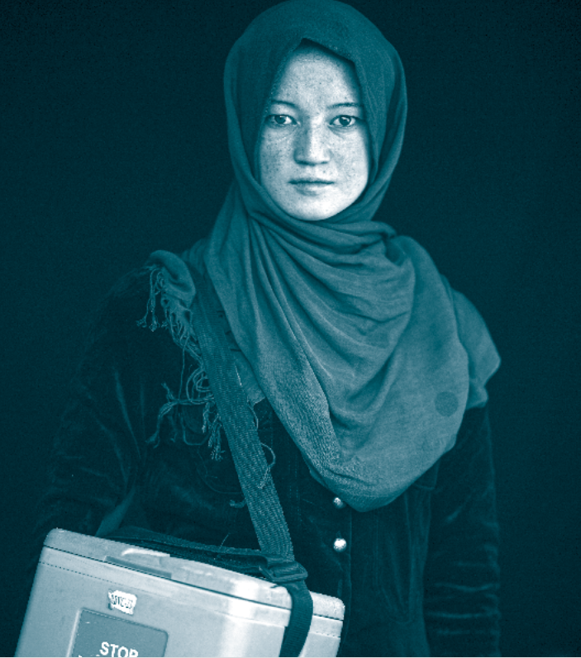
Thank you for your attention!
Let's advocate for leaving no one behind and promote health, keep the world safe and serve the vulnerable!

