Slide 1

Heart and pulse
Parwana Muradi and Joanna Moustafa

Slide 2
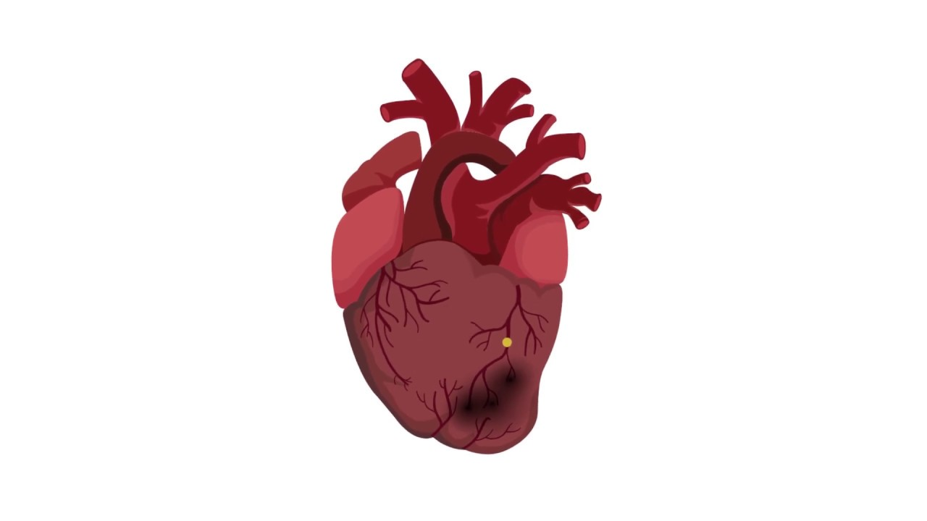
content
General terms related to heart and pulse
Terms related to blood pressure
Terms denoting a normal pulse
Terms denoting abnormal/pathological pulses

Slide 3
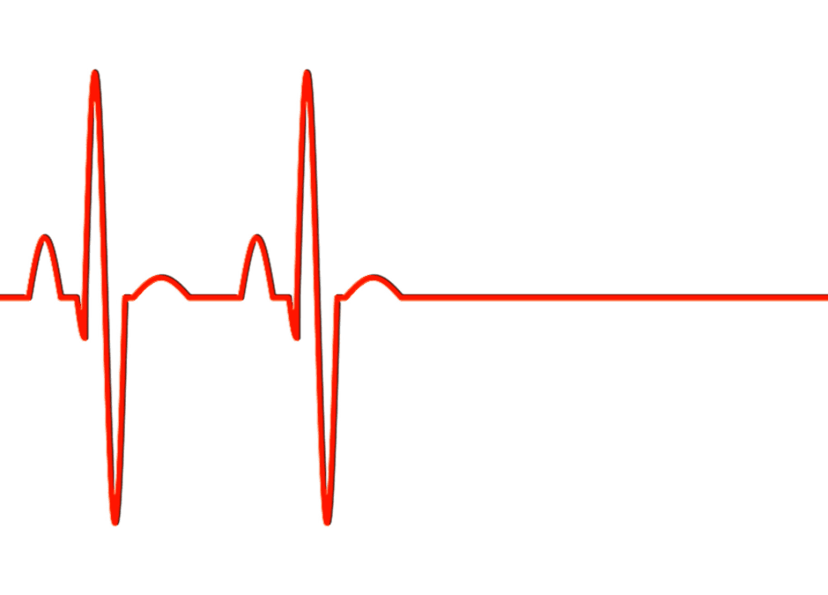
General terms related to heart and pulse
Pulsus, us, m
Latin, 4th declension, paradigm: ductus
English: pulse
Pulsatio, onis, f
Latin, 3rd declension, paradigm: dolor
English: pulsation
Pulsans, ntis
Latin 3rd declension
English: pulsating

Slide 4
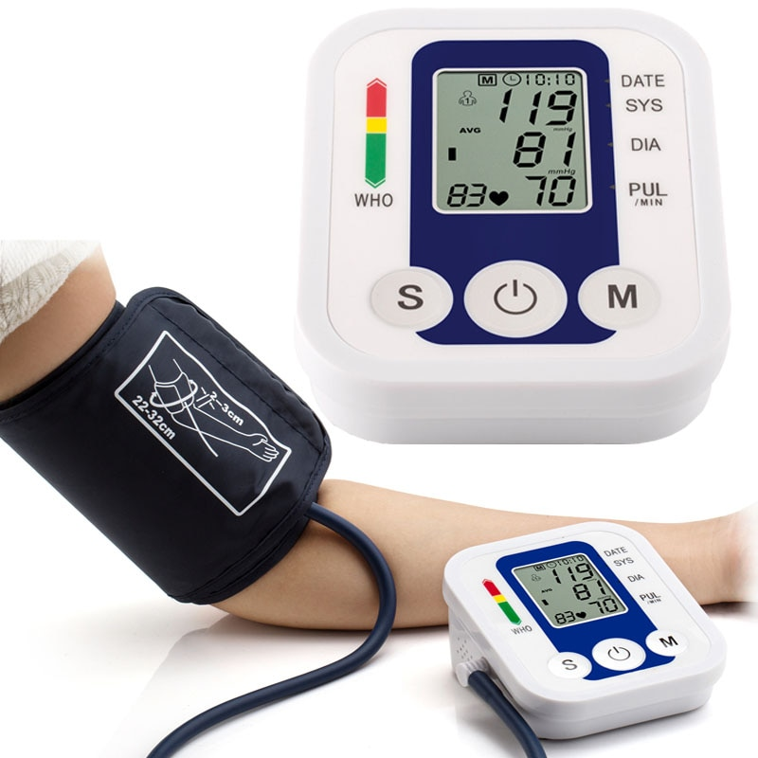
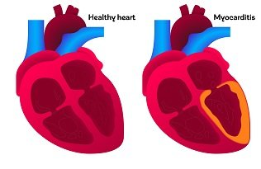
General terms related to heart and pulse
Greek roots:
Sphygmo-
Meaning: pulse
Example: sphygmometria (an instrument for measuring the strength of the pulse beat)
Card-
Meaning: heart
Example: myocarditis (inflammation of heart muscle
.

Slide 5
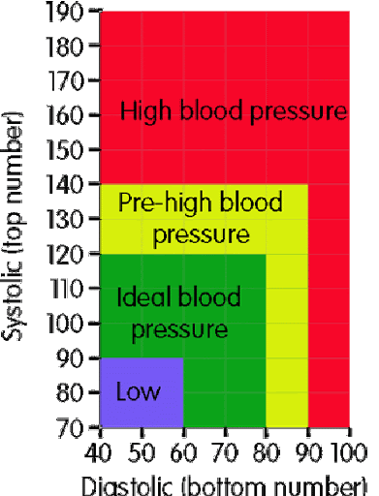
Terms related to blood pressure
normotensio, onis, f. / normotonia, ae, f
Meaning: blood pressure within normal range
hypotensio, onis, f. / hypotonia, ae, f.
Meaning: low blood pressure
Causes: pregnancy, heart problems, dehydration
hypertensio, onis, f. / hypertonia, ae, f.
Meaning: High blood pressure
Causes: smoking, diet, stress
The greek roots used:
-tensio
Meaning: blood pressure
-ton-
Meaning: tone disorder

Slide 6
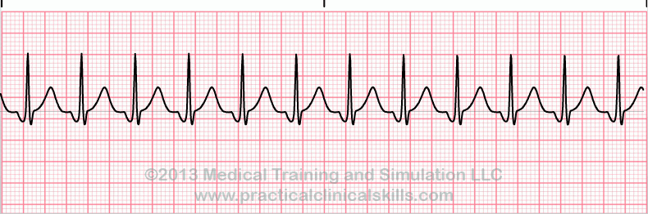
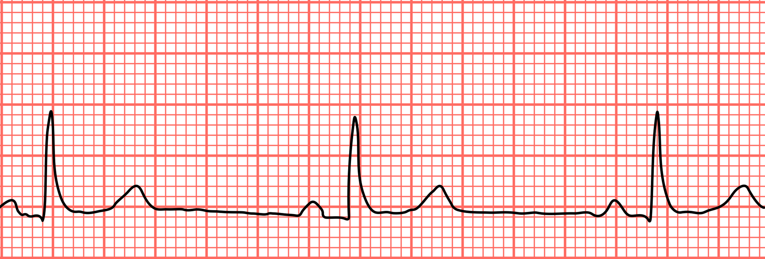
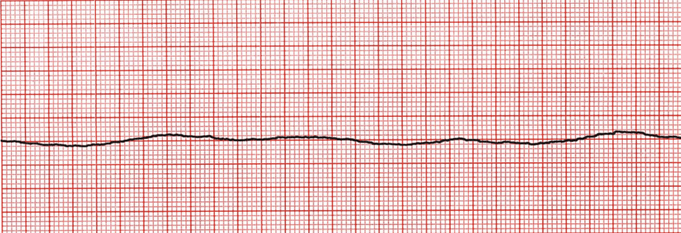
Terms related to blood pressure
Greek roots used:
Tachy- means fast
Brady- means slow
tachycardia, ae, f.
Meaning: heart rate faster than normal
Causes: anemia, diabetes
bradycardia, ae, f.
Meaning: heart rate slower than normal
Causes: heart tissue damage, heart defect
asystolia, ae, f.
Meaning: absence of contraction of the heart
Causes: suffocation, stroke etc.

Slide 7
Terms denoting normal pulses
p. aequalis
Meaning: even, steady pulse concerning the amplitude
p. regularis
Meaning: regular pulse concerning frequency
p. plenus
Meaning: full pulse (occuring when the arteries are filled with blood properly)

Slide 8
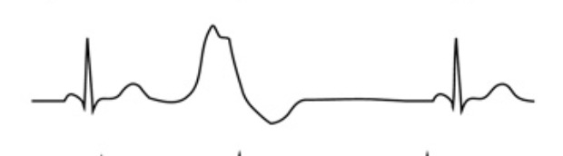
TERMS DENOTING ABNORMAL/PATHOLOGICAL PULSES
p. inaequalis
Meaning: uneven and usteady pulse (concerning the amplitude)
p. Irregularis
Meaning: Irregular pulse (concerning frequency)
Associated with: arrhythmia, conductive heart dysfunction
p. intermittens
Meaning: Discontinuation, long pauses occurring between pulse beats
Associated with: premature atrial and ventricular contractions, atrial fibrillation

Slide 9
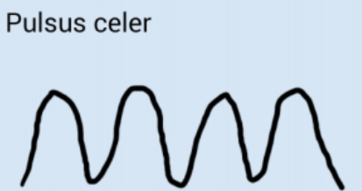

TERMS DENOTING ABNORMAL/PATHOLOGICAL PULSES
p. intercurrens
Meaning: Irregular pulse + heart extrasystole
p. celer or frequens
Meaning: Accelerated pulse, fast pulse
Association: Side effect of many medications
p. tardus or rarus
Meaning: Slow pulse, rare pulse
Association: Intoxication, lack of potassium and hypothyroidism

Slide 10
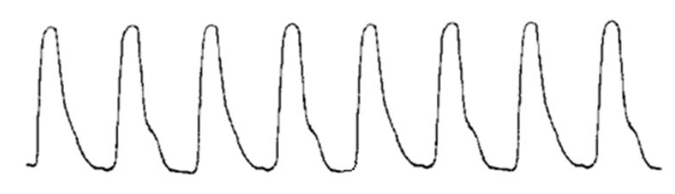

TERMS DENOTING ABNORMAL/PATHOLOGICAL PULSES
p. fortis or magnus
Meaning: Abnormally strong pulse
Associated with: anemia, hypertonia
p. mollis or parvus
Meaning: Shallow and weak pulse
Associated with: hypovolemic shock, cardiogenic shock
p. durus
Meaning: Hard pulse
Associated with: high blood pressure

Slide 11
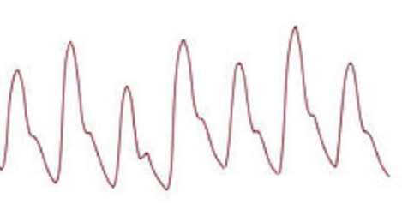
TERMS DENOTING ABNORMAL/PATHOLOGICAL PULSES
p. alternans
Meaning: Alternating, strong pulse and weak pulse
Associated with: Left ventricular dysfunction
p. insensibilis
Meaning: Non-palpable pulse
Associated with: asystole, ventricular fibrillation
p. filiformis
Meaning: Thready and wiry pulse
Associated with: circulation centralisation, hypovolemic shock

Slide 12

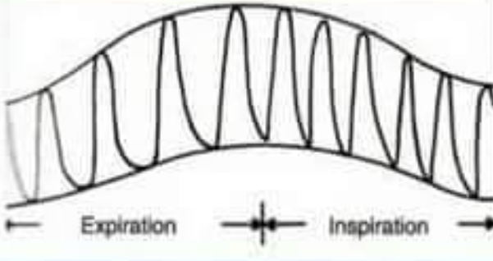
TERMS DENOTING ABNORMAL/PATHOLOGICAL PULSES
p. vibrans
Meaning: Quavery pulse, difficult to palpate
Associated with: stenosis of vessels, arteriosclerosis
p. bigeminus
Meaning: Normal pulse which is followed by a abnormal second pulse in short time, long pause
Associated with: electrolyte imbalance, mycardinfarction, cardiac conduction fail
p. paradoxus
Meaning: A pulse that weakens abnormally during inspiration and is symptomatic of various abnormalities
Associated with: Pericarditis

Slide 13

TERMS DENOTING ABNORMAL/PATHOLOGICAL PULSES
p. undosus
Meaning: Wavy pulse, uncertain - hits strong but retreats slowly (gentle)
Associated with: Low blood viscosity, excess of blood

Slide 14
Thank you for listening

