Slide 1


Chronic heart failure
;
Martin Radvan
Notes:
1

Slide 2
What we will talk about?
Patophysiology
Clinical signs
Diagnosis
Therapy

Slide 3
Hemodynamics
Stroke volume
Ejection fraction
Cardiac output
Cardiac index

Slide 4
Hemodynamics
Stroke volume = EDV-ESV
Ejection fraction = SV/EDV
Cardiac output = SV x HR
Cardiac index = CO/BSA

Slide 5
Definition of HF
HF is a clinical syndrome characterized by typical symptoms that may be accompanied by typical signs caused by a structural and/or functional cardiac abnormality, resulting in a reduced cardiac output and/or elevated intracardiac pressures at rest or during stress

Slide 6
Definition of HF
Low cardiac output despite normal heart filling (not enough for peripheral tissues)
Normal filling only under condition of elevated filling preasurres
BNP, NT-proBNP

Slide 7
Signs and symptoms
breathlessness
ankle swelling
fatigue
elevated jugular venous pressure
pulmonary crackles
peripheral oedema
orthopnoe

Slide 8
Signs and symptoms
breathlessness
ankle swelling
fatigue
elevated jugular venous pressure
pulmonary crackles
peripheral oedema
orthopnoe

Slide 9

Signs and symptoms
breathlessness
ankle swelling
fatigue
elevated jugular venous pressure
pulmonary crackles
peripheral oedema
orthopnoe

Slide 10
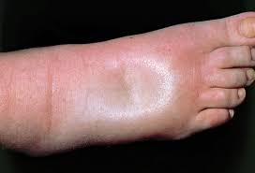
Signs and symptoms
breathlessness
ankle swelling
fatigue
elevated jugular venous pressure
pulmonary crackles
peripheral oedema
orthopnoe

Slide 11
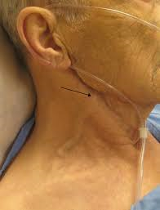
Signs and symptoms
breathlessness
ankle swelling
fatigue
elevated jugular venous pressure
pulmonary crackles
peripheral oedema
orthopnoe

Slide 12
Patophysiology
Hypertension
Aterosclerosis
Coronay Artery Disease
Diastolic dysfunction
Systolic dysfunction
Left atrial enlargement
(HFpEF)
(HFrEF)
Atrial fibrilation
Stroke
Invalidity
Death

Slide 13
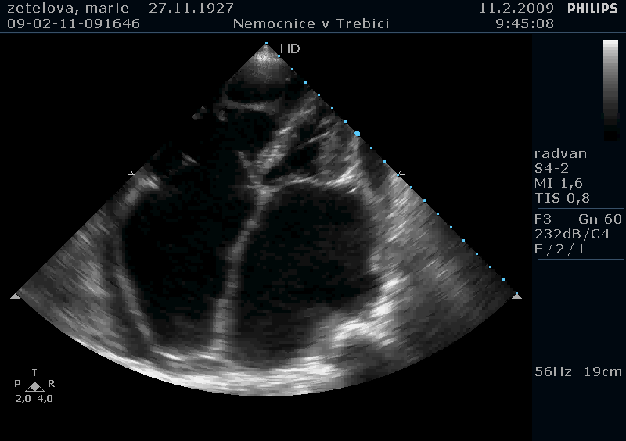
HFrEF vs HFpEF

Slide 14
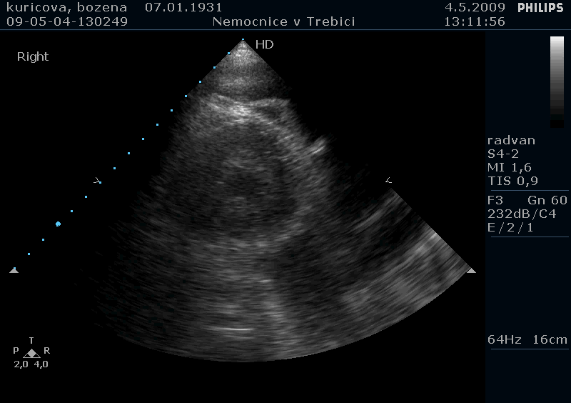
HFrEF vs HFpEF

Slide 15
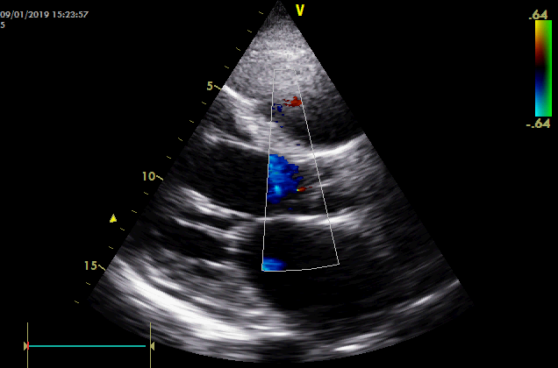
HFrEF vs HFpEF

Slide 16
Aetiology
HFrEF – CAD, DCMP
HFpEF
  hypertension, diabetes, AF
  CAD
  HCMP
  Right ventricle failure/PH
  Valvular disease
  High output HF
  „zebras“

Slide 17
Diagnosis?

Slide 18
Diagnosis
Anamnesis
Clinical signs
Ultrasonography
X-ray of the chest
Coronarography
Stress tests
Labs
…

Slide 19
Therapy of heart failure
Prevention
Therapy of the cause (CAD, myocarditis, DKMP..)
Diuretics – furosemid, thiazidy
Spironolakton, eplerenon
βblokátory, ACEi a AT II
Digoxin
CRT/D
Vaccination – flu, pneumococi
Ivabradin
Sacubitril/valsartan, gliflozins
Heart transplant/MCS

Slide 20
Therapy of heart failure (HFrEF)
Prevention
Therapy of the cause (CAD, myocarditis, DKMP..)
Diuretics – furosemid, thiazidy
Spironolakton, eplerenon
βblokátory, ACEi a AT II
Digoxin
CRT/D
Vaccination – flu, pneumococi
Ivabradin
Sacubitril/valsartan, gliflozins
Heart transplant/MCS

Slide 21
Therapy of heart failure (HFrEF)
Prevention
Therapy of the cause (CAD, myocarditis, DKMP..)
Diuretics – furosemid, thiazidy
Spironolakton, eplerenon
βblokátory, ACEi a AT II
Digoxin
CRT/D
Vaccination – flu, pneumococi
Ivabradin
Sacubitril/valsartan, gliflozins
Heart transplant/MCS

Slide 22
Therapy of heart failure (HFpEF)
Prevention
Therapy of the cause (hypertension)
Diuretics – furosemid, thiazidy
Spironolakton, eplerenon
Heart transplant/MCS

Slide 23
Therapy of heart failure (HFpEF)
Prevention
Therapy of the cause (hypertension)
Diuretics – furosemid, thiazidy
Spironolakton, eplerenon
Heart transplant/MCS

Slide 24
β - blokátory
Bisoprolol
Carvedilol
Metoprolol sukcinát
Nebivolol
Lower risk especially of sudden heart death
All stuides made before ICD on the stage

Slide 25
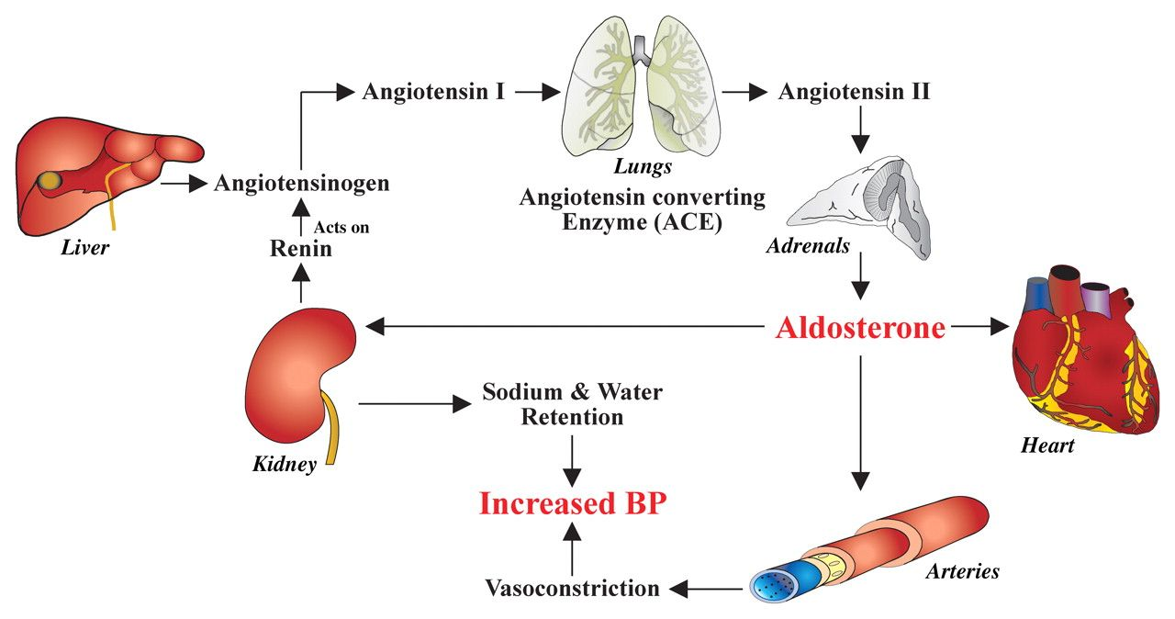
Renin-angitensin-aldosteron

Slide 26
Renin-angitensin-aldosteron
Renin inhibitor
aliskiren

Slide 27
Renin-angitensin-aldosteron
ACEi
Renin inhibitor
aliskiren

Slide 28
Renin-angitensin-aldosteron
ARBs
ACEi
Renin inhibitor
aliskiren

Slide 29
Renin-angitensin-aldosteron
ARBs
ACEi
Renin inhibitor
aliskiren
Aldosterone/
/eplerenone

Slide 30
ACE inhibitory
Captopril (3x50mg)
Enalapril (2x10-20mg)
Ramipril (2x5mg)
Trandolapril (1x4mg)
Lisinopril (1x20-35mg)
Titration to the maximal dosage

Slide 31
Sartans
Candesartan (1x32mg)
Losartan (1x150mg)?
Valsartan (2x160mg)
Only for ACEi intoletrant
Do not combine with ACEi

Slide 32
Diuretics
Furosemid (two doses a day)
20mg-1g/day
HCTH (12,5-25mg)

Slide 33
MRA
Spironolactone 25mg (gynekomastie, mastodynie, erektilní dysfunkce)
Eplerenon 25-50mg

Slide 34

MRA
Spironolactone 25mg (gynecomasty, mastodynie, erectile dysfunction)
Eplerenon 25-50mg

Slide 35
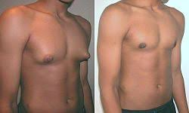
MRA
Spironolactone 25mg (gynecomasty, mastodynie, erectile dysfunction)
Eplerenon 25-50mg

Slide 36
Ivabradin
Selective binding: I_{f} receptor in sinoatrial node
Decrease of HR in SR
Symptomatic patient with HFrEF, SR above 70-75/min, symptomatic despite full heart failure therapy inclusive BBlokru
5mg BID → 7,5mg BID
Well tolerated

Slide 37
Gliflozins – SGLT2 inhibitors
Dapagliflozin, empagliflozin
Glycosuric agent
Originally in DM2 patients

Slide 38
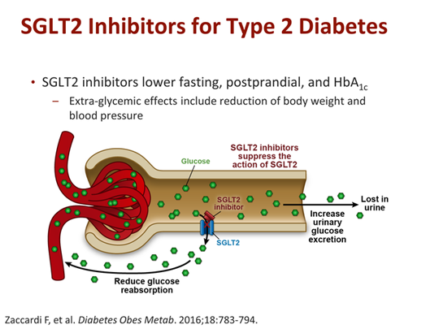
Gliflozins – SGLT2 inhibitors
Dapagliflozin, empagliflozin
Glycosuric agent
Originally in DM2 patients

Slide 39
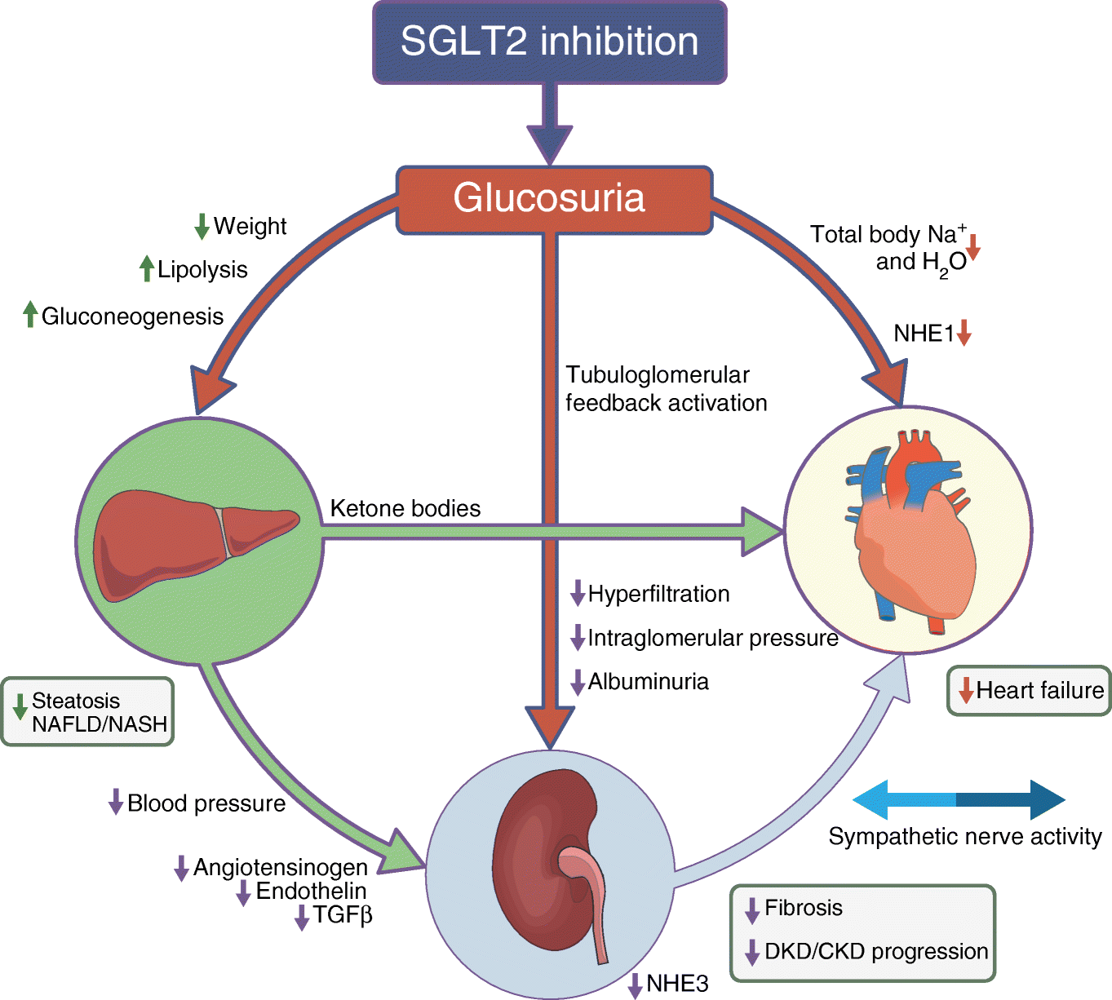
Gliflozins – SGLT1 inhibitors
Dapagliflozin, empagliflozin
Glycosuric agent
Originally in DM2 patients

Slide 40
Digoxin
Symptomatic patient with normal GFR, especially in patients with atrial fibrilation to control frequency, symptomatic despite full therapy
Low dose (0,125mg/daily)

Slide 41
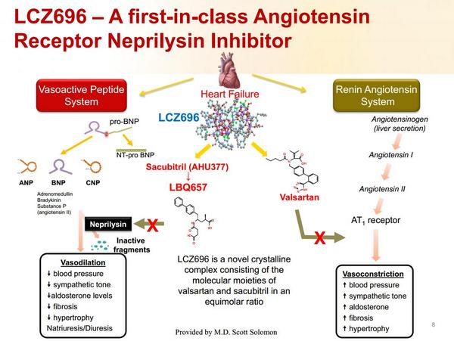
Sacubitril/valsartan

Slide 42
Sacubitril/valsartan
HFrEF: EF LK ≤35% (40)
NYHA ≥ II
Doses 24/26, 49/51, 97/103mg BID
Mortality and hospitalisation for HF: 20% decrease (Paradigm-HF)

Slide 43
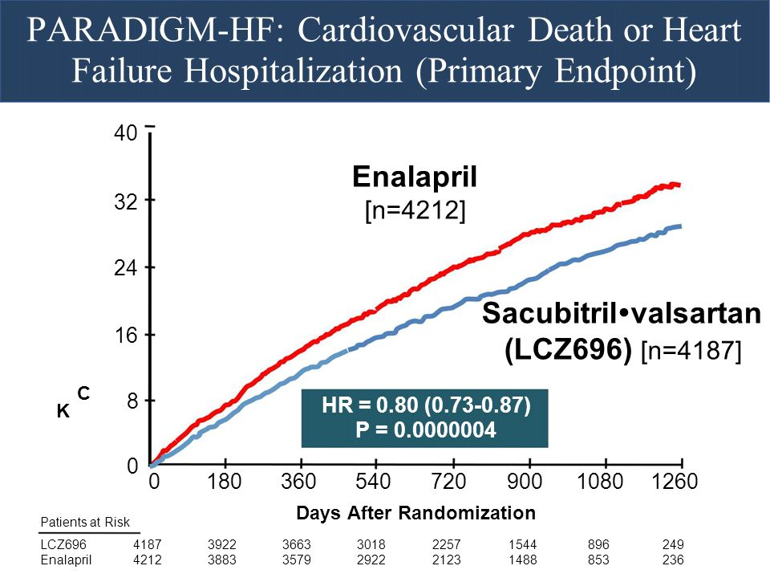
Sacubitril/valsartan

Slide 44
Sacubitril/valsartan
Renal functions – GFR ≤ 30 (20)ml/min/m²
Hypotension
Potasium level (combination with spironolactone)
Wash-out period: 36h after last dose of ACEi
Risk of angioedema (low)

Slide 45
Sacubitril/valsartan
Studies in HFpEF (Paragon, Paralax)
- negative
Studies with initioation during hospitalisation for acute decompensation of HFrEF (Transition trial)
- positive

Slide 46
CRT a CRT-D
EF LK ≤ 35%, NYHA II, III despite full therapy
EF LK ≤ 35%, NYHA II, III despite full therapy, QRS wider then 0,12-0,15, ideally LBBB

Slide 47
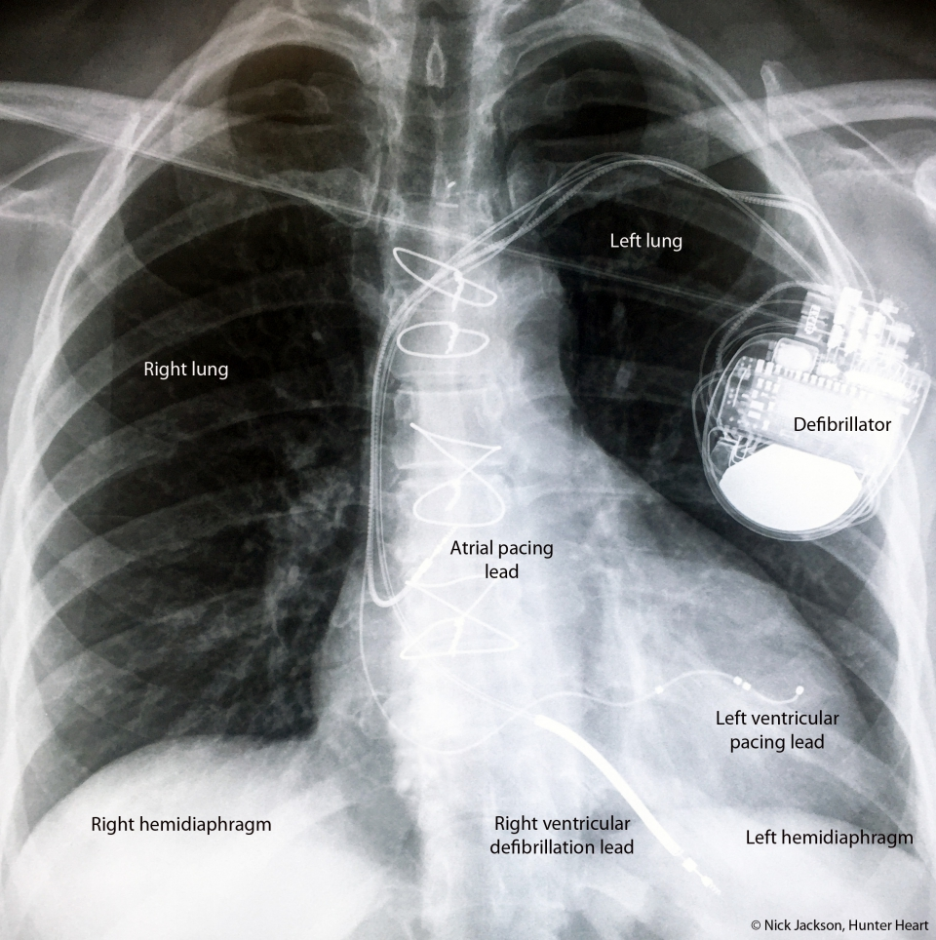
CRT a CRT-D
EF LK ≤ 35%, NYHA II, III despite full therapy
EF LK ≤ 35%, NYHA II, III despite full therapy, QRS wider then 0,12-0,15, ideally LBBB

Slide 48
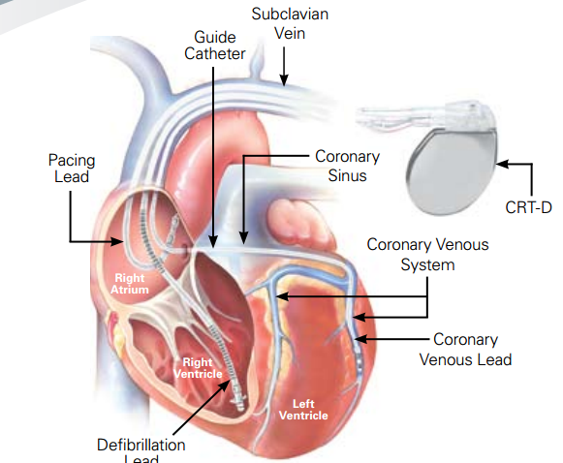
CRT a CRT-D
EF LK ≤ 35%, NYHA II, III despite full therapy
EF LK ≤ 35%, NYHA II, III despite full therapy, QRS wider then 0,12-0,15, ideally LBBB

Slide 49
MCS
LVAD
Total artificial heart
ECMO
Impella
Bridge to recovery/decision/transplantation
Destinantion therapy

Slide 50
Transplantation
Age?
Life expectancy (except heart)
Spiroergometry VO₂max
Imunosupression
Rejection, infection
Vasculopathy of the graft

Slide 51
Conclusions
Heart failure is syndrome (not disease)
Blood preasure control
Therapy of the cause
Pharmacotherapy
Vaccination
MCS
Transplantation

Slide 52
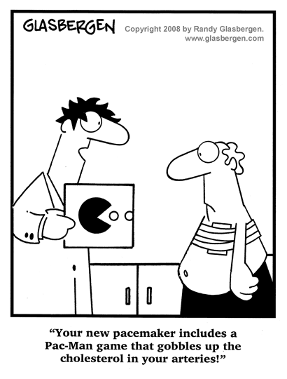
Děkuji za pozornost

