Slide 1
ADVERSE DRUG REACTIONS AND DRUGS SAFETY

Slide 2
Copyright notice
The presentation is copyrighted work created by employees of Masaryk university.
Students are allowed to make copies for learning purposes only.
Any unauthorised reproduction or distribution of the presentation or individual slidesis against the law.

Slide 3
Adverse drug reactions – classification, character.
Definition
According to expectations
According to severity
According to frequency
According to the mechanism of origin
  A
  B
  Idiosyncrasy, allergies - type I, II, III, IV
  C
  D
  Mutagenesis, teratogenesis, carcinogenesis
  E

Slide 4
1. Adverse drug reactions
Adverse drug reactions are undesirable responses to therapeutic doses.
The adverse effect is an unintended or adverse reaction after administration of one or more medicinal products under normal use conditions, even when the drug was not used in accordance with the summary of the product characteristic for which it is suspected that arose in the context of drug administration.
Adverse reactions represent a very heterogeneous group of reactions.
They can be classified according to expectations, severity, frequency of occurrence or mechanism of origin.
ADRs accompany the main pharmacotherapeutic effect of drug:
  Excessively strong main effect
  ADR doesn´t dependent on the main effect

Slide 5
Adverse drug reactions
USA
Germany
5 - 20% reasons for hospitalization due to ADRs
cca 100.000 fatal ADRs !
0,3 - 8% reasons for hospitalization due to ADRs
cca 8.000 fatal ADRs !
5th place in the causes of death
ADRs increase the cost of healthcare!

Slide 6
Adverse drug reactions
- according to expectations
An unexpected adverse reaction is an adverse reaction whose nature, severity or consequence is not listed in the Summary of Product Characteristics (SPC).
An expected adverse reaction effect is listed in the SPC.
SPCs of registered products in the Czech Republic are available on the website www.sukl.cz in the Medicines section or on the website of the European Medicines Agency www.emea.europa.eu in the Product information / Human medicines section.

Slide 7
Adverse drug reactions
- according to severity
Serious Adverse Drug Reaction (SADR) means such adverse drug reaction which results in:
  death,
  is life-threatening,
  requires hospitalisation or prolongation of existing hospitalisation,
  results in permanent or significant damage to health or
  limitation of capabilities or is manifested as a birth defect in offspring.
Non-serious Adverse Drug Reaction

Slide 8
Adverse drug reactions
- according to frequency
Frequency of ADR | Number of cases per patients
Very common | More than 1/10
Common (frequent) | More than 1/100
Uncommon (infrequent) | Between 1/100-1/1000
Rare | Between 1/1000- 1/10 000
Very rare | Less than 1/10 000

Slide 9
Adverse drug reactions
- According to mechanism of origin
A – augmented – caused by the same mechanism as a pharmacological effect.
B – bizzare - „pacient’s reaction“ – caused by a genetic mechanism (idiosyncrasy) or by an imunological mechanism (allergies).
C – chronic - caused by a long term taking.
D – delayed - show after a longer period of latency.
E – end-of-use - syndrom caused by discontinuing a drug.

Slide 10
A - Augmented
caused by the same mechanism as the pharmacotherapeutic effect.
Induced by unappropriated dosage or by change in pharmacokinetics as a result of pathological process.
  predictable
  directly dependent on the dose
  frequent, seldom fatal
Insulin > hypoglycemia
Anticoagulans > bleeding
Betalytics > bronchi-constriction > asthmatic attack

Slide 11
B - Bizzare
Caused by a genetic mechanism (idiosyncrasy) or by an immunological mechanism (allergies).
  unpredictable
  do not depend on the dose
  less frequent (1:1 000 až 1:10 000)
  higher mortality
Idiosyncrasy – reaction on the first dose, without previous sensibilisation (suxamethonium in individuals with atypical cholinesterase), polymorfisms.
Allergic reaction - reaction after a previous sensibilisation.

Slide 12
Allergic reaction
The antigen must have a molecular weight of at least 1000.
The non-immunogenic molecule of the substance (hapten) covalently binds to endogenous carriers and forms a conjugate> antigen.
The antigen can cause:
  production of specific antibodies (humoral response) or
  T-cell response (cellular response) > inflammatory process.
Reactions I, II, III - caused by antibodies.
Reaction IV - caused by cells.

Slide 13
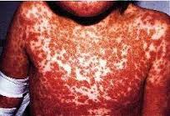
Allergic reaction - Type I
Immediate anaphylactic reaction mediated by IgE antibodies - life threatening.
Antigen-antibody reactions on the surface of
  mast cells > degranulation of mast cells > release of pharmacologically active substances
  (histamine, leukotrienes, prostaglandins, platelet-activating factor, etc.).
  Insect stings, allergic bronchial asthma, seasonal allergic rhinitis, urticaria,
  penicillin and erythromycin antibiotics,
  X-ray contrast agents,
  salicylates.
http://zdravi.e15.cz/clanek/priloha-lekarske-listy/beta-laktamova-antibiotika-142697

Slide 14

Allergic reaction - Type II
It depends on IgG and IgM antibodies, which are able to fix complement on the cell surface and induce cell lysis.
It is clinically manifested as anemia, thrombocytopenia, leukopenia and pernicious anemia.
This reaction can be provoke by:
  quinidine,
  sulfonamides,
  heparin.
https://escholarship.org/uc/item/5368s5x8

Slide 15
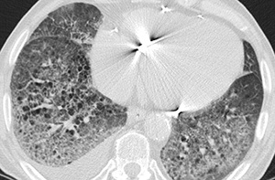
Allergic reaction - Type III
Antigen-antibody interactions induce the formation of immunocomplexes > serum sickness.
A similar mechanism probably arises:
  pulmonary fibrosis during amiodarone therapy,
  lupus-like syndrome associated with hydralazine treatment or
  interstitial nephritis caused by non-steroidal anti-inflammatory drugs.
http://www.angisrevue.cz/revue/archiv/cislo/detail/35/

Slide 16
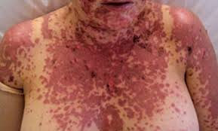
Allergic reaction - Type IV
Delayed hypersensitivity reaction.
The substance that enters the skin forms antigenic conjugates with proteins and stimulates the production of sensitized T cells in the regional nodes. If repeated contact with the substance occurs, then a skin reaction (rash) develops.
This type of reaction can also be induced by systemic administration of the substance.
  Contact dermatitis after administration of penicillin
  or after aminoglycoside antibiotics.
http://www.australiandoctor.com.au/clinical/therapy-update/cutaneous-drug-eruptions

Slide 17
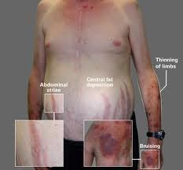
C - Chronic
caused by a long term taking of drug
  analgetics > nefropathy
  prednisolone > iatrogenic Cushing´s syndrome
  laxative > gastrintestinal dysfunction
http://medlibes.com/entry/cushings-syndrome

Slide 18
D - Delayed
manifest after a longer latency period (or in children treated patients)
  mutagenesis
  teratogenesis
  carcinogenesis
common features:
  alteration of genetic information by affecting DNA
  sensitivity of dividing and growing tissue
  irreversibility of induced changes
  non-specificity and diversity of external stimuli capable of inducing similar effects

Slide 19
Mutagenesis
Sudden, unregulated and permanent change in genotype that is transmitted during cell division.
Some types of mutations can cause carcinogenic effects because they alter the coding sequence for proteins that are part of growth regulation.
From the pharmaceuticals, mutagens are, for example, cytostatics from the group of alkylating agents.

Slide 20
Teratogenesis
Variations in the development of the individual - from fertilization of the egg to the postnatal period, including death of the embryo or fetus, morphological malformations, mental defects, growth retardation and intellect to various functional organ defects.
Thalidomide (Contergan) 1960> Focomelia
Decisive factors:
  Type of substance, physical and chemical properties> placental penetration
  Dose and duration of exposure
  New fetal developmental stage - Gametogenesis> Blastogenesis> Organogenesis> Fetal developmental period
  Maternal organism (age)
  Individual reactivity

Slide 21
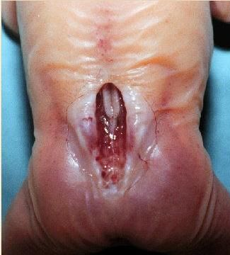
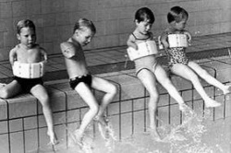

Teratogens
Spina bifida (valproic acid)
http://ec.cotot.com/spina-bifida
Fokomalia (thalidomide)
http://magazin.atlas.sk/spektrum/nezvratny-osud-katastrofy-za-ktore-si-mozeme-sami/727881.html
Gingival hyperplasia (phenytoin)
http://www.otszonline.hu/haziorvoslas/cikk/szisztemas_betegsegek_szajuregi_tunetei

Slide 22
Cancerogenesis
Substances which, by exposure, cause tumor growth in predisposed tissues
carcinogens show a dose-response effect> dose accumulation
participation of other factors:
  viral interactions
  environmental impact
  age
  sex
  immunological factors

Slide 23
E – End of use
It manifests itself at the end of the administration of the active substance, eg as a rebound phenomenon (withdrawal syndrome).
up / down-regulation of receptors
Examples:
Tachycardia after discontinuation of beta-drugs.
Adrenocortical insufficiency after discontinuation of glucocorticoids.
Seizures after discontinuation of anticonvulsant drugs.

Slide 24
Pharmacovigilance = monitoring of drug safety
is the science and activities relating to the:
  detection,
  assessment,
  understanding,
  prevention of adverse effects or any other medicine-related problem such as misuse or abuse of medicines, drug interactions, effects on foetus, breast-fed babies, etc.
post-authorisation surveillance over medicinal products aimed at ensuring a maximum safety and as beneficial a risk/benefit ratio of the medicinal product as practicable.

Slide 25
Pharmacovigilance
a system for collecting and evaluating the reports/signals, especially on how effectively drugs work
the system for reporting adverse reactions concerns:
                physicians
                pharmacist
                marketing authorization holders
                healthcare providers
                patients
monitoring the safety of drugs in clinical trials and clinical practice
identification of safety risks of drugs
measures to increase the safety of drugs
OBJECTIVE: to minimize the risk associated with the use of drugs

Slide 26
Terminology in pharmacovigilance
Adverse Event (AE)
  an adverse change in the health condition affecting the patient or the trial subject who is the recipient of the medicinal product, even if it is not known whether it is in causal relationship with the treatment with this medicinal product. (Section 3(5) of the Act on Pharmaceuticals)
Adverse Drug Reaction (ADR)
  a reaction to a medicinal product, which is adverse and unintended. (Section 3(4) of the Act on Pharmaceuticals)
  implies a certain degree of causality. In a clinical trial, it is an adverse event, in the case of which it is possible to state suspicion of a causal relationship with a certain medicinal product or multiple medicinal products, which were used in the study.

Slide 27
Terminology in pharmacovigilance
Serious Adverse Event (SAE)
  adverse event that results in death, is lifethreatening, requires hospitalisation or prolongation of existing hospitalisation, results in permanent or significant damage to health or limitation of capabilities or is manifested as a congenital anomaly or birth defect in offspring, irrespective of the administered dose of the medicinal product (Section 3(6) of the Act on Pharmaceuticals)
Serious Adverse Drug Reaction (SADR)
  such adverse drug reaction which results in death, is life-threatening, requires hospitalisation or prolongation of existing hospitalisation, results in permanent or significant damage to health or limitation of capabilities or is manifested as a birth defect in offspring. (Section 3(4)(a) of the Act on Pharmaceuticals)

Slide 28
Terminology in pharmacovigilance
Unexpected Adverse Drug Reaction
  adverse reaction the nature, severity or consequence of which is not consistent with the information available, for example with the investigator's brochure for an investigational medicinal product without marketing authorisation, or with the summary of product characteristics for an authorised medicinal product. (Section 3(4)(b) of the Act on Pharmaceuticals)
Unexpected Serious Adverse Reaction
  must comply with the definition of a serious adverse reaction and, at the same time, that of an unexpected adverse reaction
Suspected Unexpected Serious Adverse Reaction (SUSAR)
  occurrence of serious unexpected adverse reaction is in causal relationship with the investigational medicinal product. Evaluation of whether there is reasonable probability of a causal relationship is usually carried out by the investigator. If the investigator presenting the report does not provide information on a causal relationship, the sponsor should contact the investigator and request the investigator to comment on this aspect

Slide 29
Pharmacovigilance after marketing authorisation
Clinical trials with antidepressants
(75 clinical trials)
  Trials with positive result:
    All 38 trials were published
  Trials with negative result:
    3 trials published
    23 trials have never been published
    11 publlished only in FDA summaries – never in academic litarature
In fact, we have 38 positive studies and 37 negative ones, but in the academic literature we have 38 positive and only 3 negative ones.
Erick Turner et al., "Selective Publication of Antidepressant Trials and Its Influence on Apparent Efficacy,"New England Journal of Medicine, January 17, 2008

Slide 30
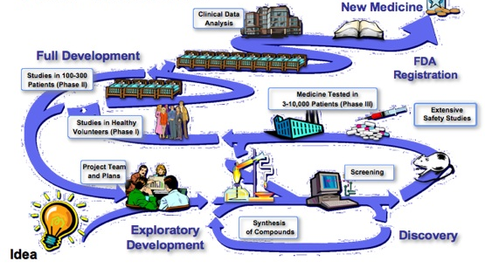
Critical point!
Data are missing
The probability that negative results are published
is 20 times lower.
What can we do?
Re-evaluate in clinical practice!
Tool: pharmacovigilance

Slide 31
Drugs withdrawn from the market in connection with safety
462 drugs were withdrawn from the market for the period 1953 - 2013 for safety reasons, the most common reason being hepatotoxicity
The average time from the first notification of an ADRs to withdraw a product from the market is 6 years and the interval does not shorten over time
https://www.ncbi.nlm.nih.gov/pubmed/26843061/

Slide 32
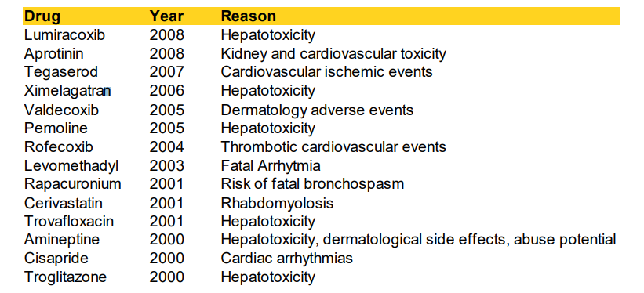
Withdrawn Drugs (in the US, since 2000)

