Slide 1
Orthodontic treatment fixed appliances
MUDr. Alena Bryšová, Ph.D.

Slide 2
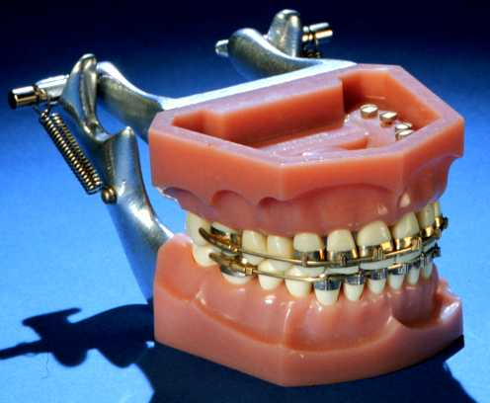
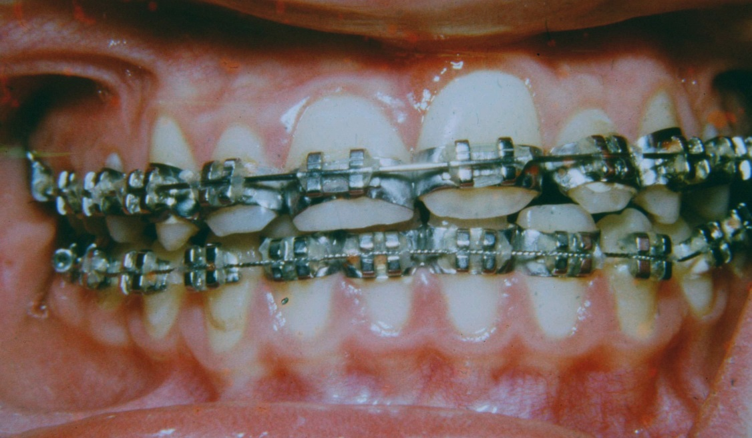
Fixed appliances -History

Slide 3
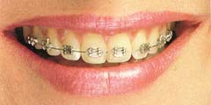
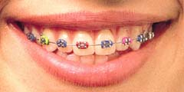
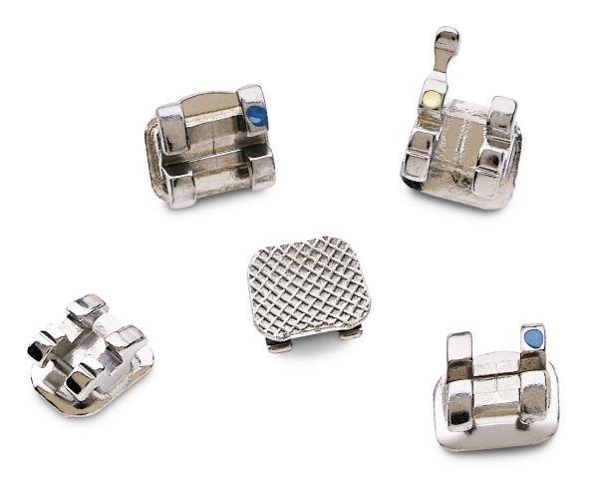
Orthodontics brackets
Stainless steel brackets
Advantages Disadvantages:
- strong, do not crack - Aesthetic - smooth, low profile - recyclable - low friction - price

Slide 4
Stainless steel brackets

Slide 5
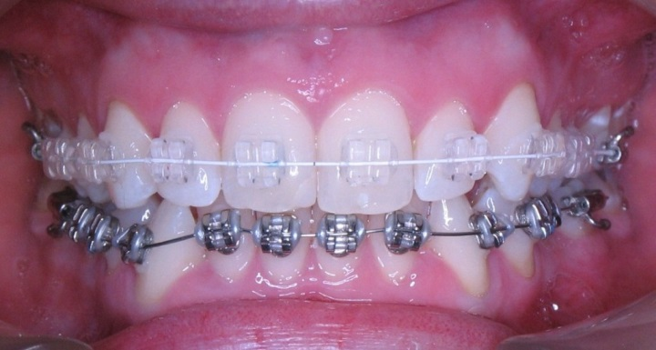
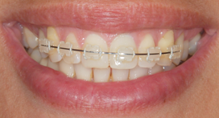
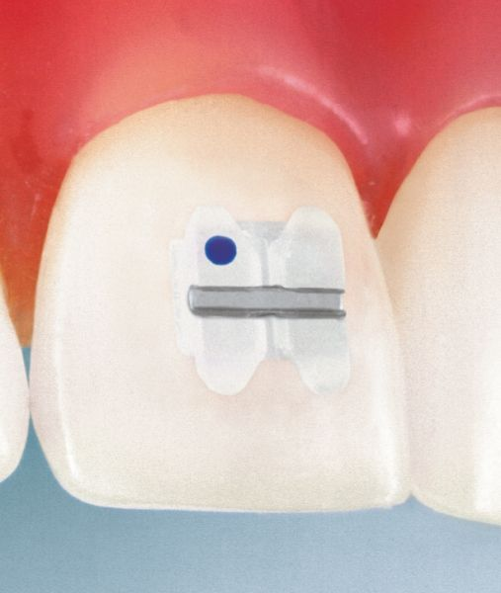
Orthodontics brackets
Ceramic brackets
Advantages: Disadvantages:
- Aesthetics - repeated bonding problem - robust - crack - higher friction (avoid metal slot) - price

Slide 6
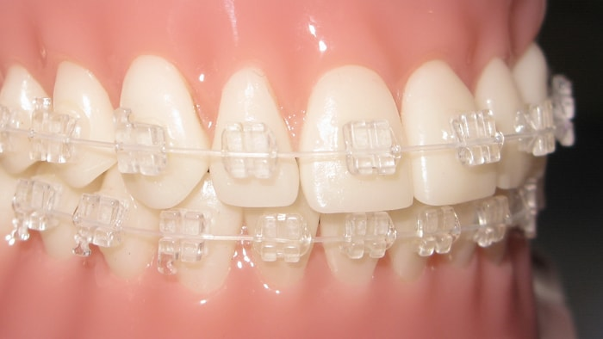
Ceramic brackets

Slide 7
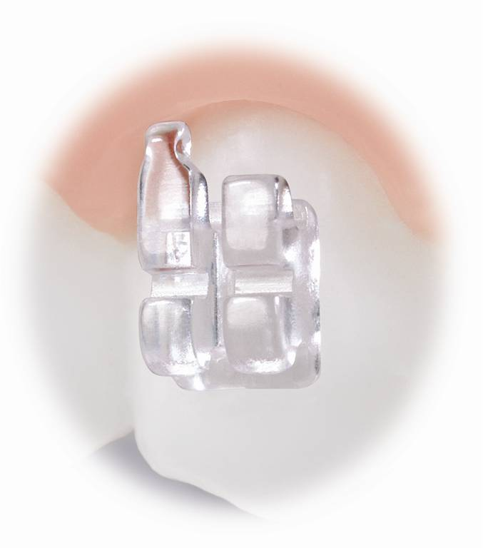
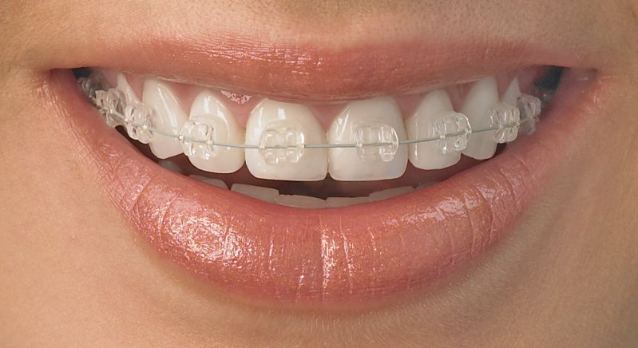
Orthodontics brackets
Sapphire brackets
Advantages Disadvantages:
- aesthetic - repeated bonding problem - robust - crack - higher friction (avoid metal slot) - price

Slide 8
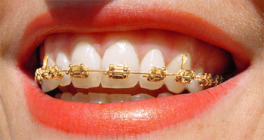
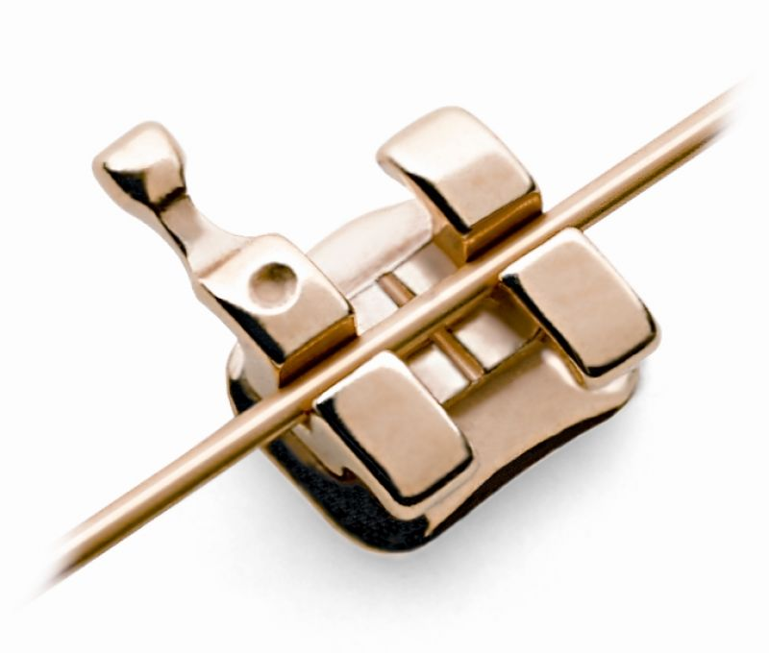
Orthodontics brackets
Gold-coated brackets
Advantages: Disadvantages:
- suitable for allergy sufferers - price - strong, do not crack - smooth, low profile - recyclable - Low friction - Aesthetics

Slide 9
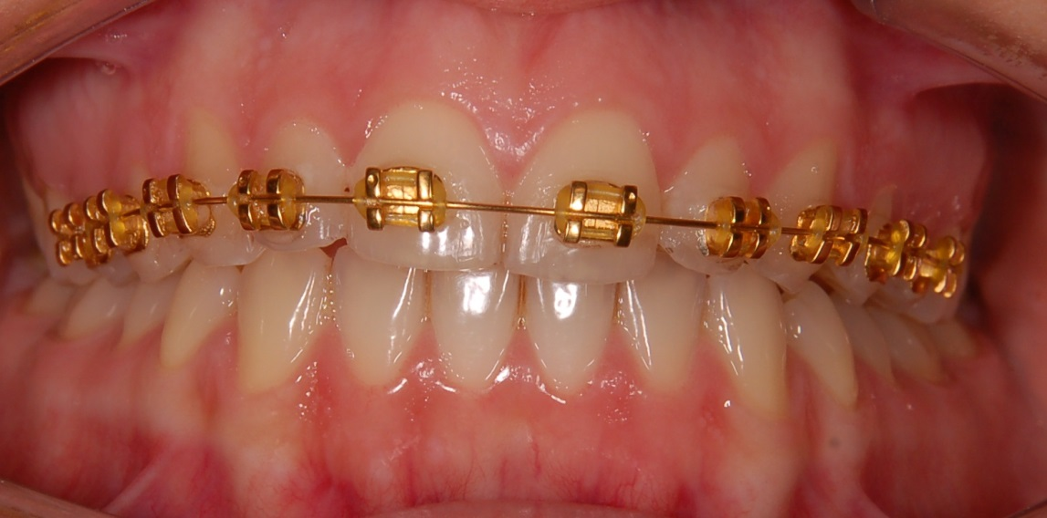
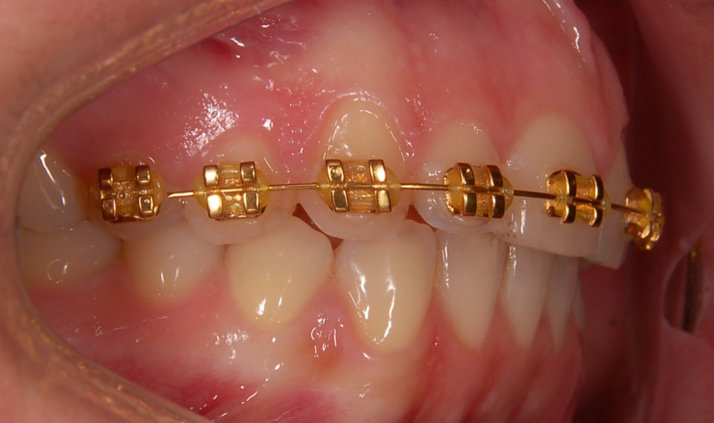
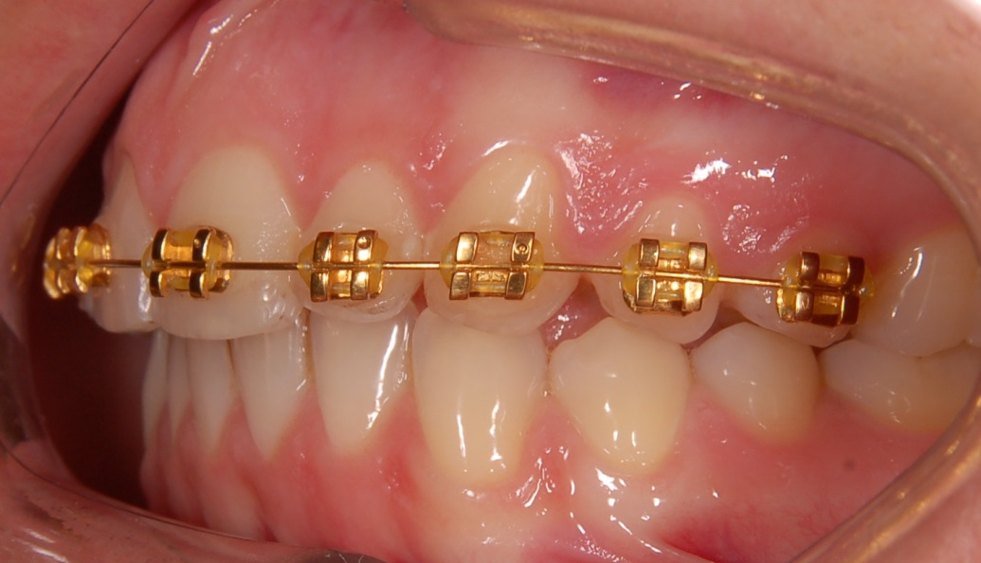

Slide 10
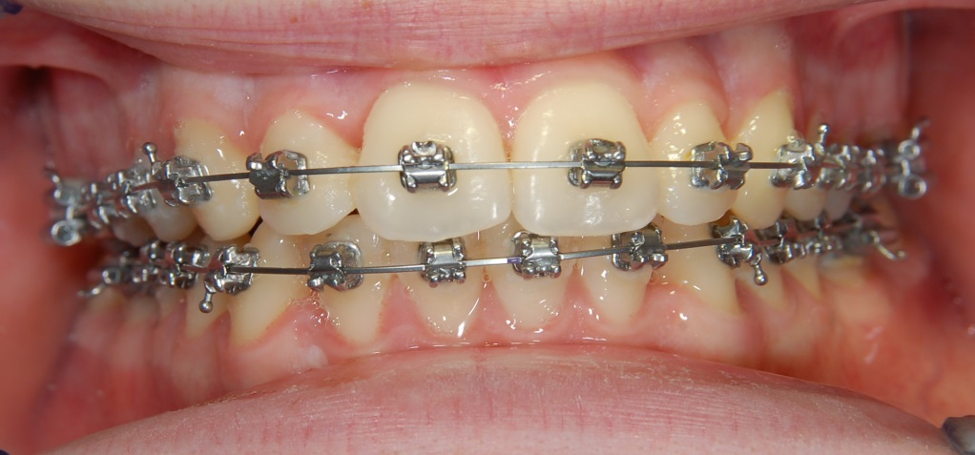
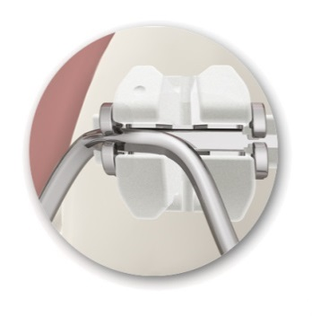
Orthodontics brackets
Selfligating brackets – metal and ceramic
Advantages: Disadvantages:
- not suitable for all - minimum friction types of defects - low power - faster treatment
- fewer office visits

Slide 11
Selfligating stainless steel brackets

Slide 12
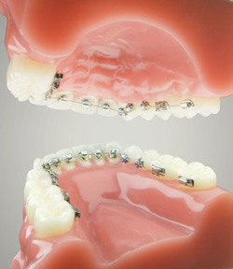
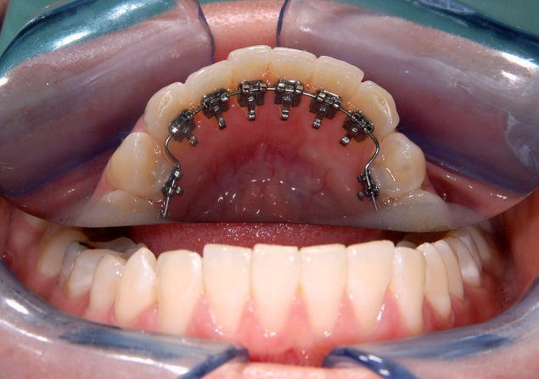
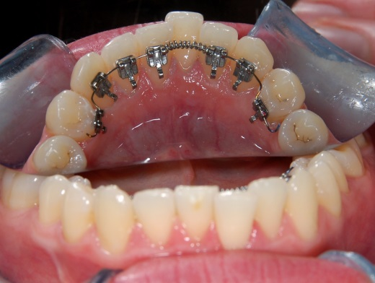
Orthodontics brackets
Lingual brackets – 2D,3D
Advantages: Disadvantages:
- Aesthetics - unsuitable for all types of defects - Difficulty hygiene - (patient discomfort)

Slide 13
Lingual bracket

Slide 14
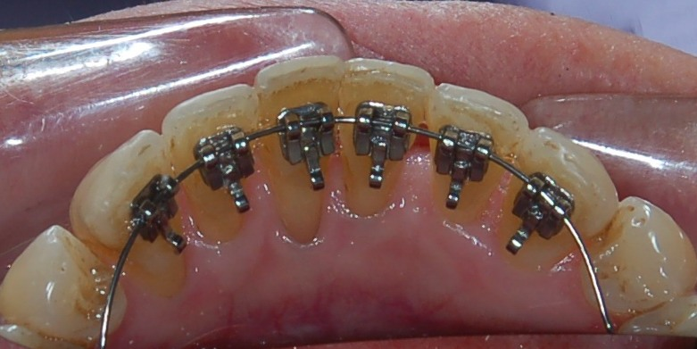
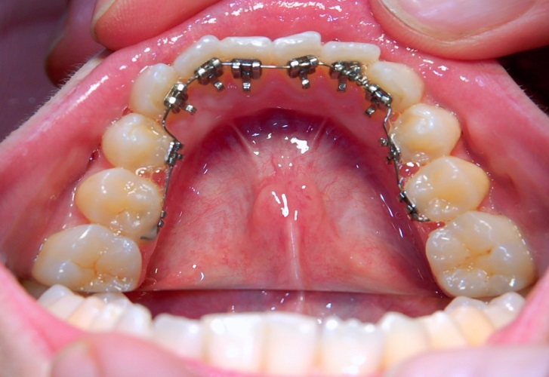
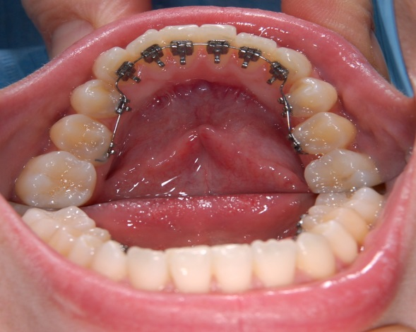

Slide 15
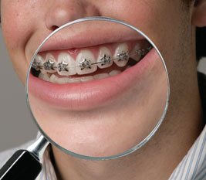
Orthodontics brackets
Decorative brackets

Slide 16
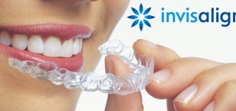

Slide 17
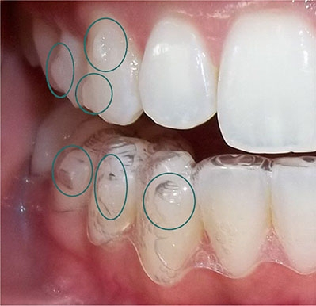
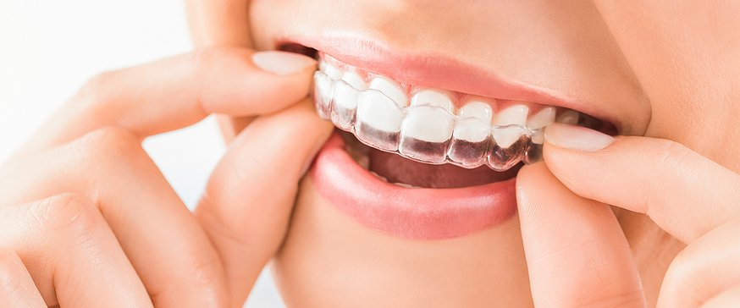

Slide 18
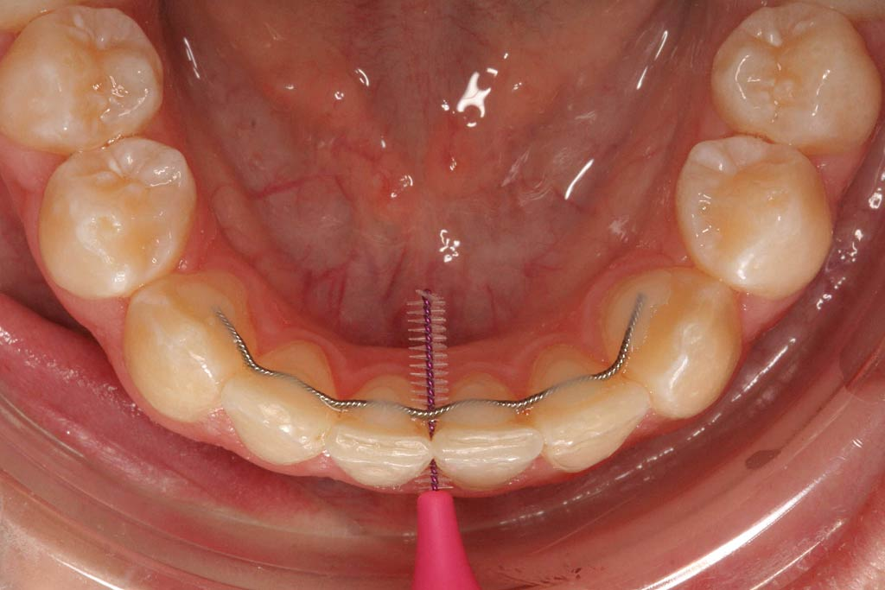
Fixed lingual retainer

Slide 19
Direct bonding
1.cleaning 2. etching
3.rinse 4. drying

Slide 20
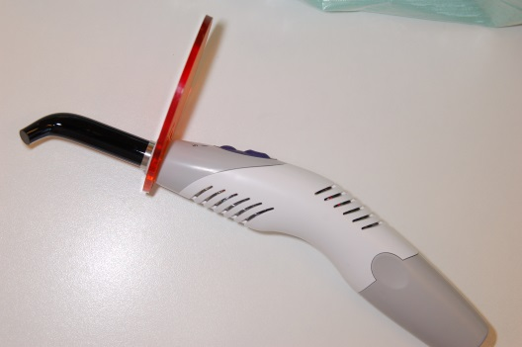
Direct bonding
5. primer 6. bonding
7. remove excess 8. light or chemically cured

Slide 21
Indirect bonding

Slide 22
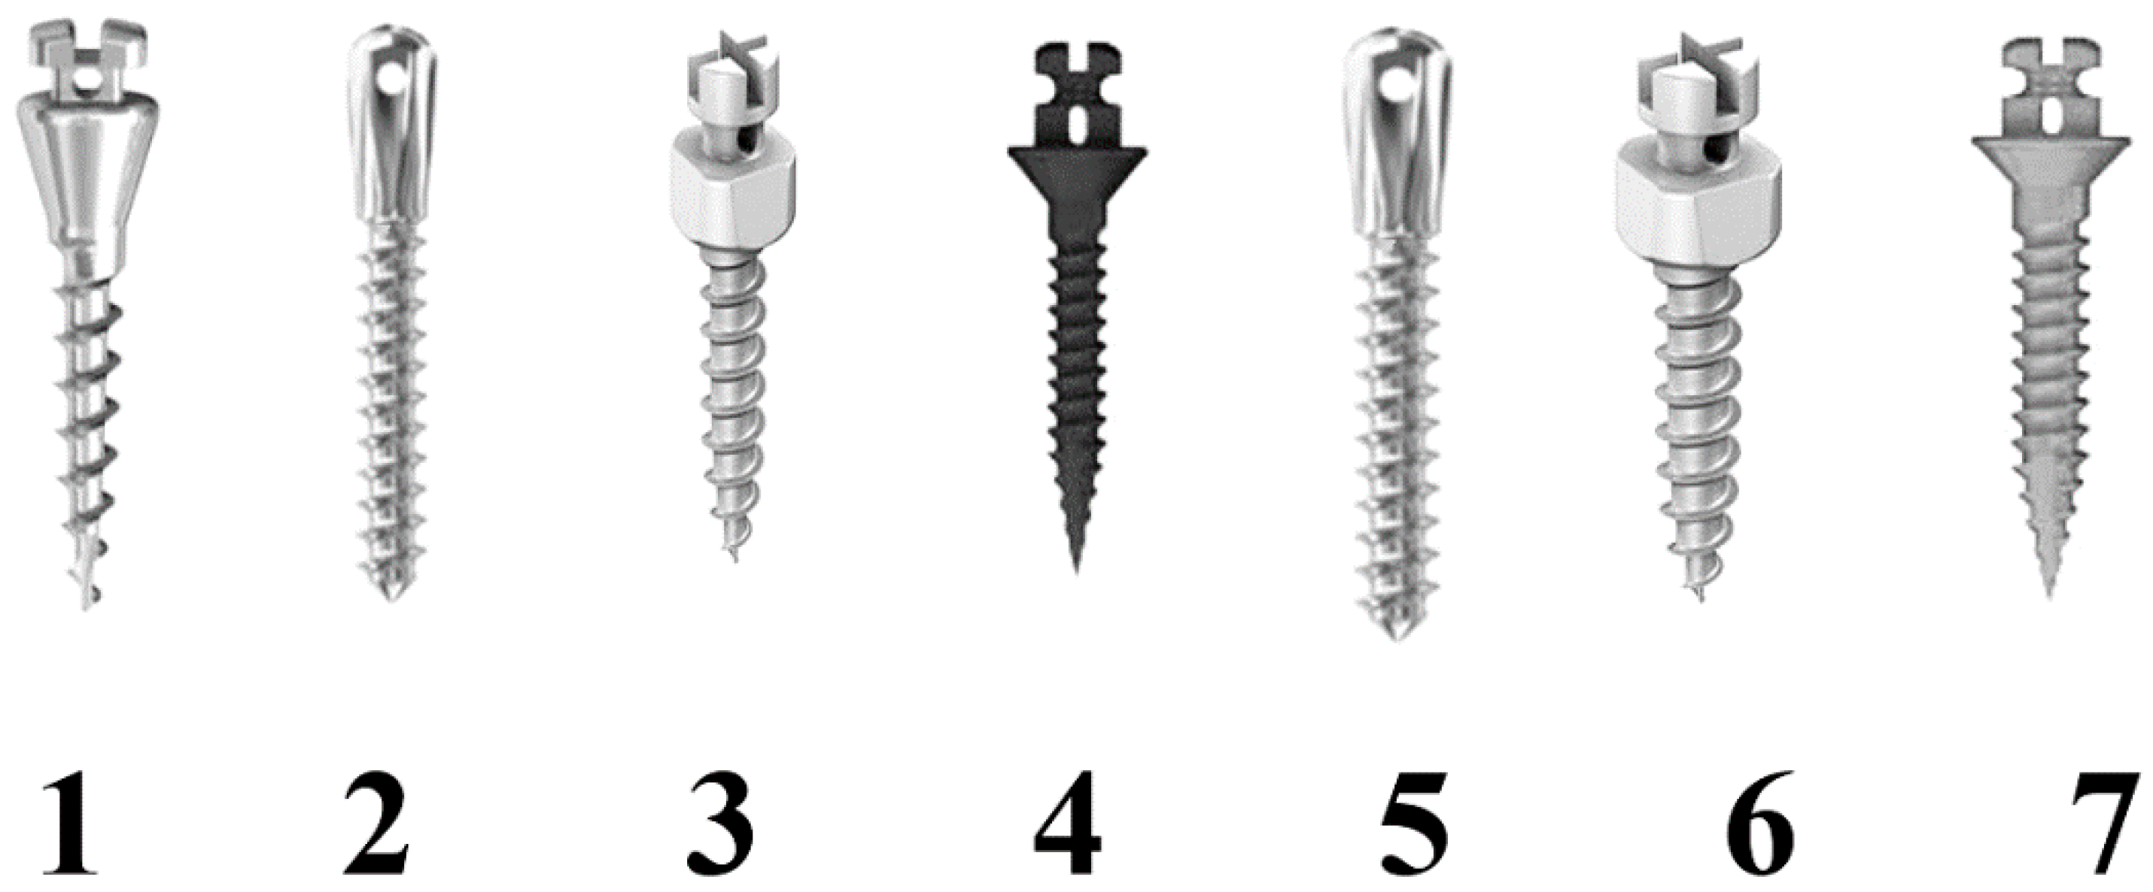
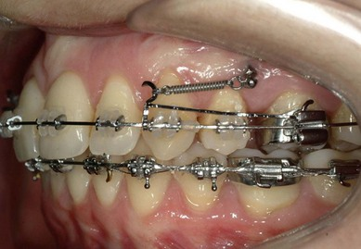
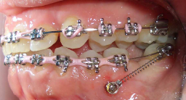
TAD – Temporary Anchorage Devices –
Mini Srew, Implants

Slide 23
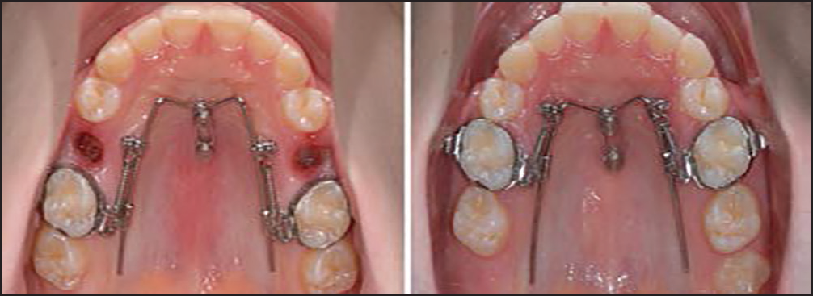
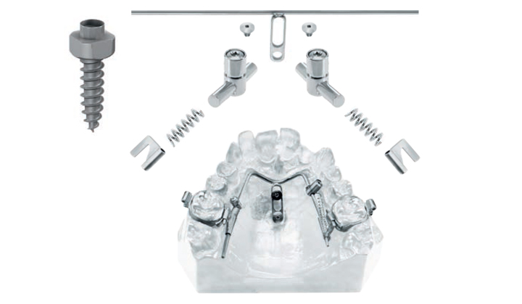
TAD – Temporary Anchorage Devices –
Mini Srew, Implants
Benefit Systém, hybrid hyrax

Slide 24
Haas Hyrax with Face mask

Slide 25
cases

Slide 30
Treatment time – 11 months

Slide 33
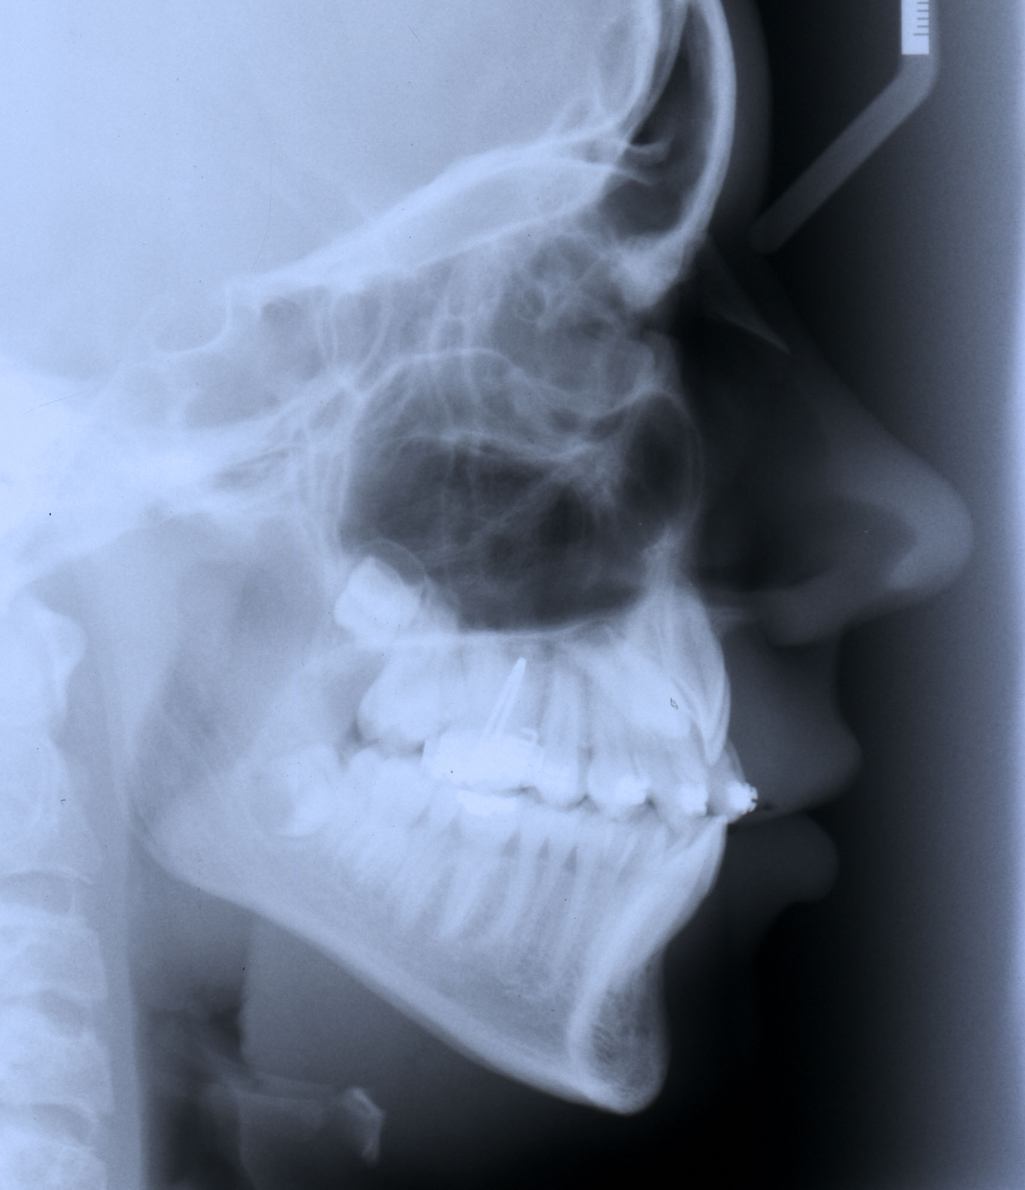

Slide 34
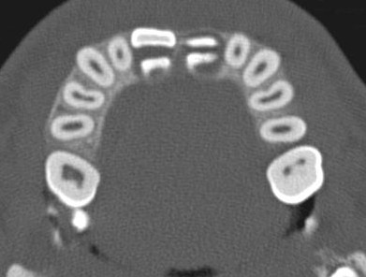
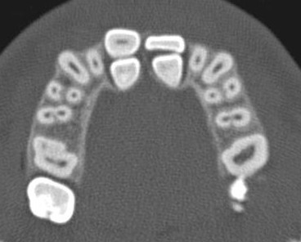
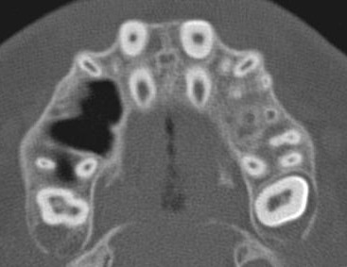
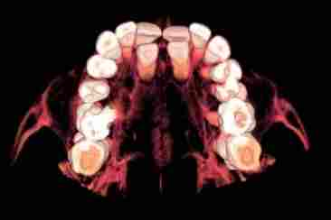
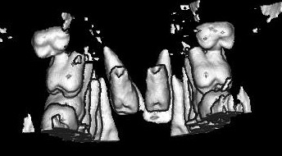
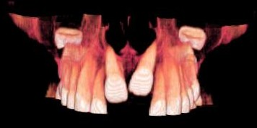

Slide 35
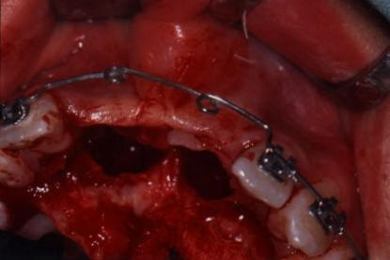
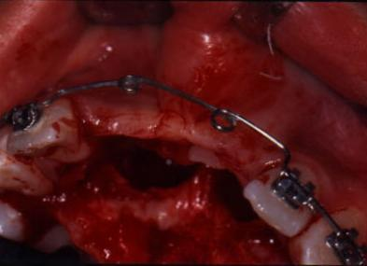
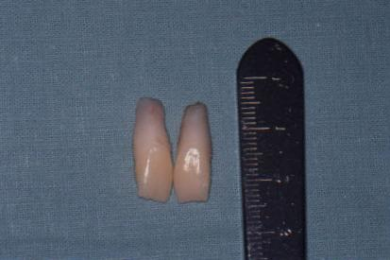

Slide 36
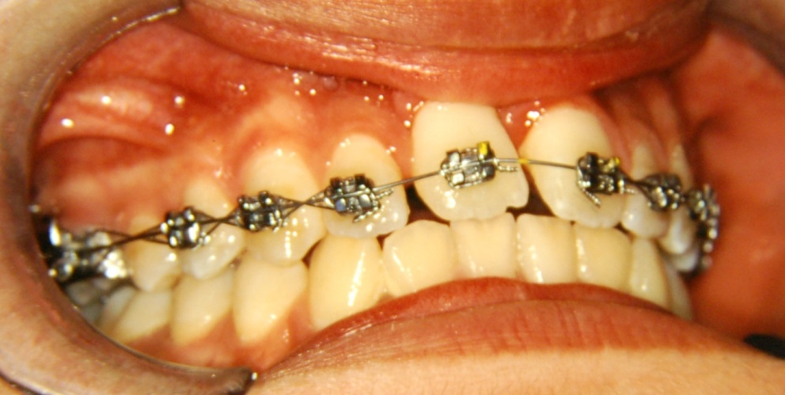

Slide 38
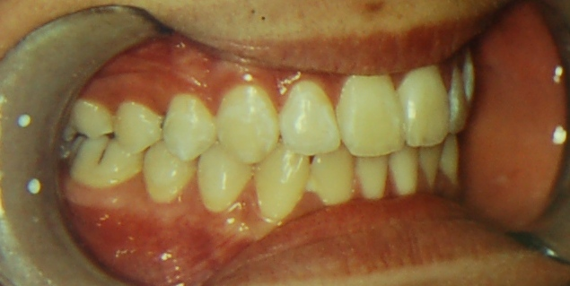
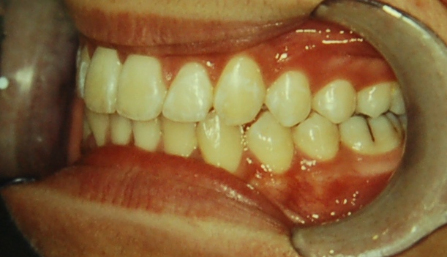
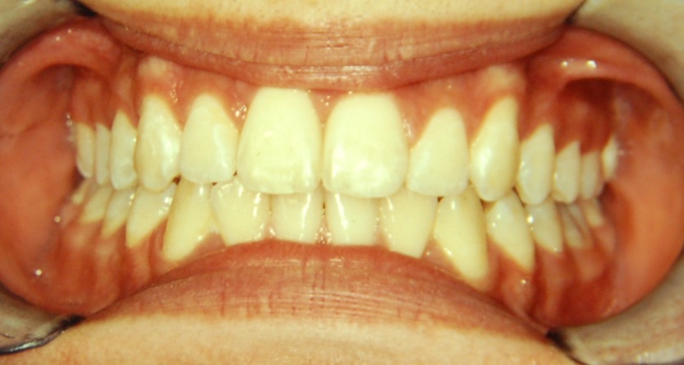
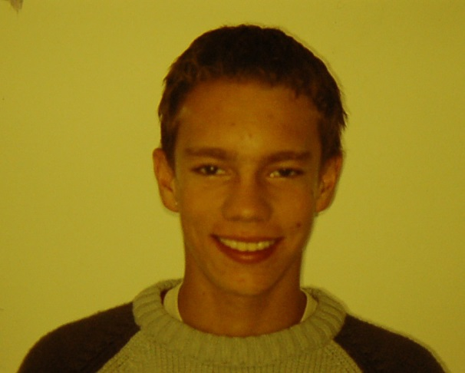

Slide 39
Treatment time – 16 months

Slide 53
Before treatment
After treatment

Slide 54
Before Treatment
After Treatment

Slide 58
Thank You four Your attention
Questions – email – alena.brysova@fnusa.cz
Consultation – Orthodontic department - St. Anne's Hospital, building D2b – Thursday 1-2 p.m.

