Slide 1
Qualitative Research
Zlata Kapounová, PhD
Victoria Hawk, PhD, MPH, RD
April 28, 2022

Slide 2
Why Do Research?
Learn
Learn new things
Seek a solution for a problem
Understand
Understand different views or opinions
Improve
Make a difference and improve people’s lives
Contribute to the knowledge base

Slide 3
Diabetes Prevention Program (DPP)
2002
Study Question:
Does a lifestyle intervention or treatment with metformin prevent or delay the onset of diabetes?
Study Type:
Randomized clinical trial at 27 centers in USA
Participants:
3,234 adults with pre-diabetes
Methods:
3 Groups:
Intensive lifestyle counseling (goal 7% weight loss with 150 minutes exercise per week)
Medication (Metformin)
Placebo
Data Collected included:
BMI, Gender, Ethnicity, Blood sugar value, Diabetes diagnosis
Results:
Intensive Lifestyle counseling - REDUCED incidence of diabetes by 58% vs Placebo
Medication Intervention - REDUCED incidence of diabetes by 31% vs Placebo

Slide 4
DPP Brno
Generalizable Results
  Through Lifestyle Change Type 2 Diabetes can be prevented
Czech Republic has increasing prevalence of pre-diabetes in adults
WHAT IF we conducted the DPP in Brno
We Followed research protocols and collected quantitative data
BUT the results were DIFFERENT
  Compared to other groups, Lifestyle Counseling was not more effective at preventing diabetes for people in Brno
  But WHY…… How can you find out?

Slide 5
What is Qualitative Research?
Used to answer the whys and how's of human behavior, opinion, and experience
involves the researcher collecting and analyzing non-numerical data (e.g., text, video, or audio) to understand concepts, opinions, or experiences
Analyzes information that is difficult to obtain through more quantitatively-oriented methods of data collection. Finding are not from standard statistical procedures or other means of quantification.

Slide 6
Qualitative and Quantitative Research
Video Link

Slide 7
Today’s Plan
Introduction
Group Activity
Review Qualitative Research

Slide 8
Group Activity
Form 4 Groups
Review Journal Articles

Slide 9

Qualitative Articles: Journals and Titles

Slide 10
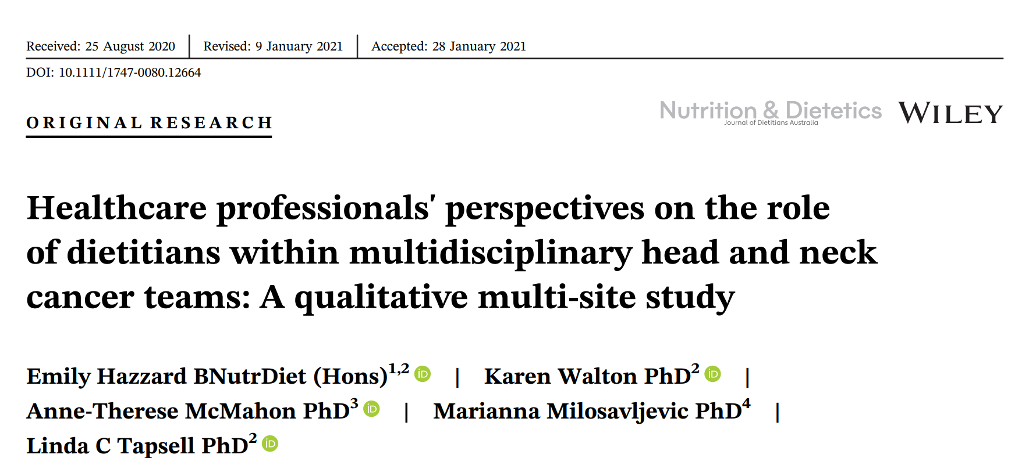
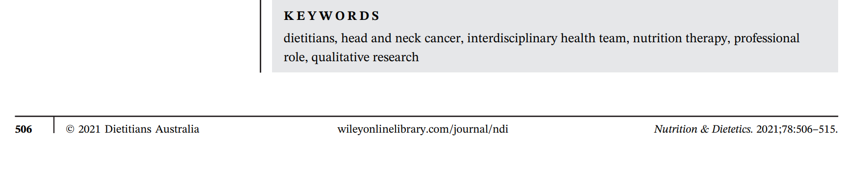
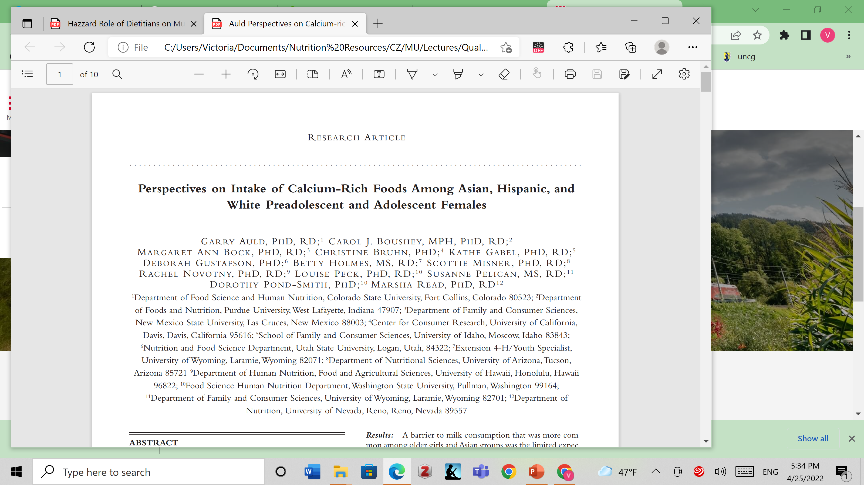
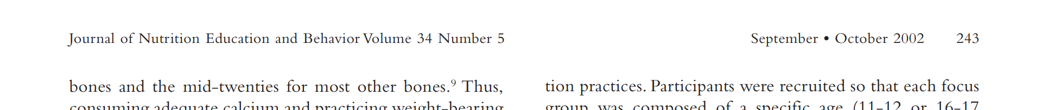




Where to find the name of the journal and the article title
Title on first page
Journal name at bottom of the page
Journal name at
top of page 2

Slide 11
Research Questions
Guide the study and determines if qualitative or quantitative methods will be used to answer the question
1 or 2 main questions
Qualitative Study questions usually begin with WHAT or HOW
Qualitative questions tell the reader what the researchers are attempting to:
discover
describe
explore
identify

Slide 12
Qualitative Research Questions
How does social media shape body image in teenagers?
How do children and adults interpret healthy eating in the UK?
What are the attitudes of elderly people with stroke towards the daily use of thickened liquids?

Slide 13
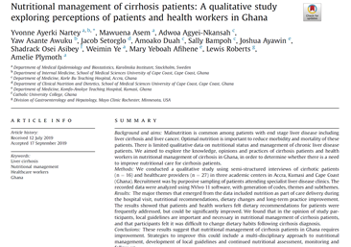
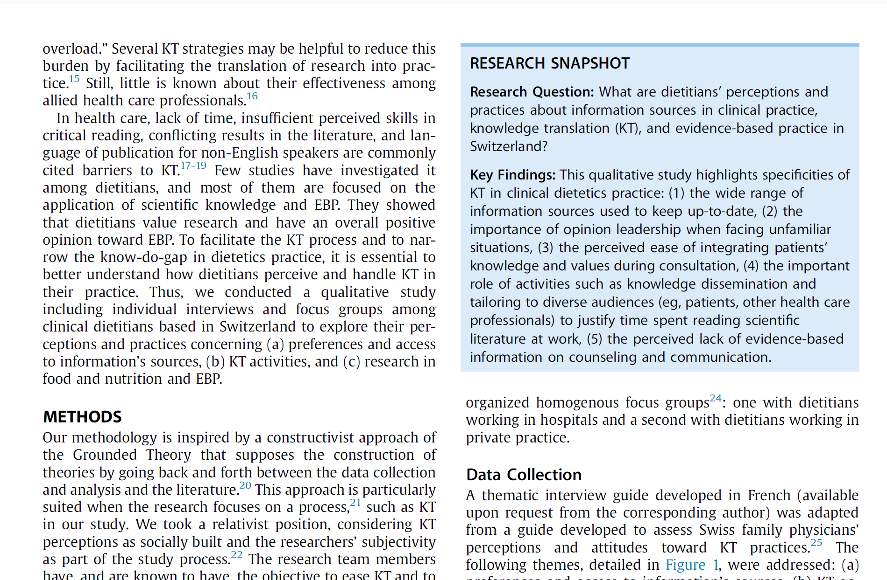
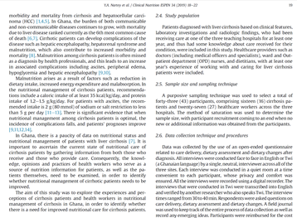


Where to find the research question
Research Snapshot
Abstract
End of Introduction Section

Slide 14

Qualitative
Research Questions

Slide 15
How to collect qualitative data
Observations: recording what you have seen, heard, or encountered in detailed field notes.
Interviews: personally, asking people open-ended questions in one-on-one conversations.
Focus groups: asking open-ended questions and generating discussion among a group of people.
Surveys: distributing questionnaires with open-ended questions.

Slide 16
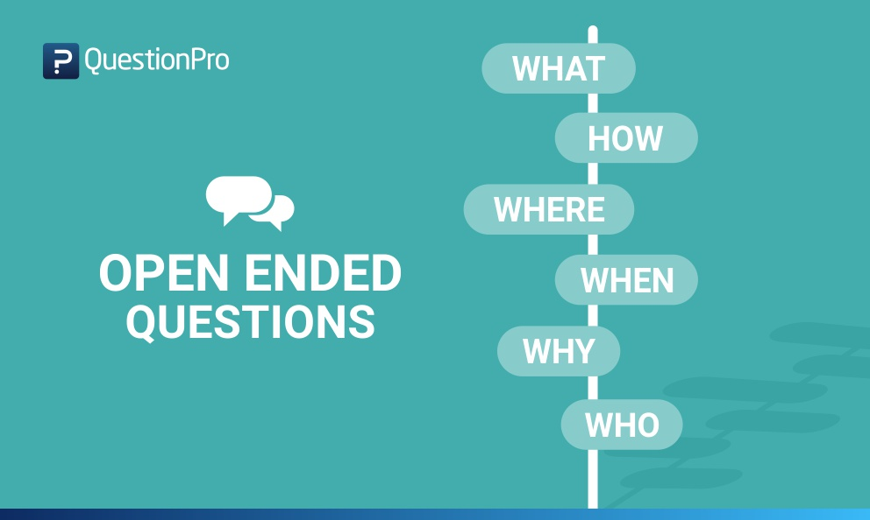
What are

Slide 17
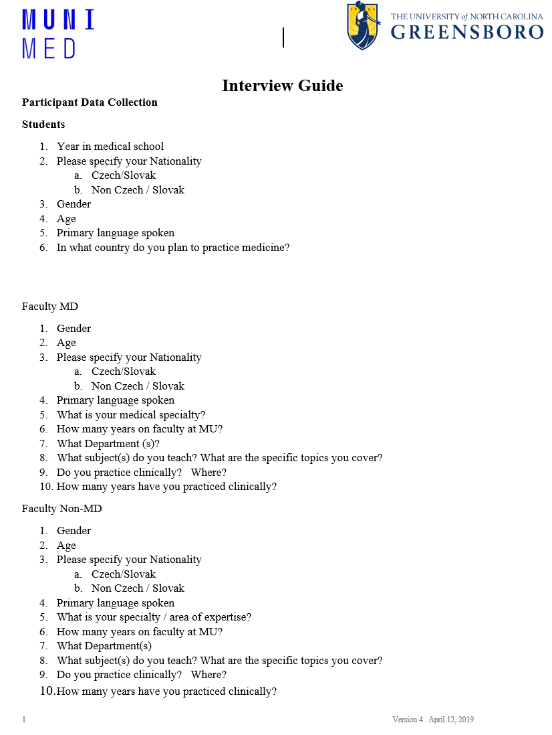
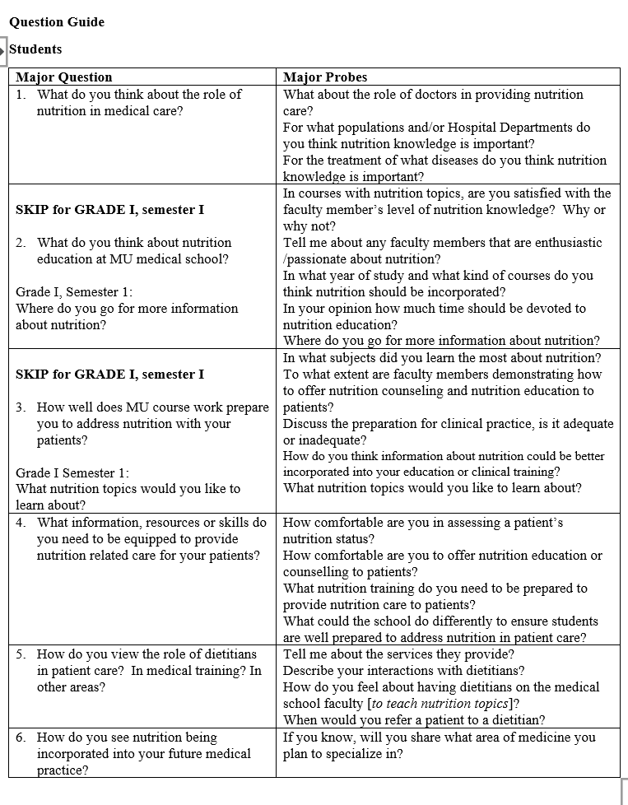
Interview Guide
Demographic Data
Open Ended Questions

Slide 18
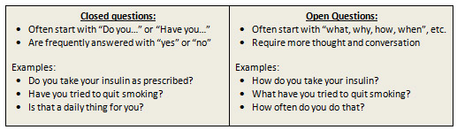
Use Open-Ended Questions

Slide 19
Participants
Who to include
How to recruit

Slide 20
How to Recruit Participants
Recruitment is the process of finding, screening, and scheduling qualified candidates for the study
Methods to contact candidates include:
  sending letters, emails or telephone calls
  hanging posters
  In-person - visiting places where candidates may be found
  Referrals from study participants
Goal is to identify qualified participants without introducing bias through the selection process

Slide 21

Method of Data Collection and Participants

Slide 22
Stages of Data Analysis
Transcription of Interview data
De-Identification of sensitive data
Reviewing and reading data
Grouping data into categories - Coding
Identification of Themes or main ideas from the data
Methods to Validate data collection and analysis

Slide 23
Research Findings
Answer the research question using:
Themes (main ideas)
Representative quotes
Conclusions

Slide 24
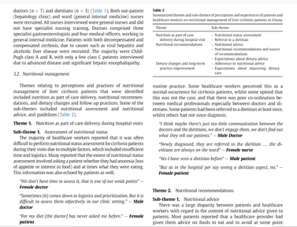
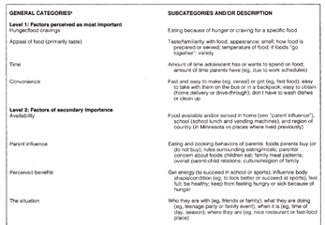

How are Qualitative Results Presented in Articles
Table of Categories and Descriptions
Table of Themes
Theme and Representative Quotes

Slide 25

Study Results

Slide 26
How can Qualitative Findings be used
Development of theories based on views and opinions of the group.
Write and publish reports using quotes and data to support findings
Inform plans for follow up and
future research

Slide 27
DPP in Brno
If lifestyle change was not effective at preventing diabetes for people in Brno
HOW can we determine WHY?

Slide 28
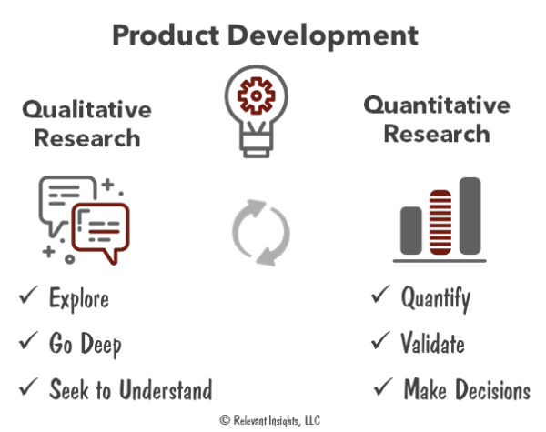
Qualitative
& Quantitative Research Work Together

Slide 29

What Questions do you have?

