Slide 1
Digestive system
Teeth, general structure, sets of teeth (types of dentition), characteristic features of individual types of teeth of permanent dentition
Teeth formula of deciduous and permanent dentitions, teeth eruption and exchange
Oral vestibule (vestibulum oris): borders, content, communication with the oral cavity proper
Oral cavity proper (cavum oris proprium): borders, contents
Tongue (lingua): gross anatomy, blood supply
Tongue (lingua): muscles, nerves
Hard palate: structure, blood supply and nerves
Soft palate: muscles, blood supply and nerves
Major salivary glands: syntopy and courses of their ducts
Salivary glands: nerves
Pharynx: parts, general structure of the wall, syntopy
Pharynx: muscles, nerves
Oesophagus: wall structure, course, syntopy, physiological constrictions
Oesophagus: blood supply and nerves
Stomach (ventriculus, gaster): description, structure of the wall, syntopy
Stomach (ventriculus, gaster): blood supply and nerves
Small intestine (intestinum tenue): structure of the wall, division, blood supply
Duodenum: parts, position, relation to the peritoneal cavity, blood supply
Large intestine (intestinum crassum): parts, structure of the wall, relation to the peritoneal cavity, blood supply
Caecum: structure, appendix (appendix vermiformis), relation to the peritoneal cavity, blood supply
Rectum: structure, syntopy, blood supply
Liver (hepar): gross anatomy, structure, syntopy
Liver (hepar): nutritional blood supply
Liver (hepar): functional blood supply, portal vein
Liver (hepar): extrahepatic bile ducts
Gallbladder (vesica biliaris): structure, syntopy, flow of bile
Pancreas: structure, syntopy, blood supply
Abdominal regions and orientation lines
Structure of the abdominal wall
Projections of organs onto the anterior abdominal wall
Umbilical region (reg. umbilicalis)
Inguinal canal (canalis inguinalis)
Supracolic compartment of the peritoneal cavity (pars supramesocolica)
Infracolic compartment of the peritoneal cavity (pars inframesocolica)
Retroperitoneal space (spatium retroperitoneale)
Peritoneum: folds
Recesses of the peritoneal cavity
Spleen (lien): structure, blood supply, syntopy

Slide 2
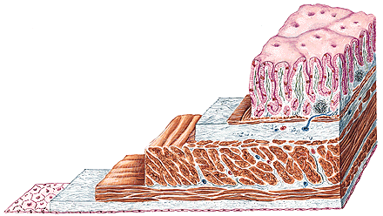
Describe the structure of the gastrointestinal tube:

Slide 3
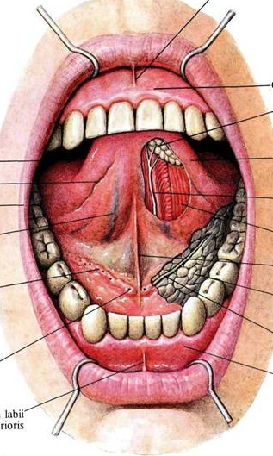
What is located on the inferior surface of tongue and on the floor of the oral cavity:
Q
Oral vestibule (vestibulum oris): borders, content, communication with the oral cavity proper
Oral cavity proper (cavum oris proprium): borders, contents

Slide 4
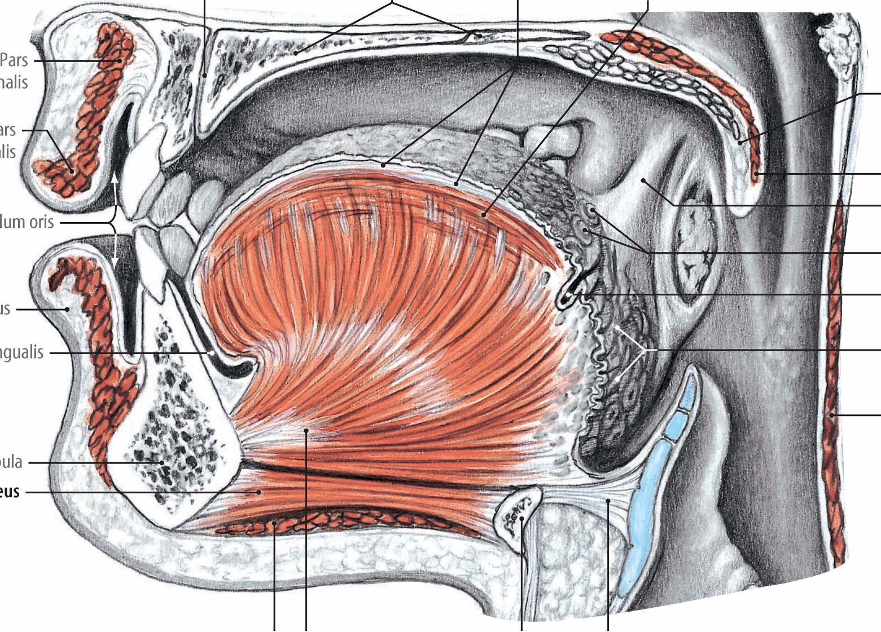
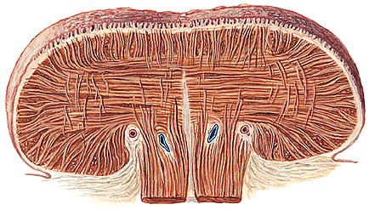
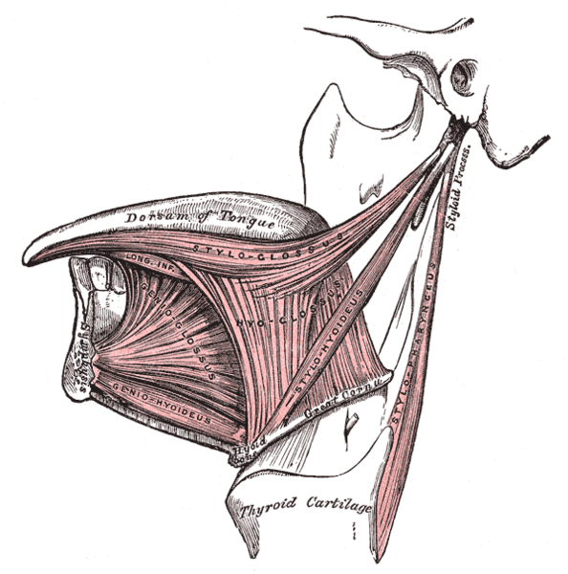
What innervates the muscles of the tongue?
Q
Tongue (lingua): gross anatomy, blood supply
Tongue (lingua): muscles, nerves

Slide 5
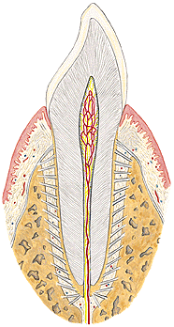
Name the teeth:
Describe differences betwen periodontium and parodontium:
52
36
Q
Teeth, general structure, sets of teeth (types of dentition), characteristic features of individual types of teeth of permanent dentition
Teeth formula of deciduous and permanent dentitions, teeth eruption and exchange

Slide 6
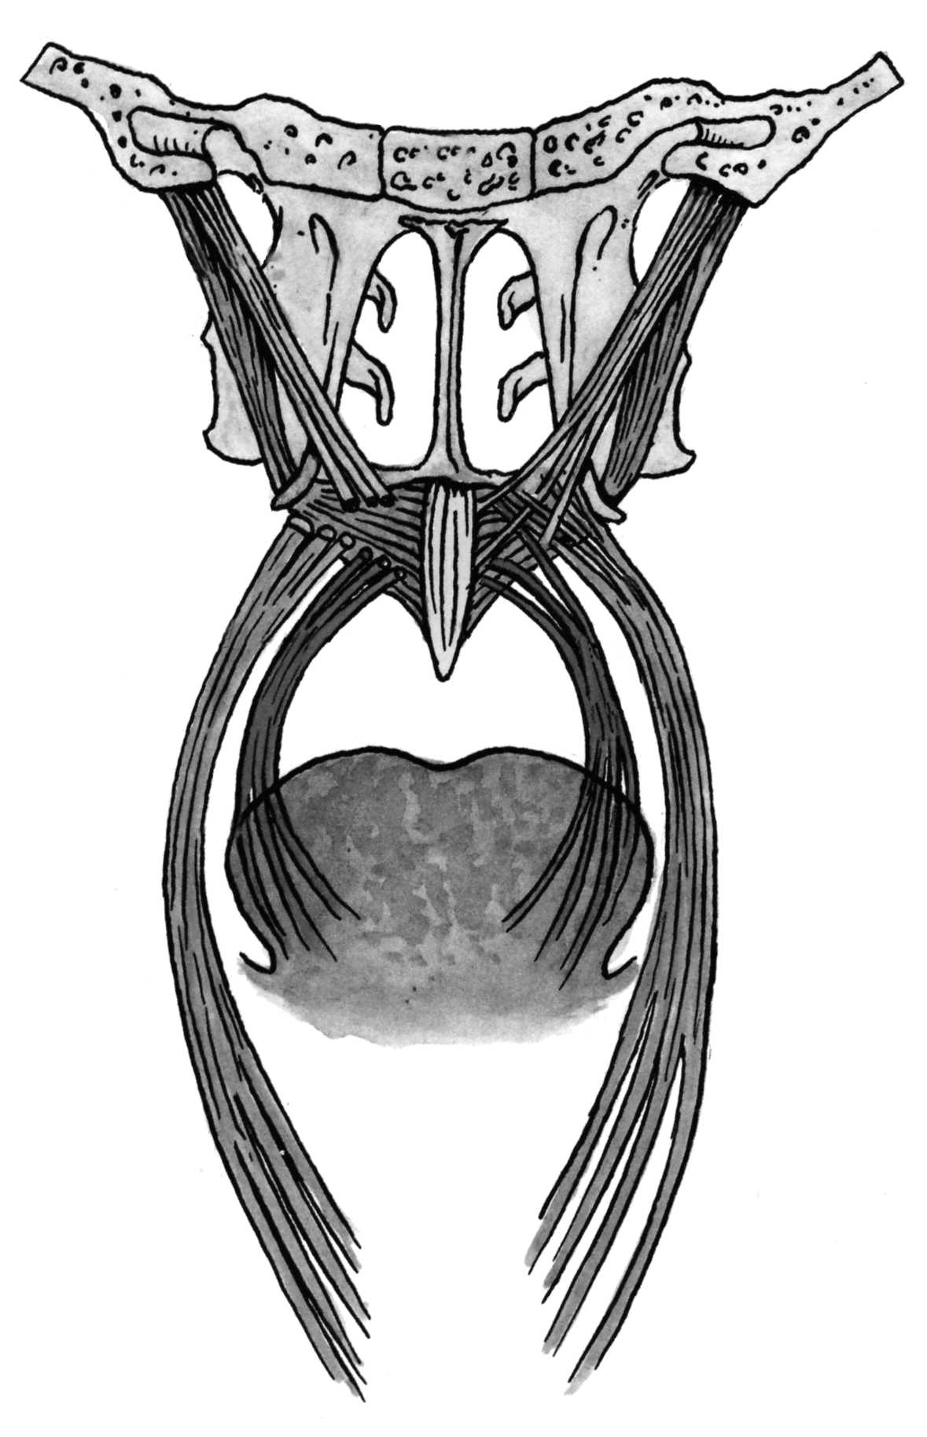
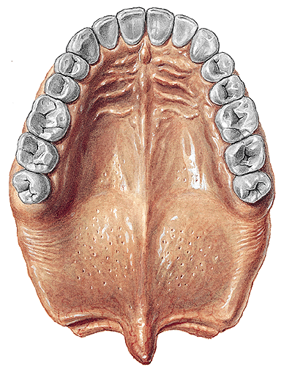
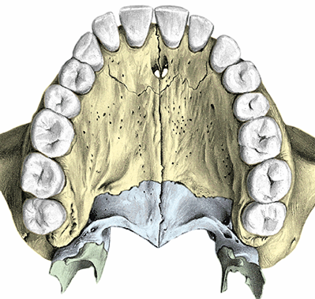
Name the muscles of the soft palate:
Q
Hard palate: structure, blood supply and nerves
Soft palate: muscles, blood supply and nerves

Slide 7
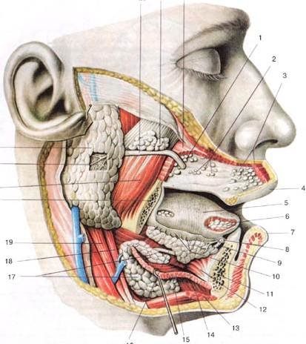
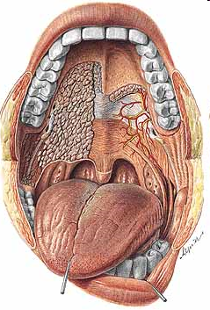
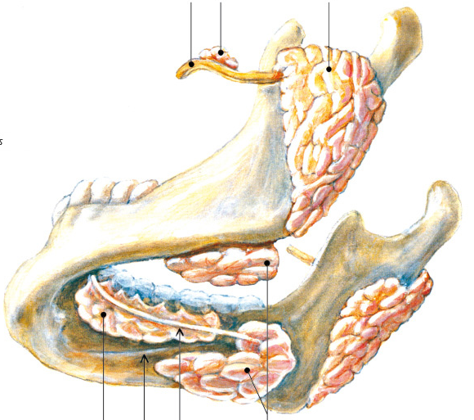
Q
Major salivary glands: syntopy and courses of their ducts
Salivary glands: nerves
Where are the oppenings
of the major salivary glands:

Slide 8
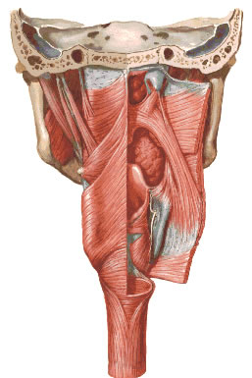
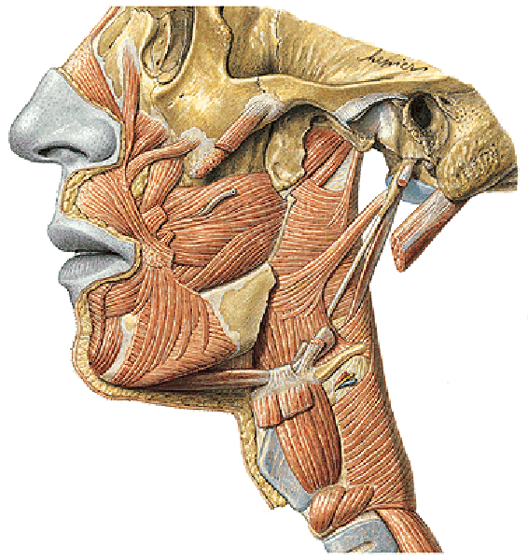
Name the pharyngeal muscles:
Q
Pharynx: parts, general structure of the wall, syntopy
Pharynx: muscles, nerves

Slide 9
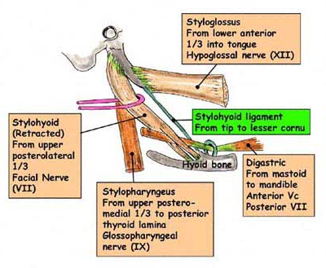
Describe the styloid septum:

Slide 10
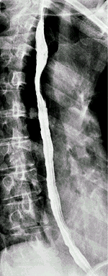
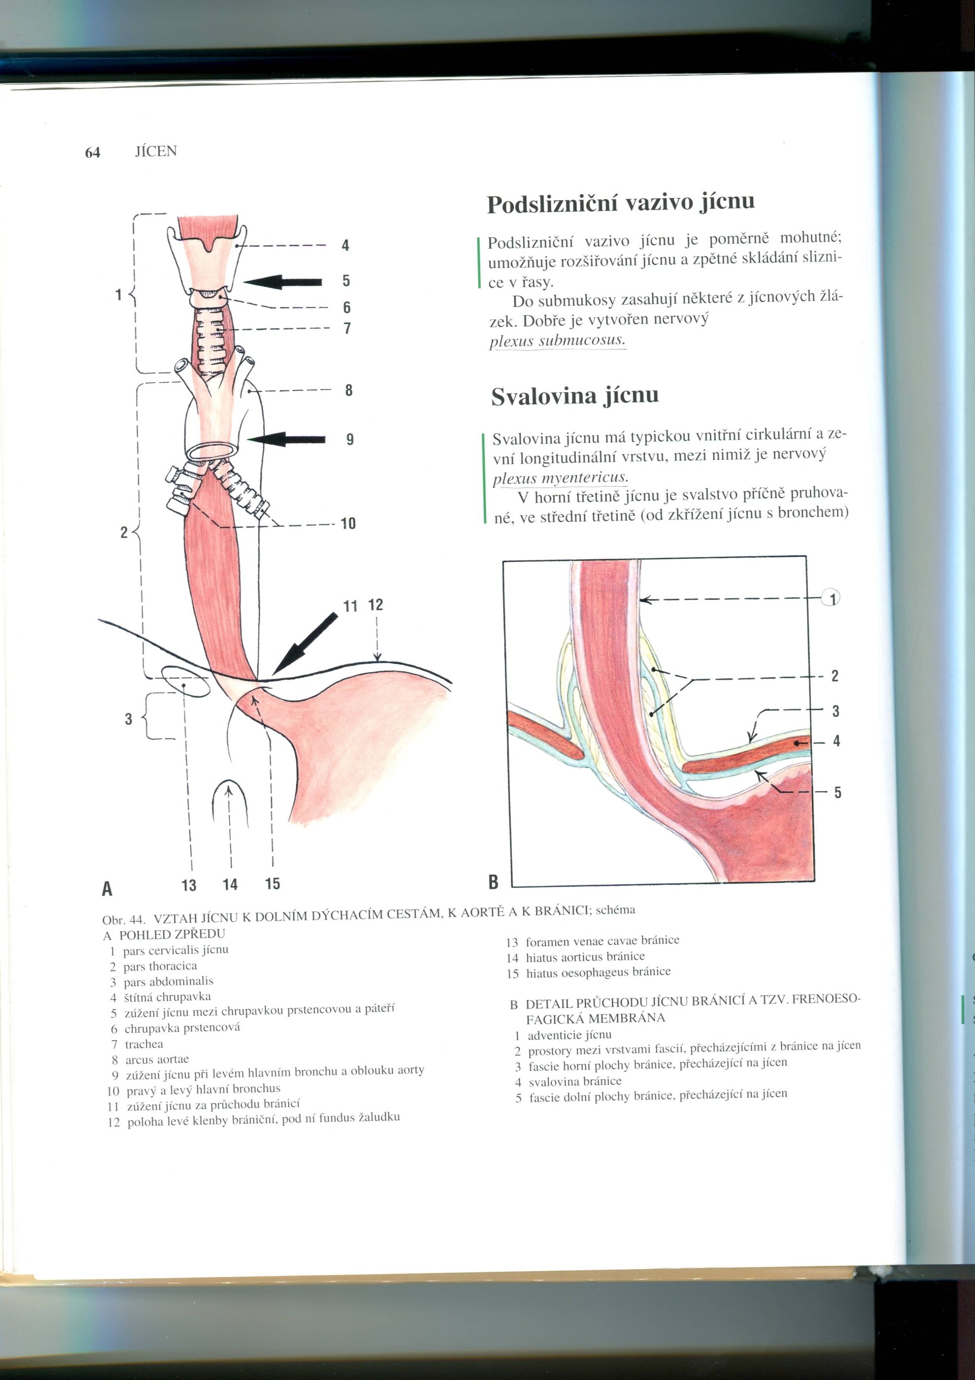
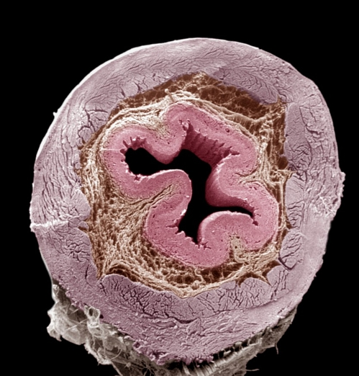
Describe the constrictions of the esophagus:
Q
Oesophagus: wall structure, course, syntopy, physiological constrictions
Oesophagus: blood supply and nerves

Slide 11
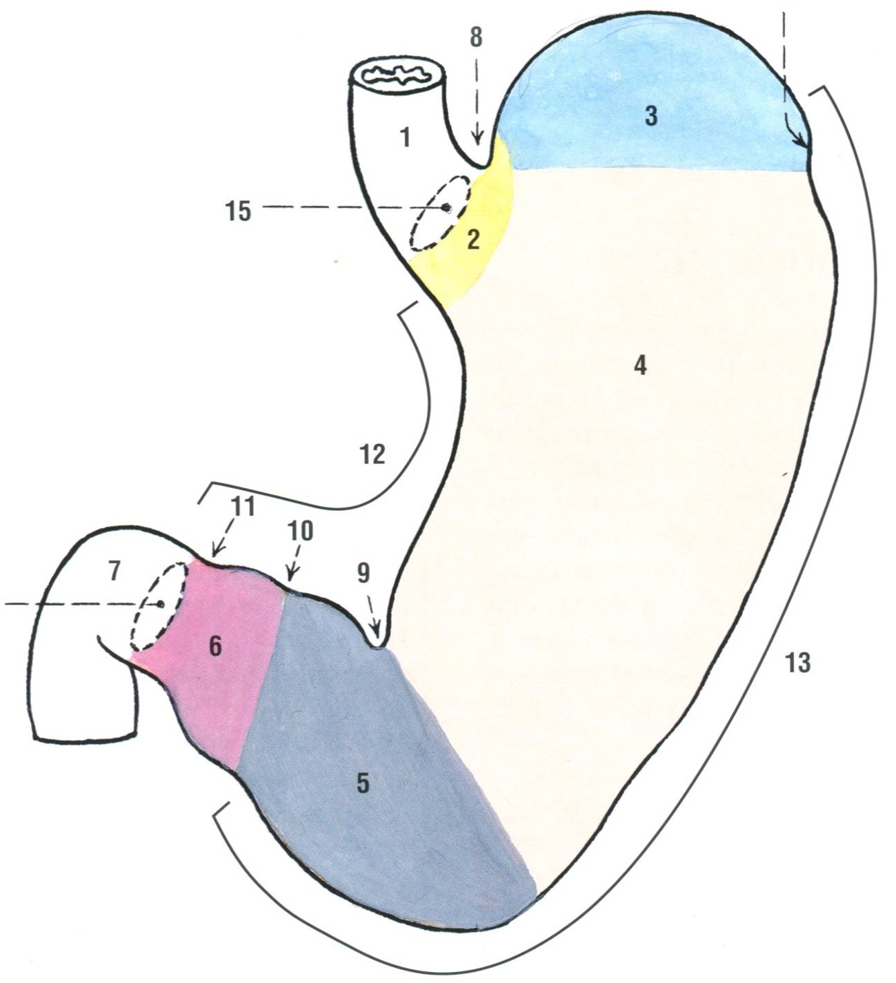
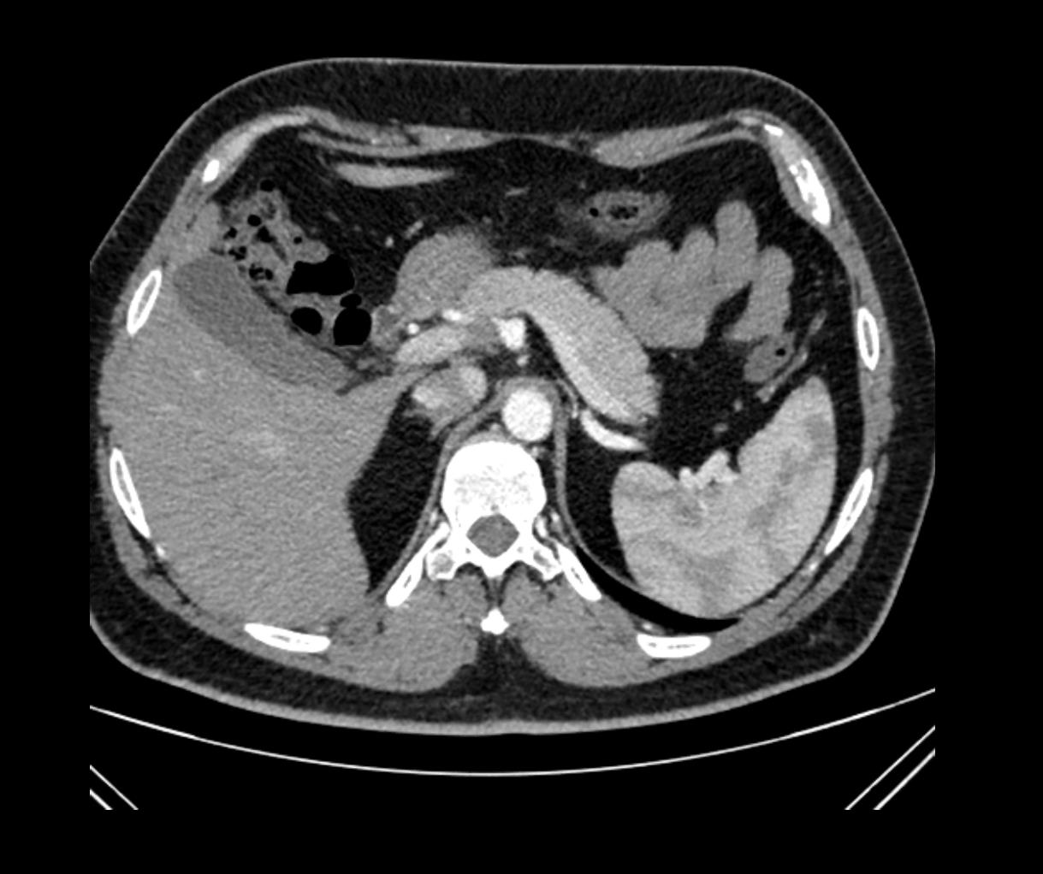
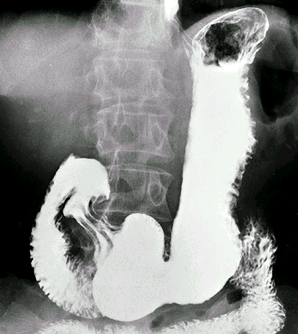
Describe the muscular layer of stomach:
Q
Stomach (ventriculus, gaster): description, structure of the wall, syntopy
Stomach (ventriculus, gaster): blood supply and nerves

Slide 12
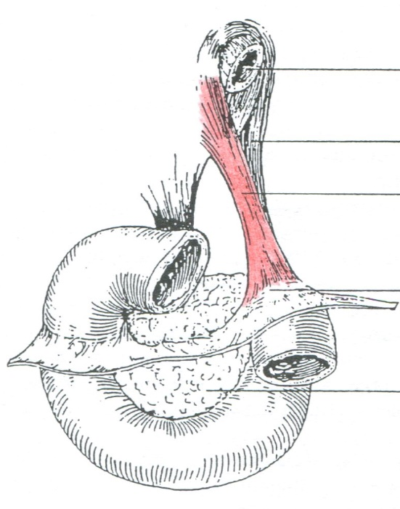
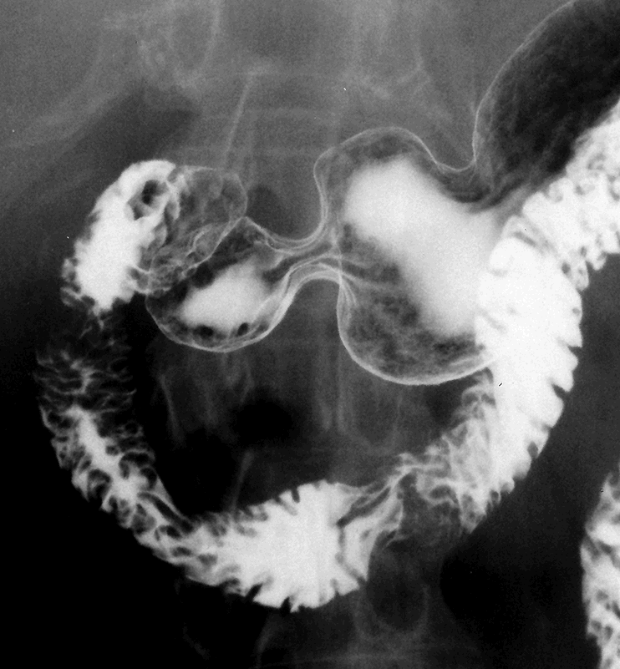
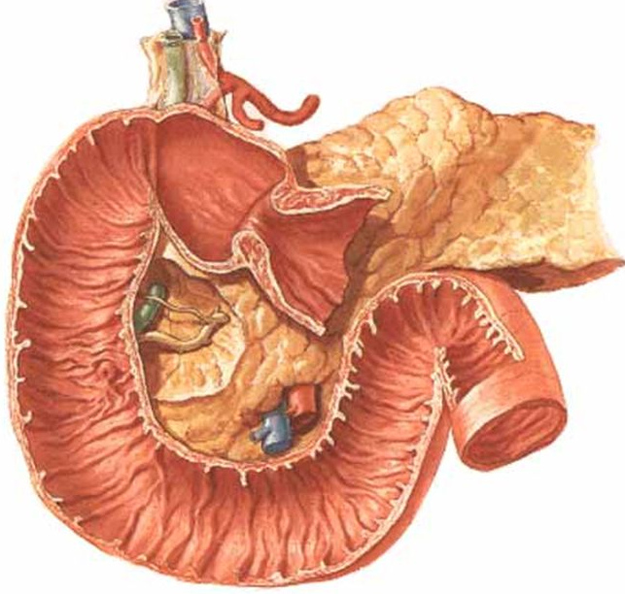
Name the parts of duodenum:
Q
Duodenum: parts, position, relation to the peritoneal cavity, blood supply

Slide 13
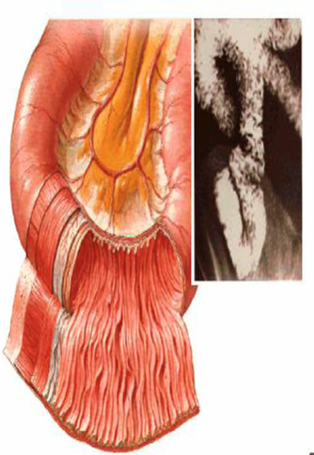
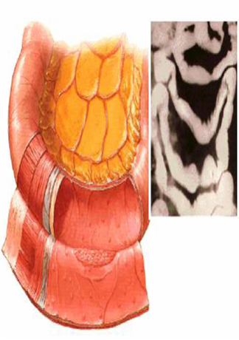
Describe differences between jejunum and ileum:
Q
Small intestine (intestinum tenue): structure of the wall, division, blood supply

Slide 14
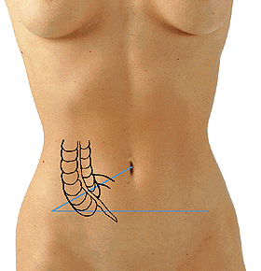
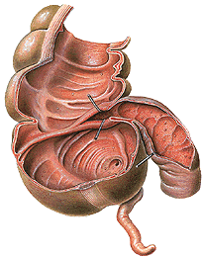
Describe the projection of the appendix on the anterior abdominal wall:
Q
Caecum: structure, appendix (appendix vermiformis), relation to the peritoneal cavity, blood supply

Slide 15
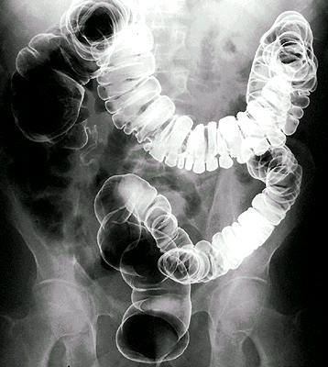
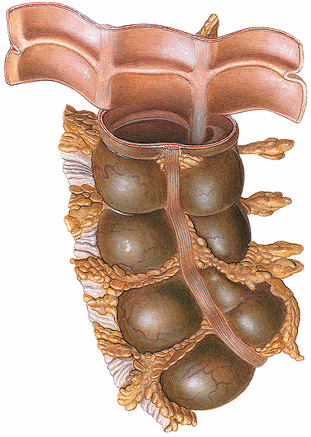
Describe differences- haustra and teniae:
Q
Large intestine (intestinum crassum): parts, structure of the wall, relation to the peritoneal cavity, blood supply

Slide 16
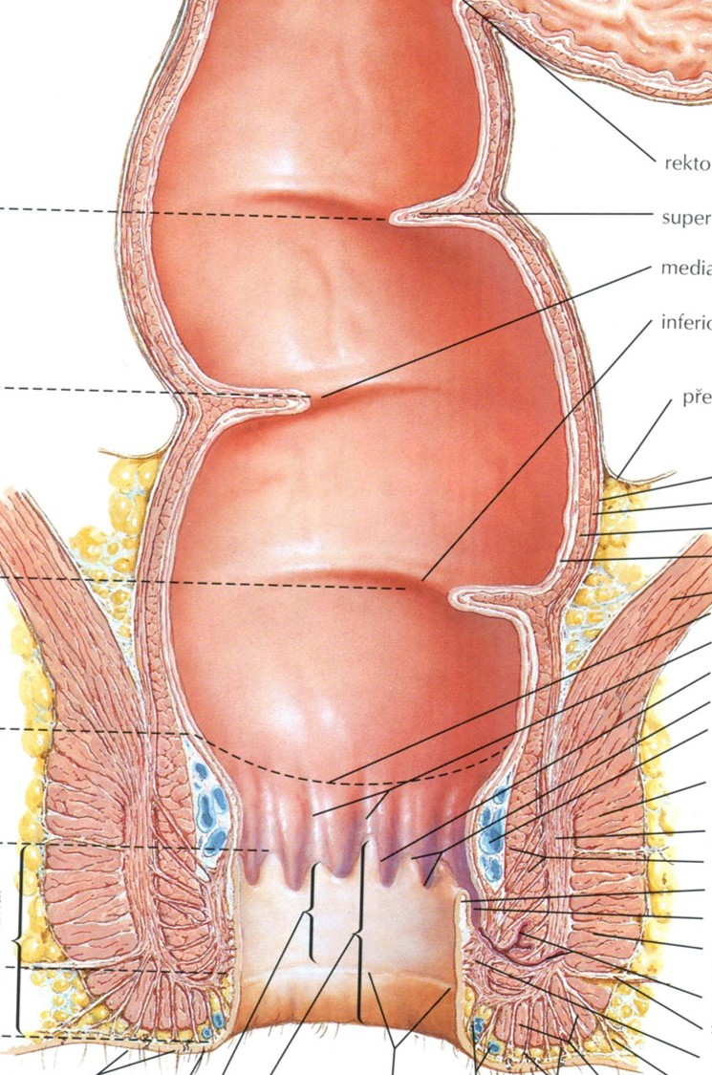
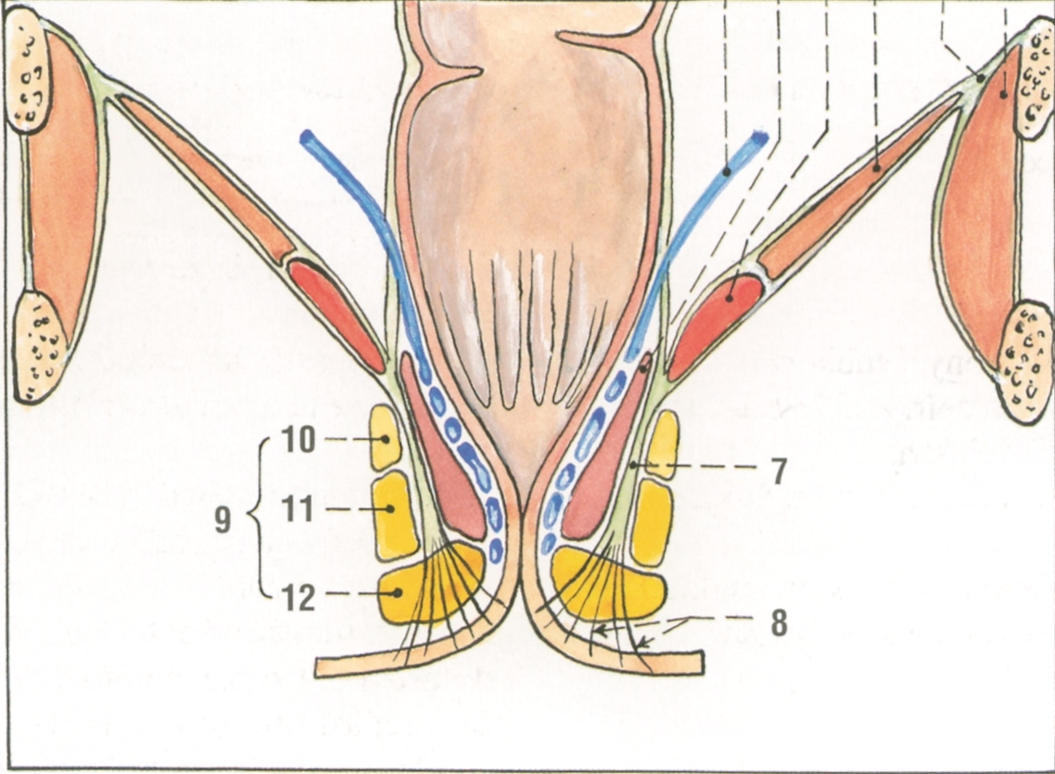
Describe the curvatures of rectum (in the sagital and frontal plane) :
Q
Rectum: structure, syntopy, blood supply

Slide 17
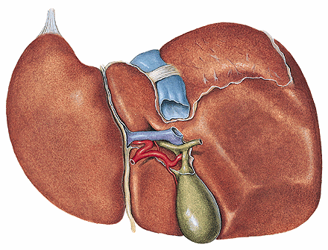
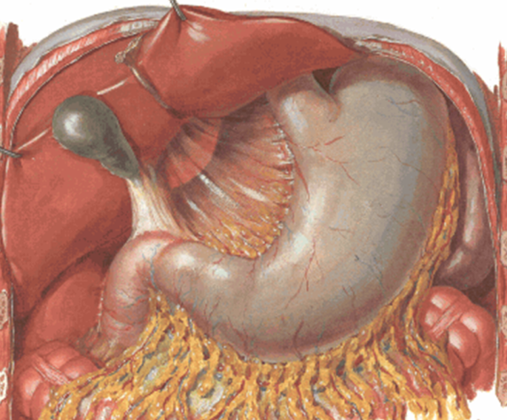
Describe impressions:
Q
Liver (hepar): gross anatomy, structure, syntopy
Liver (hepar): nutritional blood supply
Liver (hepar): functional blood supply, portal vein
Liver (hepar): extrahepatic bile ducts

Slide 18
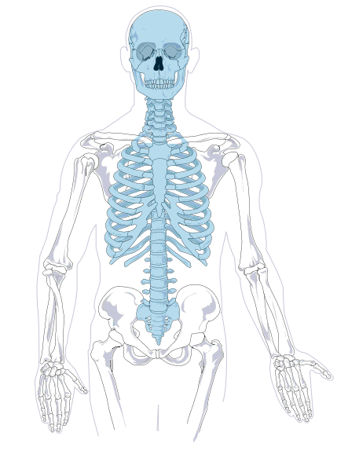
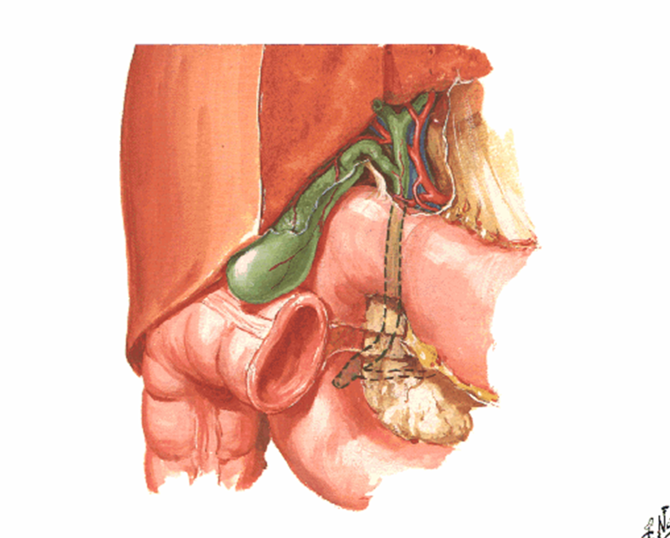
Draw the projection of the gallbadder and papilla duodeni major:
Q
Gallbladder (vesica biliaris): structure, syntopy, flow of bile

Slide 19
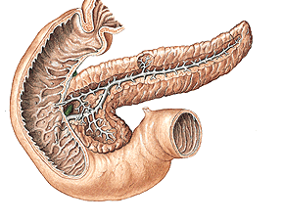
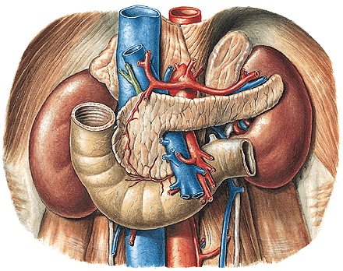
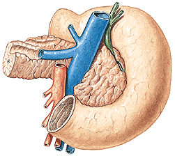
Describe the exocrinal part of pancreas:
Q
Pancreas: structure, syntopy, blood supply

Slide 20
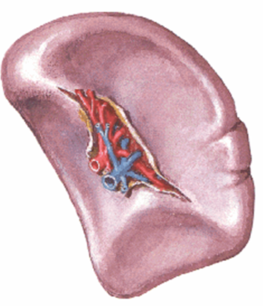
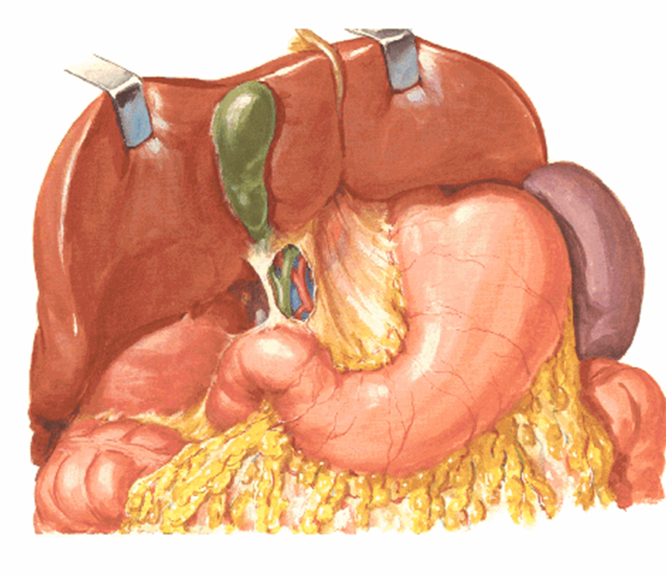
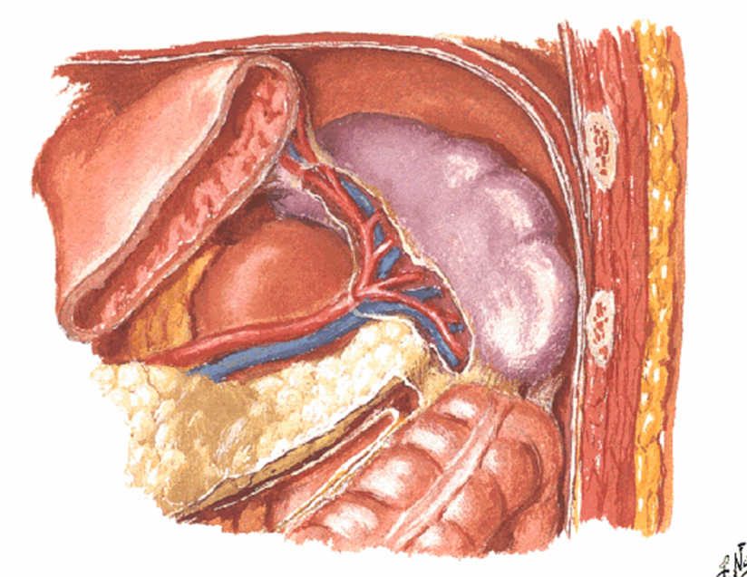
Describe the impressions :
Q
Spleen (lien): structure, blood supply, syntopy

Slide 21
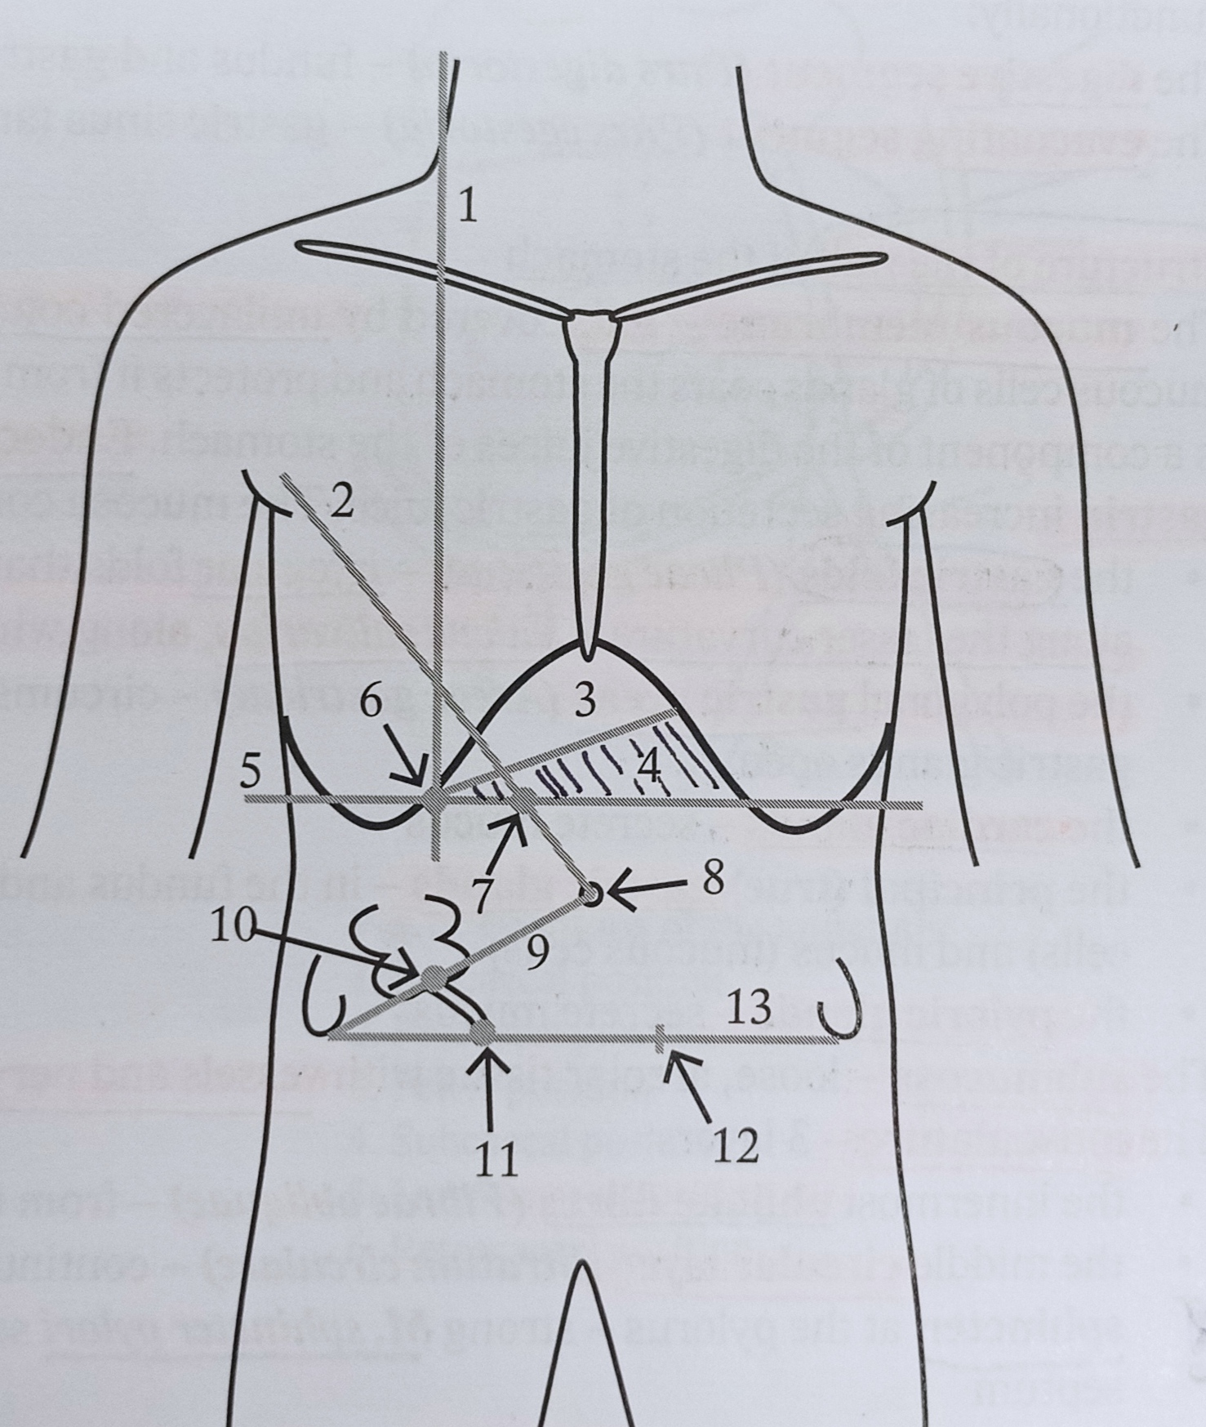
Projections of the organs on the anterior abdominal wall:
Q
Abdominal regions and orientation lines
Structure of the abdominal wall
Projections of organs onto the anterior abdominal wall
Umbilical region (reg. umbilicalis)
Inguinal canal (canalis inguinalis)
Supracolic compartment of the peritoneal cavity (pars supramesocolica)
Infracolic compartment of the peritoneal cavity (pars inframesocolica)
Retroperitoneal space (spatium retroperitoneale)
Peritoneum: folds
Recesses of the peritoneal cavity

Slide 22
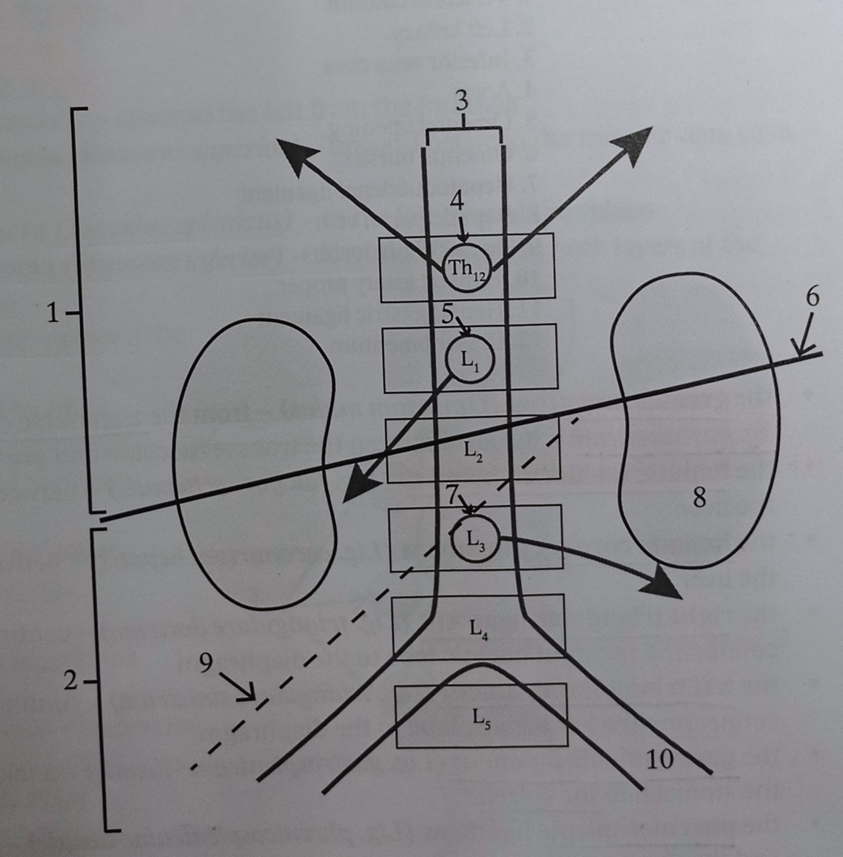
Divisions of the abdominal cavity:

Slide 23
1. table:
Ventriculus (gaster)
Intestinum tenuae
Intestinum crassum
Duodenum
Ceacum
Rectum
2. table :
Cavum oris
Palatum durum et mole
Lingua
Glandulae salivariae
Dentes
Pharynx
3. table :
Liver
Spleen
Pancreas
4. table :
1. peritoneum

Slide 24
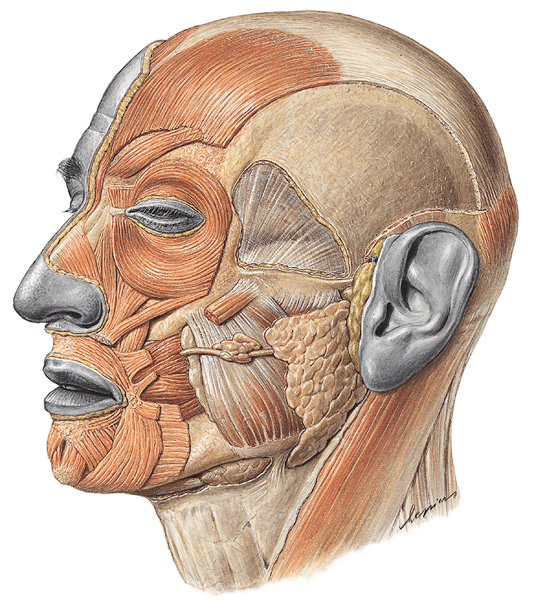
Q _last semester:
What muscle is indicated by the arrow?

Slide 25
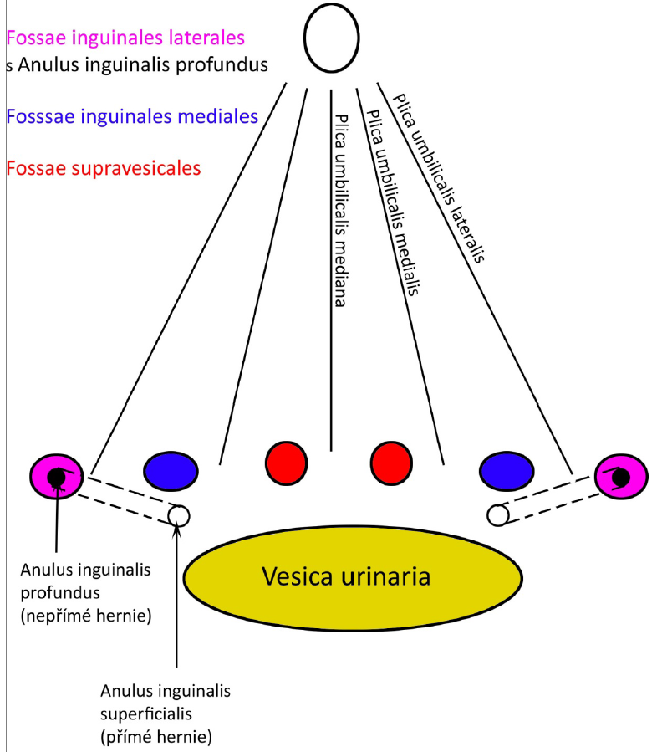
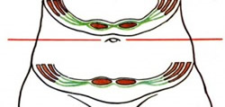
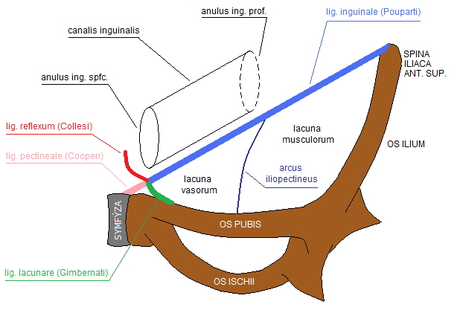
n.femoralis
n.cutaneus femoris lateralis
n.genitofemoralis
a.femoralis
m.iliopsoas
v.femoralis

