Slide 1
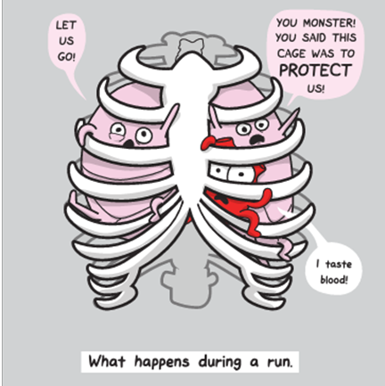

Slide 2
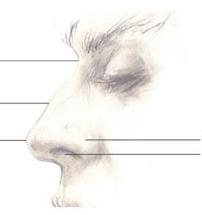
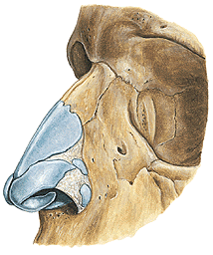
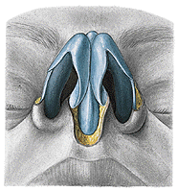
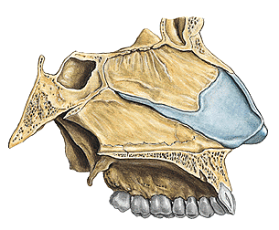
1. Horní cesty dýchací
Q External nose (nasus externus): parts, structural background

Slide 3
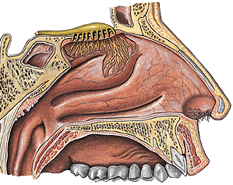
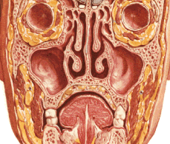
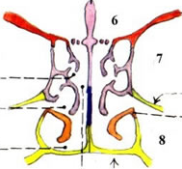
Q Nasal vestibule (vestibulum nasi)
Nasal cavity (cavitas nasi): borders, functions, regions

Slide 4
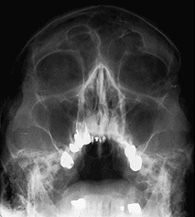
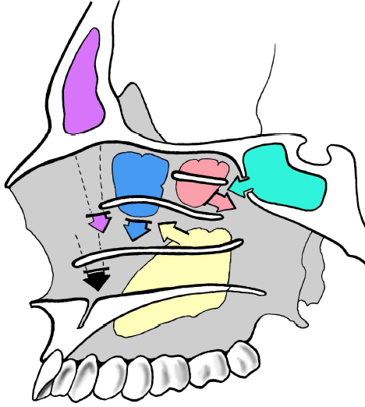
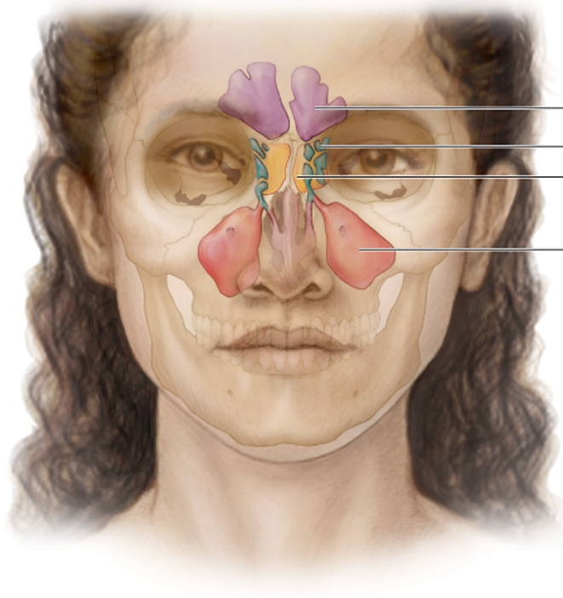
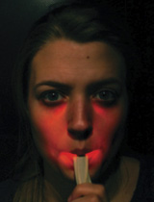
Q Name the paranasal sinuses

Slide 5
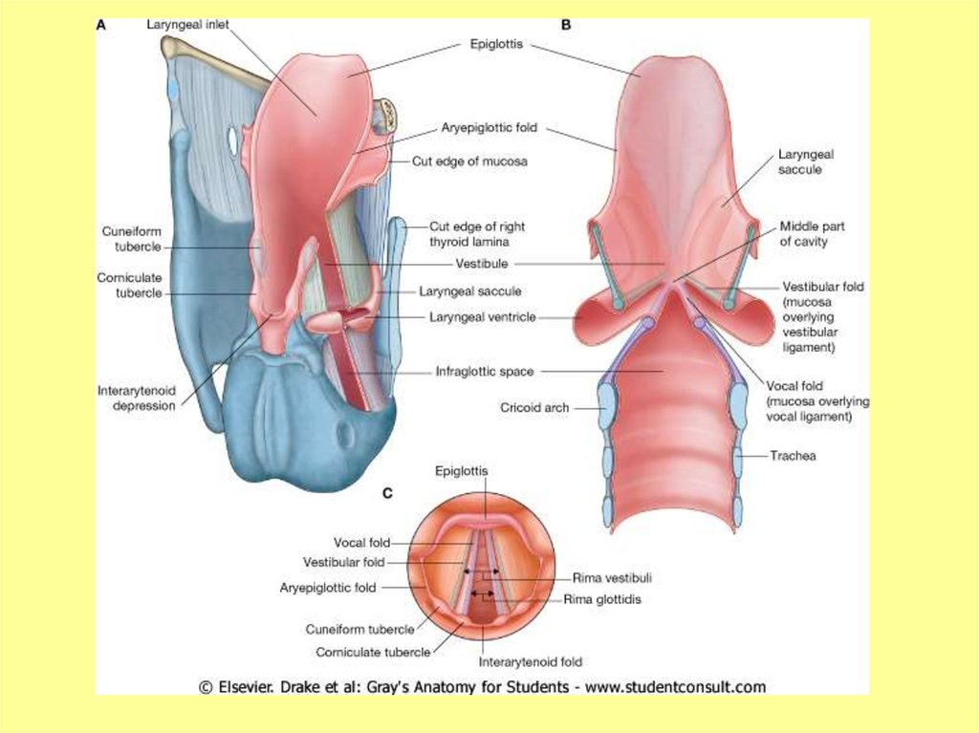
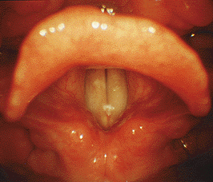
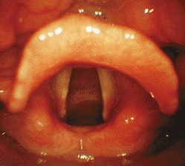
Q Larynx: cartilages
Larynx: joints
Larynx: muscles, functional divisions
Larynx: laryngeal cavity

Slide 6
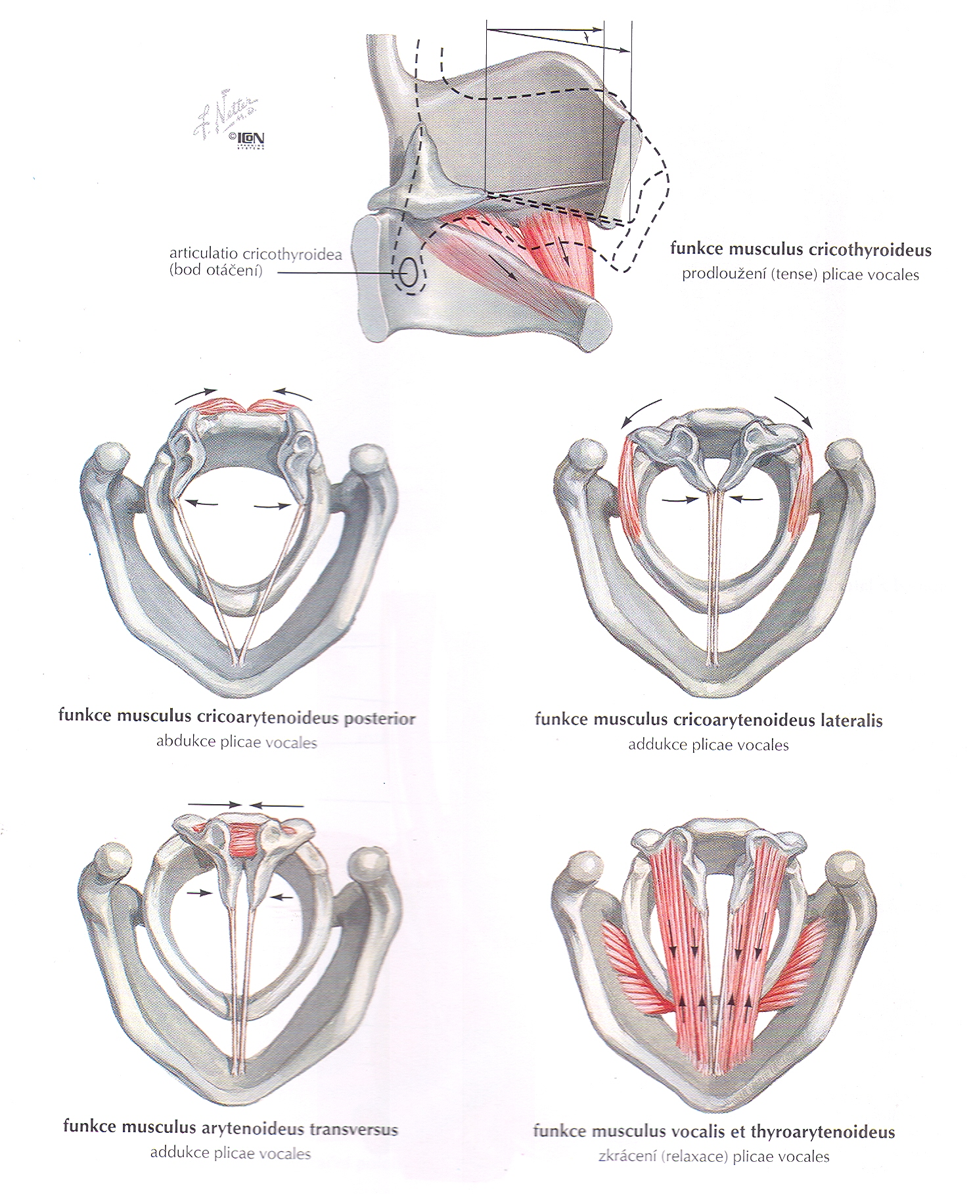
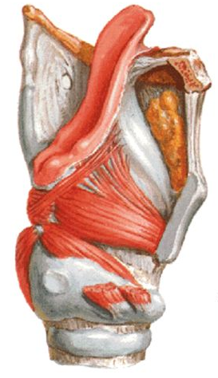
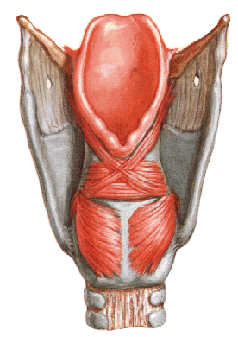
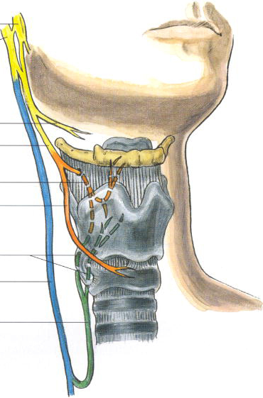
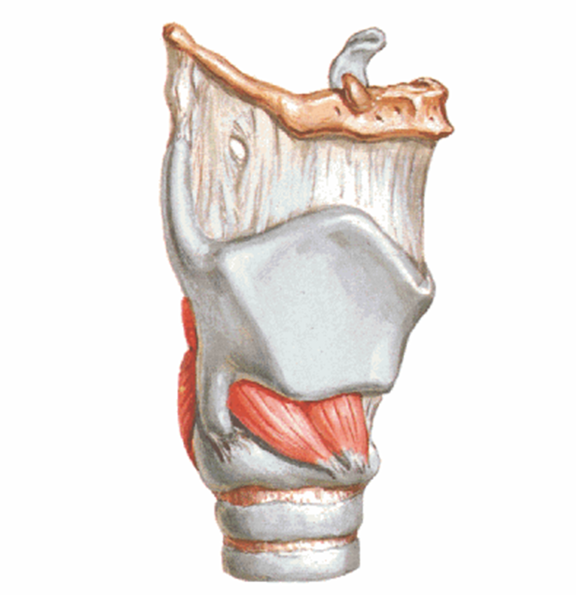

Slide 7
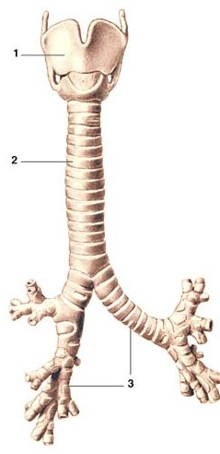
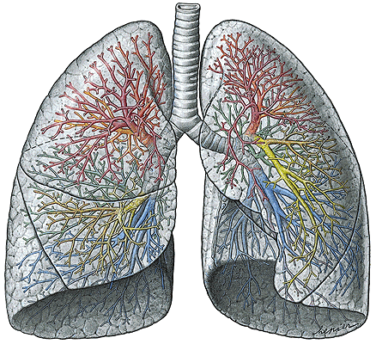
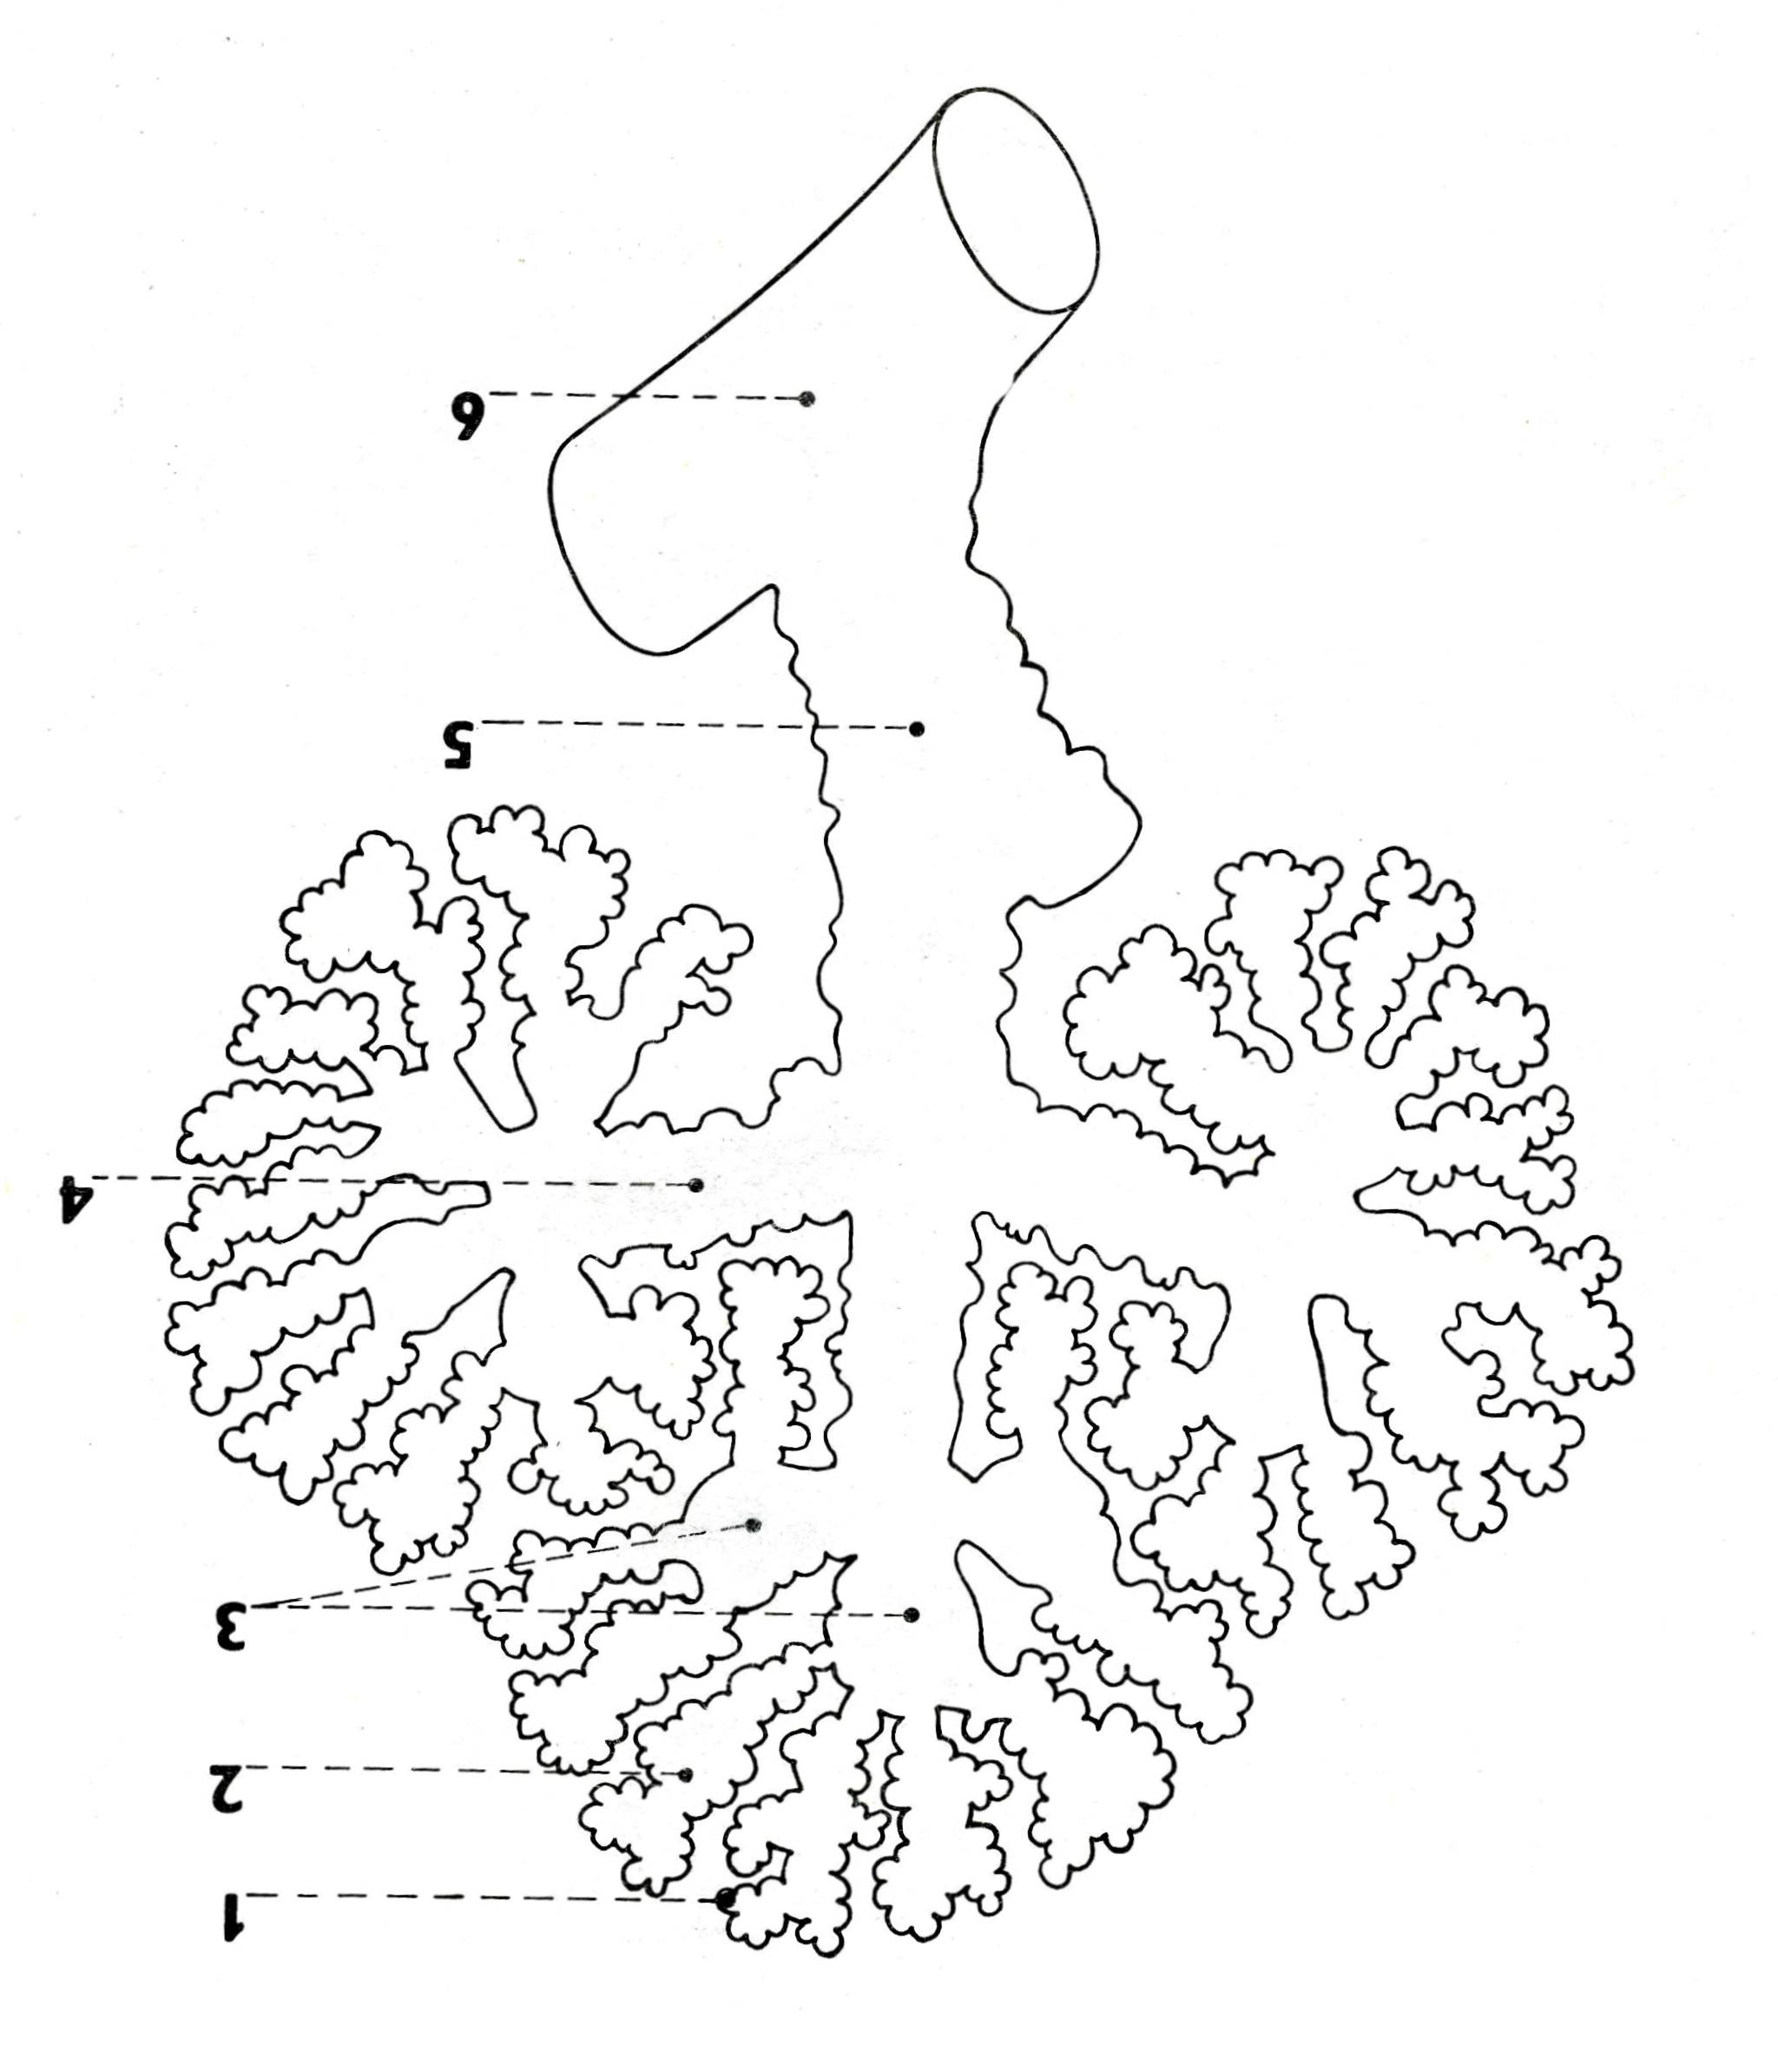
Q Trachea: structure of the wall, syntopy; principal bronchi, arbor bronchialis

Slide 8
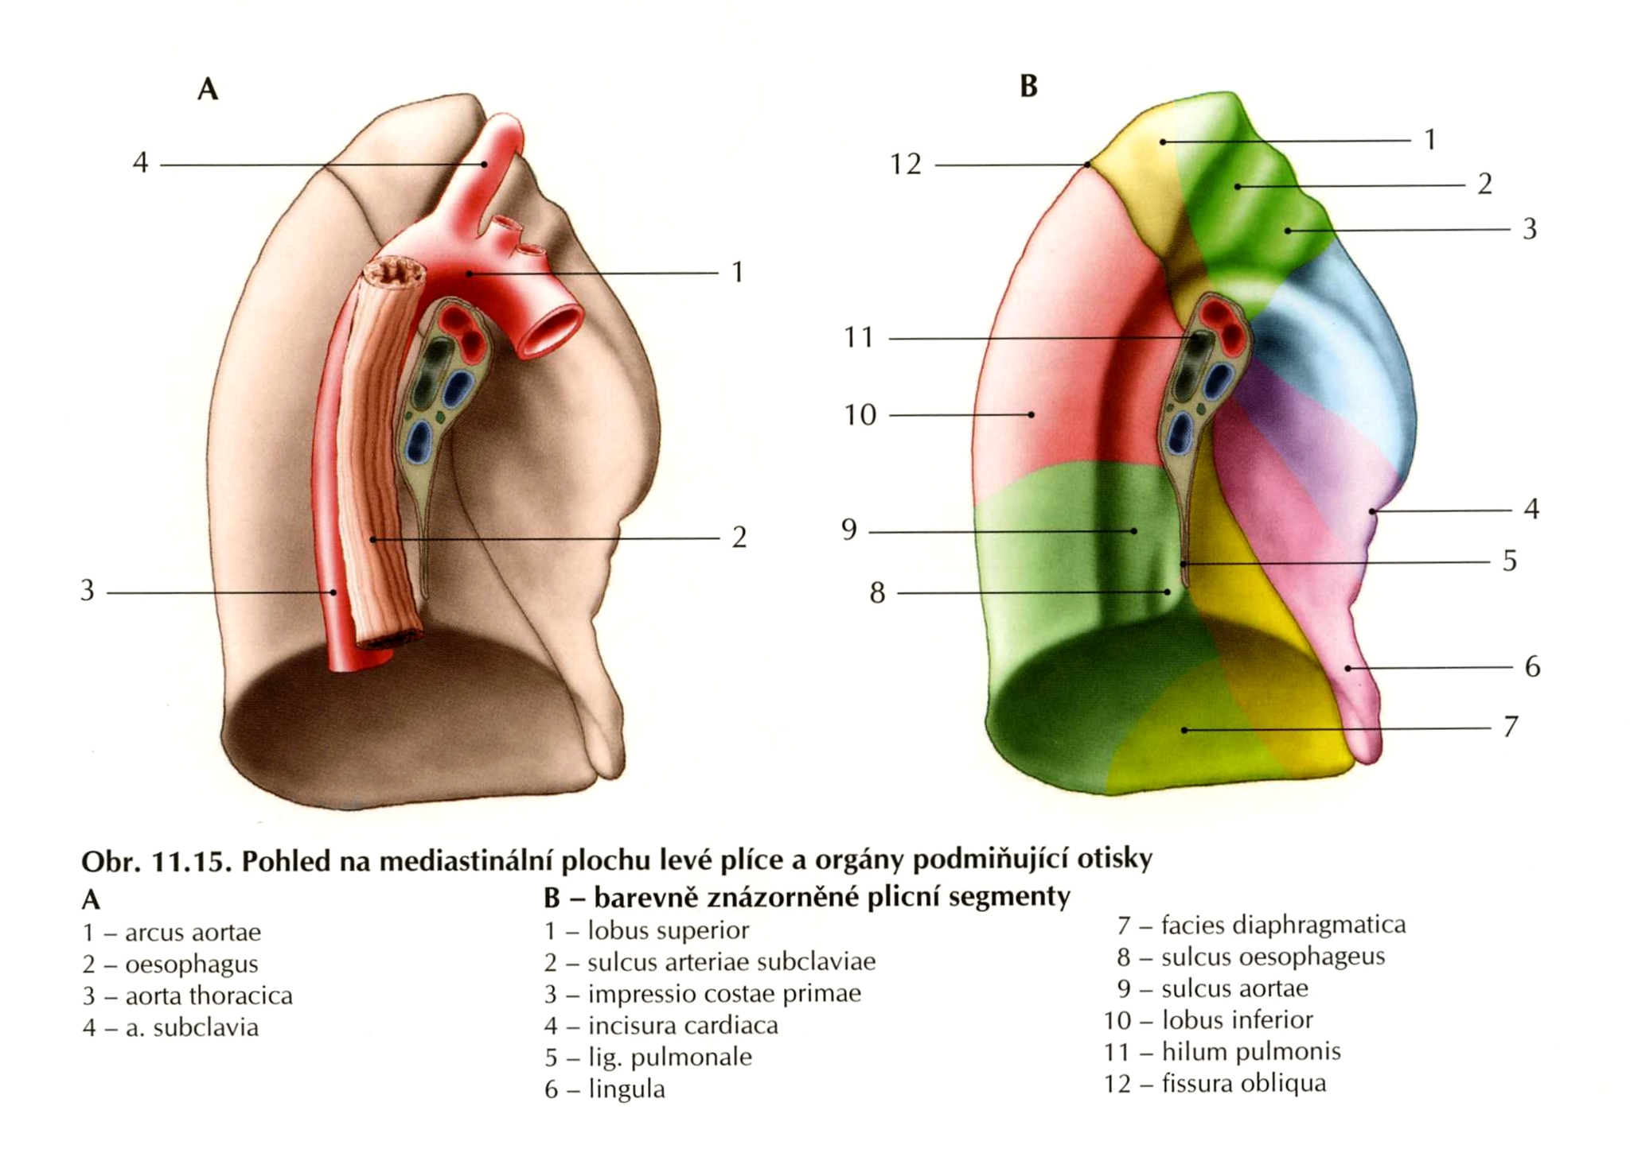
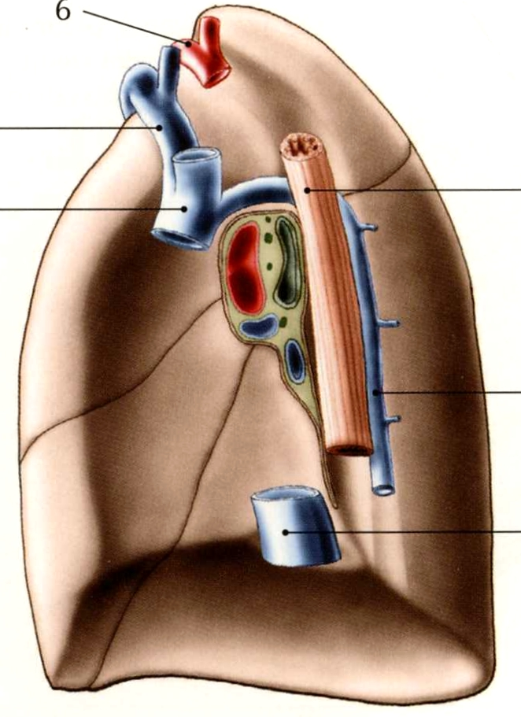
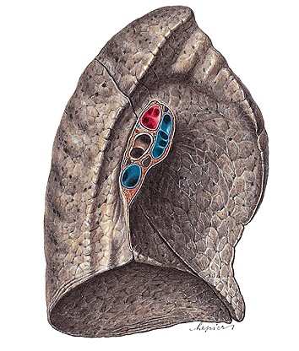
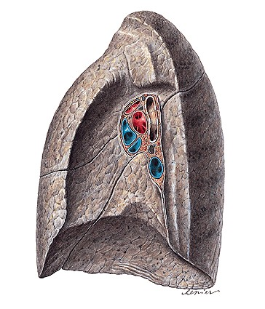
Q Lungs (pulmones): gross anatomy, lobes, syntopy
Root of lung (radix pulmonis)

Slide 9
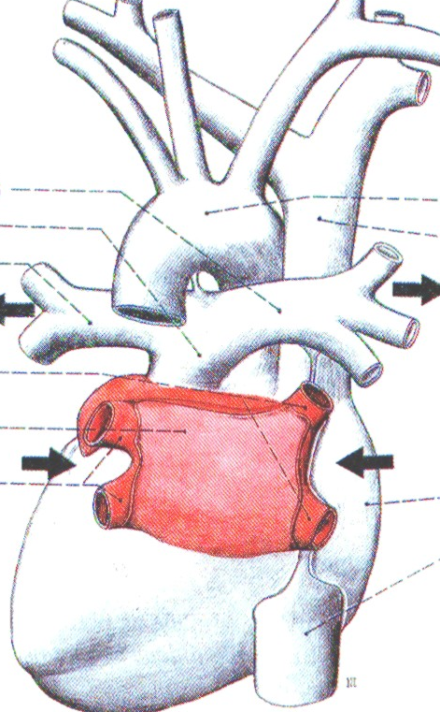
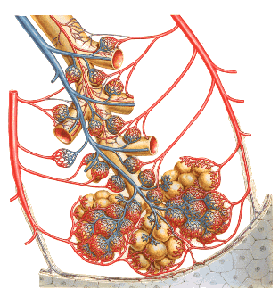
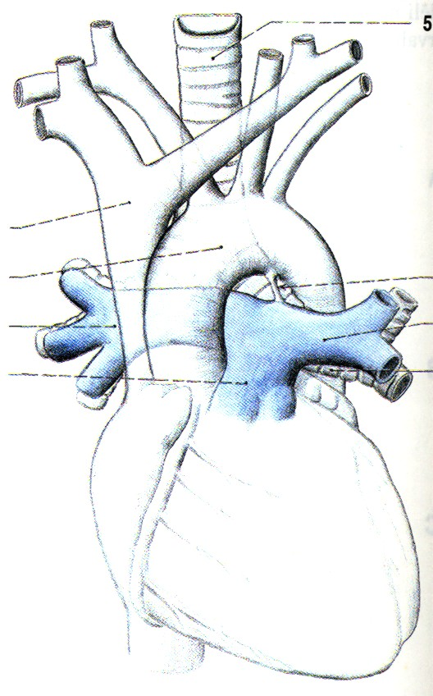

Slide 10
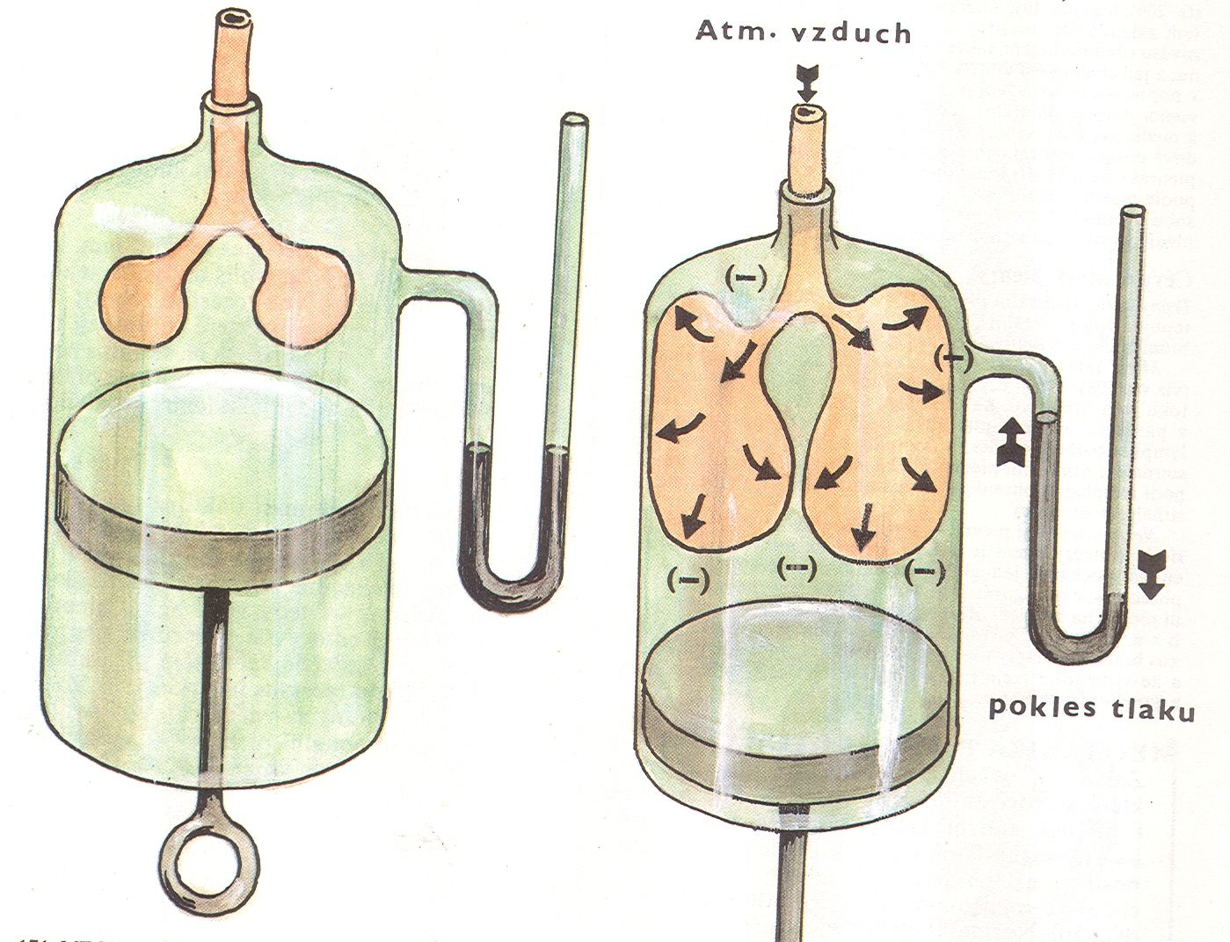
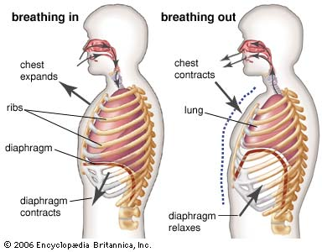
Q Mechanism of inspiration, main and auxillary muscles
Mechanism of expiration, main and auxillary muscles

Slide 11
Q Pleura: description, division, pleural recesses, connections of parietal and visceral pleurae

Slide 12
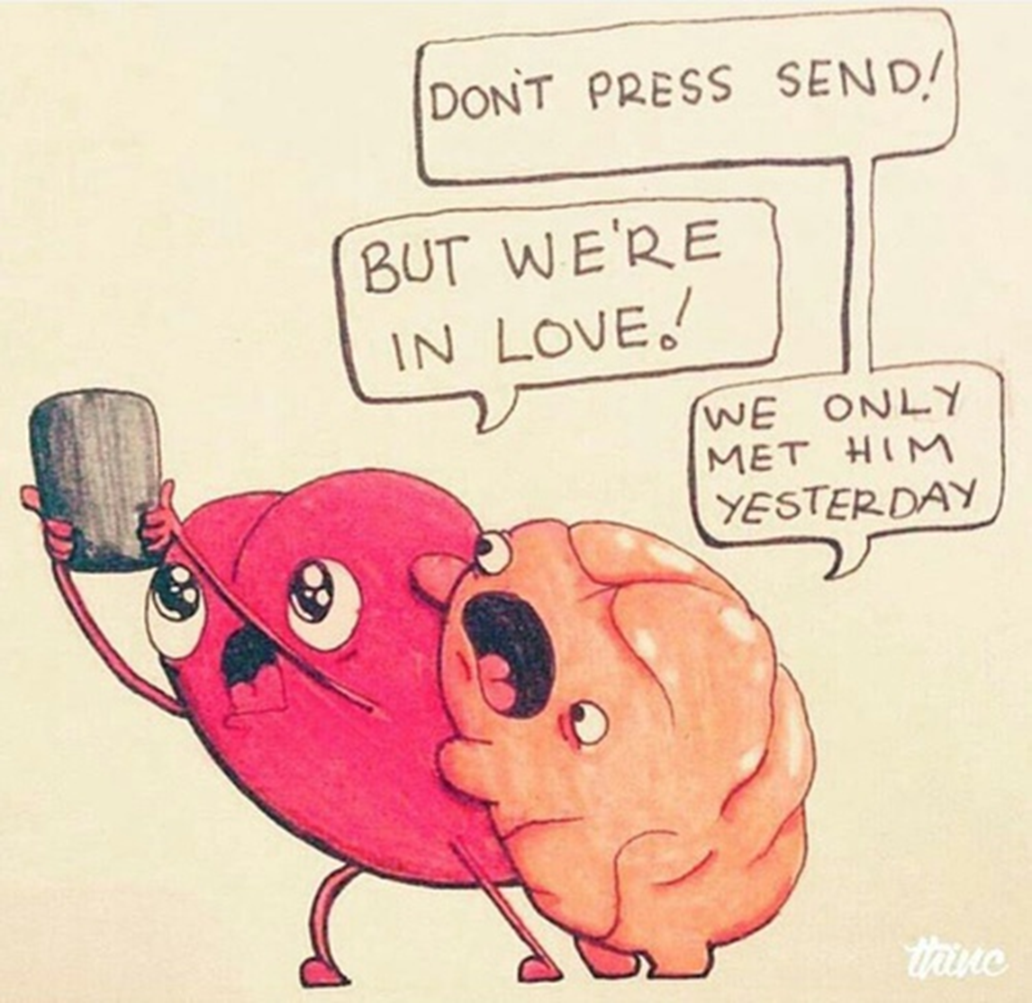

Slide 13
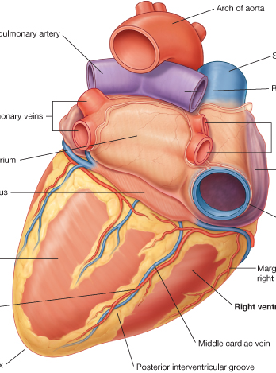
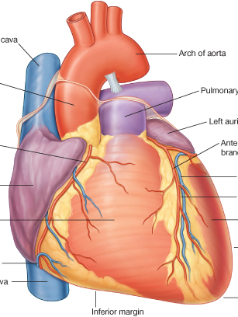
Q Heart (cor): gross anatomy, syntopy

Slide 14
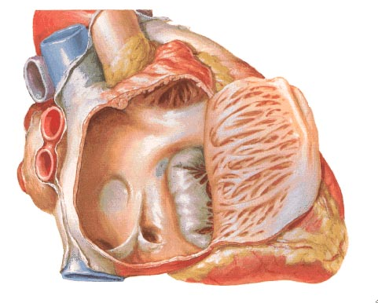
Q Right atrium (atrium dextrum)
Notes:
Atrium dextrum

Slide 15
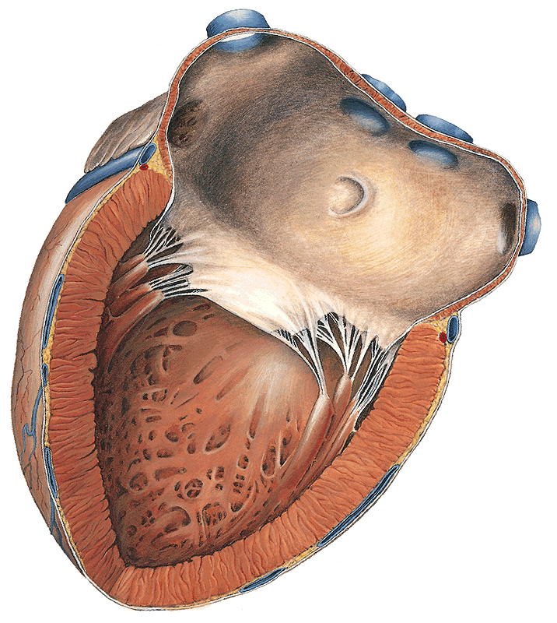
Q Left atrium (atrium sinistrum)
Notes:
Atrium sinistrum

Slide 16
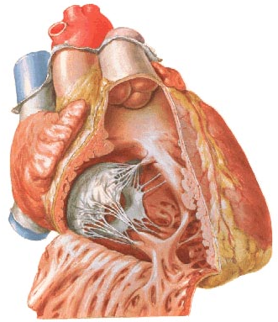
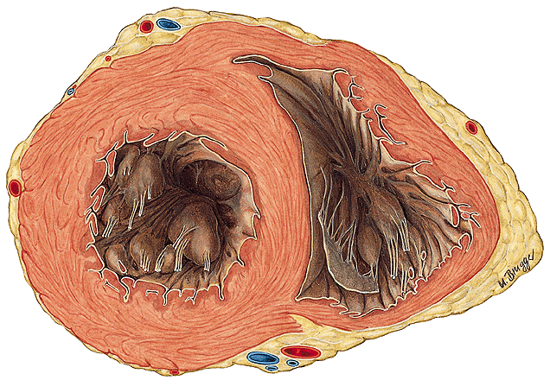
Q Right ventricle (ventriculus dexter)
Notes:
Ventriculus dexter

Slide 17
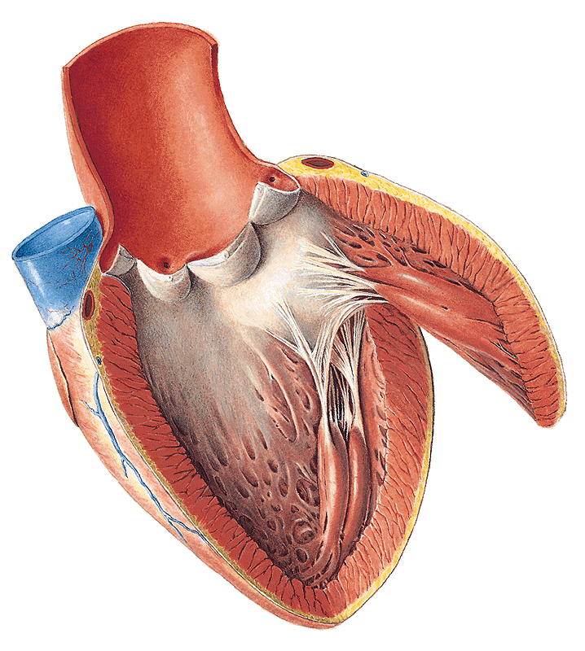
Q Left ventricle (ventriculus sinister)
Notes:
Ventriculus sinister

Slide 18
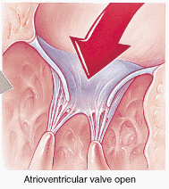
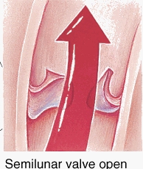
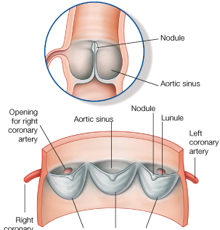
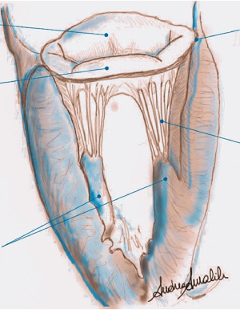
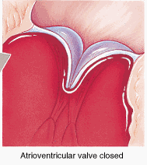
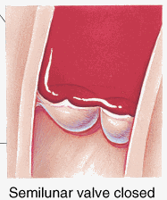
Q Cardiac valves

Slide 19
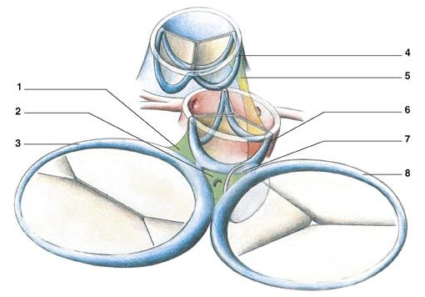
Q Structure of the heart, cardiac skeleton

Slide 20
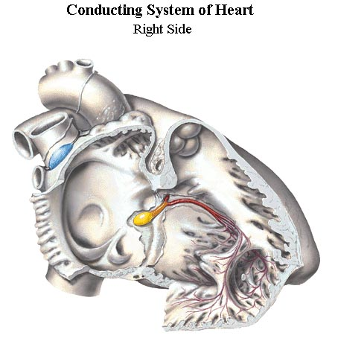
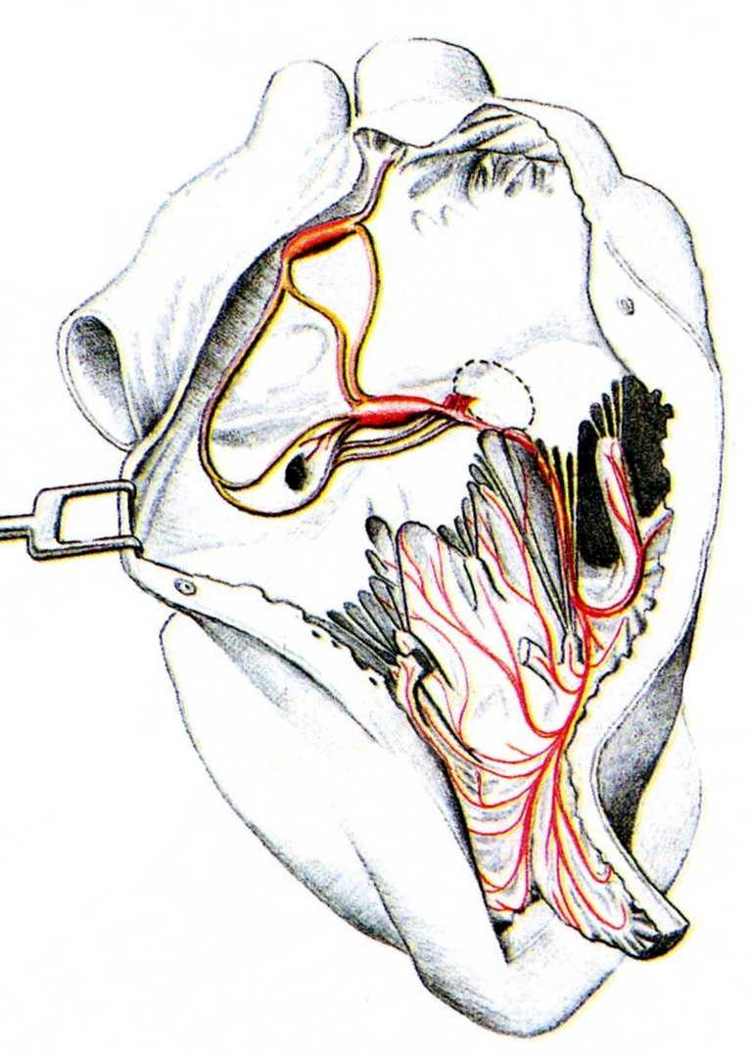
Q Conducting system of the heart (complexus stimulans cordis)

Slide 21
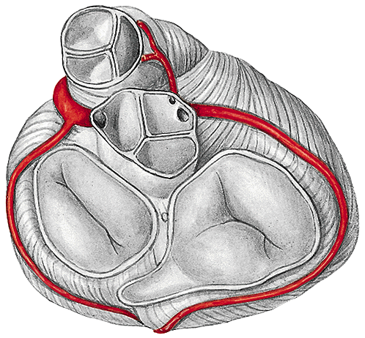



Cross section of the heart
Q Coronary arteries (arteriae coronariae)
Cardiac veins (venae cardiacae)

Slide 22



Q Innervation of the heart

Slide 23


Auscultatory areas

Slide 24


X-ray picture: posteroanterior projection
Notes:
RTG- zadopřední projekce

Slide 25


Slide 26

1

Slide 27


Thyroid gland (glandula thyroidea): syntopy, blood supply
Parathyroid glands (glandulae parathyroideae): syntopy, blood supply

Slide 28
Q
Nasal cavity (cavitas nasi ossea) – lateral wall
Nasal cavity (cavitas nasi ossea) – bony nasal septum (septum nasi osseum), roof and floor
Nasal cavity (cavitas nasi ossea) – nasal meatus (meatus nasi)

