Slide 1
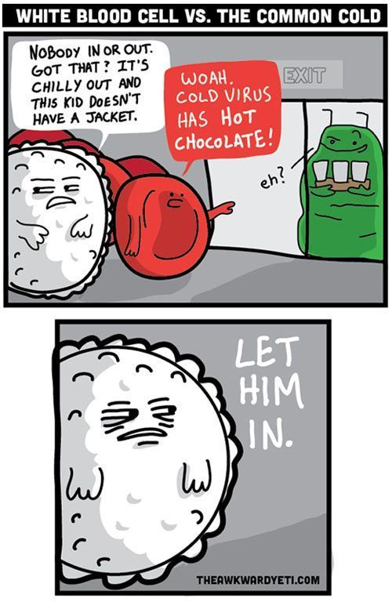
Arteries, veins, lymph
3. seminar

Slide 2
Aorta, parts and course
Aortic arch (arcus aortae): course and primary branches
Thoracic aorta (aorta thoracica): course and primary branches
External carotid artery (arteria carotis externa): ventral branches
External carotid artery (arteria carotis externa): terminal branches
External carotid artery (arteria carotis externa): medial and dorsal branches
Internal carotid artery (arteria carotis interna)
Subclavian artery (arteria subclavia): course and primary branches
Vertebral artery (arteria vertebralis)
Internal thoracic artery (arteria thoracica interna)
Axillary artery (arteria axillaris): course and primary branches
Brachial artery (arteria brachialis): course and primary branches
Main arteries of the forearm and hand (arteriae antebrachii et manus): courses and targets
Abdominal aorta (aorta abdominalis): course and primary branches
Coeliac trunk (truncus coeliacus): main branches, their courses and targets
Superior mesenteric artery (arteria mesenterica superior): main branches and their targets
Inferior mesenteric artery (arteria mesenterica inferior): main branches and their targets
Common and internal iliac arteries (arteria iliaca communis, arteria iliaca interna): courses, main branches and targets
External iliac and femoral arteries (arteria iliaca externa, arteria femoralis): courses, main branches and targets
Popliteal artery, anterior and posterior tibial arteries (arteria poplitea, arteria tibialis anterior et posterior): courses and targets
Main arteries of the foot (arteriae pedis): courses and targets

Slide 3
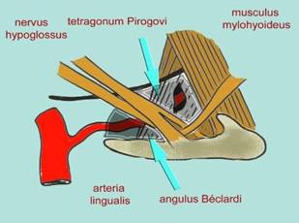
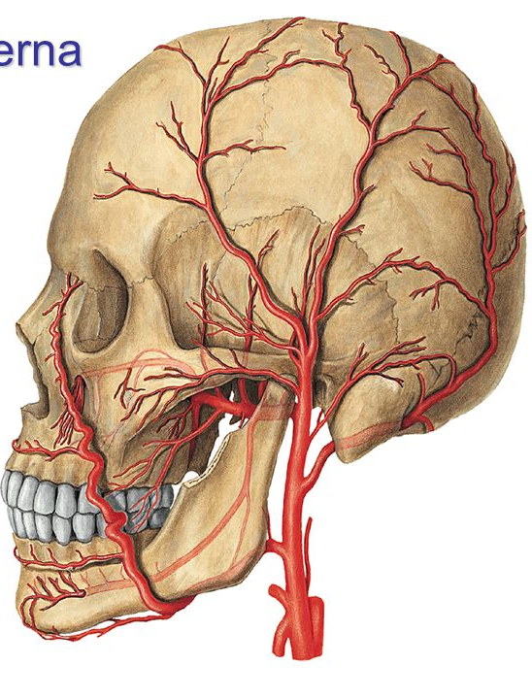

Slide 4
Fossa pterygopalatina

Slide 5
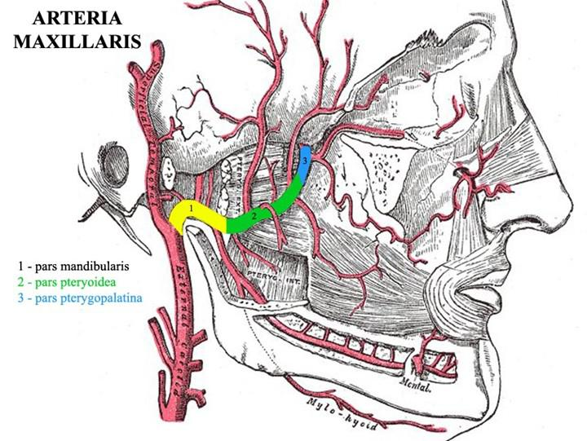

Slide 6
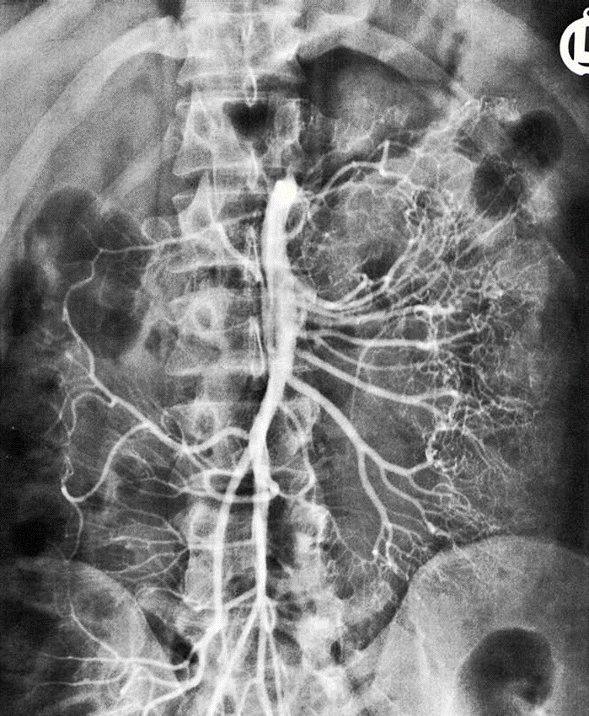
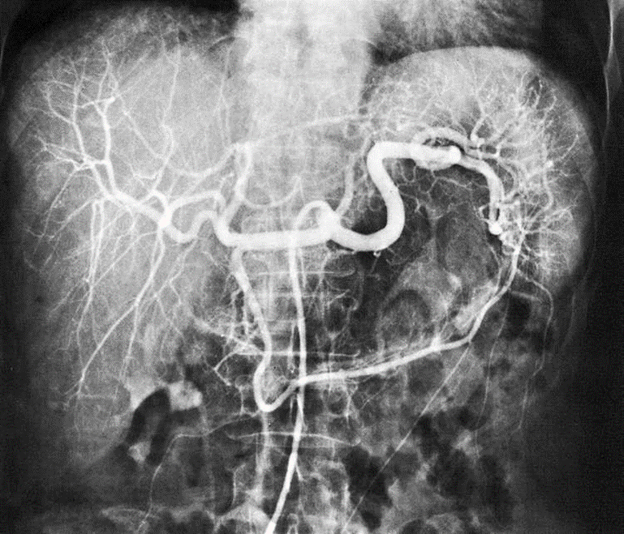

Slide 7
Superior vena cava (vena cava superior): course and tributaries
Internal jugular vein (vena jugularis interna): course and main tributaries
Veins of the brain (venae cerebri)
Dural venous sinuses (sinus durae matris)
Subclavian vein (vena subclavia): course and main tributaries
Deep veins of the upper extremity (venae profundae membri superioris): courses and main tributaries
Superficial veins of the upper extremity (venae superficiales membri superioris): courses and main tributaries
Inferior vena cava (vena cava inferior): course and main tributaries
Deep veins of the lower extremity (venae profundae membri superioris): courses and main tributaries
Superficial veins of the lower extremity (venae superficiales membri superioris): courses and main tributaries
Fetal circulation
Spleen (lien): structure, blood supply, syntopy
Hepatic portal vein (vena portae hepatis), portal circulation and its function
Cavocaval anastomoses
Portocaval anastomoses

Slide 8
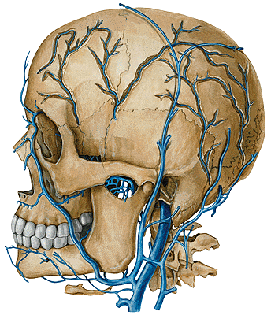
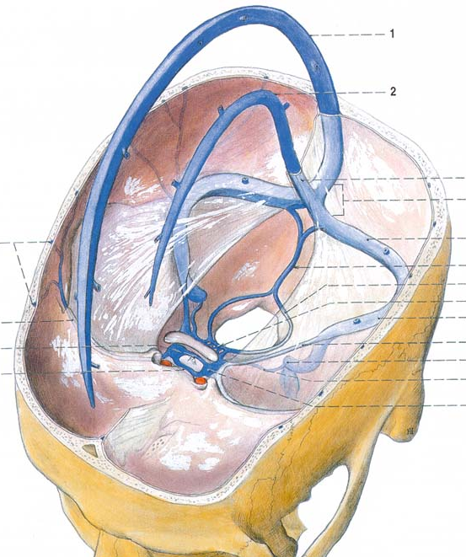
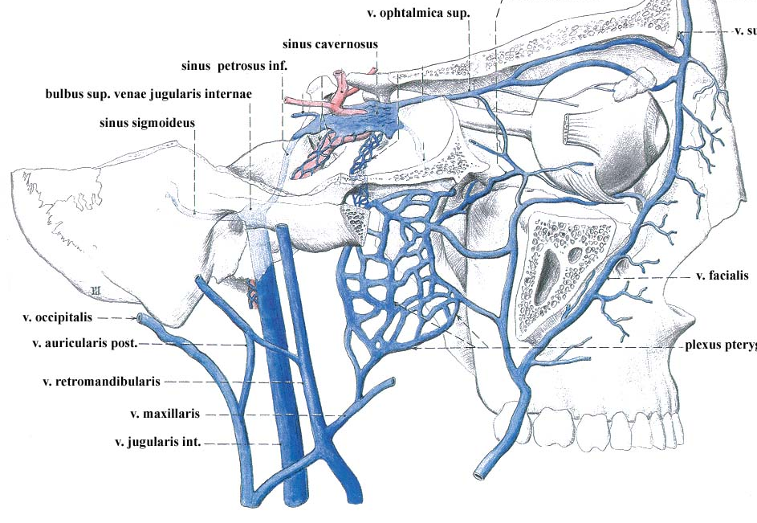

Slide 9
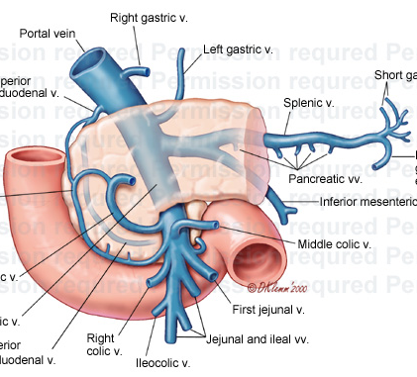
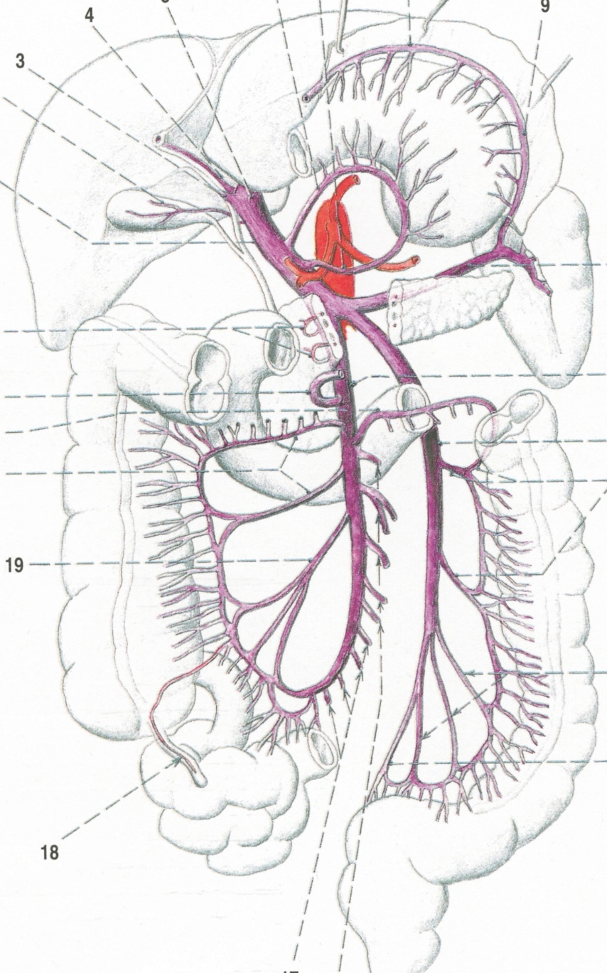
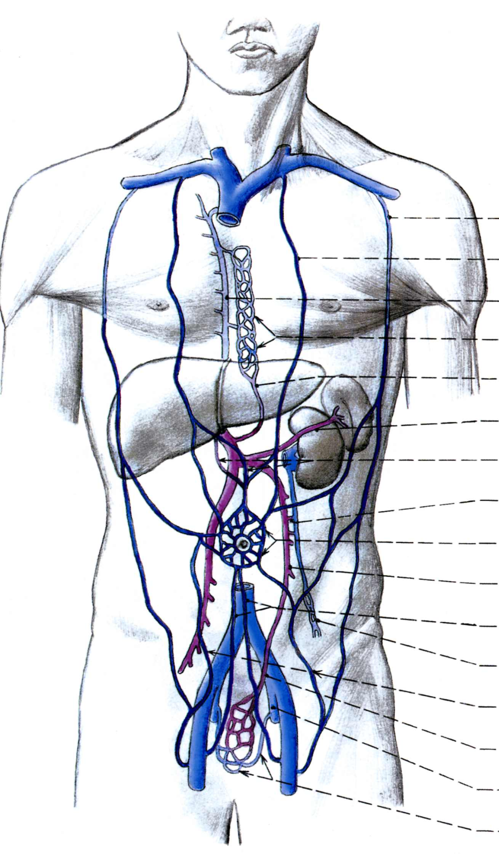

Slide 10
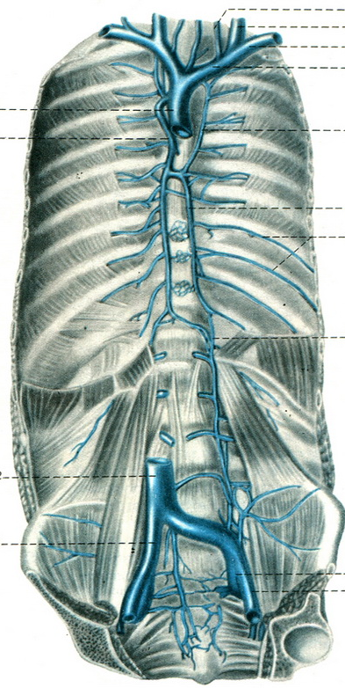
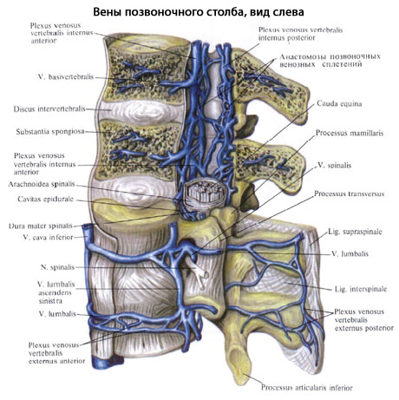

Slide 12
Structure of the lymphatic system (lymph, lymph capillaries, lymph vessels, lymph nodes, lymphatic trunks and ducts)
Thymus, its structure and syntopy
Lymph nodes and vessels of the head
Lymph nodes and vessels of the neck
Lymph nodes and vessels of the upper extremity
Lymph nodes and vessels of the thorax
Lymph nodes and vessels of the lower extremity
Lymph nodes and vessels of the abdomen
Lymph nodes and vessels of the pelvis
Tonsils, Waldeyer lymphatic circuit

Slide 13
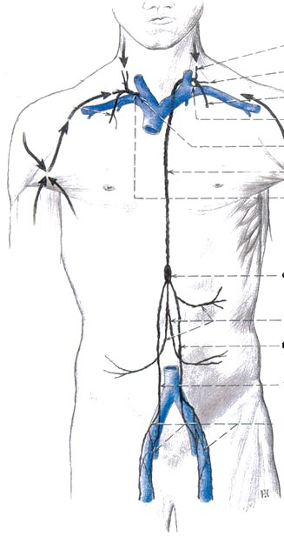
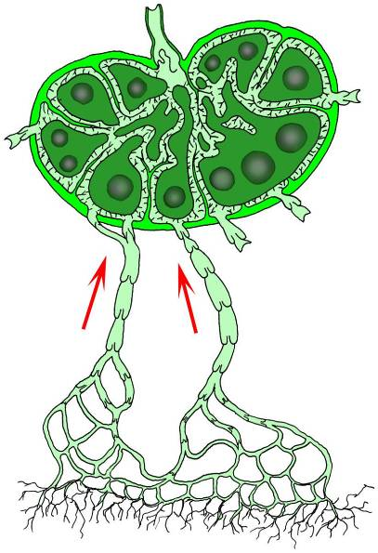

Slide 14
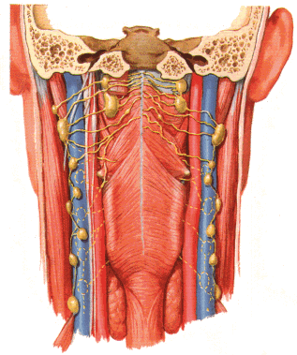
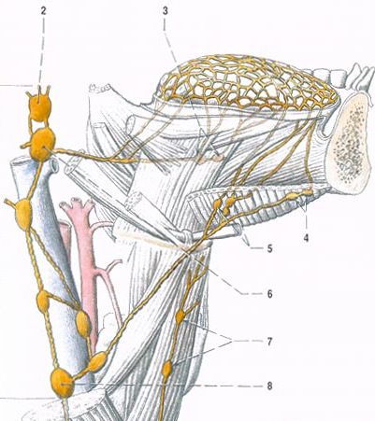
Mízní uzliny hlavy

Slide 15
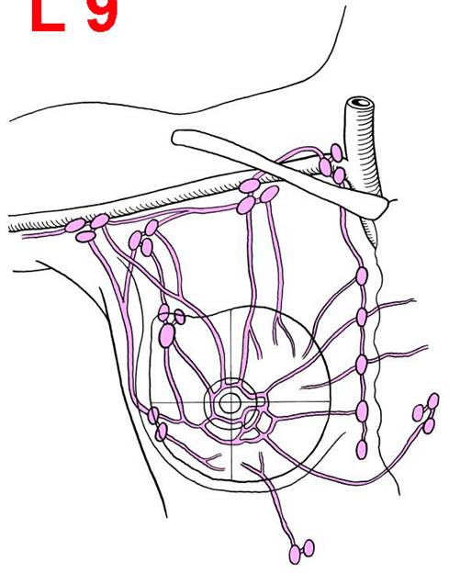
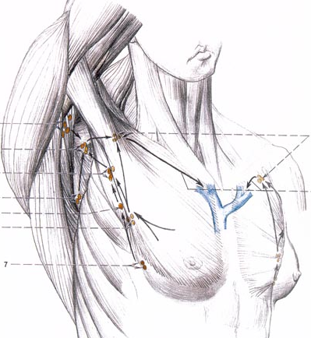

Slide 16
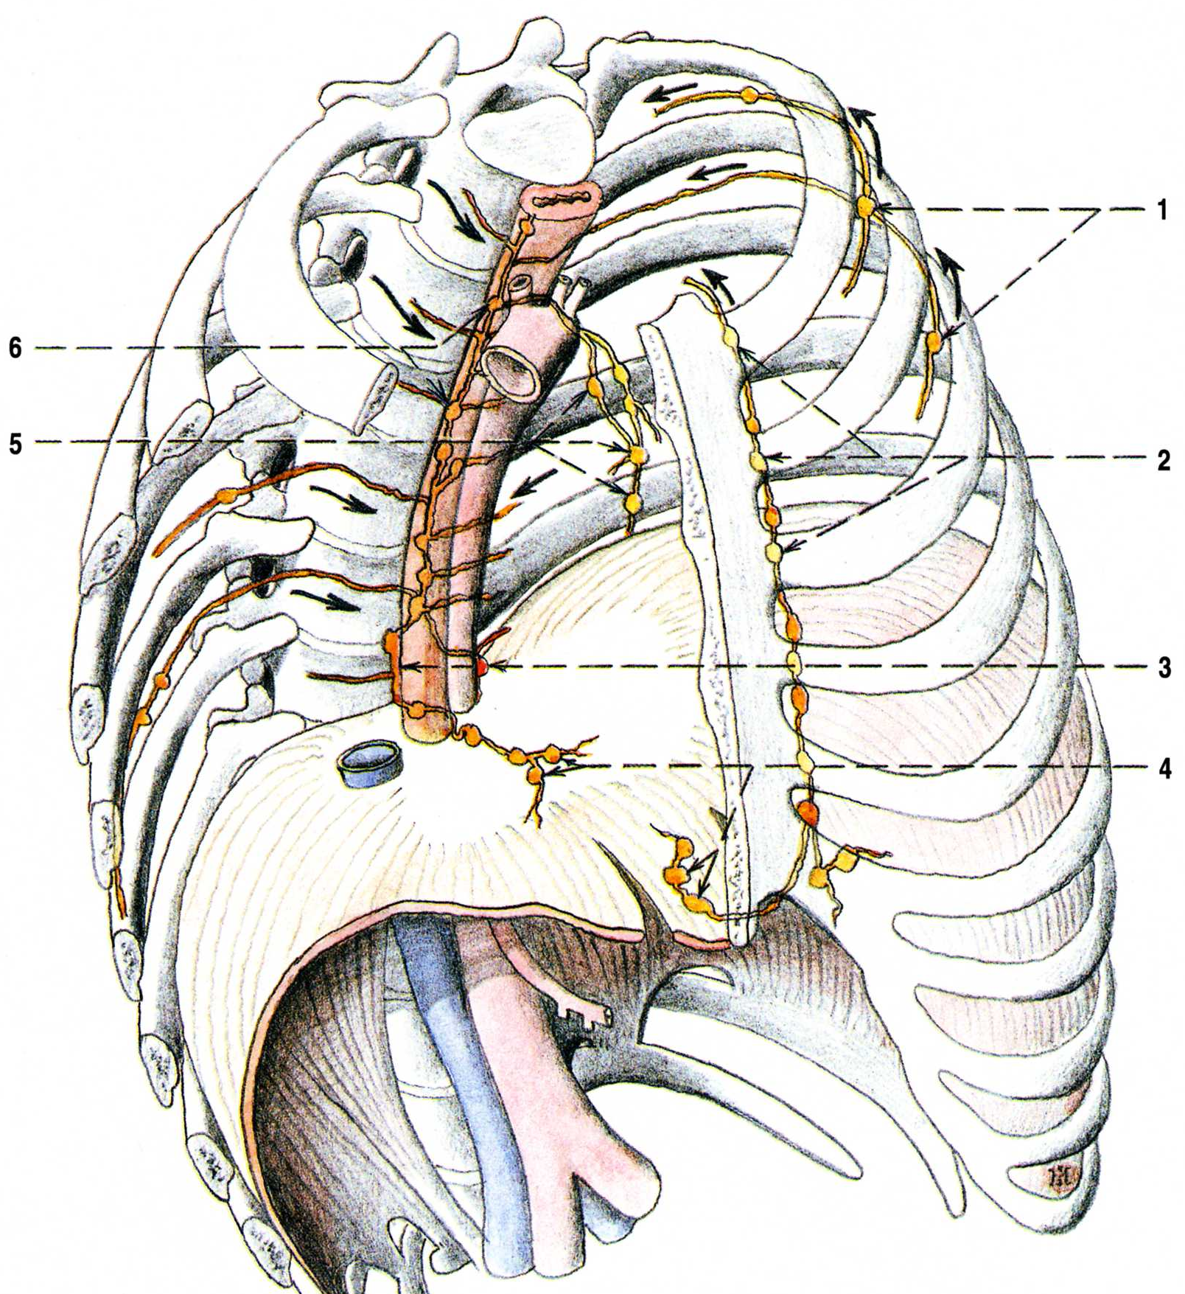
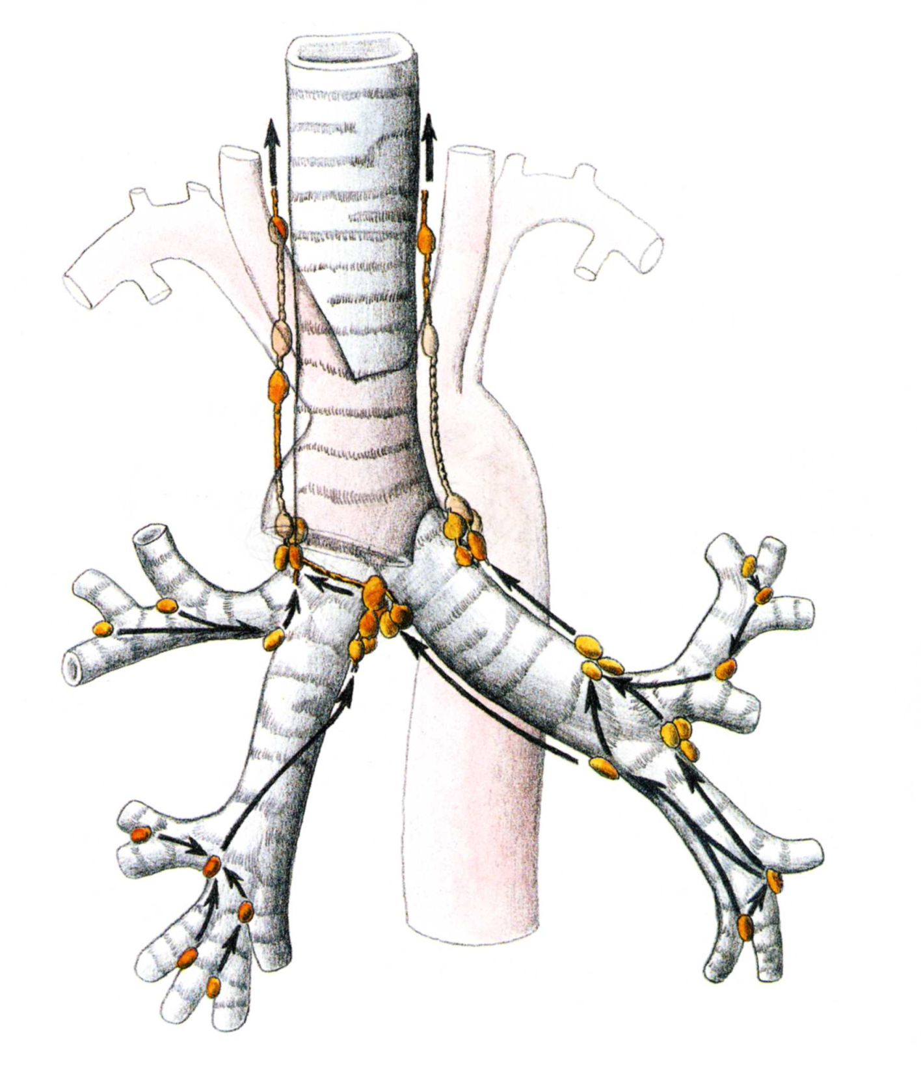
(mezižeberní prostory, páteřní kanál)

Slide 17
