Slide 1
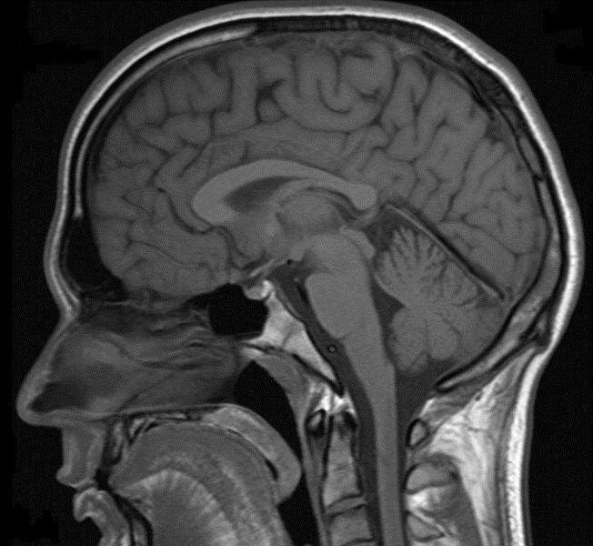
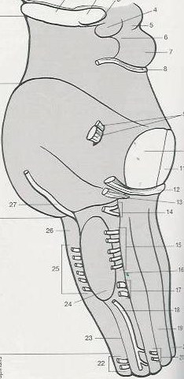
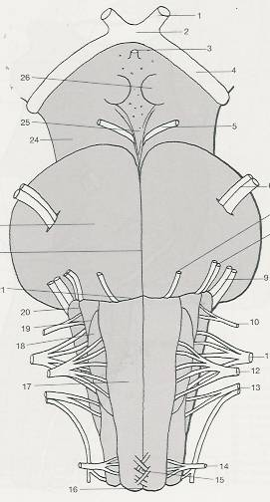
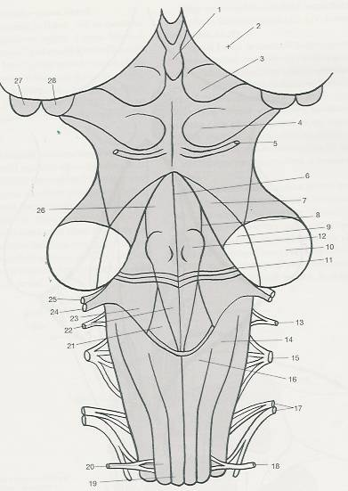
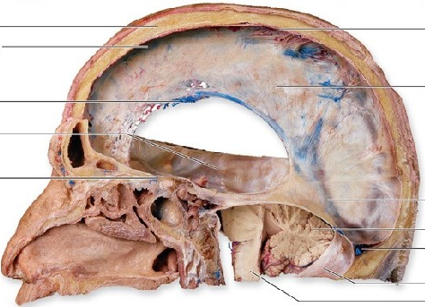
BRAINSTEM– LONGITUDINAL PARTS

Slide 2
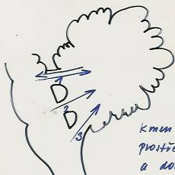
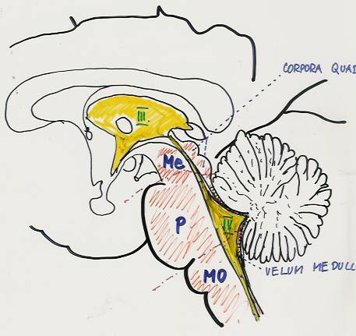
SAGITAL SECTION OF THE BRAINSTEM

Slide 3
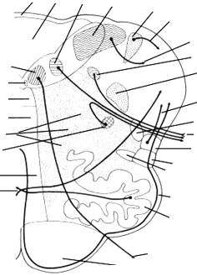
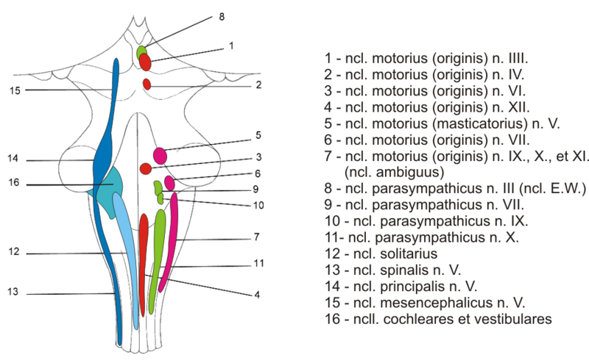
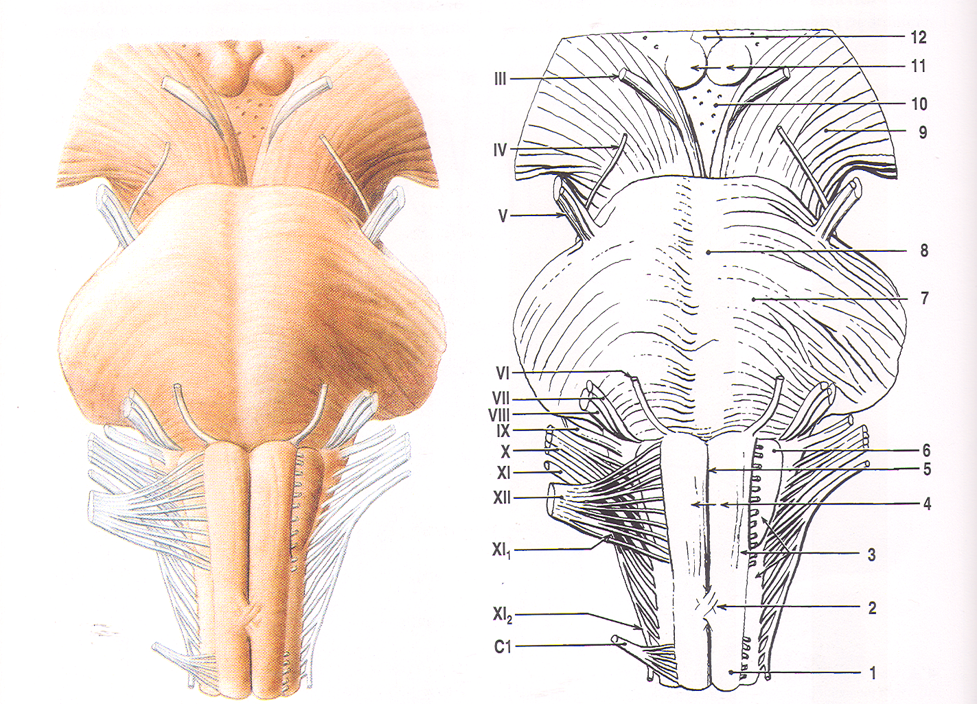
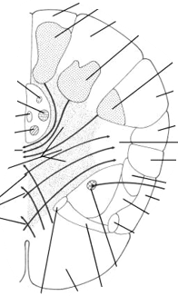
Medulla oblongata
Ventral side of the medulla oblongata

Slide 4
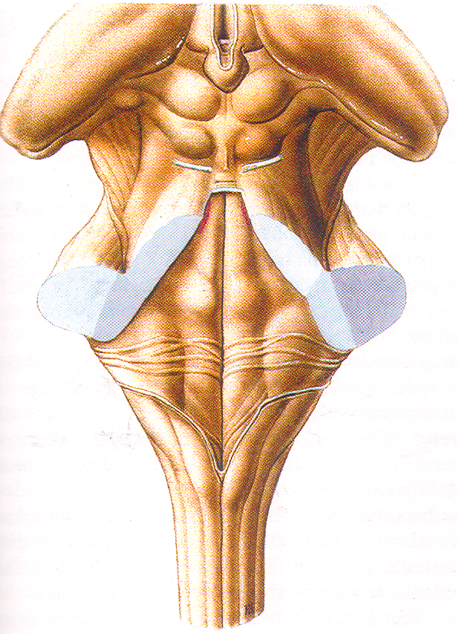
Dorsal side of the medulla oblongata

Slide 5
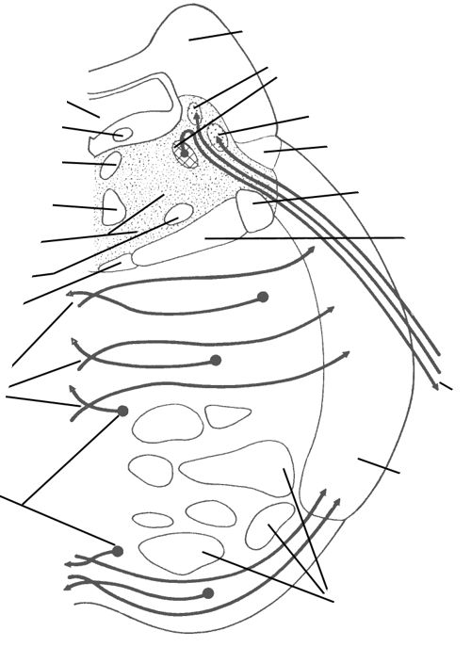
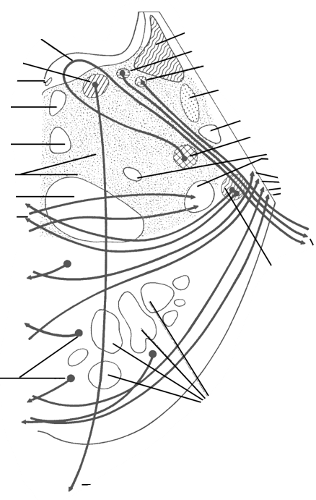
Pons Varoli
Ventral side of the pons Varoli

Slide 6
Dorsal side of the pons Varoli

Slide 7
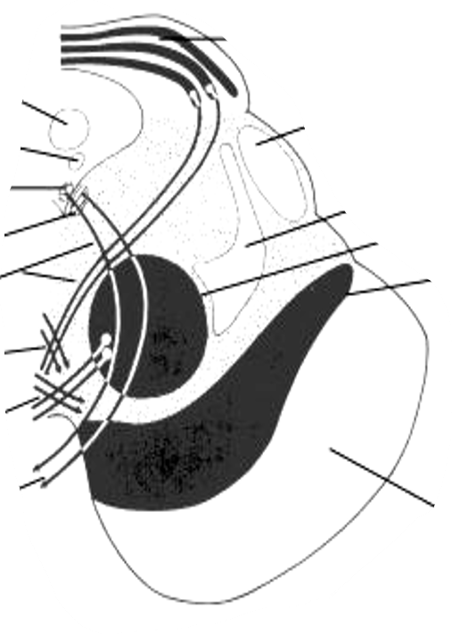
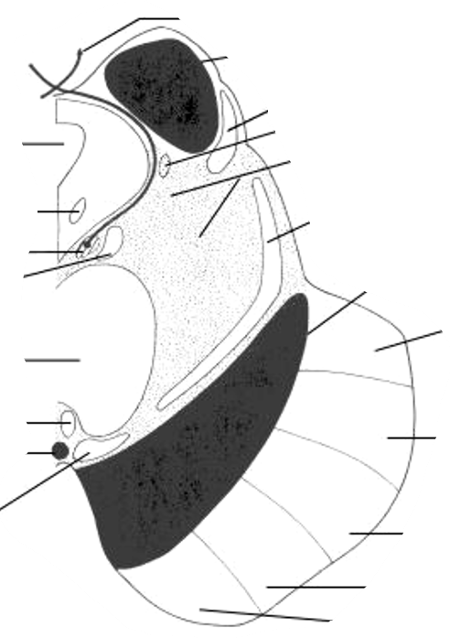
Mesencephalon
Dorsal side of the mesencephala

Slide 8
Ventral side of the mesencephala

Slide 9
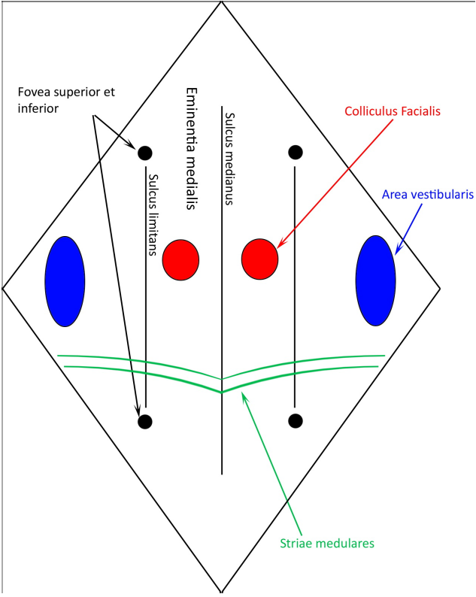
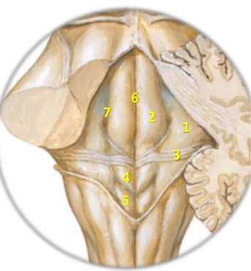
  Fossa rhomboidea

Slide 10
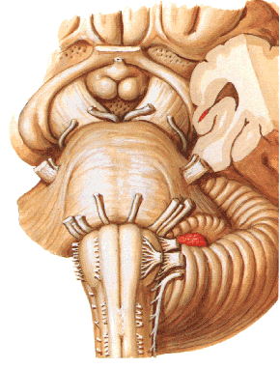
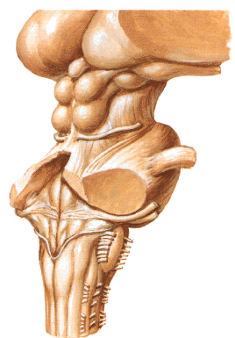
OUTPUTS OF THE CRANIAL NERVES FROM THE BRAINSTEM

Slide 11
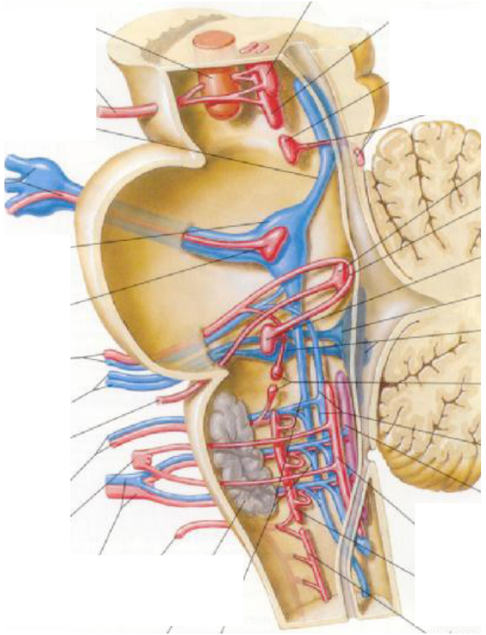
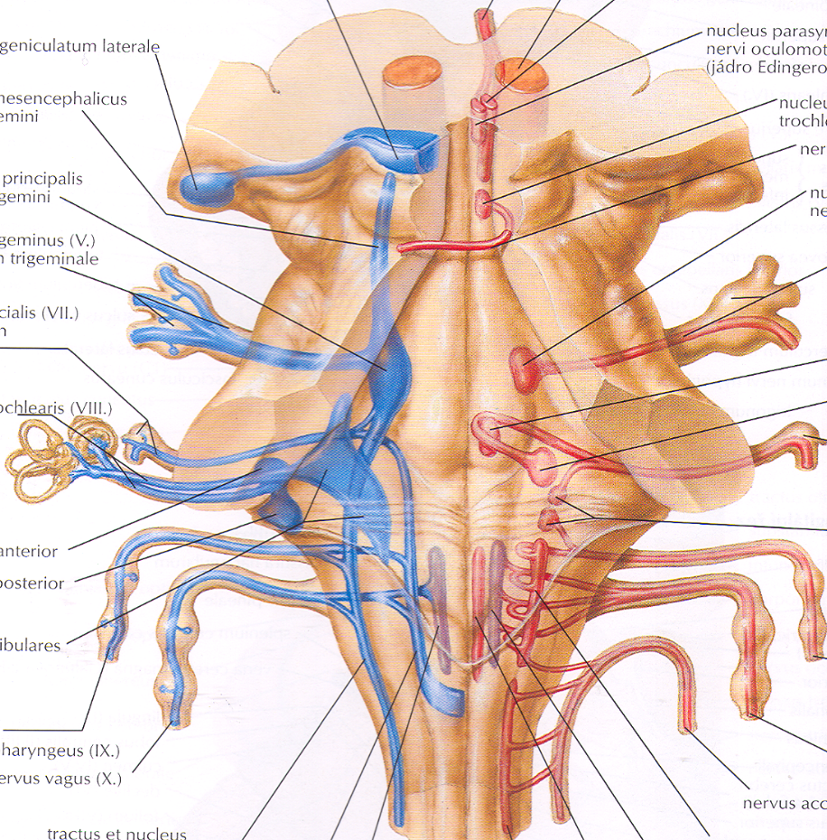
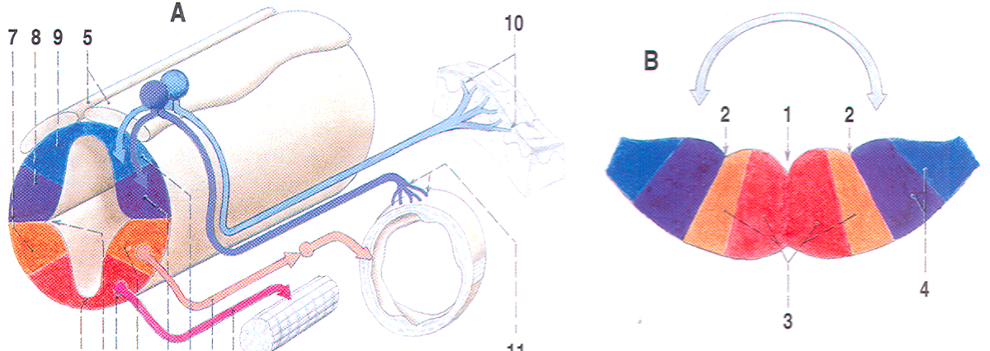
NUCLEI OF THE CRANIAL NERVES
brainstem- fossa rhomboidea

Slide 12
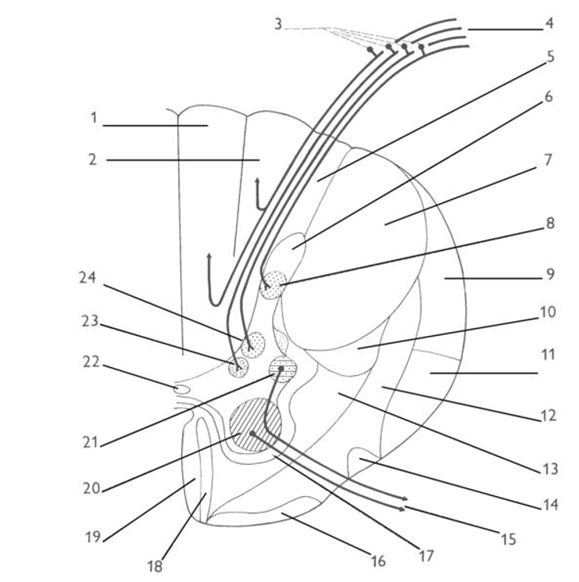

Slide 13
MEDULLA OBLONGATA

Slide 14
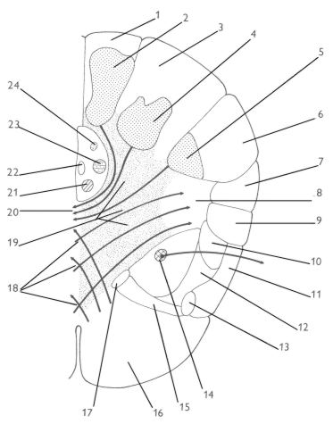

Slide 15
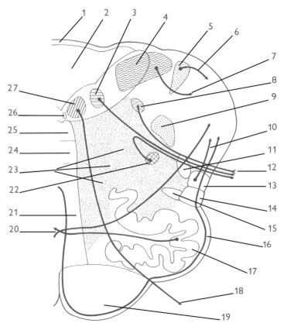

Slide 16
PONS VAROLI

Slide 17
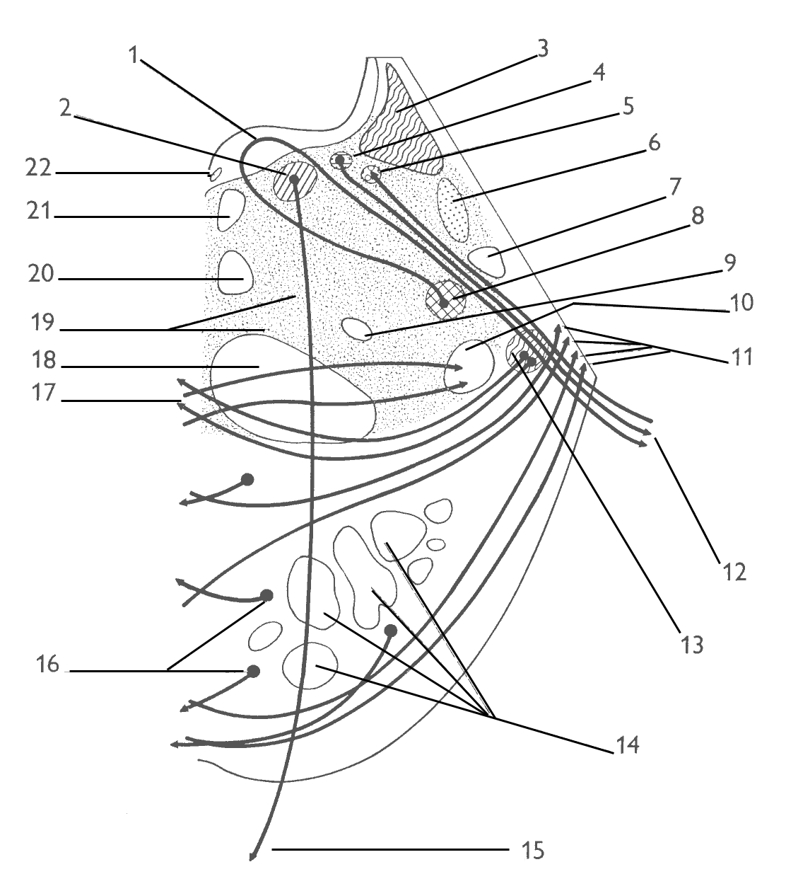

Slide 18
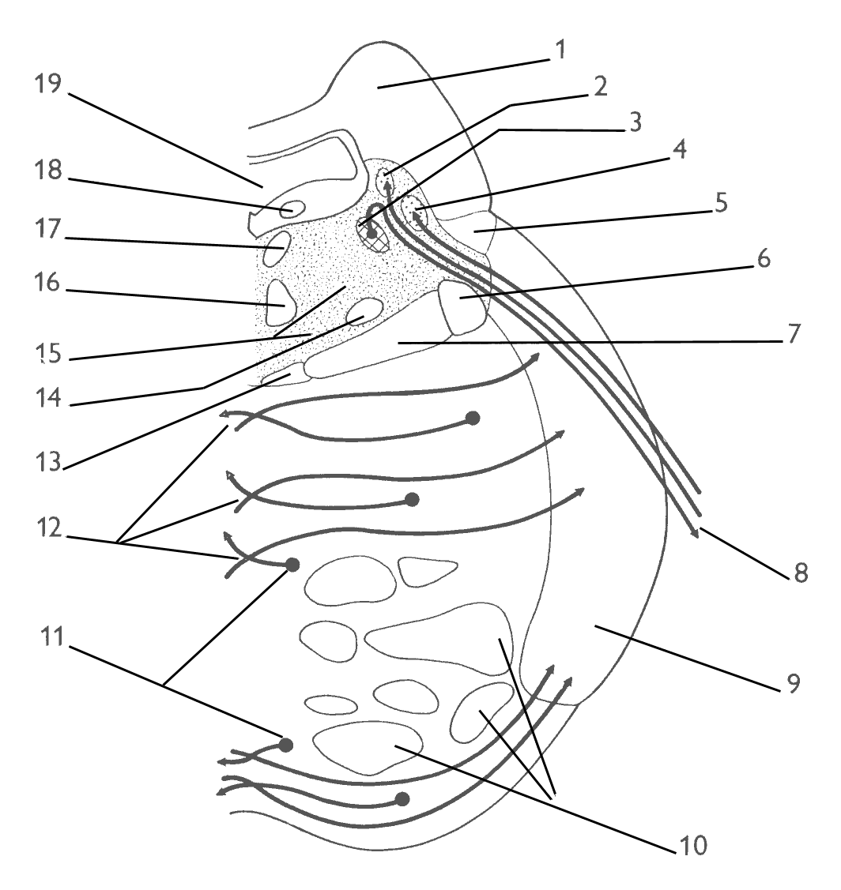

Slide 19
MESENCEPHALON

Slide 20
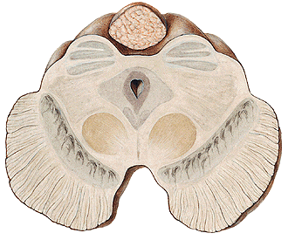
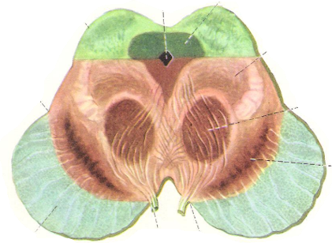
TECTUM
PAG
P
E
D
U
N
C
U
L
U
S
TEGMETUM
CRUS

Slide 21
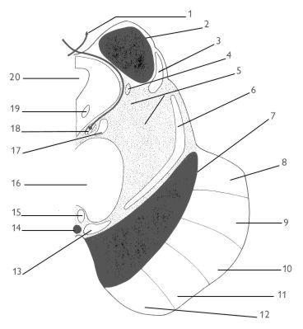
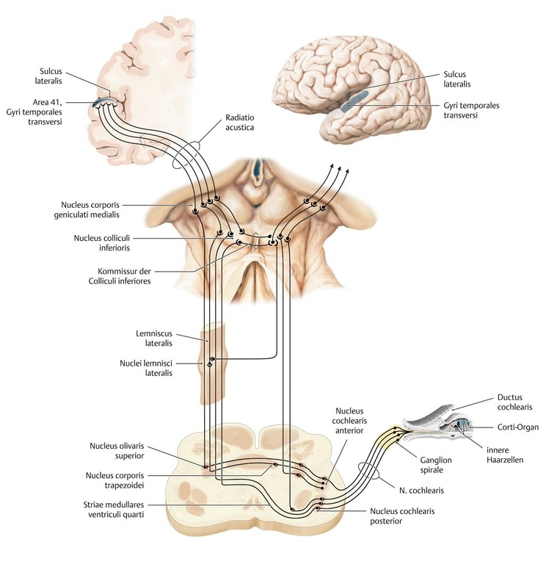

Slide 22
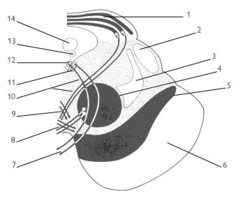
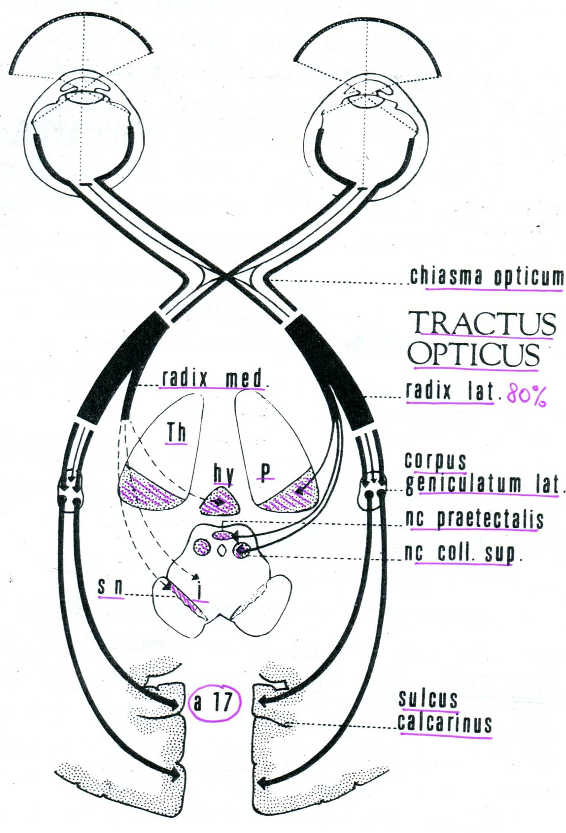

Slide 23
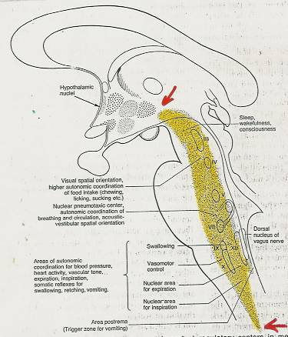
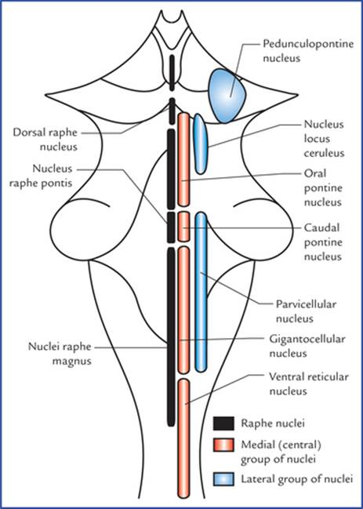
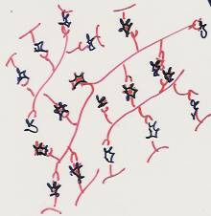
RETICULAR FORMATION (RF) OF THE BRAINSTEM

Slide 24
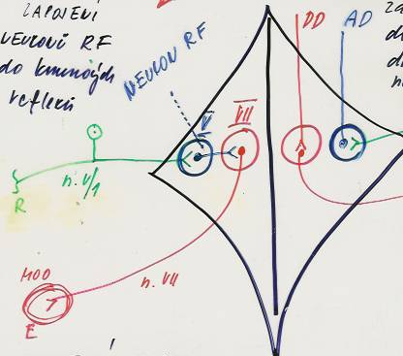
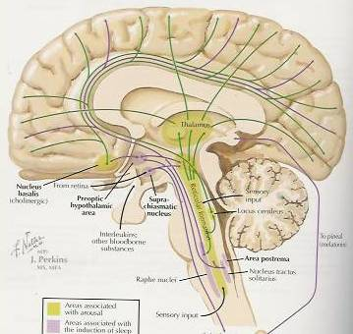
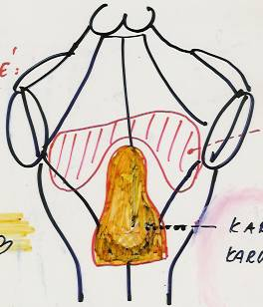
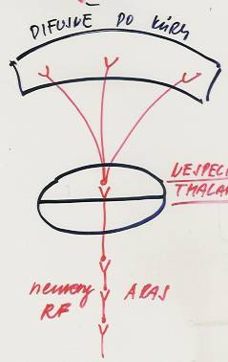
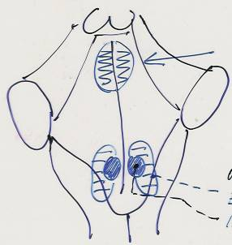
connections of the cranial nerve´s nuclei:
involvement of RF in reflexive arcs - mediation of defensive and vital reflexes
FUNCTIONS OF RF
ARAS - ascending activating system
Connections with nonspecific thalamus and cortex telencephali - regulation of wakefulness and sleep
Vegetative centers:
to control vital functions: breath, heart beat, blood preasure
Vasomotoric center
Cardiostimulation and
cardioinhibition centers
Low pain – poorly localizable
Respiratory center
  Descending system of FR
  Motor system of descending long RF fibers, connected to the control of the movement. The central regulator of muscle tonus - the connections between the higher sections of the CNS affecting muscle tonus and motoneurons of the anterior horns of the spinal cord. Increases the tension of antigravity muscles (functionally extensors) while reduces the tension of flexors. It allows upright position.
Nonspecific
thalamus
ARAS

Slide 25
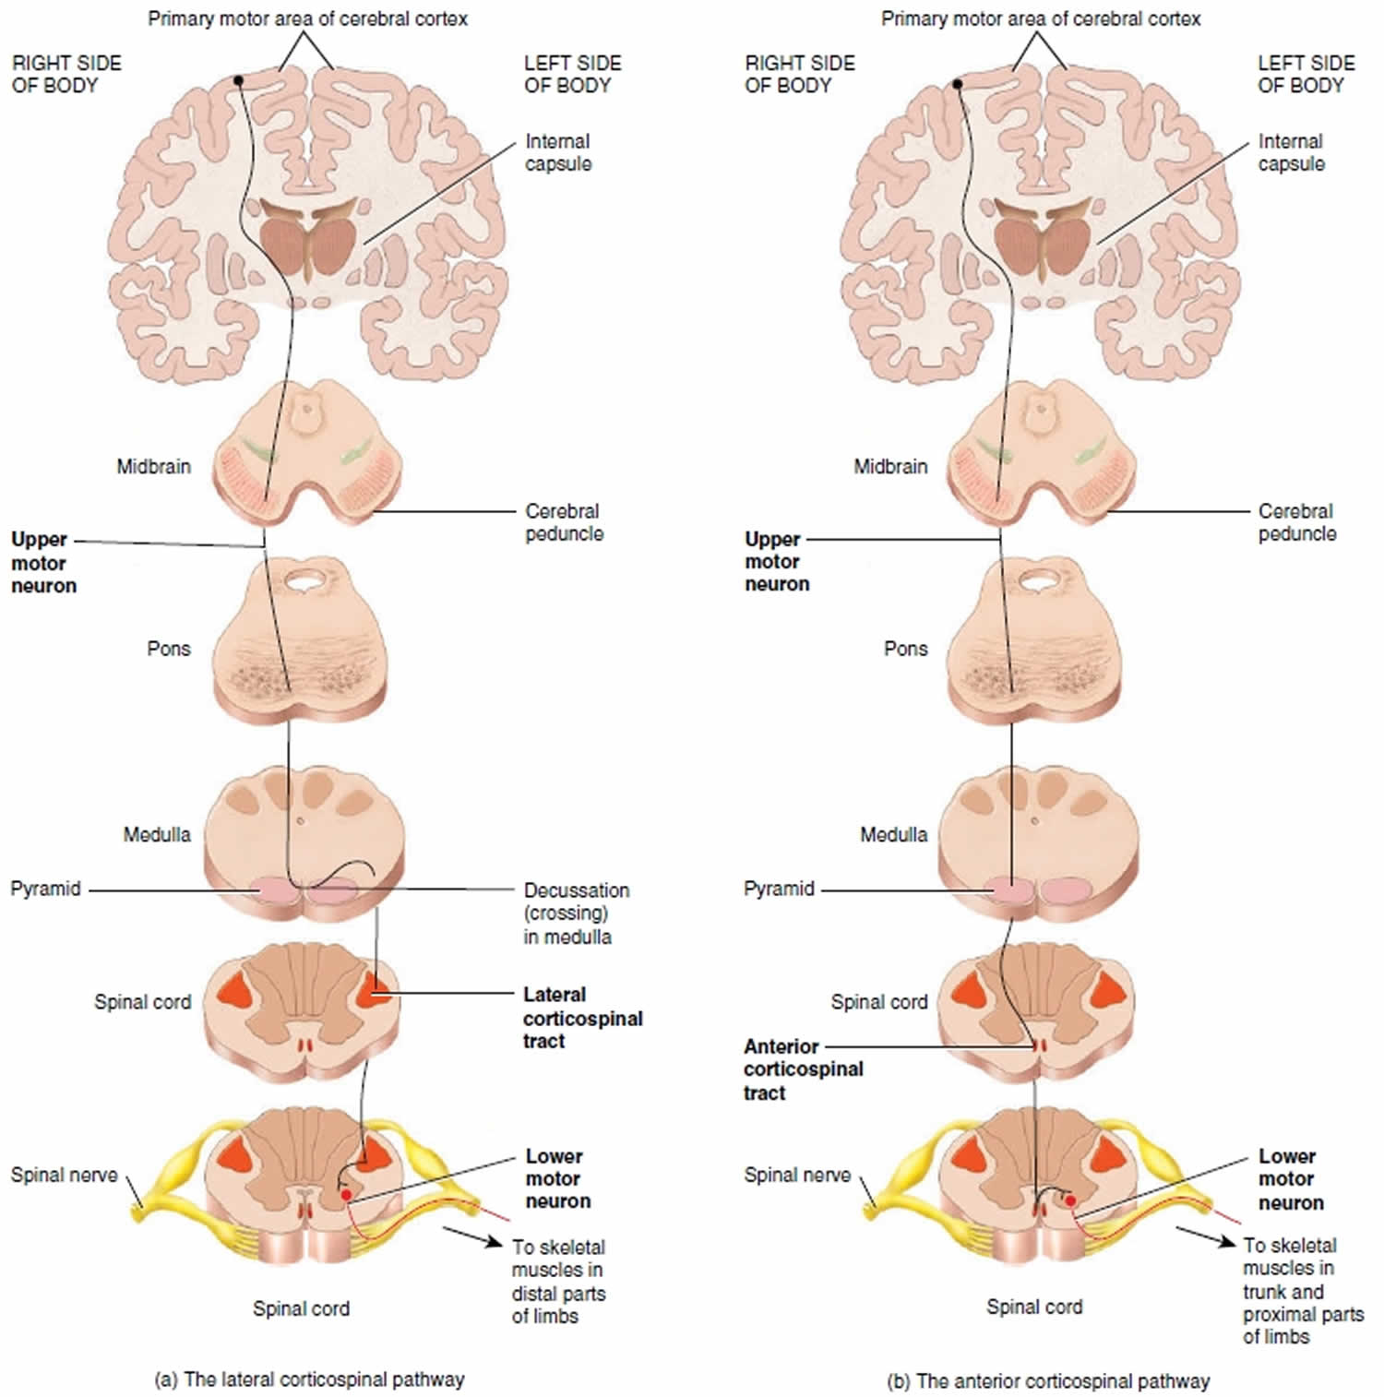
MOTOR (DESCENDING)
PYRAMIDAL (DIRECT)

Slide 26
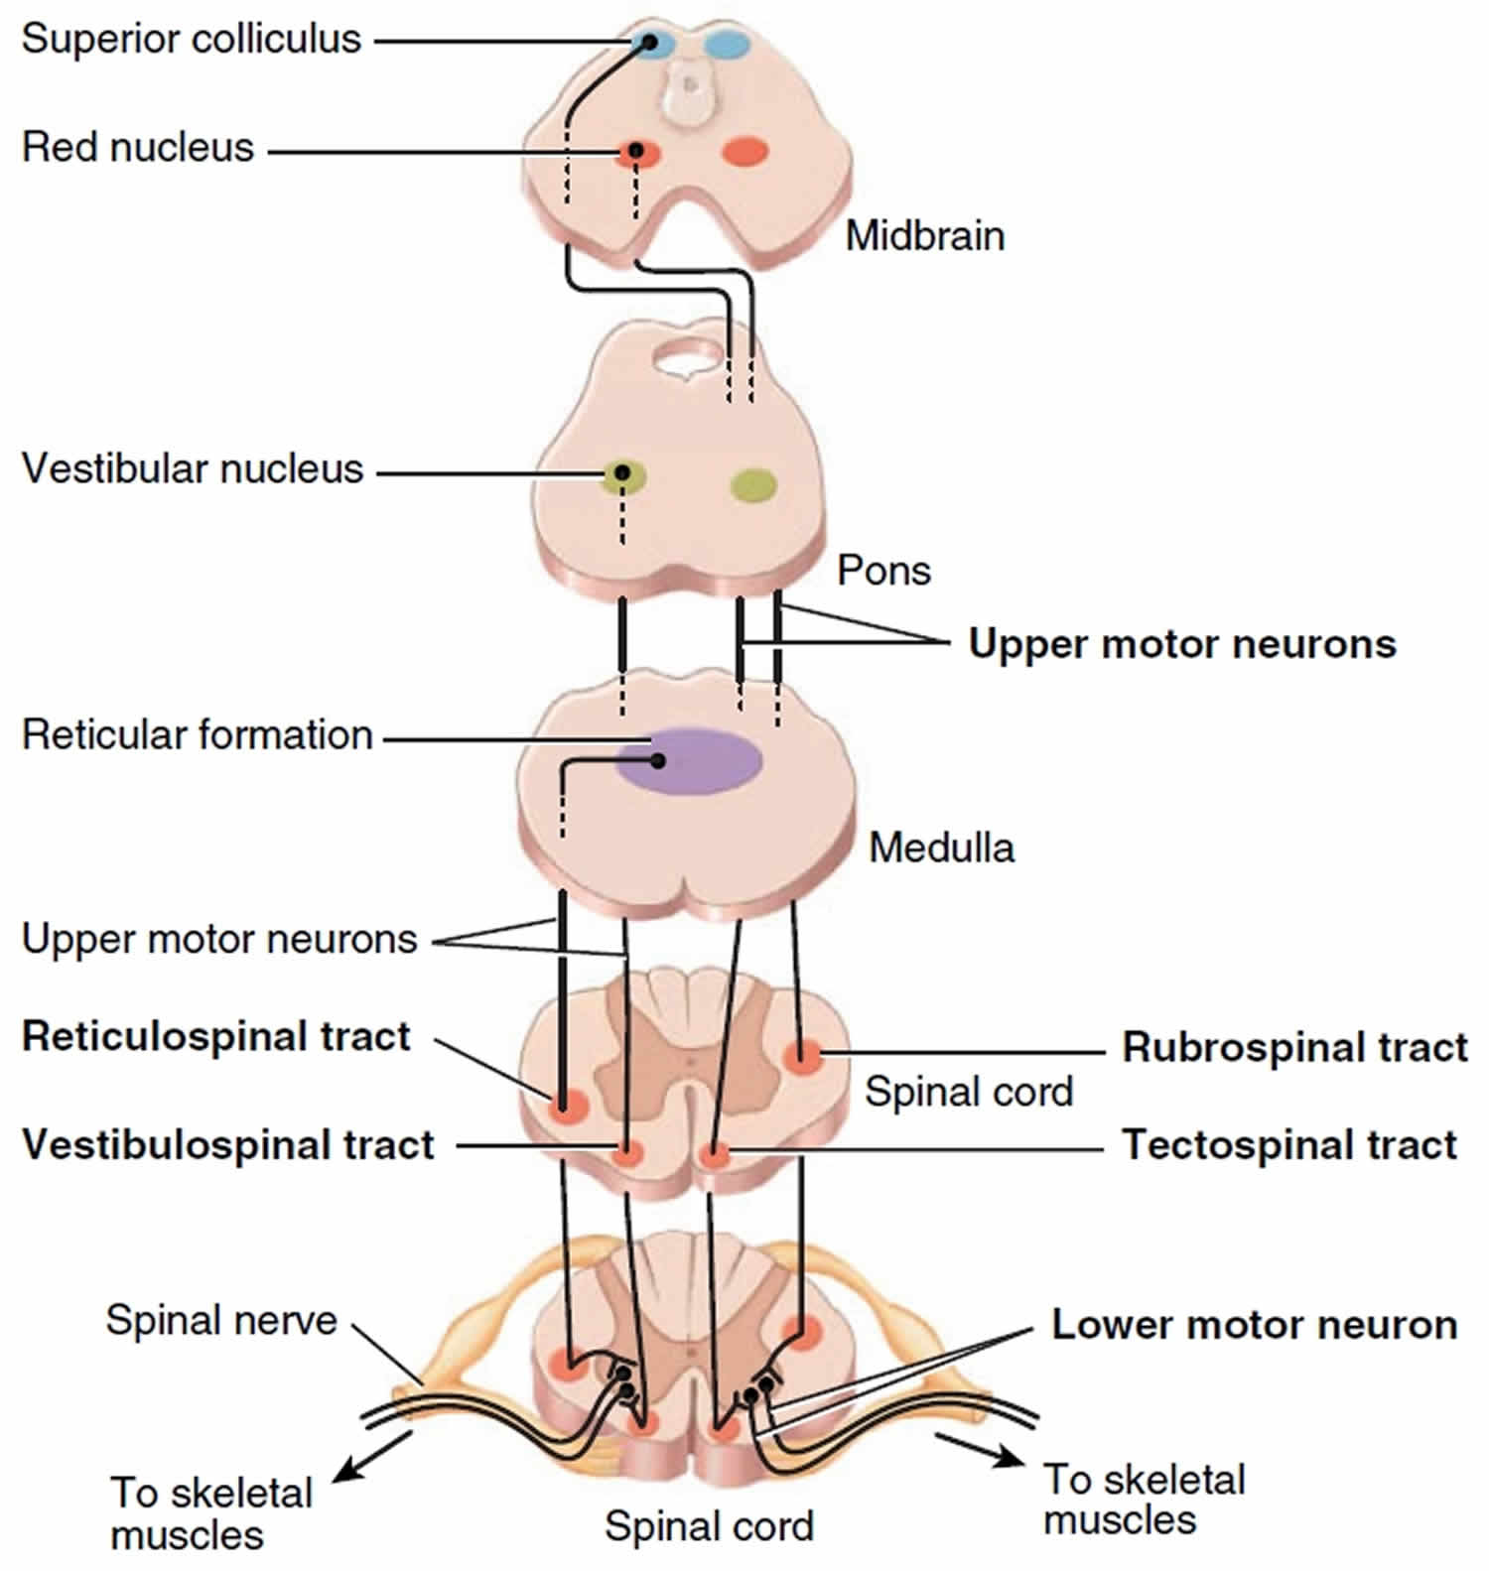
MOTOR (DESCENDING)
EXTRAPYRAMIDAL (INDIRECT)

Slide 27
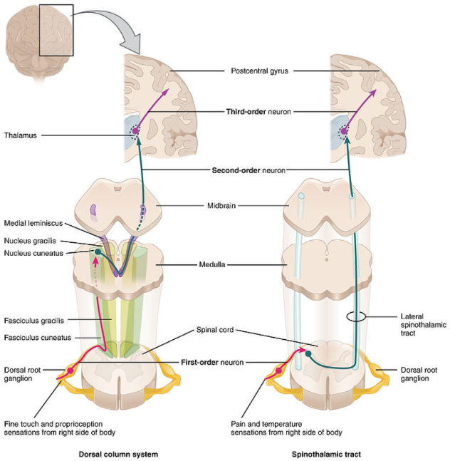
SENSORIC (ASCENDING)
EPICRITIC AND PROTOPATIC SENSATION

Slide 28
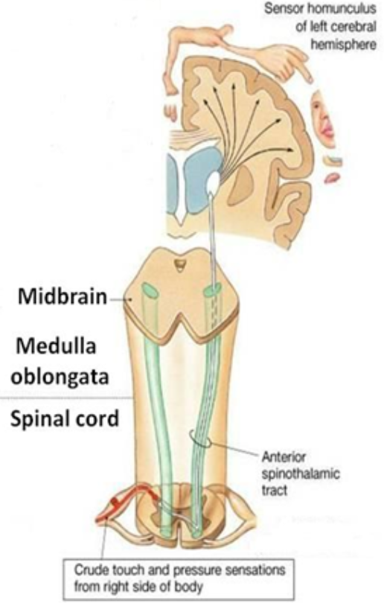
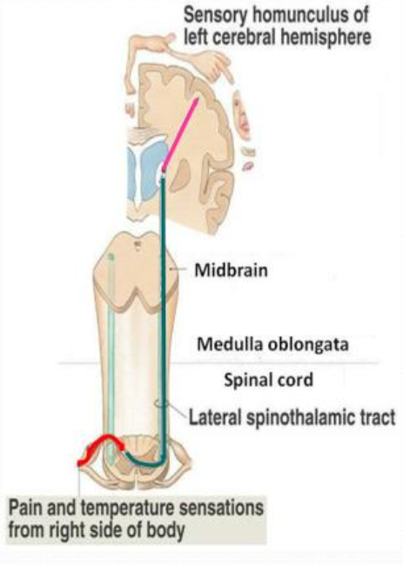
SENSORIC (ASCENDING)
PROTOPATIC SENSATION

Slide 29
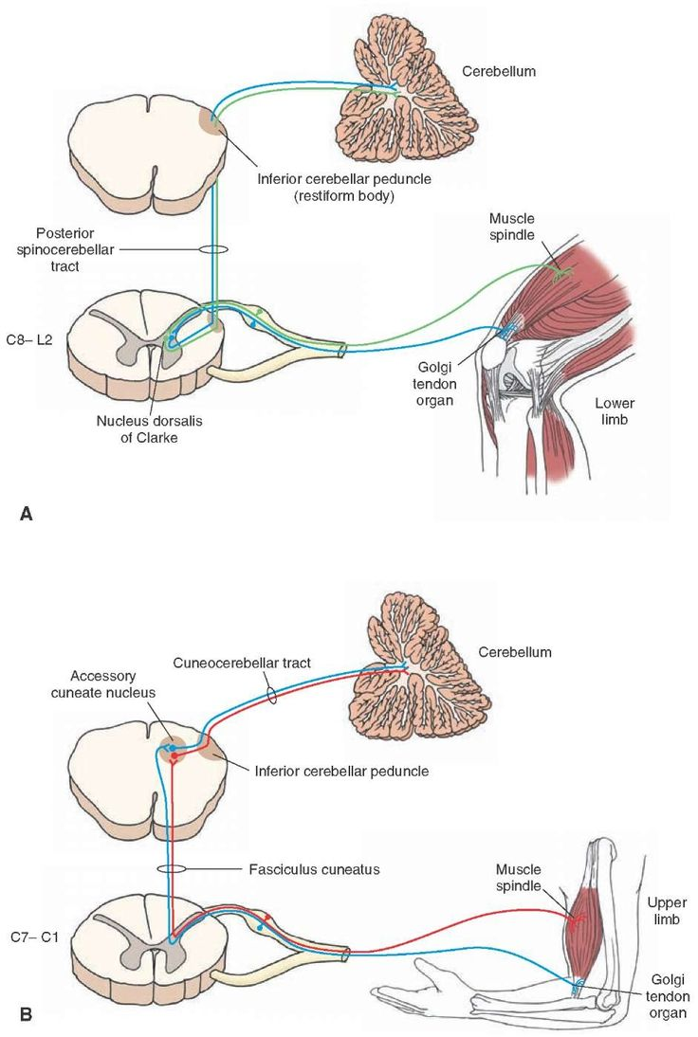
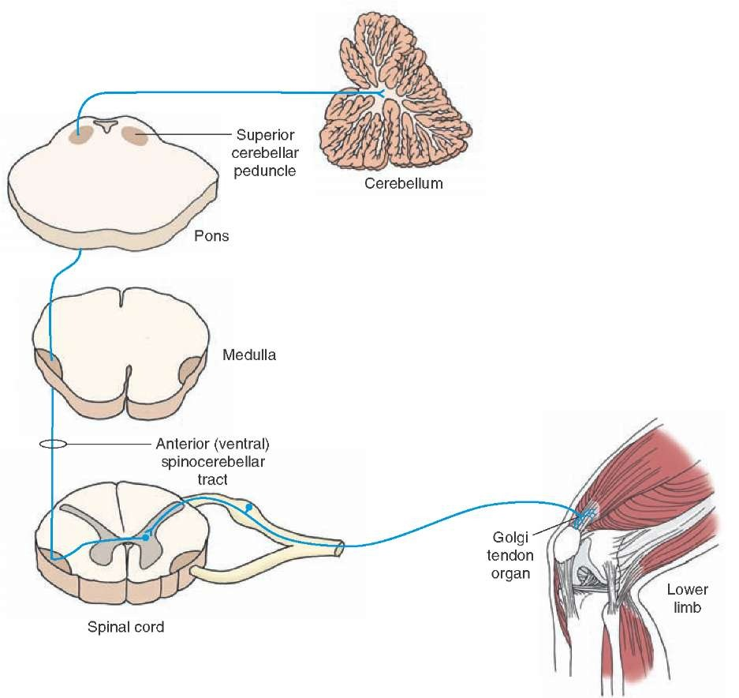
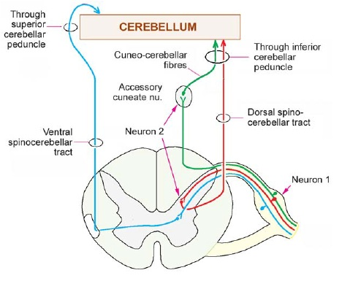
SENSORIC (ASCENDING)
PROPRIOCEPTION

