Slide 1
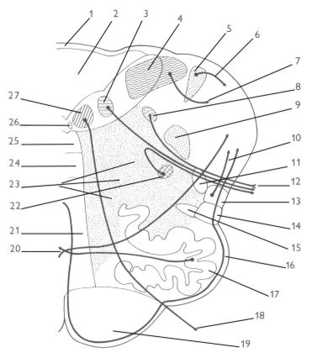
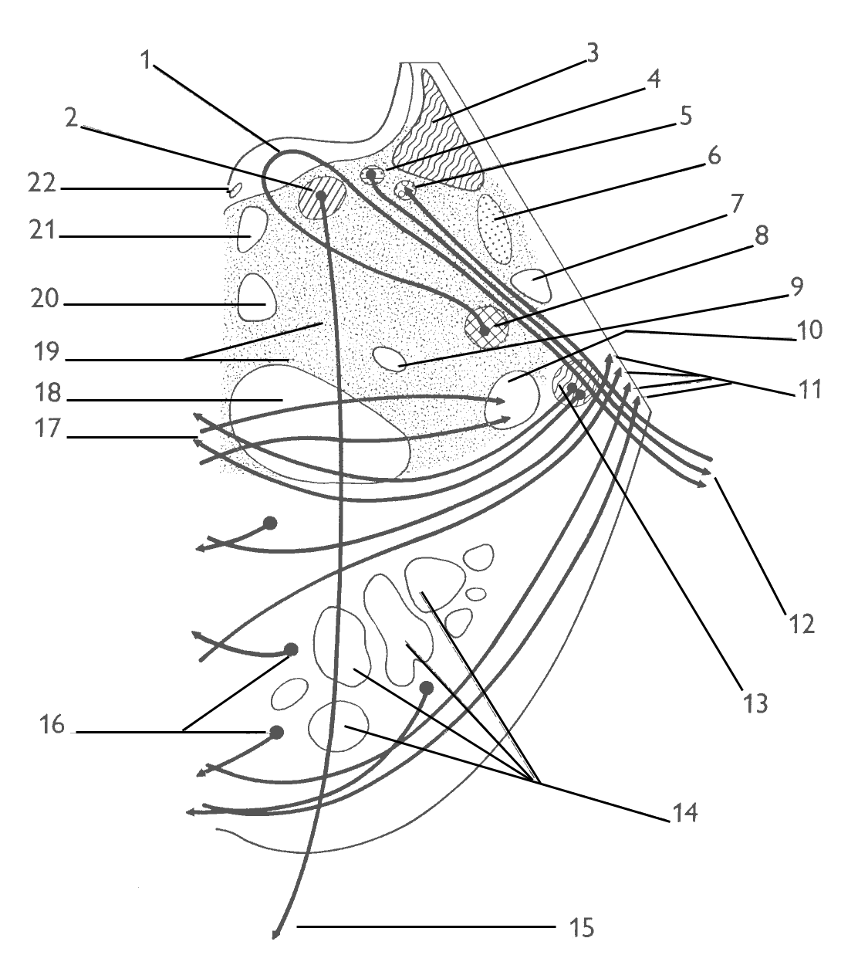
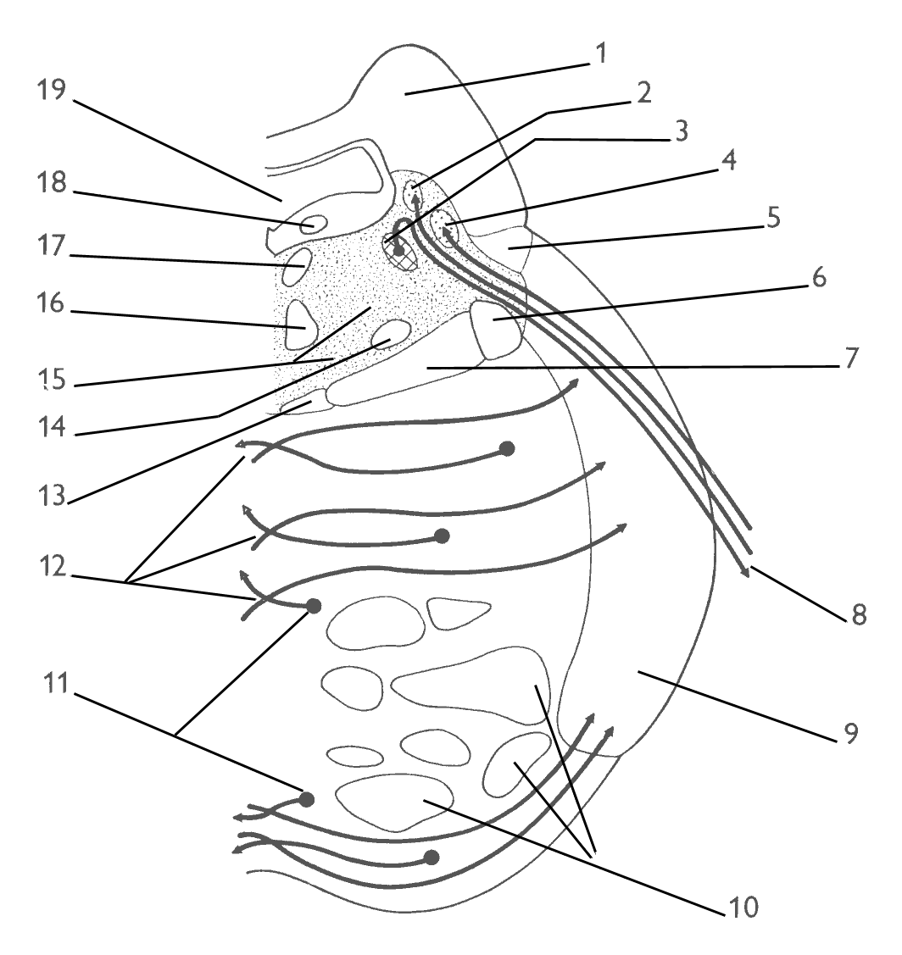
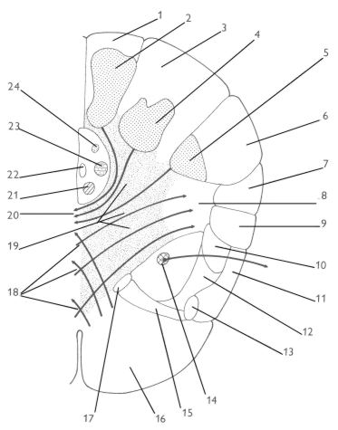
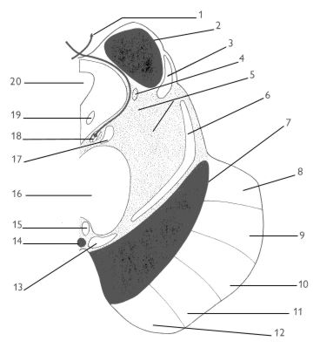
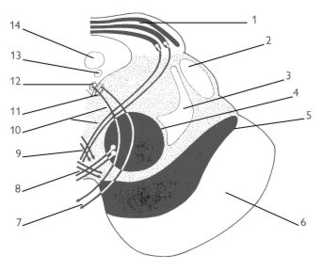

Slide 2
CEREBELLUM DIENCEPHALON

Slide 3
14. Cerebellum: gross anatomy, principles of its organization
15. Cerebellum: main pathways and their functions
16. Diencephalon: gross anatomy
17. Thalamus: main nuclei and their structural-functional classification
18. Hypothalamus: basic classification of nuclei and their functions
19. Neurosecretion in the diencephalon: basic principle, hypothalamo-hypophysial tract (tractus hypothalamohypophysialis)
20. Neurosecretion in the diencephalon: hypophysial portal system

Slide 4
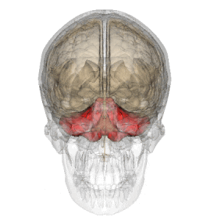
Cerebellum

Slide 5
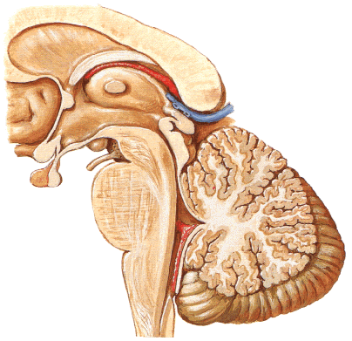
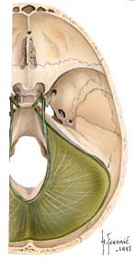
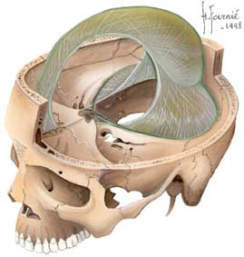
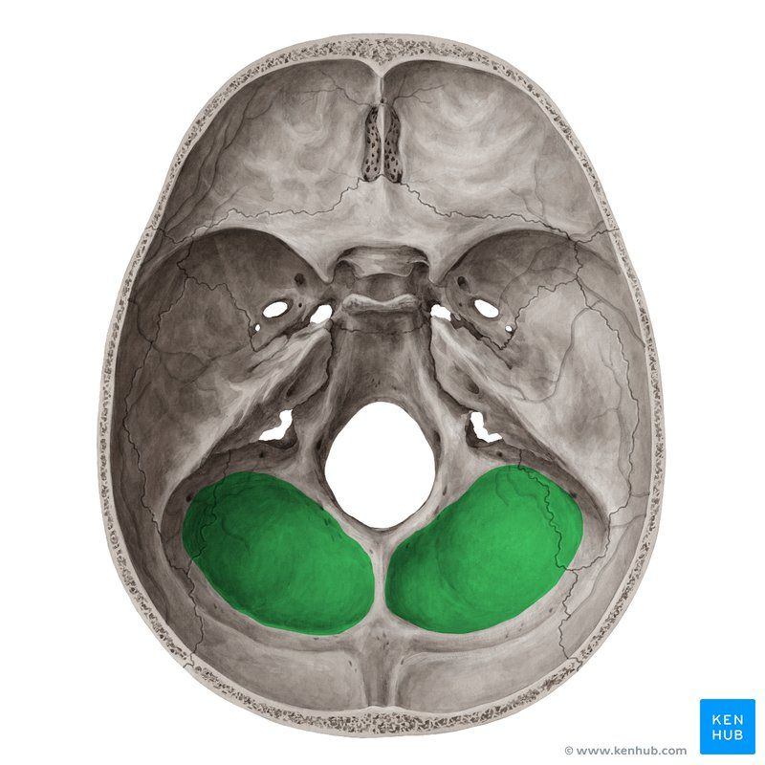

Slide 6
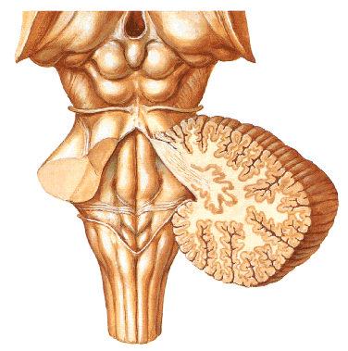
Anatomical divisions:

Slide 7
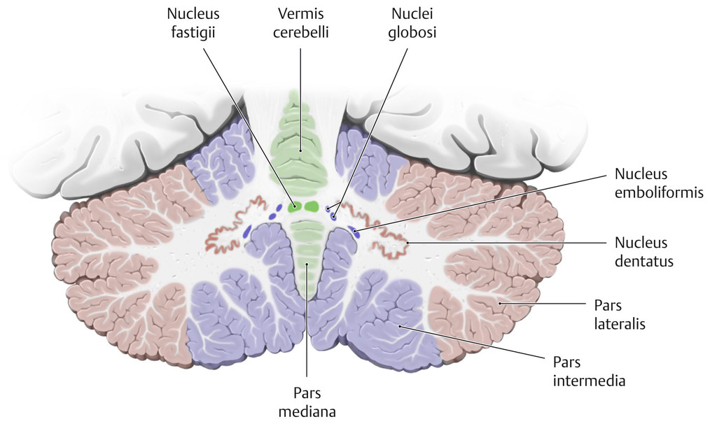
Inner structure of cerebellum

Slide 8
Functional divisions of cerebellum
phylogenetic | anatomical | connection | function
ARCHICEREBELLUM | VESTIBULOCEREBELLUM (flocculonodular lobe, lingula) | Vestibular nuclei | Posture and eye movements Maintaining of equilibrium
PALEOCEREBELLUM | SPINOCEREBELLUM (anterior, posterior vermis closed cortex) | Spinal cord | Progressive movements Coordination of movements Regulation of muscle tone
NEOCEREBELLUM | PONTOCEREBELLUM (lateral cortex) | Cerebral cortex via ncll.pontis | Speech, manipulative moovements Planning of movements

Slide 9
AFFERENTES
EFFERENTES
CORTEX
CEREBELLI
NUCLEI
CEREBELLI
POSITION OF THE BODY, EYE AND HEAD
MOVEMENT COORDINATION
FLM
NCLL. VESTIBULARES
NCLL. OF THE OCULOMOTOR CN
NCLL. VESTIBULARES
MS
TR.VESTIBULOCEREBELL.
P
U
R
K
Y
Ň
E
C
E
L
L
S
EMBOL.
NCL.OLIVARIS INF.
GLOBOSI
(extensors)
STATE OF THE LOCOMOTOR SYSTEM
RELATIONSHIP BETWEEN THE BODY AND EXTERNAL ENVIROMENT
MS
FASTIGII
FR
SPINAL CORD
TR.SPINOCEREBELL., CUNEOCEREBELLARIS – PROPRIORECEPTORS
TR.BULBOCEREBELL. – EXTERORECEPTORS
(flexors)
DENTATUS
NR
MS
(VA, VL)
(pyramid tract)
CORTEX
DENTATUS
THALAMUS
CORTEX
MS
PLANNING OF MOVEMENT
NCLL.PONTIS
TR.CORTICO-PONTO-CEREBELL.
CONTROL CIRCUIT

Slide 10
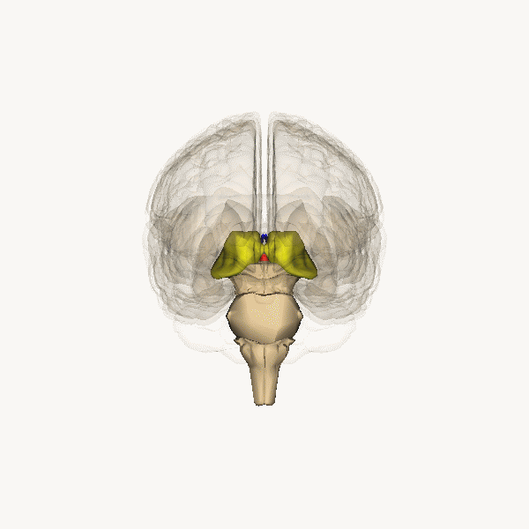
Diencephalon

Slide 11
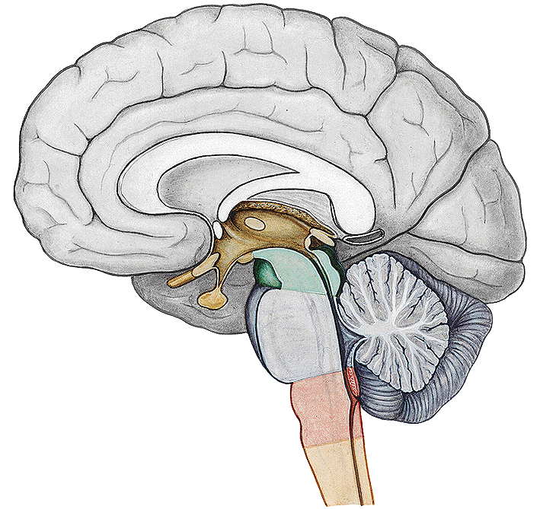
Diencephalon - parts

Slide 12
ROSTRAL SIDE OF DIENCEPHON

Slide 13
BASAL SIDE OF DIENCEPHALON

Slide 14
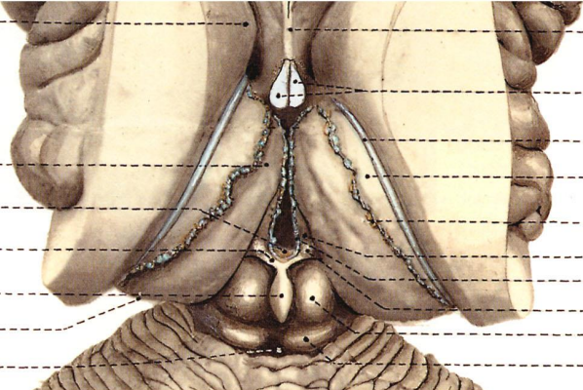
DORSAL SIDE OF DIENCEPHALON

Slide 15
MEDIAL SIDE OF DIENCEPHALON

Slide 16
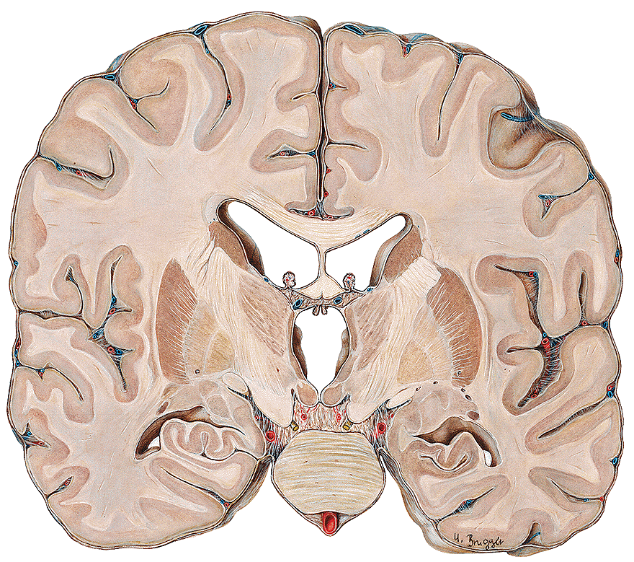
LATERAL SIDE OF DIENCEPHALON

Slide 17
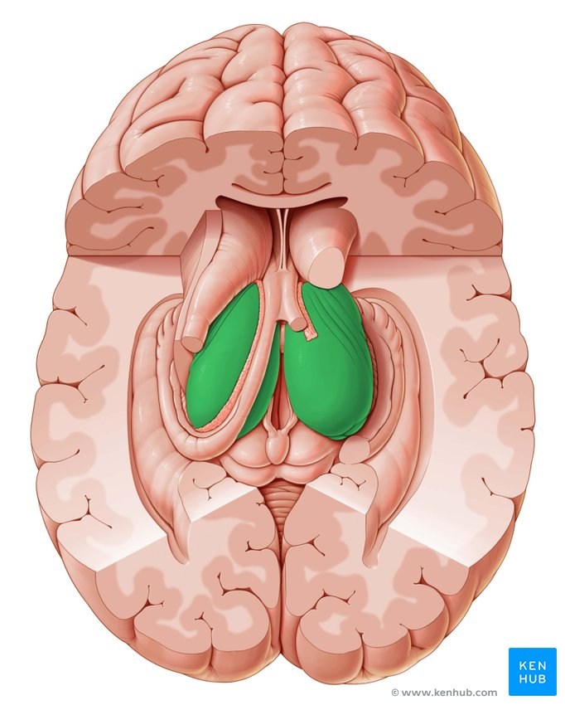
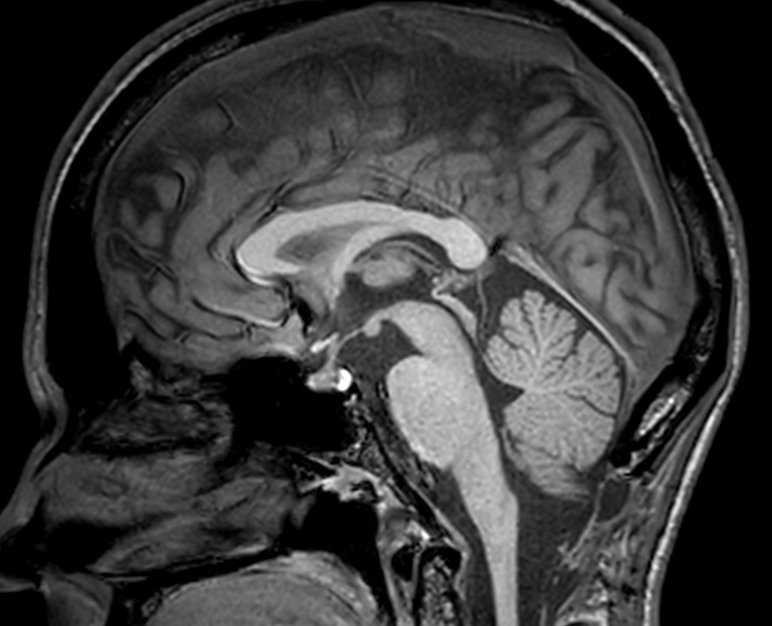
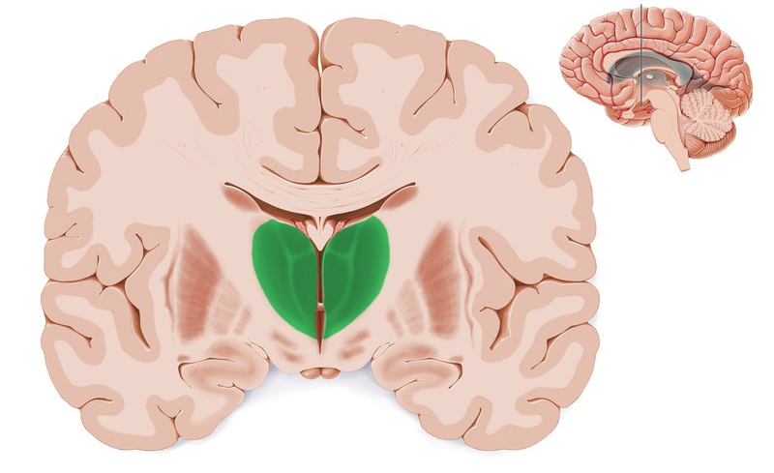
THALAMUS

Slide 18
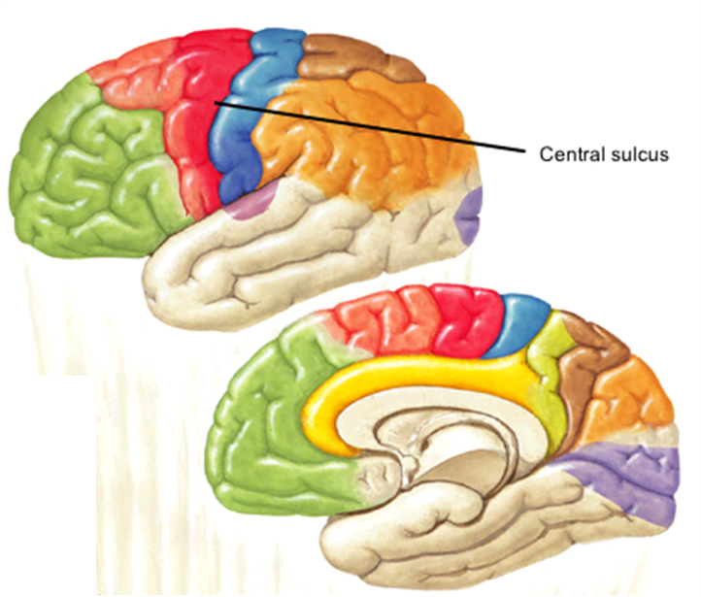
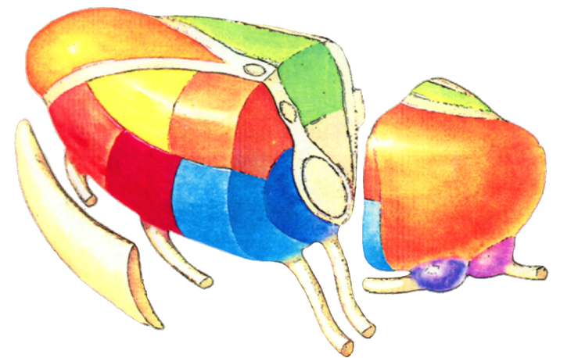
THALAMIC NUCLEI

Slide 19
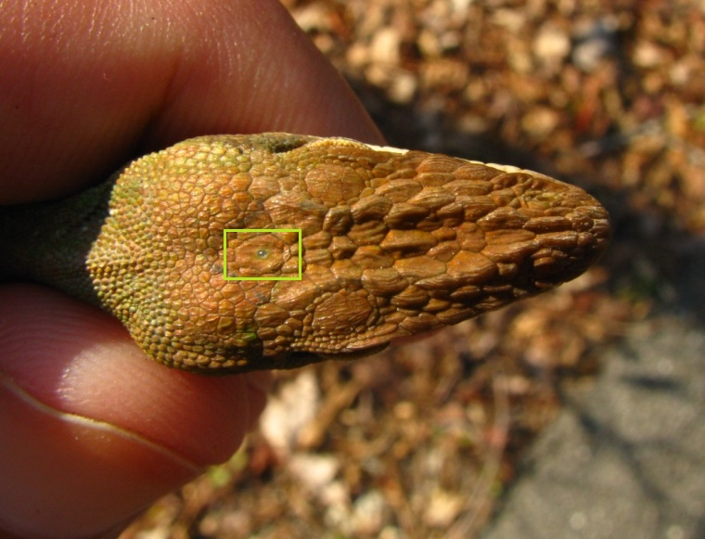
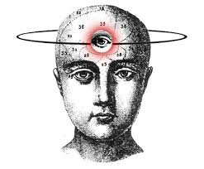
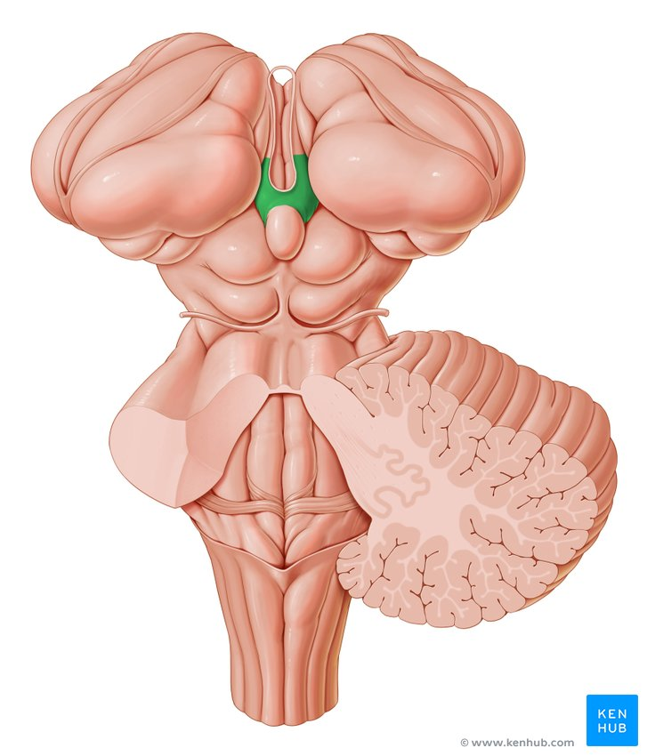
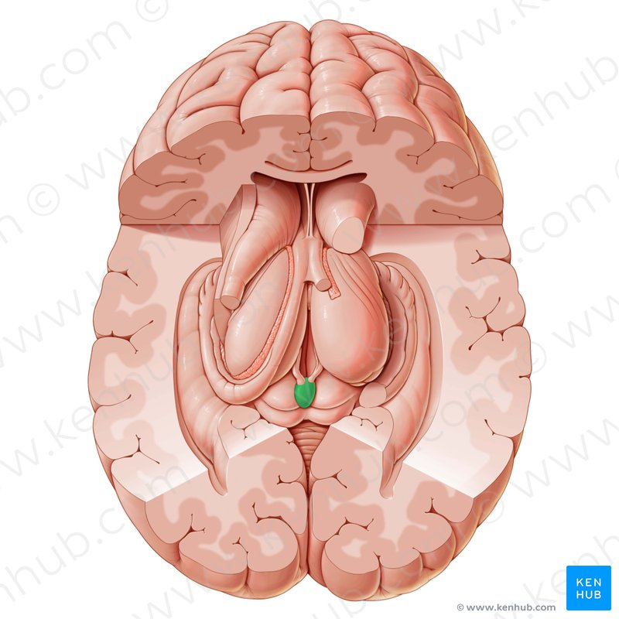
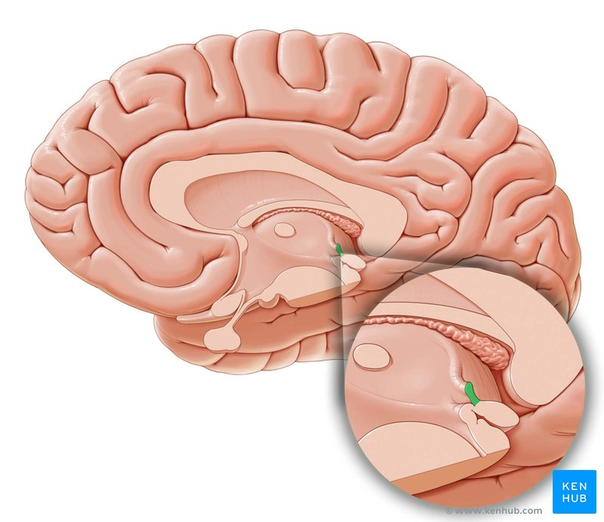
EPITHALAMUS

Slide 20
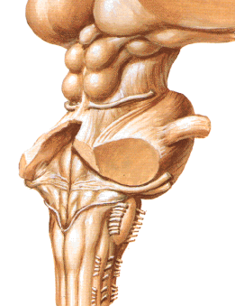
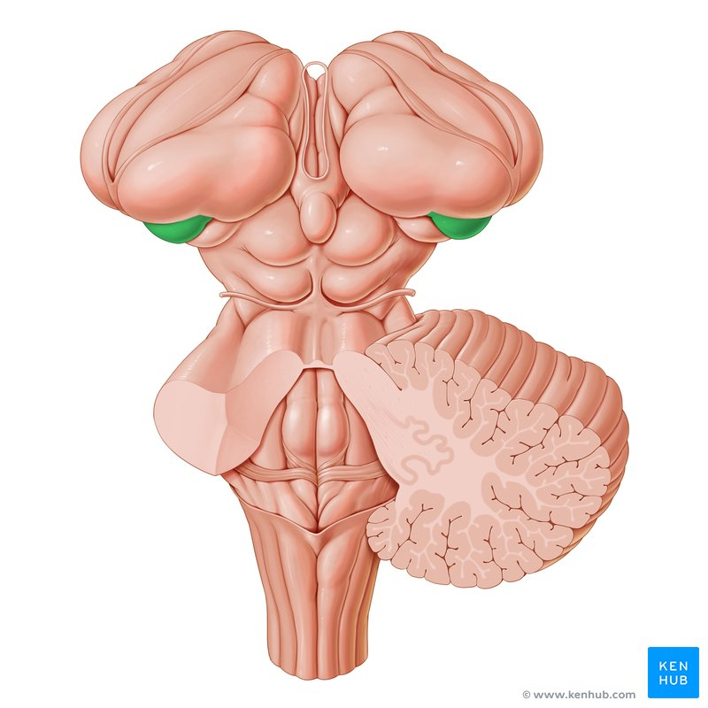
METATHALAMUS

Slide 21
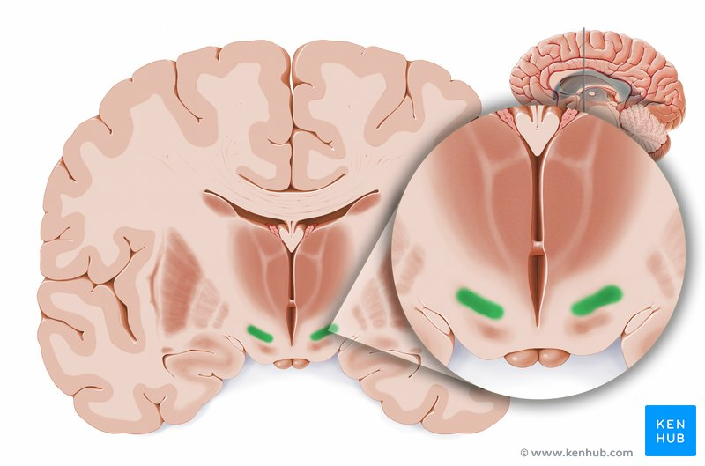
SUBTHALAMUS
NCL.SUBTHALAMICUS
ZONA INCERTA

Slide 22
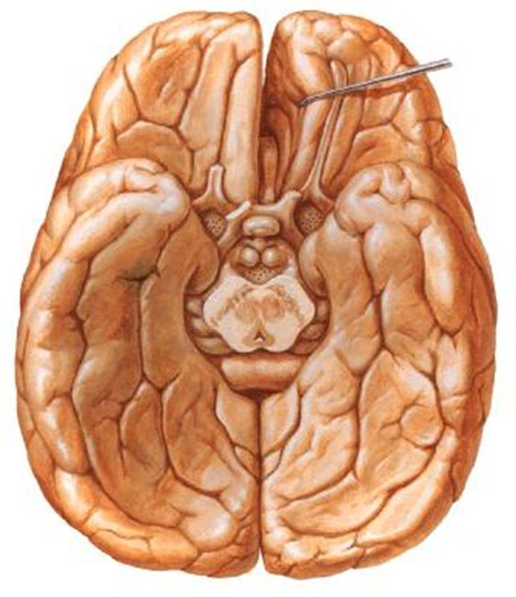
HYPOTHALAMUS

Slide 24
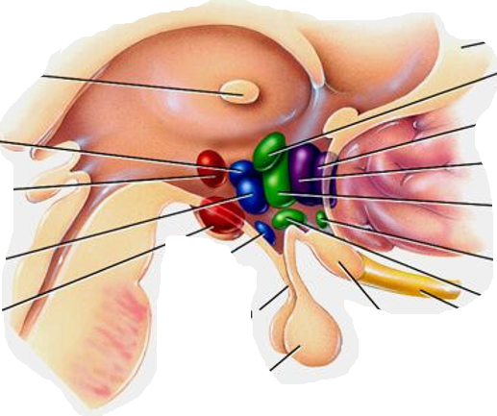

Slide 25
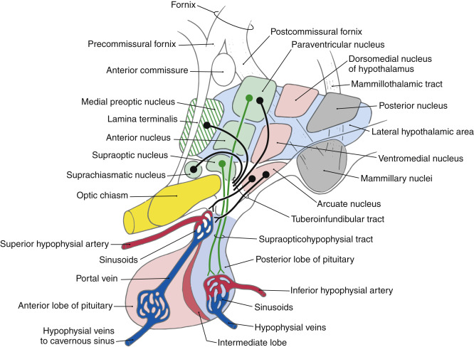

Slide 26
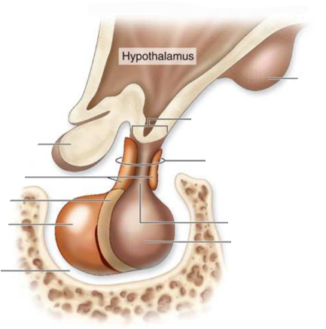
HYPOPHYSIS

Slide 27
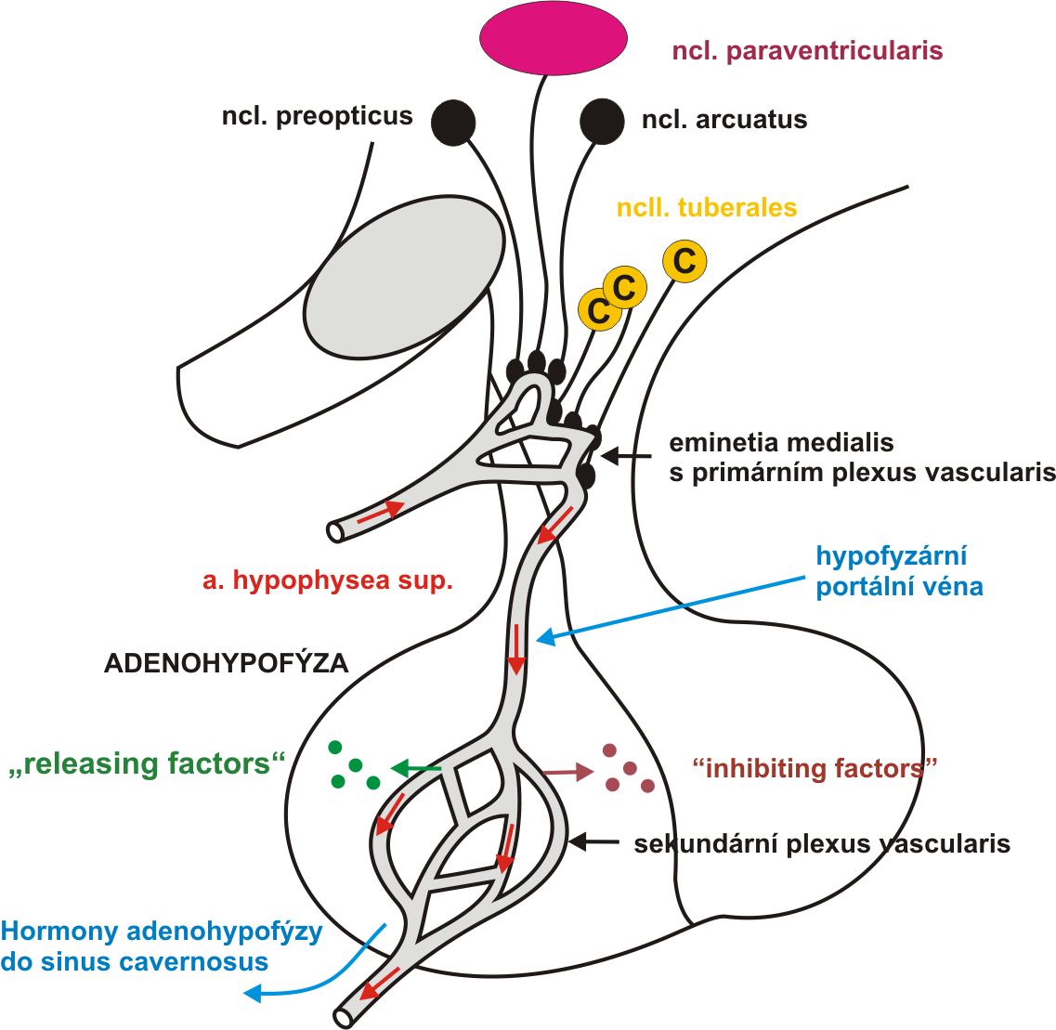
ADENOHYPOPHYSIS
NEUROHYPOPHYSIS

Slide 29
... With Anatomy
Gross anatomy and structure of the telencephalon
Ventricles, meninges and blood supply of the CNS
Gross anatomy and structure of the telencephalon Ventricles, meninges and blood supply of the CNS

