Slide 1
Oscillometric blood pressure measurement
VL jaro 2019

Slide 2
Oscilometrická metoda

Slide 3
Advantages and disadvantages
Advantages
Easy handling
Less prone to external noise (except mechanical vibrations)
Disadvantages
Inaccurate measurement when
      Arrhythmias
      Preeclampsia
      Pulsus paradoxus
      Pulsus alternans

Slide 4
Theory:
170
140
Cuff pressure [mmHg]
100
Mean pressure
Systolic pressure
70
Diastolic pressure
Oscillation in cuff

Slide 5
Compliance and bp measurement
Pressure in a cuff
BP
Pressure in a cuff
Blood pressure
bone
arm
MAP

Slide 6
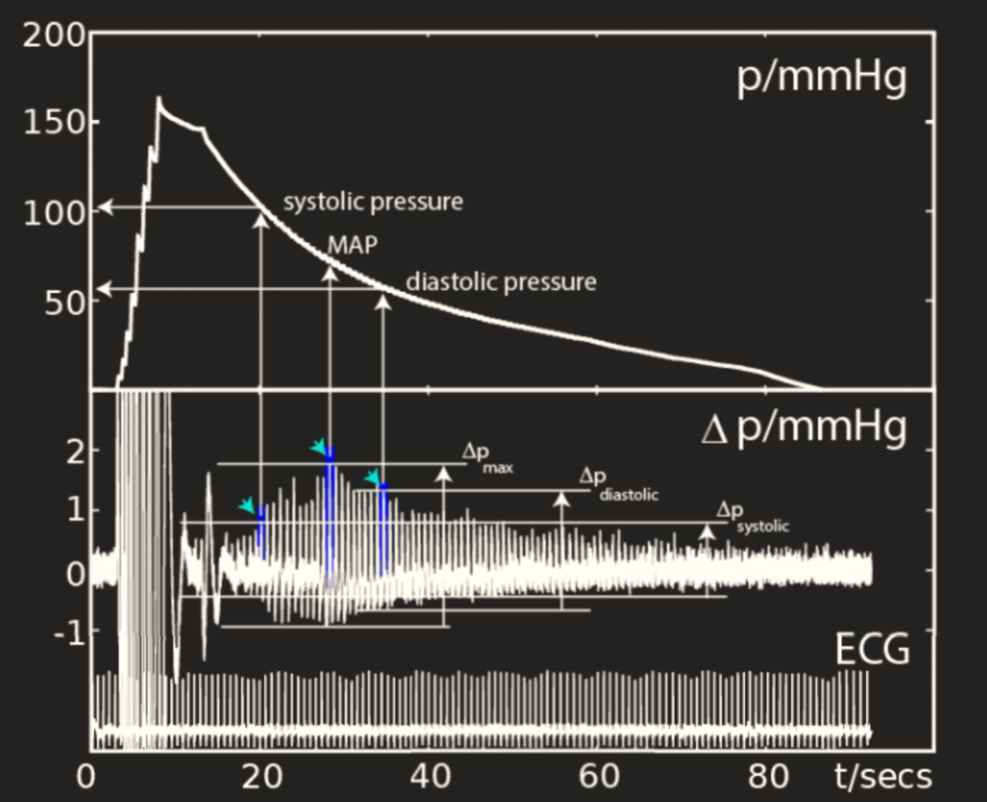
Theory
1
0,8
0,55

Slide 7
Auscultation vs. oscillometry
Auskultstion systolic pressure
(141)
Auskultstion diastolic pressure
(78)
200
Pressure in cuff
0
Oscillation in cuff
Oscillation systolic pressure
(145)
Oscillation diastolic pressure
(80)
Oscillation mean pressure
(106)

Slide 8
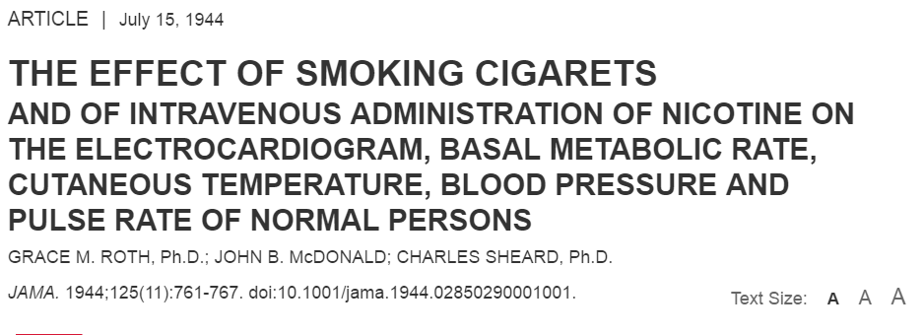
Smoking effect

Slide 9
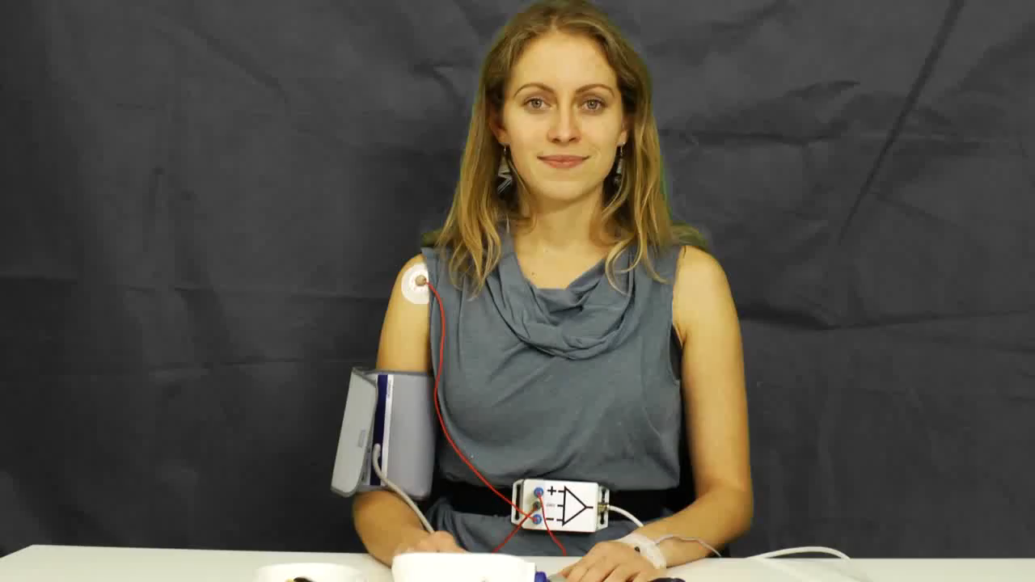
Efekt kouření
https://www.youtube.com/watch?v=J5vPJPfNH3k&index=3&list=PLWnTQ-kqjDMVXPojn6rXMo9Ov268nGPas

Slide 10
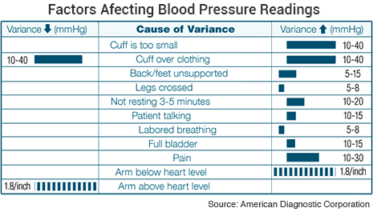
Factors afecting blood pressure

